Slide 1
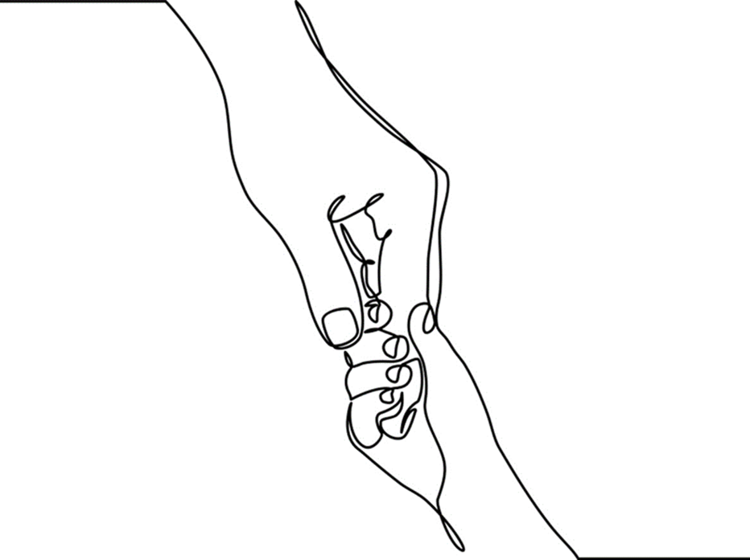
Chapter 3: Learning How to Love

Slide 2

Connection to others is the central organizing feature of human development. (Miller & Stiver, 1997)
Notes:
1. Feminist theorists advanced attachment theory, viewing relationship and connection as evidence of healthy psychological development. This was a departure from traditional psychoanalytic theory, which saw separation as the highest level of human functioning.
2. Children learn about their own thoughts and feelings through engagement with others who can be with them in both their ‘good’ and ‘bad’ feelings and behaviors.
3. Engagement in growth-promoting relationships is central to development and healing.
Miller, J. B. & Stiver, I. P. (1997). The healing connection: How women form relationships in therapy and life. Boston: Beacon Press.
Photo: www.flickr.com

Slide 3
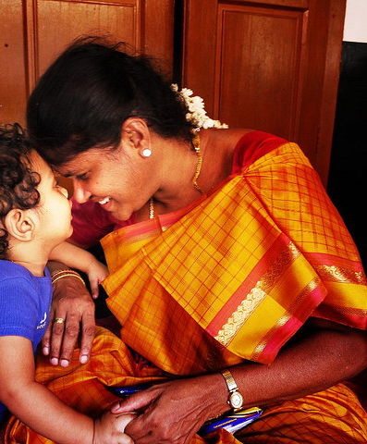
Attachment describes enduring and reciprocal relational bonds between children and primary caregivers.
Notes:
Attachment plays a significant and influential role in child development.
Positive attachments are formed through reliable, consistent, and enduring relationships between infants and caregivers.
As infants and caregivers get to know one another they develop a synchronicity that ensures babies’ needs are met.
When needs are reliable met, infants learn how to regulate emotions and behaviors; they come to trust themselves and become skillful in delaying the immediacy of their needs.
When infants feel secure within relationship they become able to explore their world.
Photo: Sundaram Ramaswamy at flickr by Yahoo.

Slide 4
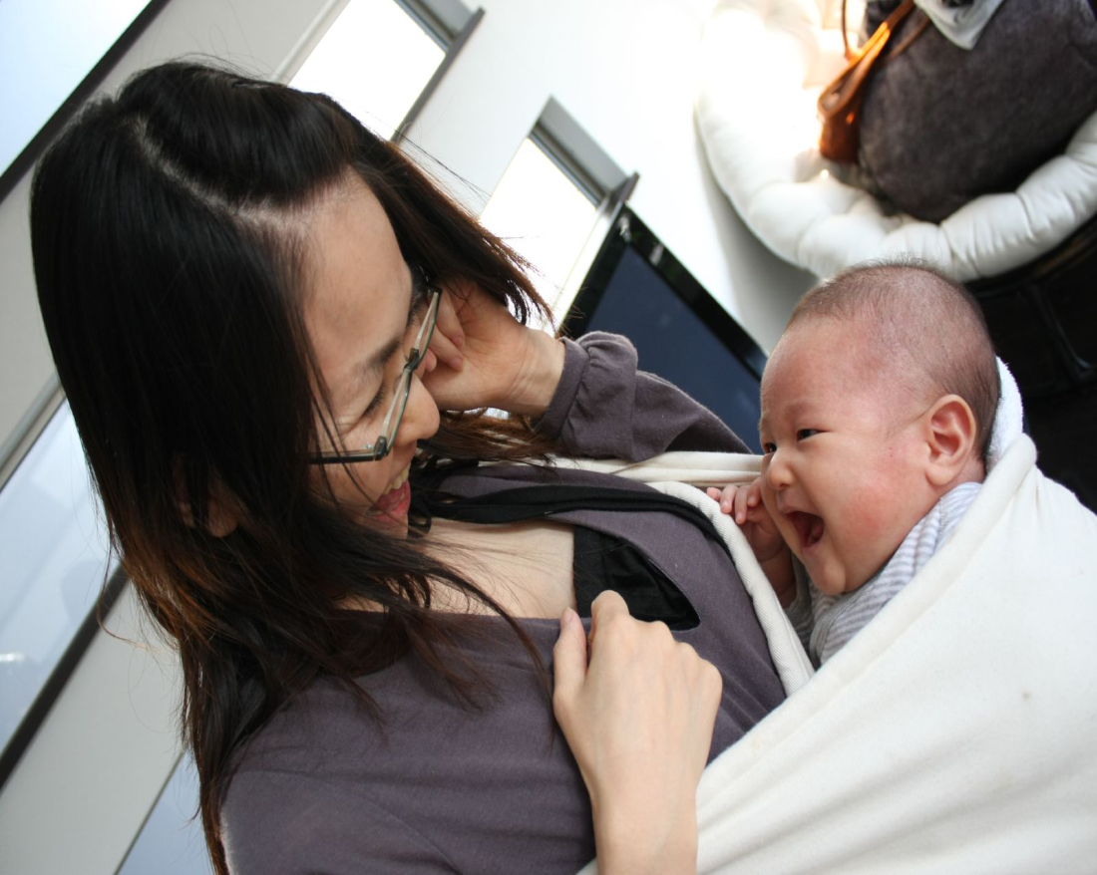
Caregivers with positive attachments fall in love with their infants.
Notes:
Strong relational ties make it possible for parents/caregivers to endure the rigors of childrearing and all its challenges.
Photo: Commons.Wikimedia.org.

Slide 5

Relational attunement is a reciprocal process of communication, responsiveness, and understanding that ensures children grow and thrive under their parent’s safety net of care.
Notes:
Dependent infants rely on their parents attentive and attuned care.
As toddlers begin to explore their environments they do so under their parents’ watchful gaze.
As children grow, parents adjust their expectations for independence and dependence while at the same time providing safety and security.
Eventually positive attachments transform into warm and mutually satisfying relationships between parents and adult children who are able to endure the natural ebb and flow of life’s changes, conflicts, and unexpected transitions.
Over the last several decades, research and brain imaging have advanced understanding of the underlying intersectionality of neurobiology and attachment relationships, linking the physiological with the psychological and with the formation of and later capacities for social intelligence and empathy
Photo: Photo by Benji Aird on Unsplash

Slide 6

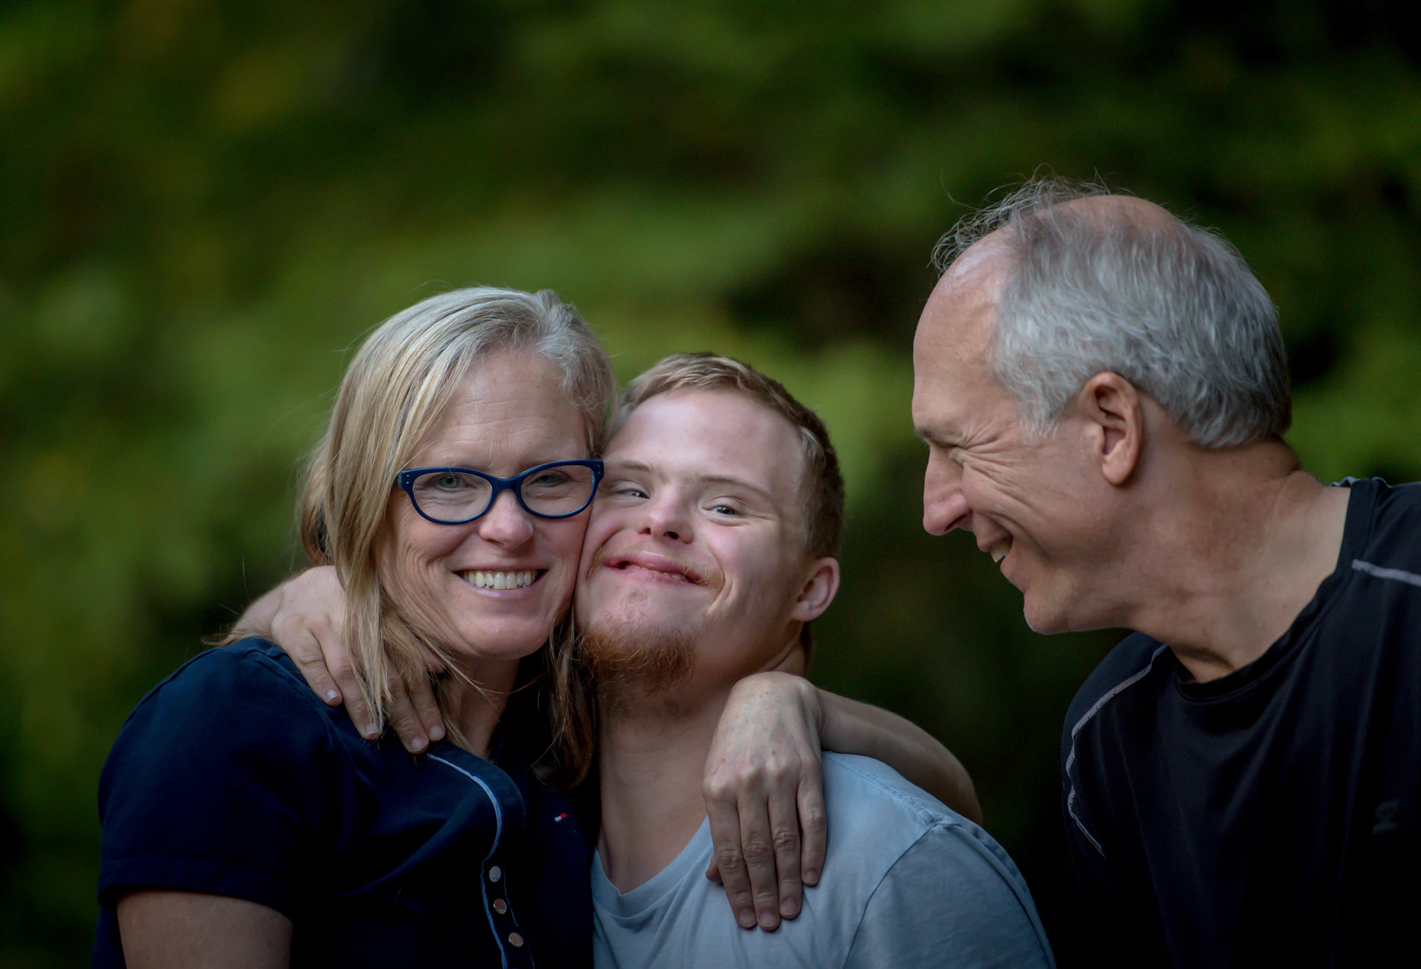
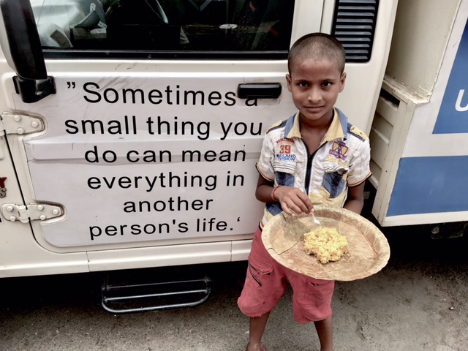
Relational attachments are highly varied, affected by factors such as the child’s temperament, the family’s cultural practices, goodness of fit between parent and child, and by the child’s developmental capacities and health.
Notes:
Human responsivity and relational attachments are highly varied, affected by factors such as the child’s temperamental proclivities, the family’s cultural practices, goodness of fit between parent and child, and by the child’s developmental capacities and health.
Factors such as economic stability, mental health, and the active presence of adverse circumstances and strains can influence the quality of attachment.
Family stressors can also affect the quality of early and ongoing attachments.
Image: Photo boy and parents by Benji Aird on Unsplash; Photo 2 homeless child by HelloDolly89 - Own work, CC BY-SA 4.0, https://commons.wikimedia.org/w/index.php?curid=62745516 Photo 3 Tibetan family by Evgeny Nelmin on Unsplash.

Slide 7

Attachment Theorists
Sigmund Freud
D. W. Winnicott
John Bowlby
Mary Salter Ainsworth
Theorists who recognized that early relationships matter
Notes:
Sigmund Freud, a founder of psychoanalysis in the early 20th century emphasized the importance of early attachments and their influential meaning throughout life.
In the mid 1950’s D. W. Winnicott, a pediatrician by training, observed the relationships between children and parents. He believed that the quality of early relationships affected the child’s capacity to grow and thrive. He coined the phrase “good enough mothering” to describe a relational baseline of attachment and caring necessary to the health of the growing child.
John Bowlby is recognized as “the father” of attachment theory. He believed that attachment was essential to human growth and survival. He argued that without human connection people can neither thrive nor endure.
In the 1970’s Mary Salter Ainsworth and colleagues identified variations in human relational patterns.

Slide 8

Attachment Patterns
Insecure Attachment
Secure Attachment
Disorganized Attachment
Notes:
In the 1960’s Ainsworth’s ‘Strange Situation Procedure’ examined whether there were different patterns of attachment linked to divergent parenting styles. The study yielded 3 different attachment patterns –
Secure attachment – results when primary caregiver is attuned, connected and responsive to the child. Securely attached children tolerate frustration, learn self-regulation, explore, and trust the world.
Insecure resistant attachment - results from inconsistent and remote parenting styles. Children respond to this pattern by being fearful and distressed upon separation. These children may seek attention yet be uncertain as to what to do when in relationship to others.
Insecure avoidant attachment – Ainsworth speculated that this pattern emerged in response to angry or overly controlling caregiving. These children seemed indifferent to separation, more interested in toys than human contact.
Disorganized attachment was identified in 1990’s by Mary Main and colleagues. Disorganized attachments are generated by unpredictable and sometimes extreme caregiving situations. Children with disorganized attachments seem to not have strategies to deal with connection. They tend to be aggressive, completely disinterested, or fearful of relationships.
Photo: Photo by Brittany Simuangco on Unsplash.

Slide 9
Four Determinants of Attachment
Proximity Maintenance
Safe Haven
Secure Base
Separation Distress
Notes:
Bowlby’s Four Determinants of Attachment:
Proximity Maintenance – the desire to be close to those to whom we are attached.
Safe Haven – inner knowledge that one has a secure relationship they can go to in uncertain times.
Secure base – the presence of a consistent, familiar person who provides safety for exploration and separation.
Separation distress – anxiety/distress in the absence of a secure attachment.

Slide 10
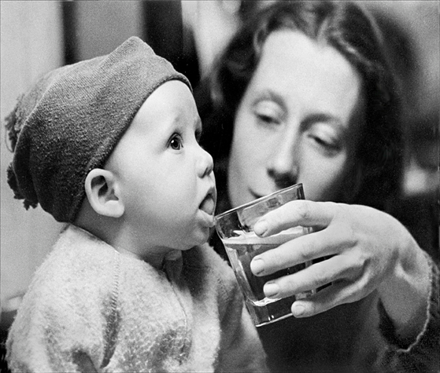
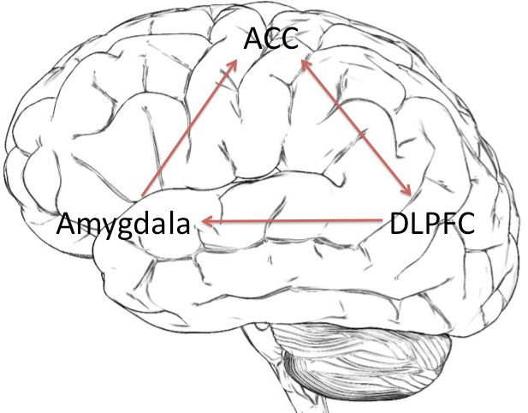
Attachment and the Brain
Primary caregivers model and regulate the infant’s developing central nervous system
Notes:
Human capacities for communication, intimacy, social acuity and emotional/behavioral regulation are thought to be tied in with early attachments and caregiver responsivity.
In neuroscience terms the primary carer acts as a regulator for the infant’s developing brain and central nervous system (CNS). This requires that they be attentive to the infant’s verbal and non-verbal solicitations and responses.
Synchronistic responsiveness promotes right brain development, which in turn, helps the infant develop self-regulation and promotes social/emotional functioning.
When caregiver responsiveness is insufficient, children are less apt to develop effective regulation skills. Poor regulation sets the child up for later cognitive and behavioral problems.
Photo: Mother & Child at www.flickr.com; Brain at Commons.wikimedia.org.

Slide 11
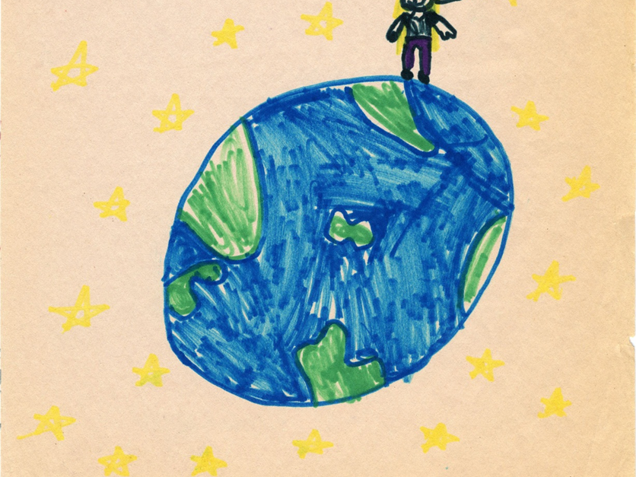
Relational practice engages child client and worker in transformational, brain-changing interventions.
Notes:
New evidence suggests that the brain is more receptive to change than previously thought.
Relational therapies targeting right brain processes appear to improve clients’ regulatory and relational capacities throughout life.
Paired interactions with caregivers mediate how stress is perceived, managed, and resolved.
If the infant’s cry is met with need-fulfilling responses, anxiety is alleviated and return to calm is achieved.
Over time, the infant’s developing brain organizes repeated responses into patterns that inform healthy regulation
When science explains ‘bad’ behavior it’s more likely to evoke compassion from those who previously would have lost hope or been discouraged by children’s seemingly unmanageable behaviors.

Slide 12


Regardless of the quality of care, children yearn to be loved by their parents.
Notes:
Ambiguous losses are experienced by children who are separated from their parents. This is true for children who have known their parents and those, like adopted children, who have never known them.
Workers must respect the ties children have to their parents in order to effect a therapeutic alliance.
The tenacity of children’s ties to their parents is powerful and enduring.
Photo: Photo by Liv Bruce on Unsplash

Slide 13
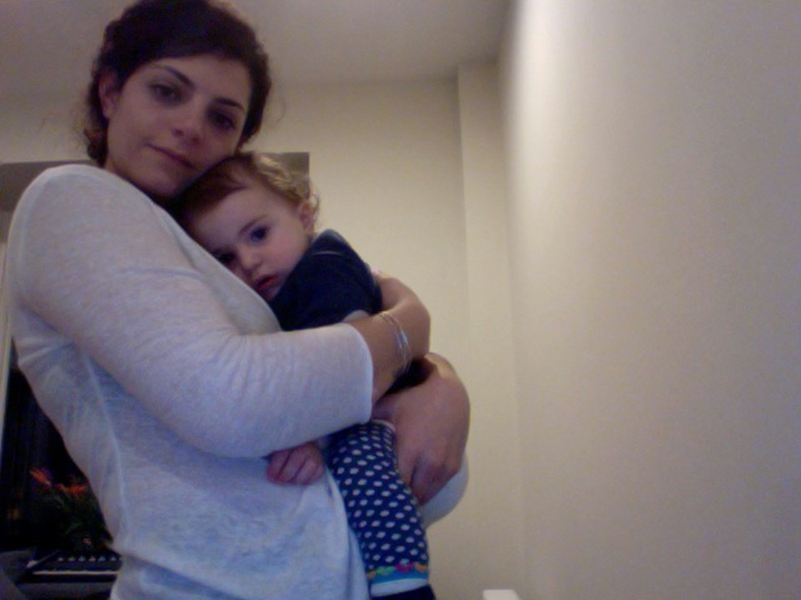
Sarina’s Story
Notes:
Sarina was fifteen when I first met her. She had been in foster care since age four. Her initial foster placement occurred after her sleeping mother’s cigarette burned down the family trailer.
The family was lucky to have survived, as the trailer was in an isolated, rural location. Smoke from the blaze was noticed by a police officer who just happened to be in the trailer park looking for kids who had robbed a local convenience store. After the fire, Sarina, four, and her sister, Katie, six, were placed in separate foster homes. Their mother, Marlene, thirty-three, was sent to the
local hospital’s psychiatric unit to detox from alcohol and prescription medications.
During the following two years, child protective services attempted many times to reunify the sisters with their mother. Marlene was able neither to maintain sobriety nor to adequately demonstrate ability to provide appropriate care for her young daughters. Just prior to the termination of parental rights (TPR) hearing, Marlene was given a dual diagnosis of polydrug addiction and schizoaffective disorder. This diagnosis enabled Marlene to receive
much needed health insurance and disability benefits, including Section 8
housing. In combination, however, the diagnosis and TPR led to multiple losses and transitions for Sarina and Katie.
When I met Sarina eleven years later, she was still longing for reunion with her mother. She had lived in five different foster homes. Each placement had been disrupted because of Sarina’s impulse to locate her mother and ‘‘take care of her.’’ Similarly, Sarina and Katie found and lost each other multiple times, in part due to episodic changes in their residencies. When asked about these disruptions, Sarina told me that she loved her mother and knew in her heart that her mother loved her, too. She truly believed that they were meant to be together. Sarina insisted that she was
grateful to all the foster parents who tried to ‘‘give me a family.’’ Yet she knew that she was unable to genuinely accept their caring. When I last heard about Sarina, she was nineteen and had a baby of her own, a little girl named Marlena. She was studying for a GED and hoped to get work in the future as a counselor helping kids in foster care.
Photo: www.flickr.com

Slide 14

“Yeah, like, if you tell an adult something, like a problem that you have, and they are a nice adult and helpful adult, they will relate to it and they will say, “Oh yeah, in my life that happened to me and I can relate to it and this is what I did to deal with that.”
Adolescent on how adults can build trust
Notes:
Evidence strongly suggests that adolescents not only want relational attention but thrive when it is supplied with qualities of secure attachment in mind.
Youth seek out confiding and caring relationships that act as protective factors against high risk behaviors.
Genuine interest, active listening, and expressed empathy are qualities identified by adolescents as relational links to bridging mistrust and promoting productive and trusting alliances.
Image by Photo by Matthew T Rader on Unsplash

Slide 15

Reflective practice considers how clients’ stories resonate with workers’ personal attachment histories and affect professional perspectives and practice choices.
Notes:
From a critical knowledge standpoint, attachment theory prepares practitioners to be compassionate towards those they might otherwise judge, avoid, or disdain.
Reflective practice supports empathy and positive regard.
Image by: Photo by Patrick Brinksma on Unsplash

Slide 16

Children have the right to be nurtured, to belong, and be loved.
Notes:
To be cared for and nurtured is a human right. Human rights advocates understand the intrinsic meaning and importance of children’s relational connections.
The Convention on the Rights of Children (CRC) recognizes that children have rights to protection of their relationships with family members and communities.
When family systems fail, governments have a responsibility to ensure that all children have opportunities to be nurtured.
Image by: Photo by Chiến Phạm on Unsplash

Slide 17
Conversation Starters
Describe the basic tenets of attachment.
How do attachment and neuroscience discoveries offer hope for those who have experienced early adversities? What are their implications across the life course.
Discuss attachment and caring as a human right.
Apply attachment theory to Sarina’s story?
Reflect upon your attitudes, assumptions, and beliefs about Sarina. How would they help or hinder your relationship?

