Slide 1
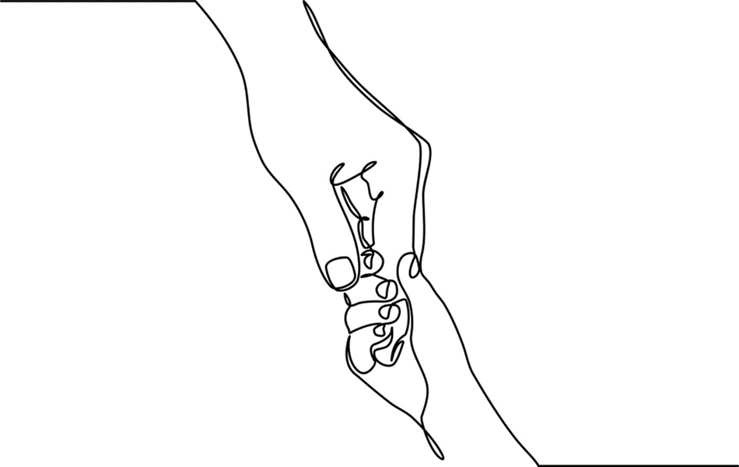
Chapter 9: Neurodiversity & Developmental Disabilities of Childhood

Slide 2

Notes:
Neurodiversity is a term used to describe atypical or divergent neurological development.
Understanding the variability of children’s brains is important for those who live with and work alongside children with neurodiversity and developmental and intellectual disabilities.
Diagnostic classifications such as autism spectrum disorders (ASD) and Tourette’s syndrome (TS) fall under this description.
Learning differences, developmental disabilities, for example Down syndrome, and a range of conditions that contribute to intellectual disabilities are included as part of a larger spectrum of human neurodevelopmental variability.
Scientists and sociologists study the origins and implications of neurodiversity while child-centered practitioners support children with neuro-differences and support their families as they work to keep pace with life’s complicated demands.
Photo: www.flickr.com.

Slide 3
In 2013 the Diagnostic and Statistical Manual of Mental Disorders version 5 (DSM-5) revised criteria for autism spectrum disorder (ASD).
Criteria One
Social Communication and Interaction
Criteria Two
Restricted and Repetitive Behaviors
Eliminated
Asperger Syndrome
Pervasive Developmental Disorder
Disintegrative Disorder
Notes:
The DSM-5 reflects significant modifications in ASD criteria.
New diagnostic criteria were reduced from three to two domains: 1) problems in areas of social communication/interaction, and 2) restricted and repetitive behaviors; each of which are considered on a continuum of occurrence and severity of symptoms in these areas.
Sub-diagnoses such as Autistic Disorder, Asperger Syndrome, Pervasive Developmental Disorder Not Otherwise Specified, and Disintegrative Disorder have been eliminated.

Slide 4

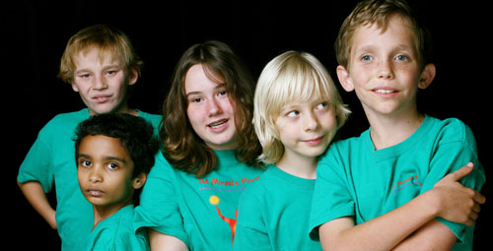
Meet Wyatt
http://www.youtube.com/watch?v=S_XRVwRFPKk
Notes:
Children with autism are often misunderstood by adults and peers alike. Wyatt introduces us to what it’s like to see the world through his eyes. Although he understands that he’s different, he doesn’t yet have the skills to negotiate social and interpersonal relationships. He is the target of bullies; children who also don’t how to manage difference. Wyatt’s mother exhibits great compassion and listens attentively to Wyatt’s trials. For parents too, living with autism can be challenging.
Photo: Flickr
YouTube link segment from Hall, E., Katon, R. & Regan, T. (2008). Autism: the Musical. HBO Documentary Films. New York: New Video Group.

Slide 5
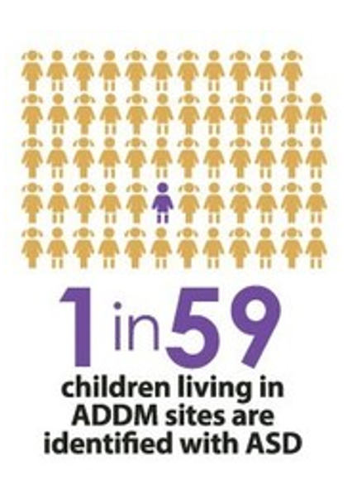
In 2019, the U. S. Center for Disease Control estimates that 1:59 children are annually diagnosed with Autism Spectrum Disorders
Notes:
Dr. Leo Kanner (1943) identified children in his practice with “extreme autistic aloneness.” He rejected the early belief that their condition was caused by rejecting parents and turned his attention to neurobiological sources of the disability.
2. Contemporary research points to autism spectrum disorders (ASD) being a continuum of neurologically-based developmental disabilities of yet unknown etiology
3. In the 21st century rates of ASD diagnoses are increasing. General estimates indicate that approximately 1:150 children in the United States and Canada are annually diagnosed with ASD before the age of 4.
Bar Chart File:US-autism-6-17-1996-2007.png, commons.wikimedia.org.

Slide 6
Special Interests
Intellectual Disability
Transition Distress
Autism varies in
severity affecting
social perceptions
interactions & communication
Notes:
The effects of ASD vary in composition and severity from individual to individual; some youngsters with autism may be intellectually high functioning with impairments to social communication only.
However a greater majority, nearly 70% have co-occurring cognitive disabilities and/or mood disorders. In some instances, children with ASD display significant psychiatric impairment.
Common among children with ASD is their inability to understand the give and take of relationships.
Preoccupation and special interests as well as repetitive motor mannerisms are behavioral capstones of ASD.
ASD researchers have noted that that children and adolescents with ASD have lower quality of life (QOL) than their typically developing peers
Photos: Large -- www.flickr.com; Top Right – commons.wikimedia.org; Middle Right -- www.flickr.com; Bottom Right -- www.flickr.com.

Slide 7

Siblings
Notes:
Siblings are impacted in different ways by autism in the family.
On the negative side, siblings experience feelings of being neglected or of less importance to their parents as compared to their diagnosed sibling.
Conversely, siblings often possess strengths and show resourcefulness and maturity. Positive sibling outcomes include increased capacity for compassion and capacity for solution-building especially when parents are engaged in the process.
This solution-focused perspective for working with siblings and families aligns well with resiliency models presented in the previous chapter.
Photo by Annie Spratt on Unsplash

Slide 8
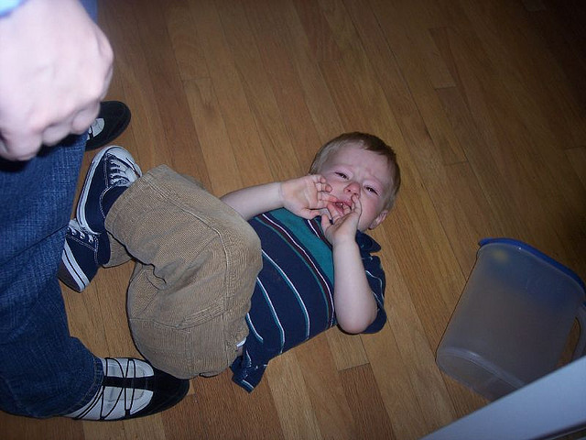
Daily Life
Notes:
Difficulties with transitions significantly affect family functioning and the overall quality of daily life.
People with ASD rely heavily on structure and become agitated when routines are altered.
Routine activities, for example, waking, mealtime, going to school, taking a bath, and going to bed are potentially accompanied by behavioral meltdowns.
In some cases atypical development may not be noticed by family members because of its gradual onset; other families report that they were aware of their children’s atypical development but did not receive validation for their perceptions from extended family, pediatricians, and/or educators.
Siblings are especially affected by autism; the affected child takes up much of the parents’ time.
Photo: www.flickr.com.

Slide 9
TRUST
Respect
Communication
Competence
Commitment
Equality
Advocacy
Notes:
The family quality of life (FQL) paradigm is a well-researched, resiliency-based model for working with families of children with disabilities developed by researchers at the University of Kansas and expanded upon by other disability scholars.
Quality of life for children and families1 relies on resilience, resources, and positive partnerships.
Quality parent-professional partnerships consist of seven essential principles: communication, professional competence, respect, commitment, equality, advocacy, and trust; trust being the “keystone” or base from which all other principles emanate.
¹ See http://www.beachcenter.org.

Slide 10

A Grandfather’s Story http://video.pbs.org/video/1884325580
Notes:
Link to a grandfather’s story about his young grandson with autism whose special interest is a particular ride on the Boston subway.
Photo: www.flickr.com.

Slide 11
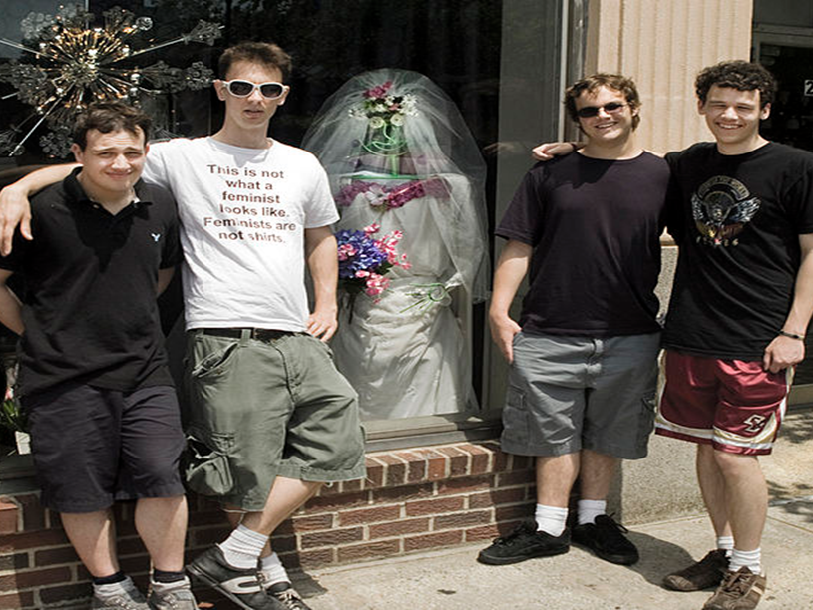
The Culture of Autism
Notes:
Those working in the field suggest that we view autism as a ‘culture’; one that shares common child, adult, and family characteristics including willingness to get to know each child/person as an individual; openness; ability to tolerate uncertainty; and knowledge that there is not a one-size-fits all approach to treatment and care.
The internet has opened new possibilities for youth with autism to create community and belonging.
Film reference: The film Adam (2009), directed by Max Mayer, tells the story of a young man with Asperger's Syndrome and his relationship with a young woman who lives in his apartment building. It offers credible insight into the worlds of young adults with autism.
Photo: commons.wikimedia.org.

Slide 12
Treatment Approaches
TEACCH
DIR: FLOORTIME
STRENGTHS PERSPECTIVE
TO FUNCTION AS MEANINGFULLY AND INDEPENDENTLY AS POSSIBLE
Notes:
There is an array of valid educational theories and therapeutic strategies for working with children and youth with ASD.
It is most beneficial when workers and educators are open to a diversity of therapeutic and educational approaches geared to the unique child’s needs and capacities.
Proponents of the TEACCH¹ program advise that treatment for ASD must occur within the context of caring, consistent, and accepting relationships. TEACCH staff suggest that children with autism learn best through visual and structured therapeutic education.
DIR, the developmental, individual-difference, relationship based model, uses play to facilitate social and communicative development, a method they call Floortime.
The strengths perspective applied to autism treatment highlight the benefits of conducting assessments and implementing treatment approaches focused on the strengths of children and their families. They propose that concentrating on successes rather than on deficits creates a foundation of hope.
At the present time there is no known cure for autism thus regardless of chosen treatment approach, children seem to do best when workers/educators focus on developing strengths that will enable each unique child “to function as meaningfully and as independently as possible” in their homes and in their communities (TEACCH Mission Statement, 2012).
¹Treatment and Education of Autistic and Communication related handicapped Children.
Photos: Left -- commons.wikimedia.org; Middle – www.flickr.com; Right – commons.wikimedia.org.

Slide 13

I Have Tourette’s But Tourette’s Doesn’t Have Me!
http://www.youtube.com/watch?v=aDipNAuZuZI
Notes:
Tourette’s syndrome (TS) is an often misunderstood neurodevelopmental condition characterized by motor and vocal tics.
Prevalence estimates range from 1-10% per 1000 in children between the ages 6-17. Boys are more often diagnosed with TS than girls and its symptoms seem to diminish with age.
Young people report that tics are particularly difficult to manage and control while at school due to stress caused by cognitive and social strains; teasing and bullying are common.
4. TS often goes unrecognized or misdiagnosed because of lack of awareness and training.
5. Similar to families with children living with autism, family impact from TS can significantly affect daily functioning and quality of life.
5. There is not as yet a cure for Tourette’s but there are a number of therapeutic strategies (CBT, narrative approaches, relational therapies) along with proper medication management, that reduce problematic behaviors and stresses associated with the disorder.
6. The link goes to a segment of the film ‘I Have Tourette’s But Tourette’s Doesn’t Have Me!’, an HBO documentary.
Photo: commons.wikimedia.org.

Slide 14
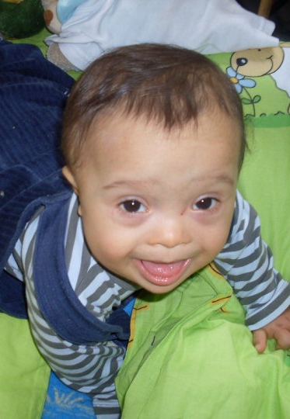
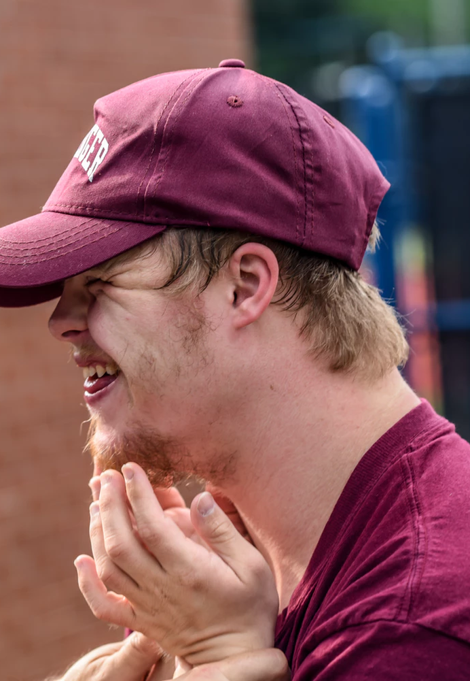
Notes:
Most parents who have a baby with Down syndrome or other developmental disability learn of the diagnosis after birth because for a number of reasons there was no prenatal testing.
Even when prepared, parents are surprised by the range of emotions they experience in response to having a child with disabilities. Shock, disappointment, guilt, grief and anger are common yet disenfranchised emotions reported by parents.
Difficult feelings co-exist with powerfully positive emotions such as love, pride, and awe at what children are able to accomplish given their struggles.
No matter how knowledgeable or skilled workers might be, they can never truly know what it’s like to raise a child with special needs.
Photo: commons.wikimedia.org.

Slide 15

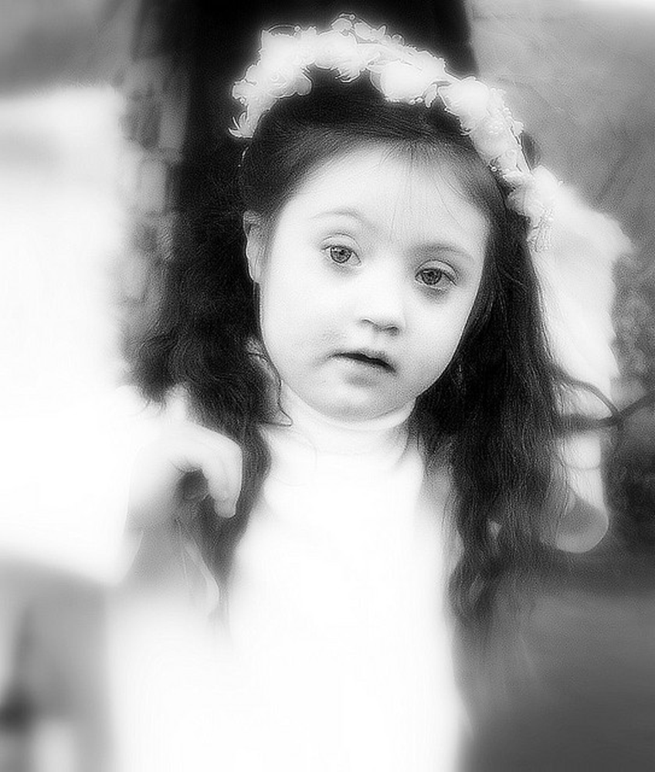
Myrna & Phoebe
Notes:
Myrna & Phoebe (Modified from Chapter 9, pp. 212-213): Early on the snowy evening of February 18, 2000 Phoebe Anna Fleming was born. When Myrna looked at her daughter she knew immediately that she had Down syndrome, however no one, not even the pediatrician said a word. She felt anxious and frightened and strangely disconnected from her tiny newborn. The day after Phoebe’s birth Myrna was visited by a woman who introduced herself as another mother of a child with Down syndrome. Myrna was appalled by the intrusion and asked the woman to leave. Before leaving the hospital, their pediatrician confirmed the diagnosis – Phoebe had Down syndrome also known as Trisomy 21. What he could guarantee was that Phoebe would be slower in her development than a youngster without Down syndrome; what he didn’t know was how much slower nor could he specify what other symptoms or conditions might evolve.
For the first few months of Phoebe’s life Myrna kept hoping that the doctor was wrong. “I kept looking at her and thinking that she would suddenly be normal. But then I’d see her tiny mouth and too large tongue, her flattened nose and her short little fingers and those almond eyes and I knew there was no going back.”
When Phoebe was 5-months-old Myrna contacted the woman who had come to the hospital. They gradually became close friends as well as vocal advocates for kids with disabilities in their school district. Phoebe’s older siblings were helpful however Gregory the five-year-old, was jealous and sometimes behaved aggressively towards his baby sister.
As she got older Phoebe’s engaging personality earned her admirers. The Flemings were lucky that Mike’s insurance covered most of her health expenses. This was especially important because shortly after birth Phoebe was diagnosed with an intestinal malformation that required two surgeries. The family paid out of pocket for many of her non-covered therapies, which strained their tight resources. To make ends meet Myrna opened a small home day care to supplement the family income.
Myrna candidly talks about the exhaustion she feels and admits at earlier times she was resentful of Phoebe. But these feelings were eased when Phoebe danced into the living room and made everyone’s day a little brighter. Both Mike and Myrna worry about what the future will hold for their young daughter. “She’s advancing far beyond what we expected,” Myrna said. “But her deficits will likely prevent her from living on her own and we don’t know yet what that means for her and for us?”
Both parents acknowledge that waves of grief still encompass them when they think about their little girl and the prospects lost. They describe moments of overwhelming sorrow that hits at unexpected times.
Yet they wouldn’t want Phoebe to be anyone but who she is. “She’s brought our family an amazing perspective on life. She always sees the positive. She’s always in the present. She’s always hopeful. And even when she’s uncompromisingly stubborn, she does it in a way that reminds us to slow life down – just like the doctor said, she would take things slower and now we do, too.”
Photo: www.flickr.com.

Slide 16
Conversation Starters
Do you know people with autism or other neurodiverse conditions? What have you learned that has influenced or changed your previous assumptions?
Myrna’s story is unique to one family’s experience. What thoughts do you have about her experience of raising a child with Down syndrome?
What role does attachment play in Phoebe and Myrna’s story?
How do micro and macro advocacy play a role for neurodiverse children and their families?

