Slide 1
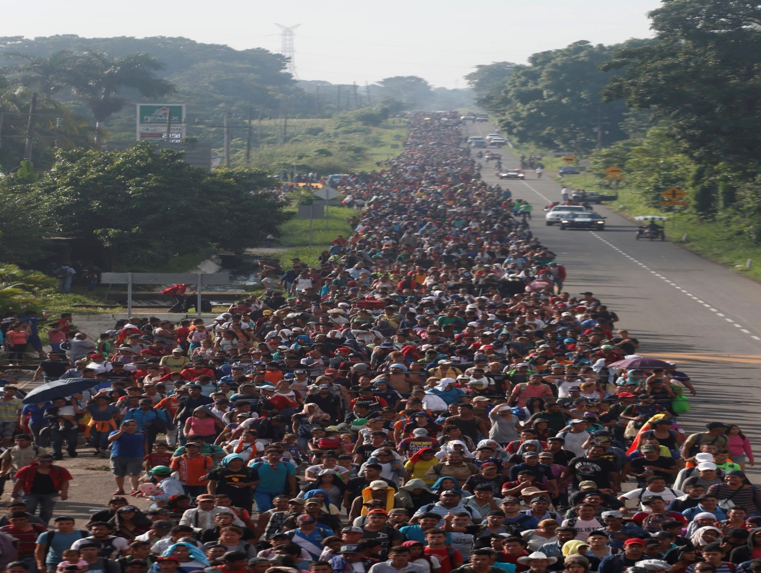
Chapter 1 Global Politics Matters
Notes:
1

Slide 2
Chapter 1 Global Politics Matters Topics
Why Global Politics Matters
Global Politics
Grappling with Global Complexity

Slide 3
Chapter 1 Learning Objectives
1.1 Discuss the ways that global politics directly and indirectly affects you and your world.
1.2 Discuss the complexity of global politics within the context of history and the changing types and roles of global actors. Theory will help shape that discussion throughout this book

Slide 4
Why Global Politics Matters 1 of 7
Global challenges impact your life and your local community.
The history, theories, and practices of global politics.

Slide 5
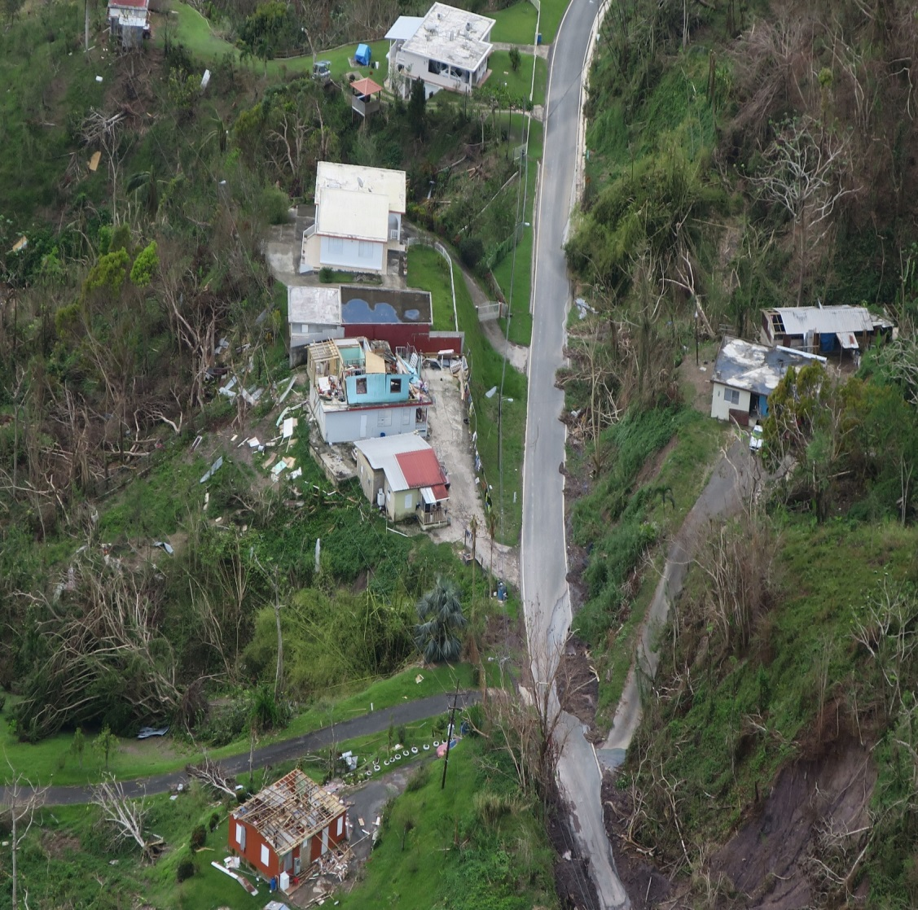
Why Global Politics Matters 2 of 7
2017 Hurricane Irma and Maria cost Puerto Rican about $139
Damages to property, infrastructure, social services etc.

Slide 6
Why Global Politics Matters 3 of 7
Global economic issues often affect national affairs
The 2015 Canadian election
The 2016 Brexit vote in the United Kingdom
The 2016 U.S. presidential election
The 2018 election of Jair Bolsonaro in Brazil
Notes:
Indeed, the interconnections between national and global affairs are so close that many social scientists now use the term intermestic to symbolize the intersection of international and domestic concerns.

Slide 7
Why Global Politics Matters 4 of 7
Global Politics and Climate Change
2018 UN report; 0.5°C of warm could expose tens of millions
Life-threatening heat waves, water shortages, and coastal flooding
Impact physical environment for e.g. air quality, drinking water, food

Slide 8
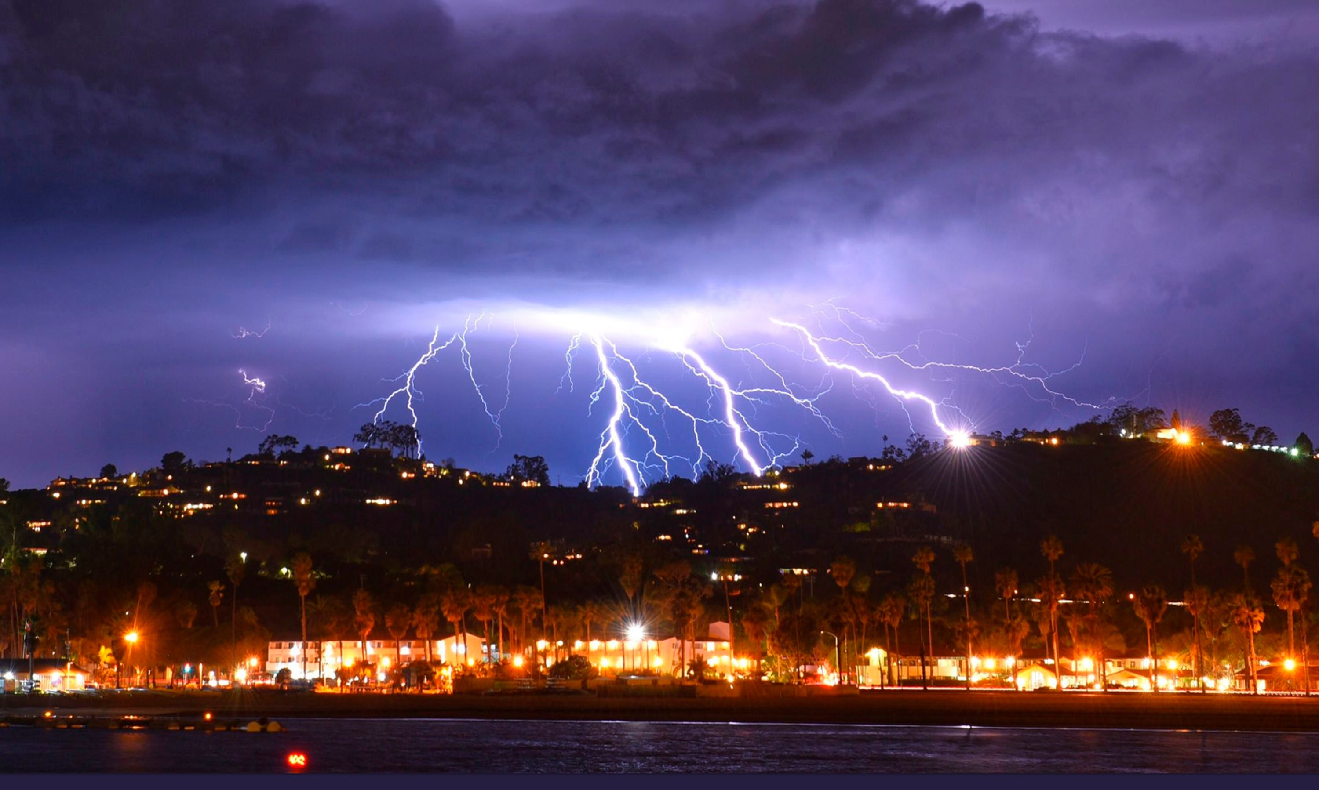
Why Global Politics Matters 5 of 7
Notes:
California coastal flooding, rains or fires

Slide 9
Why Global Politics Matters 6 of 7
Global Politics affects your personal security
Diseases and potential violence are high-value, low-probability problems
The 2015 Iran nuclear deal is an example of a high-value, low-probability challenge
Individually and collectively problems
Notes:
High-value, low-probability problems, they are unlikely to occur. If they do will be extremely serious

Slide 10
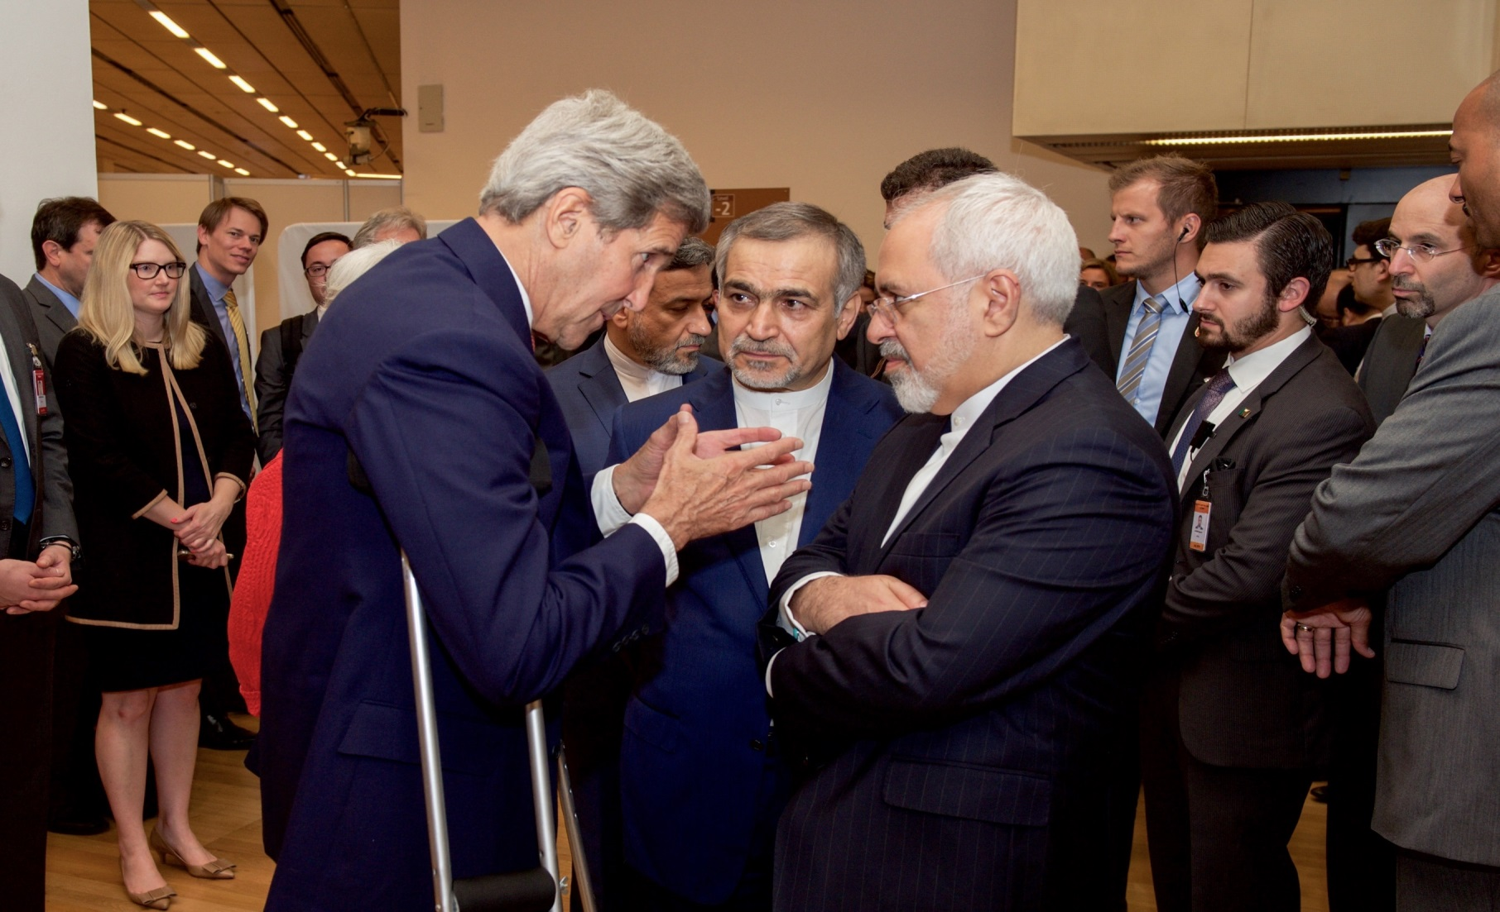
Why Global Politics Matters 7 of 7
Notes:
Photo depicts Iran nuclear deal

Slide 11
Grappling with Global Complexity 1 of 16
Less support for U.S. military action in Iraq and Afghanistan 2000s compared to 1990s
Globally commitment to environmental sustainability but fail to deliver
impossible to get consensus on economic policies

Slide 12
Grappling with Global Complexity 2 of 16
The Study of Global Politics
Topics of IR dates back millennium in ancient India and biblical times
Focus on modern IR oriented to the responses to World War I
The study of global politics evolves and grow
Notes:
1. The study of global politics has continued to evolve and grow into an interdisciplinary field of academic inquiry.
a) the International Studies Association (ISA; www.isanet.org), a leading forum of the study of global affairs.
b) Special study sections on diplomatic studies, feminist theory, global health, history, technology, communication, law, sociology, economics, demography and geography, religion, and more.
2. The first Chair in the field of IR was established at the University of Wales, Aberystwyth, in 1919

Slide 13
Grappling with Global Complexity 3 of 16
The Study of Global Politics
The current actors in global affairs are constantly changing
Term global better capture the scope of global interactions
The term better captures the multifaceted process of Globalization
Notes:
1. Why not choose international relations, global relations, or global affairs in the title instead of Politics?
a) Part of the reason the authors educational grounds are rooted in political science (PhD).
b) Part of it has to do with what classes will find this book helpful.
c) The linguistic conventions that still keep most academic study tied to disciplines.
d) It has a lot to do with the desire to keep the question of power a central theme of the book.

Slide 14
Grappling with Global Complexity 4 of 16
Global Actors
Most actors in global politics are organizations
States or countries Primary types of organizational actors
Sovereignty central organizing principle of all states
Lack of central governing authority is anarchy
States engage in the global system in different and asymmetrical ways.
Notes:
2. There are almost 200 states in the global community.
3. Some states are more involve in global politics than others because of their power, history, geographic location etc

Slide 15
Grappling with Global Complexity 5 of 16
Global Actors
International Organizations
Actors that are surrounded on a particular issue
about 300 prominent (IGOs)
Lack of central governing authority is anarchy
NGOs; formal, legal entities distinct from the state
MNCs; are private enterprises

Slide 16
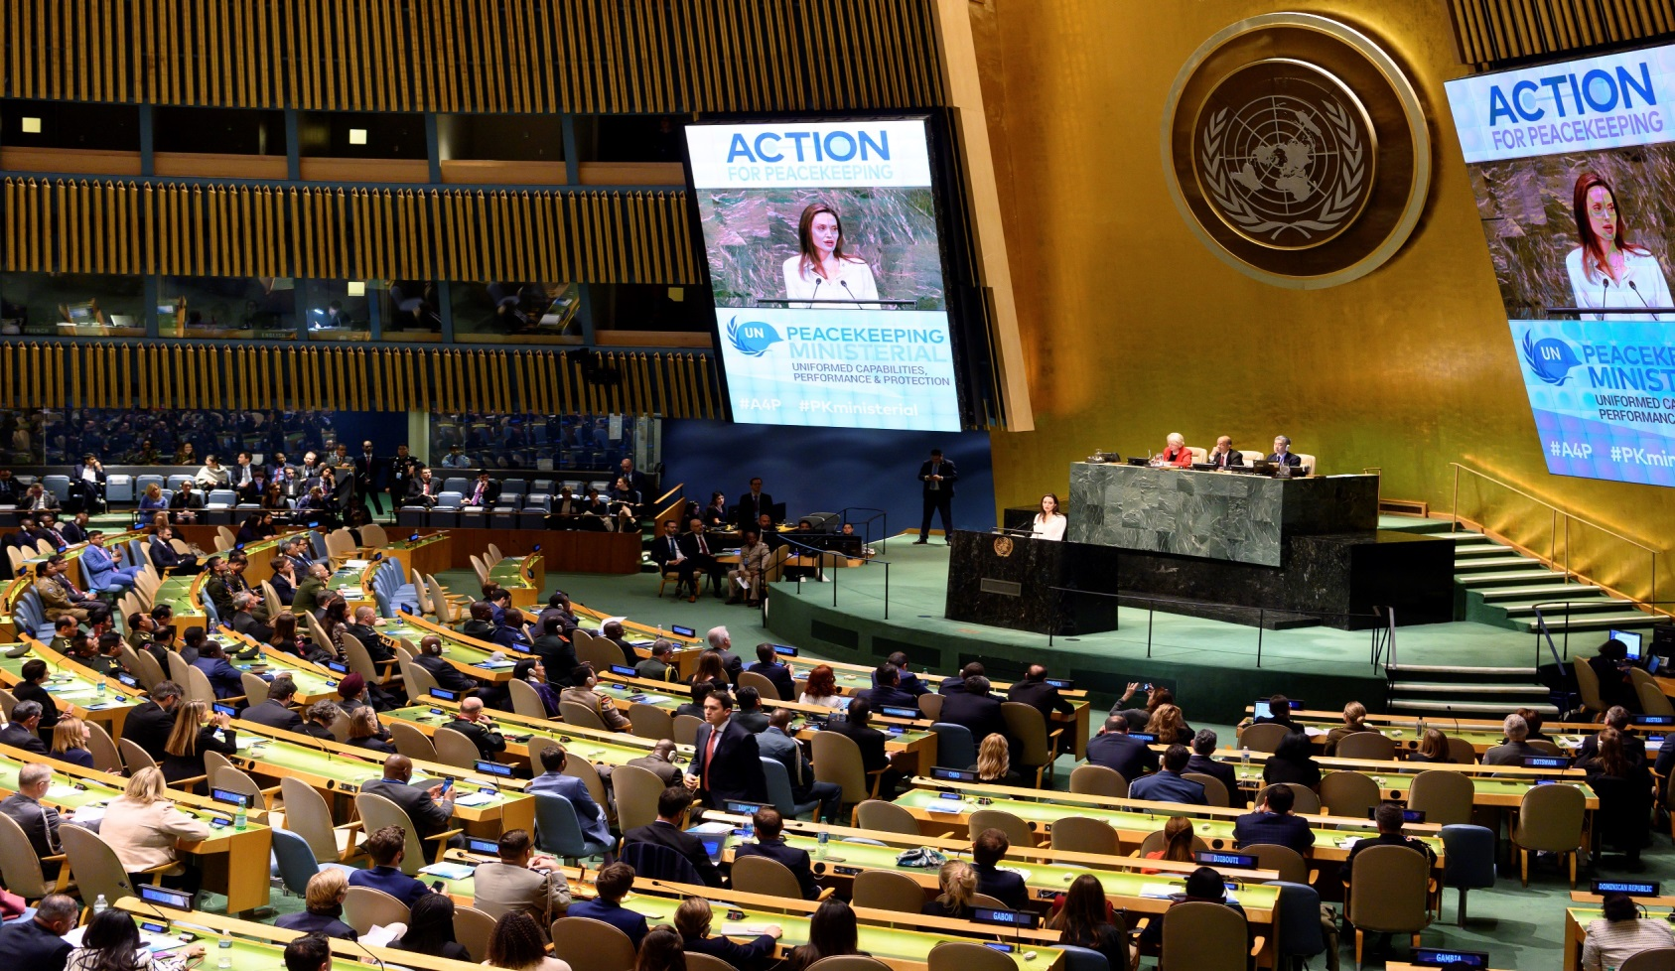
Grappling with Global Complexity 6 of 16
Global Actors
Notes:
UN General Assembly and Equal Representation

Slide 17

Grappling with Global Complexity 7 of 16
Global Actors
Notes:
Multinational corporation; Monsanto agribusiness

Slide 18
Grappling with Global Complexity 8 of 16
Global History in Context
Leaders and communities must learn from the past
History provides details on critical events
History help foster generalizations

Slide 19
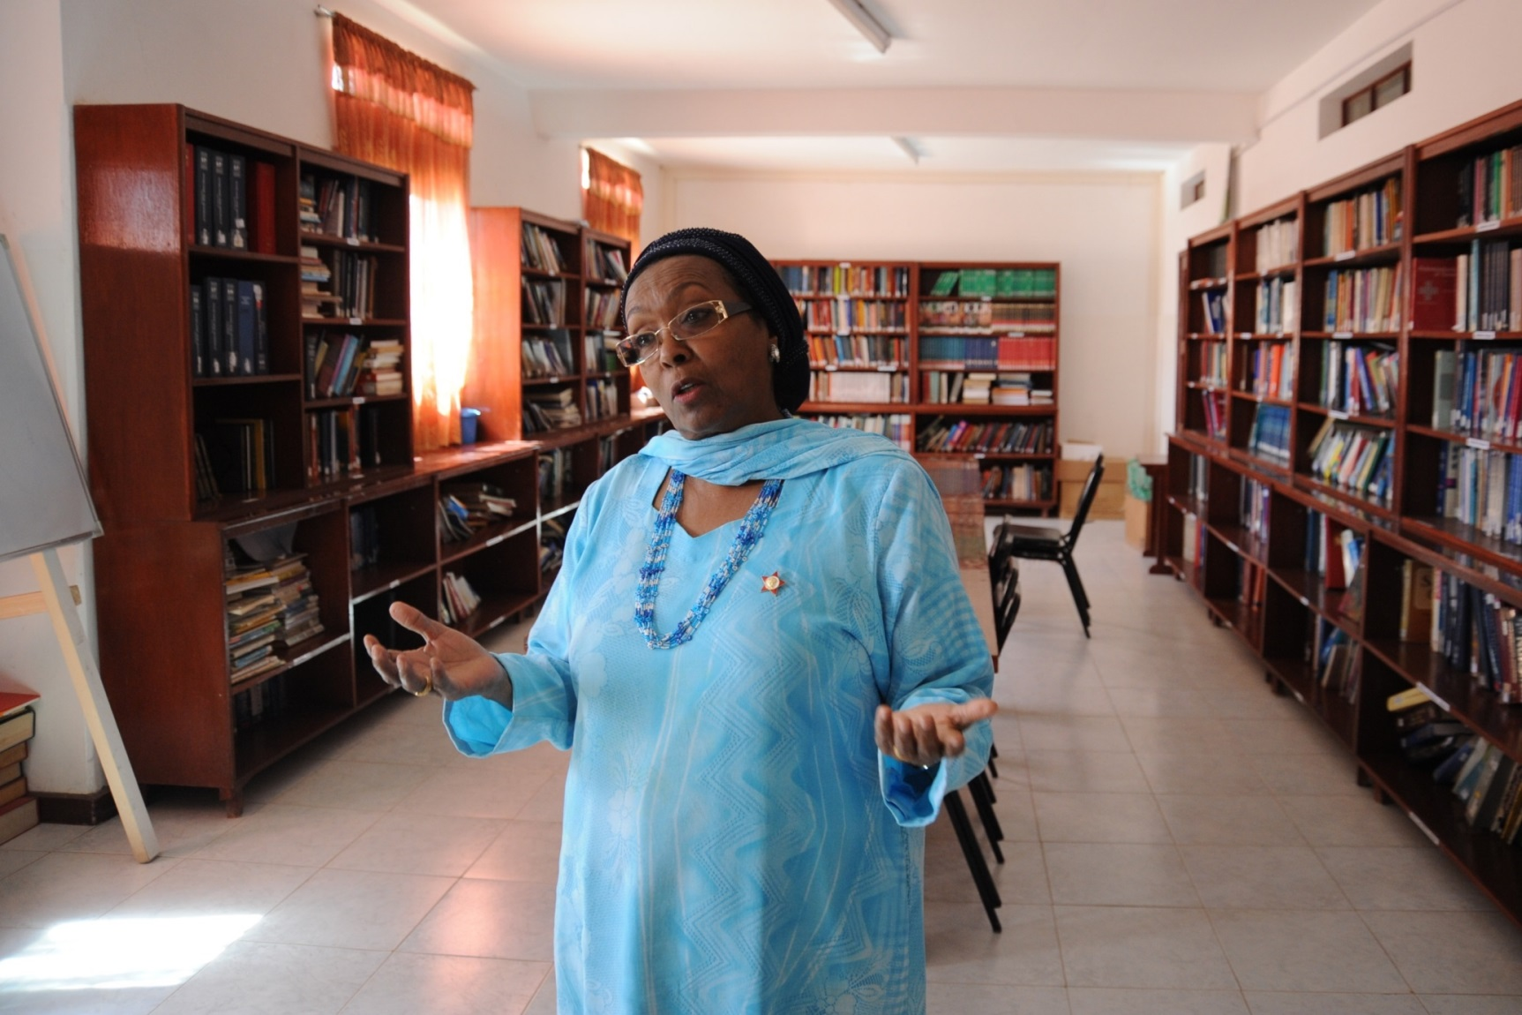
Grappling with Global Complexity 9 of 16
Global History in Context
Notes:
Edna Adan, a Somalian woman who built Somalia’s first maternity hospital

Slide 20
Grappling with Global Complexity 10 of 16
Global History in Context
The Peace of Westphalia of 1648
Sovereignty to most small states in Europe
Ending the ruling Holy Roman Empire
Monarchs were able to decide their domestic policies
States became the primary actors post-Westphalian
States are still the most dominant actors

Slide 21
Grappling with Global Complexity 11 of 16
Global History in Context
The dominance of states in IR theory
Realism; state as the main actor in global affairs
Realism; polarity or concentration of power
Cold War; bipolar system
Multipolar system characterized in the 1990s
Realism’s dominance began to breakdown early 20th

Slide 22
Grappling with Global Complexity 12 of 16
Global History in Context
The dominance of states in IR theory
IR early 20th ; economic issues and non-state actors
Imperial Western collapsed post World War II
The Global North – Global South Divide continues
North and South Korea still at Korean War
Globalization has empowered non-state actors

Slide 23
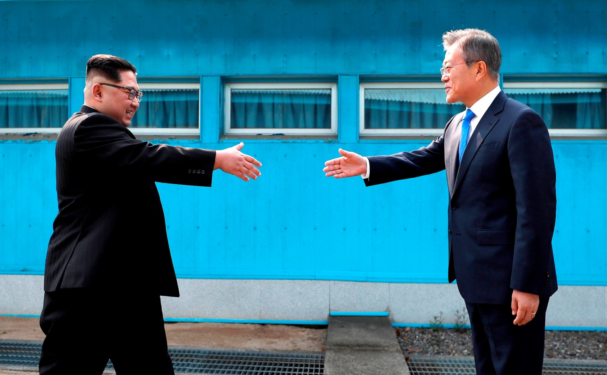
Grappling with Global Complexity 13 of 16
Global History in Context

Slide 24
Grappling with Global Complexity 14 of 16
Interpreting Global Politics
Traditionally, global politics has been tumultuous and often violent
2017 report Global Peace Index; world is more peaceful
Traditional conceptions of analyzing global politics are not as they once were in academia or in policy

Slide 25
Grappling with Global Complexity 15 of 16
Interpreting Global Politics
Attribute | Traditional Conceptions | Evolving Trajectories
Human organization | National societies | Multiple identities and community affiliations: global, regional, local; religious, ethnic, race, gender, class.
Interests | National interests | Global and regional interests; local identity-based interests
Predominant Interactions | Competitive Zero-Sum | Mixture of cooperation and competition; non zero-sum
Pursuit of Security | Focus on the National | Multiple focal points of security across actors and issues.
Pursuit of prosperity | Economic nationalism | Mutual effort; recognition of interdependence; management of globalization
Locus of authority | Sovereign states | Many, including international organizations, individuals, NGOs, subnational groups
Conflict resolution | Power centric | Law and Norm centric in addition to power centric
Notes:
Table suggest growing complexity in the global system, and there is tangible evidence of this trend. First, the evolving trajectories in global politics reflect how we interact as individuals inside our own countries

Slide 26

Grappling with Global Complexity 16 of 16
Interpreting Global Politics
Notes:
flow of goods; trucks at US-Mex border

Slide 27
Thinking Theoretically 1 of
Tools for Studying Global Politics
Understanding world allows us to make sense of what is going on
Several theoretical perspectives
The on-going Brexit situation; UK and EU conflicted history

Slide 28
Thinking Theoretically 1 of
Tools for Studying Global Politics
Draw on history and theory to help think critically about the world
Theory allows us to describe, explain, and even predict phenomena
Theory helps build knowledge

Slide 29
Thinking Theoretically 1 of
Tools for Studying Global Politics
Five different theoretical perspectives
Realism and Liberalism (the dominant theories)
World Systems, Feminism, and Constructivism (provoking challenges to their dominant theories)

Slide 30
Thinking Theoretically 1 of
Tools for Studying Global Politics
Each theory has numerous variations
Realists do not necessarily see things as they “really” are
liberal” here with left-of-center political parties in American domestic politics.
No theories discussed are truly comprehensive
Liberal are not left-of-center political parties in U.S.
Liberalism is more closely tied to the writing of 18th and 19th

Slide 31
Chapter 1 Review of Learning Objectives
1.1 Discuss the ways that global politics directly and indirectly affects you and your world.
1.2 Discuss the complexity of global politics within the context of history and the changing types and roles of global actors. Theory will help shape that discussion throughout this book

