Slide 1

Chapter 2
Theory is Everywhere
Notes:
1

Slide 2
Chapter 2
Theory is Everywhere
Theoretical Perspectives: Diverse Views on Global Events
World Systems Theory: An Emphasis on Inequality
Realist Theory
Liberal Theory
World Systems Theory: An Emphasis on Inequality
Constructivism
Feminist Theory

Slide 3
Chapter 2
Learning Objectives 1 of 2
2.1 Identify five theories that help to improve our understanding of global politics and to interpret the behavior of states, societies, and individuals.
2.2 Explain the principles of realist theory and the focus on the self-interest and promotion of the state and nation.
2. 3 Outline the principles of liberalism and how the world has moved in this direction during the past century.

Slide 4
Chapter 2
Learning Objectives 2 of 2
2.4 Discuss world systems theory and its challenge to the paradigms of realism and liberalism.
2.5 Describe constructivism in the context of international economic policies.
2.6 Discuss feminist theory and the way in which global politics is structured around socially constructed conceptions of gender and the intersection with political and economic power.

Slide 5
Theoretical Perspectives: Diverse Views on Global Events 1 of 2
Some aspects of theory might resonate with you
Theories; empirical (factual) and normative (value-based) aspects
Good empirical theory provides insightful descriptions and explanations

Slide 6
Theoretical Perspectives: Diverse Views on Global Events 2 of 2
Can a theory accurately make prediction?
No consensus of the predictive power of theories.
Prescriptiveness of theory help understands a country’s foreign policy.

Slide 7
Realist Theory 1 of 9
Realism
Competitive self-interest, given the preeminent goal of survival, drives global politics
Assumption that anarchy reigns in IR
Competition among states
The struggle for power is a zero-sum game.
Notes:
Competition among states results in rife, conflict and war, arms race, competing alliance structures, espionage and intelligence gathering, and economic nationalism

Slide 8
Realist Theory 2 of 9
Realism
National loyalty to country or political such as religion, ethnicity, or culture
States are the main actors
Competition among states
Realism has made great contribution war and security studies
Notes:
Competition among states results in rife, conflict and war, arms race, competing alliance structures, espionage and intelligence gathering, and economic nationalism

Slide 9
Realist Theory 3 of 9
Realism: An Emphasis on Power
Centered around Darwinian; power key to national survival
Amassing military and economic power.
Competition among states
The highest moral duty of the state is to do good for its citizens

Slide 10
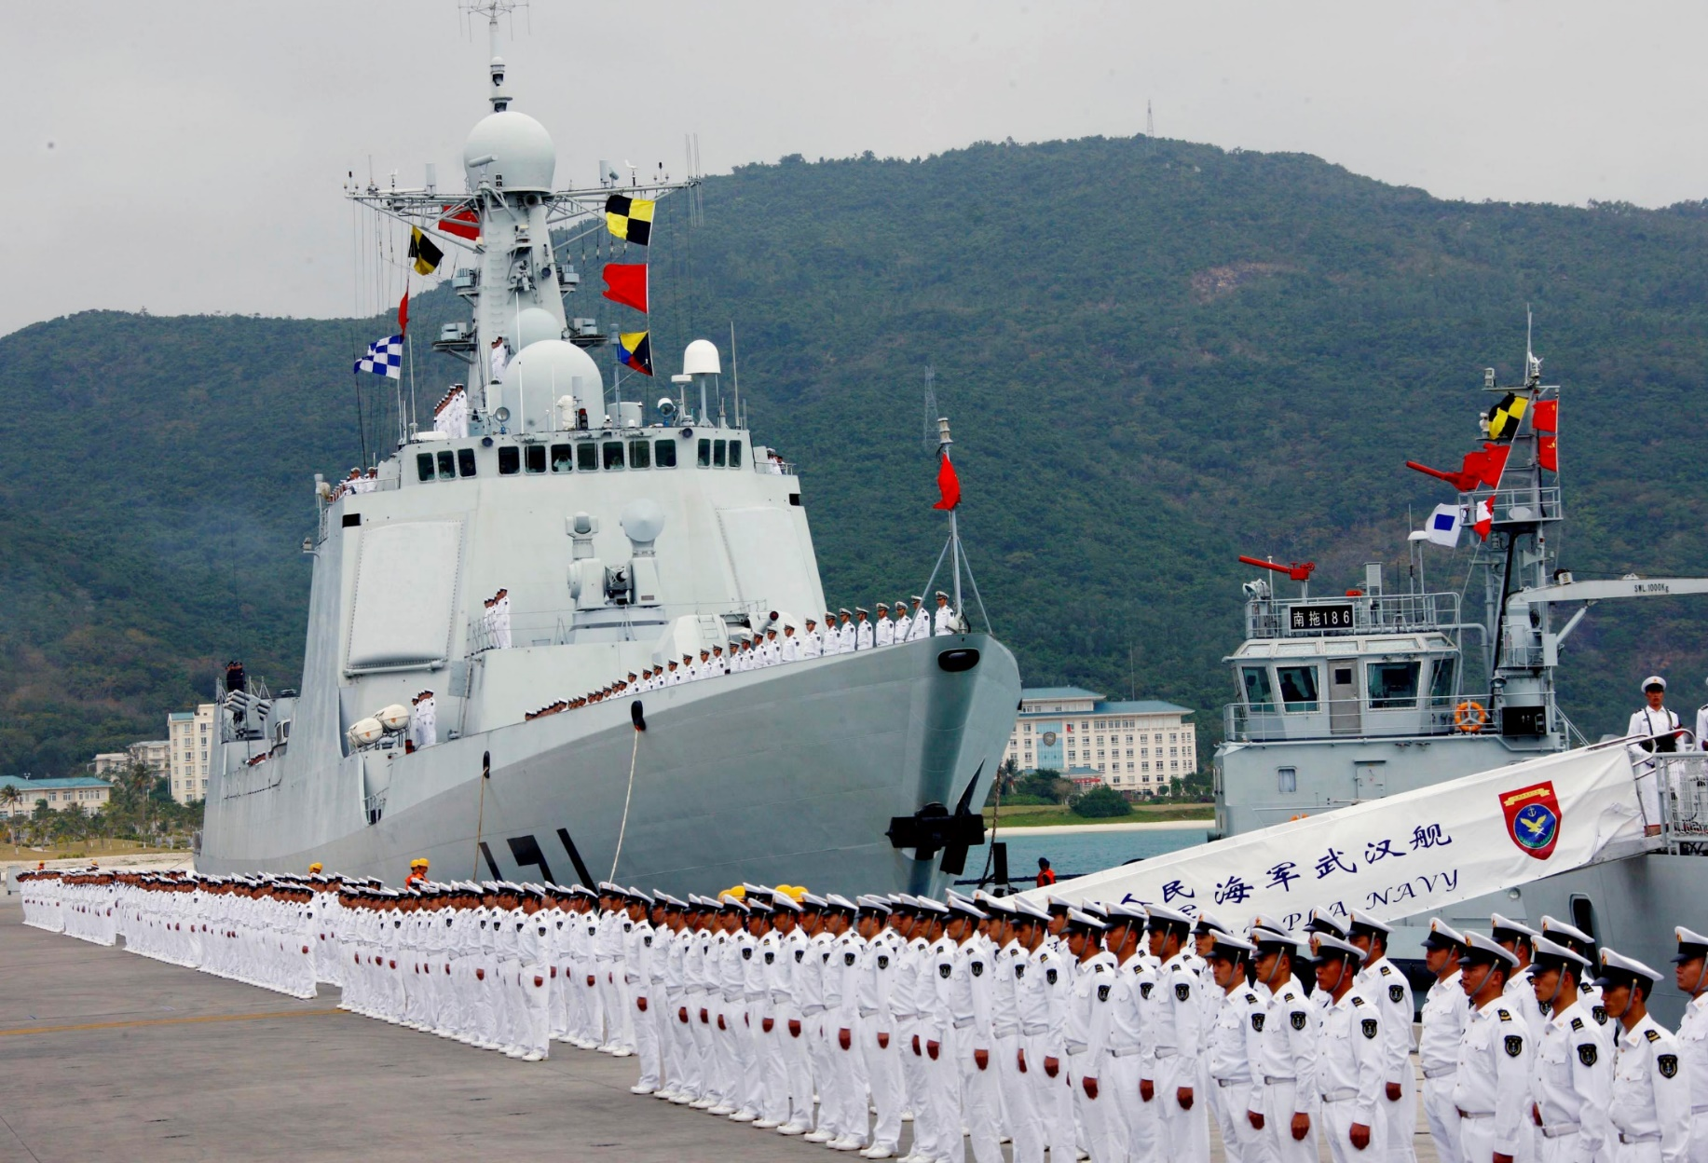
Realist Theory 4 of 9
Realism: An Emphasis on Power

Slide 11
Realist Theory 5 of 9
Classical Realism
Early; Thucydides, Machiavelli, and Hobbes
Modern (mid-20th); George Kennan and Hans Morgenthau
Relies on power and interest, morality and legalism had no place.

Slide 12
Realist Theory 6 of 9
Classical Realism
Self-interest more important than value
Sovereign to rule with force when necessary
Humanity will use force when face with scarcity, seeking prestige, or uncertainty

Slide 13
Realist Theory 7 of 9
Classical Realism
Political struggle is inevitable because human beings are inherently selfish
It is foolish to trust other countries

Slide 14
Realist Theory 8 of 9
Neorealism
Struggle for power because of the anarchic (unregulated) structure of the global system
Neorealist are sometimes referred to as structural realists
Lack of central governing authority
Notes:
Neorealism also portrays global politics as a struggle for power, but neorealists believe that the cause of conflict is not human nature per se, or the individual choices and preferences that follow from it, but rather the anarchic (unregulated) structure of the global system
Lack of central governing authority means a constant struggle for survival within the international system

Slide 15
Realist Theory 9 of 9
Neorealism
States must assume worst case scenario about each other
Offensive and defensive realists agree that balance of power
Globalization of cultural trade as an economic sector

Slide 16
Liberal Theory 1 of 12
Liberalism
Main counterpoint to realism in IR theory
Reject the realists’ notion of power
Globalization of cultural trade as an economic sector
Does not dismiss power and interest

Slide 17
Liberal Theory 2 of 12
Liberalism
Morality, ideology, emotions, friendship, cooperation, altruism etc. are also important
Global Politics do not have to be a zero-sum game
Cosmopolitanism; beyond national boundaries to forge ties and enhance collective good

Slide 18
Liberal Theory 3 of 12
Liberalism: An Emphasis on Cooperation
Applying power for self-interested is not the essence of global politics.
States can cooperate with each other and find mutual interest.
Economic diversification; economic integration and cooperation.

Slide 19
Liberal Theory 4 of 12
Liberalism: An Emphasis on Cooperation
International institutions and agreements fosters deeper cooperation
Global expansion of democracy
Continued (if declining) utility of military power in global politics
Notes:
Global expansion of democracy
a)Since its emergence in the French and American Revolutions
b)Promotes the interest of democratic nations
c)Additional opportunities for cooperation by democracies and their citizens because of mutual respect, values, norms, institutions etc.

Slide 20
Liberal Theory 5 of 12
Liberalism: An Emphasis on Cooperation
Military force could be used as a form of coercion (self-defense or against international aggression).
Favors the use of military if authorized by the UN
Liberal internationalists
Based on its proponents’ view of human nature
Notes:
Liberal internationalists:
a) Support concerted and assertive effort to expand and promote liberalism, even forcibly.
b) Example Woodrow Wilson sent American troops to Europe in an effort to “make the world safe for democracy.
c) George W. Bush invaded Iraq to overthrow the authoritarian regime of Saddam Hussein in an effort to foster democracy.
d) Closely related to classical liberal thoughts, Enlightenment thinkers (Immanuel Kant and John Stuart Mill).
e) Major influence on post–Cold War leaders especially in the U.S.
f) For the U.S. promoting improvements in global economic conditions, human rights, and democracy is very much in the national interest.
g) Civil and political rights, democracy and free market capitalism.
h) Disagree with realist that pursuing ethical policy often works against the national interest.
i) President Obama’s commitment in Afghanistan to fight against the Islamic State

Slide 21
Liberal Theory 6 of 12
Classical Liberalism
Influenced by and indebted to Enlightenment-era thinking
The ‘inside-out’ emphasis; both states and citizen
Citizen and leaders fosters international cooperation
Optimistic about human nature

Slide 22
Liberal Theory 7 of 12
Classical Liberalism
Self-interested societies with rational faculties means that they are able to learn
Influenced by and indebted to Enlightenment-era thinking
People can come to appreciate the benefits of cooperation

Slide 23
Liberal Theory 8 of 12
Classical Liberalism
Immanuel Kant’s concept of asocial sociability
Intellectual lineage: Jean-Jacques Rousseau and Immanuel Kant
Rousseau’s The Social Contract.
Kant’s work Perpetual Peace (1795)

Slide 24
Liberal Theory 9 of 12
Classical Liberalism
Fukuyama; End of History and the triumph of liberalism
No two democracies have gone to war with one another over the past two centuries
Neoliberal Institutionalism (NLI)

Slide 25
Liberal Theory 10 of 12
Neoliberalism
Outside-in explanation: cooperation, international institutions
Complex interdependence
cooperation because of transaction costs
International organizations are very important

Slide 26
Liberal Theory 11 of 12
Neoliberalism
International organizations are very important
The WTO for example helps with trade and compliance
National politics promote global democracy

Slide 27
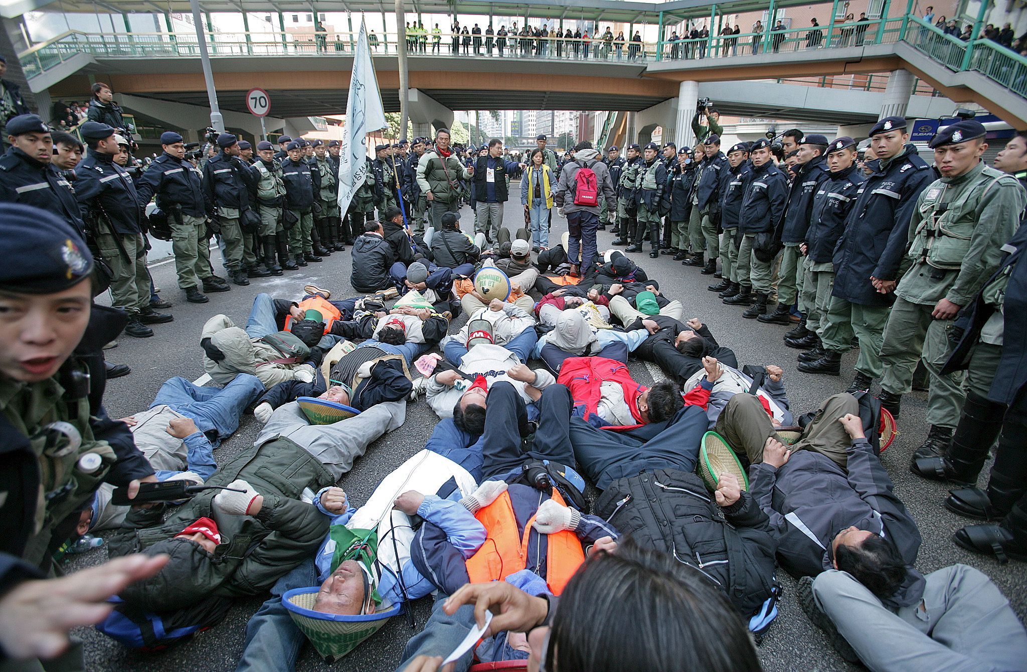
Liberal Theory 12 of 12
Neoliberalism

Slide 28
World Systems Theory 1 of 11
World Systems Theory: An Emphasis on Inequality
A group of theories rooted in Marxist
Economic structures and forces main factors shaping global politics
World system as a capitalist economy has replaced the nation-state as the central actor in global politics

Slide 29
World Systems Theory 2 of 11
World Systems Theory: An Emphasis on Inequality
Immanuel Wallerstein: international axial division of labor
Global North (core) vs. Global South (periphery) argument
Semi-peripheral states (e.g. South Korea and Singapore)

Slide 30
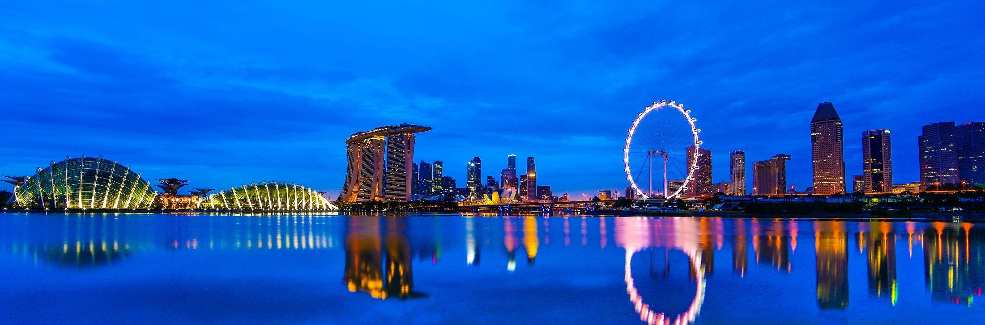
World Systems Theory 3 of 11
World Systems Theory: An Emphasis on Inequality

Slide 31
World Systems Theory 4 of 11
World Systems Theory: An Emphasis on Inequality
A capitalist world economy creates and sustain structural inequality
Most fundamentalist main political identity is their religion not their state.
Monopoly capitalism

Slide 32
World Systems Theory 5 of 11
World Systems Theory: An Emphasis on Inequality
Natural end-state of capitalism is to control all means of production
States play crucial role in perpetuation of a capitalist world by supporting bourgeois
Domestic and international policies to promote capitalist expansion

Slide 33
World Systems Theory 6 of 11
Marxism
Karl Marx and Friedrich Engels: The Communist Manifesto
The first Soviet Communist Party chief Vladimir Ilyich Ulyanov
Lenin argued in Imperialism: The Highest Stage of Capitalism

Slide 34
World Systems Theory 7 of 11
Marxism
Lenin’s revolution against the Tsarist regime in Russia in 1917
Marx’s views of unequal distribution of capital in global politics
Global politics and the nature of imperialism

Slide 35
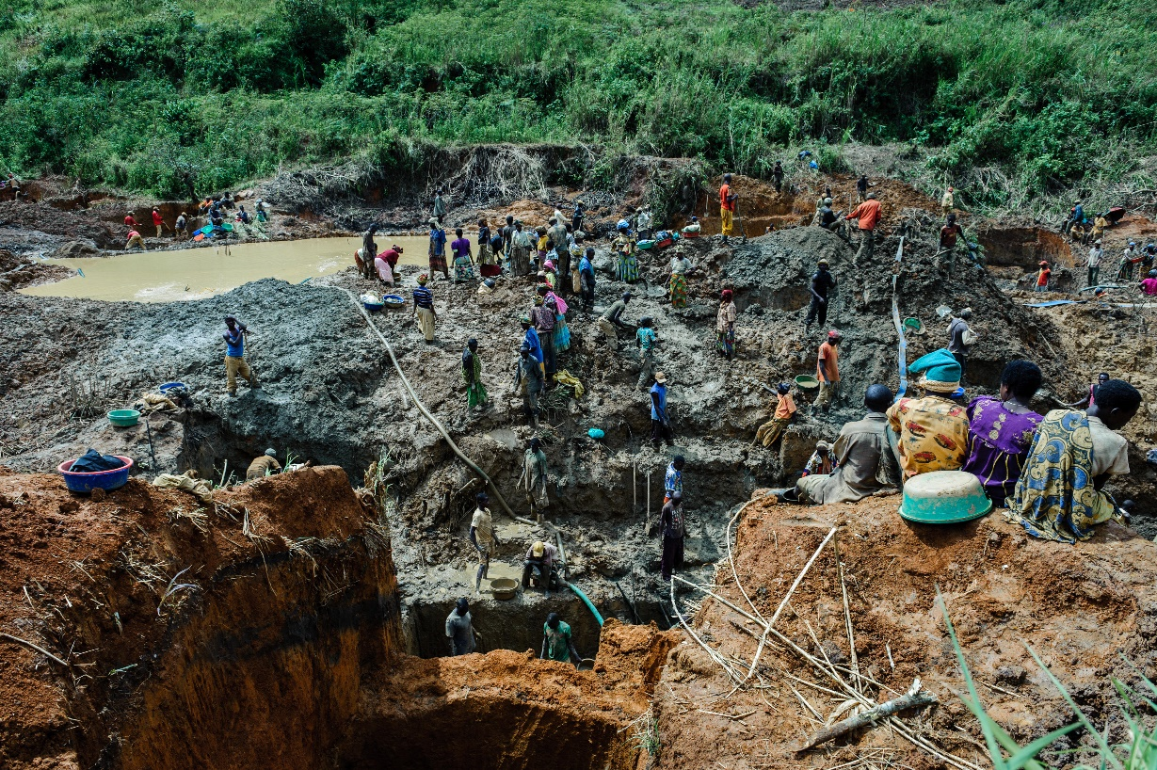
World Systems Theory 8 of 11
Marxism

Slide 36
World Systems Theory 9 of 11
Dependency Theory
1950s Economic Commission for Latin America and the Caribbean (ECLA)
Raul Prebisch, Andre Gunder Frank, Fernando Henrique Cardozo, Enzo Faletto
The global capitalist order promotes subordination

Slide 37
World Systems Theory 10 of 11
Dependency Theory
1950s Economic Commission for Latin America and the Caribbean (ECLA)
Workers of the world would not unite if freed of their respective bourgeoisie masters
More state involvement

Slide 38
World Systems Theory 11 of 11
Dependency Theory
Neocolonialism: operates without colonies, but is still imperialistic
Global North has greater voting power (IMF leaders in the North)
Many leaders in the Global South receive benefits from the North

Slide 39
Constructivism Theory 1 of 8
Constructivism
Changing ideas, norms, and identities of global actors shape global politics
Ideas are the key to understand global politics
Ideas define identity, shape interest, produce behavior
Contrast to materialist and behavioralist theories

Slide 40
Constructivism Theory 2 of 8
Constructivism
Deep roots in social science disciplines such as sociology and psychology
Social domain can be our community, our state, our nation, or the whole world
Anarchy is what states make of it

Slide 41
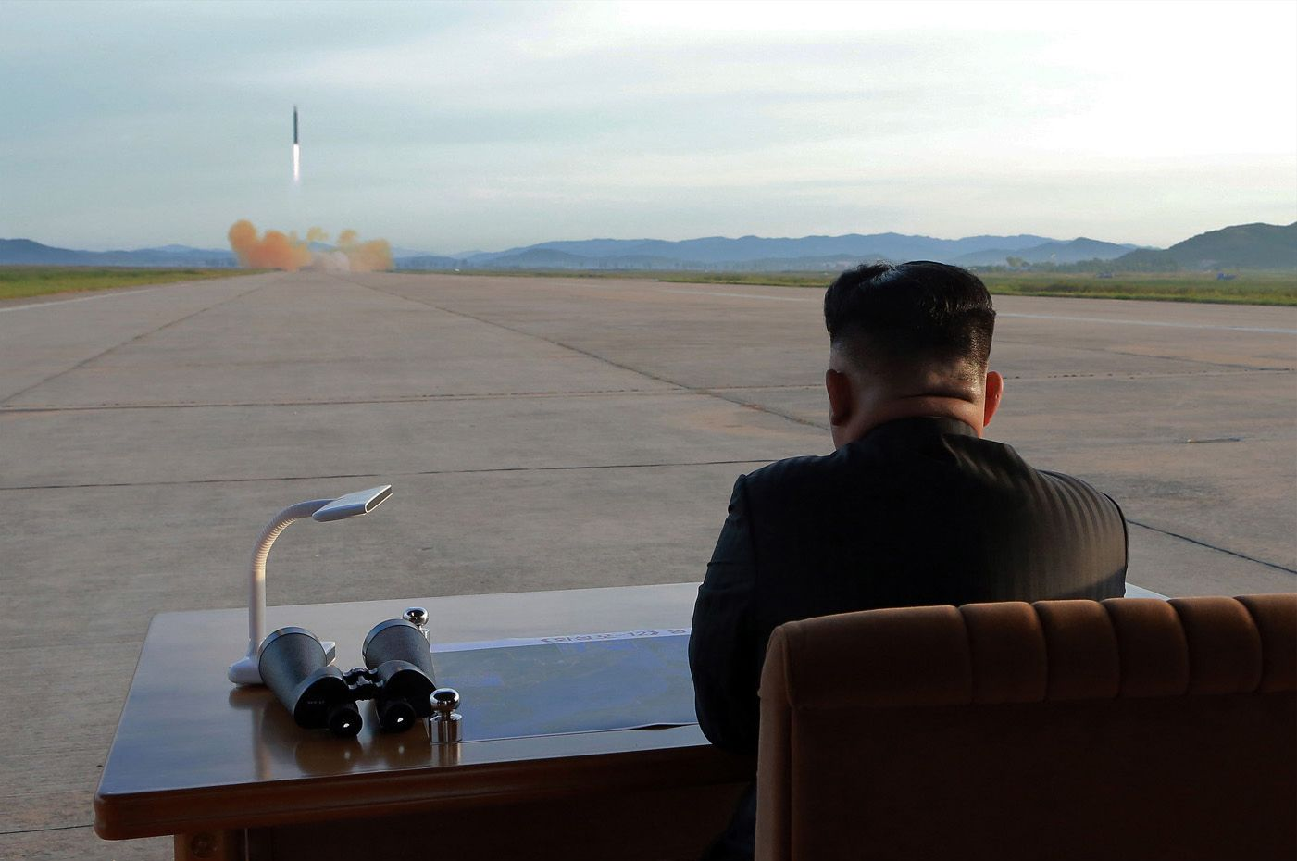
Constructivism Theory 3 of 8
Constructivism

Slide 42
Constructivism Theory 4 of 8
Constructivism: An Emphasis on Norms
Which ideas constitute norms?
How are norms diffused?
ISIS are good example of norms and ideas explaining behavior.
Which ideas are more appealing to the majority in society?

Slide 43
Constructivism Theory 5 of 8
Constructivism: An Emphasis on Norms
Notion of Identity are different from realist and liberals.
Identify is very important to constructivism
The ideas of the EU post-World II changed the national identity of EU
The Han Dynasty

Slide 44
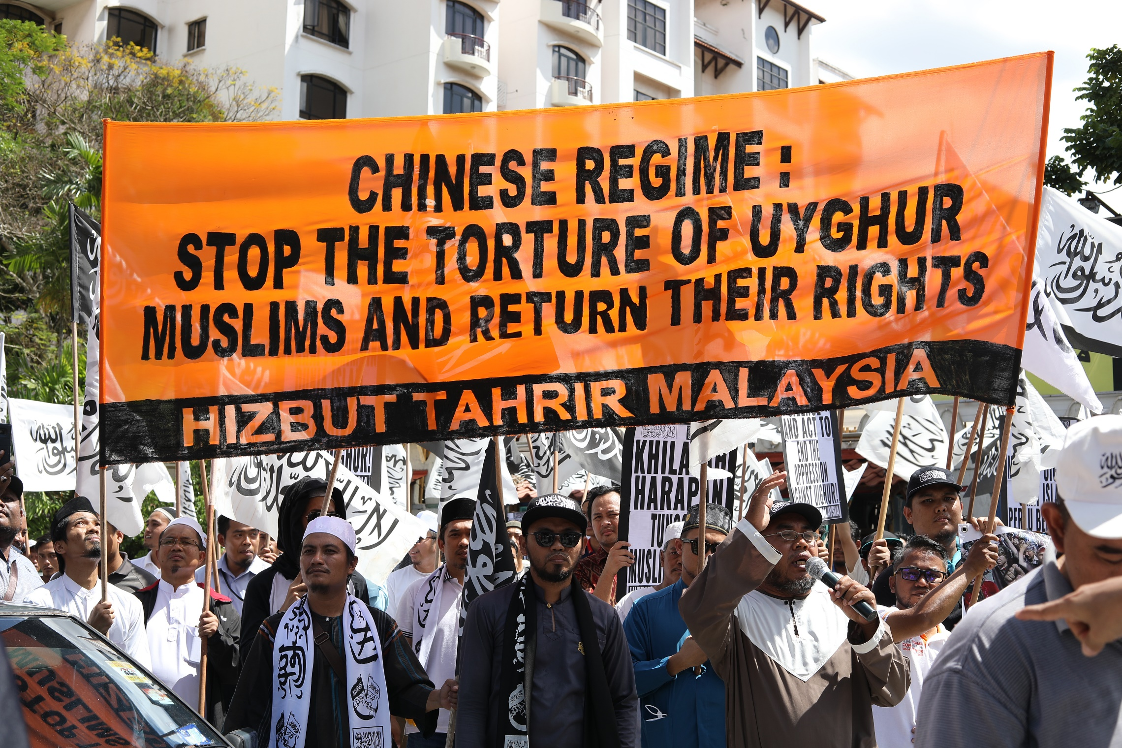
Constructivism Theory 6 of 8
Constructivism: An Emphasis on Norms

Slide 45
Constructivism Theory 7 of 8
English School and Critical Theory
Late 1950s in the United Kingdom
The U.S.-based Rockefeller Foundation
Theoretical alternative to realism and liberalism
Social basis of international politics
Constructivism to assert broader critique of IR

Slide 46
Constructivism Theory 8 of 8
English School and Critical Theory
Third Debate and of the 1970s and 1980s.
Critical theories: Anthony Giddens, Jurgen Habermas and Michel Foucault
Issues such as agency, legitimacy, sovereignty, and most of all power in society

Slide 47
Feminist Theory 1 of 5
Feminism
Disproportionate explanatory power of gender in global politics
Intersection of gender with economic and political power
Rejects realist and liberals’ notions of IR
Like constructivist language play important role

Slide 48
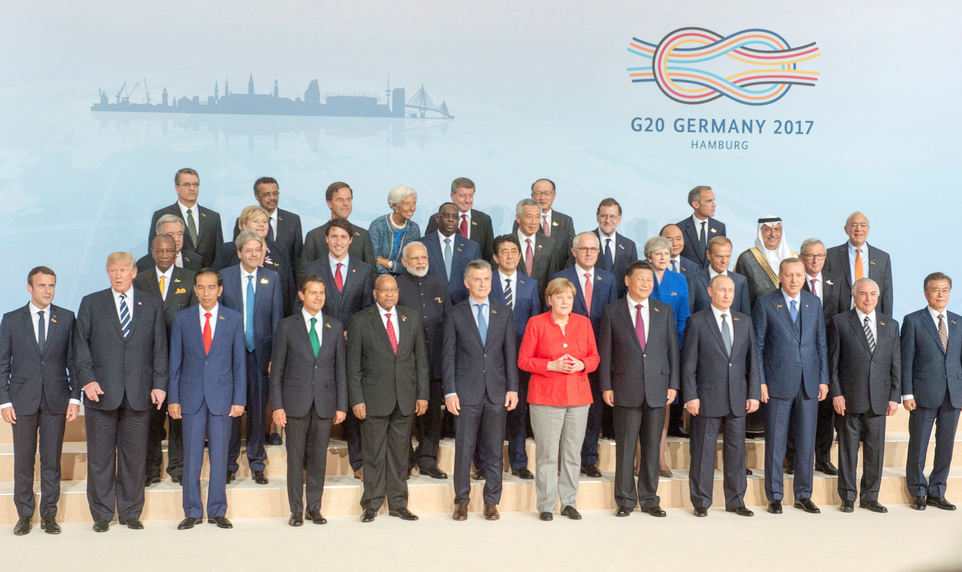
Feminist Theory 2 of 5
Feminism

Slide 49
Feminist Theory 3 of 5
Feminism and Gender Analysis
Gender is no longer considered irreverent in IR
Gender is accepted but also misunderstood in IR
Incorporated into global policymaking by the UN, the EU, NATO etc.
Gender and women are not the same
Gender not the same as sex

Slide 50
Feminist Theory 4 of 5
Strands of Feminism
Liberal or Orthodox Feminism
Focus on the position of women in existing power structures
Why are few women in position of global leadership?
What gender equality would mean for world peace?

Slide 51
Feminist Theory 5 of 5
Strands of Feminism
Critical or Radical Feminism
Less concern with women in power
More concern with existing structures in the first place
Patriarchal systems continue to persist
Institutions are structured unequally

Slide 52
Chapter 2
Review of Learning Objectives 1 of 2
2.1 Identify five theories that help to improve our understanding of global politics and to interpret the behavior of states, societies, and individuals.
2.2 Explain the principles of realist theory and the focus on the self-interest and promotion of the state and nation.
2. 3 Outline the principles of liberalism and how the world has moved in this direction during the past century.

Slide 53
Chapter 2
Review of Learning Objectives 2 of 2
2.4 Discuss world systems theory and its challenge to the paradigms of realism and liberalism.
2.5 Describe constructivism in the context of international economic policies.
2.6 Discuss feminist theory and the way in which global politics is structured around socially constructed conceptions of gender and the intersection with political and economic power.

