Slide 1
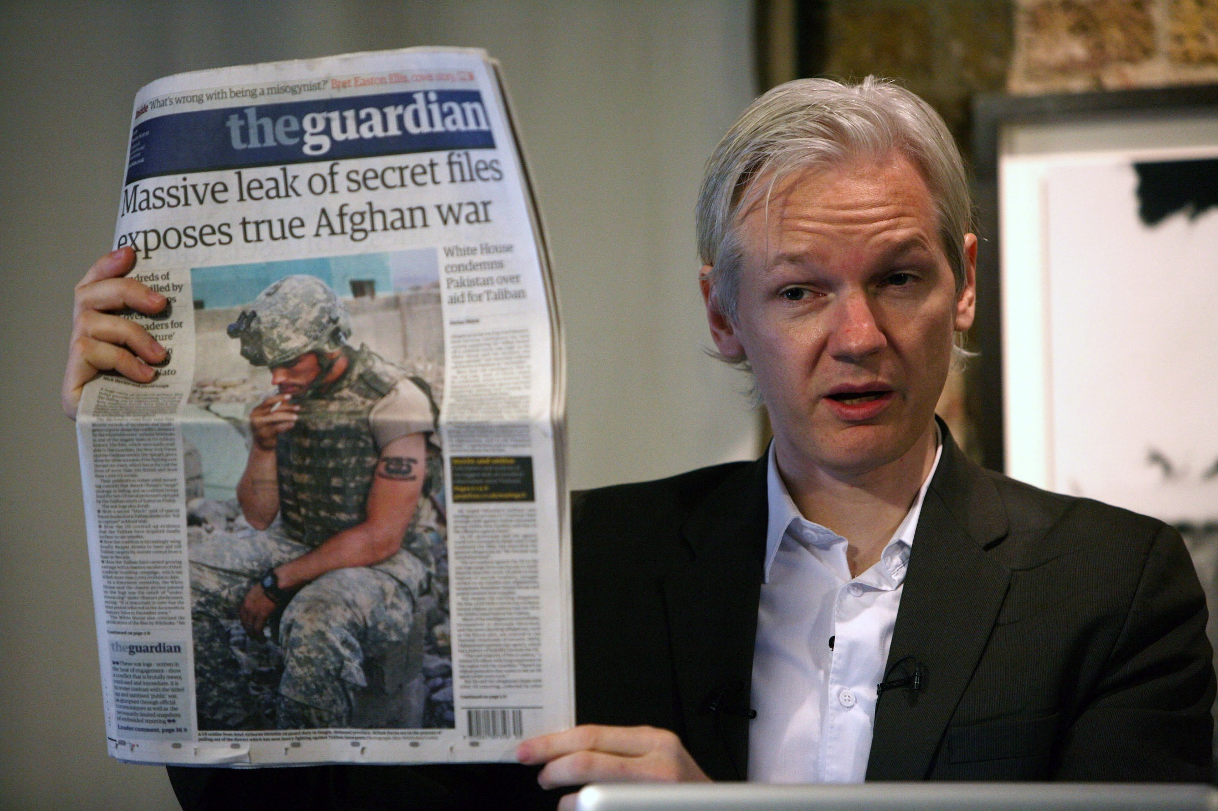
Chapter 3 Interpreting Power: A Levels-of-Analysis Approach
Notes:
1

Slide 2
Chapter 3 Interpreting Power: A Levels-of-Analysis Approach
Defining Power in Global Politics
The Levels-of-Analysis Approach
Individual-Level Analysis
State-Level Analysis
System-Level Analysis

Slide 3
Chapter 3 Learning Objectives
3.1 Define the concept of power in global politics.
3.2 Describe the levels-of-analysis approach
3.3 Identify the main characteristics of individual-level analysis.
3.4 Discuss the structure and dynamics of state-level analysis, the dominant level of analysis.
3.5 Identify the structures, patterns and interactions among actors in systems-level analysis.

Slide 4
Defining Power in Global Politics 1 of 9
Power is an elusive concept. Most people talk about it but few understands it.
The factor that explains who gets what, when, and how
Power still remains the primary mechanism used by actors
Wikileaks’ power of information

Slide 5
Defining Power in Global Politics 2 of 9
Characteristics of Power
Power as Asset and Aspiration
Power is both an asset and aspiration
Most discussion on power mostly focus on asset
Power is like money: It is fungible and can be converted to a desired end

Slide 6
Defining Power in Global Politics 3 of 9
Characteristics of Power
Power as Asset and Aspiration
Political power far less fungible than money
U.S. military budget far exceed that of other countries but struggle against ISIS
Power is also an aspiration, something actors seek

Slide 7
Defining Power in Global Politics 4 of 9
Characteristics of Power
Hard and Soft Power
Realist understanding of power is coercive
Hard Power often relies on credible threats
Power is not the same as coercion

Slide 8
Defining Power in Global Politics 5 of 9
Characteristics of Power
Hard and Soft Power
Soft power has little to do with threats
Everything to do with incentives
Realist tend to dismiss soft power
Liberals advocate for soft power

Slide 9
Defining Power in Global Politics 6 of 9
Characteristics of Power
Absolute and Relative Power
U.S. 6800 nuclear warheads: Absolute Power
The destructive capabilities of U.S. nuclear arsenal
Power takes into account the power of adversary
China has the largest army

Slide 10
Defining Power in Global Politics 7 of 9
Characteristics of Power
Capabilities and Credibility
Power is shape by available material factors
Military strength, economic assets, technology etc.
Organizational leaders, size, etc. non-state actors
Global presence depends on both capabilities and credibility

Slide 11
Defining Power in Global Politics 8 of 9
Characteristics of Power
Objective and Subjective Power
Objective power: Assets actor possesses and uses
Bush Admin. vs. Saddam Hussein; Objective Power
Organizational leaders, size, etc. non-state actors
Reputation matters
Power is diminished if no thinks you will use it

Slide 12
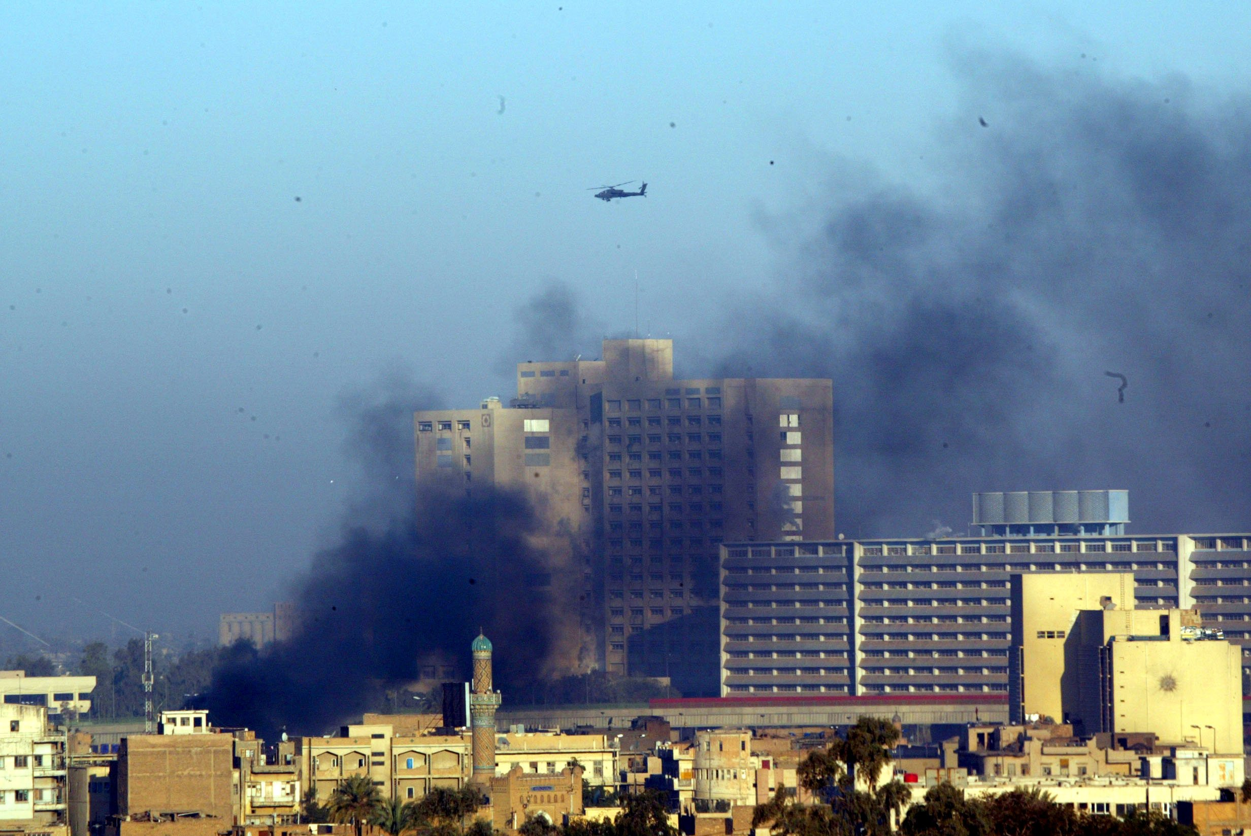
Defining Power in Global Politics 9 of 9
Characteristics of Power

Slide 13
Levels-of-Analysis Approach 1 of 2
Origins of the Approach
Early proponents of behavioralism in IR
Blueprint for a more rigorous scientific analysis
J. David Singer; coined the term levels of analysis
Unit-level (state and individual) and structural (system)
Where and What are the sources of power

Slide 14
Levels-of-Analysis Approach 2 of 2
Applicability of the Approach
Not a theory but rather an analytical tool
Some realist focus on human nature and social behavior while others on the state
Levels-of-analysis not the same context as the five theoretical approaches
Allows us to analyze power in three ways (individual, state, and system)

Slide 15
Individual-Level Analysis 1 of 10
Rationality and Its Limits
Humans function individually and collectively
An assumption that humans are rational actors
Human beings are complex and may act irrational
Suicide bombers, first responders to 9/11
There are limitations to rational choice

Slide 16
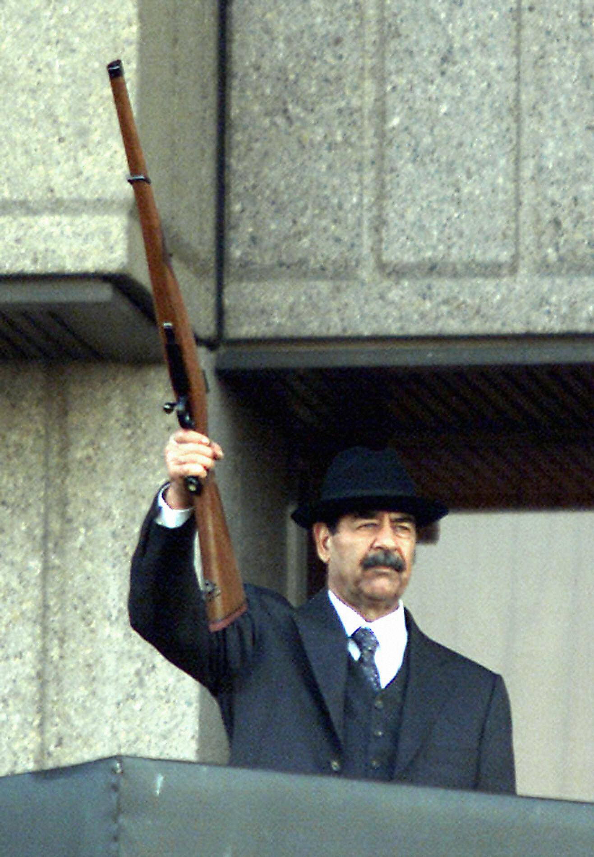
Individual-Level Analysis 2 of 10
Cognitive Factors
Cognitive Consistency
Optimistic Bias
Heuristic Devices
Notes:
1. Cognitive Consistency
a) Discounting ideas and information that contradict their beliefs.
b) U.S. and UK top decision-makers willingness to accept bad intelligence about Saddam Hussein
c) Cognitive dissonance: believing information that there was no nuclear program
2. Optimistic Bias
a) People overestimate their likelihood of attaining a successful outcome.
b) Hawkish leaders win in policy debate over the use of force
c) Why Saddam Hussein chose to fight rather than retreat safely into exile.
3. Heuristic Devices
a) Mental shortcuts that help us make decisions more easily
b) Trump Admin. Assertion of “Islamic terrorism” even though many terrorist incidents have no link to Islam at all

Slide 17
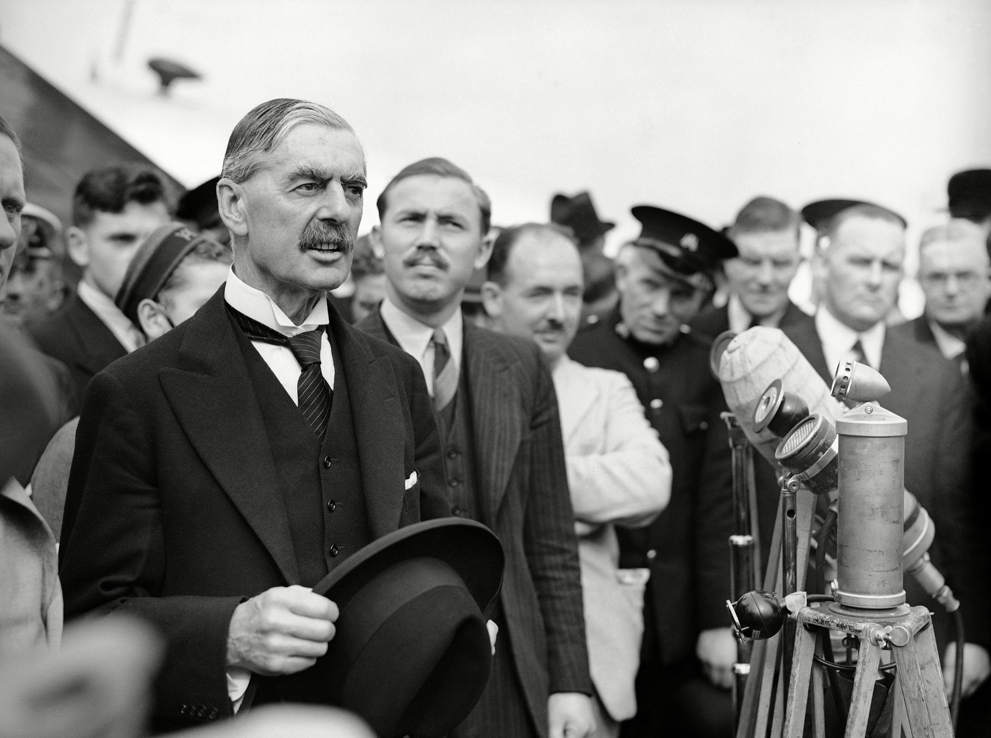
Individual-Level Analysis 3 of 10
Cognitive Factors

Slide 18
Individual-Level Analysis 4 of 10
Sex and Gender
Gender; a social construct rooted of masculinity
Femininity plays critical role in explaining power
No woman UN Secretary-General as of today
Major gender opinion gap on war
Hawkish leaders post-World War II Margaret Thatcher and Golda Meir.

Slide 19
Individual-Level Analysis 5 of 10
Sex and Gender
Differences between men and women in attitudes toward U.S. drone strikes.
The systematic use of rape as a weapon of war or the transnational sex trade
Major contribution by feminist IR scholars
Fallacy of a gender binary

Slide 20
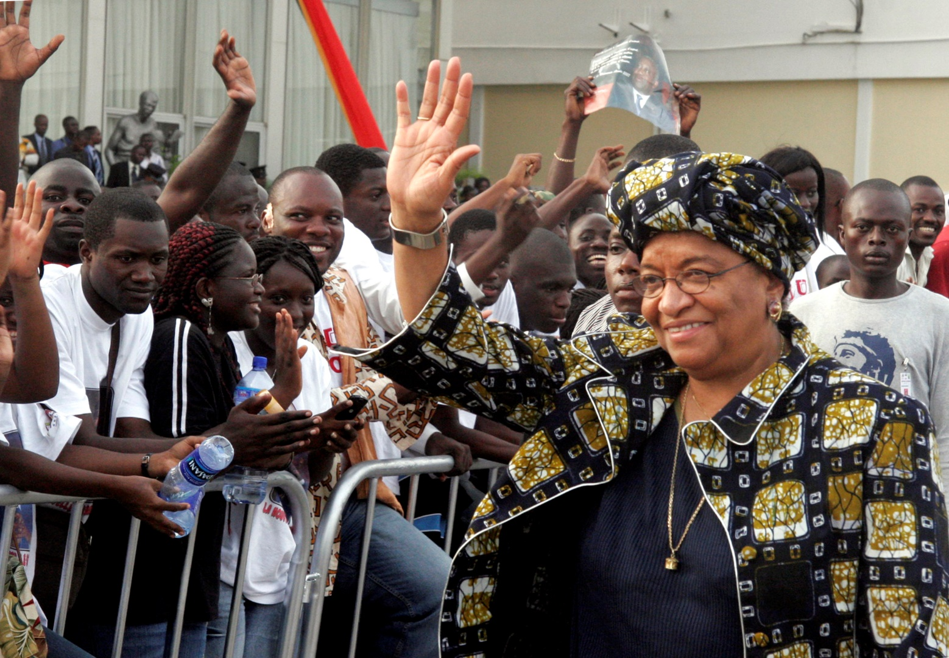
Individual-Level Analysis 6 of 10
Sex and Gender

Slide 21
Individual-Level Analysis 7 of 10
Leadership
Leaders receive most of the emphasis
Structure of global politics tied to a group of top leaders
Focusing on leaders: idiosyncratic analysis
Personal traits of leaders affect their conception and use of power

Slide 22
Individual-Level Analysis 8 of 10
Leadership
Leaders receive most of the emphasis
Structure of global politics tied to a group of top leaders
Focusing on leaders: idiosyncratic analysis
Personal traits of leaders affect their conception and use of power

Slide 23
Individual-Level Analysis 9 of 10
Personality Type
Personality along an active–passive scale and a positive–negative scale
Active leaders (policy innovators)
Passive leaders (reactors)
Positive personalities
Negative personalities
Notes:
Bill Clinton: active–positive personality
George W. Bush: active–positive personality or positive–passive
Barack Obama might fall into the active-negative

Slide 24
Individual-Level Analysis 10 of 10
Operational Code
Person’s perceptions create
Person’s philosophical beliefs and instrumental beliefs
Obama: The U.S. operate in a complex world
Bush: More a gut player than intellectual
Obama: multilateral diplomatic approach
Bush: World black or white

Slide 25
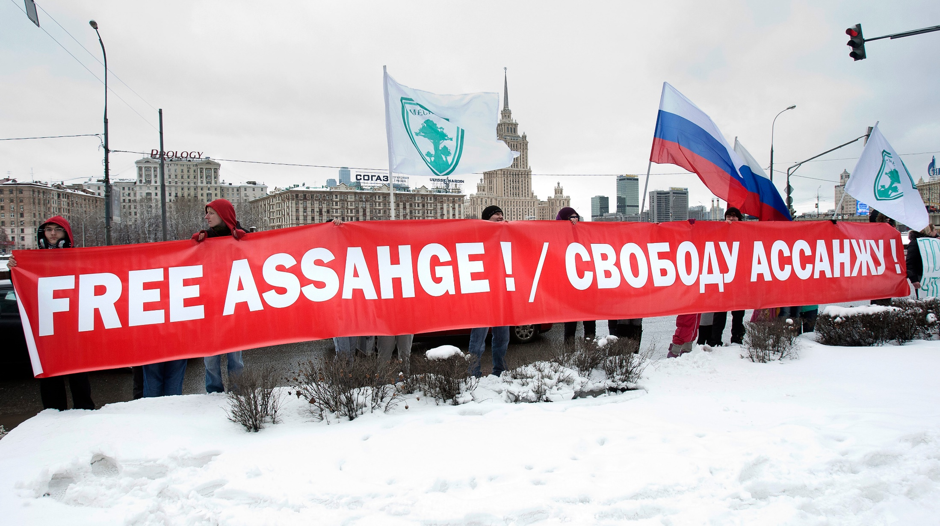
State-Levels Analysis 1 of 6
Policy Choice
Political infrastructure shape its foreign policies
Sensitive information about their foreign policies
Internet is difficult for states to regulate

Slide 26
State-Levels Analysis 2 of 6
Governmental Sources
Statecraft: A stat use of power in foreign policy
Isolate government factors that explain power
State Sovereignty
Most important factor to take into account when explain government source

Slide 27
State-Levels Analysis 3 of 6
State Sovereignty
Clearly defined and identifiable national group
Oriented around some common characteristic(s), seeking self-determination.
Clearly demarcated territorial space.
The formation and successful governance
Aforementioned conditions by other states and the international community.

Slide 28
State-Levels Analysis 4 of 6
Regime Authority
No single state foreign policy
State’s foreign policy varies
Scale: absolute authoritarian govt. to unfettered democratic governments
Democratic states are more open

Slide 29
State-Levels Analysis 5 of 6
Bureaucracy
Military Capabilities
Economic Capacity
Societal Factors
Physical and Technical Factors
Notes:
Bureaucracy
1. Influences every state’s use of power, regardless of the strength or type of its government.
2. Political leaders still have t navigate through their bureaucracy in order to govern
E. Military Capabilities
1. Major determinant of state power in an anarchical global system
2. Defense spending is one of the largest categories in most country
3. Few scenarios in which the armed forces of any other country could defeat U.S. forces in a conventional war
Economic Capacity
1. A state’s influence is a function of its economic capacity.
2. Financial solvency is also key to a state's economic power.
3. Countries with high debits are vulnerable
4. A state’s a state’s import-export ratio is also very important
5. A country’s agricultural capacity is also a reflection of its economic power
Societal Factors
1. Political Culture
2. Demographics
3. Human Development
Physical and Technical Factors
1. Technological Sophistication
2. Information and communications technology (ICT)
3. Geography
4. Resource curse theory

Slide 30
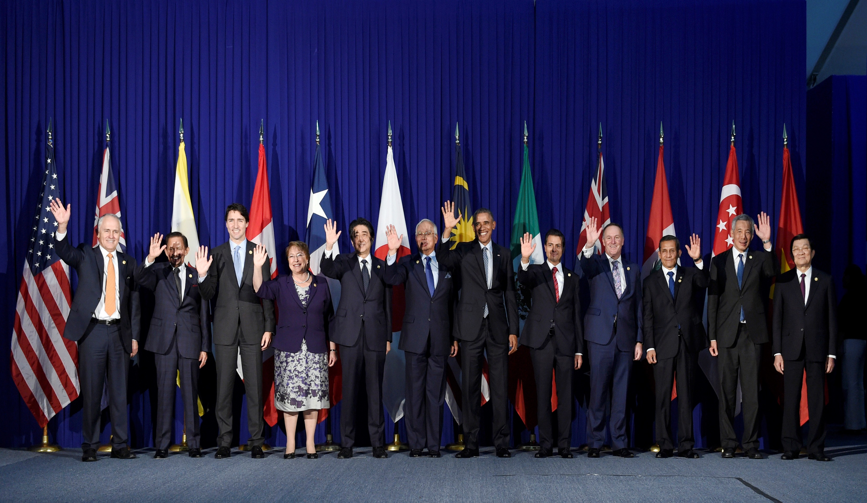
State-Levels Analysis 6 of 6

Slide 31
System-Levels Analysis
Constraints and opportunities that the global system imposes on states and non-state actors alike
Top-down approach by realist
Analyze the interaction among all state actors.
System-level factors weaken the ability of weaker states to act.

Slide 32
Chapter 3 Review Learning Objectives
3.1 Define the concept of power in global politics.
3.2 Describe the levels-of-analysis approach
3.3 Identify the main characteristics of individual-level analysis.
3.4 Discuss the structure and dynamics of state-level analysis, the dominant level of analysis.
3.5 Identify the structures, patterns and interactions among actors in systems-level analysis.

