Slide 1
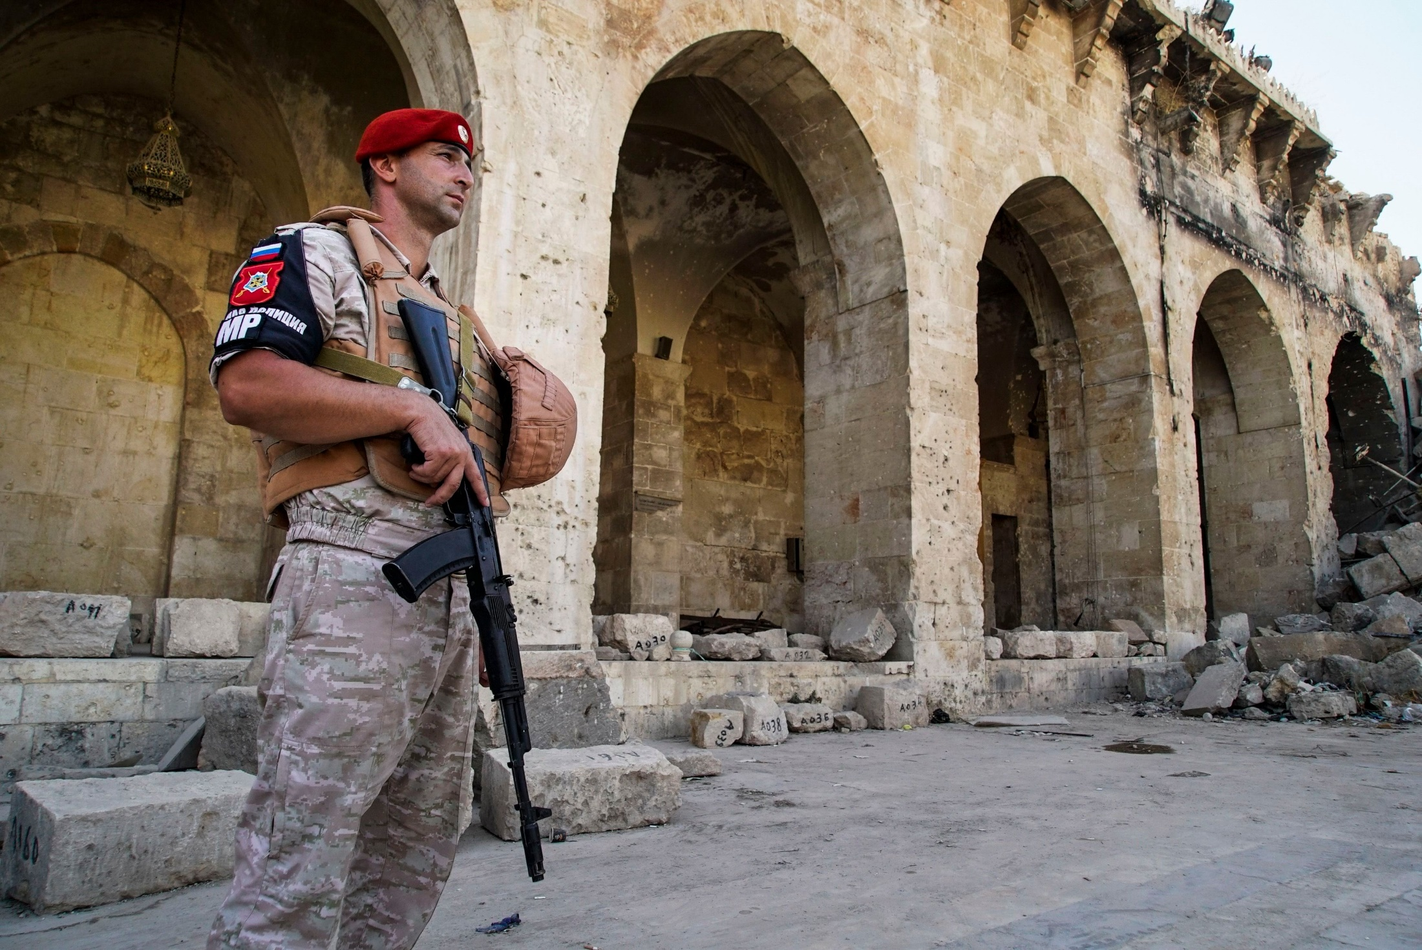
Chapter 7
War and Terrorism
Notes:
1

Slide 2
Chapter 7
War and Terrorism
War as a Concept
Armed Conflict: Causes and Objectives
Global Trends in Armed Conflict
The Changing Context of War
Asymmetrical Warfare: Terrorism

Slide 3
Chapter 7
Learning Objectives 1 of 2
6.1Discuss the ways that war is defined, classified, and measured
6.2 Discuss the causes and objectives of war at the individual, societal, and systemic levels of analysis.
6.3 Identify the patterns and prevailing trends in the incidence, type, intensity, and qualitative of armed conflict.

Slide 4
Chapter 7
Learning Objectives 2 of 2
6.4 Explain the impact of identity, globalization, and transnationalism on war and armed conflict, particularly with respect to contemporary intrastate conflicts.
6.5 Discuss the appeal, sources, tactics, and perpetrators of transnational terrorism

Slide 5
War as a Concept 1 of 4
Defining and Measuring War
War lacks a single widely accepted definition
J. David Singer and Melvin Small definition
Armed conflict (less than a 1000 deaths)
Lewis Richardson
Sweden’s University of Uppsala Conflict Data Project
Study of Civil War (CSCW)

Slide 6
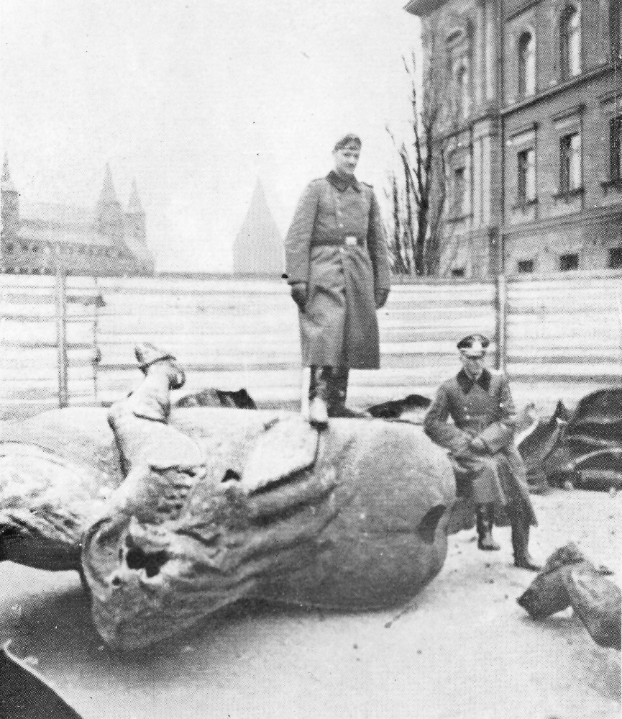
War as a Concept 2 of 4
Classifying Warfare
Wars of aggression
Wars of self-defense
Wars of preemption

Slide 7
War as a Concept 3 of 4
Persistence vs. Obsolescence
War has been declared obsolete
Organized armed violence
The codification of practice of a state
Concert of Europe: Aimed averting major wars

Slide 8
War as a Concept 4 of 4
Persistence vs. Obsolescence
Declarations of war’s obsolescence
Iron law of the democratic peace
New world order post-Cold War
Extensive proliferation of armed conflict
fallacy of triumphal proclamations of the end of history

Slide 9
Armed Conflict: Causes and Objectives 1 of 4
Individual Level
War a form of behavior is an individual’s choice
War is a by-product of human nature
Human Characteristics
Individual Leaders
The personality traits of leaders
Taking risks or a psychological need for power
Notes:
Human Characteristics: Inherent violence that shared among many actors.
a) Violence is intrinsic to human
b) Territoriality is intrinsic to human
Individual Leaders
a) The personality traits of leaders
b) Personality may favors taking risks or a psychological need for power

Slide 10
Armed Conflict: Causes and Objectives 2 of 4
State Level
The second Image: State dominance
Statecraft: use and threat of military force
Ability of a state to initiate armed conflict
Militarism
The diversionary theory of war

Slide 11
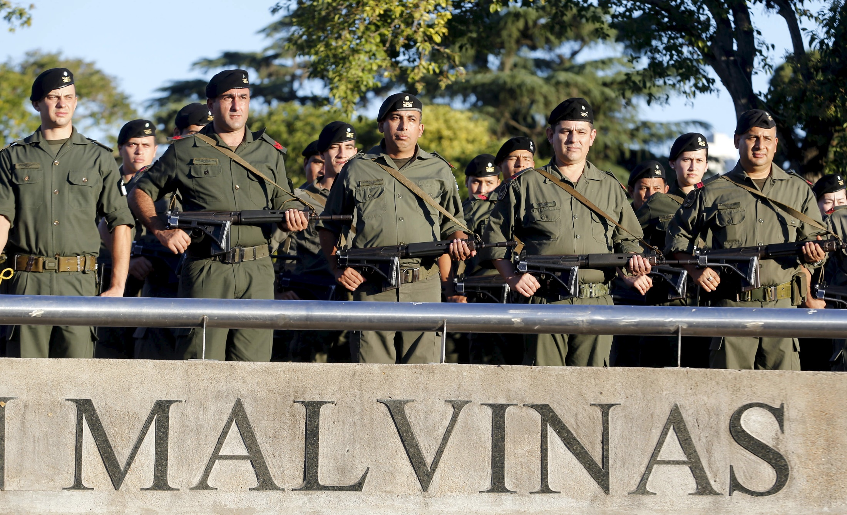
Armed Conflict: Causes and Objectives 3 of 4
State Level
The diversionary theory of war

Slide 12
Armed Conflict: Causes and Objectives 4 of 4
System Level
The third image: System level of analysis
Offensive realism
Defensive realism
Militarism
The Distribution of Power
The Anarchical Nature of the System
System-Level Resource and Economic Factors

Slide 13
Global Trends in Armed Conflict 1 of 1
Incidence
About 14,000 wars throughout recorded history.
Armed conflict increased by a factor of three 1960–1992
Since 1990, six instances of direct wars
Regional Dispersion
Notes:
Since 1990, there have been only six instances of direct wars between states
a) Gulf War (1990–1991) and its aftermath
b) Eritrea–Ethiopia (1998–2000)
c) India–Pakistan (1997–2003; 2014)
d) Iraq versus the United States and its allies (2003)
e) Djibouti–Eritrea (2008)
f) Russia-Ukraine (2014-2017)

Slide 14
Global Trends in Armed Conflict 2 of 3
Other Patterns and Trends
Warfare as something generally decline
Technology has rapidly escalated the ability to kill
Advances in the areas of robotics and AI
Unmanned aerial vehicles

Slide 15
Global Trends in Armed Conflict 3 of 3
Other Patterns and Trends
Nationalism has also qualitatively changed warfare.
The scope and cost of war have expanded as a result of technology and nationalism.
War as an endeavor has always been and remains costly

Slide 16
The Changing Context of War 1 of 4
“Old” Wars: Origins and Logic
Fought by states, by professional armed forces
By-product of a metamorphosis
Transformed war from a feudal endeavor to a thoroughly modern one
were considered mere exercises in statecraft
Waging and Sustaining “New” Wars

Slide 17
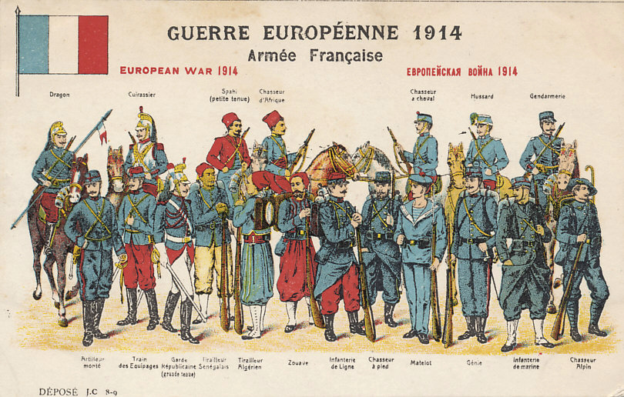
The Changing Context of War 2 of 5
“Old” Wars: Origins and Logic

Slide 18
The Changing Context of War 3 of 5
“New” Wars: Origins and Logic
Such conflicts are likely to be carried out by actors other than states
They are sustained by remittances
Globalization as Catalyst
The Crisis of the State
The Crisis of Identity

Slide 19
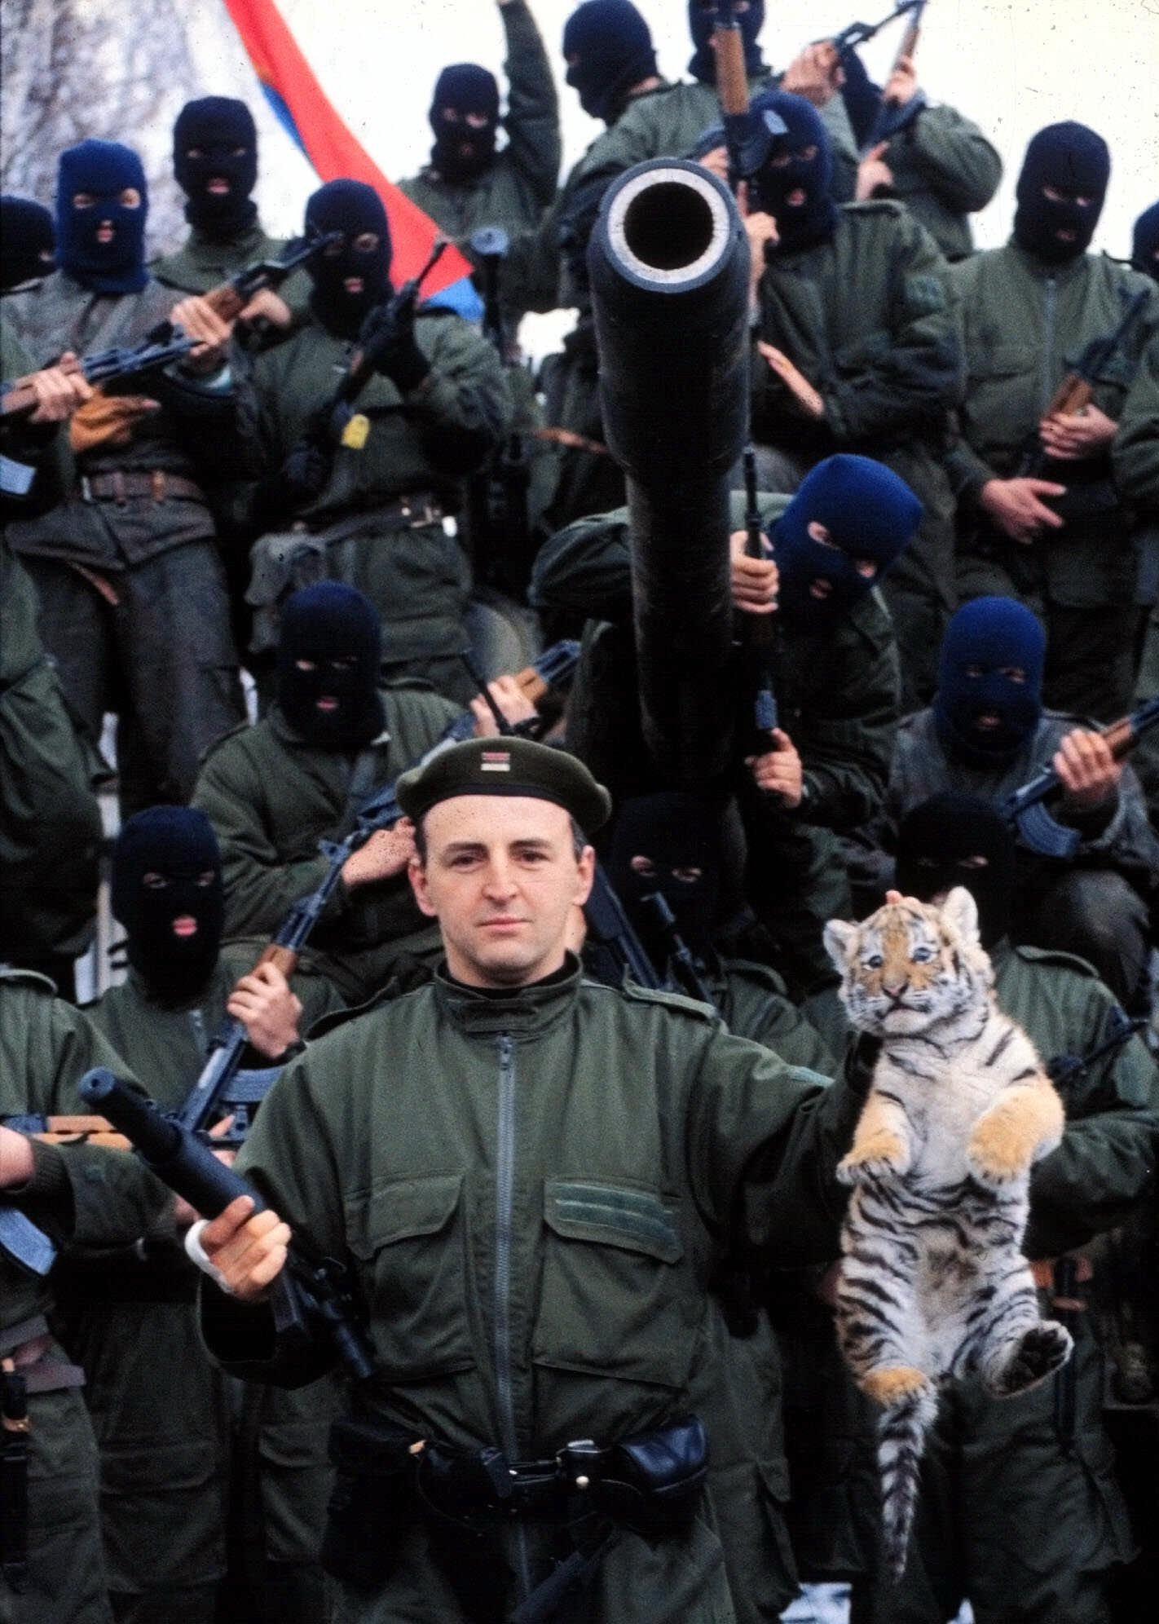
The Changing Context of War 4of 5
“New” Wars: Origins and Logic
Globalization as Catalyst

Slide 20
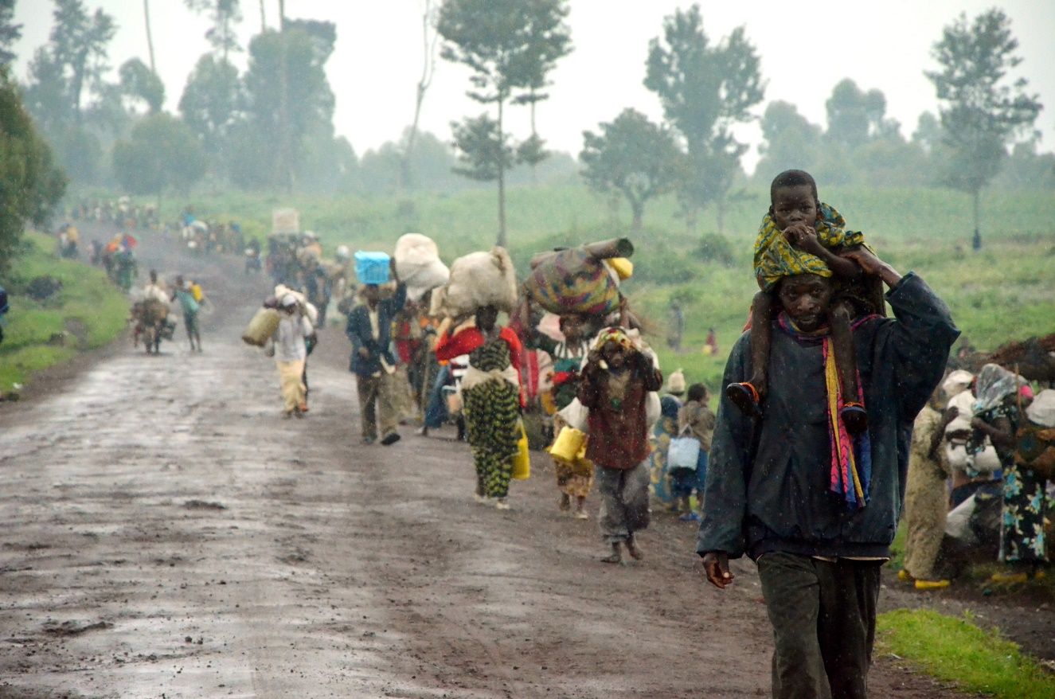
The Changing Context of War 5 of 5
“New” Wars: Origins and Logic

Slide 21
Asymmetrical Warfare: Terrorism 1 of
Definition and Scope
No single agreed upon definition of terrorism.
This has impeded treaty development
The scope and impact of terrorism has grown.
Best understood as a form of political violence
Transnational terrorism

Slide 22
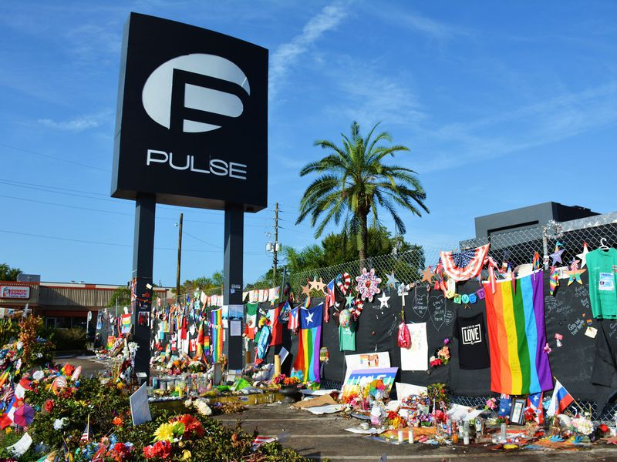
Asymmetrical Warfare: Terrorism 2 of
Definition and Scope

Slide 23
Asymmetrical Warfare: Terrorism 3 of
Causes of Terrorism
The clash between Western liberalism and other views of politics, society, and economic activity
State- or societal-level analysis
Individual level
Pragmatic level: Terrorism occurs because, like war, it can be effective

Slide 24
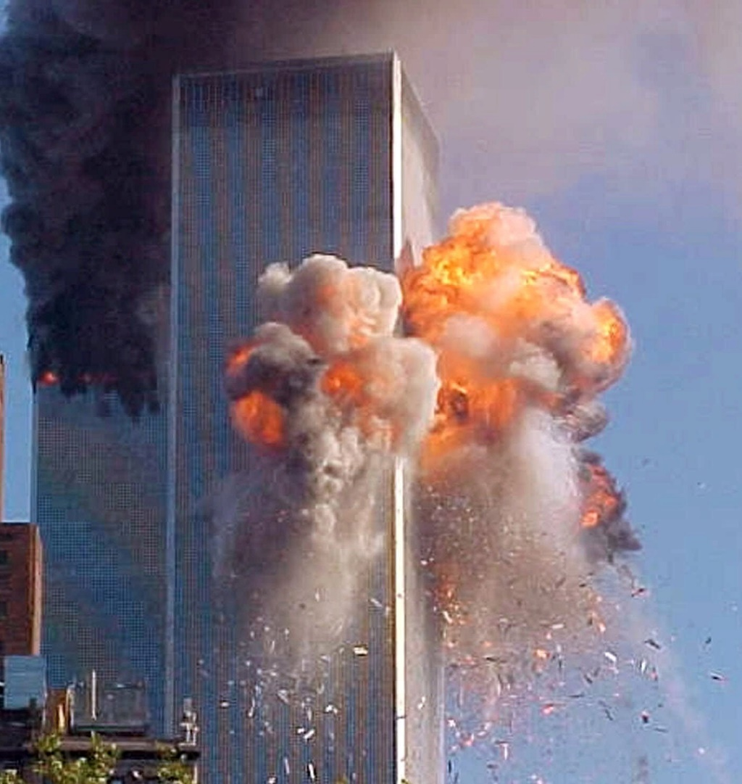
Asymmetrical Warfare: Terrorism 3 of
Sources of Terrorism

Slide 25
Asymmetrical Warfare: Terrorism 3 of
Sources of Terrorism
State-Sponsored Terrorism
Transnational Terrorist Groups
Spotlight: ISIS

Slide 26

Asymmetrical Warfare: Terrorism 3 of
Sources of Terrorism

Slide 27
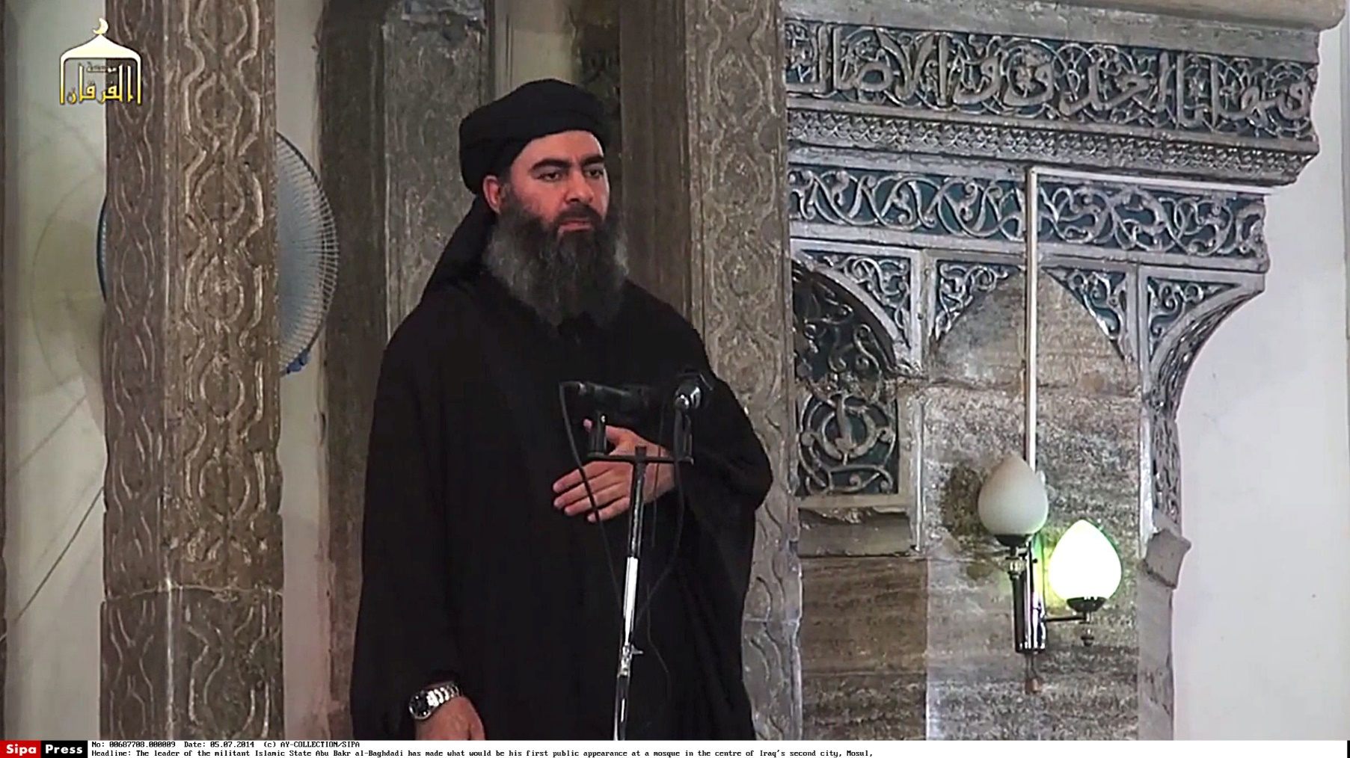
Asymmetrical Warfare: Terrorism 3 of
Sources of Terrorism

Slide 28
Chapter 7
Review of Learning Objectives 1 of 2
6.1Discuss the ways that war is defined, classified, and measured
6.2 Discuss the causes and objectives of war at the individual, societal, and systemic levels of analysis.
6.3 Identify the patterns and prevailing trends in the incidence, type, intensity, and qualitative of armed conflict.

Slide 29
Chapter 7
Review of Learning Objectives 2 of 2
6.4 Explain the impact of identity, globalization, and transnationalism on war and armed conflict, particularly with respect to contemporary intrastate conflicts.
6.5 Discuss the appeal, sources, tactics, and perpetrators of transnational terrorism

