Slide 1
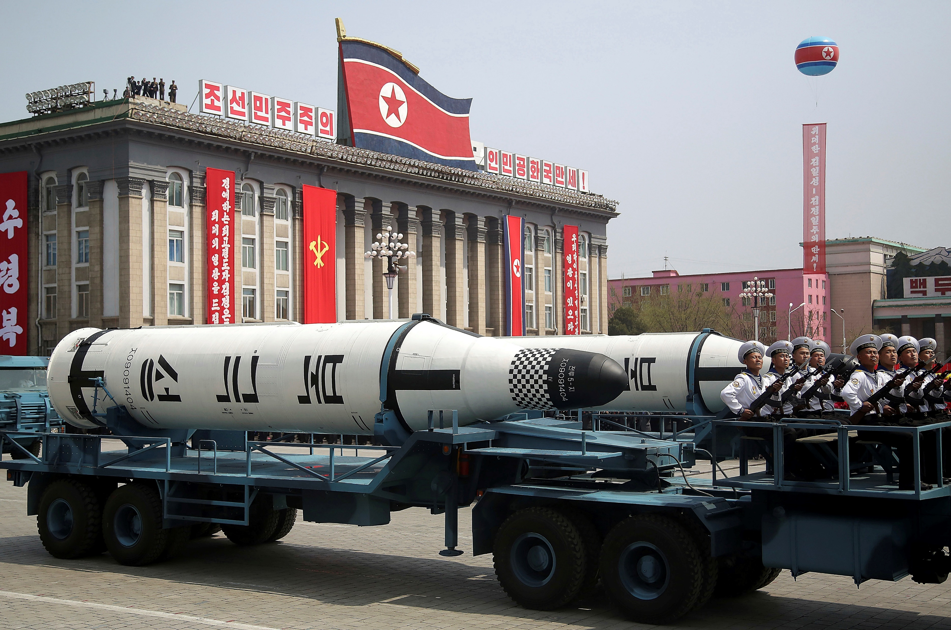
Chapter 8
Pursuing Security
Notes:
1

Slide 2
Chapter 7
Pursuing Security
The Traditional Approach
Security Re-Envisioned
Seeking Security: Illustrations
The “New” Security Environment
Threat Assessment: Weapons of Mass Destruction

Slide 3
Chapter 8
Learning Objectives 1 of 2
8.1 Discuss the ways that war is defined, classified, Identify and explain the defining features of security in the traditional (realist)
8.2 Explain the basis for and main examples of efforts to “broaden” and “deepen” the concept of security over the past quarter-century
8.3 Compare, contrast, and assess different approaches to the provision of security

Slide 4
Chapter 8
Learning Objectives 2 of 2
8.4 Discuss how broader transformations in the structure of the global political system have revealed a 'new' security environment featuring different rules, actors, and threats
8.5 Discuss how broader transformations in the structure of the global political system have revealed a 'new' security environment featuring different rules, actors, and threats

Slide 5
The Traditional Approach 1 of 3
Anarchy and Self-Help
The Treaty of Westphalia (1648); state as dominant actor
The security studies field in the 20th century
No central global authority exists to maintain order and ensure justice (Westphalian)

Slide 6
The Traditional Approach 2 of 3
A Security Dilemma for States
Anarchy is inherently competitive, volatile, and insecure
Security dilemma: states misinterpret largely defensive actions and capabilities by other states as threats
Actions intended to enhance security only breed greater insecurity

Slide 7
The Traditional Approach 3 of 3
Balance of Power Politics
States; strategies to balance against rivals
Hans Morgenthau: The aspiration for power
Unbalanced power alone represents a threat to the survival of less powerful states
Alliances are a primary tool that states can use
Realists view armed conflict as a valid

Slide 8
Security Re-Envisioned 1 of 5
Limits to the Realist Approach
Military defense has not made the world secure
Challenge traditional security logics (1980s)
Richard Ullman 1983 article Redefining Security
Post-Cold War traditional realist unsatisfactory
Proliferation of ethnic conflict, humanitarian disaster, and general social disorder

Slide 9
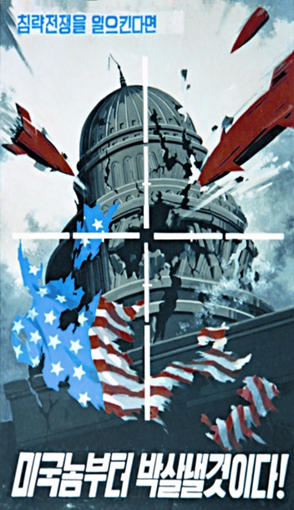
Security Re-Envisioned 2 of 5
Limits to the Realist Approach
Security equals the absence of insecurity
Human action (like a suicide bomber)
Realism’s emphasis on state sovereignty

Slide 10
Security Re-Envisioned 3 of 5
Broadening and Deepening the Security Agenda
Impossible to ignore globalization security agenda
Copenhagen School: theory of securitization
Security threats: military, political, social, economic, environmental
Issues – such as terrorism—get securitized and receive priority

Slide 11
Security Re-Envisioned 4 of 5
Broadening and Deepening the Security Agenda
Pentagon’s first report on climate change in 2003
Human Security: Within and outside of the state
Copenhagen School’s focus on securitization
Many feminist and gender-focused approaches
International community Responsibility to Protect

Slide 12
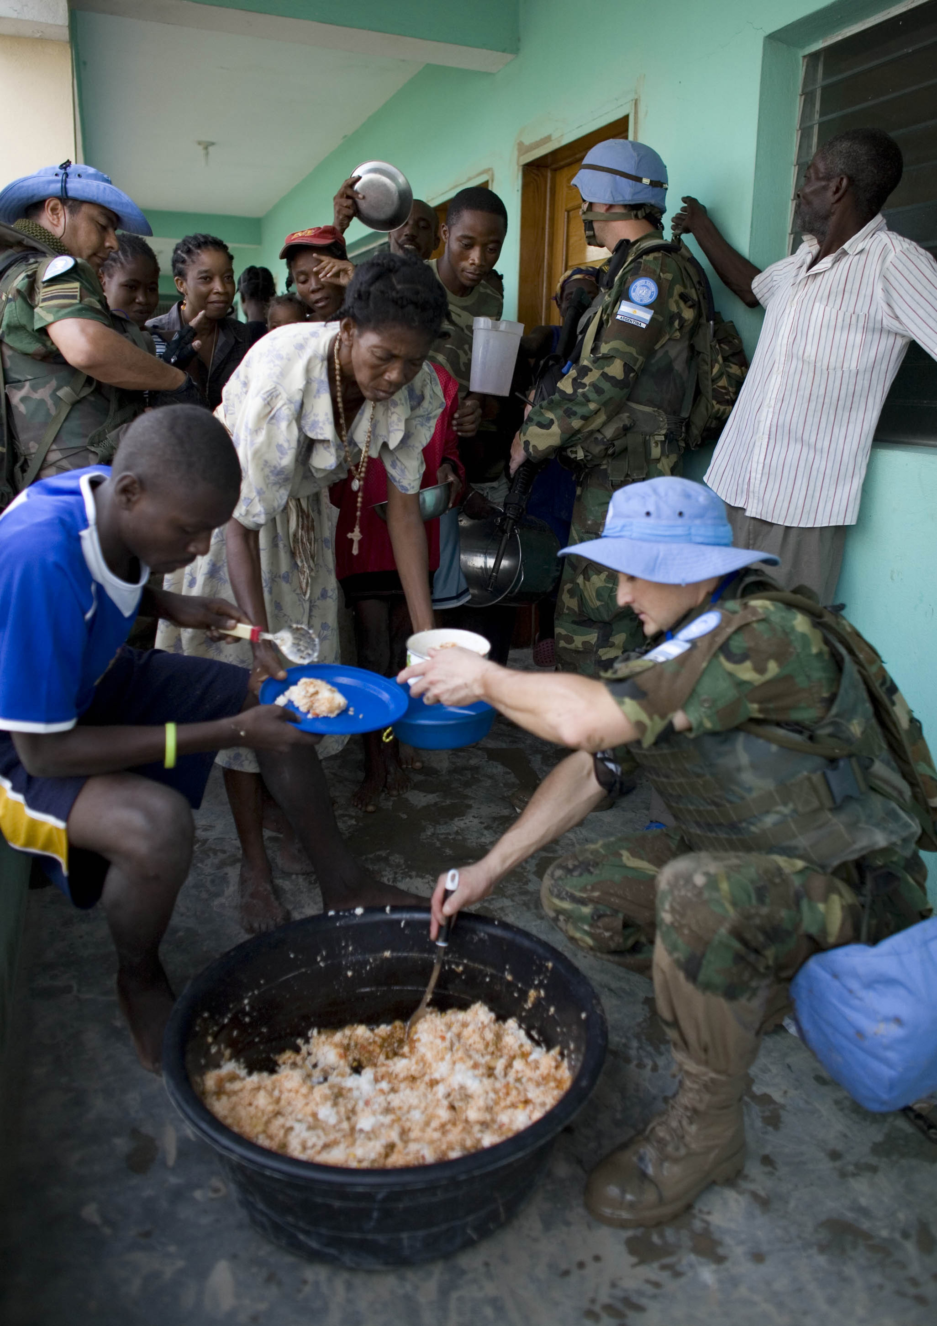
Security Re-Envisioned 5 of 5
Broadening and Deepening the Security Agenda

Slide 13
Seeking Security: Illustrations 1 of 5
Arms Control
The international arms trade is booming
Arms worldwide in 2018 was about $90 billion
Highest point since the end of the Cold War.
The United States, Russia, France, Germany, and China (in that order)

Slide 14
Seeking Security: Illustrations 2 of 5
Arms Control
Strategic alliances and subsidizing
Attempting Arms Control: Limiting the numbers and types of weapons that countries possess.
Numerical restrictions: Placing numerical limits (Strategic Arms Reduction Treaties)

Slide 15
Seeking Security: Illustrations 3 of 5
Arms Control
Categorical restrictions:
  NF eliminated an entire class of weapons.
  Cluster Munitions outlaw
Development, testing, and deployment restrictions:
  Treaty on the Non-Proliferation of Nuclear
  Comprehensive Test Ban Treaty (CTBT)

Slide 16
Seeking Security: Illustrations 4 of 5
Conflict Management
Conflict management: control conflict Consistency
Horizontal (other parties ) and Vertical escalation (violence)
Collective Security
Peacekeeping
Peace Enforcement
Rules of engagement (ROE)
Notes:
Collective Security
Armed aggression is an unacceptable form of international political behavior.
An act of aggression directed against any one member in good standing in the international com-munity is a breach of security an act of aggression against all parties.
the provision of security (including the prevention and reversal of acts of aggression) is the duty of all actors.

Slide 17
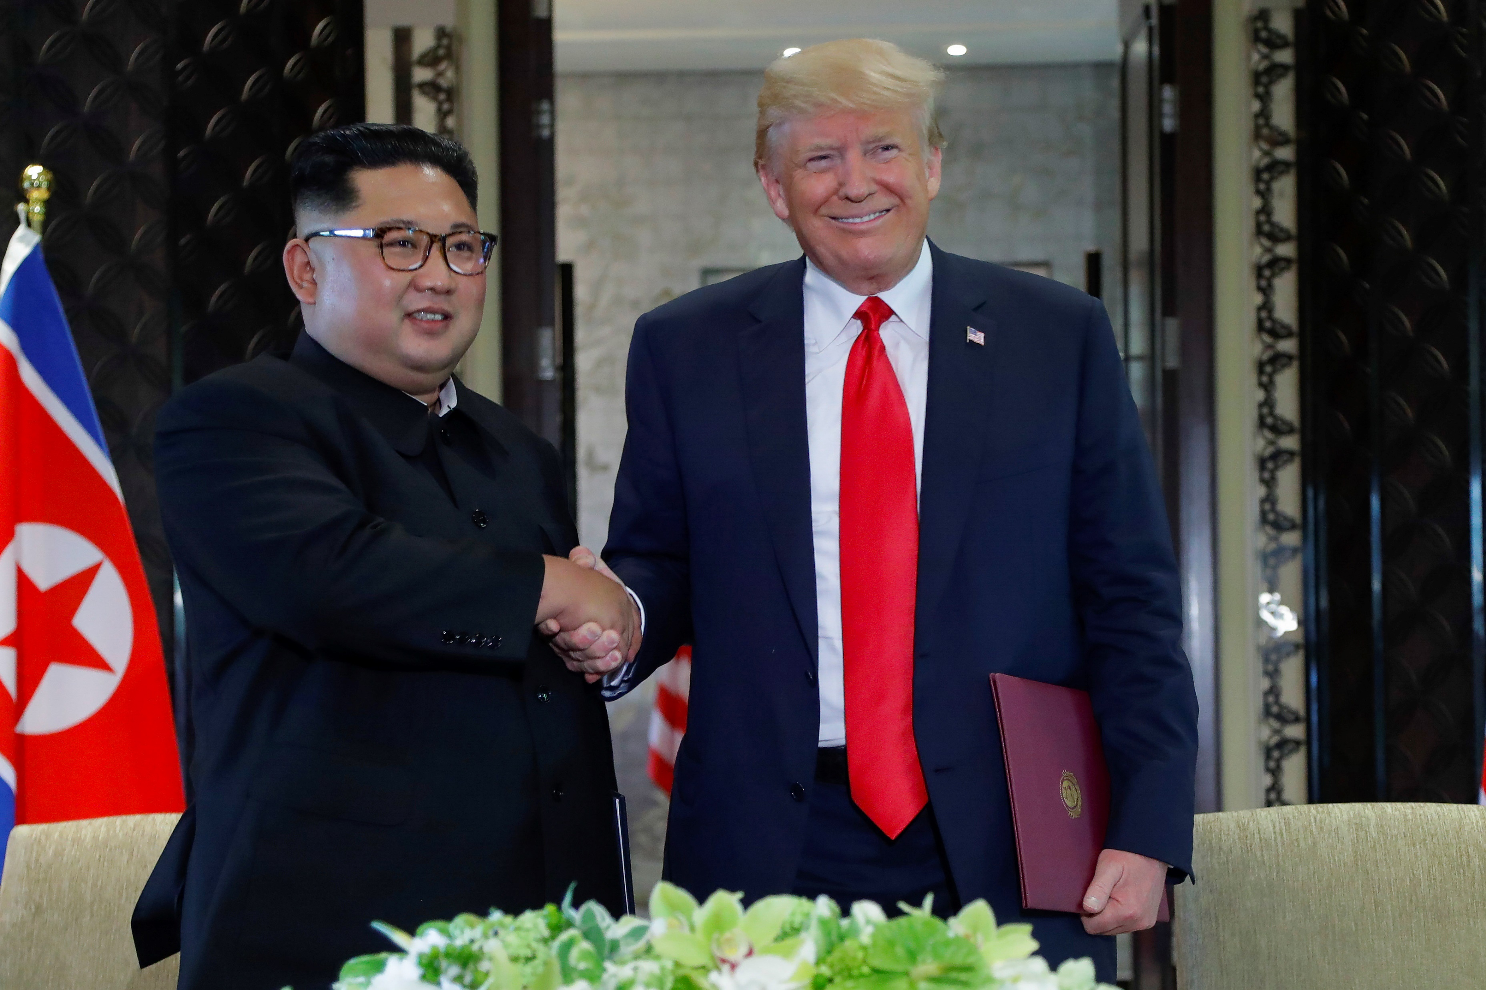
Seeking Security: Illustrations 5 of 5
Conflict Management

Slide 18
The New Security Environment 1 of 3
Origins: The End of the Cold War
Changing nature of security threats and responses post-Cold War
New security environment
The increasing frequency of intra-state conflicts,
The rampant spread of small arms and light weapons (SALW).

Slide 19
The New Security Environment 2 of 3
Defining Features: New Rules, Actors, and Threats
Shifting Rules: State Sovereignty in Decline
Realism not enough: gender inequity, poverty environmental degradation etc.
Emerging Actors: The Impact of Non–State Actors
Intensifying Threats: The “Dark Side” of Interdependence

Slide 20

The New Security Environment 3 of 3
Defining Features: New Rules, Actors, and Threats

Slide 21
Threat Assessment: Weapons of Mass Destruction 1 of 4
Biological Weapons
The use of pathogens such as viruses, bacteria,
6th century BCE, the Assyrians poisoned enemy
The Tartar army besieging Kaffa (1346)
The Black Death
British used Smallpox against Shawnee and Delaware tribes

Slide 22
Threat Assessment: Weapons of Mass Destruction 2 of 4
Biological Weapons
The use of pathogens such as viruses, bacteria,
6th century BCE, the Assyrians poisoned enemy
The Tartar army besieging Kaffa (1346)
The Black Death
British used Smallpox against Shawnee and Delaware tribes

Slide 23
Threat Assessment: Weapons of Mass Destruction 3 of 4
Biological Weapons
1972 Biological Weapons Convention (BWC)
Some states might still have: North Korea, Iran, Russia, and Syria
Iraq after the 1991 Persian Gulf War
  a germ warfare program
  132,000 gallons of anthrax and botulism toxins

Slide 24
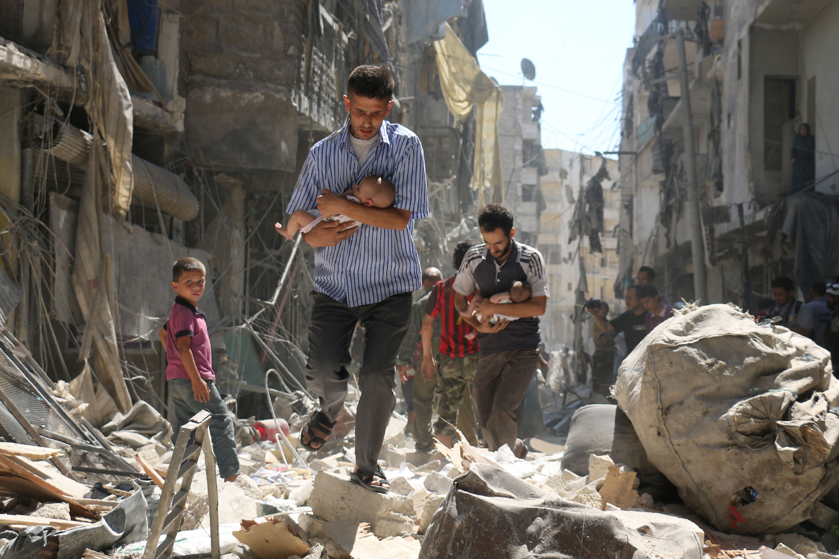
Threat Assessment: Weapons of Mass Destruction 4 of 4
Biological Weapons

Slide 25
Threat Assessment: Weapons of Mass Destruction 1 of 4
Chemical Weapons
The poor man’s atomic bomb
Same chemicals can make nerve agents, plastics and process foodstuff.
World War I both sides used it
The 1925 Geneva Protocol
Chemical Weapons Convention (CWC)

Slide 26
Threat Assessment: Weapons of Mass Destruction 2 of 4
Chemical Weapons
Both Iran and Iraq used war (1980–1988).
Iraq used; rebelling Kurdish and Shiite
Iraqi President Saddam Hussein’s first cousin Ali Hassan al-Majid (aka “Chemical Ali”).
Syria’s Bashar al-Assad used the nerve agent sarin against the rebel-held town Khan Sheikhoun

Slide 27
Threat Assessment: Weapons of Mass Destruction 3 of 4
Nuclear Weapons
By far the world’s most destructive weapons
Fission weapons (atomic bomb)
Fusion weapons (hydrogen bomb)
The Nuclear Non-Proliferation Treaty (NPT)
Comprehensive Test Ban Treaty (CTBT)

Slide 28
Threat Assessment: Weapons of Mass Destruction 4 of 4
Nuclear Weapons
Pakistan, and North Korea.
The United States and Russia Goliaths.
Nuclear Deterrence and Strategy
The strategy of mutually assured destruction (MAD)
Nuclear utilization theory (NUT)

Slide 29
Chapter 8
Review of Learning Objectives 1 of 2
8.1 Discuss the ways that war is defined, classified, Identify and explain the defining features of security in the traditional (realist)
8.2 Explain the basis for and main examples of efforts to “broaden” and “deepen” the concept of security over the past quarter-century
8.3 Compare, contrast, and assess different approaches to the provision of security

Slide 30
Chapter 8
Review of Learning Objectives 2 of 2
8.4 Discuss how broader transformations in the structure of the global political system have revealed a 'new' security environment featuring different rules, actors, and threats
8.5 Discuss how broader transformations in the structure of the global political system have revealed a 'new' security environment featuring different rules, actors, and threats

