Slide 1
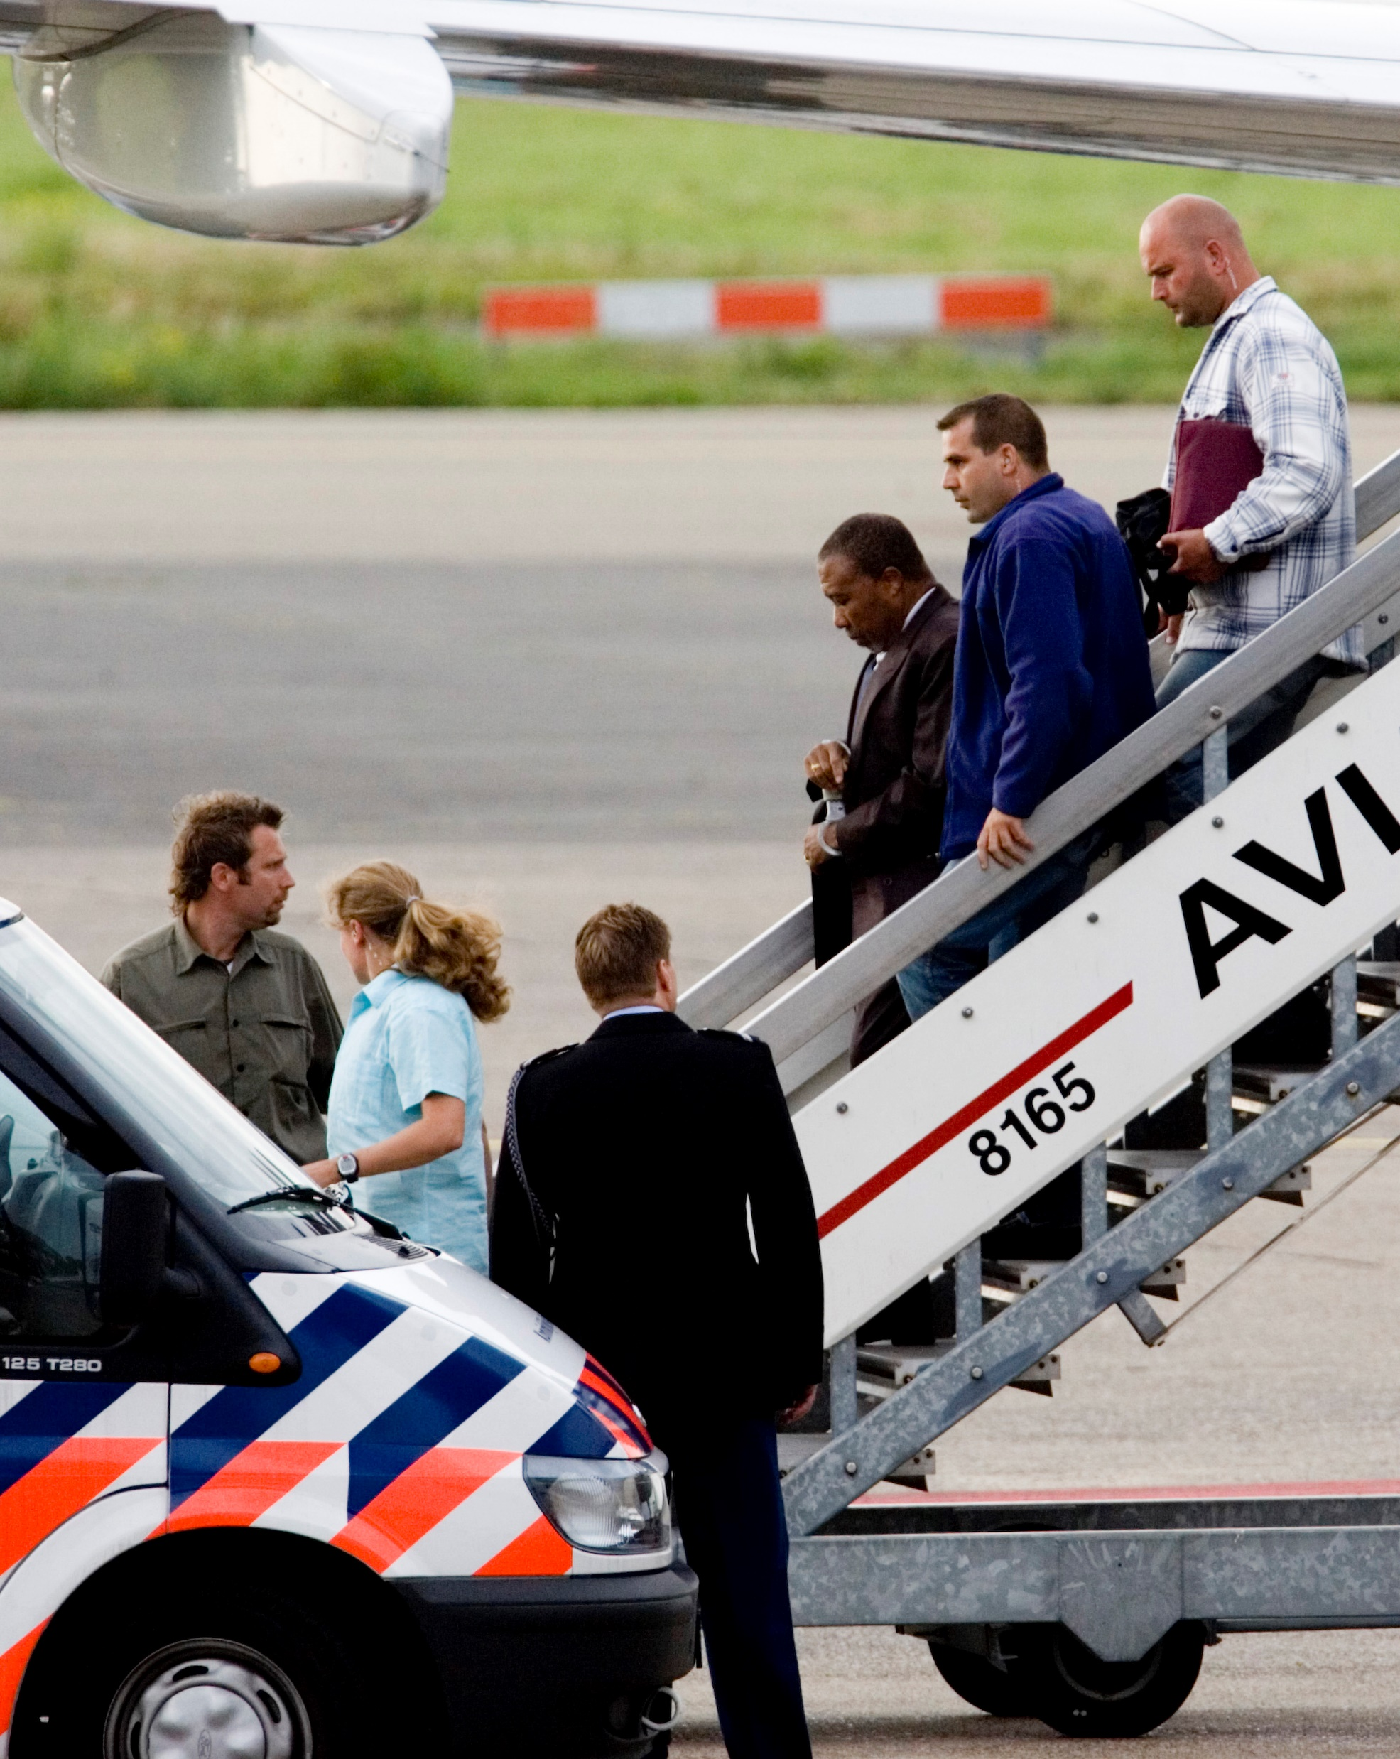
Chapter 9
International Law and the Search for Justice
Notes:
1

Slide 2
Chapter 9
International Law and the Search for Justice
Fundamentals of International Law
The International Legal System
Applying International Law and Justice
The Future of International Law and Justice

Slide 3
Chapter 9
Learning Objectives 1 of 2
9.1 Discuss the principles, customs, and rules of international law.
9.2 Explain the philosophical roots of law, the historical evolution, and how international laws are made, obeyed, and decided.

Slide 4
Chapter 9
Learning Objectives 2 of 2
9.2 Discuss the legal standards and justice amid differing cultural values and ideals, and the application and enforcement of international legal rights and responsibilities to states and individuals.
9.3. Identify and evaluate the underlying sources of and continuing debates concerning international humanitarian law.

Slide 5
The Fundamentals of International Law 1 of 6
No international executive, legislature, judiciary.
Compulsory jurisdiction does not exist
Evolutionary Nature of International Law.
Differences in culture and historical experiences
international law exists and increasingly functions in impactful ways across the globe.

Slide 6
The Fundamentals of International Law 2 of 6
Evolutionary Nature of International Law
Evolved from primitive to modern.
Falls toward the primitive end
No formal rule-making (legislative)
Resolutions are not legally binding for states.
Little compliance mechanisms: little established authority to judge or punish violations of law.

Slide 7
The Fundamentals of International Law 3 of 6
The Growth of International Law
Rooted in ancient Jewish, Greek, and Roman newer Christian concepts.
Holland’s Hugo Grotius (1583–1645) Law of War and Peace.
Treaty on the laws of treaties: Vienna Convention on the Law of Treaties, drafted in 1969 and entered into force in 1980
Notes:
Vienna Convention on the Law of Treaties, drafted in 1969 and entered into force in 1980

Slide 8
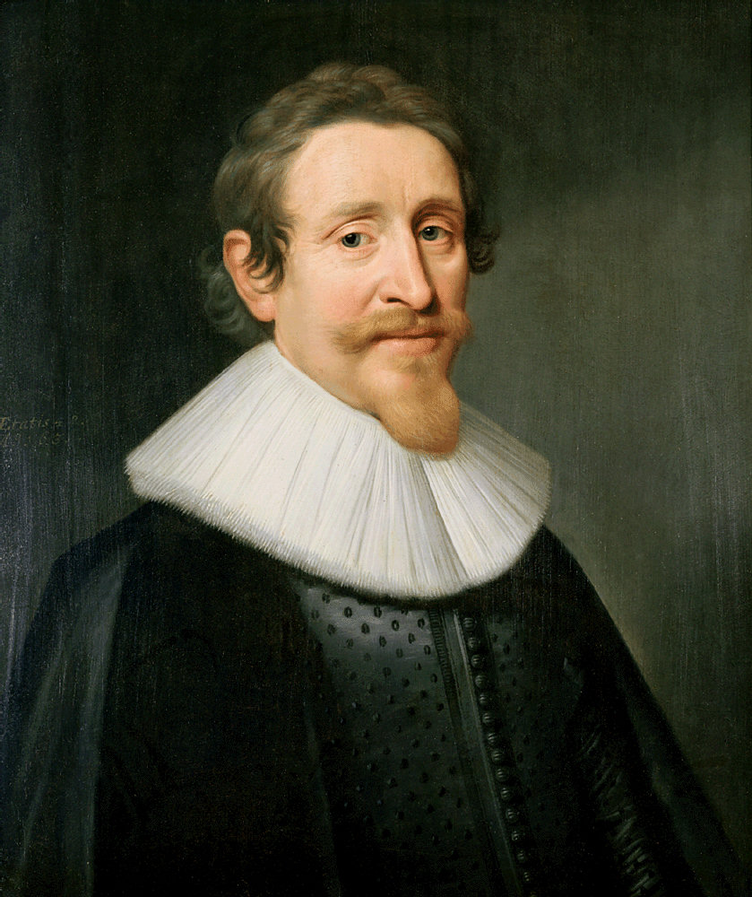
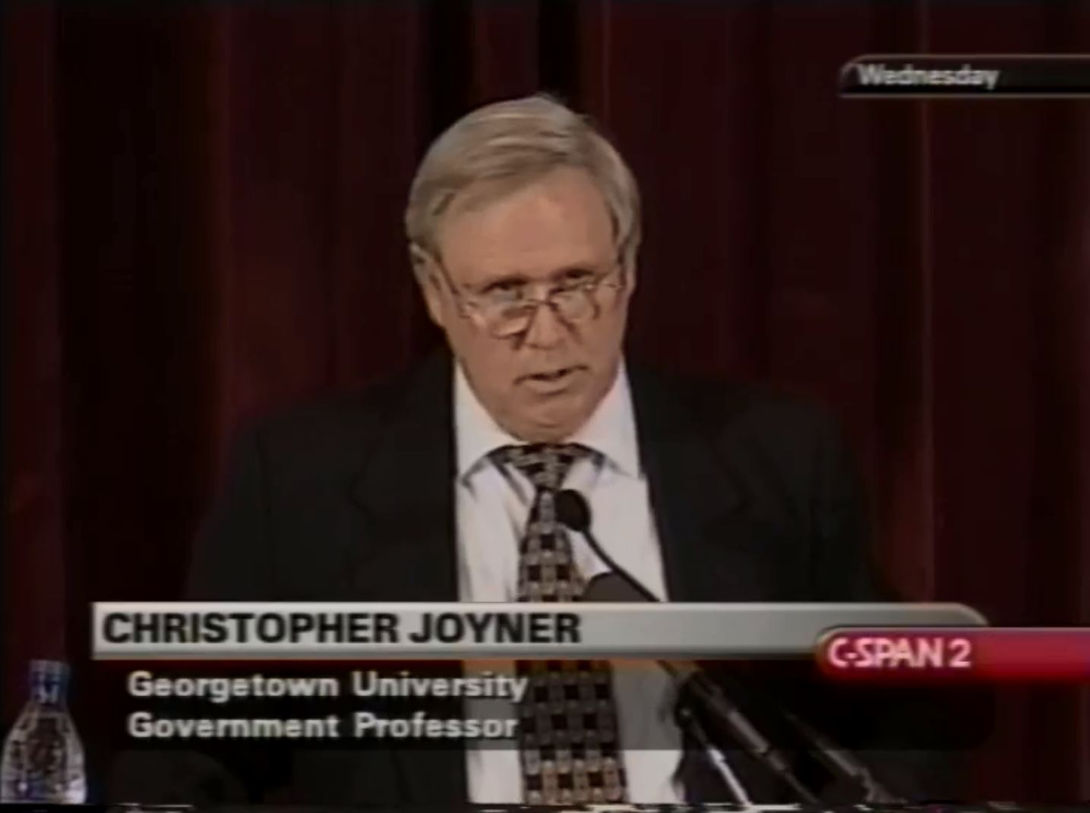
The Fundamentals of International Law 4 of 5
The Growth of International Law
Notes:
Grotius and Joyner

Slide 9

The Fundamentals of International Law 5 of 6
The Growth of International Law

Slide 10
The Fundamentals of International Law 6 of 6
The Growth of International Law
Rooted in ancient Jewish, Greek, and Roman newer Christian concepts.
Holland’s Hugo Grotius (1583–1645) Law of War and Peace.
Treaty on the laws of treaties: Vienna Convention on the Law of Treaties, drafted in 1969 and entered into force in 1980
Notes:
Vienna Convention on the Law of Treaties, drafted in 1969 and entered into force in 1980

Slide 11
The International Legal System 1 of 7
The Philosophical Roots of Law
Decentralized and fragmented
Three major schools of thought on where laws originate.
a)The ideological/theological school of Law
b)The naturalist school of law
  c) Positivist school of law

Slide 12
The International Legal System 2 of 7
The Philosophical Roots of Law
Five sources of law that the international
a) international conventions or treaties
  b) international custom
c) general principles of laws
d) judicial decisions
  e) the teaching of qualified writers and scholars.

Slide 13
The International Legal System 3 of 7
Adherence to the Law
Mostly voluntary Compliance
Pragmatic legitimacy is the key to international voluntary compliance.
Extralegal factors
Peer pressure matters.
Well-ordered domestic systems.
Tribunals and courts
Notes:
Extralegal factors, such as reputation, credibility, and socialization, tend to promote state compliance.
Tribunals and courts, centralized enforcement of international
Enforcement often occurs through armed intervention.
Increasing use of economic and diplomatic sanctions.

Slide 14
The International Legal System 4 of 7
Adjudication of the Law
Evolution of resolving disputes
a) primary reliance on bargaining between adversaries, through
b) mediation/conciliation by neutral parties
c) adjudication and the closely related process of arbitration by neutral parties

Slide 15
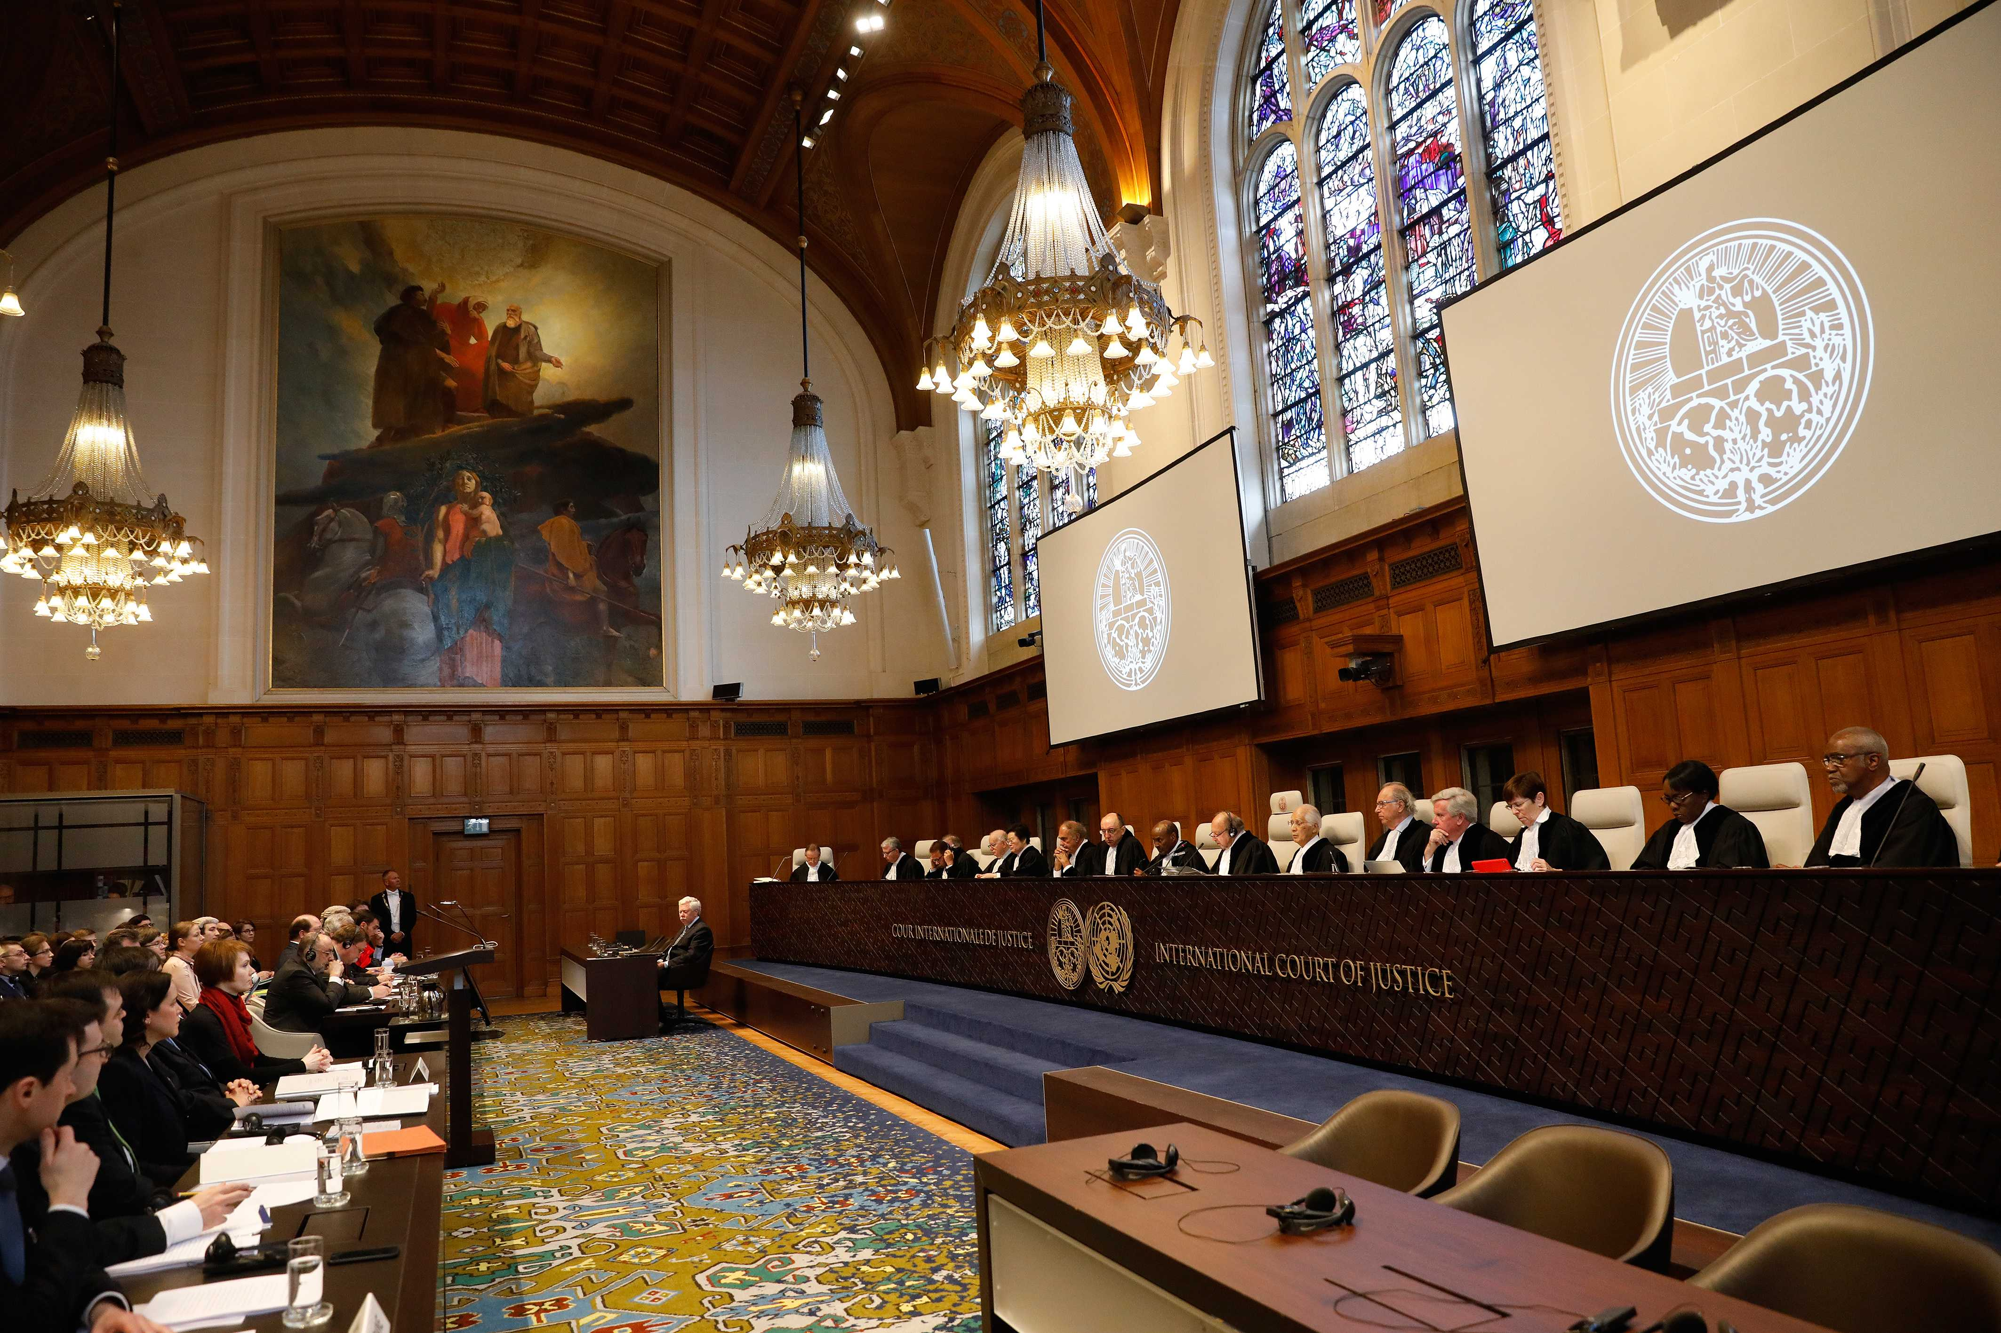
The International Legal System 5 of 7
Adjudication of the Law

Slide 16
The International Legal System 6 of 7
Adjudication of the Law
Regional courts: No authority of domestic courts.
a) EU Courts of Justice and Human Rights
b) The Inter-American Court of Human Rights
c) The Central American Court of Justice
d) The Community Tribunal of the Economic Community of West African States.

Slide 17
The International Legal System 7 of 7
Adjudication of the Law
Sovereignty potent barrier to adjudication.
Optional clause
1984 Nicaragua vs. the U.S.
ICJ advisory opinions also help resolve issues between IGOs.
Notes:
Optional clause: Parties agree to be subject to the ICJ’s compulsory jurisdiction.
1984, when Nicaragua filed a case with the ICJ charging that U.S. The ICJ ruled in favor of the Nicaragua but the U.S. withdrew its consent to the optional clause.
The ICJ has only limited effectiveness

Slide 18
Applying International Law and Justice 1 of
Law and Justice in a Multicultural World
Concept of justice impacting global politics are of Western origins.
Promotion of legal standards; major challenge
Differing cultural values and ideals
Application and enforcement of rights and responsibilities to states and individuals.
Notes:
Law and Cultural Perspectives. Western and non-Western translations and applications
Should we judge states and individuals by the same standards?

Slide 19
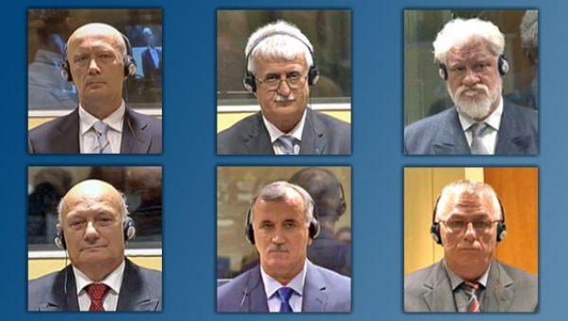
Applying International Law and Justice 2 of
Standards of Law for States and Individuals

Slide 20
Applying International Law and Justice 3 of
States, War, and International Law
Social, legal, ethical, and moral debate over when (if ever) we can justify war
International Law on Decisions to Go to War
The jus ad bellum:
  a) just cause
b) competent authority
Notes:
Law and Cultural Perspectives. Western and non-Western translations and applications
Should we judge states and individuals by the same standards?

Slide 21
Applying International Law and Justice 4 of
States, War, and International Law
The jus ad bellum:
  c) right intention
  d) reasonable hope for success
  e) proportionality (of ends desired)
  f) last resort
Notes:
1) just cause: discernment and possession of a “just cause” for war;
(2) competent authority: the sanctioning of war by a proper or what Aquinas would term a “legitimate authority,” or an authority possessing a right to rule on such a question on the basis of its sovereignty;
(3) right intention: the actor’s motivation for war as stemming from a “right intention,” de-fined as a just motivation;
(4) reasonable hope for success: a priori evidence of at least a reasonable hope for a successful outcome to the war;
(5) proportionality (of ends desired): the relative proportionality of the end or ends desired from the war relative to the means of war that would be employed to attain them; and
(6) last resort: military force can only be employed after all other peaceful alternatives have

Slide 22
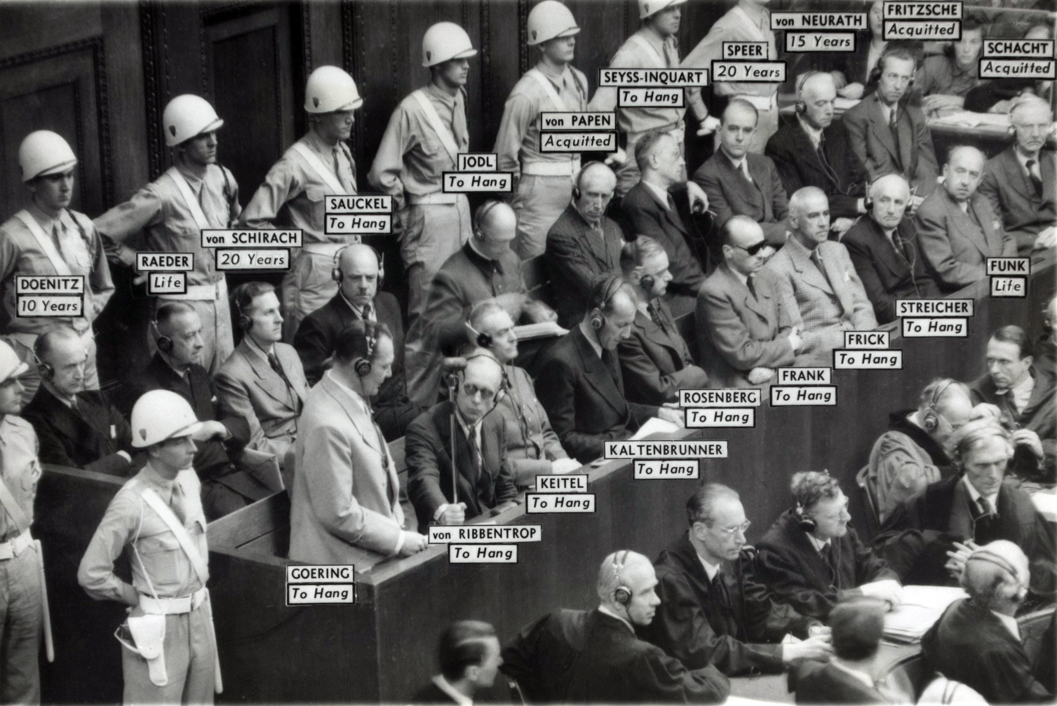
Applying International Law and Justice 5 of
States, War, and International Law

Slide 23
Applying International Law and Justice 6 of
Applying International Law and Justice to Individuals
War Crimes Tribunals
After 50 years, international tribunals reemerged in the 1990s.
Atrocities: Bosnia-Herzegovina and in Rwanda
Rape and forced impregnation emerged as a strategic weapon of war

Slide 24
Applying International Law and Justice 7 of
Applying International Law and Justice to Individuals
Kosovo in 1998-99 indicted 161 convicted 90
Slobodan Milošević, the former president of Yugoslavia.
The International Criminal Tribunal for Rwanda
Since World War II ICTR first to punish heads of state

Slide 25
Applying International Law and Justice 8 of
The Pragmatic Application of Law and Justice
Can ends justify means?
Moral argument in the face of complex choices.
Relatively weak international legal system
Should we judge others by our own standards?
Is it pragmatic to apply standards of legality and justice?

Slide 26
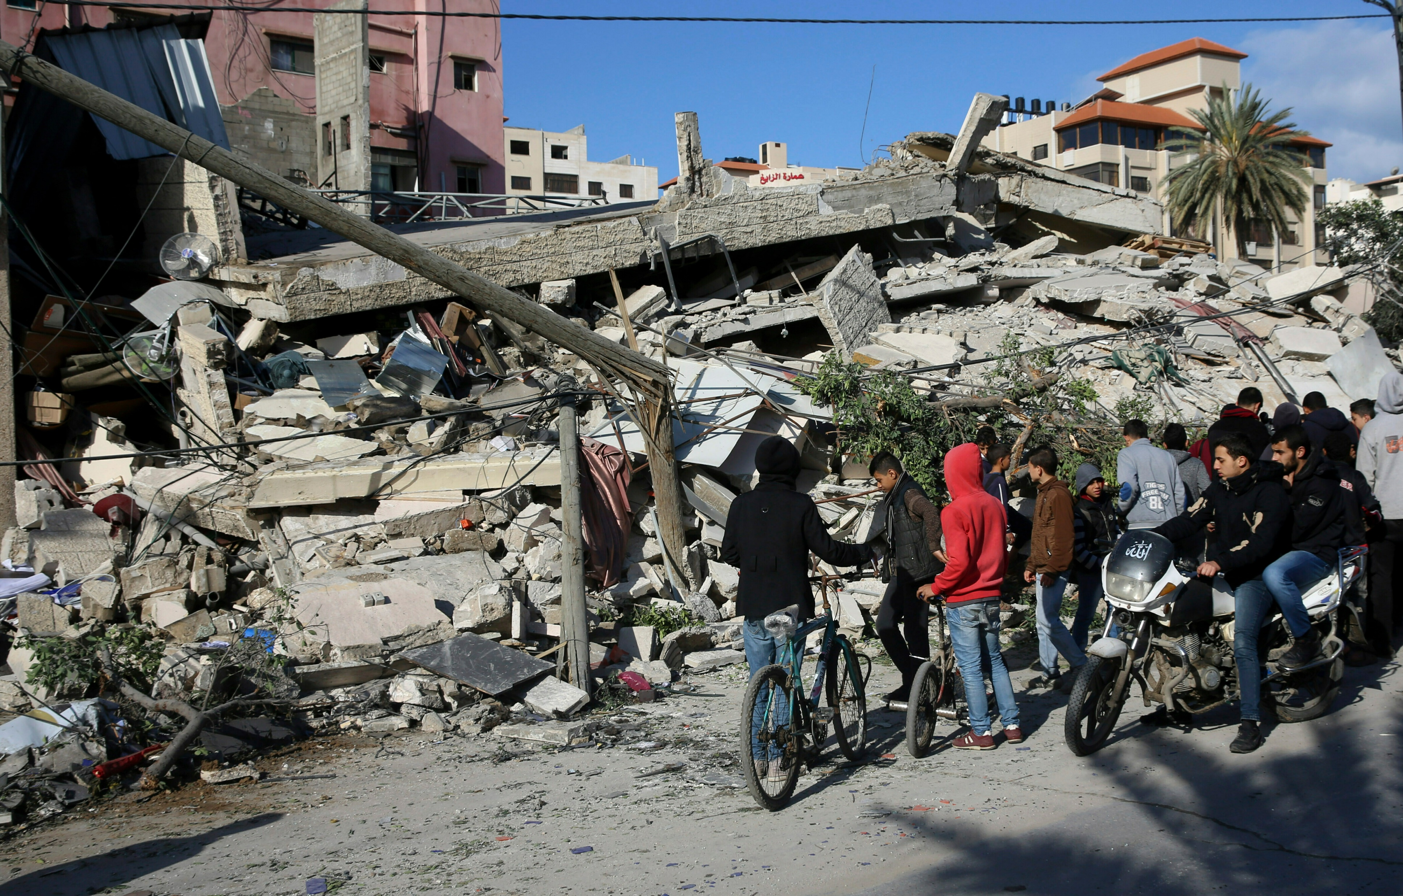
Applying International Law and Justice 9 of
The Pragmatic Application of Law and Justice

Slide 27
The Future of International Law and Justice of 1 of 1
All signs point to increasing respect for international law and a greater emphasis on adhering to at least rudimentary standards of justice

Slide 28
Summary
International law is weak in comparison to domestic law with limited compliance.
International law is derived from multiple sources, including norms and principles, customs, and treaties.
International law is very Western in origin

Slide 29
Chapter 9
Review of Learning Objectives 1 of 2
9.1 Discuss the principles, customs, and rules of international law.
9.2 Explain the philosophical roots of law, the historical evolution, and how international laws are made, obeyed, and decided.

Slide 30
Chapter 9
Review of Learning Objectives 2 of 2
9.2 Discuss the legal standards and justice amid differing cultural values and ideals, and the application and enforcement of international legal rights and responsibilities to states and individuals.
9.3. Identify and evaluate the underlying sources of and continuing debates concerning international humanitarian law.

