Slide 1
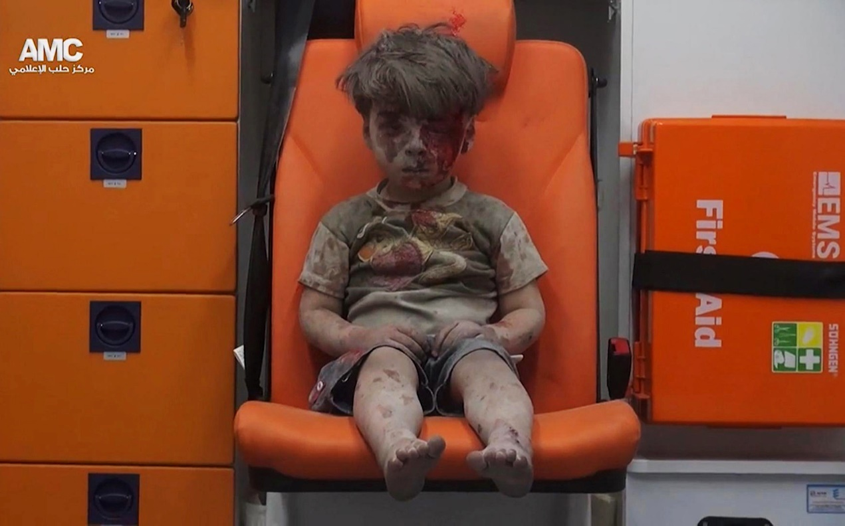
Chapter 12
Human Rights: A Tool for Preserving and Enhancing Human Dignity
Notes:
1

Slide 2
Chapter 12
Human Rights: A Tool for Preserving and Enhancing Human Dignity
The Emergence of Human Rights
Human Rights Enforcement
Human Rights Issues and Advocacy

Slide 3
Chapter 12 Learning Objectives
12.1 Identify core human rights principles. Understand various theoretical perspectives on how human rights standards have emerged since World War II
11.2 Describe the complex international legal system.
12.3 Discuss some of the greatest human rights violations of the 21st century

Slide 4
The Emergence of Human Rights 1 of 7
Human Rights Language
The emergence with European Enlightenment
First-generation rights
Second-generation rights
Third-generation rights
Governments and human rights
Critiques of the categorization of rights
Notes:
first-generation rights -- rights that focus on civil liberties and political freedoms and for many states serve as the core to a rights system based on equality and nondiscrimination. Some international relations scholars have classified these rights as proscriptive rights
second-generation rights are largely centered on economic and social rights, such as economic subsistence, education, nutrition, sanitation, work, housing, and health care. For some international relations scholars, these prescriptive rights
third-generation rights, or those rights focused on the communal aspects of being human. These rights, labeled group or solidarity rights, can only be realized collectively.

Slide 5
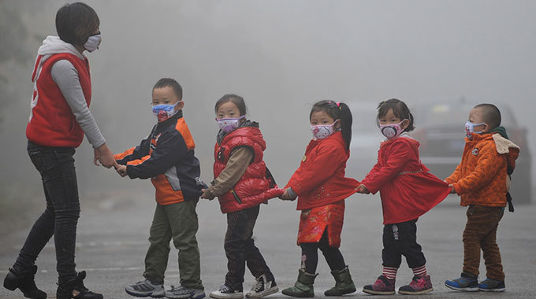
The Emergence of Human Rights 2 of 7
Human Rights Language

Slide 6
The Emergence of Human Rights 3 of 7
Human Rights Language
Critiques of the categorization of rights
Progressive realization of rights
Human rights in service of human needs
New emerging rights

Slide 7
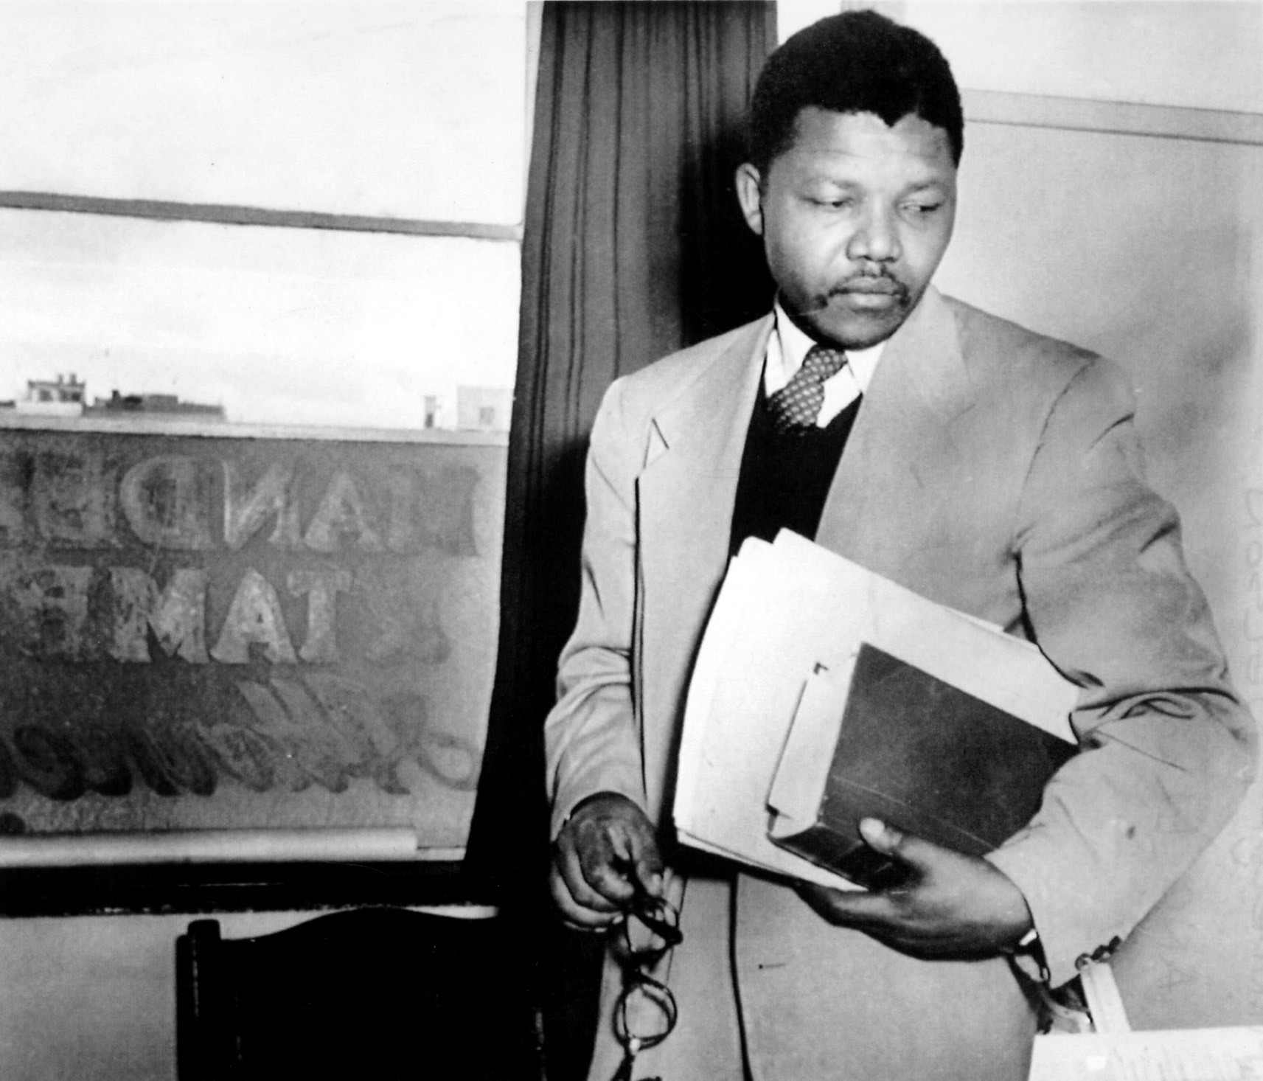
The Emergence of Human Rights 4 of 7
Human Rights Language

Slide 8
The Emergence of Human Rights 5 of 7
Human Rights Laws and Norms
World War II; modern human rights movement
Individuals, groups, and (NGOs)
The Universal Declaration of Human Rights
a) The preamble
b) Thirty principles of the (UDHR)

Slide 9
The Emergence of Human Rights 6 of 7
Human Rights Laws and Norms
The International Covenant on Civil and Political Rights (ICCPR, 1966)
The International Covenant on Economic, Social, and Cultural Rights (ICESCR, 1966)
Countries that are not signatories or have not ratified the two multilateral treaties

Slide 10
The Emergence of Human Rights 7 of 7
Human Rights Laws and Norms
UN-sponsored treaties addressing right of specific groups such as women, children, etc.
Torture and military-related human rights abuses
Regional conventions and judicial arms of Intergovernmental Organizations (IGOs)

Slide 11
Human Rights Enforcement 1 of 7
United Nations Monitoring Mechanisms
UN Commission on Human Rights (UNCHR)
UN Human Rights Council (UNHRC)
US’ domestic politics and the UNHRC
The Universal Periodic Review (UPR) and how it works

Slide 12
Human Rights Enforcement 2 of 7
Role of NGOs
NGOs’ contributions include:
a) Raising public awareness about human rights issues
b) Educating, training, and research
c) Promoting and protecting human rights
d) Advocating for human rights through education and mobilization

Slide 13
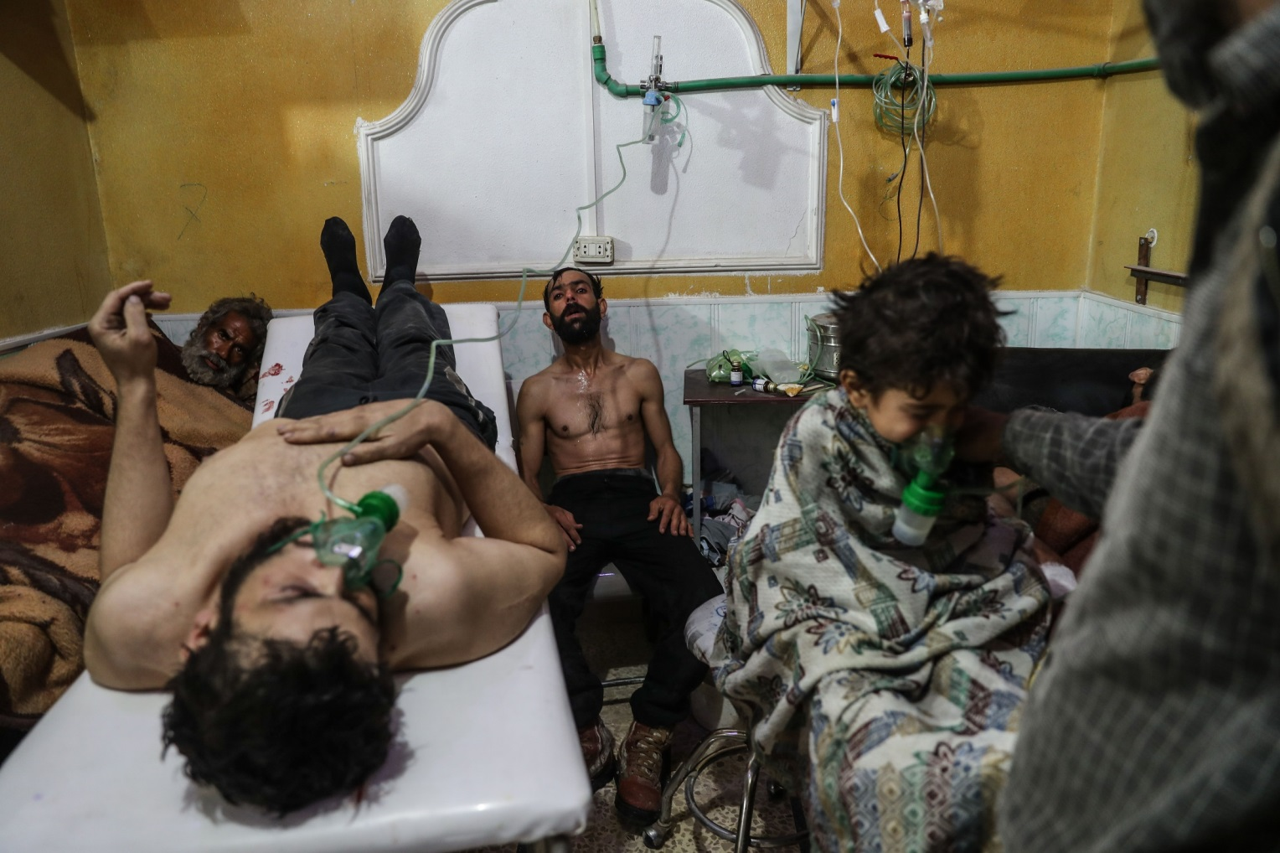
Human Rights Enforcement 3 of 7
Role of NGOs

Slide 14
Human Rights Enforcement 4 of 7
State Sovereignty and Enforcement
State’s right to sovereign control vis-à-vis
Their responsibility in promoting and upholding human rights
Role of the international community
Responsibility to Protect (R2P)
The Information Technology Revolution

Slide 15
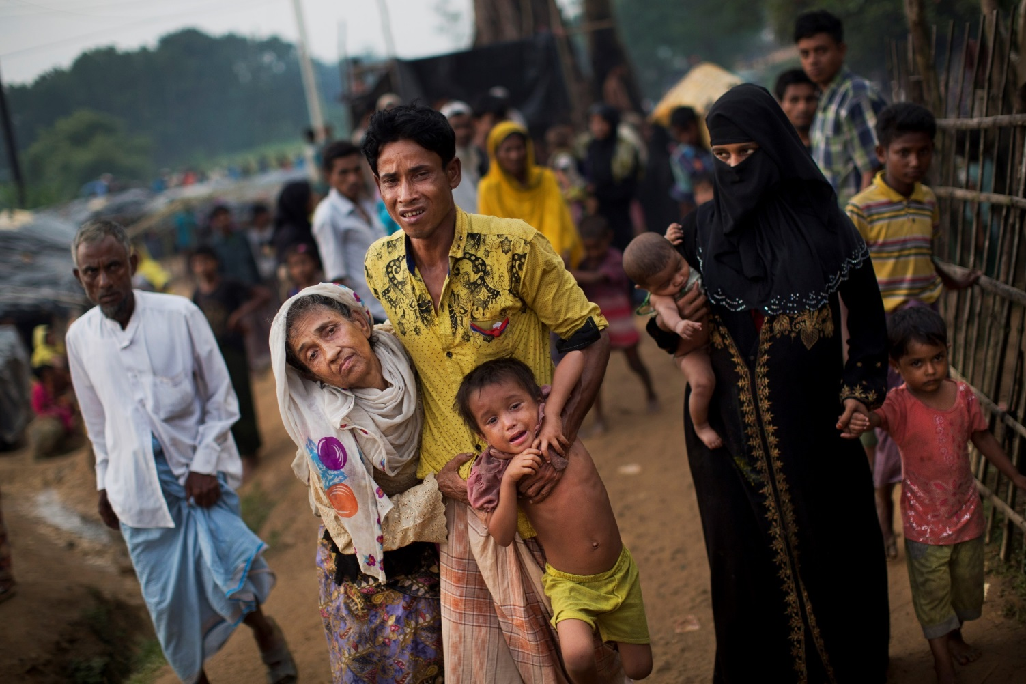
Human Rights Enforcement 5 of 7
State Sovereignty and Enforcement

Slide 16

Human Rights Enforcement 6 of 7
State Sovereignty and Enforcement

Slide 17
Human Rights Enforcement 7 of 7
Barriers to Progress on Human Rights
Being a signatory does not equal compliance
Lack of enforcement mechanisms
Challenges in the realization human rights
a) Differences in cultural standards
b) Political selectivity
c) Lack of support
d) Legal bias

Slide 18
Human Rights Issues and Advocacy 1 of 10
Critical Human Rights Violations
Violations against children
a) forced into child soldiers
b) sex slavery
b) refugees
c) internally displaced persons
Notes:
Violations against children despite the Convention on the Rights of the Child (1989) being one of the most widely ratified treaty

Slide 19
Human Rights Issues and Advocacy 2 of 10
Critical Human Rights Violations
Forced into child soldiers
b) At least 250,000 child soldiers worldwide
c) About 40% of all child soldiers are girls
d) Iraq, Syria, South Sudan, and the Philippines

Slide 20
Human Rights Issues and Advocacy 3 of 10
Critical Human Rights Violations
Refugees and IDPs
b) Syrian children
c) 2.7 million Syrian children are out of school
d) About 380,000 in Turkey alone

Slide 21
Human Rights Issues and Advocacy 4 of 10
Critical Human Rights Violations
Measuring human rights enables us to
a) Classify different violations and abusers
b) Monitor states’ responsibility
c) Recognize patterns of causes and consequences
d) Advocate for rights improvements

Slide 22
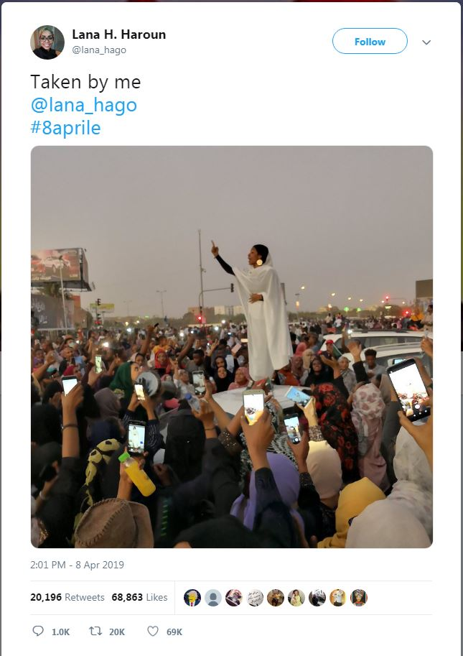
Human Rights Issues and Advocacy 5 of 10
Women’s Rights
Afghanistan or Iraq e.g.
Are women voting ?
Is it safe to travel to vote?
Disparity between women’s and men’s wages, United States

Slide 23
Human Rights Issues and Advocacy 6 of 10
Critical Human Rights Violations
Challenges in collecting the necessary data
a) Assumption of universal agreement
b) Biased and incomplete data
c) Issues of data reliability
d) Underreporting of human rights violations

Slide 24
Human Rights Issues and Advocacy 7 of 10
Student-Led Human Rights Campaigns
Student-led resistance and protests are not new
Increase in student advocacy on right issues
Students are key to human rights advocacy
The use of media to draw attention and mobilize support

Slide 25
Human Rights Issues and Advocacy 8 of 10
Student-Led Human Rights Campaigns
The anti-sweatshop movement
The anti-trafficking movement

Slide 26
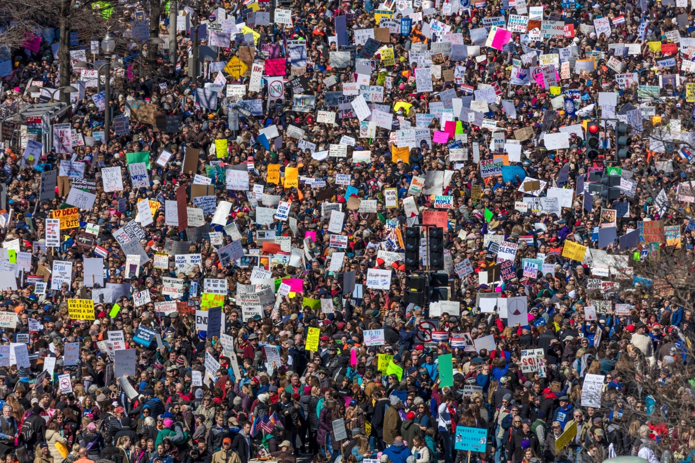
Human Rights Issues and Advocacy 9 of 10
Student-Led Human Rights Campaigns

Slide 27
Human Rights Issues and Advocacy 10 of 10
Anti-Trafficking Movement
began in the late 1990s
A form of modern-day slavery
Capture victims, including abduction, deceit, seduction, and promises of a better life
National Guestworker Alliance

Slide 28
Chapter 12 Review Learning Objectives
12.1 Identify core human rights principles. Understand various theoretical perspectives on how human rights standards have emerged since World War II
11.2 Describe the complex international legal system.
12.3 Discuss some of the greatest human rights violations of the 21st century

