Slide 1

Chapter 11
Global Political Economy – Searching for Equity in the Global South
Notes:
1

Slide 2
Chapter 11
Global Political Economy – Searching for Equity in the Global South
The World Economy: Diverse Circumstances
Dependency in the Global Economy
Applied Economic Policy
Global Economic Development Futures

Slide 3
Chapter 11
Learning Objectives
11.1 Discuss the economic circumstances that define the developing world.
11.2 Describe the relationships between the North and the South.
11.3 Explain the tools of economy policy.
11.4 Evaluate different visions of our global economic future.

Slide 4
The World Economy: Diverse Circumstances 1 of 9
North-South Patterns
Global South share a history of colonialism or neocolonial domination
Most sovereign countries did not exist in the Global South immediately after World War II.
Dependency relationship continues
South Significantly poorer compared to those of the North.

Slide 5
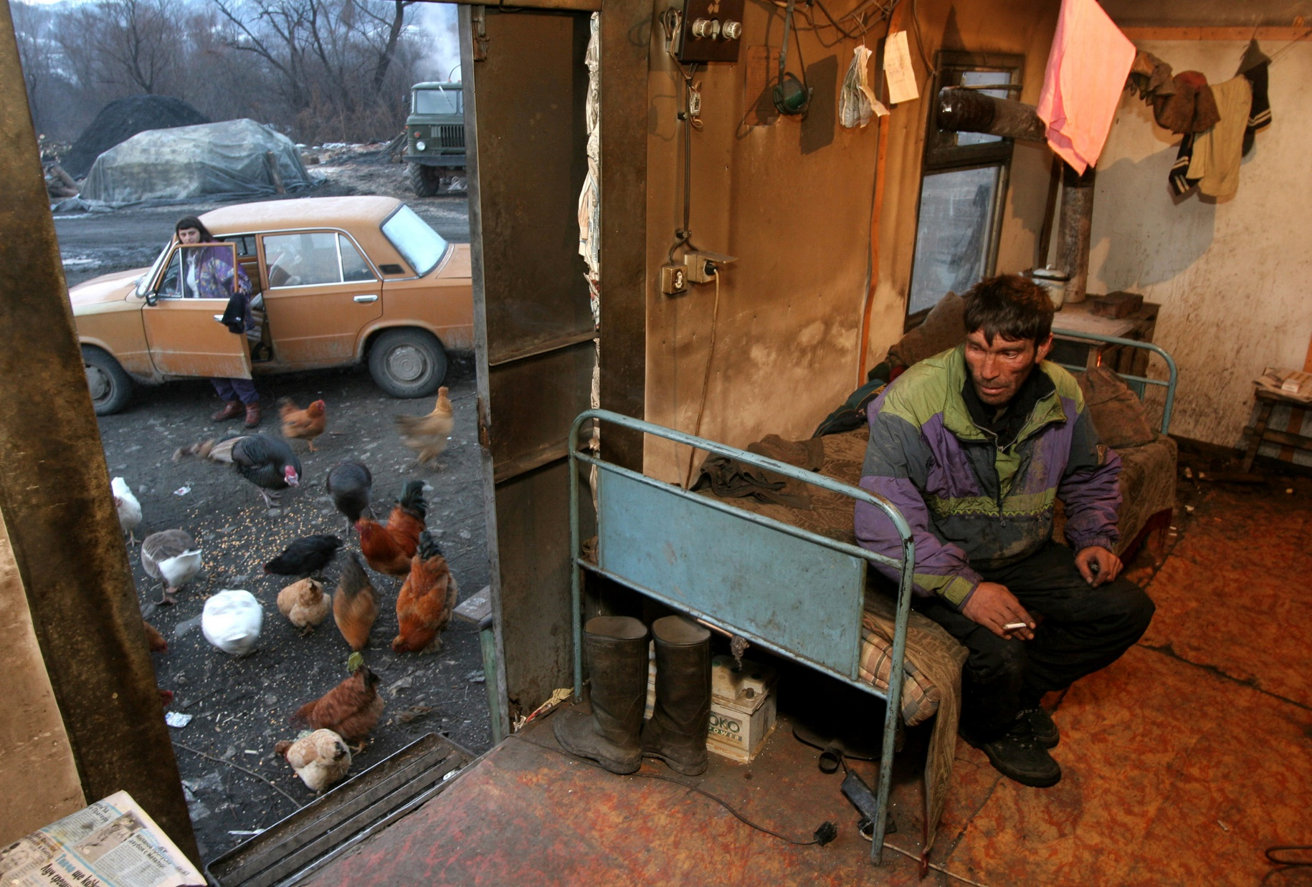
The World Economy: Diverse Circumstances 2 of 9
North-South Patterns

Slide 6
The World Economy: Diverse Circumstances 3 of 9
North-South Patterns
Huge wealth gap
Less capital in the Global South takes in
Trade differences leave the North advantaged
China, which indeed holds a unique place in the Global South
Global North produce more than $60 for every $1 is the poorest part of Global South

Slide 7

The World Economy: Diverse Circumstances 4 of 9
North-South Patterns

Slide 8
The World Economy: Diverse Circumstances 5 of 9
North-South Patterns
Investment differences favor the Global North
a) The 500 largest MNCs, about 90%
  b) U.S. firms a third of the Fortune Global 500
c) 1 is Walmart, 2 - 4 Chinese-based
  d) U.S. 9 out 20 global firms
  e) North to North: (two-thirds of all global investment flows)

Slide 9
The World Economy: Diverse Circumstances 6 of 9
North-South Patterns
1 billion people live in extreme poverty
Extreme poverty, which the World Bank defines as less than $1 a day.
Almost half of the world’s population lives on less the $2.50 per day.
About .3 doctors per 1000 people
Maternal mortality rate 37 times greater

Slide 10

The World Economy: Diverse Circumstances 7 of 9
North-South Patterns

Slide 11
The World Economy: Diverse Circumstances 8 of 9
Evaluating the North-South Gap
Highly uneven pattern of development
Mixed Data on Development
Much improvement in the quality of life in the Global South
19 % of the population still lives in extreme poverty
Improve to 28% in that condition in 1990

Slide 12
The World Economy: Diverse Circumstances 9 of 9
Evaluating the North-South Gap
Middle-income countries advanced more quickly than the low-income countries.
East Asia have made major economic strides,
Negative by-products of development
Explosive population growth
Rapid urbanization leads to Industrial and environmental danger

Slide 13
Dependency in the Global Economy 1 of 8
North-South Economic Relations
Resentment in the South over its past and present treatment by the North
a) Legacy on colonization still remain
  b) Trading relationship remains asymmetrical
c) Europeans receive mostly raw or transformed goods from Africa
Notes:
Trading relationship remains asymmetrical with greater value-added in production continuing to favor the Europeans and others in the North.
Europeans receive mostly raw or transformed goods from Africa, such as fuels, agricultural products, and textiles

Slide 14
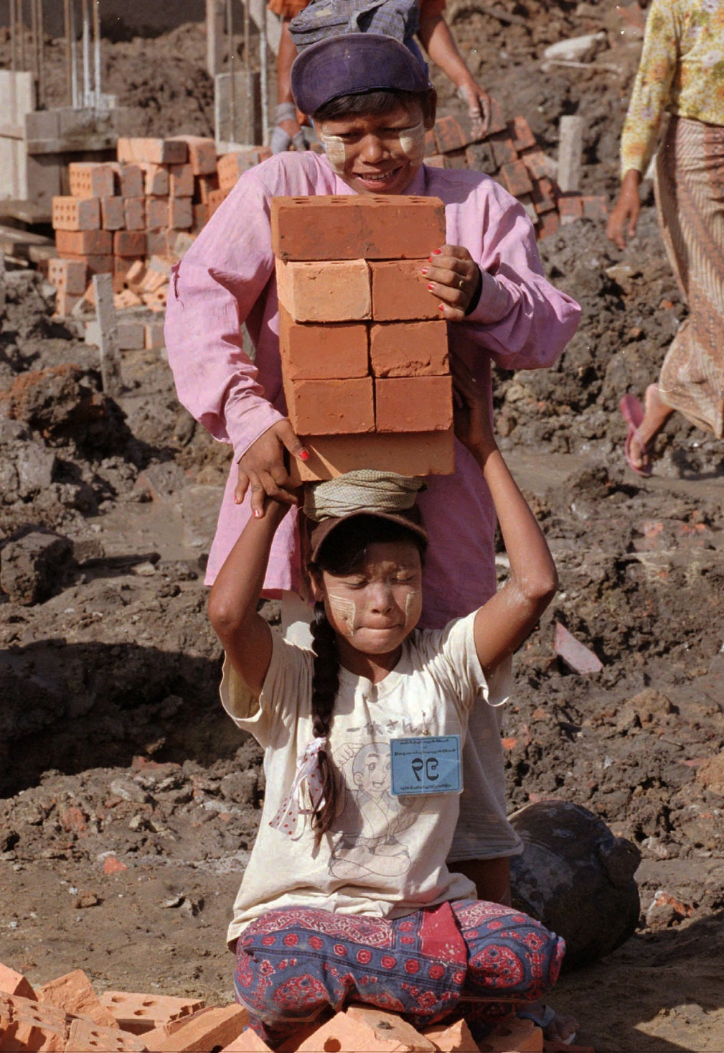
Dependency in the Global Economy 2 of 8
North-South Economic Relations

Slide 15
Dependency in the Global Economy 3 of 8
North-South Economic Relations
Assertiveness by Global South on economic issues
a) the rationale for development assistance
  b) Average Aid from the North just over 0.3% in 2016 and the U.S., 018%
  c) Colonial legacy

Slide 16
Dependency in the Global Economy 4 of 8
North-South Economic Relations
The North’s refusal of economic reforms
South’s demands for unilateral and compensatory economic reforms by the North
Increasing manufacturing good by Global South
Not much export of services from the Global South

Slide 17
Dependency in the Global Economy 5 of 8
The UN and Global Economic Regulation
UN sponsor North-South economic summit
UN’s Millennium Summit
MDG goals were not met
Sustainable Development Goals (SDGs)
Technical assistance and development funds to LDCs

Slide 18
Dependency in the Global Economy 6 of 8
The UN and Global Economic Regulation
The South’s Reform Agenda
New International Economic Order
Trade reforms, such as lowering Northern barriers
Greater labor migration for Southern workers
Elimination of economic coercion
Economic aid to the South by the North
Debt relief granted by the Northern countries

Slide 19

Dependency in the Global Economy 7 of 8
The UN and Global Economic Regulation

Slide 20
Dependency in the Global Economy 8 of 8
South-South Economic Relations
South-South competition
Increased oil prices benefit Southern states
Chinese goods may be flooding the North
China has undercut Mexico’s role as a provider of low-cost exports to the United States

Slide 21
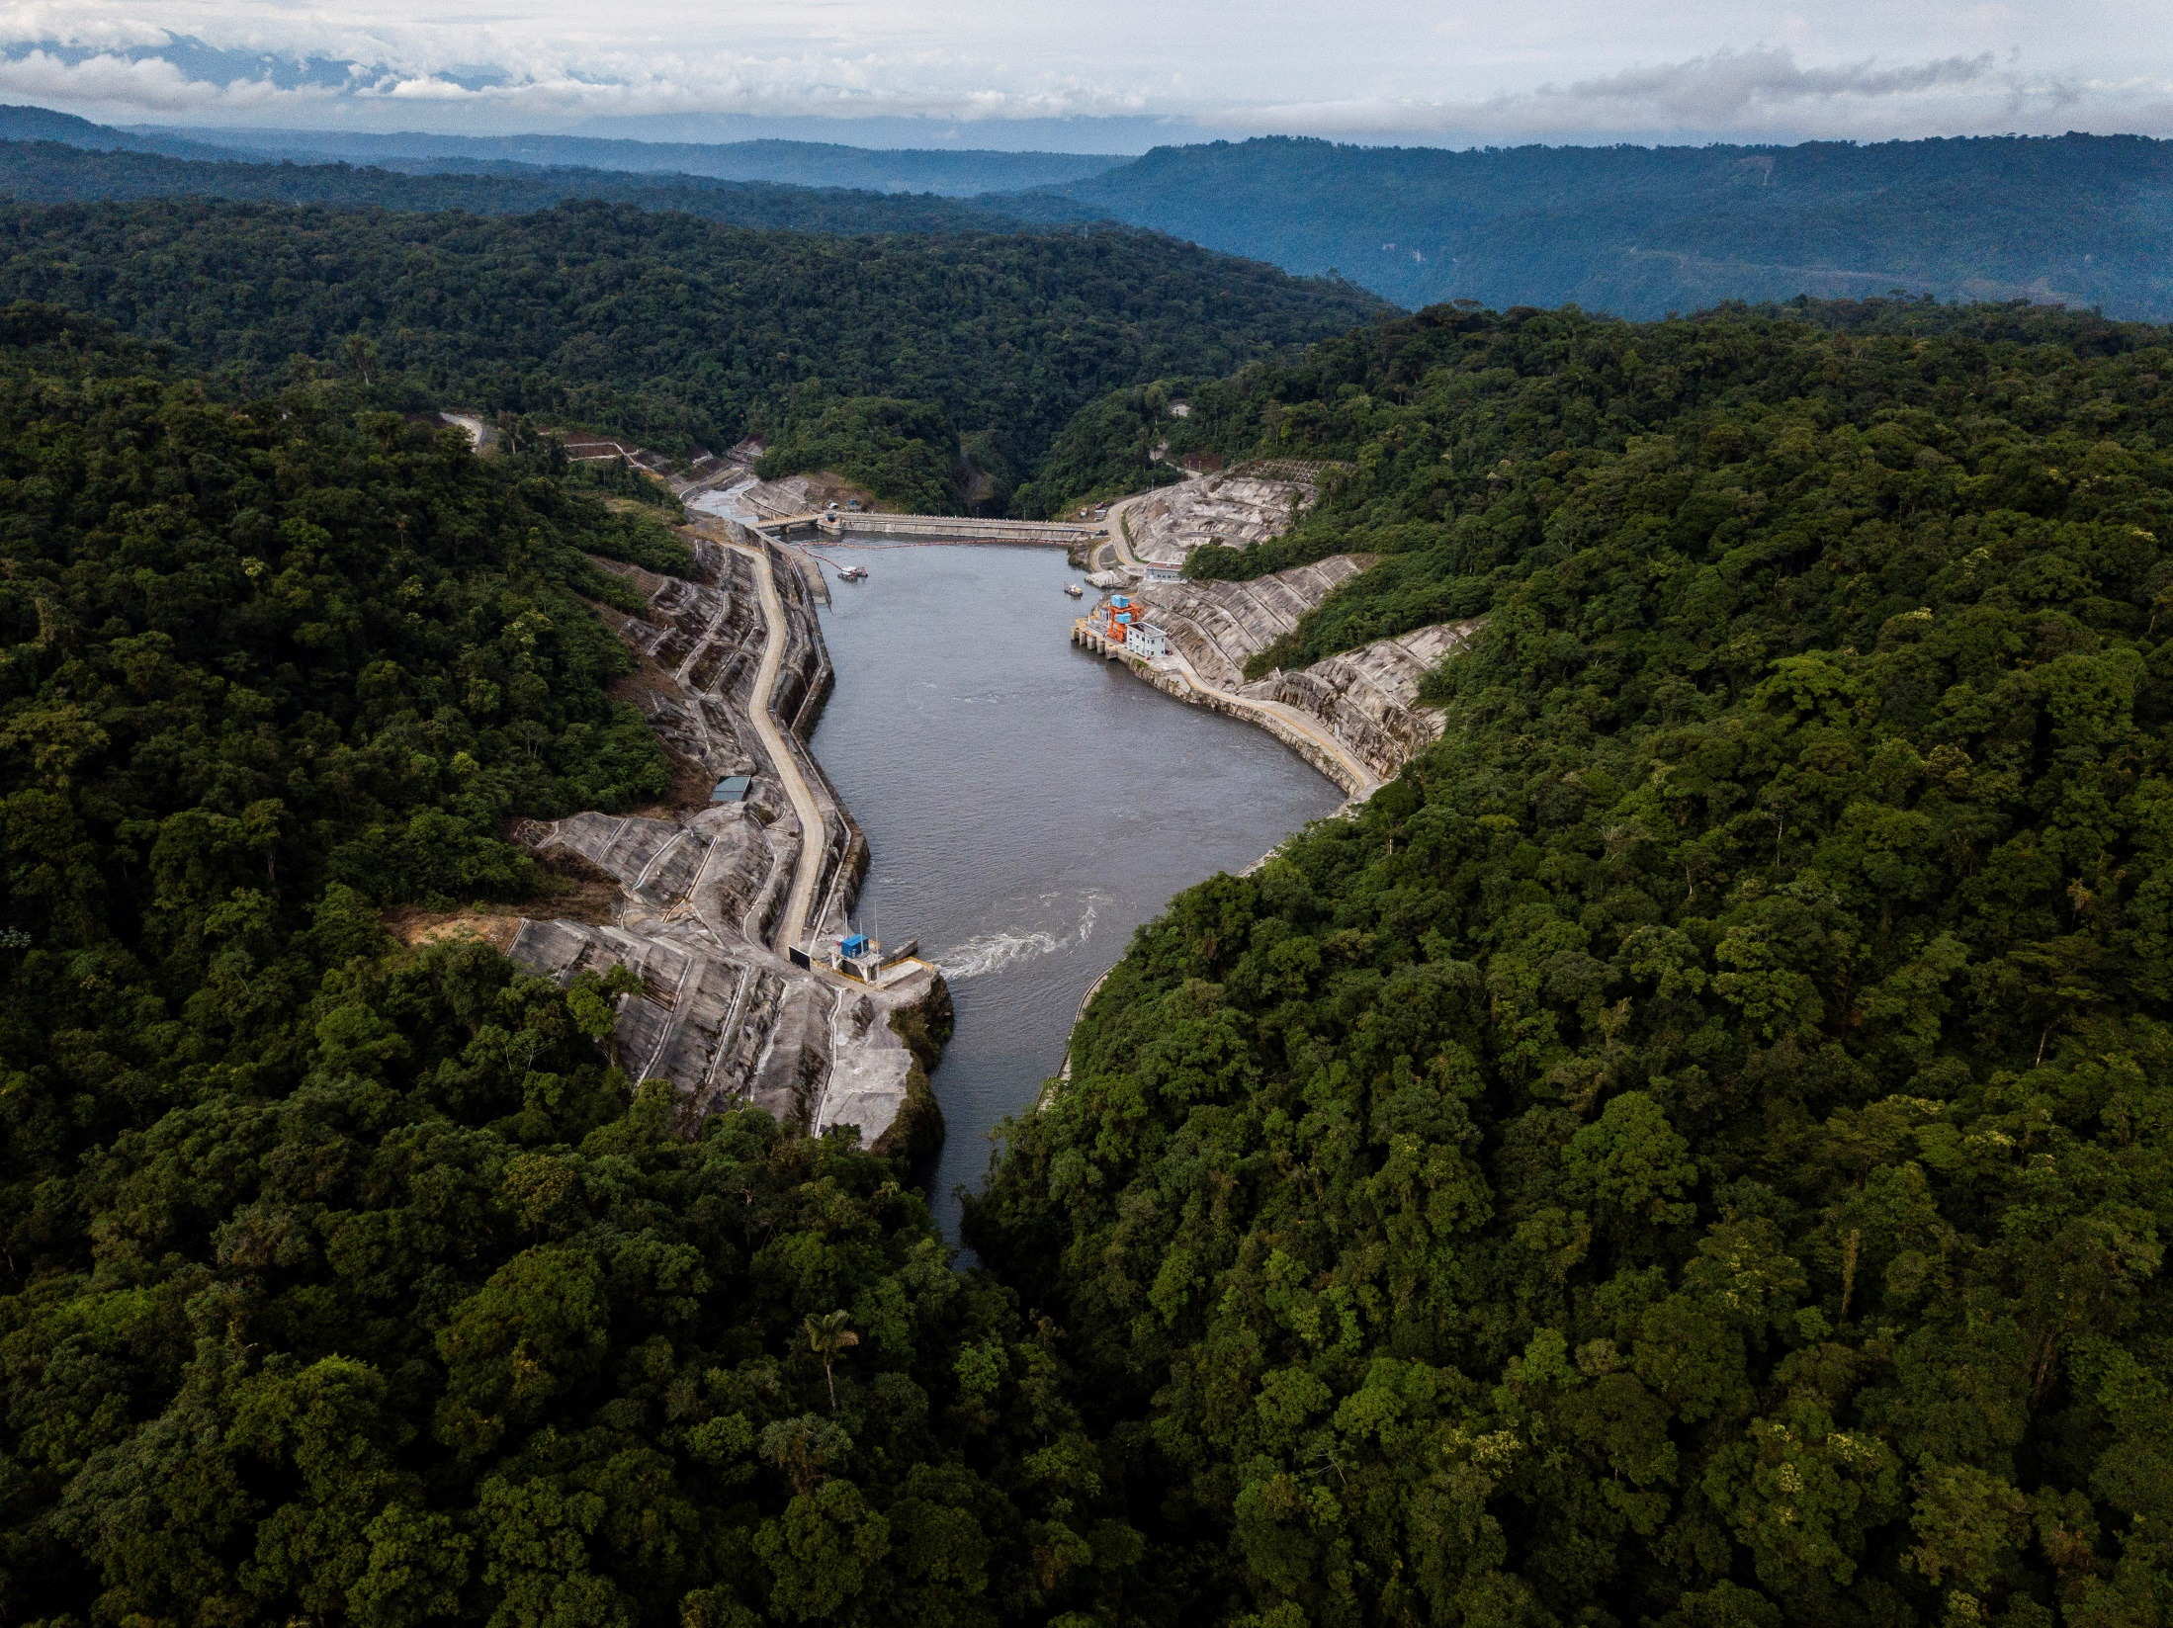
Applied Economic Policy 1 of 7
Economic Means to Achieve Economic Ends

Slide 22
Applied Economic Policy 2 of 7
Trade and Investment Barriers
tariffs, nontariff barriers,
monetary barriers, and
investment restrictions
nontariff barriers (NTBs) e.g.). Health and safety standards
the EU had a “banana war in the past

Slide 23
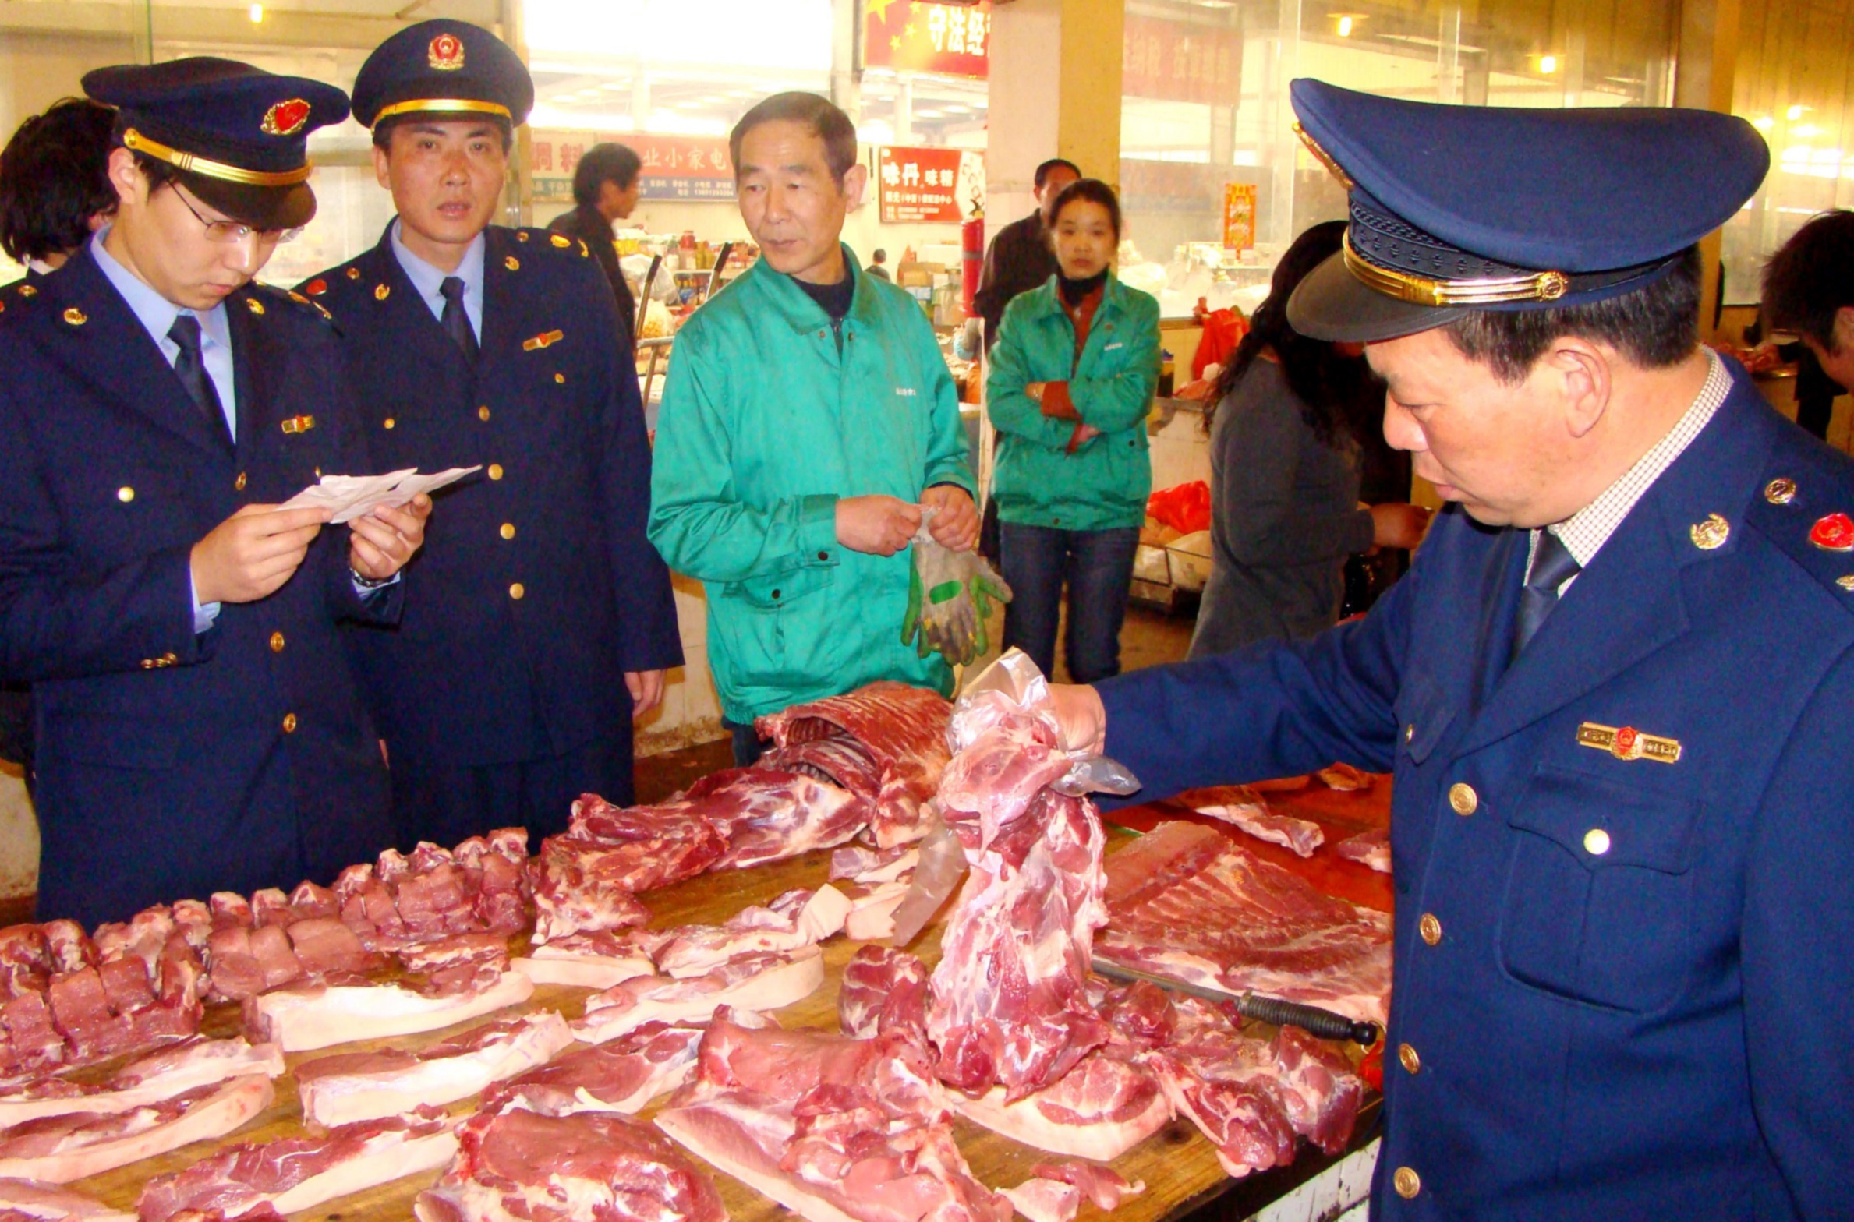
Applied Economic Policy 3 of 7
Trade and Investment Barriers

Slide 24
Applied Economic Policy 4 of 7
Trade and Investment Supports
tax breaks
provide low-cost services
financial support to subsidize domestic producers
funding research for product development
government trade promotion campaigns

Slide 25
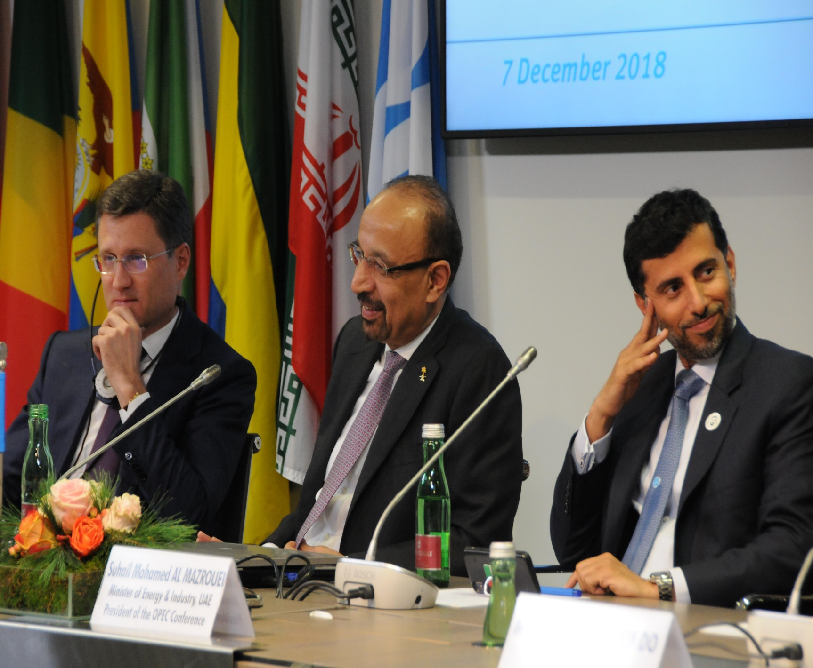
Applied Economic Policy 5 of 7
Trade and Investment Supports
Dumping
Establishing cartels
Subsidies
Notes:
Dumping: States supports a company by violating trade laws by selling its products abroad at very low cost

Slide 26
Applied Economic Policy 6 of 7
Using Economic Means to Achieve Political Ends
Policies on national security restrictions
a) concerns of Chinese migrants in the U.S
b) CBS 60 Minutes in August 2018
c) teach Chinese-Americans; how to own business and research

Slide 27
Applied Economic Policy 7 of 7
Using Economic Means to Achieve Political Ends
Economic incentives
Imposing economic sanctions
a) U.S. sanctions on Cuba
b) Iraq’s 1990 invasion of Kuwait

Slide 28
Global Economic Development Futures 1 of
Internationalism: Benefits for All?
Economic Advantages; to LDCs According to the Internationalists
a) general prosperity,
  b) the benefits of specialization,
c) the cost of protectionism,
  d) the advancement of the LDCs

Slide 29
Global Economic Development Futures 2 of
Internationalism: Benefits for All?
Better South will increase Global North
All countries will benefit when
Most economists argue that trade barriers result in higher prices consumer
Free economic interchange

Slide 30
Global Economic Development Futures 3 of
Internationalism: Benefits for All?
Noneconomic Advantages
a) advancing global cooperation
b) decreasing violence
c) promoting democracy

Slide 31
Global Economic Development Futures 3 of
Economic Nationalism: A Competitive Future A World Systems Postscript
Economic Advantages
a) protecting the domestic economy,
b) diversification
c) compensating for existing distortions, and
d) putting domestic needs first

Slide 32
Global Economic Development Futures 3 of
Economic Nationalism: A Competitive Future A World Systems Postscript
Protection for so-called infant industries
Encourage economic diversification
Citizens create and authorize their government to look after national welfare and safety
Some countries do not play by the rules:

Slide 33
Global Economic Development Futures 3 of
Economic Nationalism: A Competitive Future A World Systems Postscript
Some countries do not play by the rules
a) tariffs
b) subsidies
c) currency manipulation

Slide 34
Global Economic Development Futures 3 of
Economic Nationalism: A Competitive Future A World Systems Postscript
Protectionism and other trade distortions
a) United States should retaliate against China b) Trade and Investment Barriers

Slide 35
Global Economic Development Futures 3 of
Economic Nationalism: A Competitive Future A World Systems Postscript
Noneconomic Advantages
a) protects national sovereignty
b) enhances national security
c) permits the beneficial use of their country’s economic power as a policy tool.

Slide 36
Chapter 11
Review Learning Objectives
11.1 Discuss the economic circumstances that define the developing world.
11.2 Describe the relationships between the North and the South.
11.3 Explain the tools of economy policy.
11.4 Evaluate different visions of our global economic future.

