Slide 1
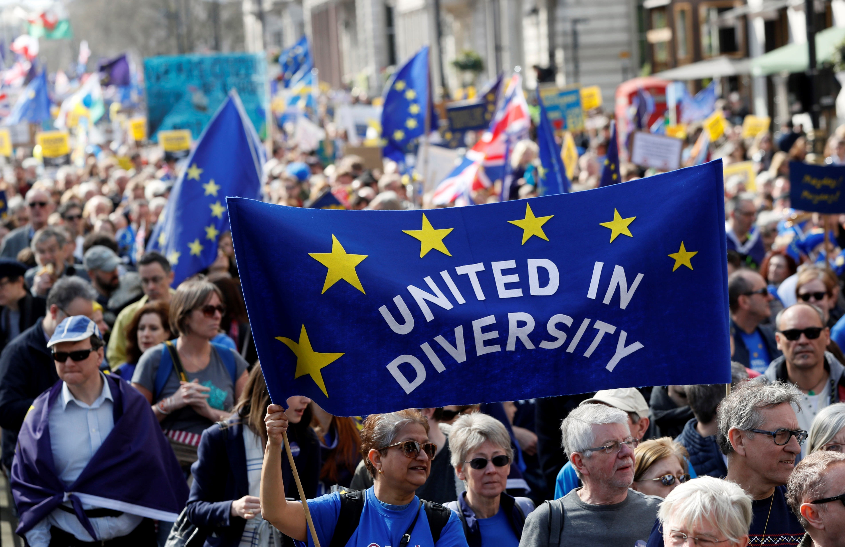
Chapter 5
Globalization and Transnationalism: Forces of Integration and Disintegration
Notes:
1

Slide 2
Chapter 5
Globalization and Transnationalism: Forces of Integration and Disintegration Topics
Causes and Conception of Globalization
Analyzing the Impacts of Globalization
Transnationalism: Actors and Movements
Continuity and Change in the Global System

Slide 3
Chapter 5
Learning Objectives
5.1 Identify the causes and conceptions of globalization.
5.2 Discuss the economic and cultural impact of globalization.
5.3 Discuss global civil society actors and the range of transnational strategies they employ.
5.4 Identify complex global and transnational forces as “new”, or recurring, features of global politics.

Slide 4
Causes and Conception of Globalization 1 of 7
Globalization; global forces, both positive and negative.
Globalization constantly impact our daily lives.
Globalization is shrinking the world allow people to interact faster and cheaper.
Notes:
While many may seen globalization as an abstract term, it constantly impact our daily lives, from the food we eat to the computer we use, our clothing all form part of a global process
Globalization is “shrinking the world” bringing people and places closer together more rapidly and more cheaply than ever before.

Slide 5
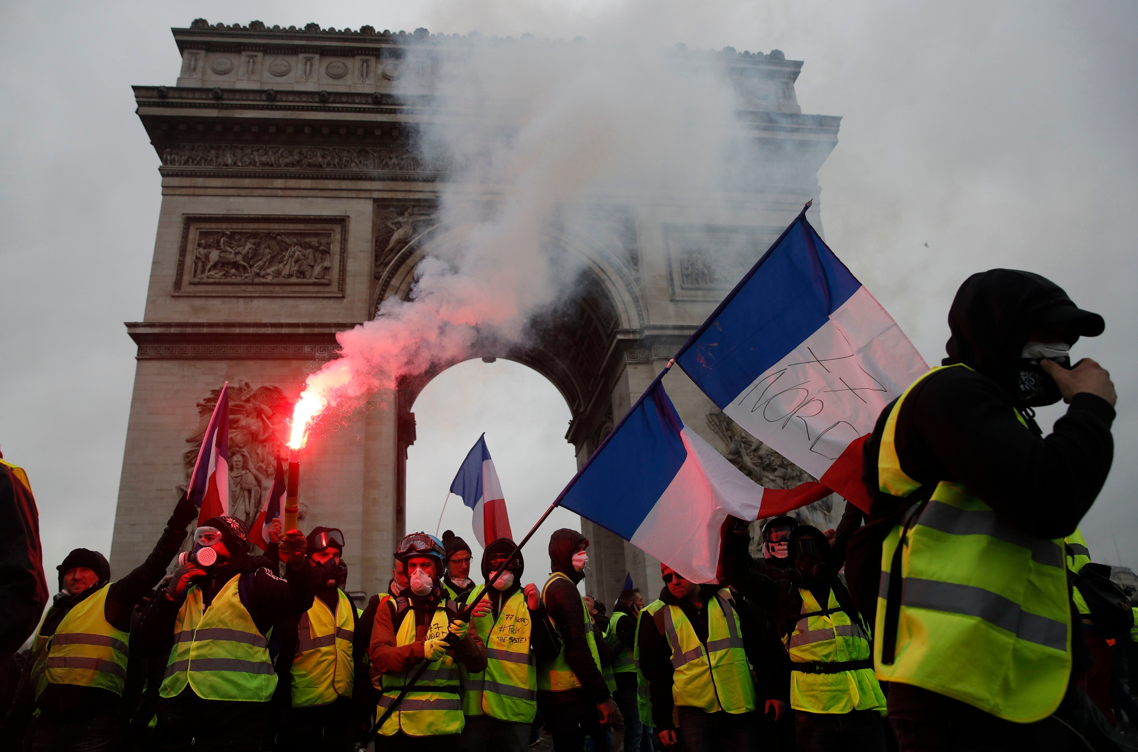
Causes and Conception of Globalization 2 of 7

Slide 6
Causes and Conception of Globalization 3 of 7
An Accelerating Political Force
Globalization is not a process new
War, colonialization, trade and investment are among the main agents of globalization the past 200 years.
Post World War II has increased globalization greatly especially with the end of the Cold War
Notes:
Globalization dates back as far as when isolated tribe began to interact through war, trade etc.
With the end of the cold War industrialized capitalism restructured the global economy and accelerated contemporary globalization.
Shift in government policies lead to greater liberalization and internationalization of economic, political and social transactions.

Slide 7
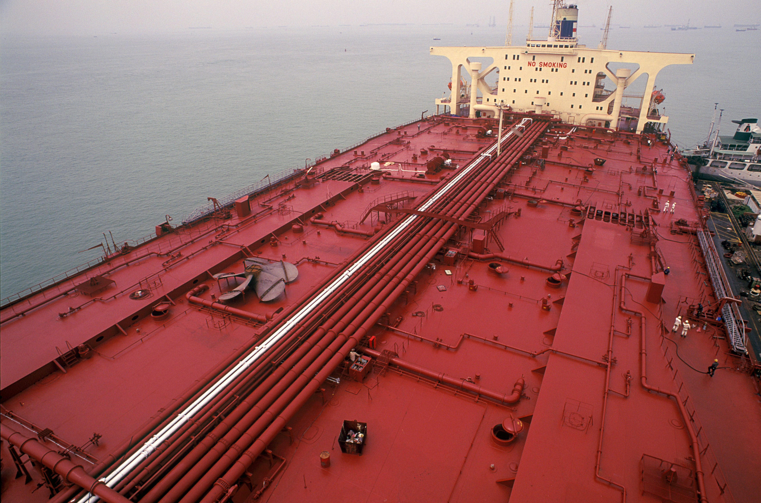
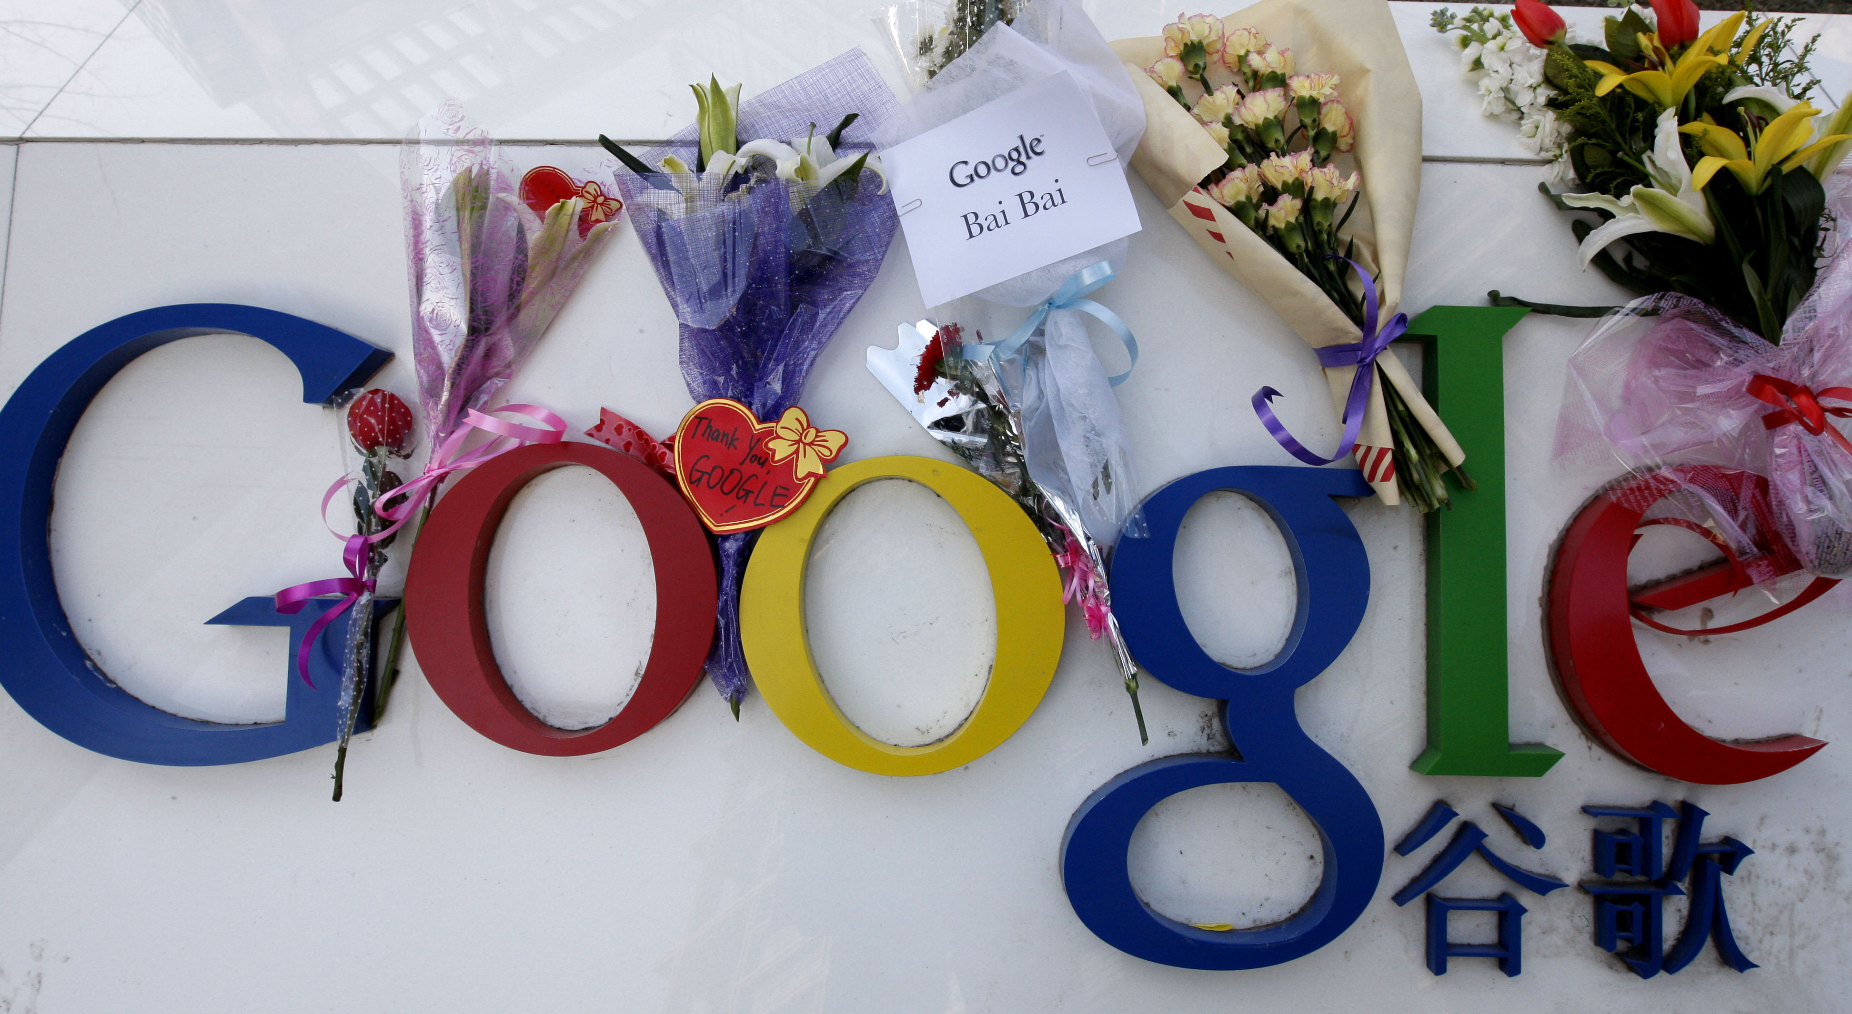
Causes and Conception of Globalization 4 of 7
An Accelerating Political Force
Technological advancement in transportation and communication has accelerate the movement of people, goods and services.
Notes:
Modern megaships, such as the tanker Jahre Viking, which at 1,504 feet long dominates the ocean. Crew members use bicycles to travel from on point to another.
Technological revolution in communication connects people globally. With digital media people can get access to news, interact with each other via social media and even organize politically as in the case of the Arab Spring.

Slide 8
Causes and Conception of Globalization 5 of 7
Interpretation of Globalization
In IR globalization has receive both criticism and support.
Opponents of globalization argue it is a new form imperialism and damages the environment.
Proponents of globalization argue that it creates integration, harmonization and facilitates democratic processes.

Slide 9
Causes and Conception of Globalization 6 of 7
Interpretation of Globalization
Complex Interdependence; neoliberal institutionalism that explains why states work together.
Dependency Theory; exploitative, with their origins in colonialism and imperialism
Notes:
Complex Interdependence is a Neoliberal institutionalism theory that sees globalization as a process in which states often cooperate through integration of economic, social and even political policies.
Dependency Theory, inspired by the work of Karl Marx argues that the global system is an exploitative and unequal relationship among countries.
Similar to colonialism and imperialism some countries dominate through capital intensive-industries and other countries providing cheap labor, agricultural production and resource-extraction economies essential to a capitalist system.

Slide 10
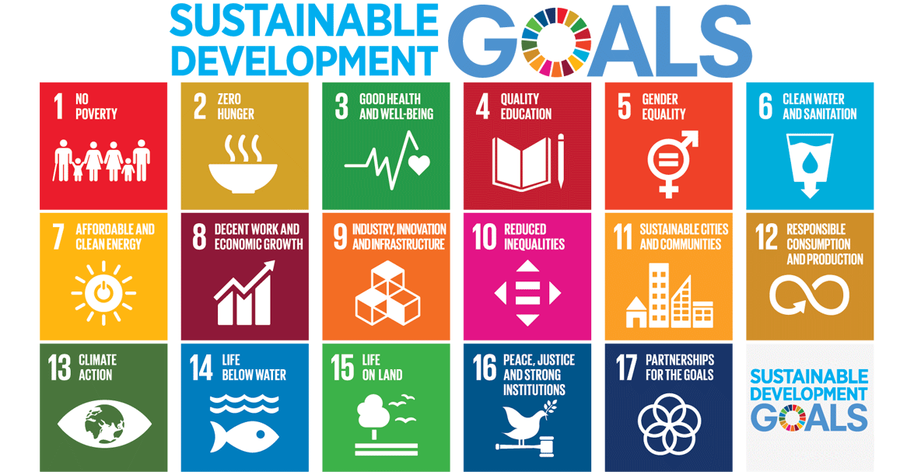
Causes and Conception of Globalization 7 of 7
Interpretation of Globalization
Notes:
The creation of the 17 Sustainable Development Goals (SDGs) is a good example of states working together.

Slide 11
Analyzing the Impact of Globalization 1 of 8
Globalization; positive or negative implications on economic, political, and cultural systems.
Globalization also impacts regional, national and local politics.

Slide 12
Analyzing the Impact of Globalization 2 of 8
Economic Globalization
Formal Sector; fostering growth and prosperity
Informal Sector; legal and illegal profit-based exchanges outside formal, market-based production.
Notes:
While the formal sector is often associated with economic growth, prosperity movement of cheap labor, the informal sector is overlooked by the normal indicators of economic growth such as GDP.

Slide 13
Analyzing the Impact of Globalization 3 of 8
Cultural Globalization
Cultural amalgamation vastly improve through better transportation and communication
Political theory; commonplace interaction increasing cultural commonalities among people creating global civil society.

Slide 14

Analyzing the Impact of Globalization 4 of 8
Cultural Globalization
Cultural Hybridity; integration process of other cultural traits whilst retaining some of its own

Slide 15
Analyzing the Impact of Globalization 5 of 8
Cultural Globalization
English is the most common language for business, diplomacy, and mass communication
Technologies such as google facilitate translation of many languages
Popular consumer goods narrow the cultural gap

Slide 16
Analyzing the Impact of Globalization 6 of 8
Arguments for Economic Globalization
Globalization → fewer international economic restrictions would → increase prosperity, thereby → fewer wars
Globalization → greater prosperity → more democracies → fewer wars
Globalization → increased interdependence → fewer wars.
Notes:
One sequence is globalization: reducing fewer international economic restrictions would → increase prosperity, thereby → decreasing a source of potential conflict among countries (Ikenberry, 2001)
Second Sequence:

Slide 17
Analyzing the Impact of Globalization 7 of 8
Concerns about Economic Globalization
Possible flawed argument to link prosperity directly to peace or indirectly through democratization to peace; e.g. Russia
Unequal distribution of global wealth

Slide 18
Analyzing the Impact of Globalization 8 of 8
Concerns about Cultural Globalization
Possible decrease in cultural diversity
Creating monoculture that one scholar has described as the eternal yawn of McWorld
Americanization of the world

Slide 19
Transnationalism: Actors and Movements 1 of 12
Transnationalism
A range of cross-border political identities and the social, economic and political links – and related activism – among people and private organizations that transcend the sovereign state.
Alternative to nationalism

Slide 20
Transnationalism: Actors and Movements 2 of 12
Global Civil Society
Global civil society goes beyond transnational linkages to include an expression of consciousness with a global reach
Notes:
Important to Global Civil Society are ideas, values, institutions, organizations, networks working beyond the boundaries of the state national markets, polities, and economies.

Slide 21
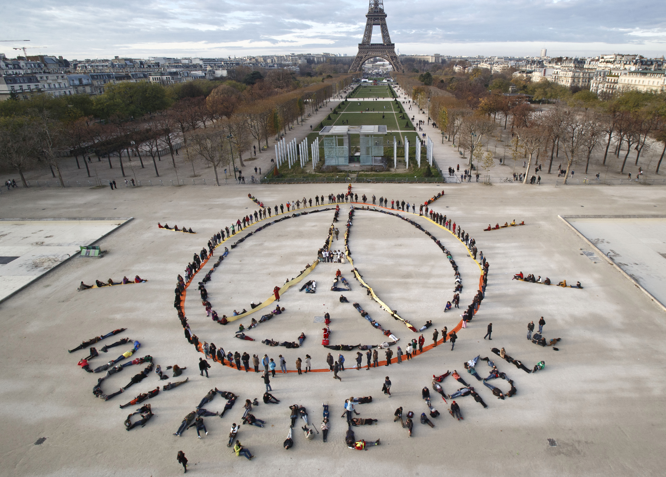
Transnationalism: Actors and Movements 3 of 12
Global Civil Society

Slide 22
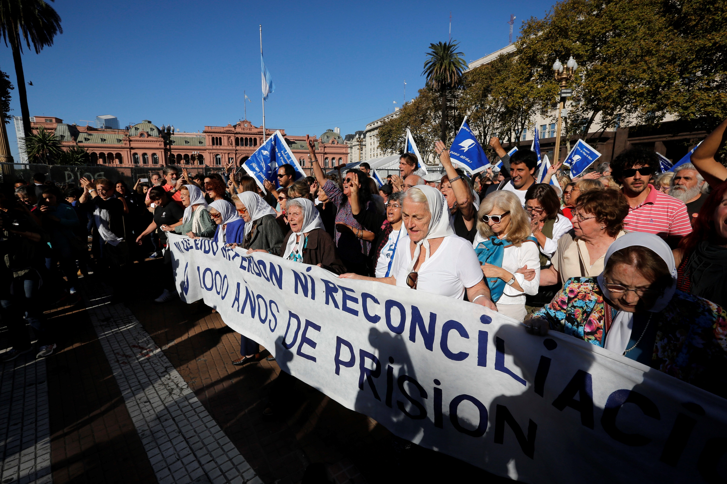
Transnationalism: Actors and Movements 4 of 12
Global Civil Society

Slide 23
Transnationalism: Actors and Movements 5 of 12
Transnational Advocacy Networks (TANs)
NGOs and IGOs that seek to foster domestic and global policy change through advocacy.
Issue areas include environment or human rights
Work through media, foundations, churches, trade unions, and other organizations

Slide 24
Transnationalism: Actors and Movements 6 of 12
Regional and Cultural Influences
Regional and cultural influence pay important role in transnationalism
68% of people from EU countries feel they are EU citizens
Pessimistic view of cultural transnationalism can result in a clash of civilization.

Slide 25
Transnationalism: Actors and Movements 7 of 12
Transnational Religious Movements
Emergence of Fundamentalism; rigid religious traditions
Fundamentalism prevalent in Abrahamic religions: Judaism, Christianity and Islam
Fundamentalism is evident in all major world religions

Slide 26
Transnationalism: Actors and Movements 8 of 12
Transnational Women’s Movement
Women most consistently marginalized group across the globe
1 out of 4 girls marries before age 18
Global #metoo movement exposed the sexual violence and harassment in all labor industries

Slide 27
Transnationalism: Actors and Movements 9 of 12
Transnational Women’s Movement
Transnational women’s movement advocates for economic and social development
International organizations are no less gendered
The UN, WTO, or the World Bank has not been headed by a woman

Slide 28
Transnationalism: Actors and Movements 10 of 12
Transnational Crime
Cheaper and faster transportation and communication has led to illegal activities
Transnational kleptocracy; state support of illegal money laundering schemes

Slide 29
Transnationalism: Actors and Movements 11 of 12
Transnational Crime
[Insert Map 5.1 about here]

Slide 30
Transnationalism: Actors and Movements 12 of 12
The Future of Transnationalism
Impossible to predict how far transnationalism will progress
Women’s movement seeks to promote differences
Race class and age

Slide 31
Continuity and Change in the Global System
Globalization presents multiple actors working on multiple space
Women’s movement provides a good example of bottom-up activism that goes beyond race, class, and gender
The works of Ester Ibanga and Shirin Ebadi act as inspirations for the women’s movement

Slide 32
Chapter 5
Review of Learning Objectives
5.1 Identify the causes and conceptions of globalization.
5.2 Discuss the economic and cultural impact of globalization.
5.3 Discuss global civil society actors and the range of transnational strategies they employ.
5.4 Identify complex global and transnational forces as “new”, or recurring, features of global politics.

