Slide 1

Armies of Deliverance
A New History of the Civil War
by Elizabeth R. Varon

Slide 2
Part I
Loyalism
Chapter 03
Sacred soil: Virginia in the summer of 1862

Slide 3
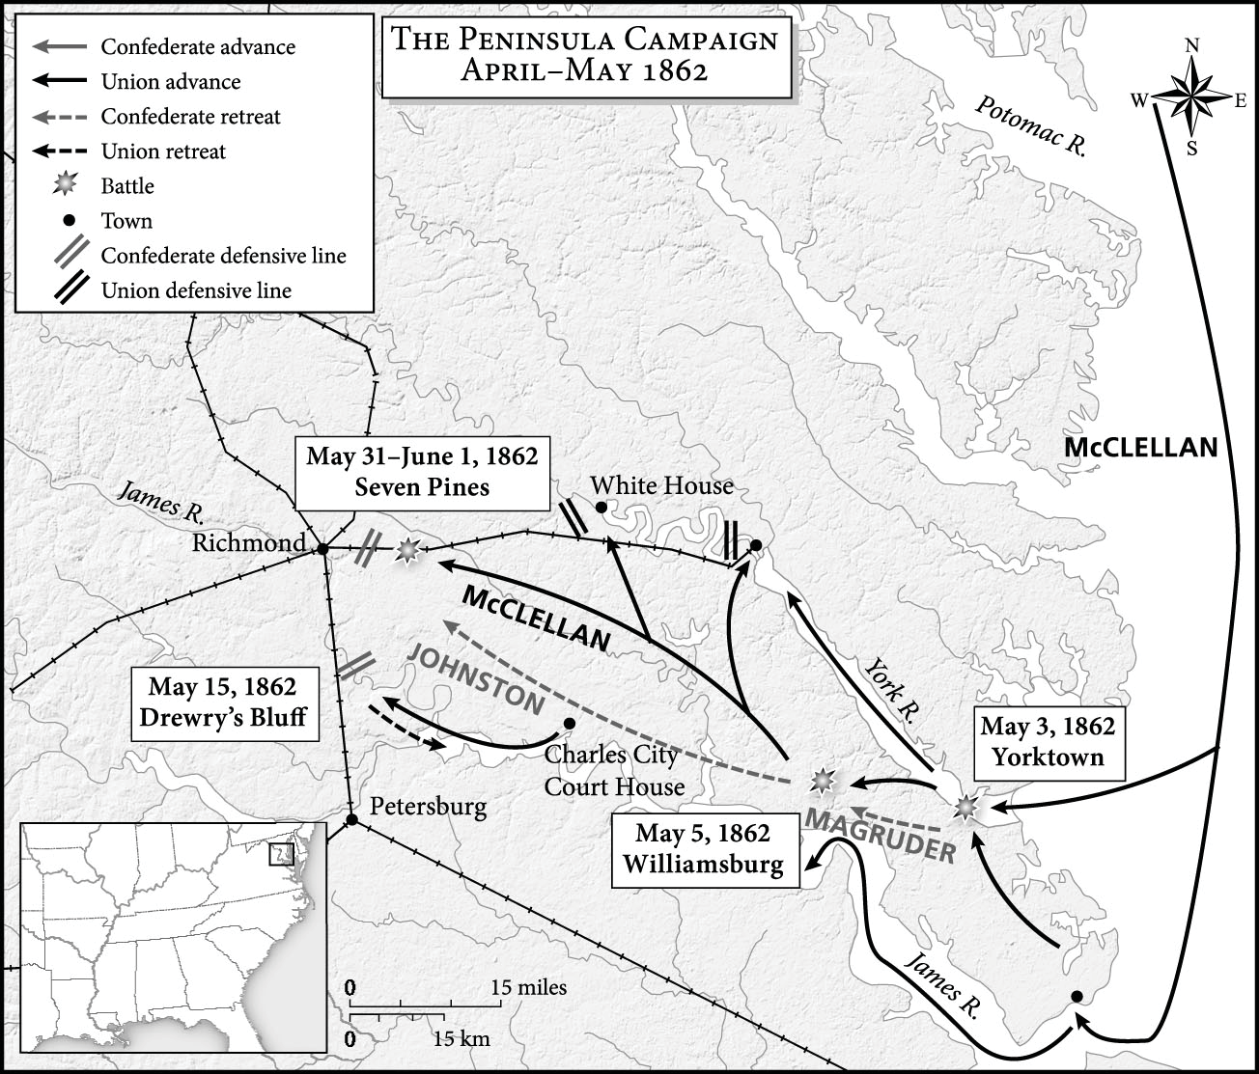
Map 3.1 The Peninsula Campaign, April-May 1862

Slide 4
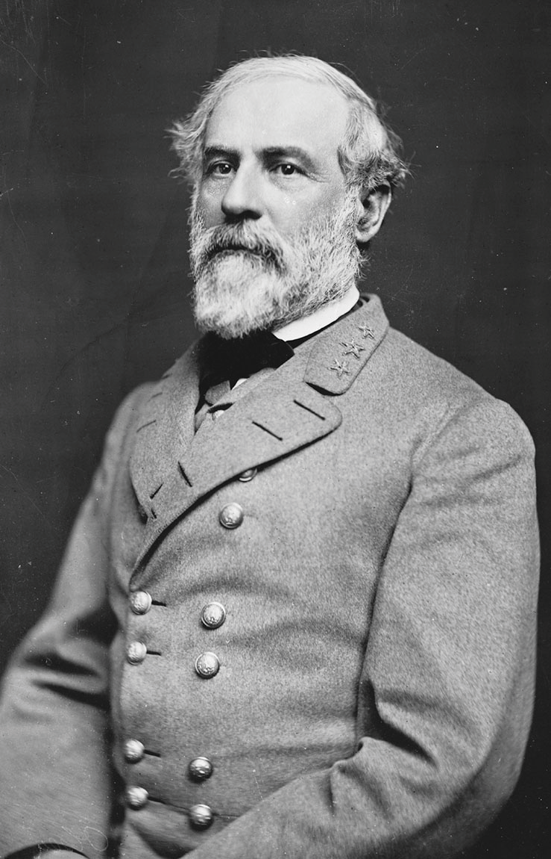

Slide 5
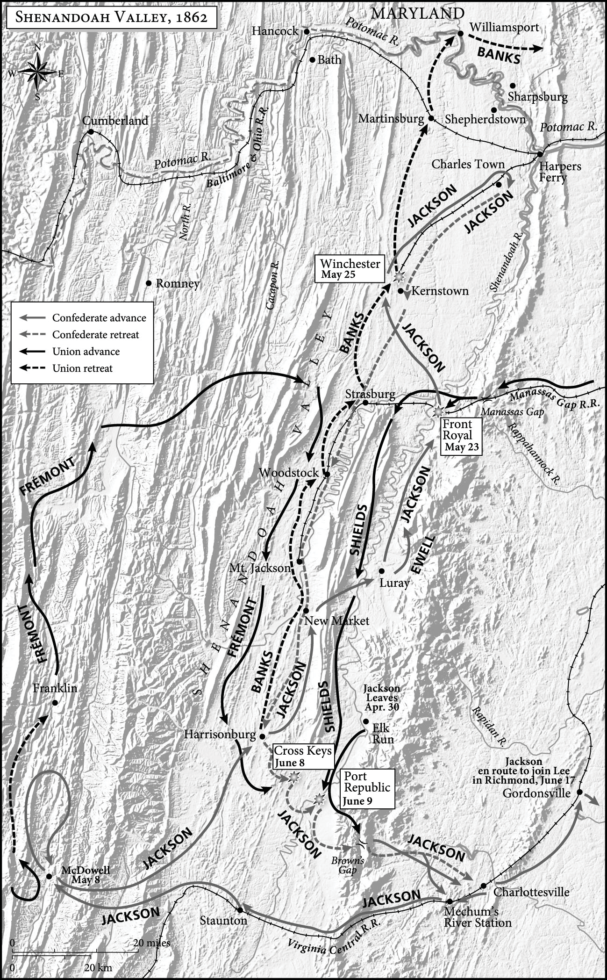
Map 3.2 Shenandoah Valley, 1862

Slide 6
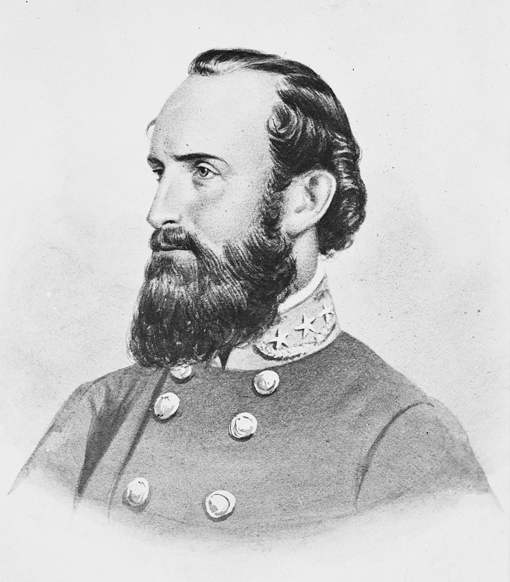

Slide 7
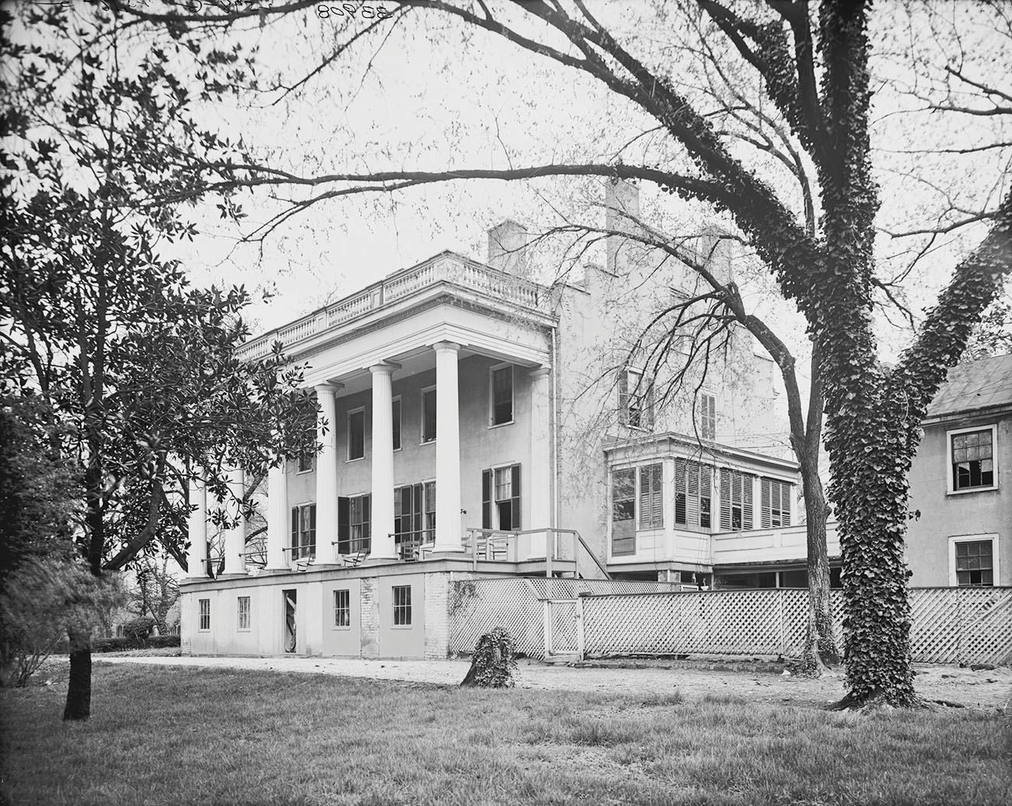

Slide 8
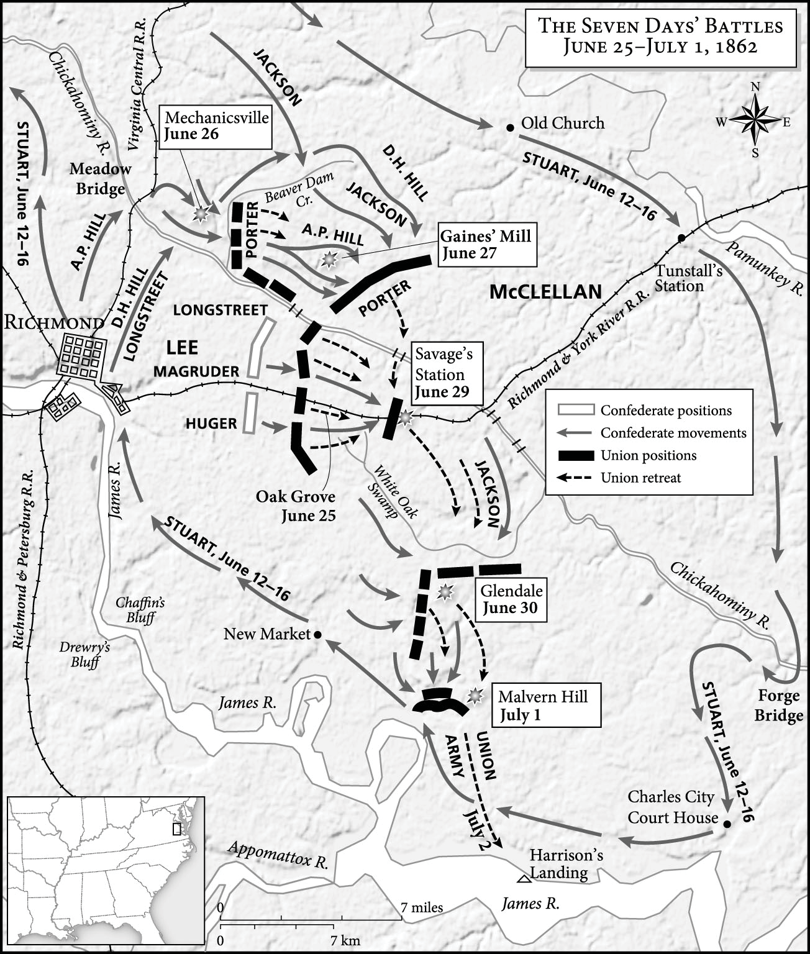
Map 3.3 The Seven Days’ Battles, June 25-July 1, 1862

Slide 9
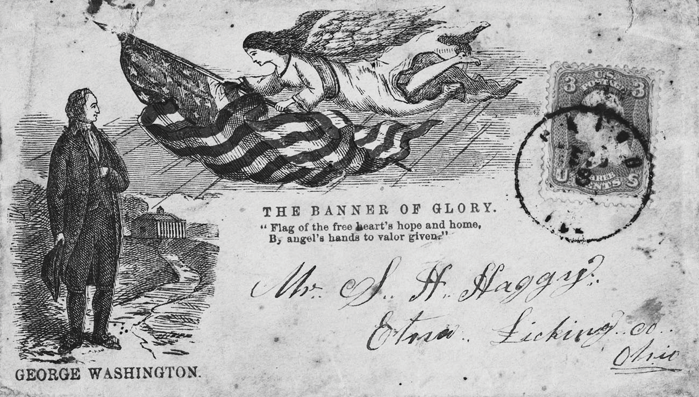

Slide 10
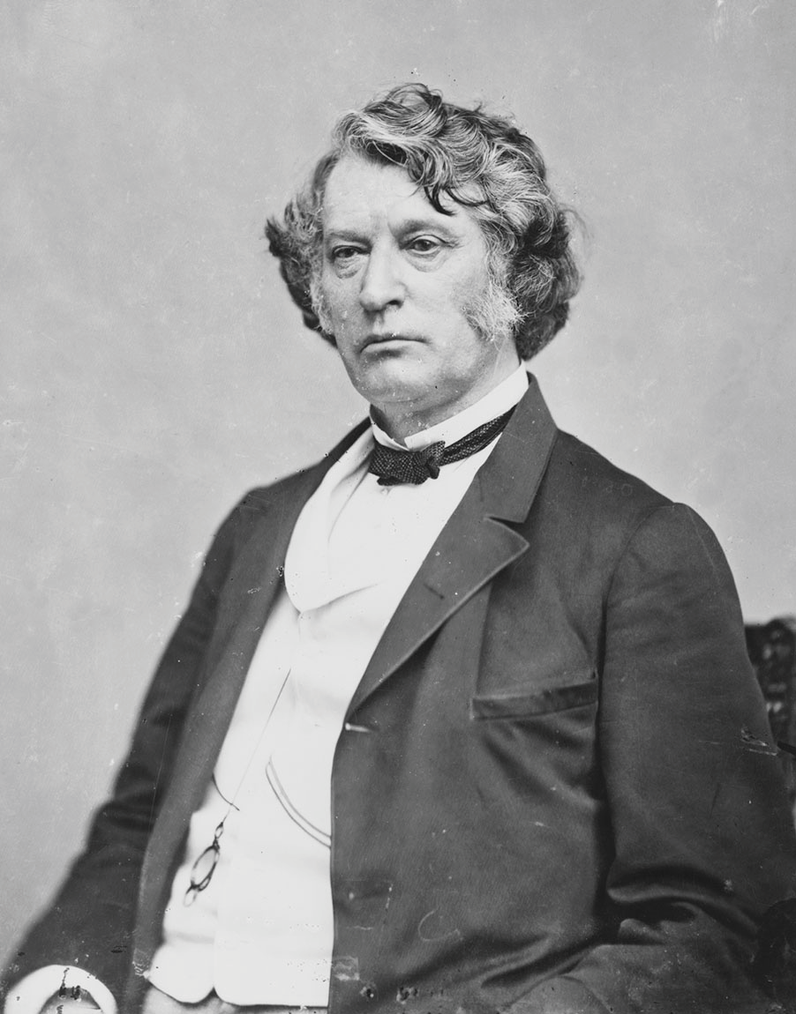

Slide 11
