Slide 1
Chapter 1
The Technological Society

Slide 2
Objectives
To understand the challenges in defining and studying technology
To obtain an overview of historical definitions of technology and their strengths and limitations
To learn about the complexity of defining technology as not merely material substance, but rather as a complex assemblage
To examine contemporary perspectives of technology that blur the boundaries of machine and human elements

Slide 3
Social and Ethical Dimensions
Examining the social side is essential as our society moves toward greater technological integration in many domains including health, education, transport, work, and commerce.

Slide 4
Social and Ethical Dimensions, cont’d
Ellul (1964) describes the changes as leading toward a technological society.
The technological society does not describe technology merely as a tool that exists as an extension of our human endeavours.

Slide 5
Case Study: Facebook Controversy
News broke in 2017 that Facebook potentially swayed voters during the 2016 US presidential election.
As this controversy evolved, three issues came to light:
  Russian propaganda
  Fake News
  Cambridge Analytica

Slide 6
Case Study: Facebook Controversy, cont’d
1) Russian propaganda
Links are suspected to Facebook pages potentially controlled by agencies in Russia with the aim of influencing public opinion in the US.
The Internet Research Agency, often referred to as a “troll farm,” has been identified as a source of misinformation with direct links to Russia.

Slide 7
Case Study: Facebook Controversy, cont’d
2) Fake news
Facebook has been accused of circulating fake news and making it difficult for users to identify truthful information from misinformation.
One problem is the use of clickbait, or sensationalized headlines, that peaks the curiosity of Facebook users.

Slide 8
Case Study: Facebook Controversy, cont’d
3) Cambridge Analytica
Through a third-party app, they were able to access information about 85 Million Facebook users, including psychological profiling, which allowed political ads to be micro targeted to users’ own political views and personality.

Slide 9
Case Study: Facebook Controversy, cont’d
The Facebook controversy shows how fake news can influence the political realm.
What are some other examples of ways fake news, or misinformation, is being used in social media?
What are the consequences of these examples?

Slide 10
Social Media & Misinformation
Fake news can affect many aspects of life including politics, health and well-being of communities.
The scandal has created some positive social change:
  how third-parties access and use the site;
  data sharing practices;
  increasing transparency and public scrutiny of companies.

Slide 11
What is Technology?
Defining technology presents a common challenge in that scholars have proposed many different definitions.
Socio-technical perspective: The study of how social factors affect technological and scientific developments.

Slide 12
What is Technology? cont’d
Technology has been defined as:
  Material substance
  Knowledge
  Practice
  Technique
  Society

Slide 13
1. Technology as Material Substance
Until recently, research on technology was carried out almost exclusively by technical/applied science fields.
When technology is treated as a physical entity—autonomous from its effects on society—it is referred to as material substance.
The material substance perspective limits our ability to fully understand the social change and impact technology has on society.

Slide 14
2. Technology as Knowledge
“Technology is based upon, utilizes, and generates a complex body of knowledge, part of which may reasonably be called specifically technological knowledge” (McGinn, 1978).
Artifacts are objects that have been modified, modelled, or produced according to a set of humanly imposed attributes.

Slide 15
Technology as Knowledge, cont’d
Limitations
  It does not consider that the knowledge required to create, utilize, and transform objects is a different entity than the object itself.
  It disregards the impact that technology has on society by limiting technology to expertise, skill, and understandings.

Slide 16
Technology as Knowledge, cont’d
Layton’s Model of Technology asserts that technology is not a single entity, but rather it embodies three main entities:
  Ideas (thought process that precedes the tool)
  Design (mediates the gap between abstract ideas and the object)
  Techniques (describes the actual artifact or technology)

Slide 17
Technology as Knowledge, cont’d
Advantages
  The definition of technology goes beyond just a consideration of the artifact.
  The model creates a link between how we visualize technologies and their actual realization.

Slide 18
3. Technology as Practice
Technology is more than just a set of artifacts but rather complex practices embedded in everyday activities.
This perspective emphasizes how technology becomes normalized within society over time.
Technology is thus a structuring force in how we live, play, and work.

Slide 19
4. Technology as Technique
Technology is examined in relation to human activity and describes an abstract concept and not an object.
It is not just a tool, but also a mechanism through which human needs can be achieved.
Habermas describes technology as a strategic action meant to provide a means for the realization of human goals.

Slide 20
5. Technology as Society
This definition takes consideration of technology and its interplay within society.
It not only acts with society, but in a way, it becomes society.

Slide 21
Making Sense of These Definitions
Each of the five different definitions of technology reviewed has its merits, helping us understand one aspect of technology.
Yet, no single definition can capture the full meaning of a particular concept.

Slide 22
Proposing a New Definition
Technology is an assemblage of material objects, embodying and reflecting society elements, such as knowledge, norms, and attitudes that have been shaped and structured to serve social, political, cultural, and existential purposes.

Slide 23
Proposing a New Definition, cont’d
This definition has four key advantages:
  It separates technology from society.
  It does not include technology as an element of society.
  It views technology as embodying and reflecting knowledge, social norms, social structures, etc.
  It also integrates the concept of sociomaterial assemblage.

Slide 24
Proposing a New Definition, cont’d
Do we need another definition of technology?
How would you define technology?

Slide 25
Contemporary Discussions of Technology
Three prominent conceptualizations of technology are:
  Simulation
  Augmentation
  Automation

Slide 26
Simulation
Artificial intelligence (AI) started as a discipline in the late 1940s.
The goal of AI is to replicate human faculties often including emotionality.
Turing Test
  This test aimed to test a machine’s potential to show intelligent behaviour.
  It aimed to assess a human’s ability to differentiate between human and machine intelligence.

Slide 27
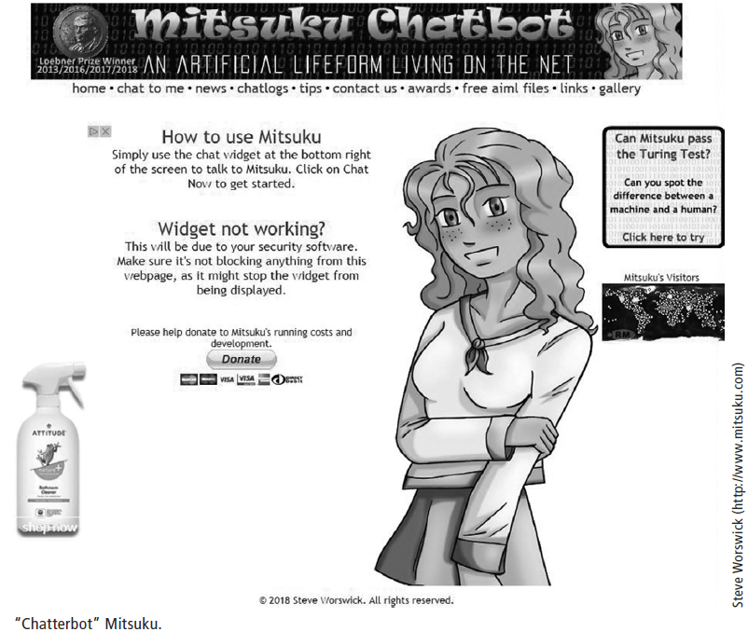
Simulation, cont’d

Slide 28
Augmentation
Rather than leaving the human figure behind, the physical body is augmented by connecting it to digital components.
This can occur in many different ways, notably through wearable computing.
The cyborg concept has moved from the annals of science fiction into the mainstream.

Slide 29
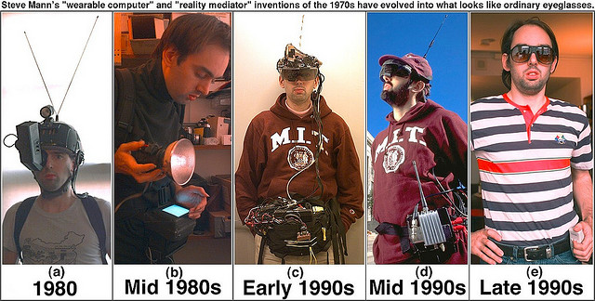
Augmentation, cont’d
Mann, S. Evolution of Steve Mann’s “wearable computer” Invention. [Image]. Retrieved from http://wearcam.org/

Slide 30
Augmentation, cont’d
What is transhumanism?
Why is it controversial?
What is your opinion about the merger of human and technological?

Slide 31
Automation
The design and implementation of machinery to a process or procedure with little or no human intervention.
Discussions of automation in the 1950s tended to view machines as better alternatives to human labour.
Automation was neither cost-efficient nor problem-free as often assumed, the costs and problems that arise from automation are different in nature.

Slide 32
Automation, cont’d
Often the term disruptive technologies is used to describe the transformative effect of these technologies.
Disruptive technologies are those that not only create social change, but exercise radical change, change that is transformative in nature.

Slide 33
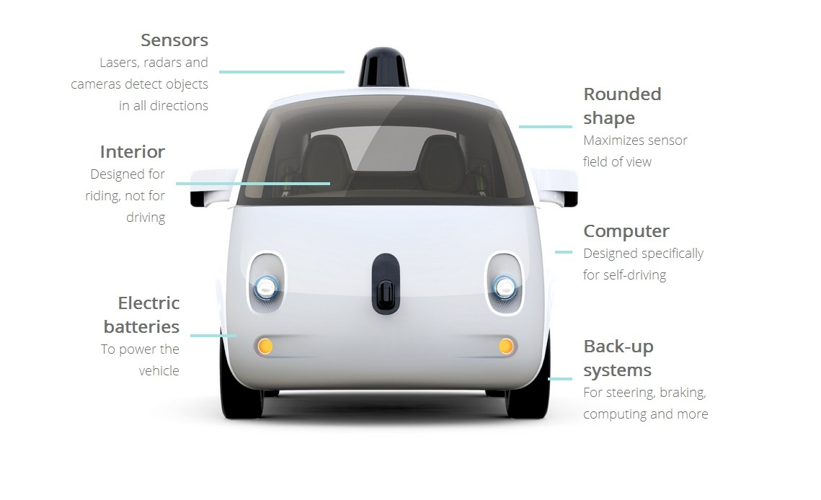
Case Study: Driverless Cars
Google’s Koala Car (Image) Retrieved from https://www.buddhilive.com/2015/09/google-koala-start-traveling-in-austin.html

Slide 34
Challenges in This Area of Study
There are 6 major challenges in the study of technology and society:
  Rapid technological advances
  Unprecedented social change
  Direction and type of effect
  Target groups
  Changing uses
  Ethical dilemmas

Slide 35
1. Rapid Technological Advances
Technology evolves at a rapid pace.
A single invention can lead to an infinite number of further developments.

Slide 36
2. Unprecedented Social Change
Technological change affects many aspects of social, cultural, and economic life.
Studying these changes is difficult because it is not easy to capture new forms of behaviour.
To assess the full impact of technology on society we need to develop new theories and forms of measurement that complement existing ones.

Slide 37
3. Direction and Type of Effect
Determining the direction of the effect is problematic because it is difficult to determine the extent to which technology affects society.
In many cases no directional effect can be observed because technology becomes normalized and is then part of everyday life.

Slide 38
4. Target Group
Many social changes associated with technology are specific to a particular social group.
The particulars of a social group have to be examined to understand how that group is appropriating the technology and how the technology has an impact on the group members’ lives.

Slide 39
5. Changing Uses
A single technology often mutates into serving multiple purposes.
The cellphone is one such example. It began as a portable device to communicate independent of location yet quickly transformed into a multi-function tool.

Slide 40
6. Ethical Dilemmas
As technologies evolve and become automated, new ethical dilemmas emerge that were not present in simpler technologies that had no agency.
Addressing ethical dilemmas becomes an important aspect of technological adoption and study.

Slide 41
Conclusion
The level of interaction and integration between technology and society continues to grow at a rapid pace.
This shift has altered human existence in ways not imaginable in the not-so-distant past.
The rationalization, critique, and characterization of technology by those in Generation Z (born 1990–2010) will be especially interesting considering their unique position and dependence upon technology.

