Slide 1

Medieval Europe by Judith M. Bennett and Sandy Bardsley

Slide 2
Chapter 03
The Byzantine Empire, c. 500–1000

Slide 3
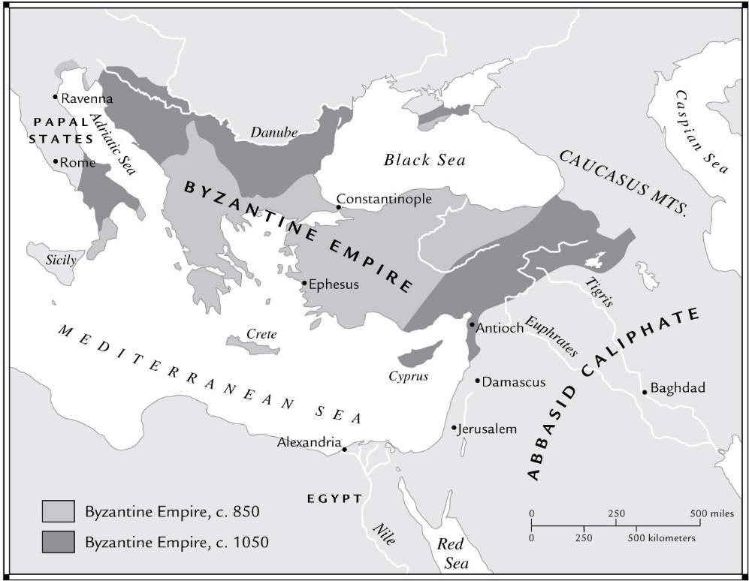
Map 3.1 Byzantine Retrenchment and Expansion, c. 850–1050

Slide 4
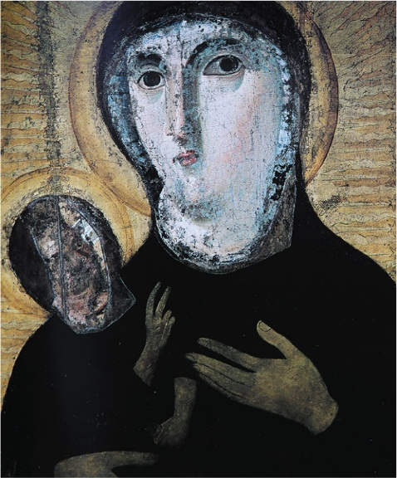
Figure 3.1 Byzantine Icon Depicting the Madonna and Child

Slide 5
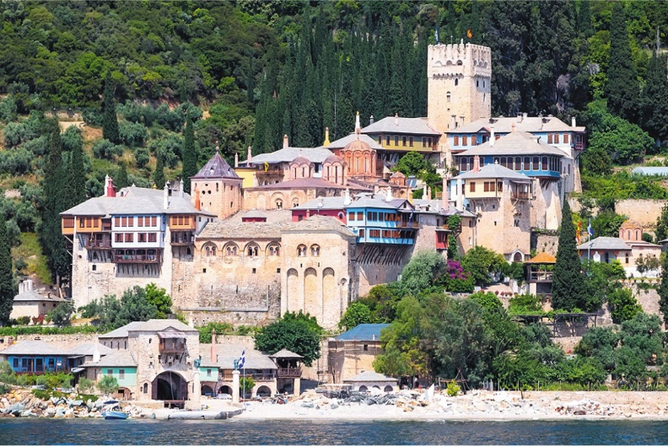
Figure 3.2 A Monastery on Mount Athos

Slide 6
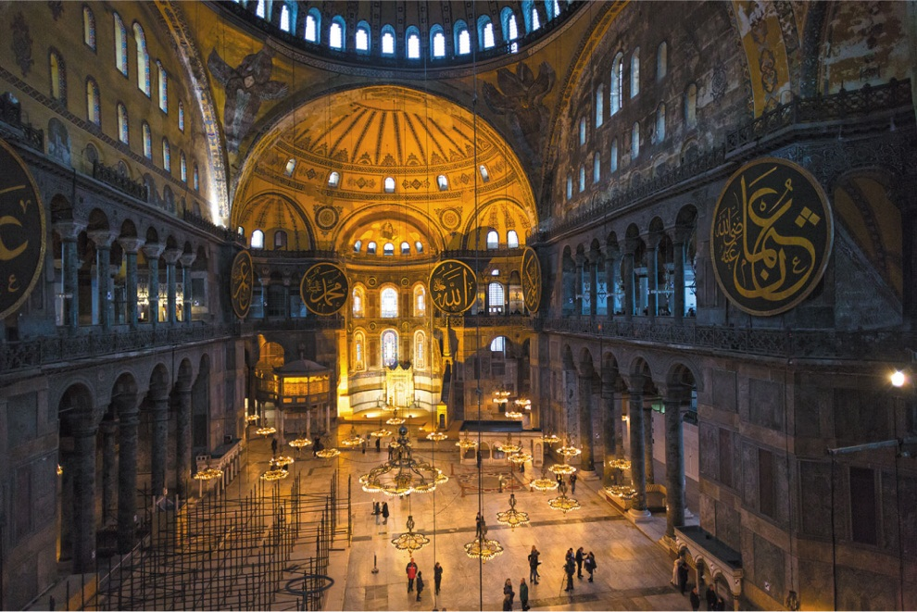
Figure 3.3 Interior of Hagia Sophia, Constantinople

Slide 7
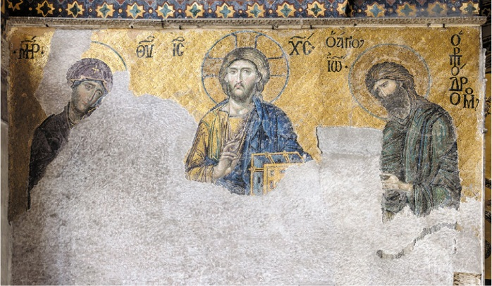
Figure 3.4 Jesus, a Mosaic from Hagia Sophia

Slide 8
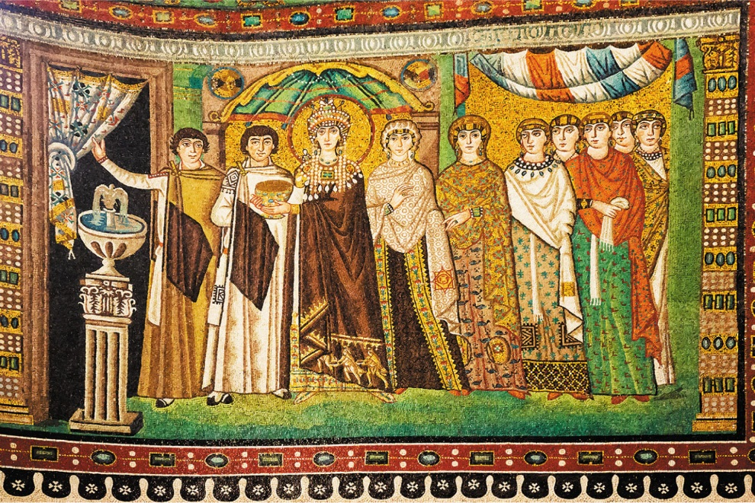
Figure 3.5 The Empress Theodora

