Slide 1

The Principles Of Equity & Trusts by Graham Virgo Qc (Hon)

Slide 2
Part I
Equity
Chapter 03
An Introduction to the Trust

Slide 3
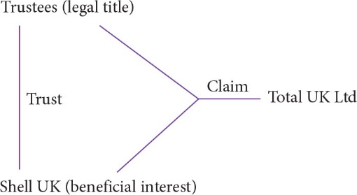
Figure 3.1 Shell UK Ltd v Total UK Ltd

Slide 4
Part II
The Express Trust
Chapter 04
The Requirements of an Express Trust

Slide 5
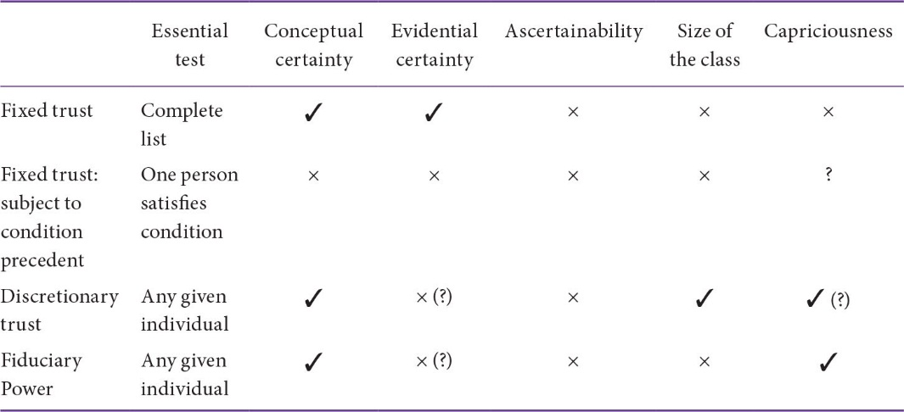
Table 4.1 Tests relating to certainty of objects

Slide 6
Part II
The Express Trust
Chapter 05
Formalities

Slide 7
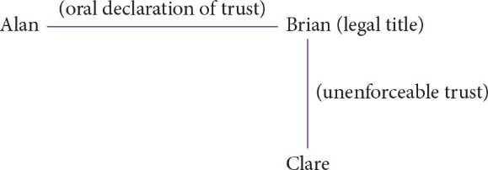
Figure 5.1 Oral declaration of trust of land

Slide 8
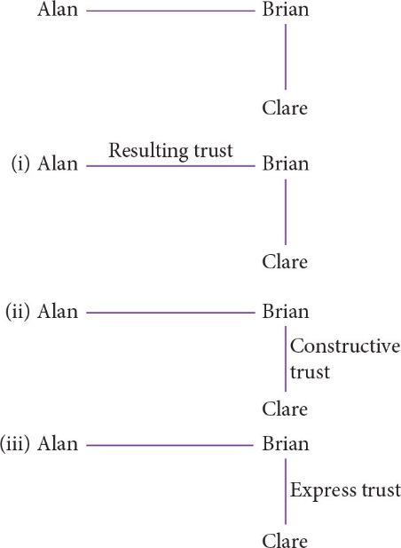
Figure 5.2 Responses to oral declarations of trust of land

Slide 9
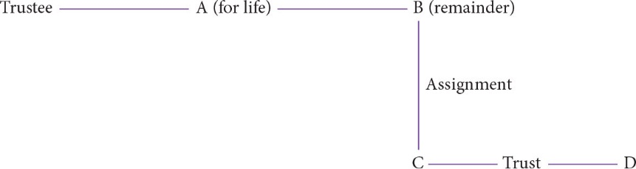
Figure 5.3 Kekewich v Manning

Slide 10
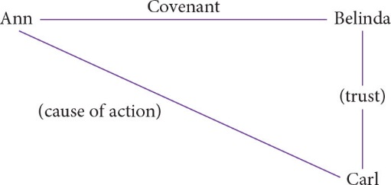
Figure 5.4 Covenants to settle property on trust

Slide 11
Part IV
Implied Trusts
Chapter 08
Resulting Trusts

Slide 12
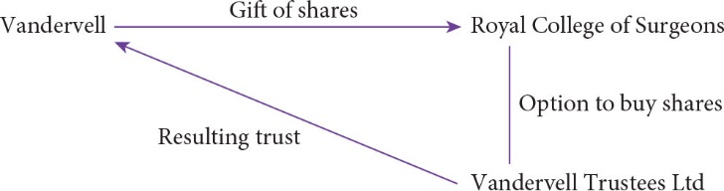
Figure 8.1 Vandervell v IRC

Slide 13
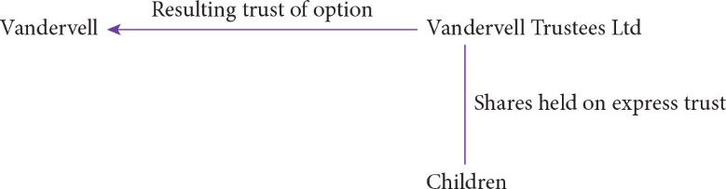
Figure 8.2 Re Vandervell’s Trusts (No 2)

Slide 14
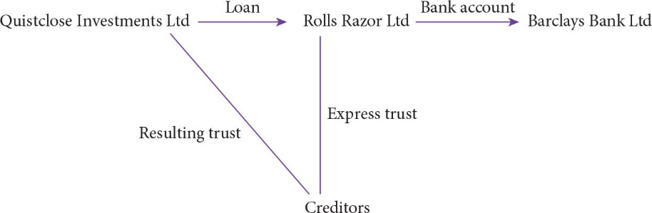
Figure 8.3 Barclays Bank Ltd v Quistclose Investments Ltd

Slide 15
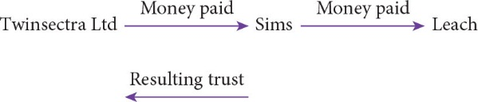
Figure 8.4 Lord Millett’s analysis in Twinsectra Ltd v Yardley

Slide 16
Part V
Beneficiaries
Chapter 11
Beneficiaries

Slide 17
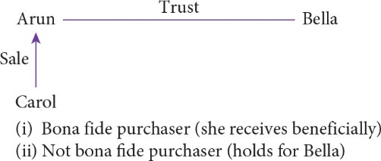
Figure 11.1 Bona fide purchaser for value

Slide 18
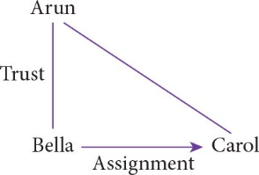
Figure 11.2 Assignment of equitable interest

Slide 19
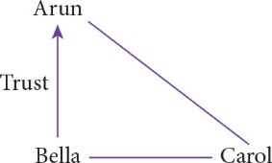
Figure 11.3 Direction to trustee to hold for another

Slide 20
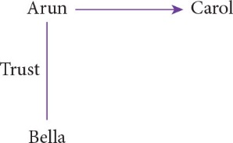
Figure 11.4 Transfer of property absolutely

Slide 21
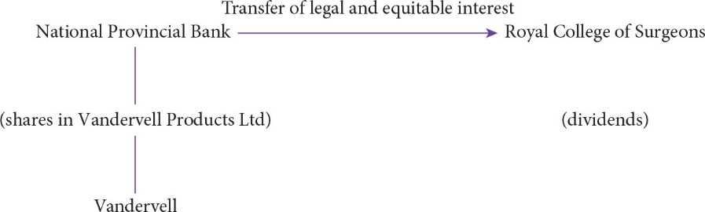
Figure 11.5 Vandervell v IRC

Slide 22
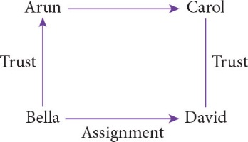
Figure 11.6 Transfer of property to be held on trust

Slide 23
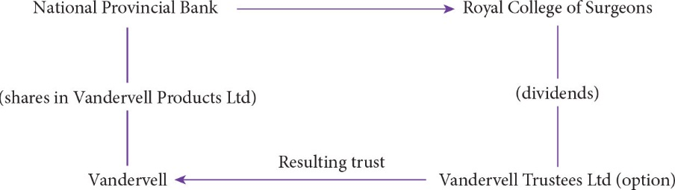
Figure 11.7 Vandervell v IRC

Slide 24
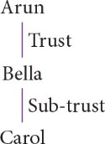
Figure 11.8 Declaration of sub-trust

Slide 25
Part VIII
Breach of Trust and Fiduciary Duty
Chapter 17
Liability for Breach of Trust and Fiduciary Duty

Slide 26
Figure 17.1 The typical context of a trust

Slide 27
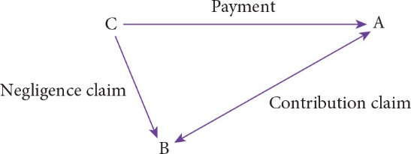
Figure 17.2 Friends’ Provident Life Office v Hillier Parker May and Rowden

Slide 28
Part VIII
Breach of Trust and Fiduciary Duty
Chapter 19
Proprietary Claims and Remedies

Slide 29
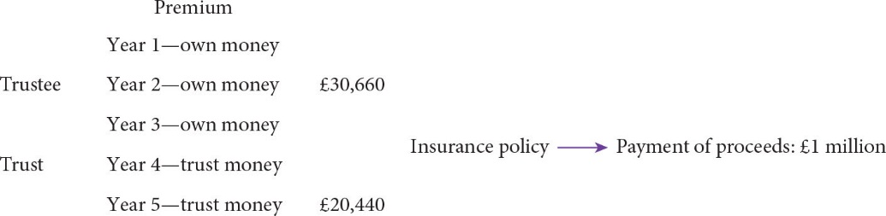
Figure 19.1 Foskett v McKeown

Slide 30
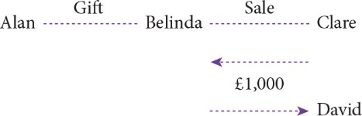
Figure 19.2 Election

Slide 31
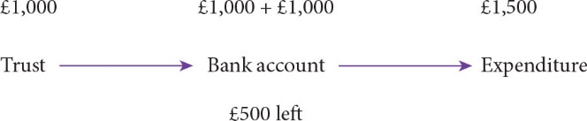
Figure 19.3 Lowest intermediate balance rule

Slide 32
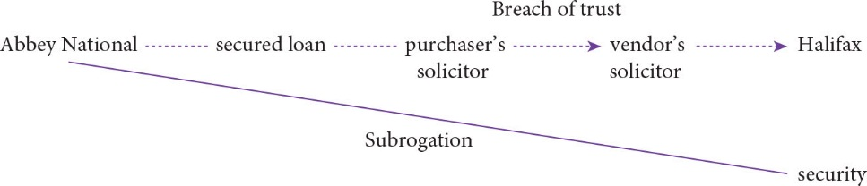
Figure 19.4 Boscawen v Bajwa

Slide 33
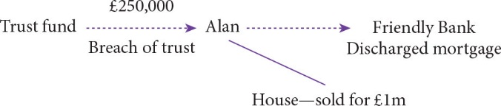
Figure 19.5 Operation of proprietary remedies

