Slide 1
An Introduction to Political Life
Chapter 1

Slide 2
Overview
What is politics?
Power
State and government
Democracy
Who gets heard and why?
Consent and legitimacy
Political identities
Political fault lines: old and new

Slide 3
Introduction
Nobody likes politicians
  Politicians have an image problem: we don’t trust them
  Lack of trust → cynicism → apathy
  Is this fair?
Politics is a “messy” activity
Politics is about balancing competing interests and views

Slide 4
What is Politics?
Politics arises from the fact of scarcity
  It is the activity by which rival claims are settled by public authorities
Consider the different definitions of politics in Box 1.1
  They agree that politics is about power
  They disagree about what power relations count as political
Political conflict is about where to draw the line between public and private realms
  What is a proper matter for public debate and decision? What should be left private?

Slide 5
Power
The ability to influence what happens
This ability is not restricted to government
Why should you obey? Three reasons or “faces of power”
1. Coercion (force)
2. Influence (persuasion)
3. Authority (legitimate)

Slide 6
Power, cont’d
Democracies rely mainly on influence and authority, but coercion is also used
  Every democracy has courts, police, and prison
How far can a democracy rely on coercion?
  The 1970 FLQ Crisis in Quebec: PM Trudeau says, “Just watch me”
  See CBC Archives video available on the Student Companion Site

Slide 7
Power, cont’d
In a democracy, those in power must justify their use of the state’s authority as being necessary to maintain such values as freedom, equality, justice, and the rule of law
People inevitably disagree over how much coercion, and in what circumstances, is acceptable to maintain these values
  9/11 and Canada’s Anti-Terrorism Act (Dec 2001)

Slide 8
State and Government
The state is a broader concept than government; keep them distinct
  Three main characteristics of a state:
    Territorial boundaries
    Complex set of institutions that wield public authority (ex. The courts)
    Defined in terms of power
Politics in a democracy is mostly about influencing and changing the government, not the state

Slide 9
State and Government, cont’d
On whose behalf does the state act? Political science offers four answers:
  Pluralism: the state responds chiefly to the demands of those groups that are best organized, have superior financial resources, can credibly claim to speak on behalf of large numbers of voters or segments of the population, and are successful in associating their special interests with the general interests of society.
  Class analysis: Marxist; the state in capitalist societies is an instrument through which the small minorities who control most of society’s wealth maintain their social and economic dominance. While subordinate classes do have some influence on state decision-makers, their influence is sharply limited by a number of factors, including a lack of class consciousness that stems from widespread acceptance of capitalist and individualist values as normal and inevitable.

Slide 10
State and Government, cont’d
  Feminism: the state is inherently patriarchal – the state, its structures, and its laws all serve to institutionalize male dominance. Increasing the representation of women in elected legislatures, the bureaucracy, and the courts, and creating governmental bodies and programs that recognize women as a group with interests and needs that are not identical to those of men can lessen this male dominance.
  Postmodernism: the state is an essentially oppressive and even repressive institution; that oppression may be targeted at groups based on their race, gender, ethnicity, sexual preference, or some other trait that places them outside the dominant group that controls the levels of state power; those that embrace this approach are called the New Left.

Slide 11
State and Government, cont’d
Government refers to those who are elected to power
  In a democracy governments are chosen and removed through elections
In a democracy we may oppose the government, but still accept its decisions as legitimate – Why?
  Because the rules and institutions that make up the state are accepted as reasonable
Government popularity and state legitimacy are not the same thing
  Unpopular Prime Ministers are still legitimate Prime Ministers

Slide 12
State and Government, cont’d
In a democracy, when is it legitimate to challenge the authority of the state?
Civil disobedience: defying the law in defence of a cause, principle, or an oppressed group
Debate over civil disobedience has resurfaced, principally around issues associated with globalization and income inequality, but also systemic racism

Slide 13
State and Government, cont’d
Government that relies primarily on threats and violence to maintain its rule is generally unstable
Totalitarianism: a system of government that suppresses all dissent in the name of some supreme goal
  Distinctions between the state, government, and society lose all meaning – indeed, they are considered to be subversive – under totalitarianism

Slide 14
State and Government, cont’d
The theory of cultural hegemony says legitimacy and consent are illusions:
  The dominant class is able to get its values and beliefs accepted as “normal”
  The dominant class controls the creation and spread of ideas, information, and images
  People who believe the state is legitimate suffer from “false consciousness”

Slide 15
Democracy
Is democracy a system of government, or does it connote a type of society?
Canada and the US claim to be democracies, but so do North Korea, China, and Iran
Turkey and Indonesia are cited as examples of a new model, Muslim democracy

Slide 16
Democracy, cont’d
Basic features include government by consent, one person–one vote, competitive elections
  But this is not enough!
Democracies protect minorities against the majority
  An important safeguard: a culture which promotes tolerance of social diversity
The concept of social capital: strong sense of civic duty, social trust
  Stable democracies such as Canada have high levels of social capital

Slide 17
Democracy, cont’d
Legal equality does not guarantee political equality
Socio-economic inequality → political inequality
  Inequalities are often claimed to undermine the democratic character of societies whose formal political institutions are based on the equality of citizens
  Is Canada a real democracy?

Slide 18
Democracy, cont’d
In modern democracies the people do not directly govern
Instead we elect our representatives, and delegate law-making power to them
  We hold them accountable through periodic elections
But most of us spend little time thinking carefully about government and are poorly informed… or to put it less politely, are ignorant

Slide 19
Democracy, cont’d
The US and Switzerland combine representative democracy with direct democracy
  Plebiscites and referendums – direct votes of citizens on important public questions
  Frequently held elections
  Choosing judges and some administrative officials through election
  “Recall” elections

Slide 20
Democracy, cont’d
Respect for rights and freedoms generally considered a distinguishing feature of democratic government
  However, protecting these rights or freedoms can sometimes produce undemocratic outcomes
Freedom House promotes the World Democracy Audit which rates countries against a checklist
  Combines measures of political rights, civil liberties, press freedom, public corruption, and the rule of law
  How does Canada rank? (See Box 1.3)

Slide 21
Democracy, cont’d
The rule of law is the foundation of all democratic government:
  No one, no matter how powerful or rich, is above the law
  Public officials can only exercise powers granted by law
  If public officials abuse their powers, they can be checked by an independent judiciary

Slide 22
Who Gets Heard, When, and Why?
Access to key decision-makers is not equally distributed in Canadian society
  Top corporate executives can phone a cabinet minister and expect a return call
Interest groups compete to influence government, change public opinion in their favour, and get their issues on the public agenda
  This is not cheap—money talks!

Slide 23
Who Gets Heard, When, and Why? cont’d
The public agenda is the matters that have been identified by opinion leaders in the media and in government as ones that warrant some policy response
Do the media challenge the powerful and well-connected?
Getting heard is not only or always a matter of money

Slide 24
Is Democracy a Process or an Outcome?
Is democracy about the right of citizens to participate by voting and electing governments? Elected officials being held accountable on election day?
  If you say yes to the above, you may believe democracy is about the right process
Should non-elected judges be allowed to make decisions about controversial issues?
  If you say yes to the above, you may believe democracy is about reaching the right outcome
Which do Canadians believe? Process or outcome?
  A bit of both

Slide 25
Political Identities
An identity is a state of mind, or a sense of belonging to a larger group defined by language, ethnicity, gender, religion, history, beliefs, or location
Identities can shape an individual’s behaviour and ideas
When individuals with a shared identity organize to lobby governments to recognize their common interests, the result is identity politics
  Governments play an important role in recognizing, defining and promoting political identities—see Box 1.4 for examples

Slide 26
Political Identities, cont’d
The nation has been a particularly crucial political identity in Canadian politics
  But the meaning of the term is hotly contested
  See Box 1.5
Nationalism usually is accompanied by territorial claims
  The nation is associated with some particular territory (“the homeland”) that is argued to belong to the members of the nation
  Territorial demands justified by the democratic right of any “people” to self-determination

Slide 27
Political Identities, cont’d
The concept of class has experienced a comeback
  Linked to the phenomenon of globalization
    the unprecedented integration of the world’s economies through trade, capital flows, and internationalized production;
    cultural integration through mass media, marketing, satellite- and computer-based information technologies, and migration

Slide 28
Political Fault Lines, Old and New
The three enduring axes of Canadian politics:
  French/English
  Canada/United States
  Central Canada/outer regions
Re-emergence of a political fault line that was assumed to be quite muted in Canada and the US:
  Class conflict and the politics of the distribution of wealth
  However, it is unclear that activism related to these issues has awakened a sense of class consciousness in the general population

Slide 29
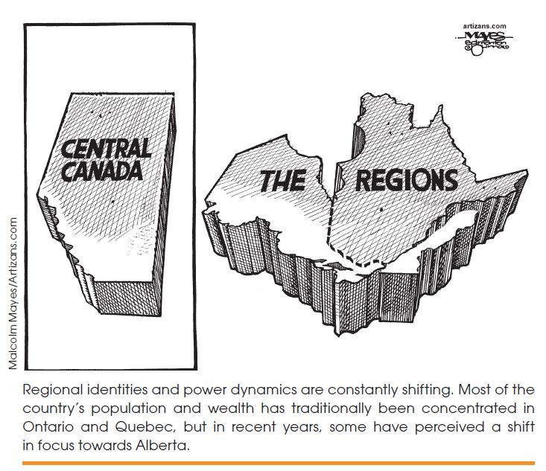
Political Fault Lines, Old and New, cont’d

Slide 30
Summing Up
Which processes, institutions, values and outcomes are necessary before we can say a society is democratic?
The definitions of democracy, power, the state, the nation = contested
What are the new dividing lines in Canadian politics?

