Slide 1
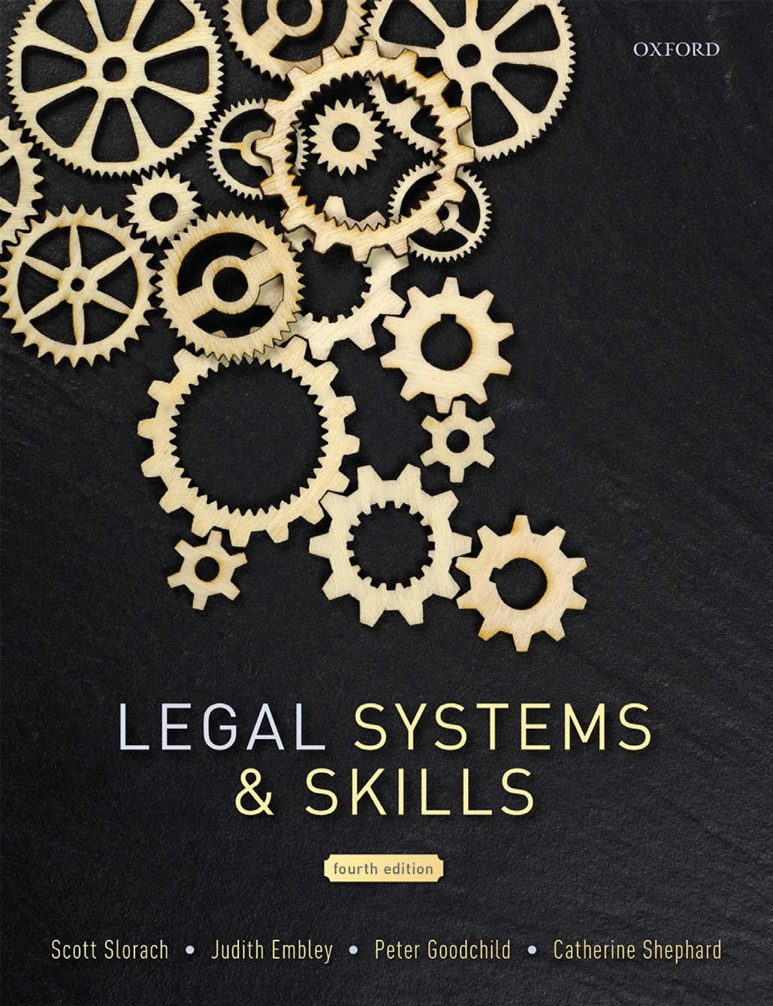
Legal Systems & Skills
by Scott Slorach, Judith Embley, Peter Goodchild and Catherine Shephard

Slide 2
Part 1
Legal Systems
Chapter 03
The court system of England & Wales

Slide 3
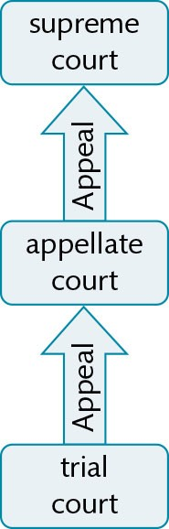
Figure 3.1 Generic appeals system

Slide 4
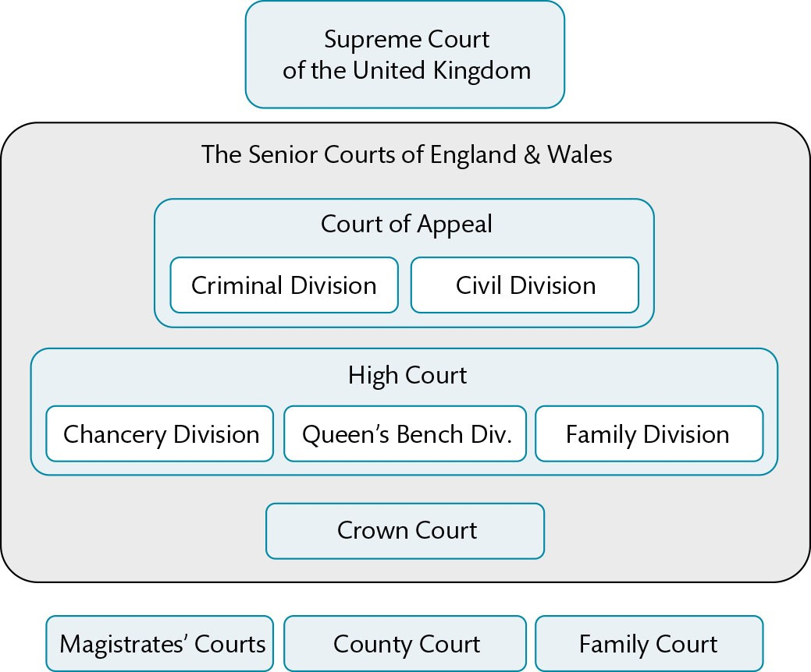
Figure 3.2 The courts of England & Wales

Slide 5
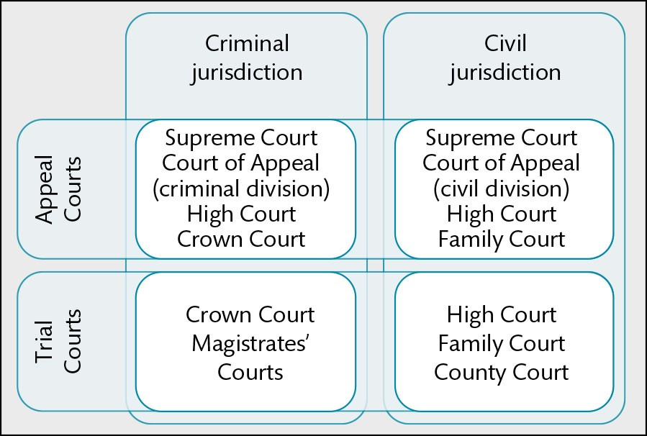
Figure 3.3 Thematic categorisation of courts in England & Wales

Slide 6
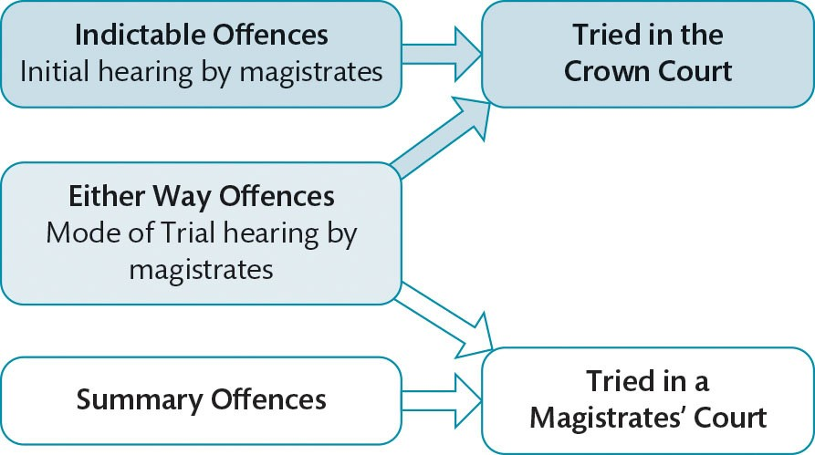
Figure 3.4 Criminal mode of trial

Slide 7
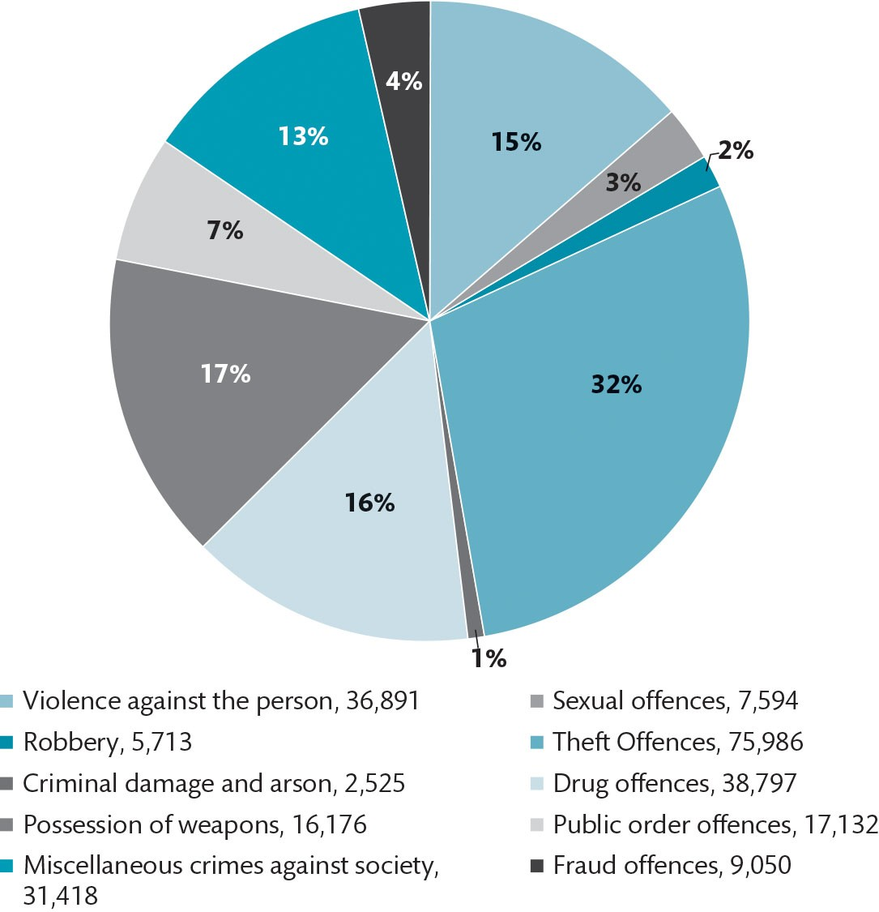
Figure 3.5 Caseload of the Crown Court, 2018

Slide 8
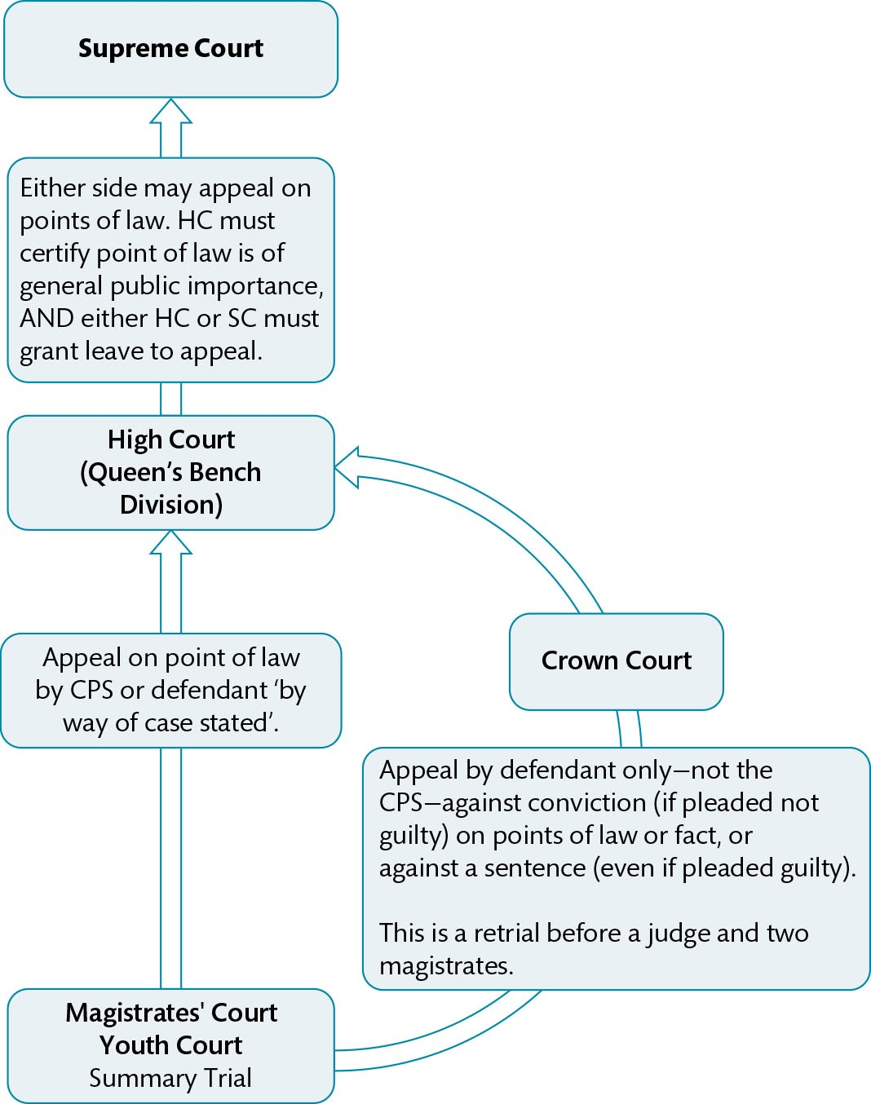
Figure 3.6 Appeals after trial in a magistrates’ court

Slide 9
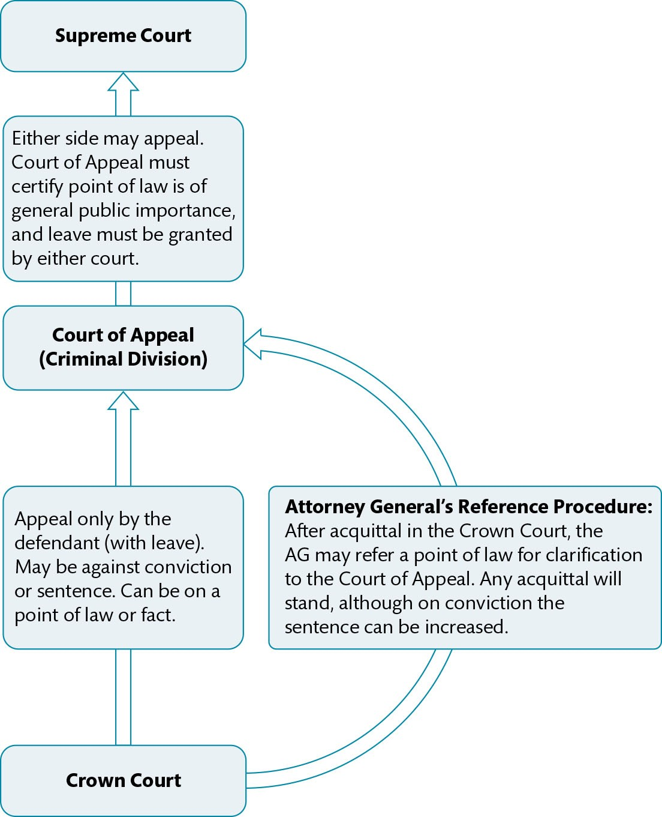
Figure 3.7 Appeals after trial in the Crown Court

Slide 10
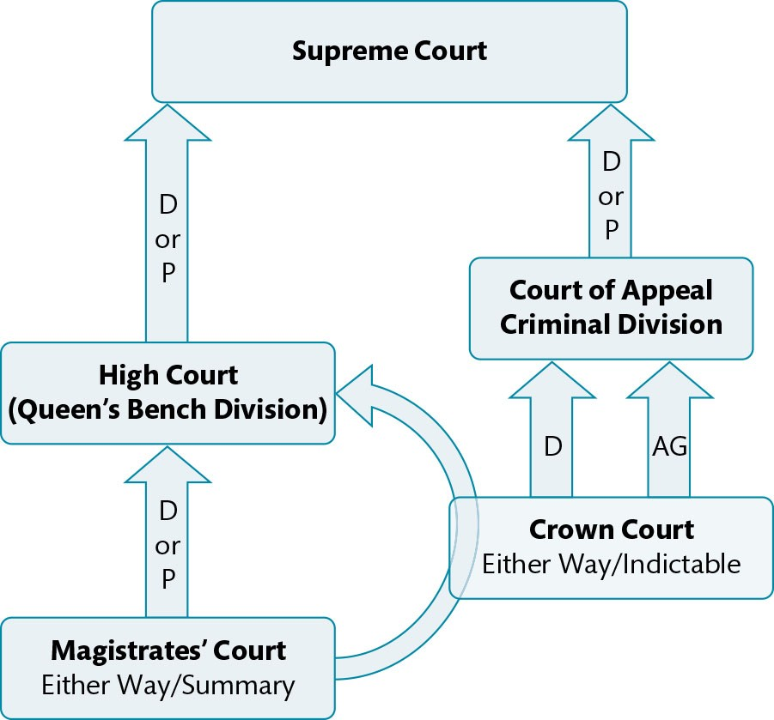
Figure 3.8 Criminal appeals—summary

Slide 11
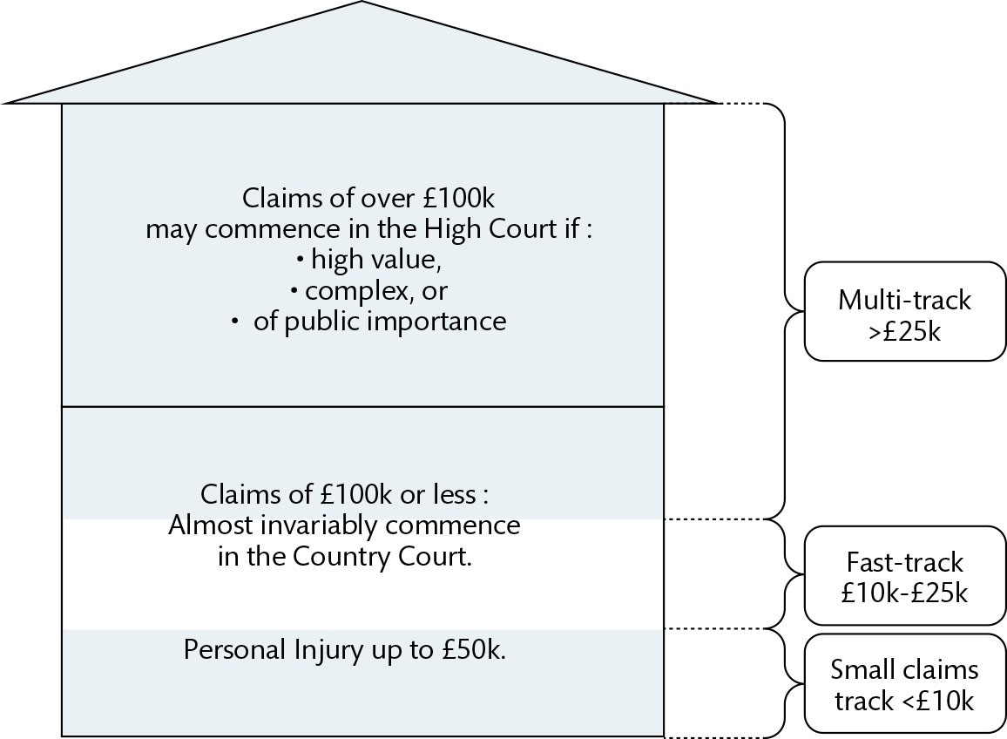
Figure 3.9 Courts of first instance—civil courts

Slide 12
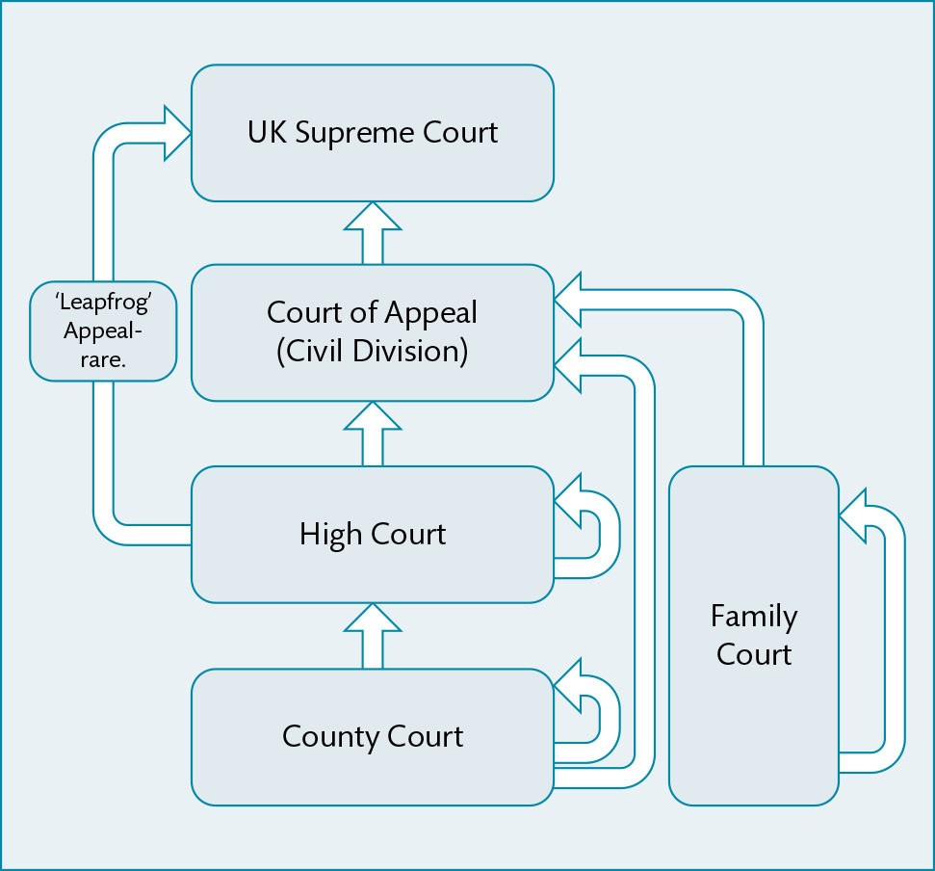
Figure 3.10 Civil appeals—summary

Slide 13
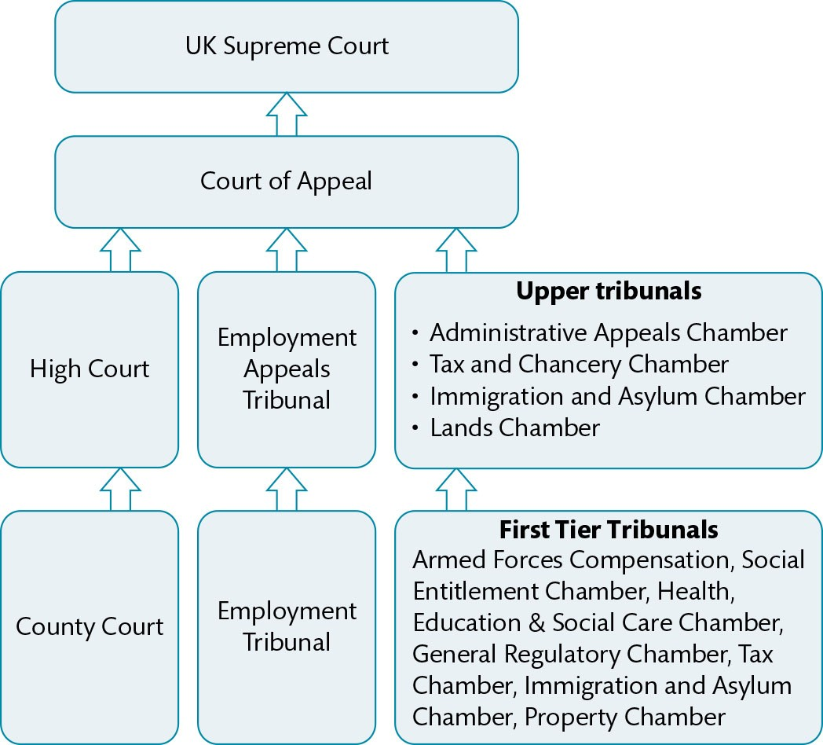
Figure 3.11 Tribunals—summary

Slide 14
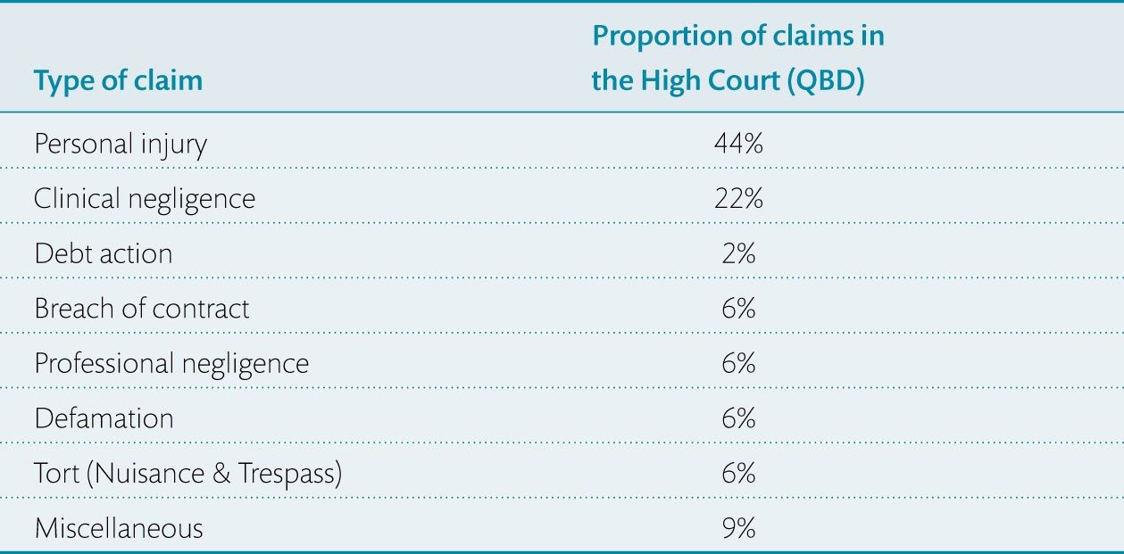
Table 3.1 Proportion of claims in the High Court (Queen’s Bench Division), by type: 2018

Slide 15
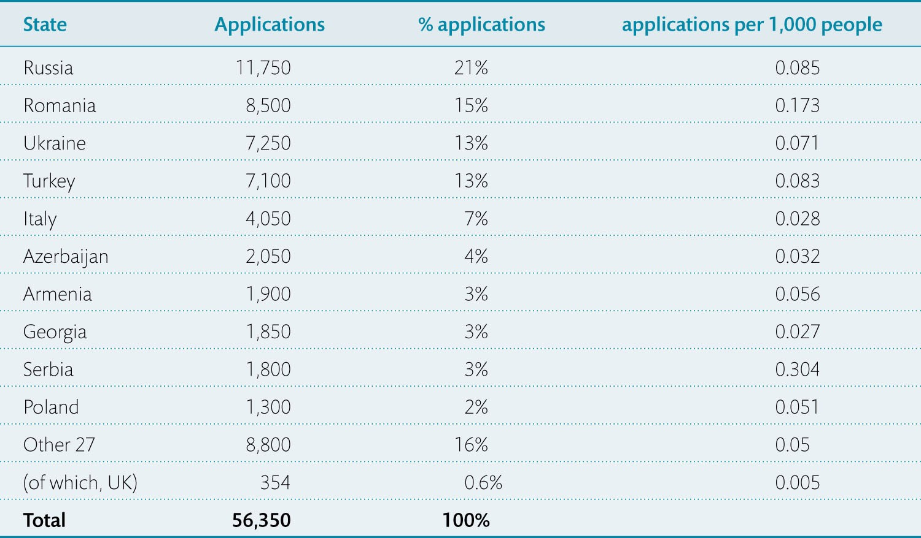
Table 3.2 Number of applications to ECtHR by country: 2018

Slide 16
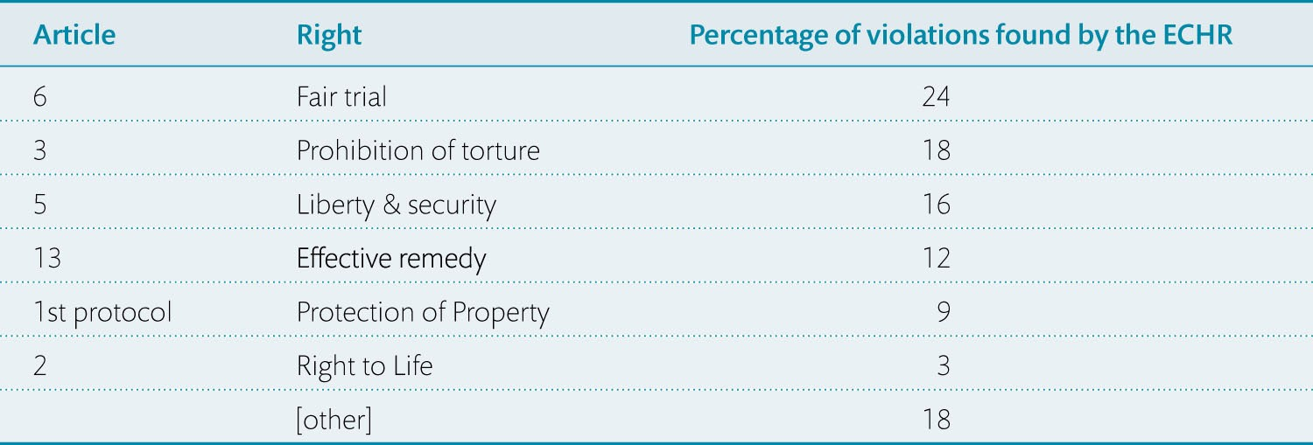
Table 3.3 ECHR – Most violated human rights by percentage of decisions

