Slide 1
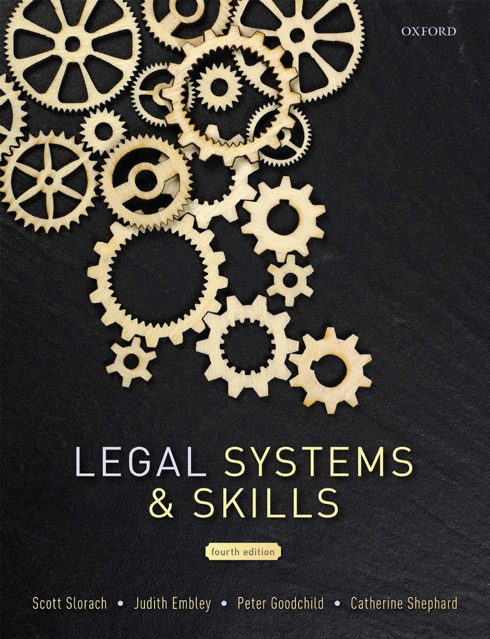
Legal Systems & Skills
by Scott Slorach, Judith Embley, Peter Goodchild and Catherine Shephard

Slide 2
Part 1
Legal Systems
Chapter 05
Case law

Slide 3
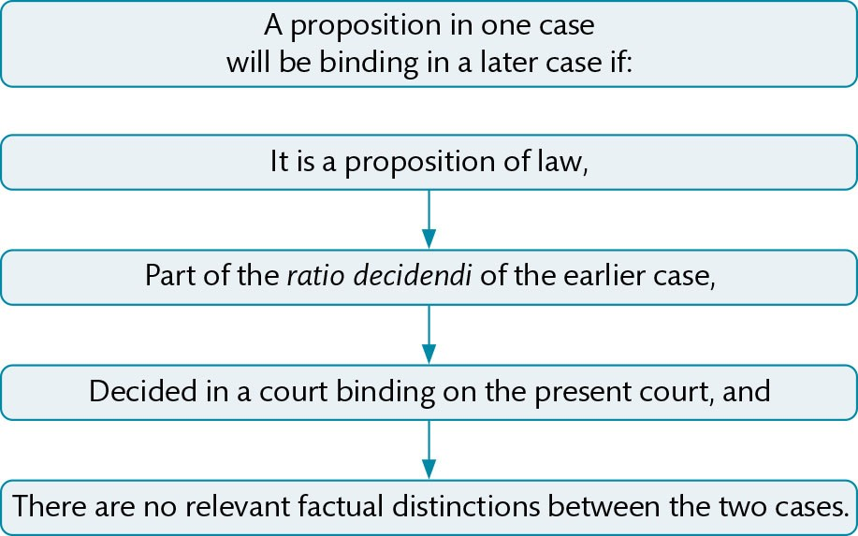
Figure 5.1 The doctrine of precedent

Slide 4
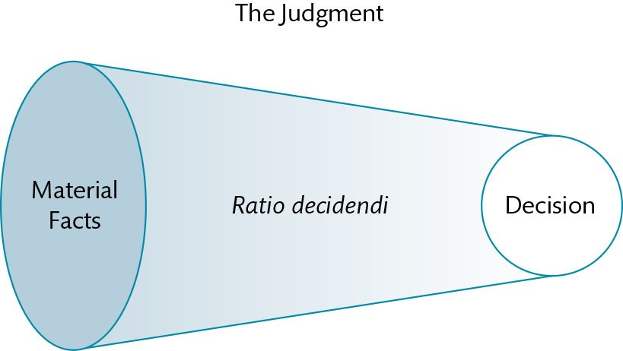
Figure 5.2 Ratio: the reasoning necessary to get from the material facts to the decision

Slide 5
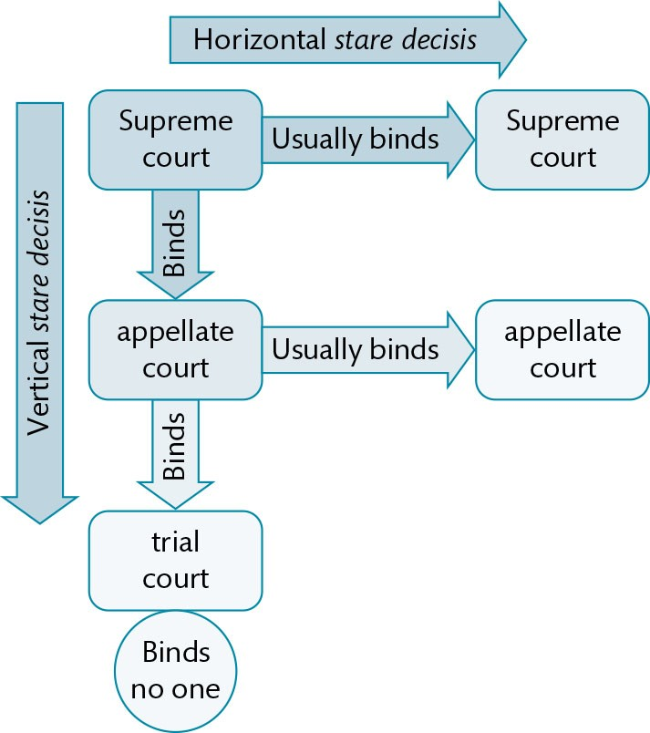
Figure 5.3 Generic representation of common law stare decisis

Slide 6
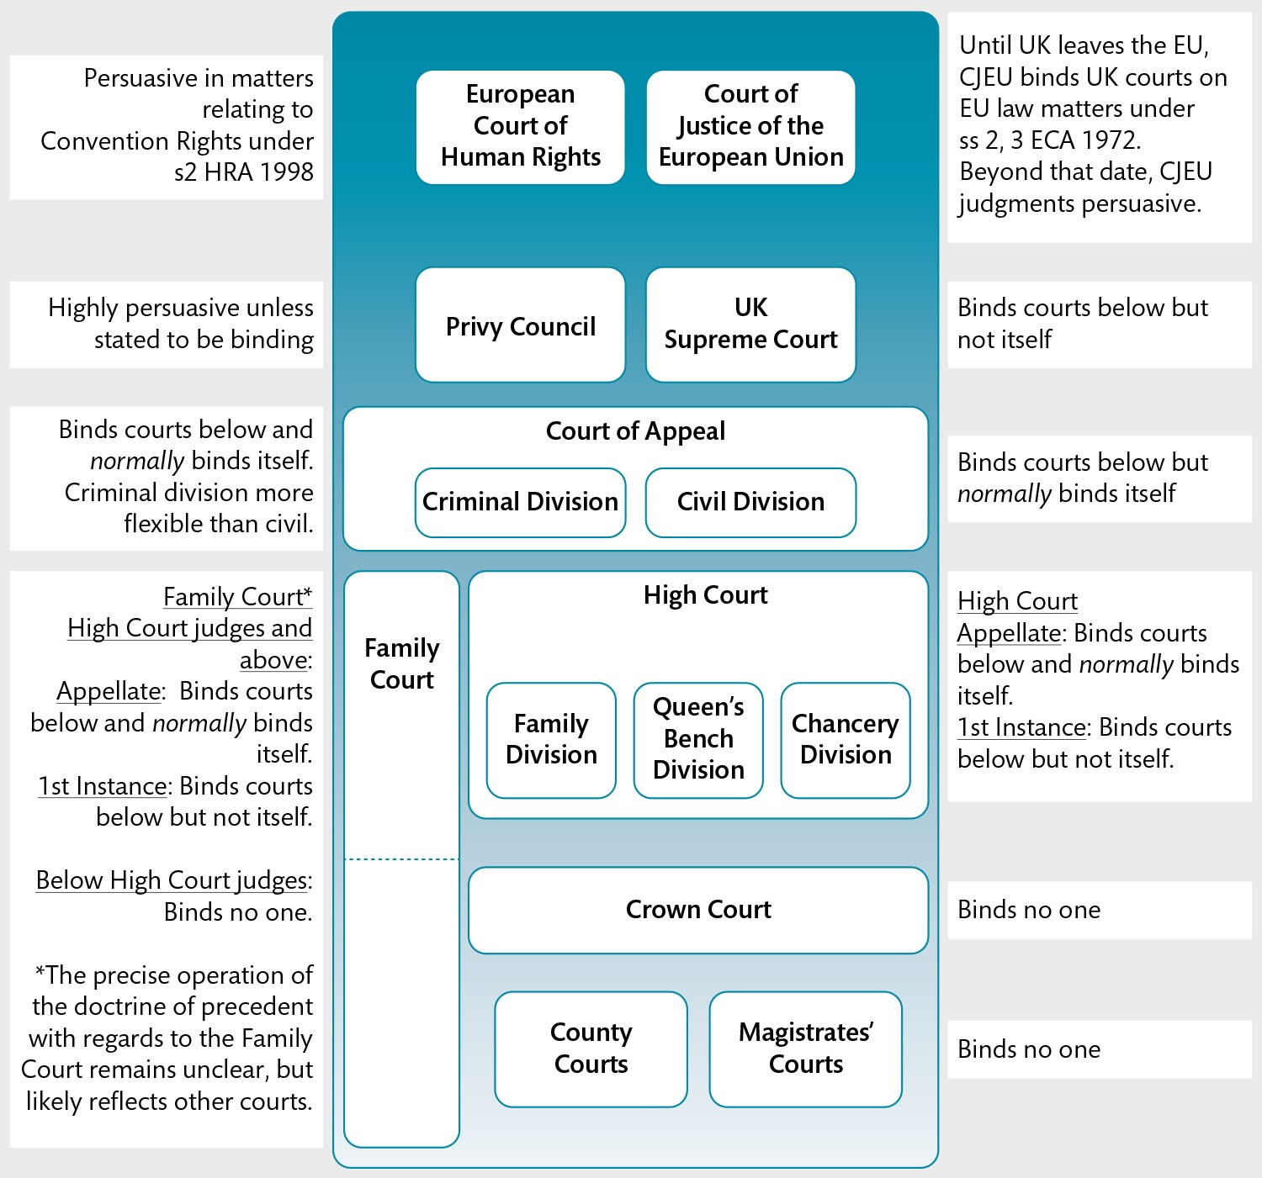
Figure 5.4 Hierarchy of courts in England & Wales

Slide 7
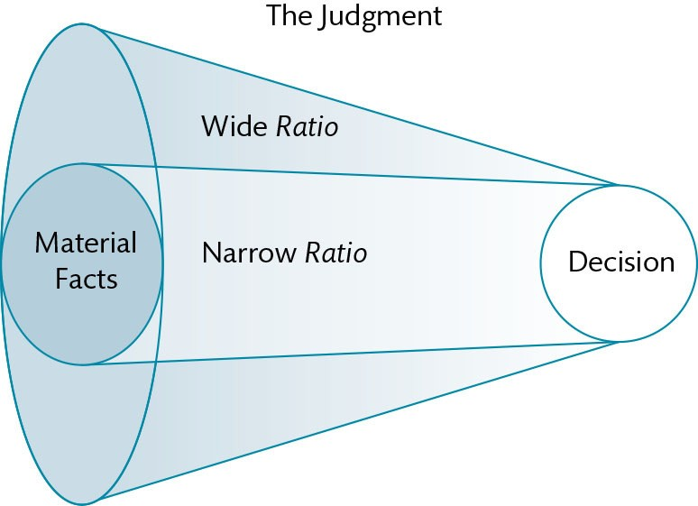
Figure 5.5 Wide and narrow ratio: the more general the facts considered relevant, the ‘wider’ the ratio

Slide 8
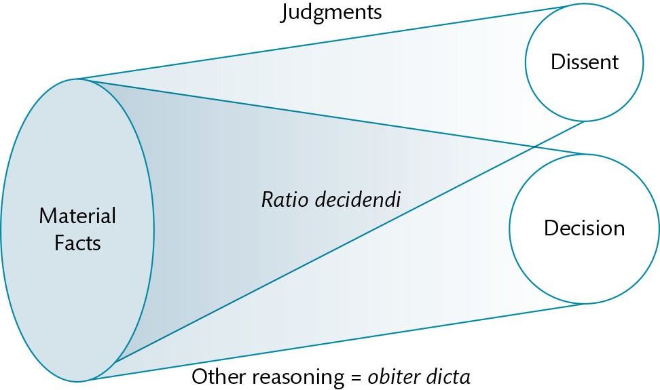
Figure 5.6 Ratio, obiter, and dissent

Slide 9
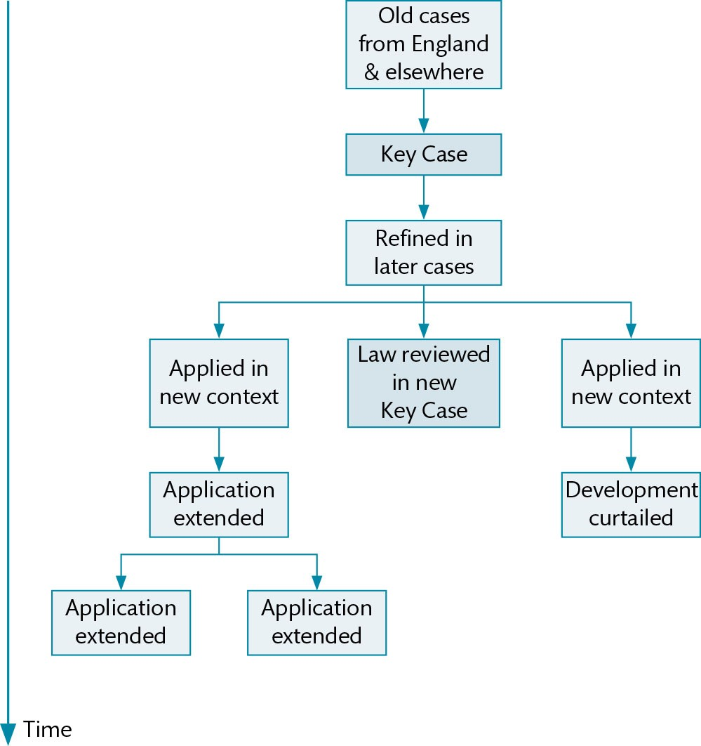
Figure 5.7 Evolution of ratio—generic diagram

Slide 10
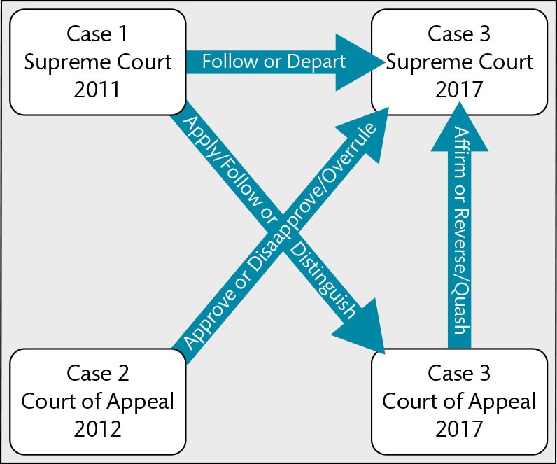
Figure 5.8 Precedent terminology: what can a later court do with an earlier precedent?

Slide 11
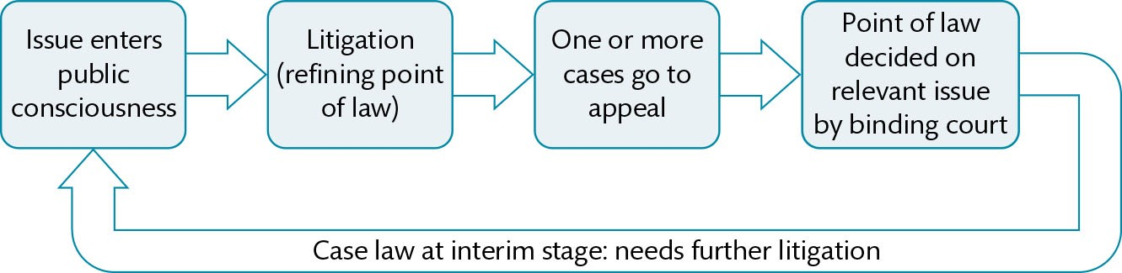
Figure 5.9 The process by which case law develops to reflect changes in society

Slide 12
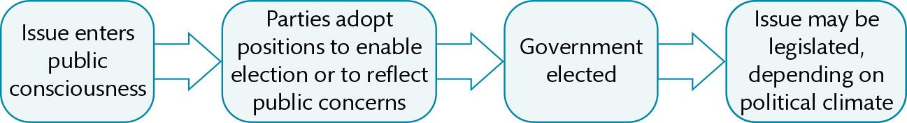
Figure 5.10 The process by which legislation develops to reflect changes in society

