Slide 1
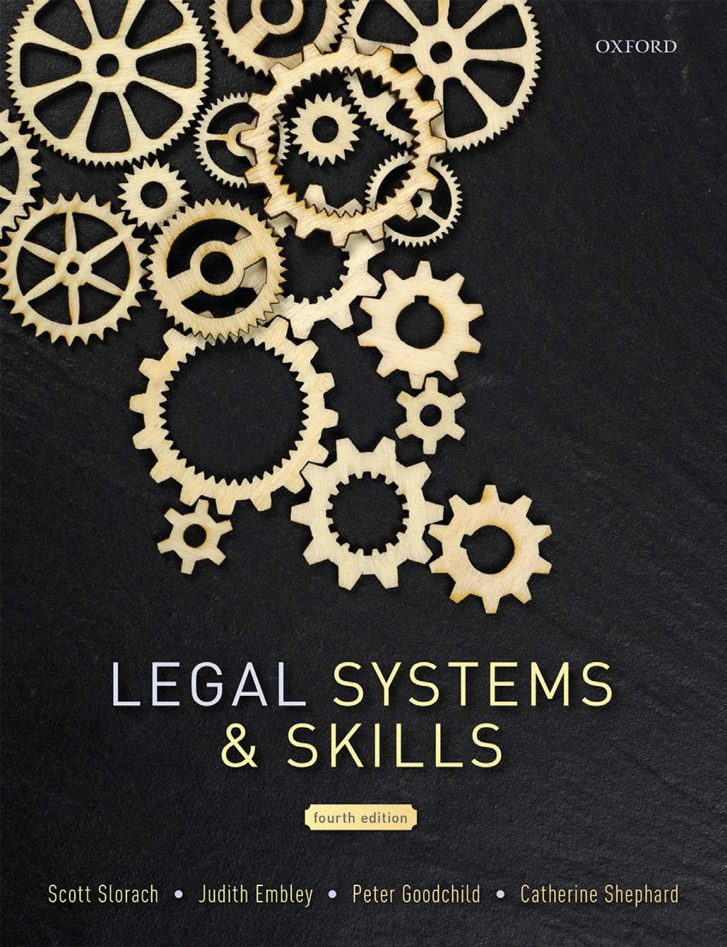
Legal Systems & Skills
by Scott Slorach, Judith Embley, Peter Goodchild and Catherine Shephard

Slide 2
Part 2
Legal Skills
Chapter 10
Persuasive oral communication and presentations

Slide 3
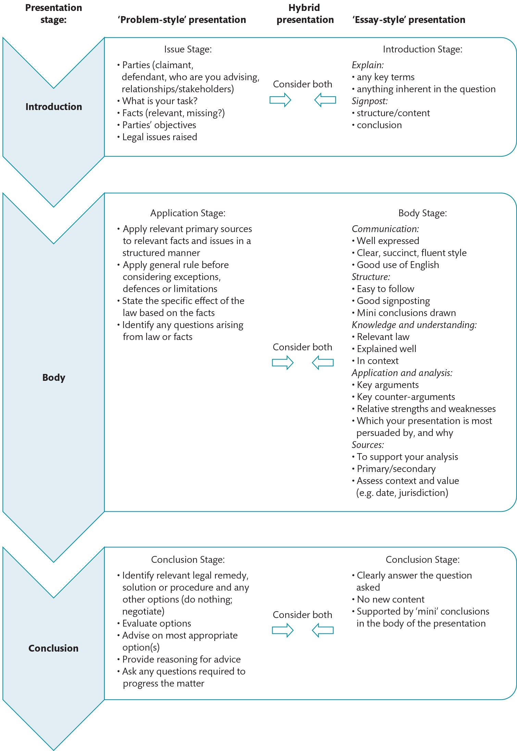
Figure 10.1 Structuring the content of a presentation

Slide 4
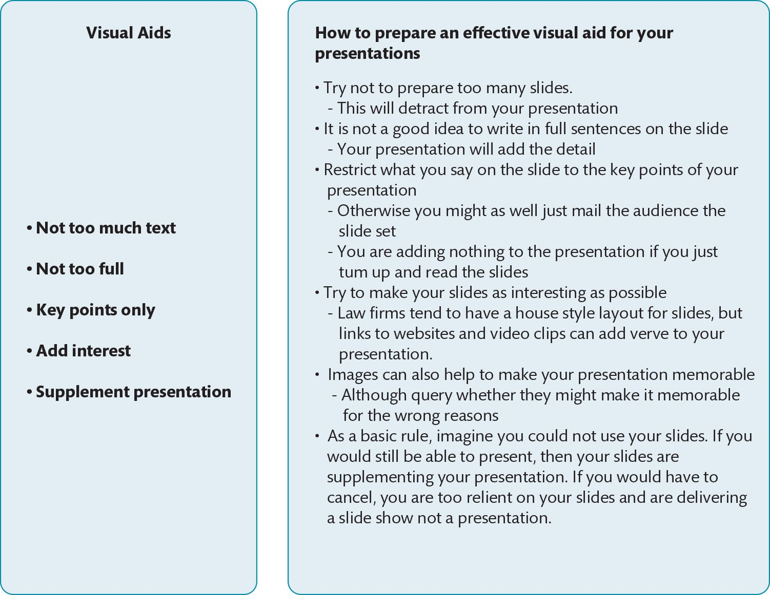
Figure 10.2 Considering the purpose of visual aids

