Slide 1
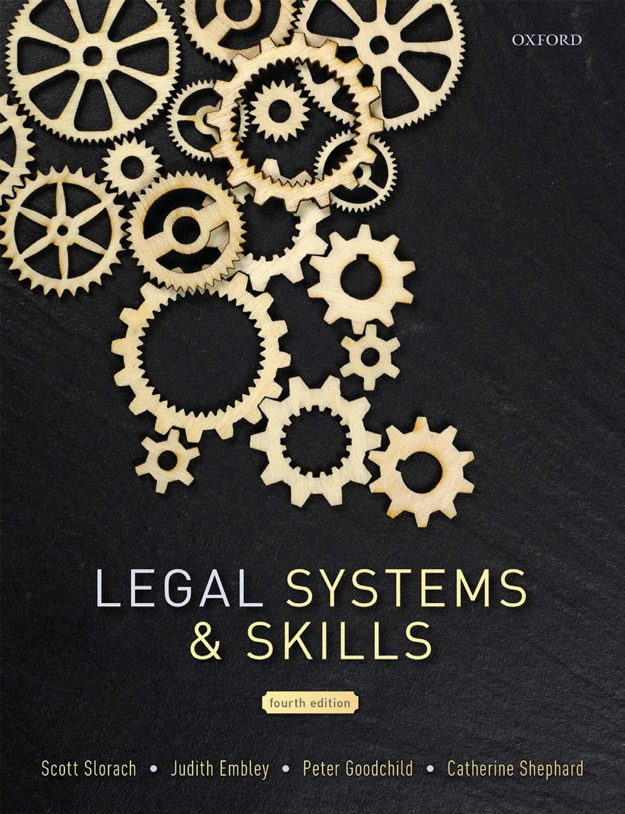
Legal Systems & Skills
by Scott Slorach, Judith Embley, Peter Goodchild and Catherine Shephard

Slide 2
Part 2
Legal Skills
Chapter 09
Problem-solving and case/matter analysis

Slide 3
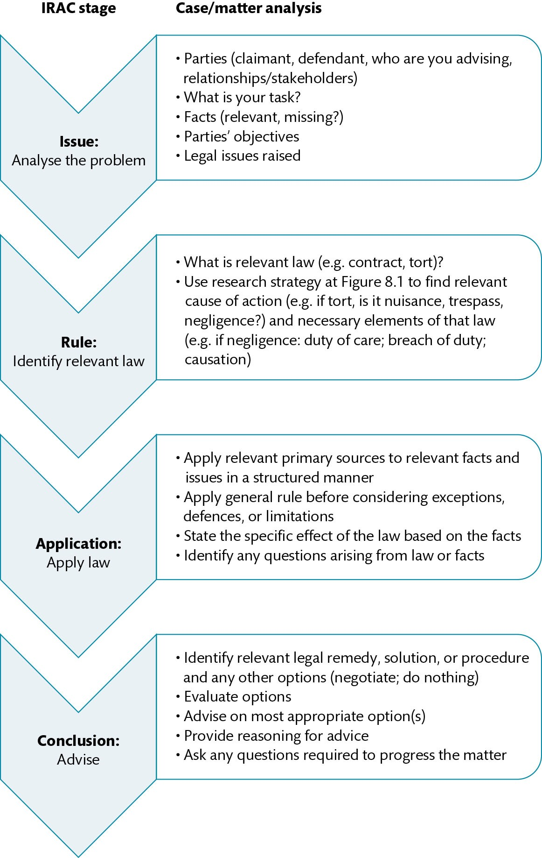
Figure 9.1 Case/matter analysis for problem-solving strategy

Slide 4
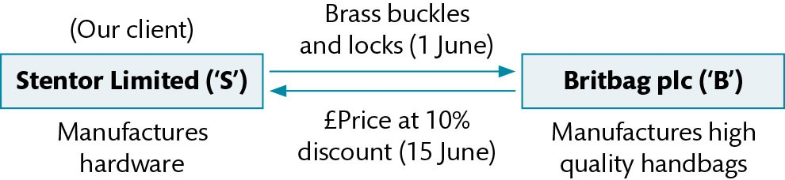
Figure 9.2 Diagram showing the transaction between S and B

Slide 5
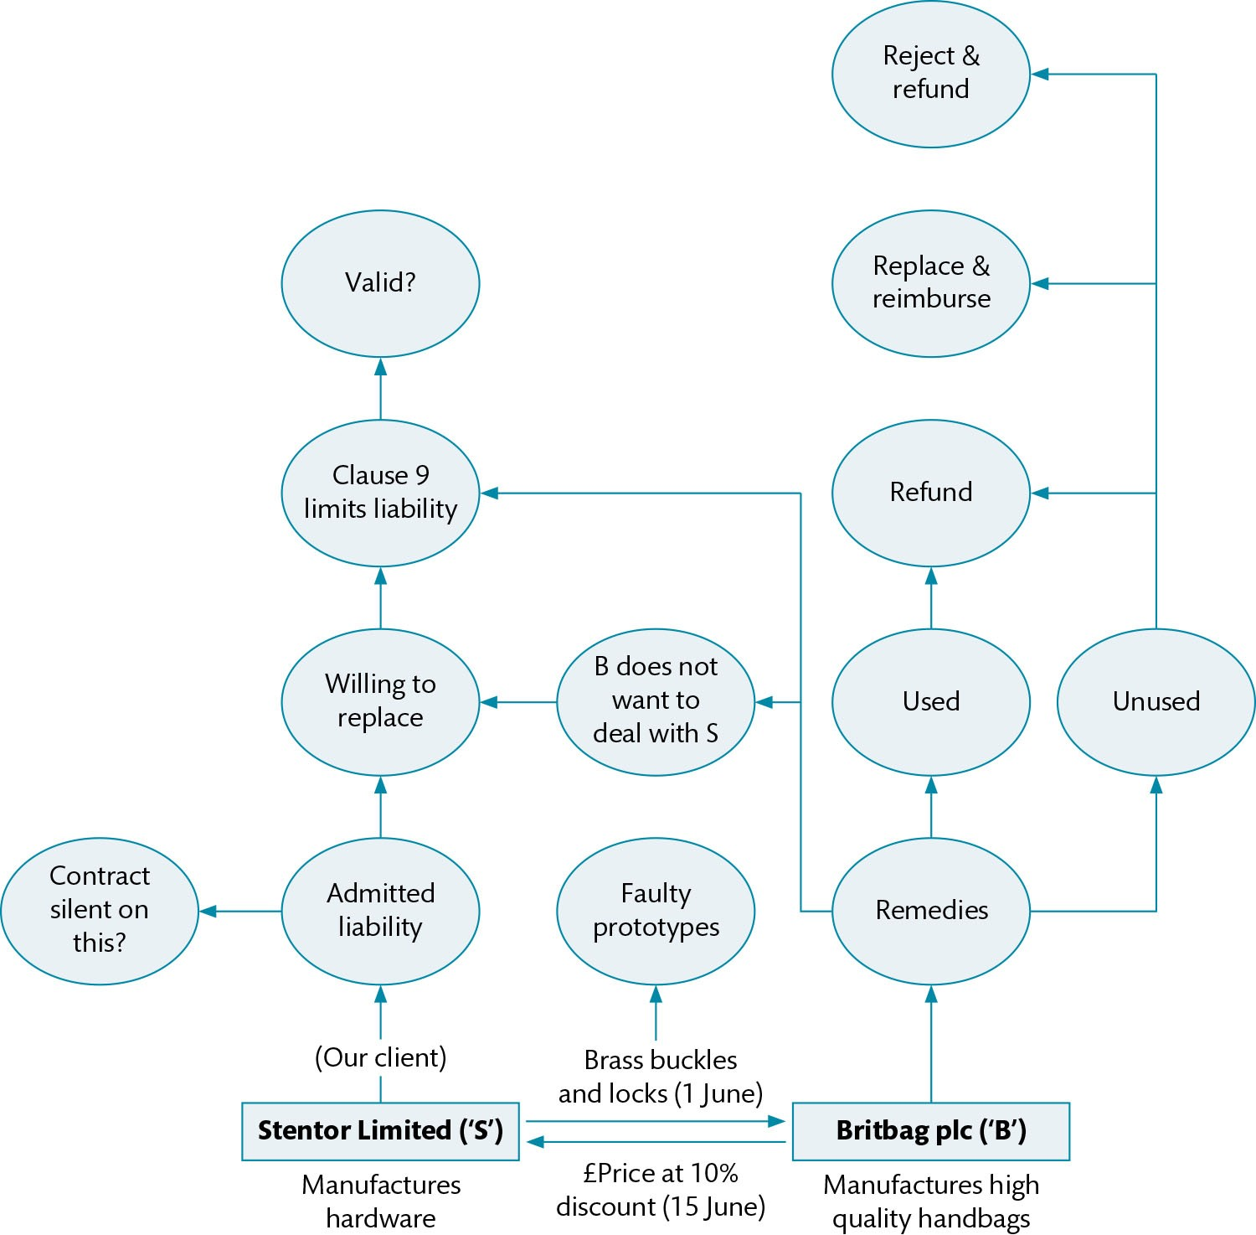
Figure 9.3 Mind map showing the transaction between S and B

Slide 6
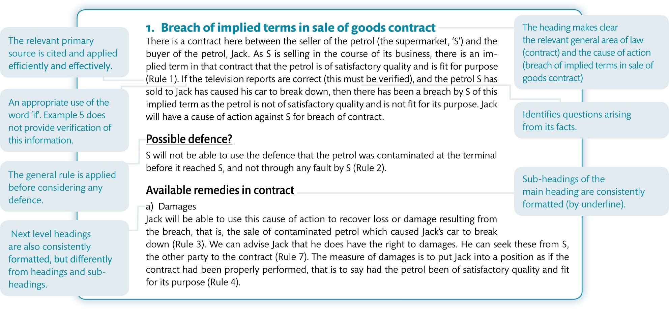
Figure 9.4 An annotated, worked example of the Application stage in practice

Slide 7
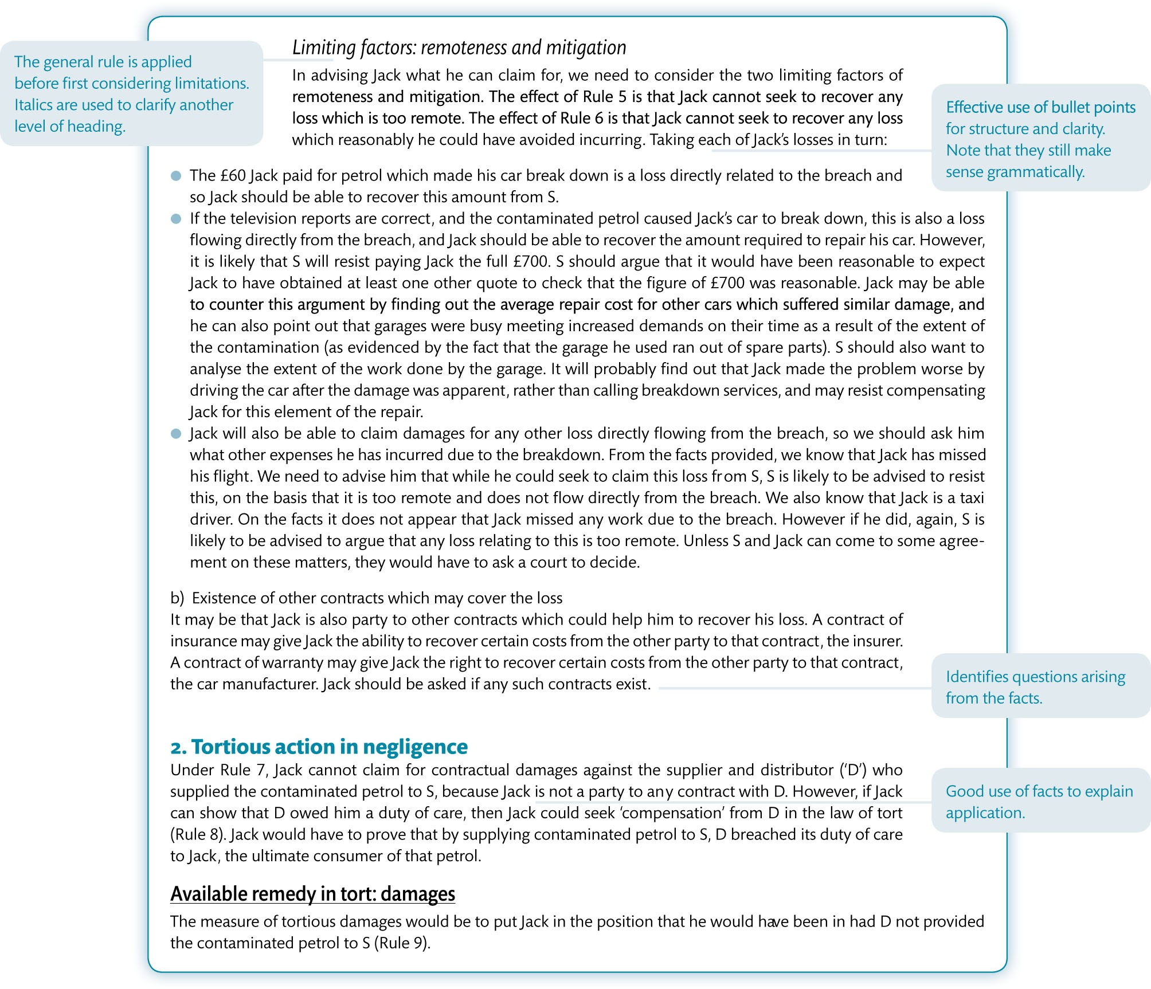
Figure 9.4 (Continued)

Slide 8
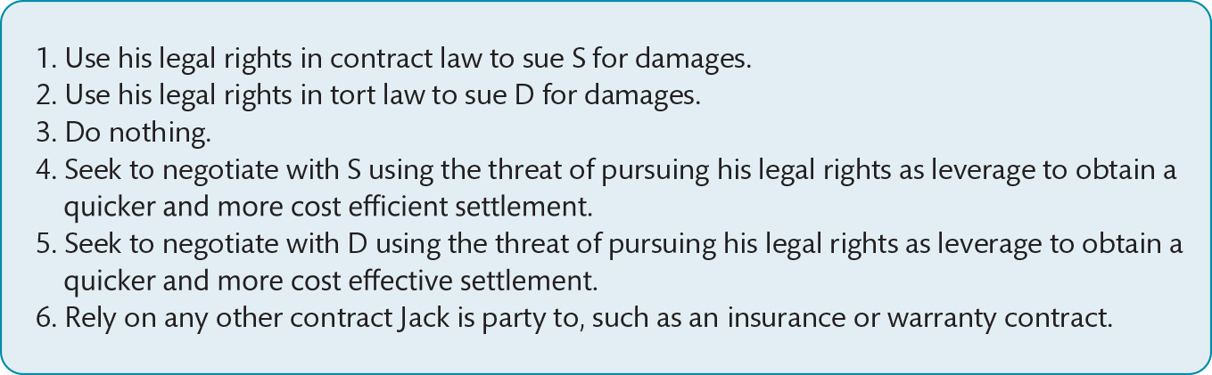
Figure 9.5 A worked example identifing relevant remedies and other options

Slide 9
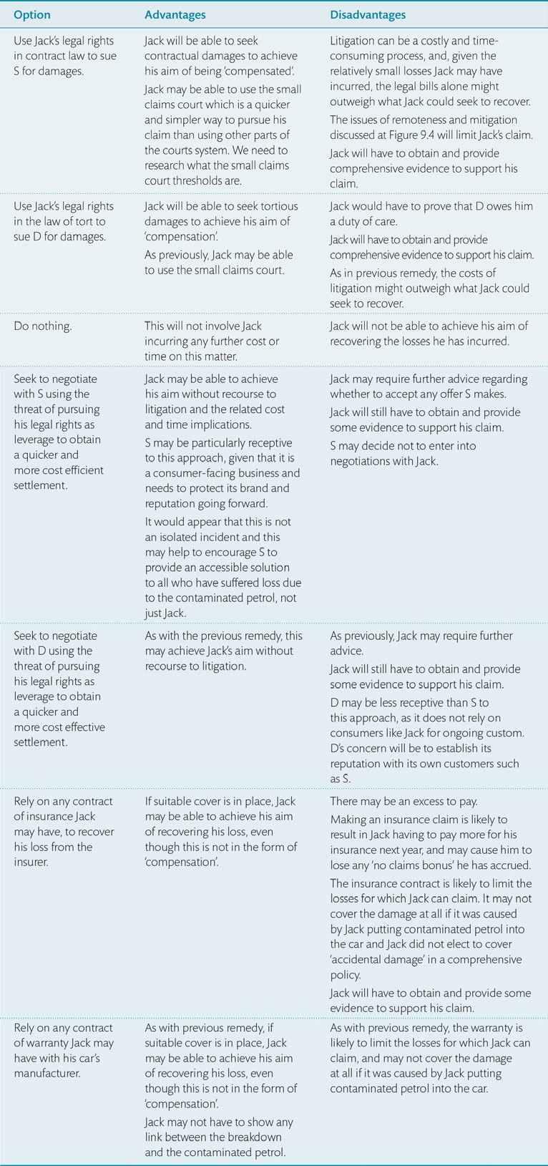
Table 9.1 A worked example of how to evaluate options in tabular form.

