Slide 1
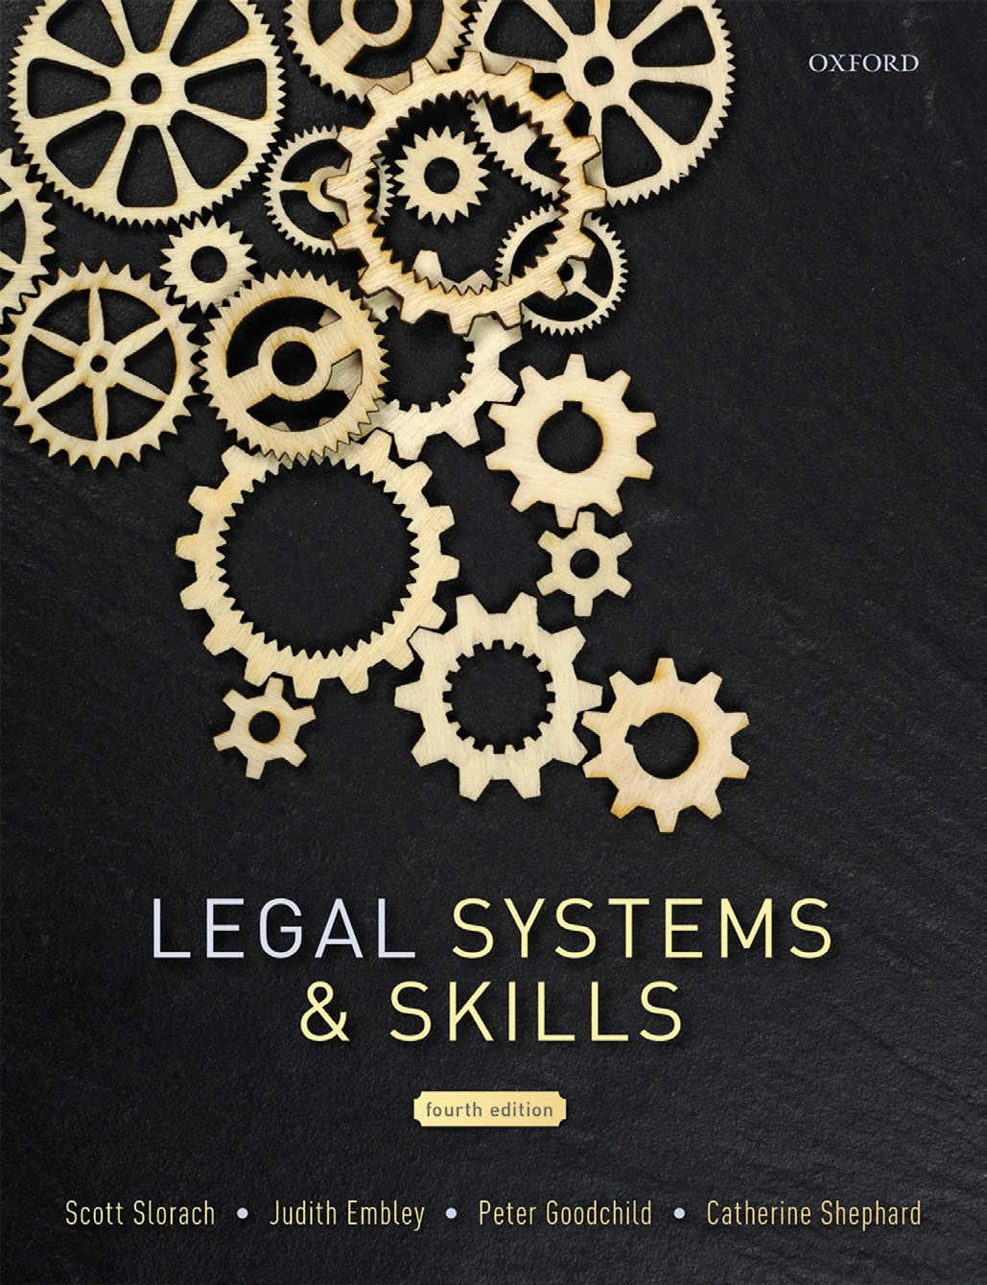
Legal Systems & Skills
by Scott Slorach, Judith Embley, Peter Goodchild and Catherine Shephard

Slide 2
Part 2
Legal Skills
Chapter 07
Reading cases and legislation

Slide 3
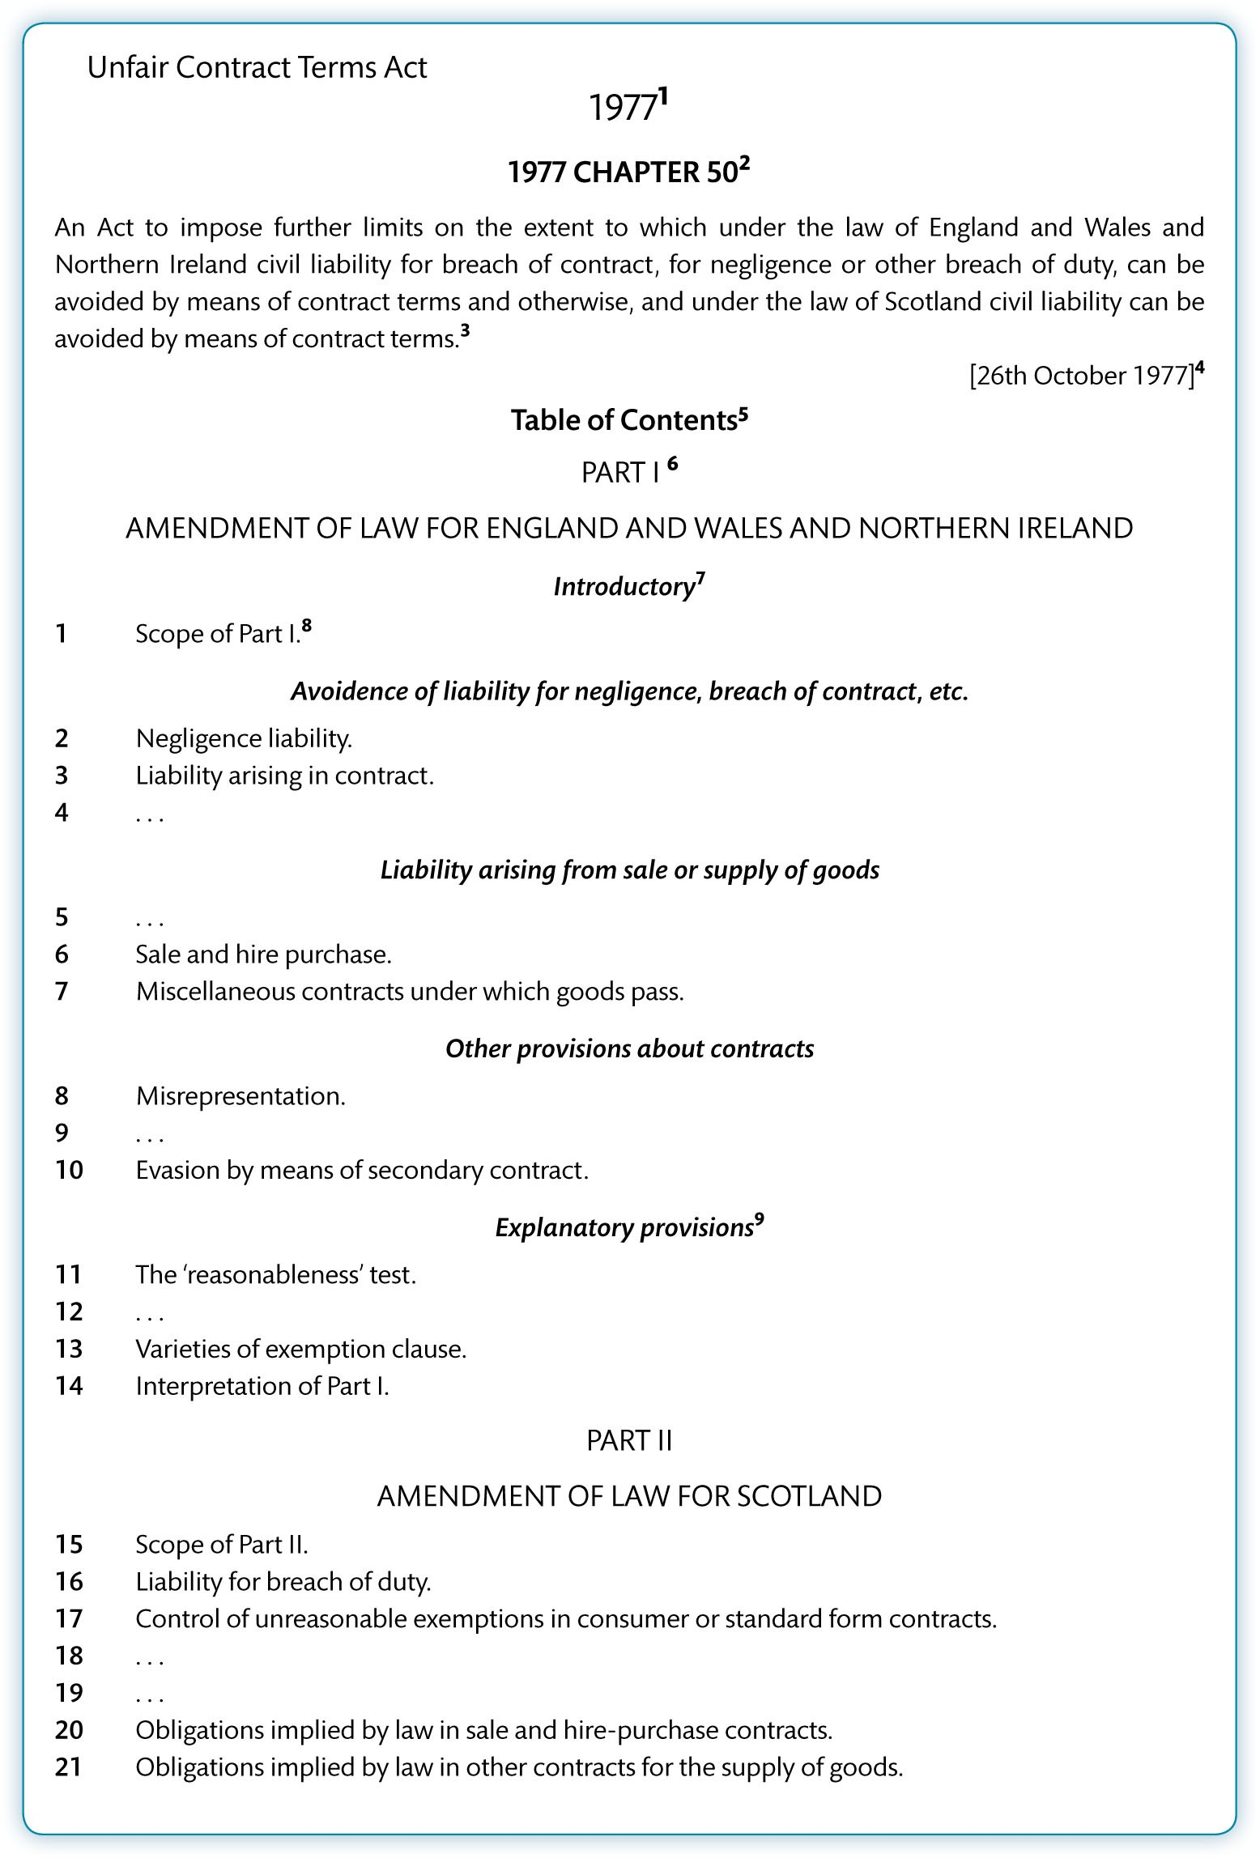
Figure 7.1 Annotated version of the UCTA

Slide 4
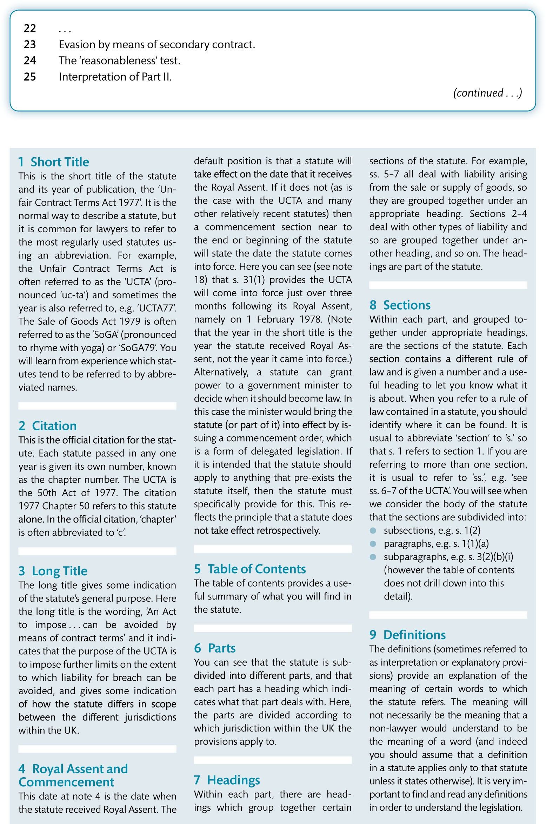
Figure 7.1 (Continued)

Slide 5
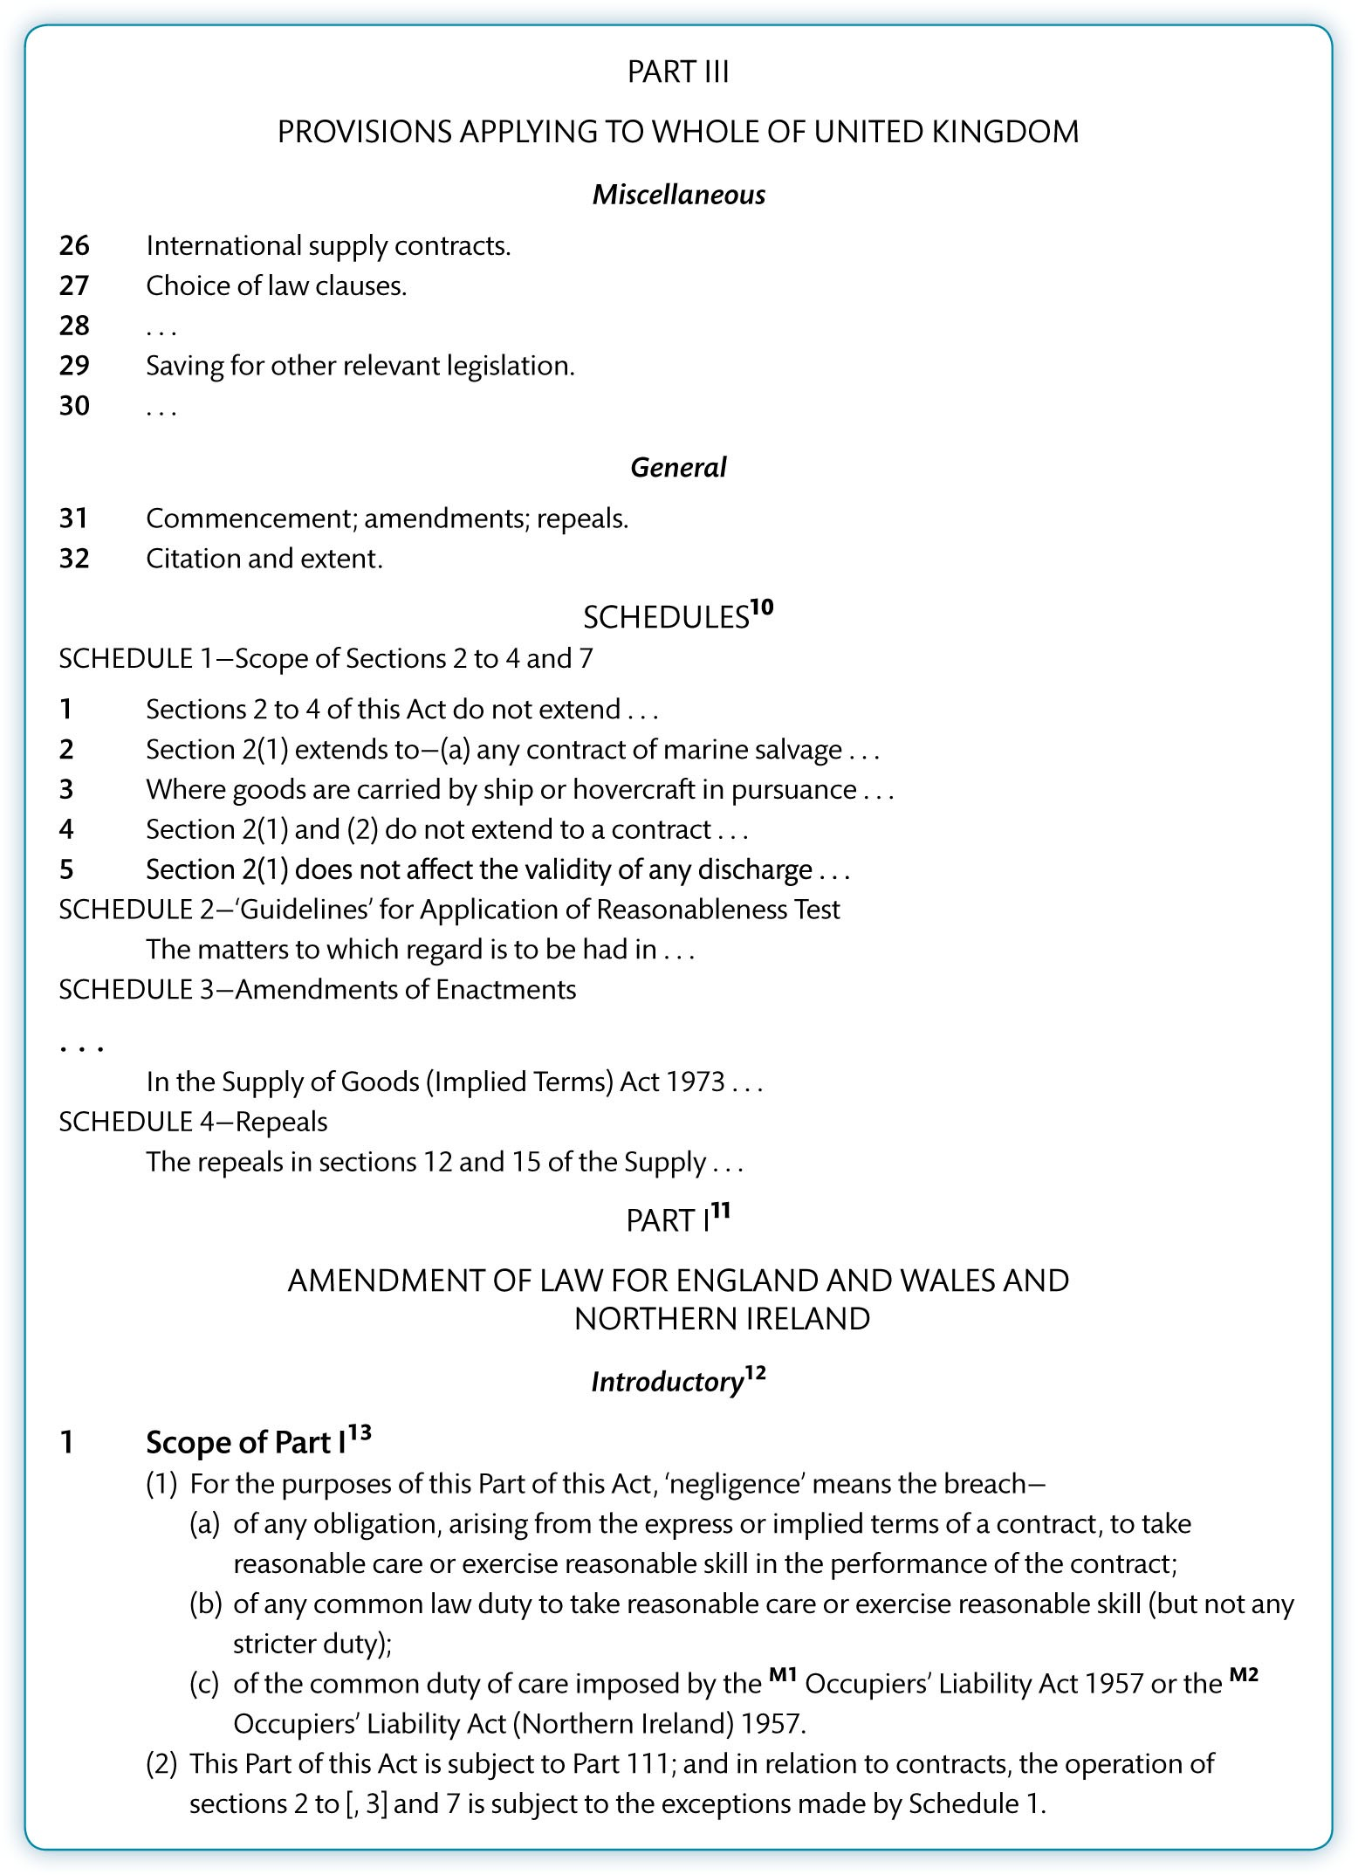
Figure 7.1 (Continued)

Slide 6
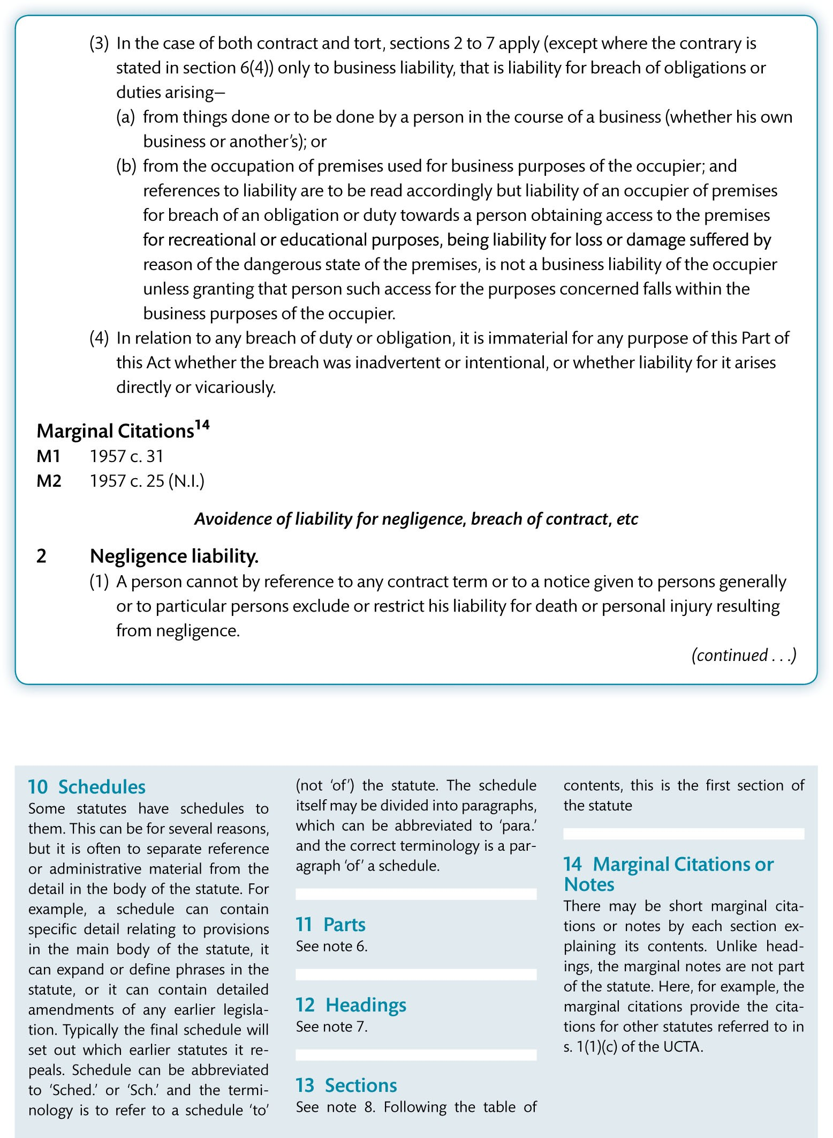
Figure 7.1 (Continued)

Slide 7
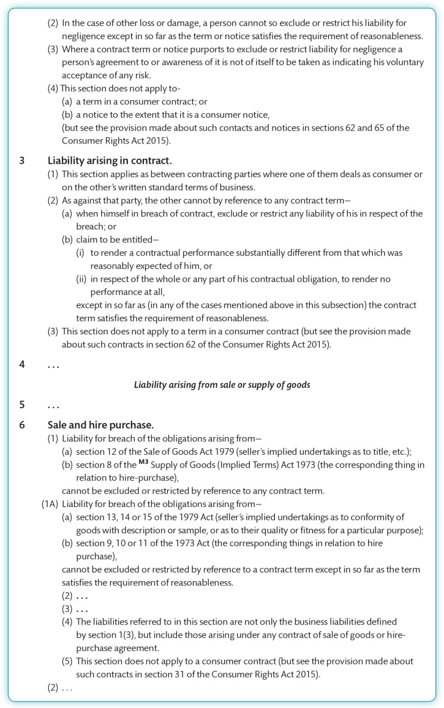
Figure 7.1 (Continued)

Slide 8
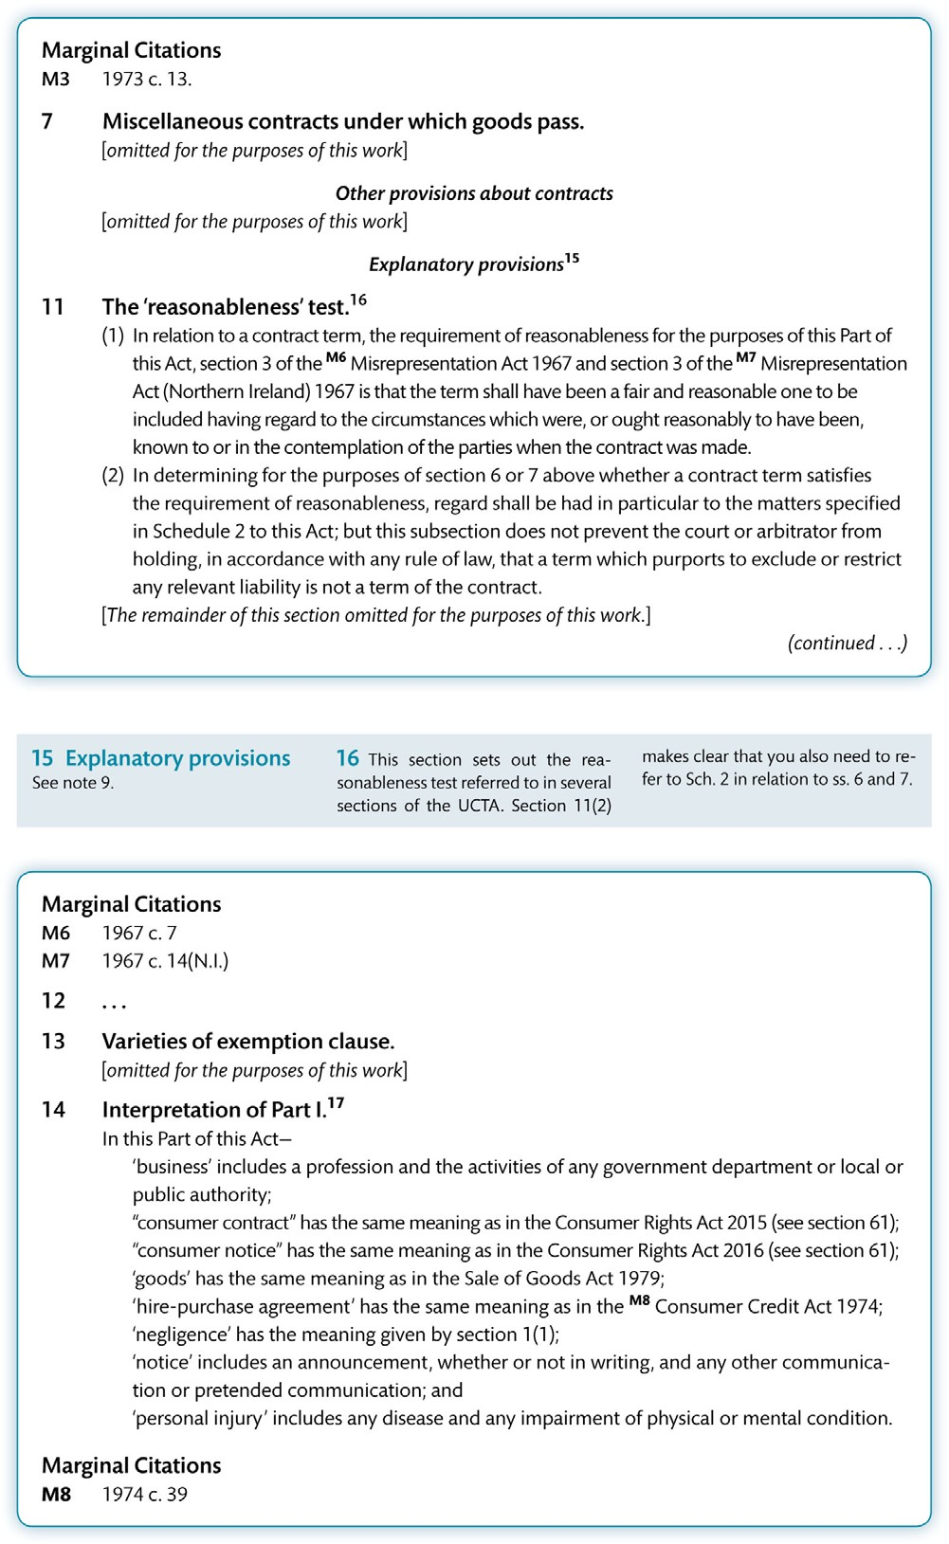
Figure 7.1 (Continued)

Slide 9
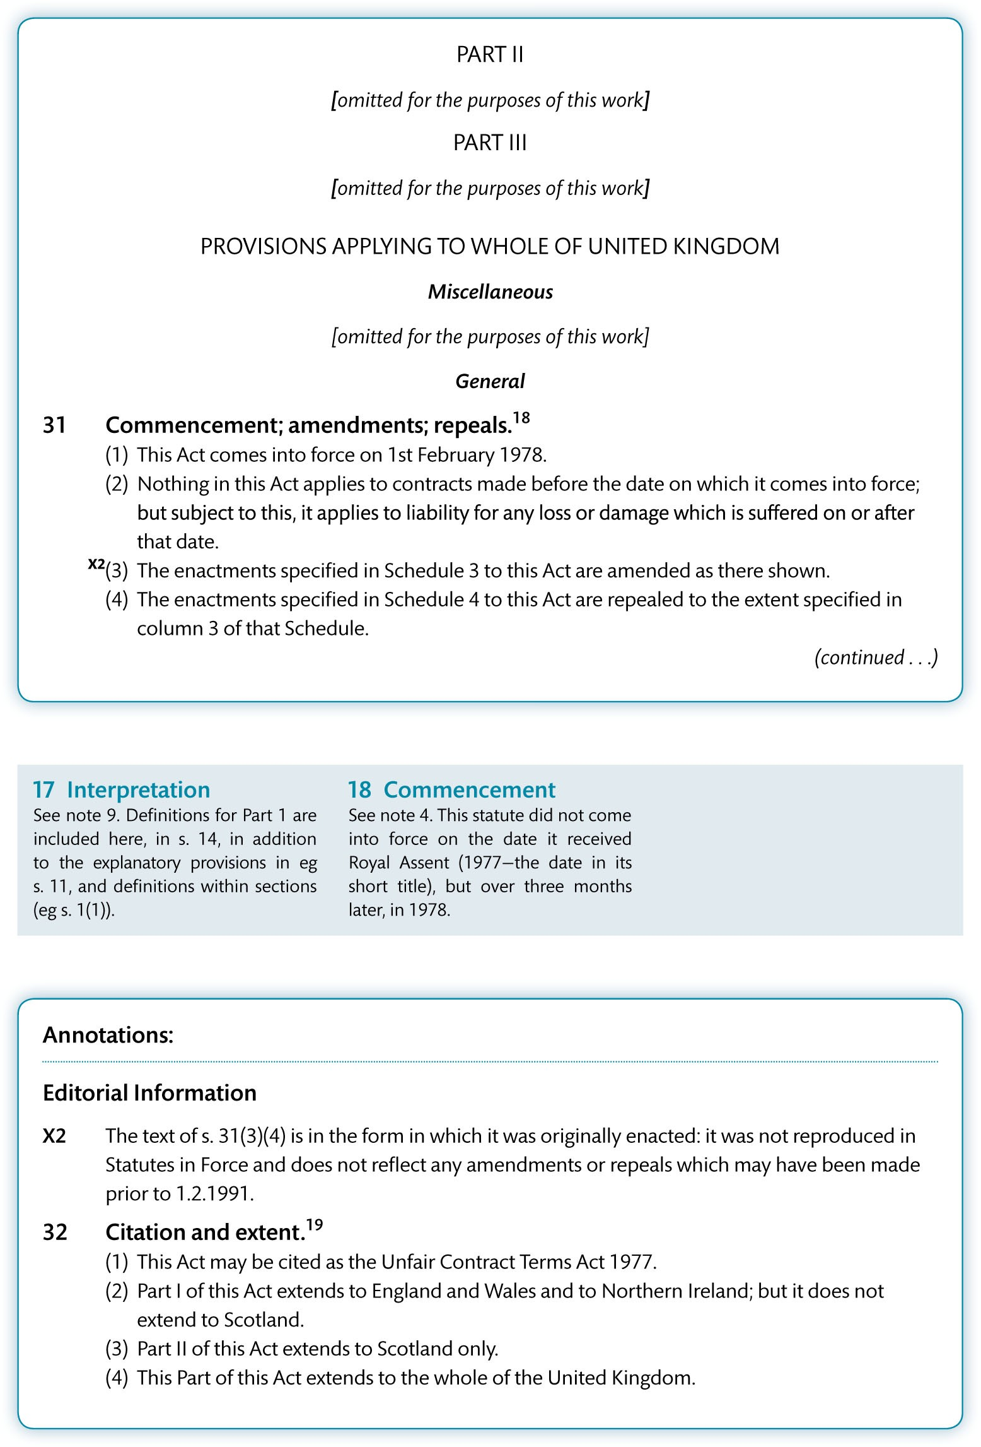
Figure 7.1 (Continued)

Slide 10
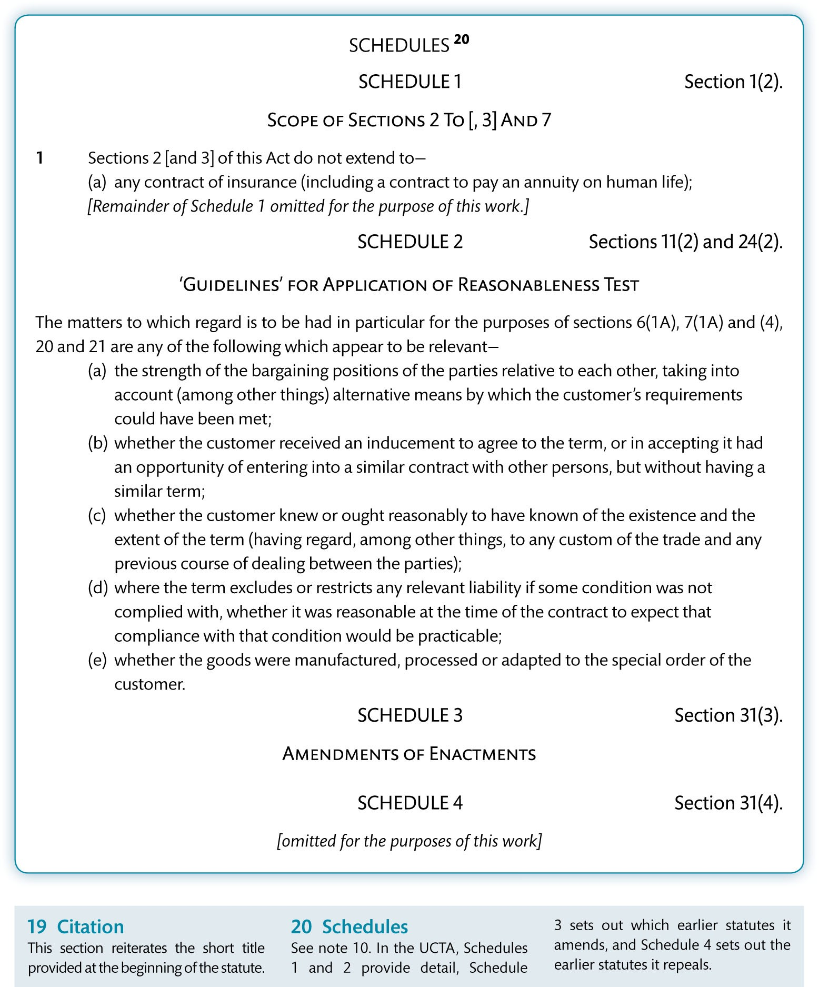
Figure 7.1 (Continued)

Slide 11
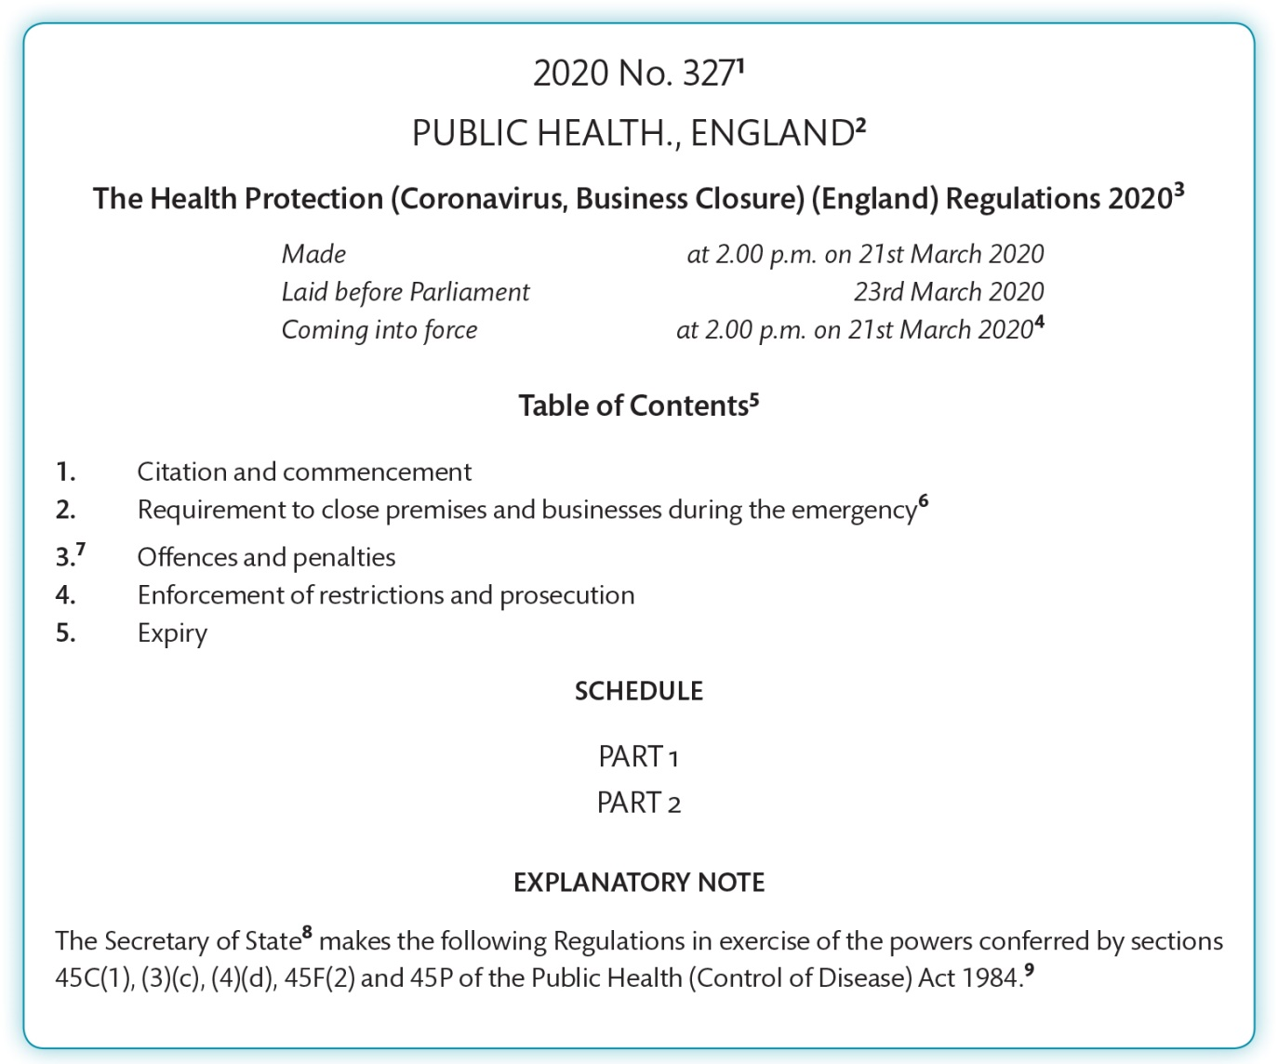
Figure 7.2 Annotated version of the Health Protection (Coronavirus, Business Closure) (England) Regulations 2020

Slide 12
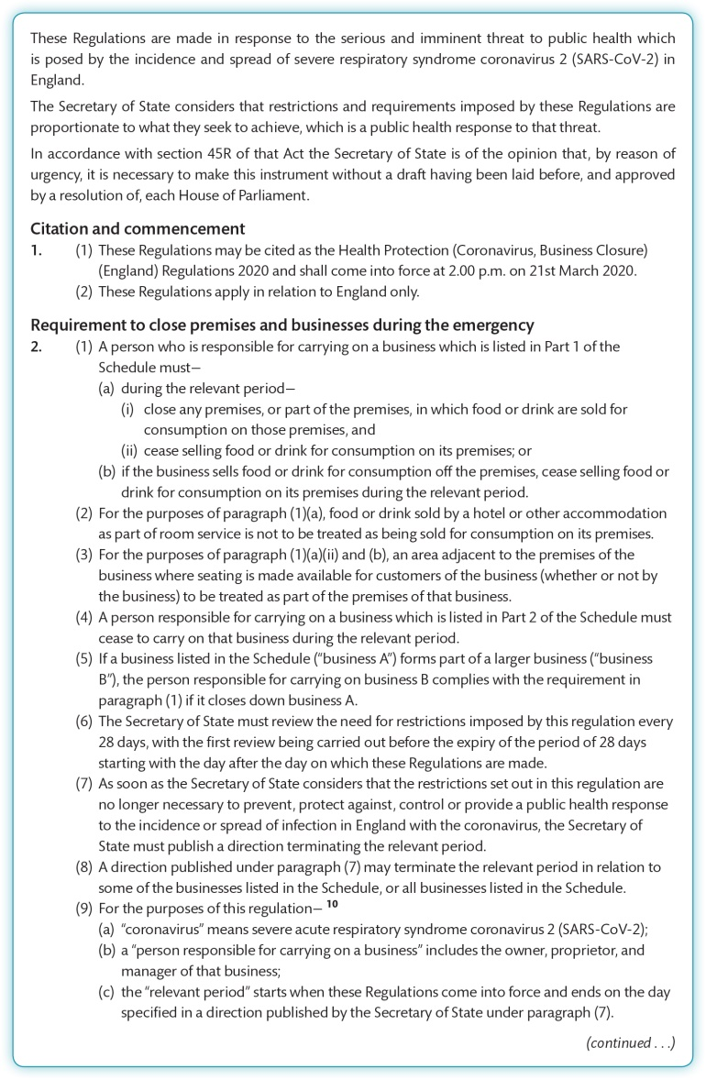
Figure 7.2 (Continued)

Slide 13
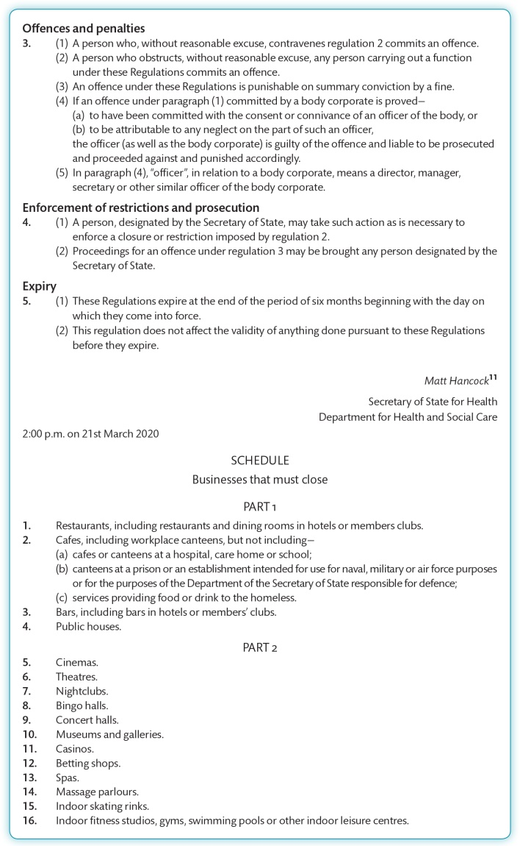
Figure 7.2 (Continued)

Slide 14
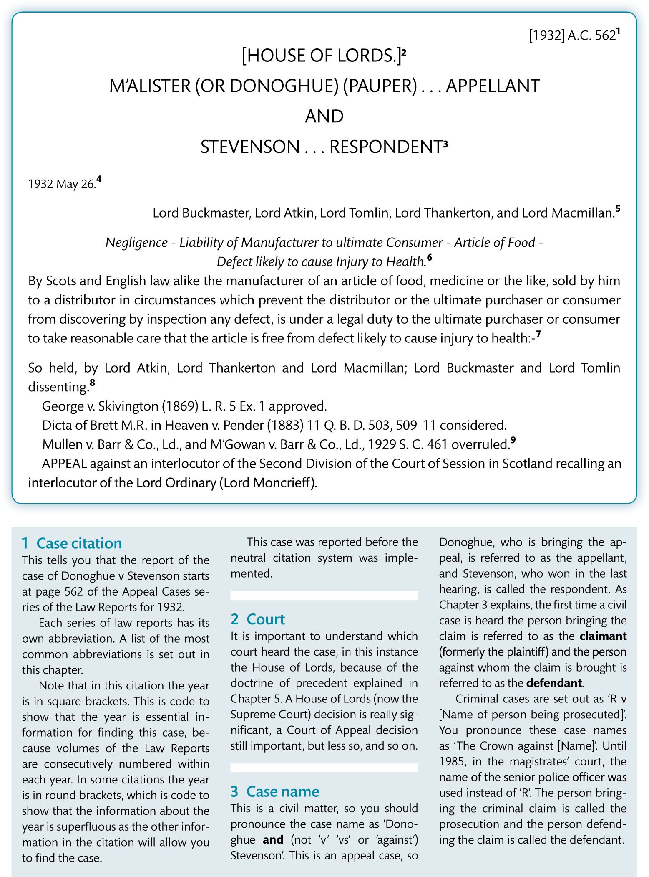
Figure 7.3 Annotated extract from Donoghue v Stevenson

Slide 15
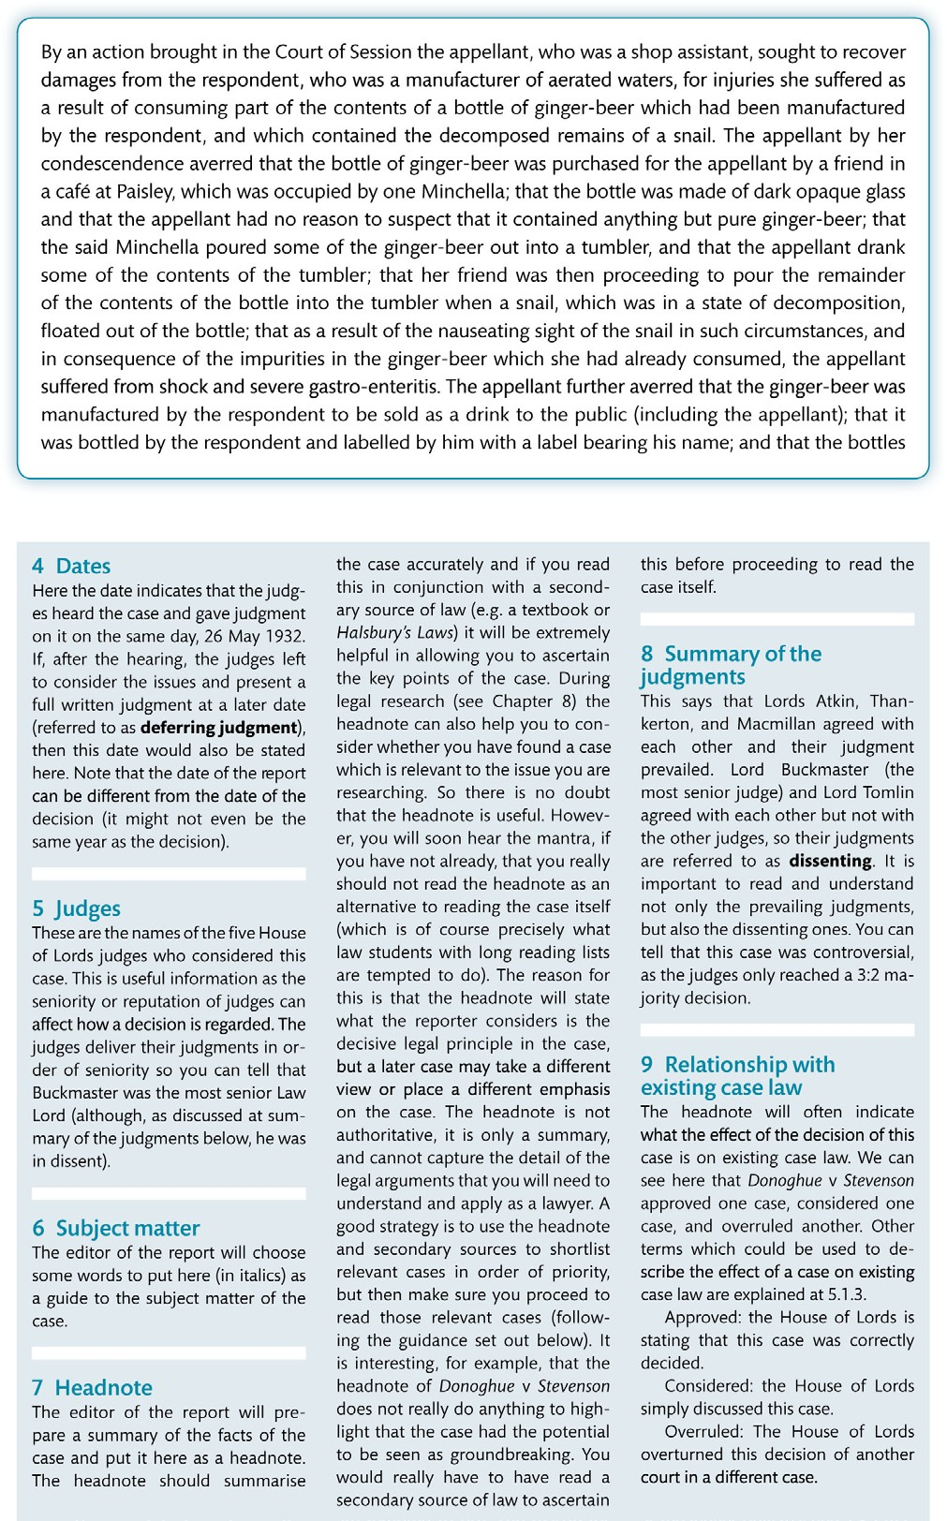
Figure 7.3 (Continued)

Slide 16
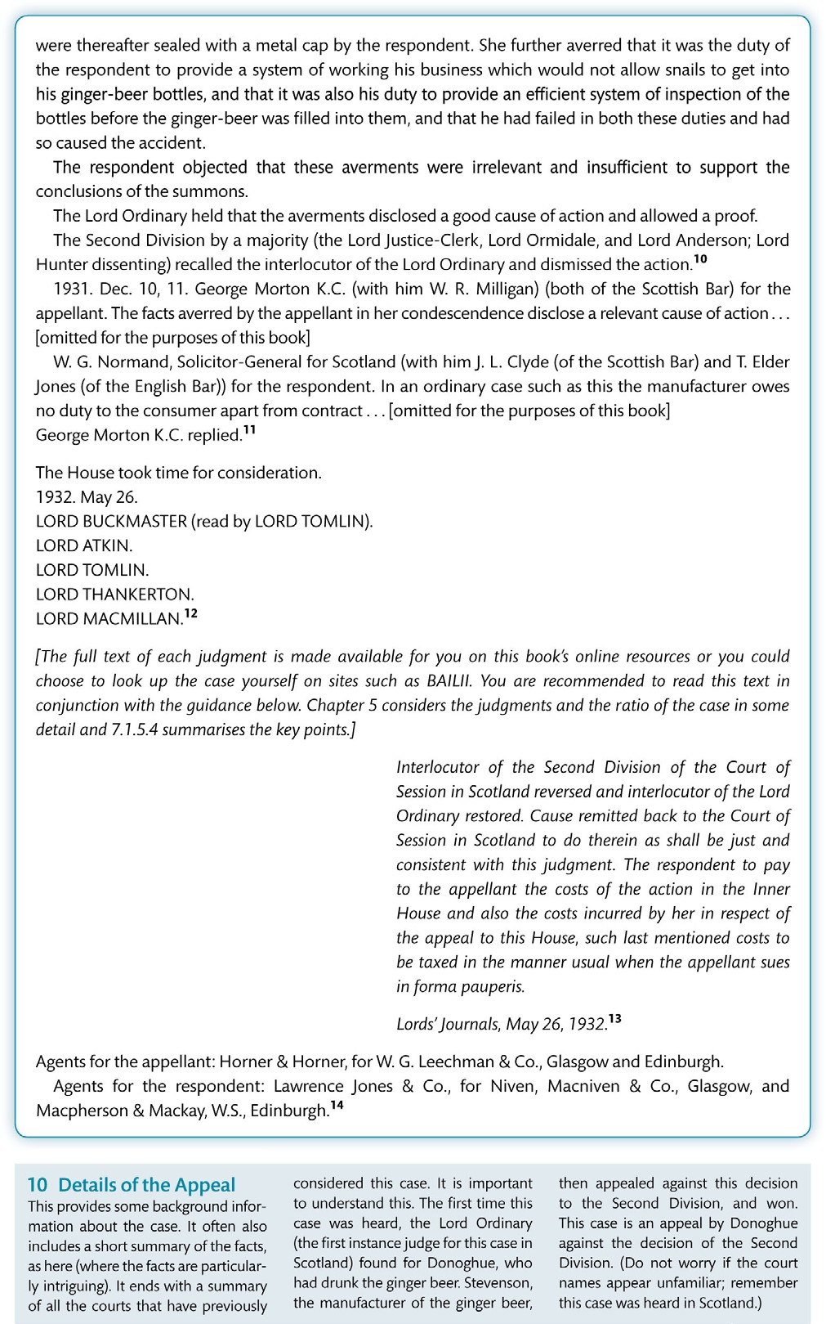
Figure 7.3 (Continued)

Slide 17
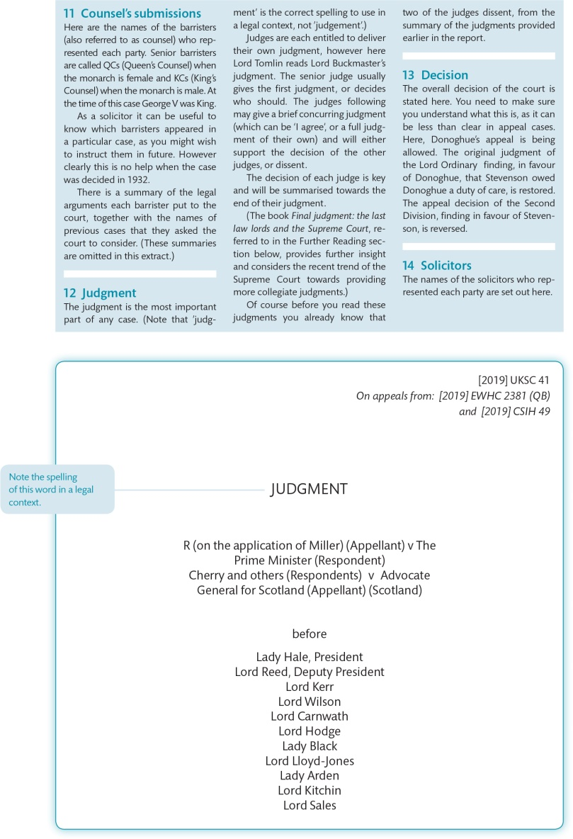
Figure 7.4 Annotated extract from R (Miller) v The Prime Minister

Slide 18
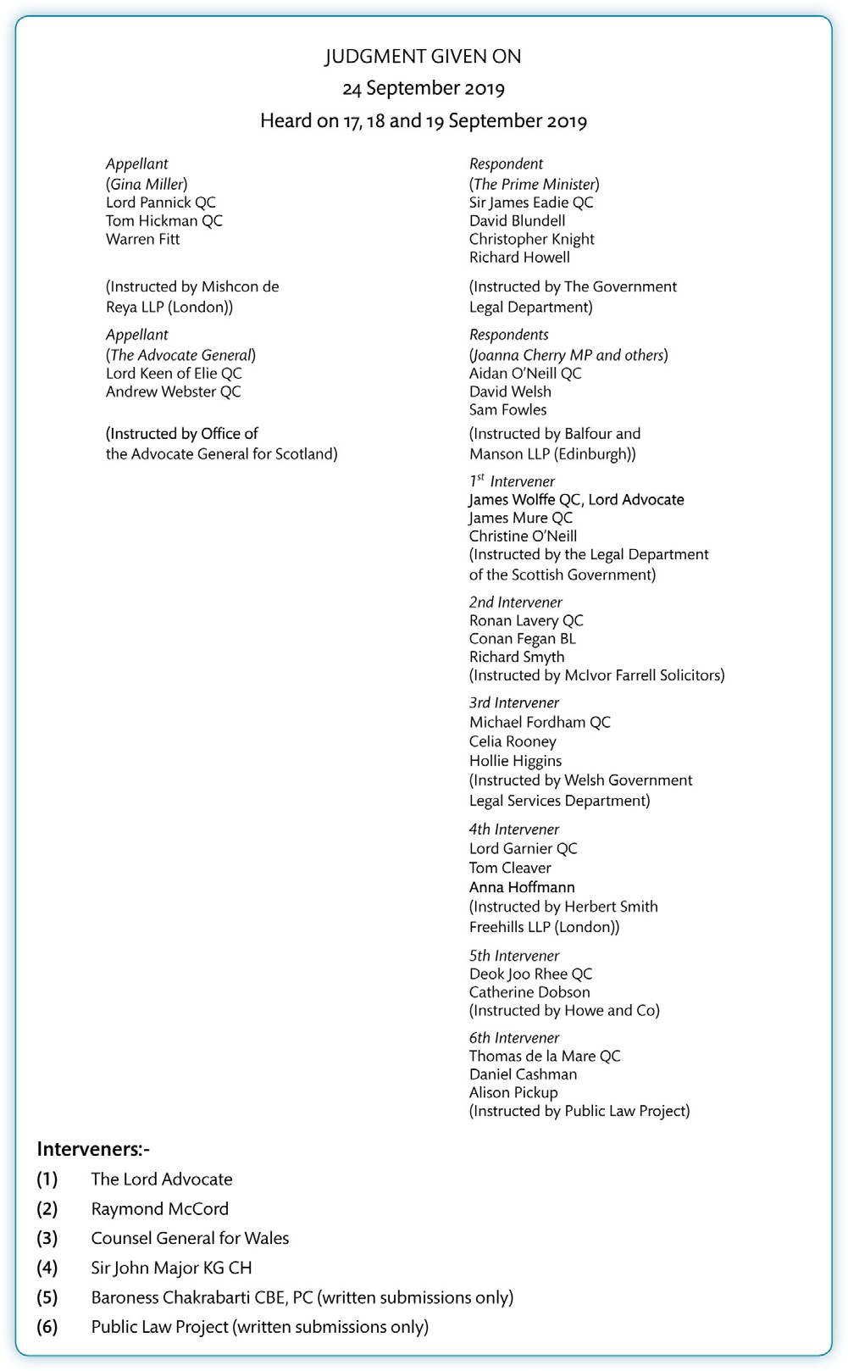
Figure 7.4 (Continued)

Slide 19
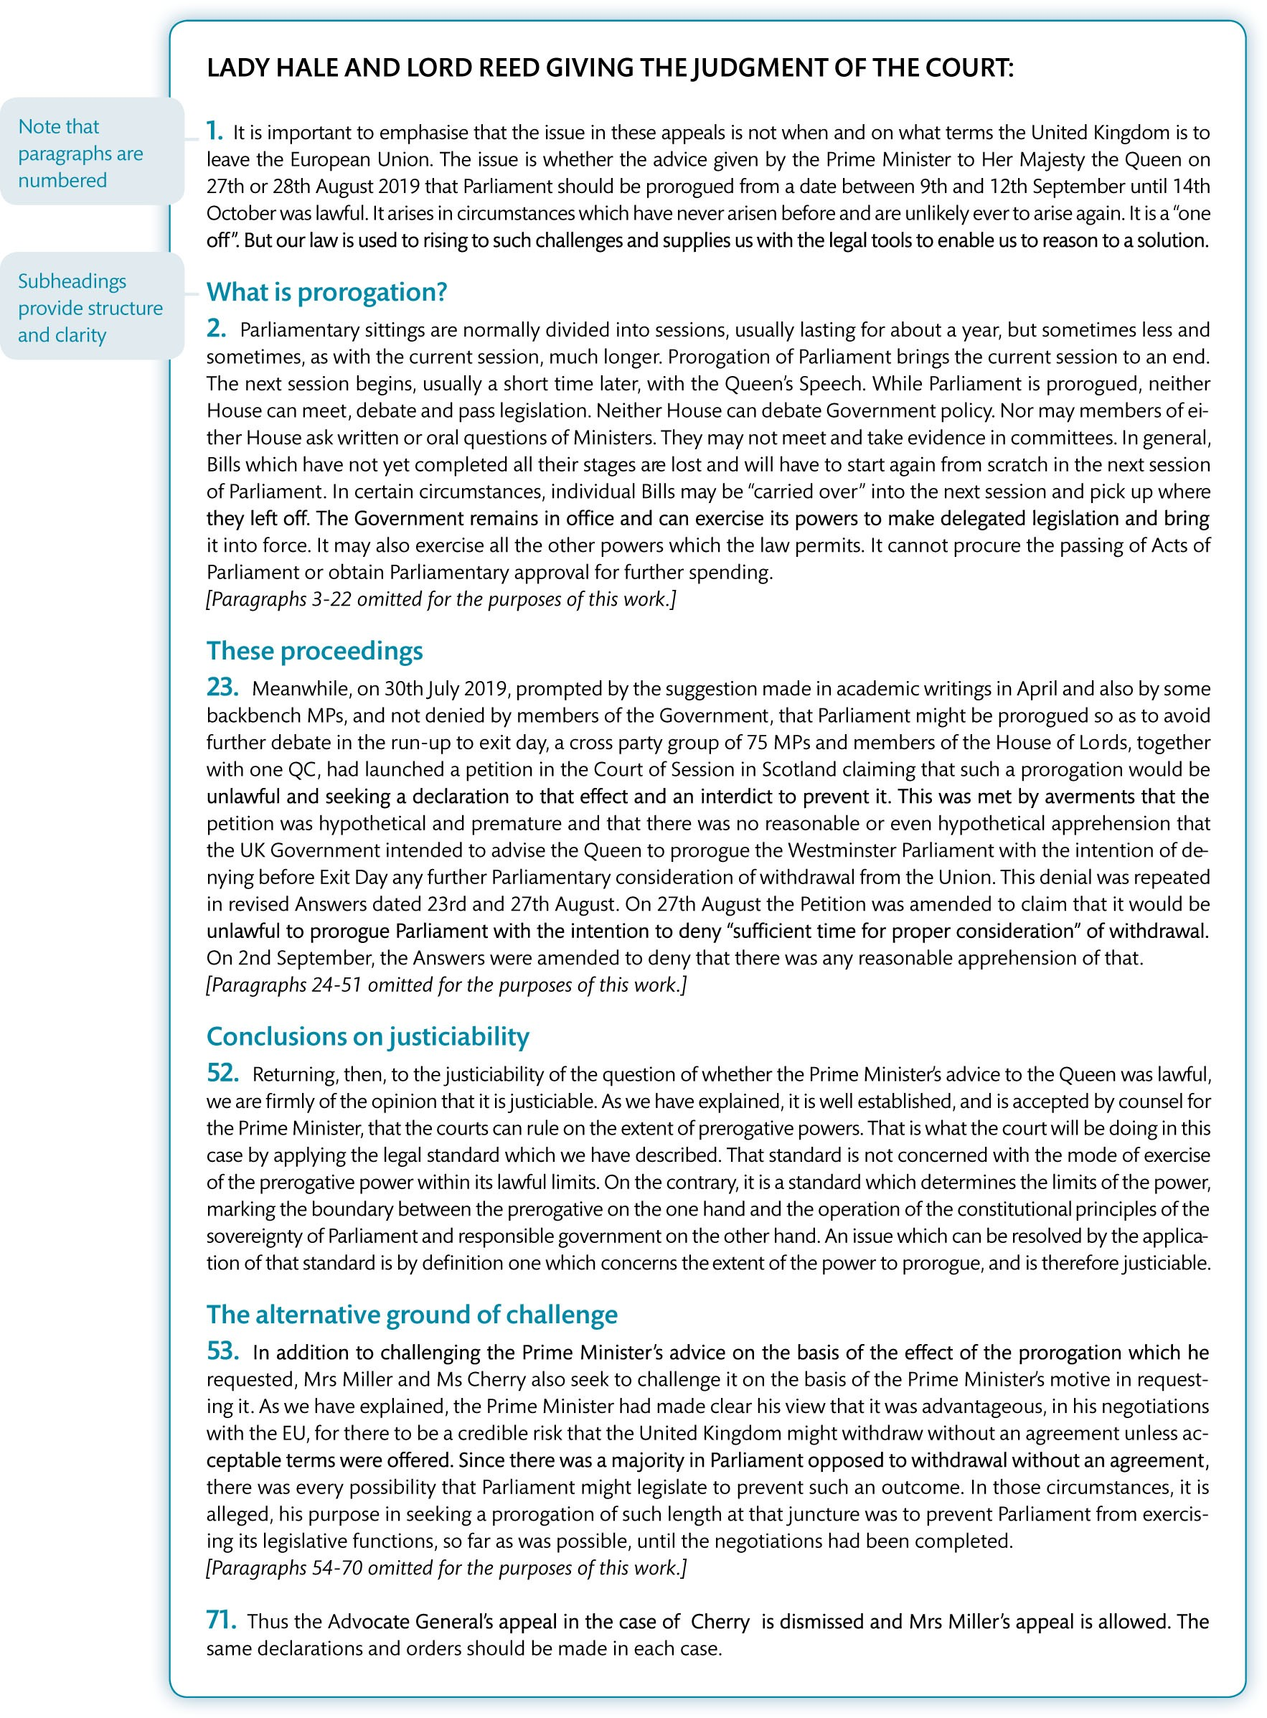
Figure 7.4 (Continued)

Slide 20
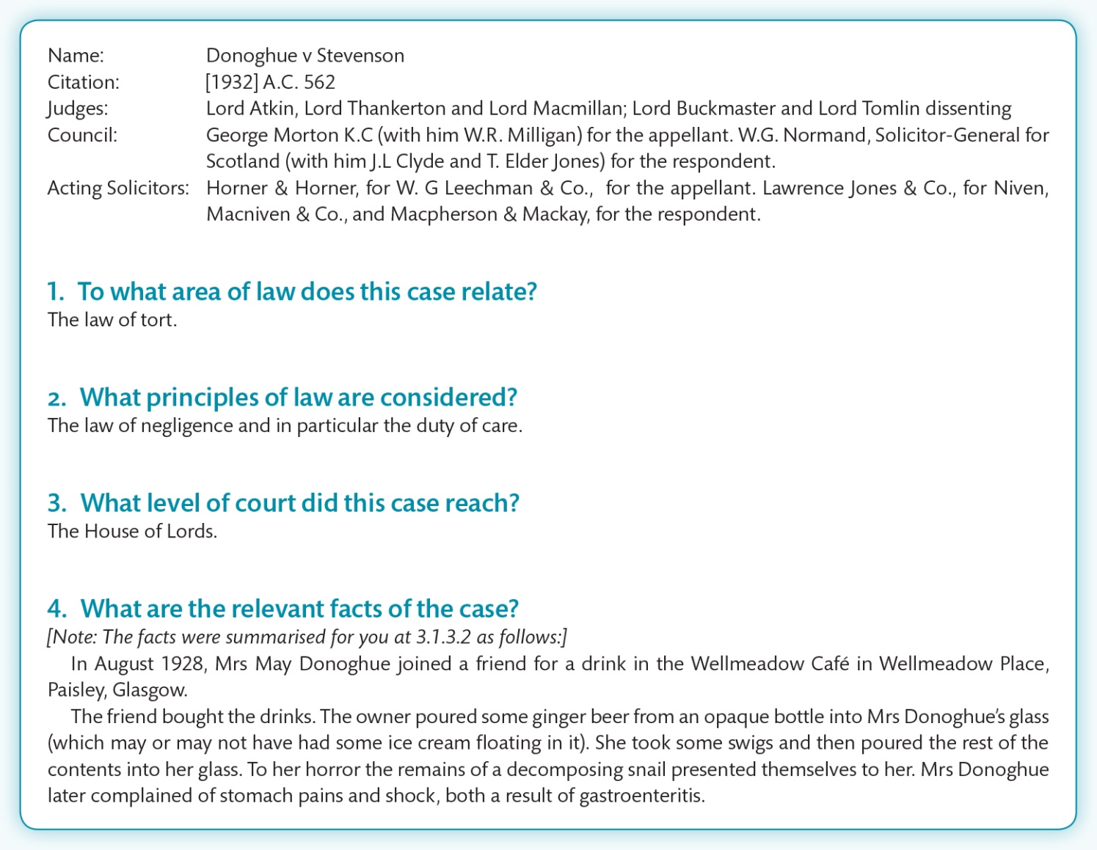
Figure 7.5 Case note on Donoghue v Stevenson

Slide 21
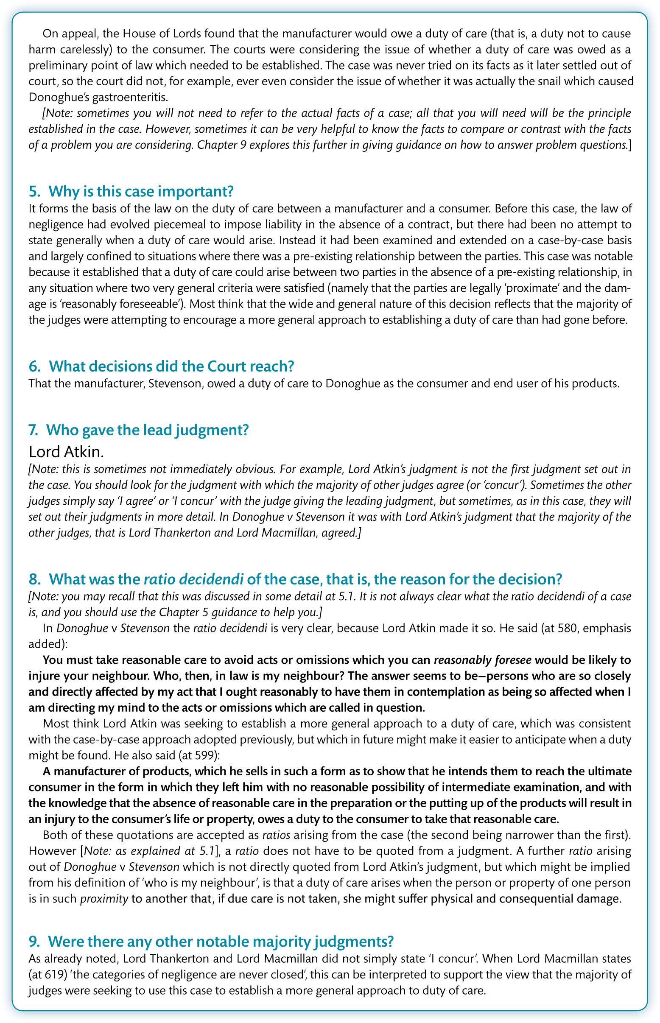
Figure 7.5 (Continued)

Slide 22
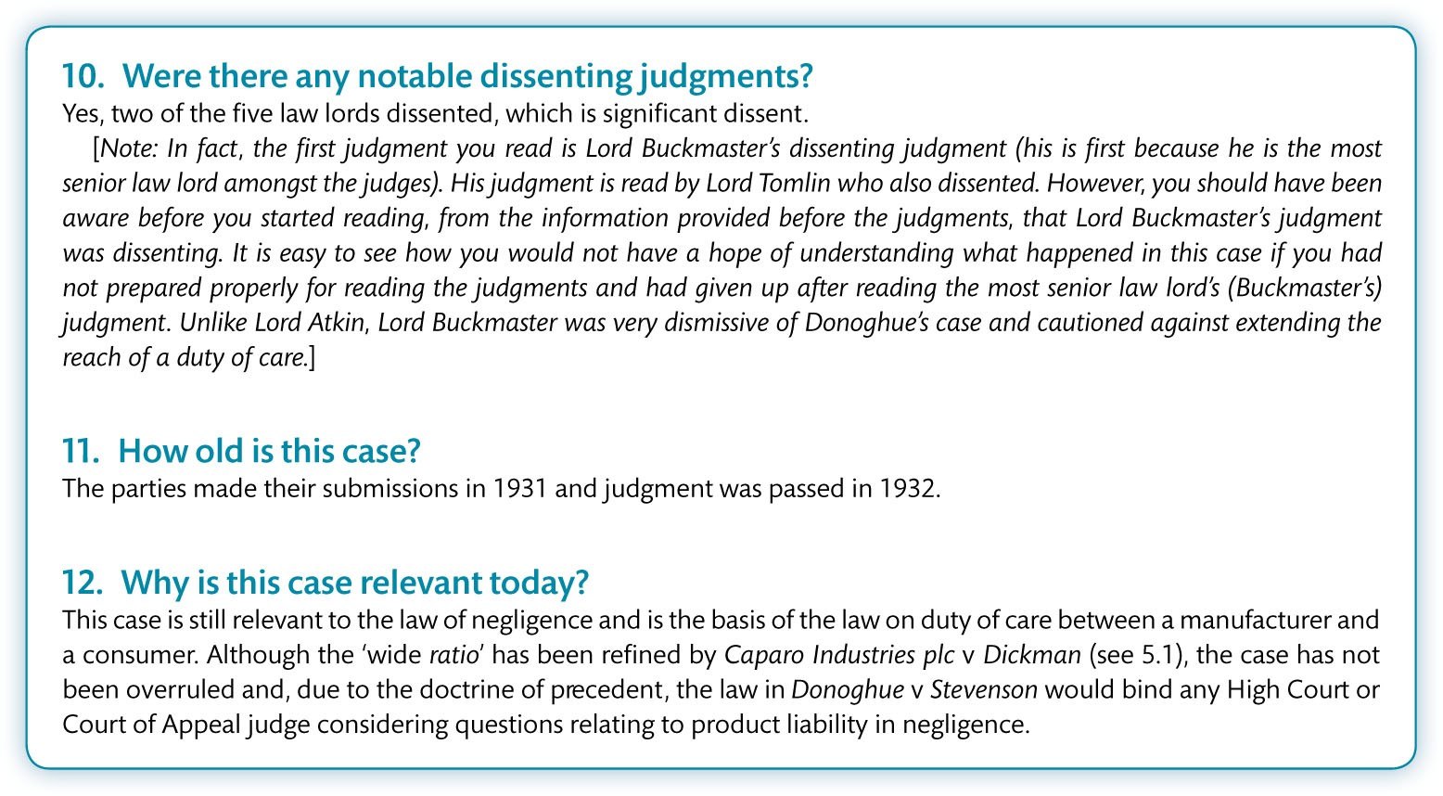
Figure 7.5 (Continued)

Slide 23
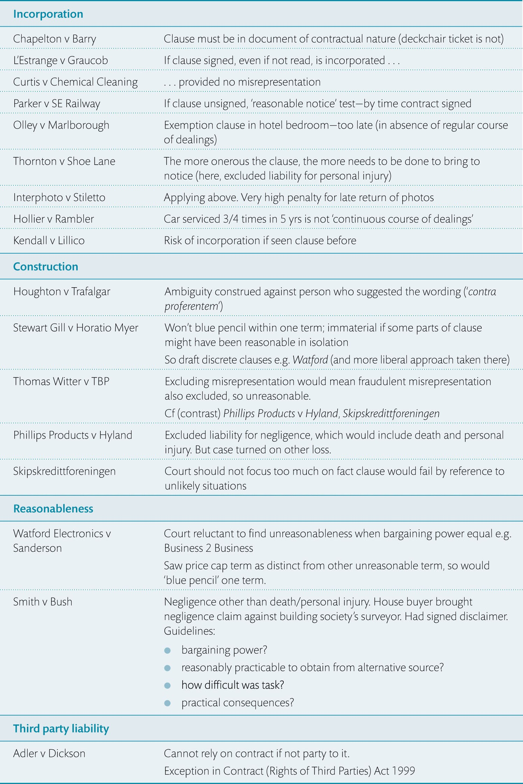
Table 7.1 Excerpt from a basic exemption clause spreadsheet

