Slide 1

Legal Systems & Skills
by Scott Slorach, Judith Embley, Peter Goodchild and Catherine Shephard

Slide 2
Part 2
Legal Skills
Chapter 11
Client interviews and meetings

Slide 3
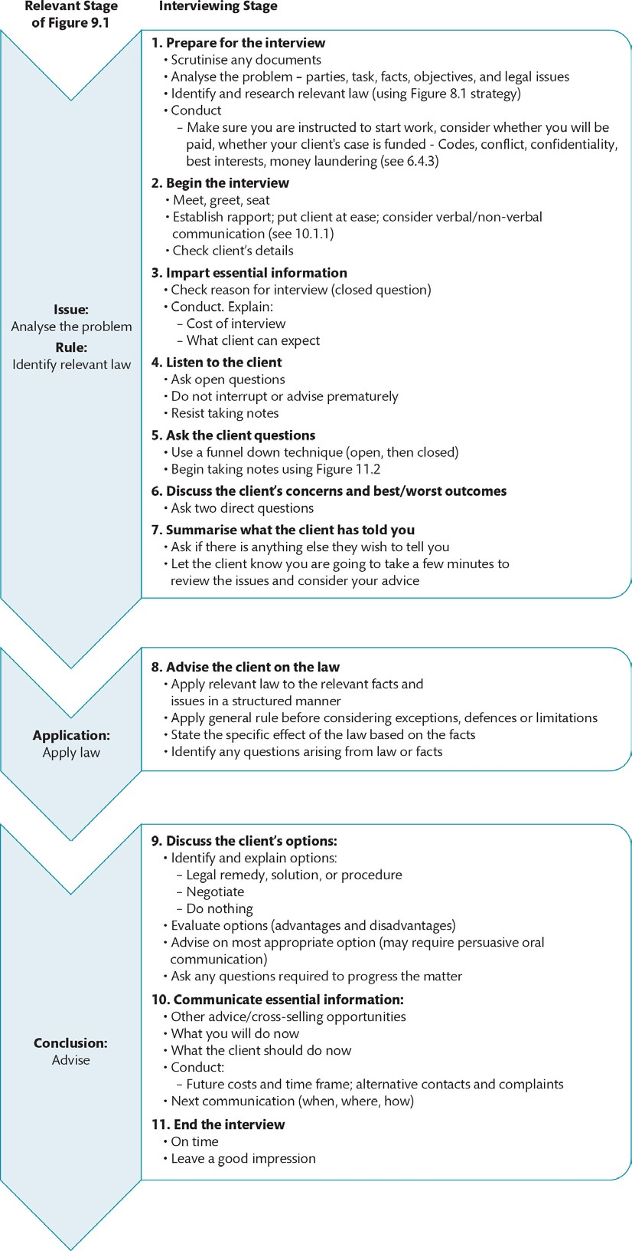
Figure 11.1 Interviewing strategy

Slide 4
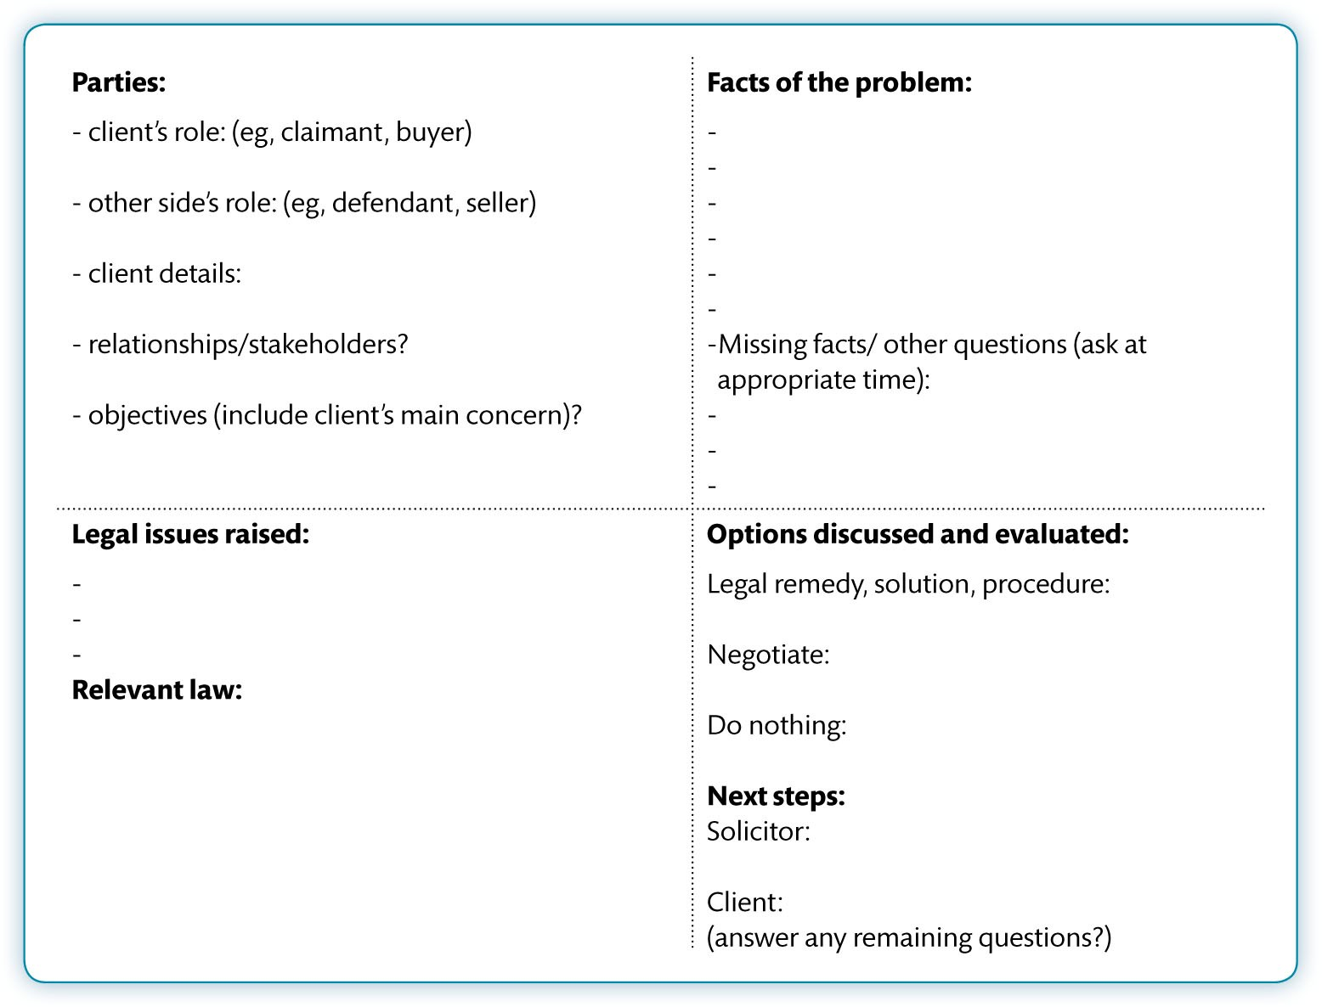
Figure 11.2 Contemporaneous note-taking for problem-solving template

Slide 5
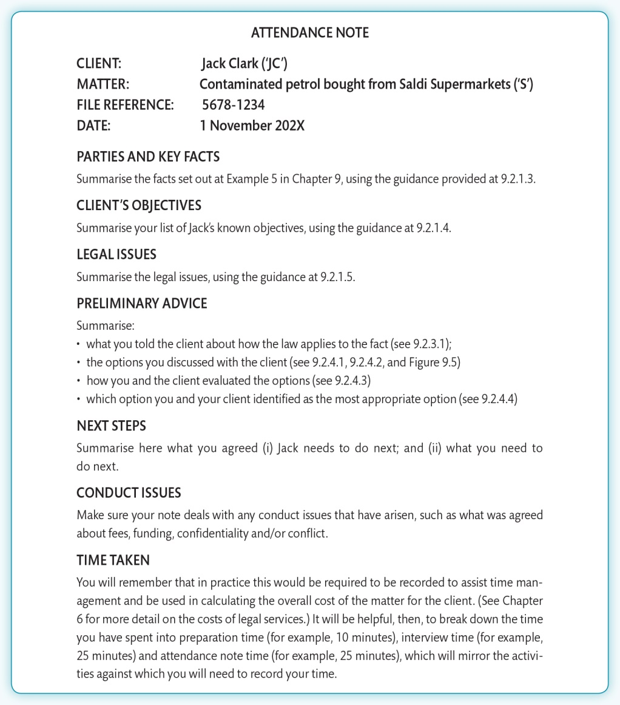
Figure 11.3 Attendance note template

