Slide 1
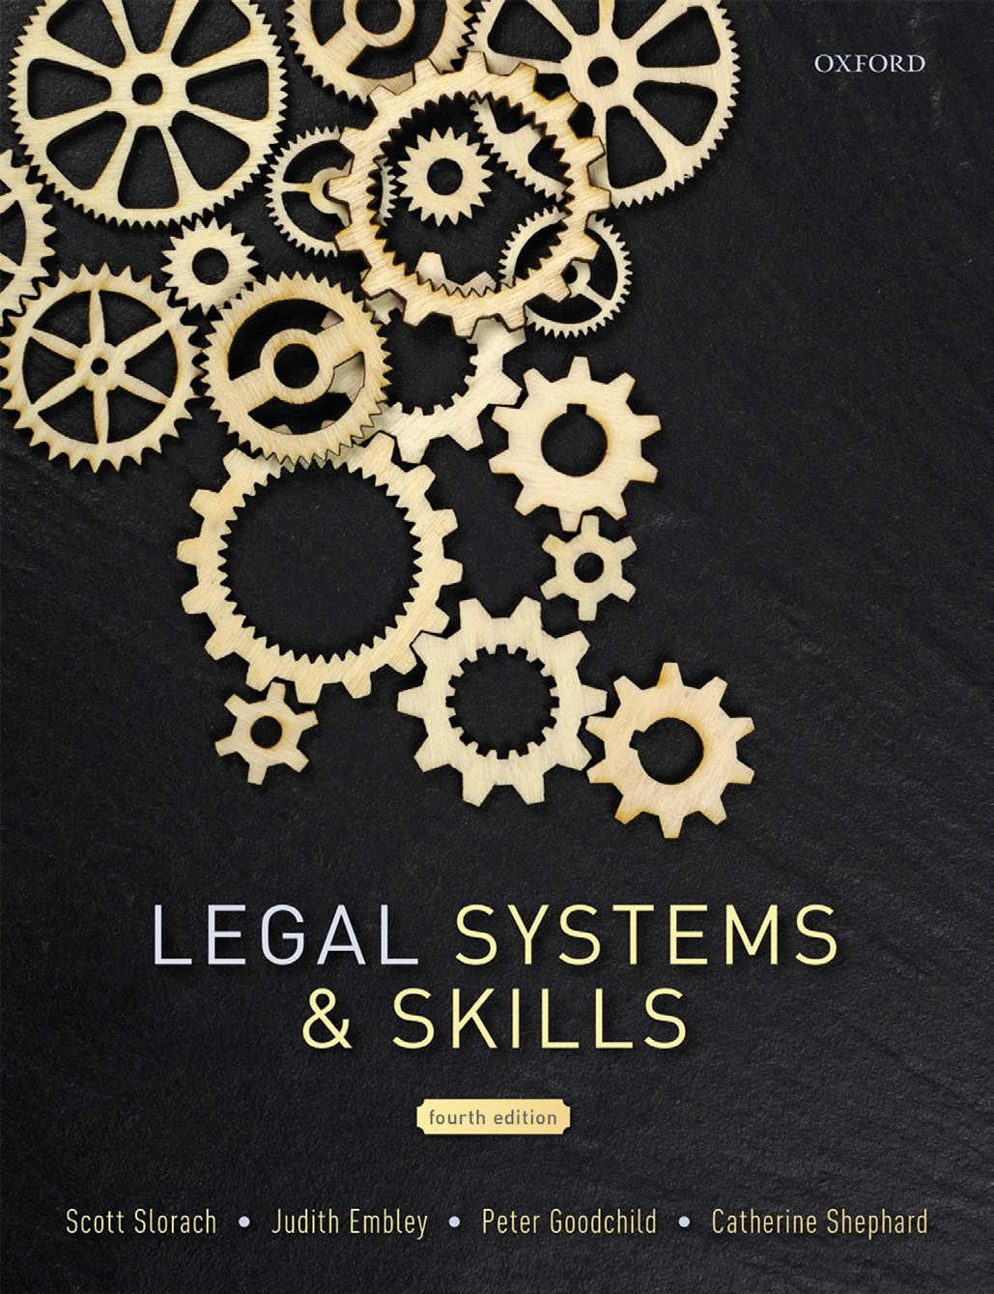
Legal Systems & Skills
by Scott Slorach, Judith Embley, Peter Goodchild and Catherine Shephard

Slide 2
Part 2
Legal Skills
Chapter 13
Advocacy and mooting

Slide 3
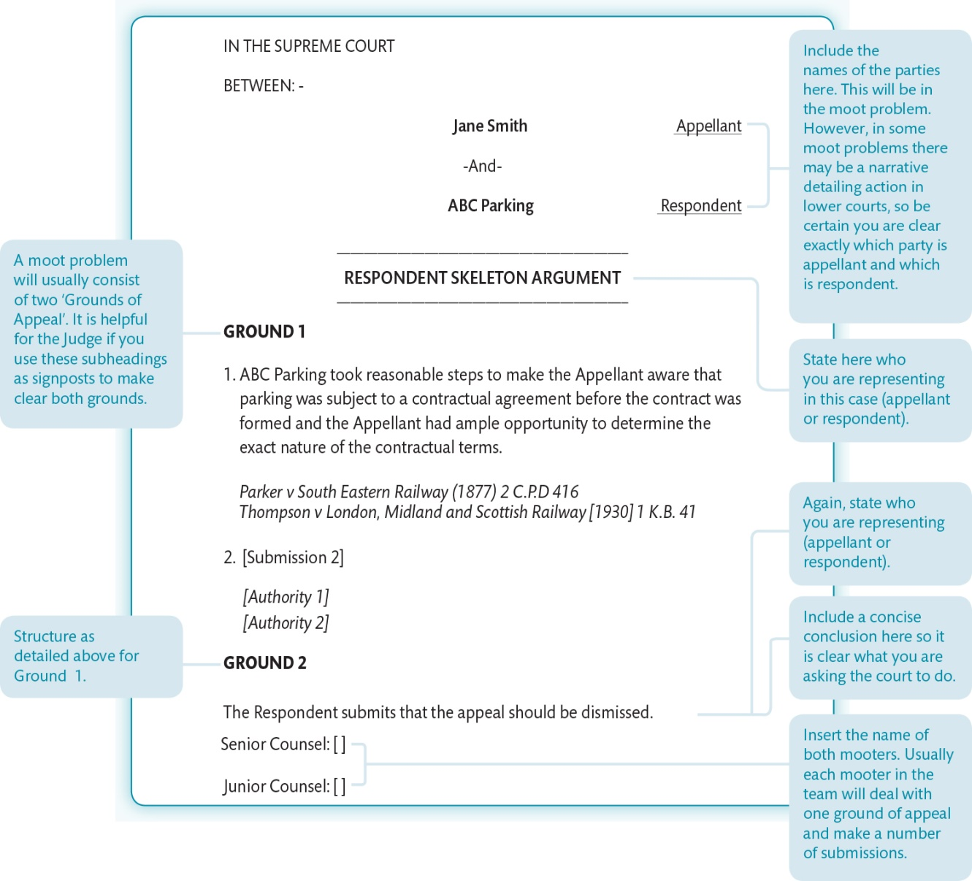
Figure 13.1 Example respondent skeleton argument

Slide 4
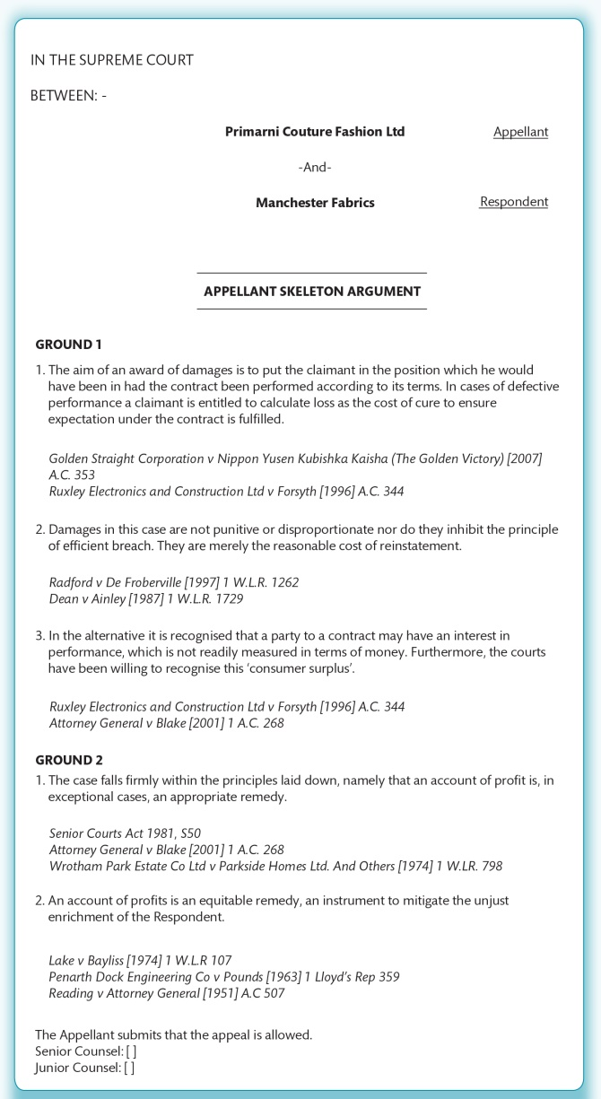
Figure 13.2 Example appellant skeleton argument

Slide 5
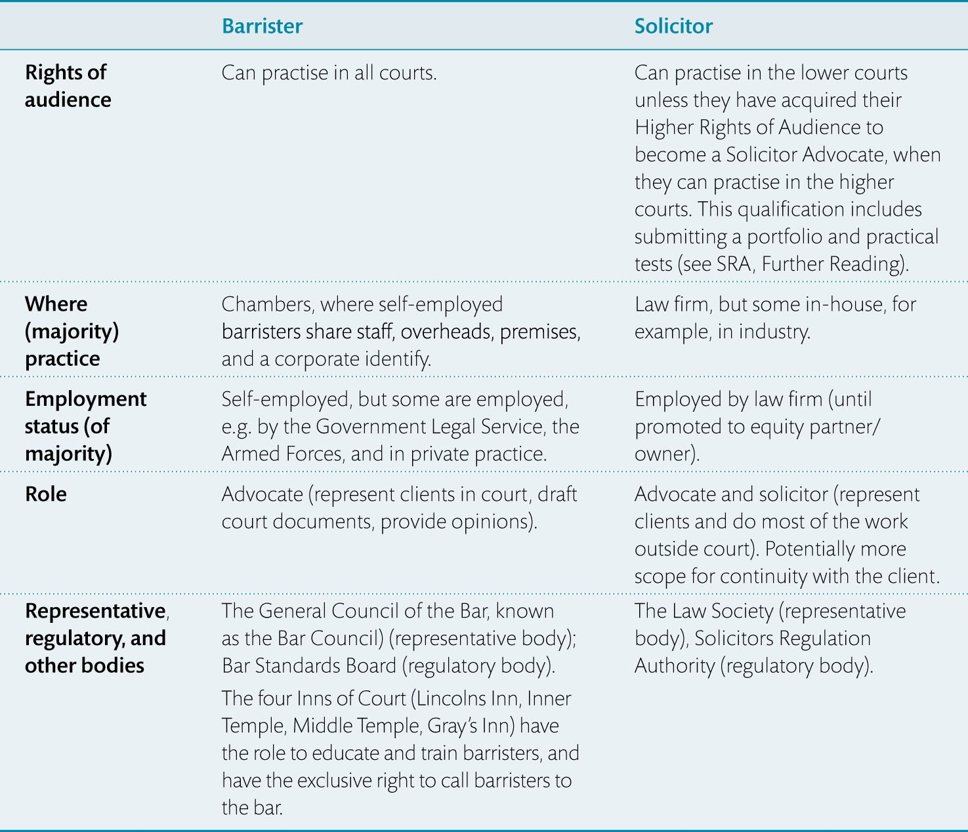
Table 13.1 Some of the key differences between a solicitor and barrister

