Slide 1
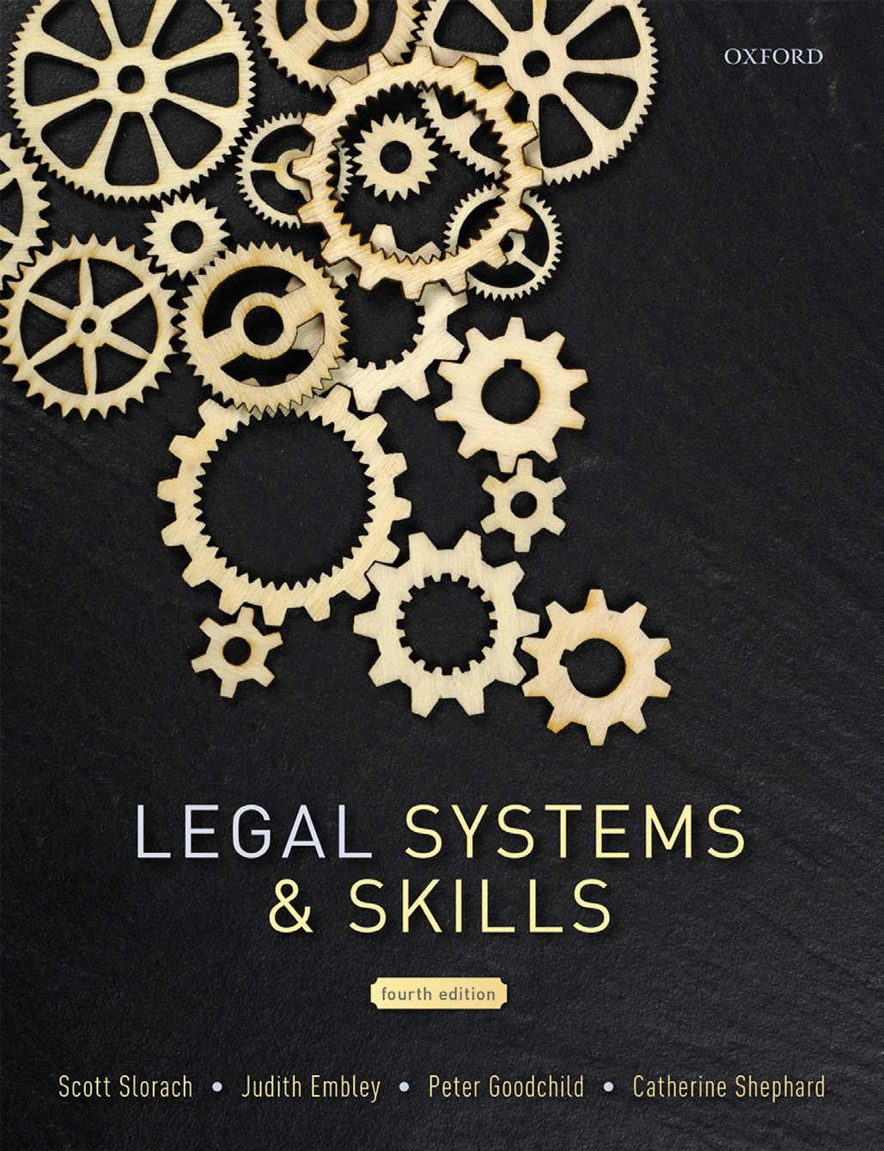
Legal Systems & Skills
by Scott Slorach, Judith Embley, Peter Goodchild and Catherine Shephard

Slide 2
Part 2
Legal Skills
Chapter 12
Negotiation and mediation

Slide 3
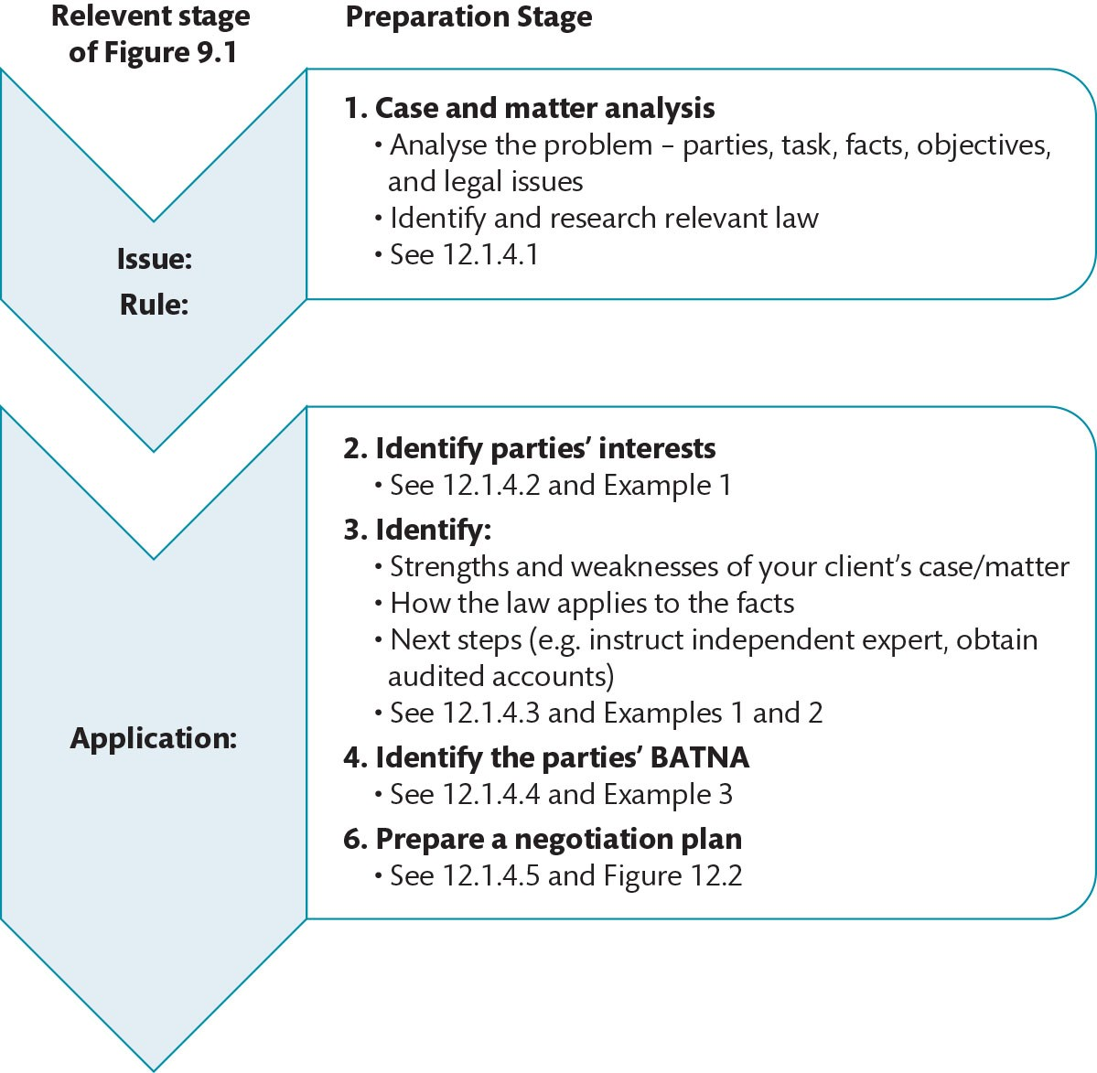
Figure 12.1 Steps to prepare for a negotiation

Slide 4
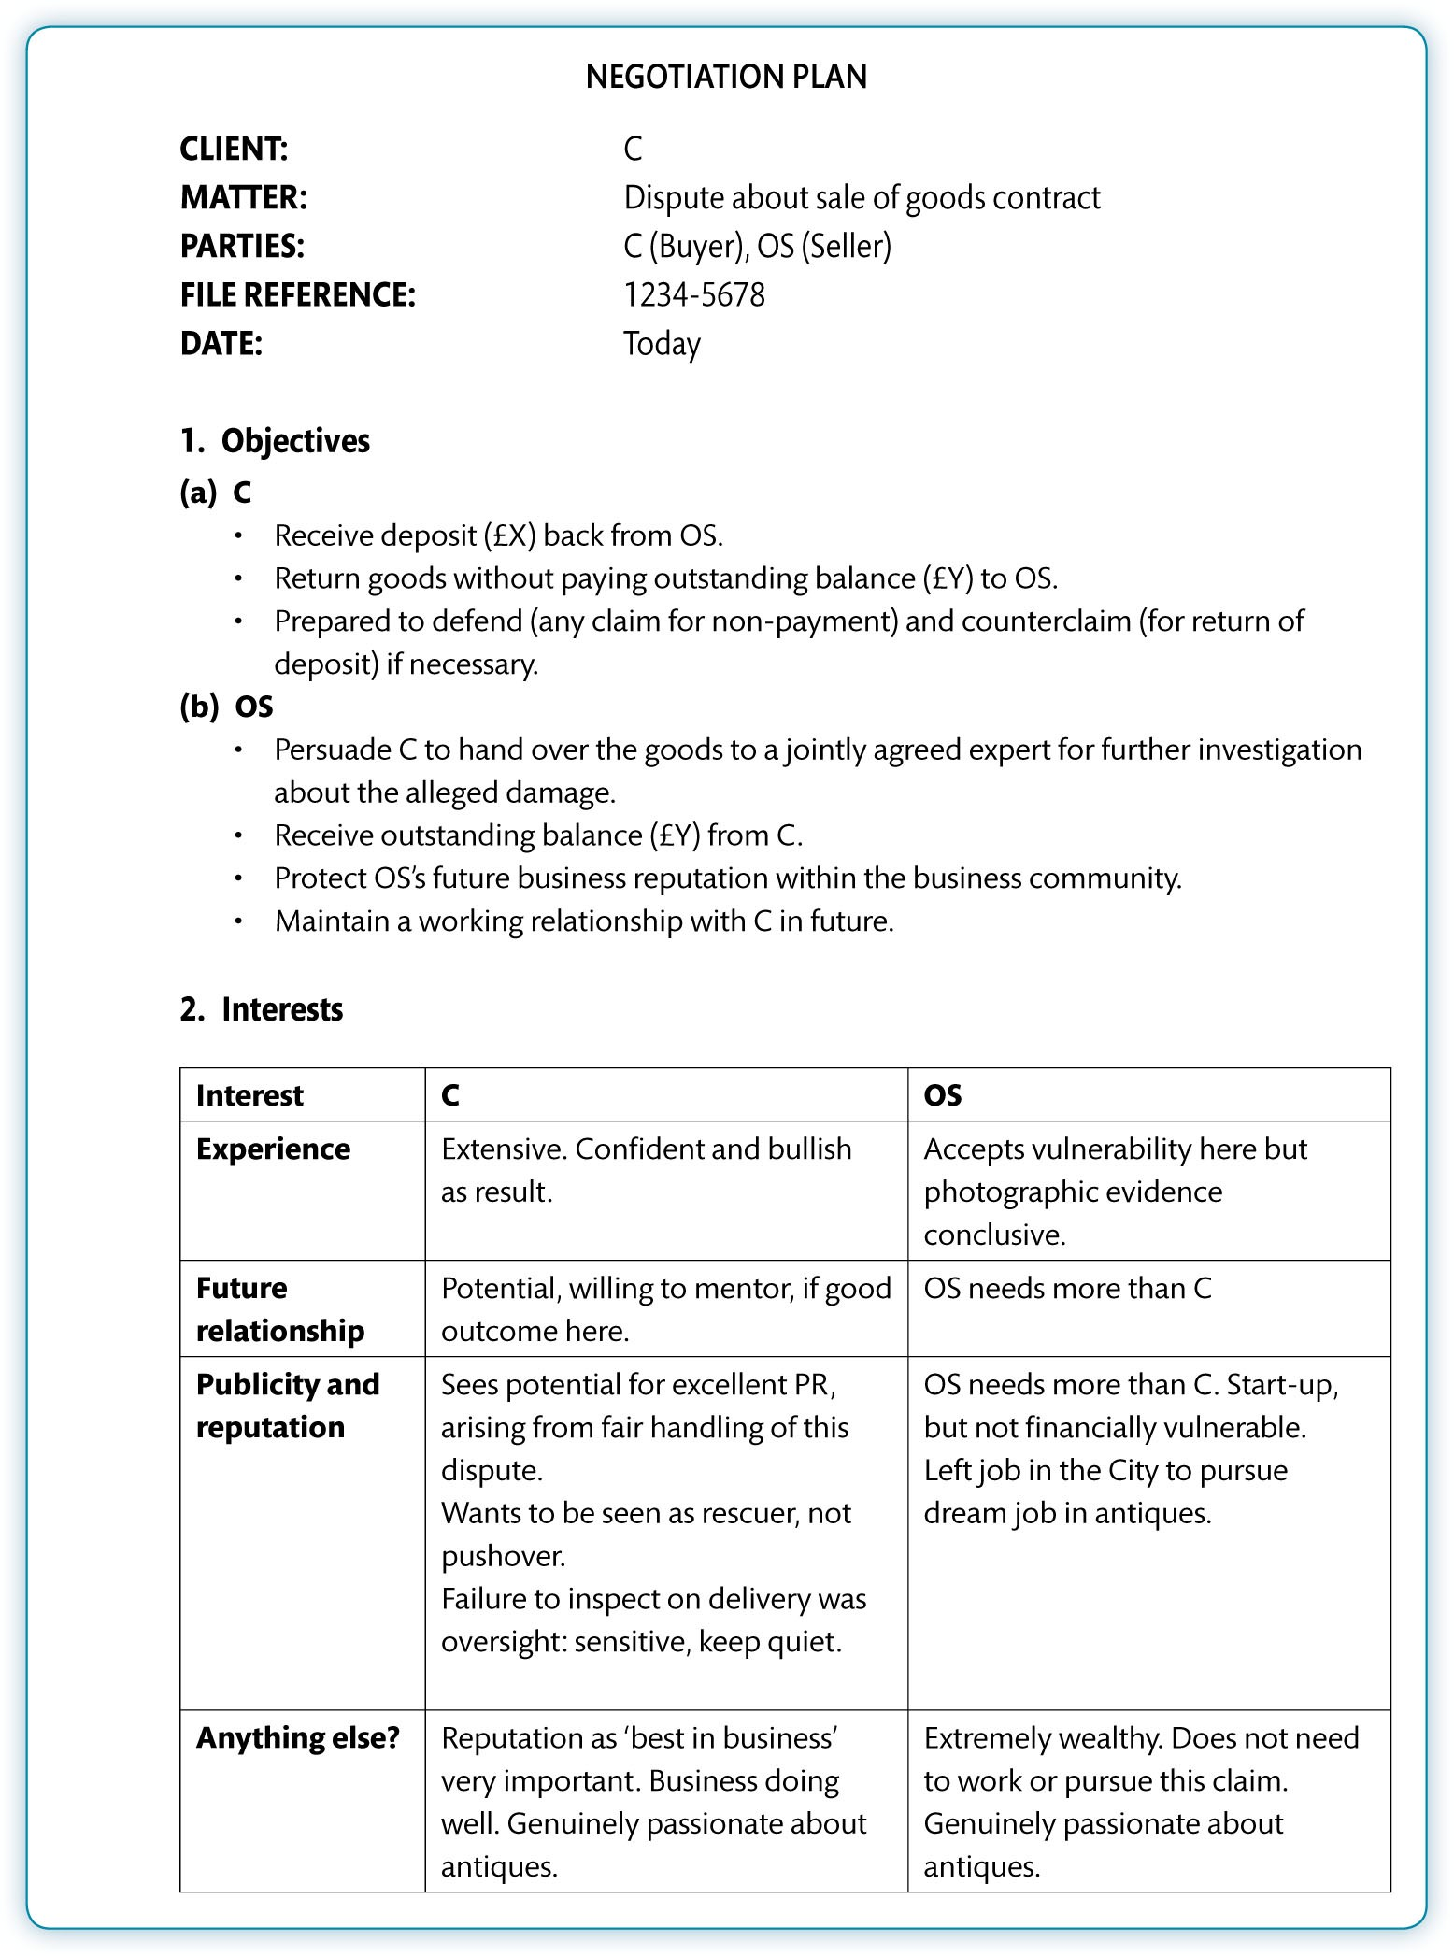
Figure 12.2 Example negotiation plan

Slide 5
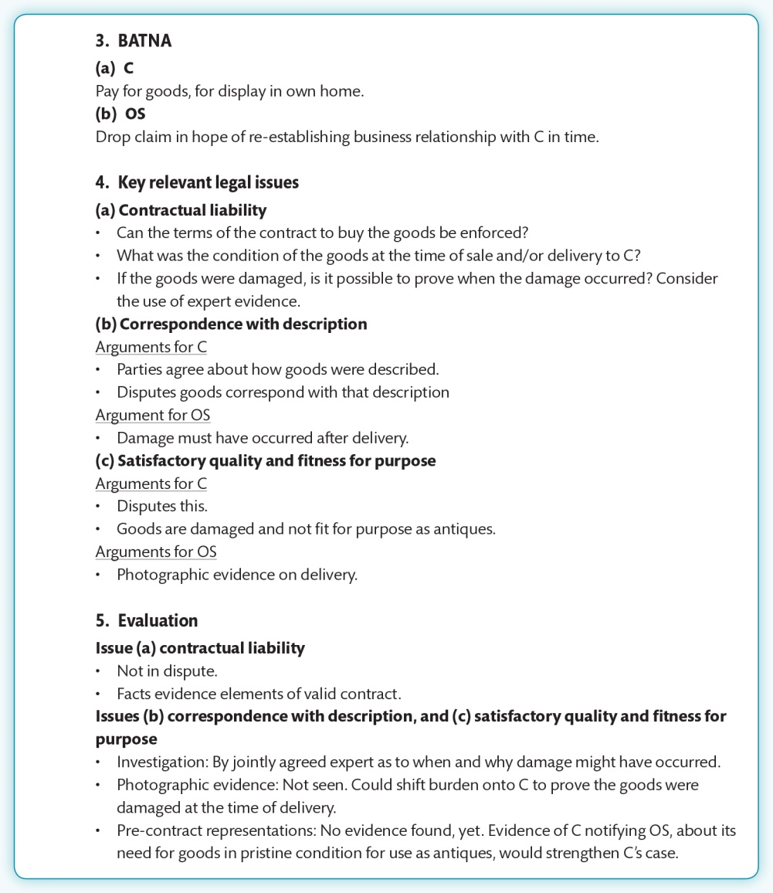
Figure 12.2 (Continued)

Slide 6
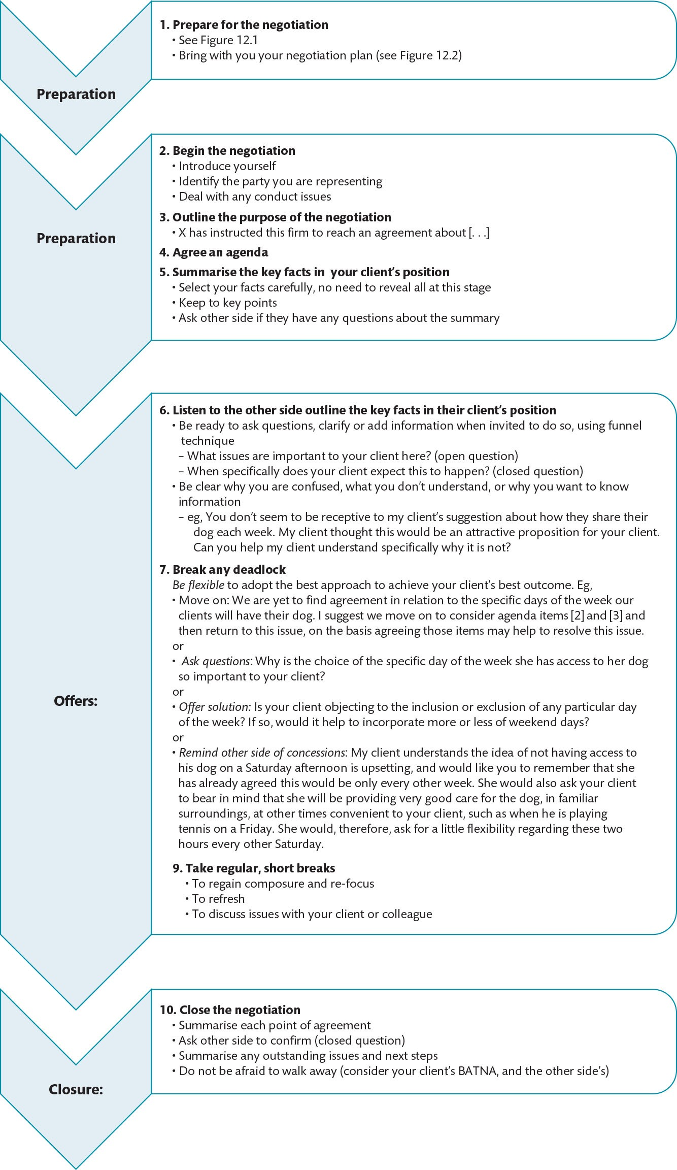
Figure 12.3 Negotiation strategy

Slide 7
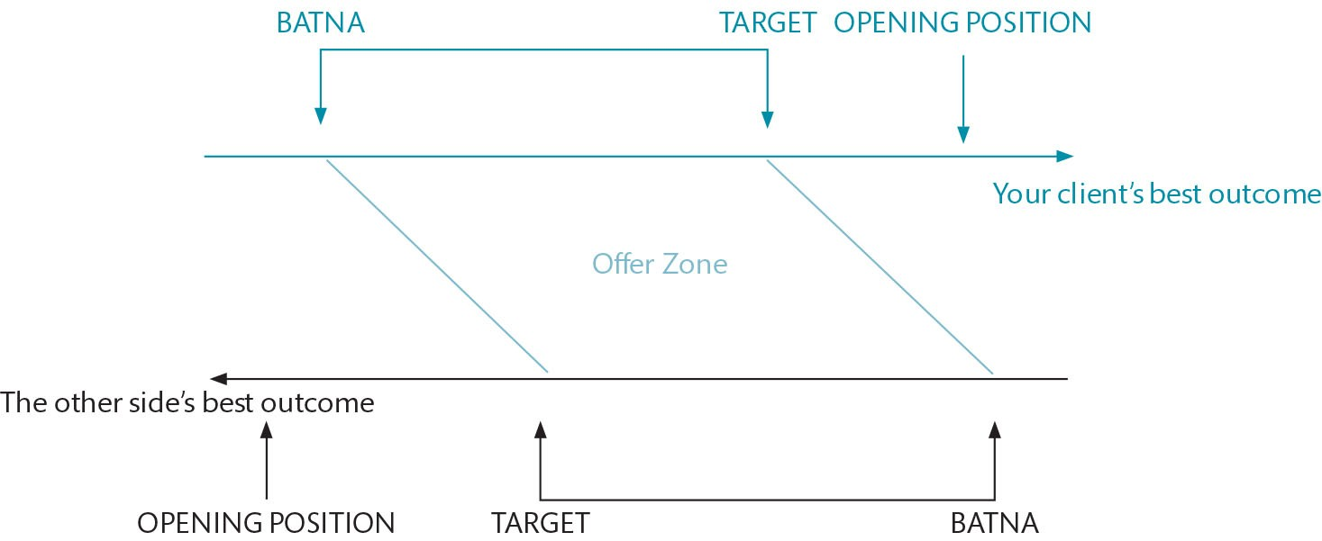
Figure 12.4 The offer zone

Slide 8
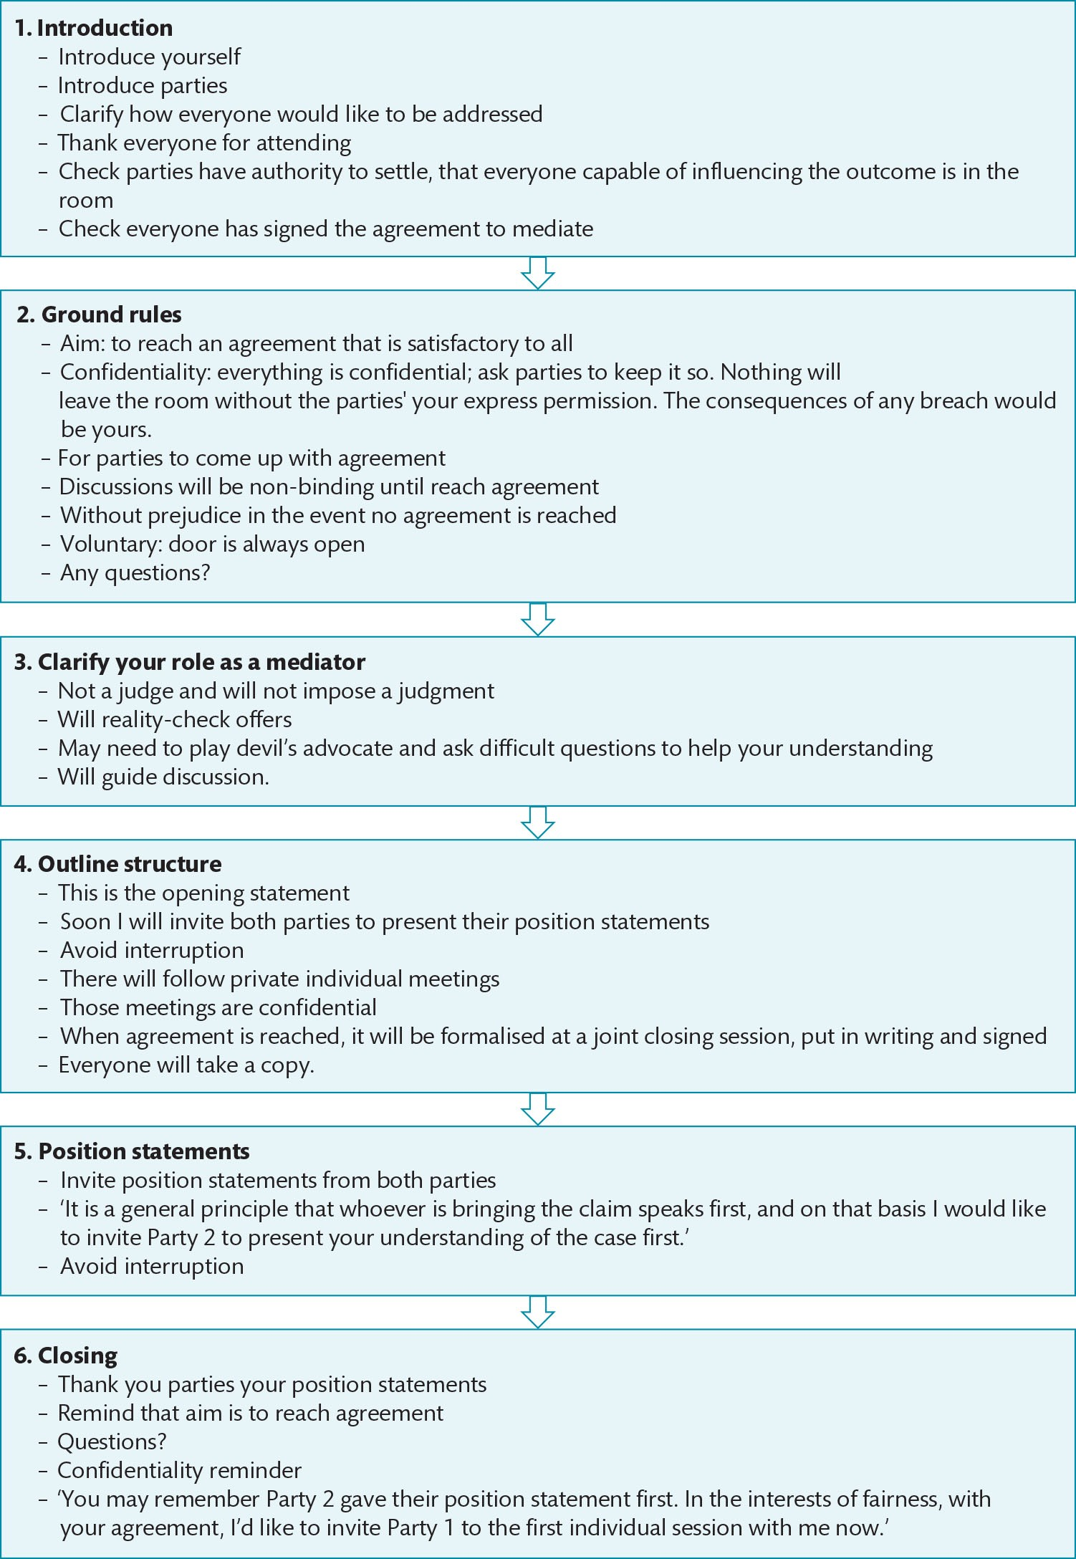
Figure 12.5 The Opening Statement

Slide 9
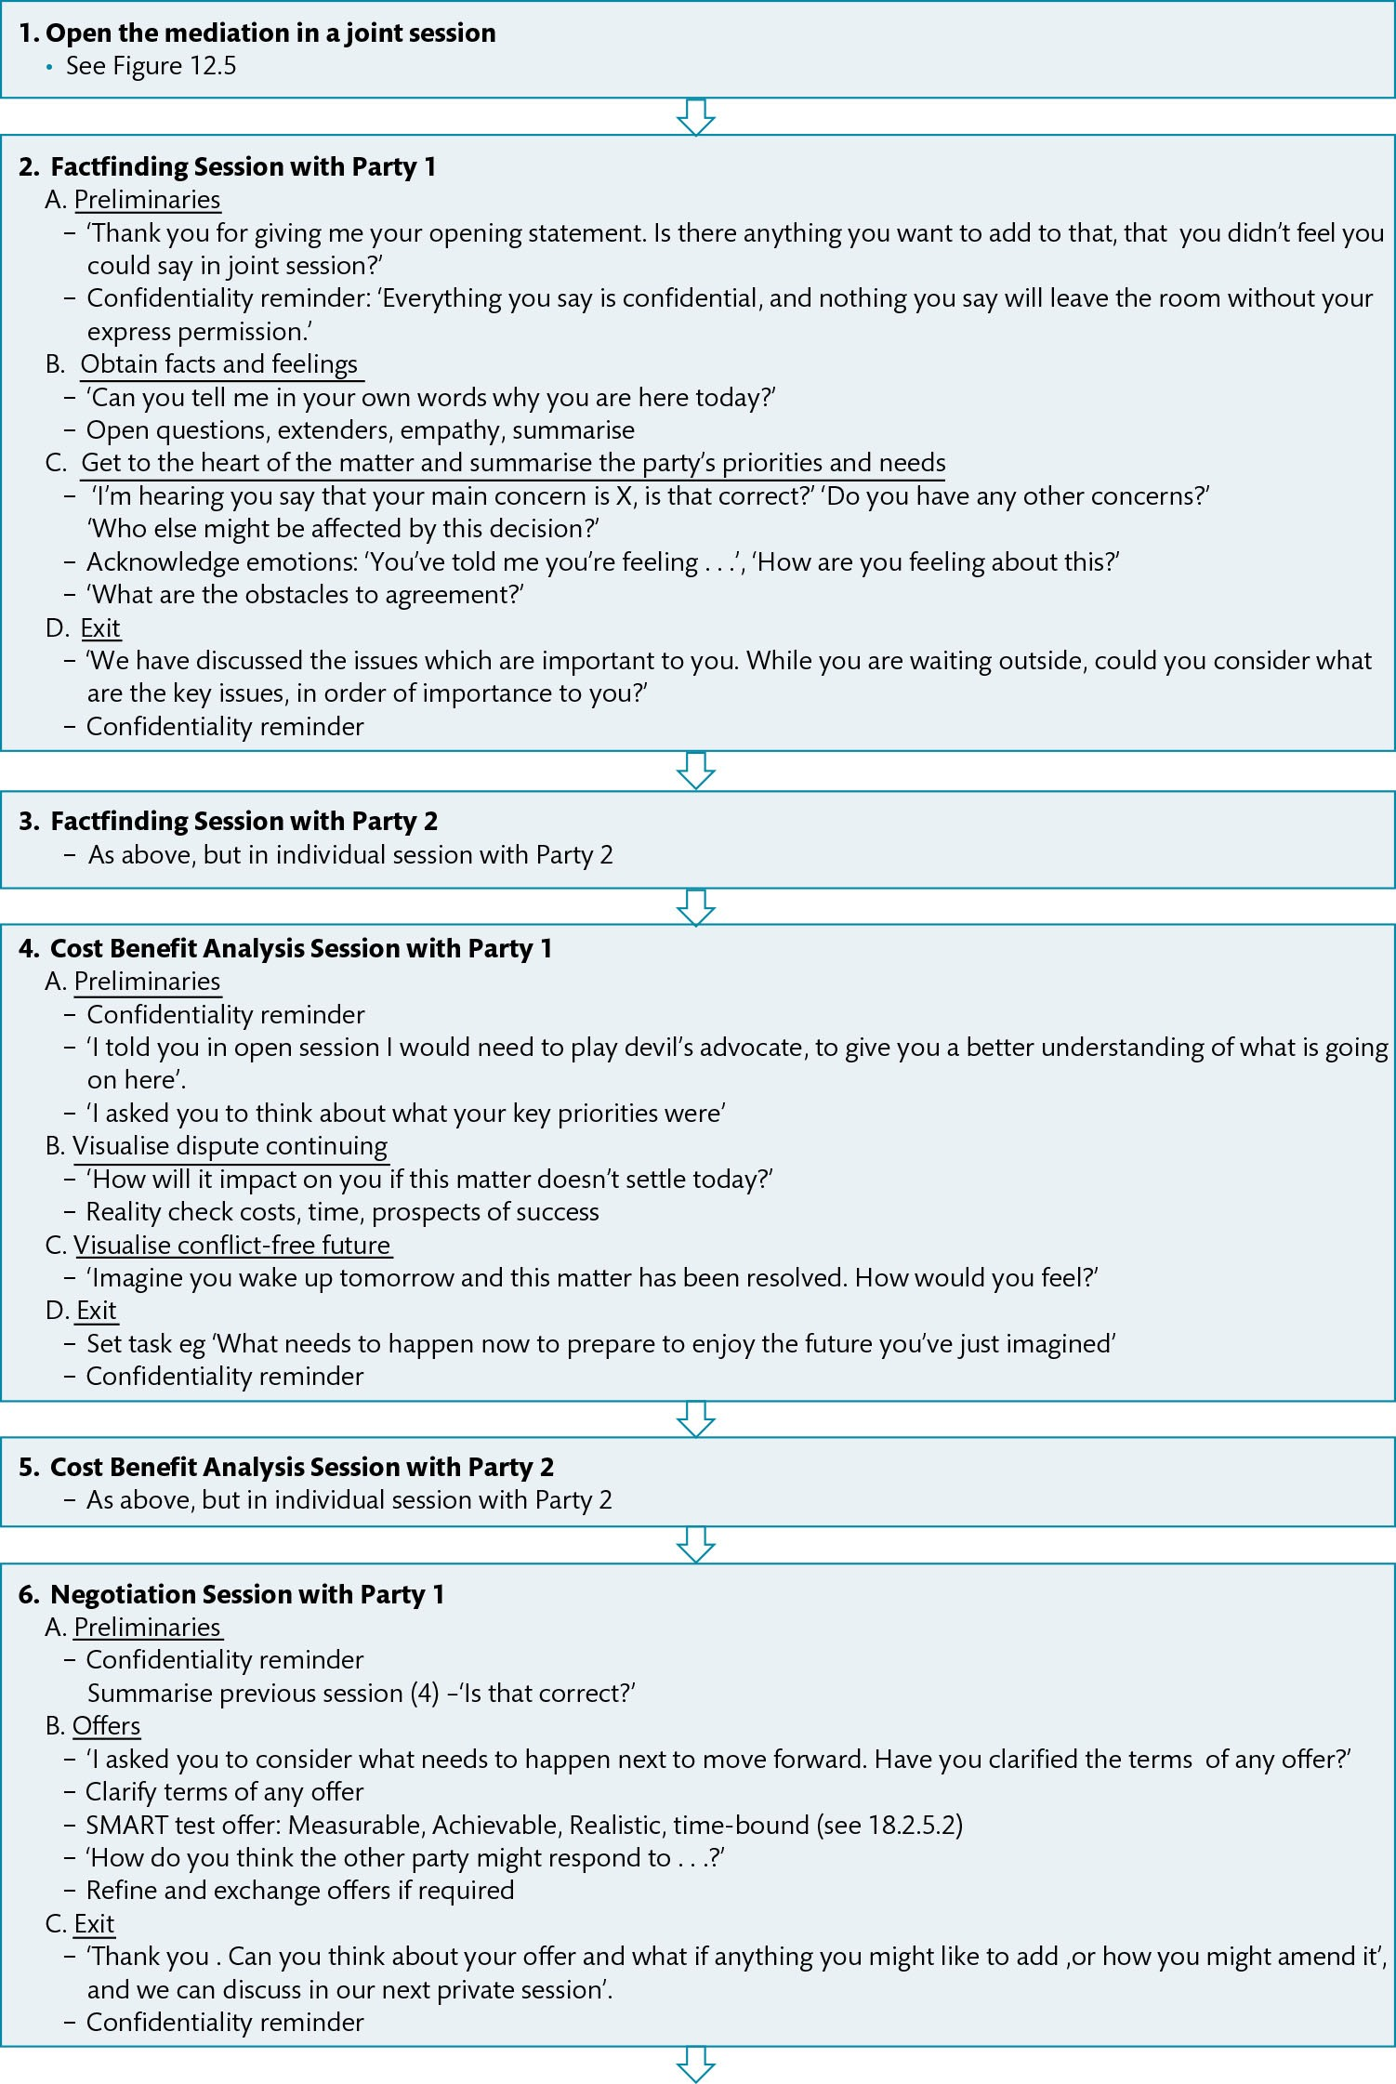
Figure 12.6 The Mediation Process

Slide 10
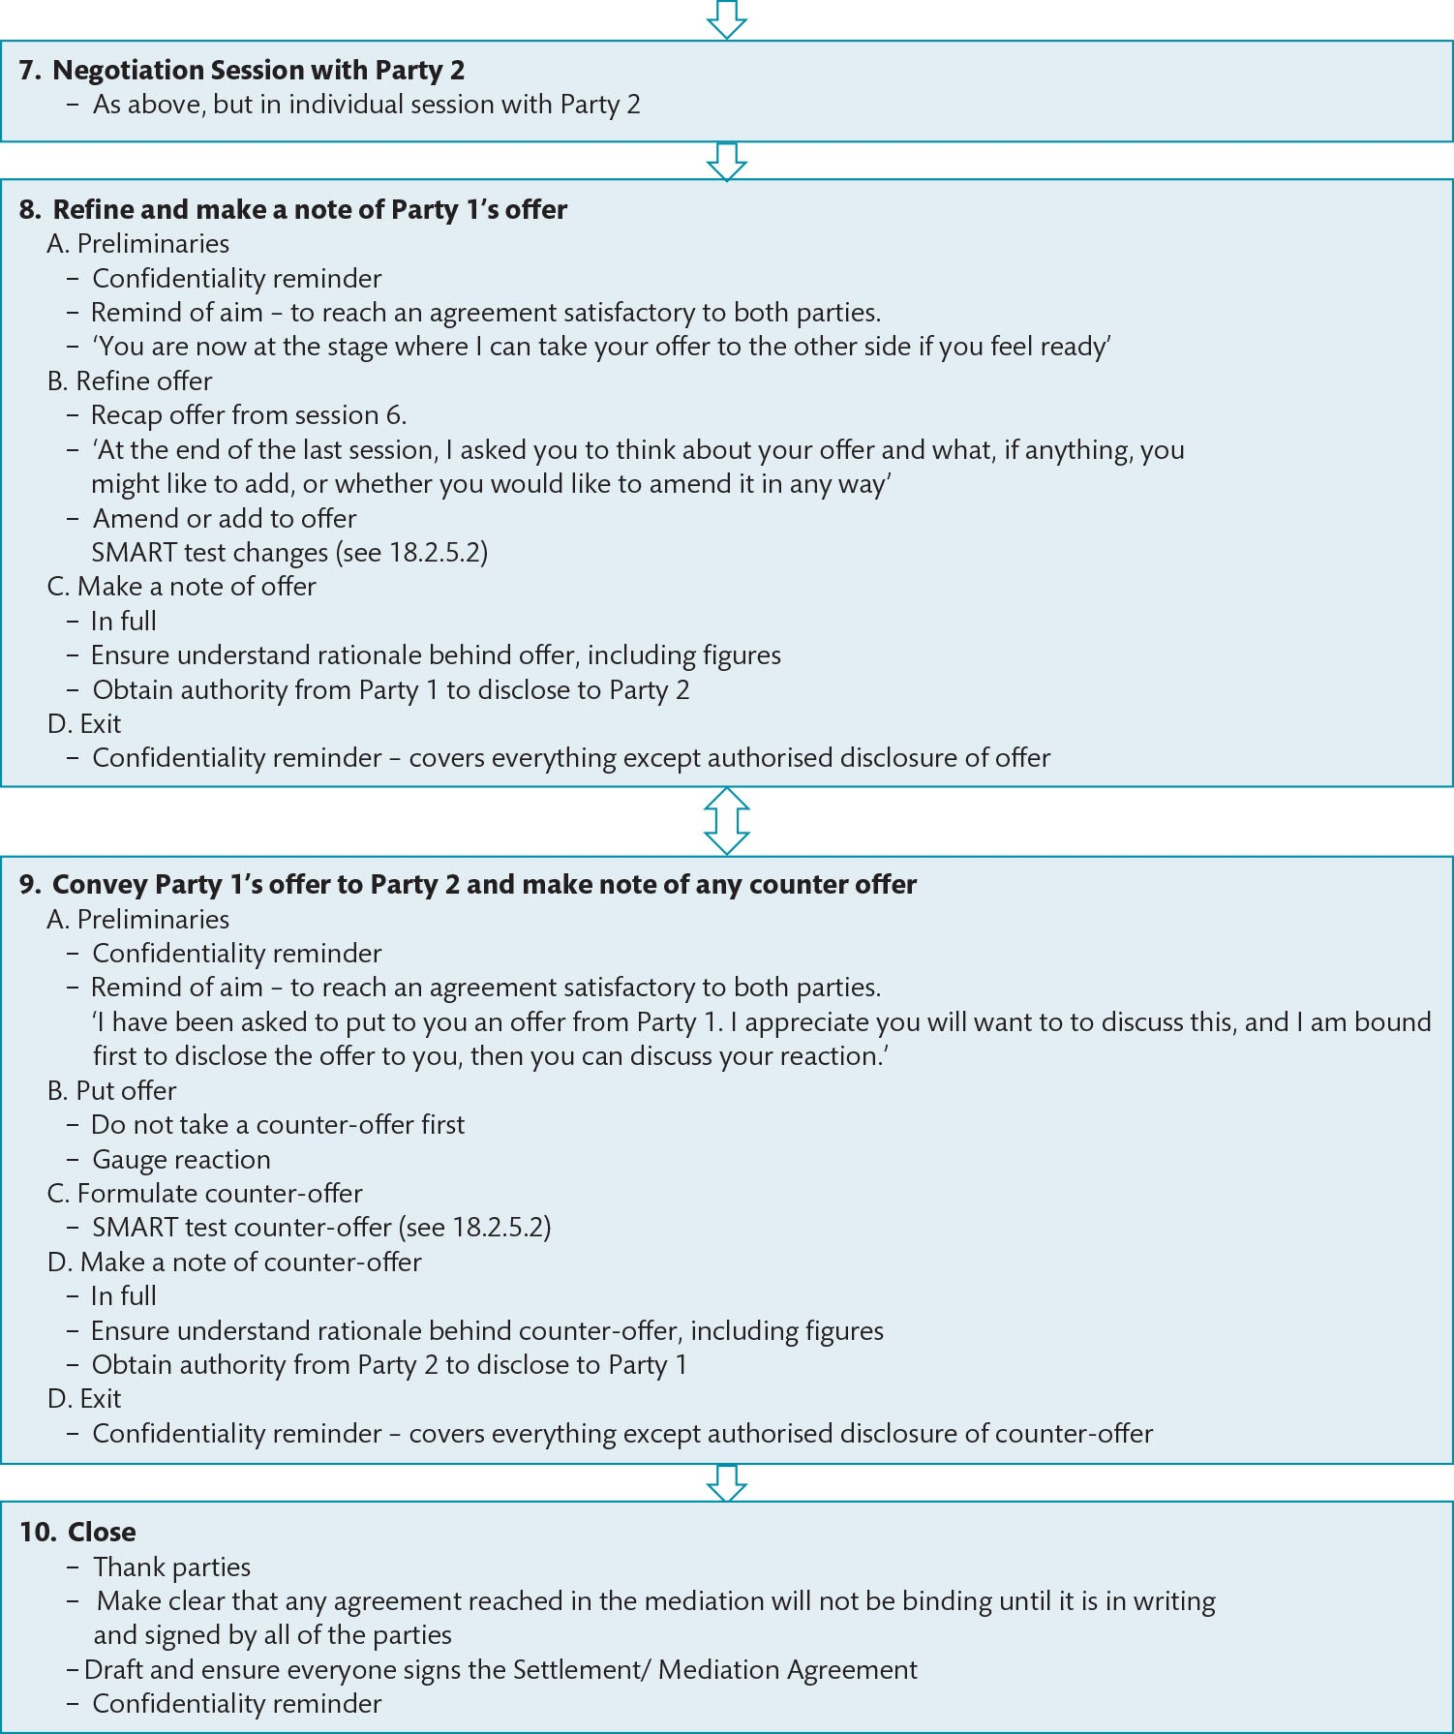
Figure 12.6 (Continued)

Slide 11
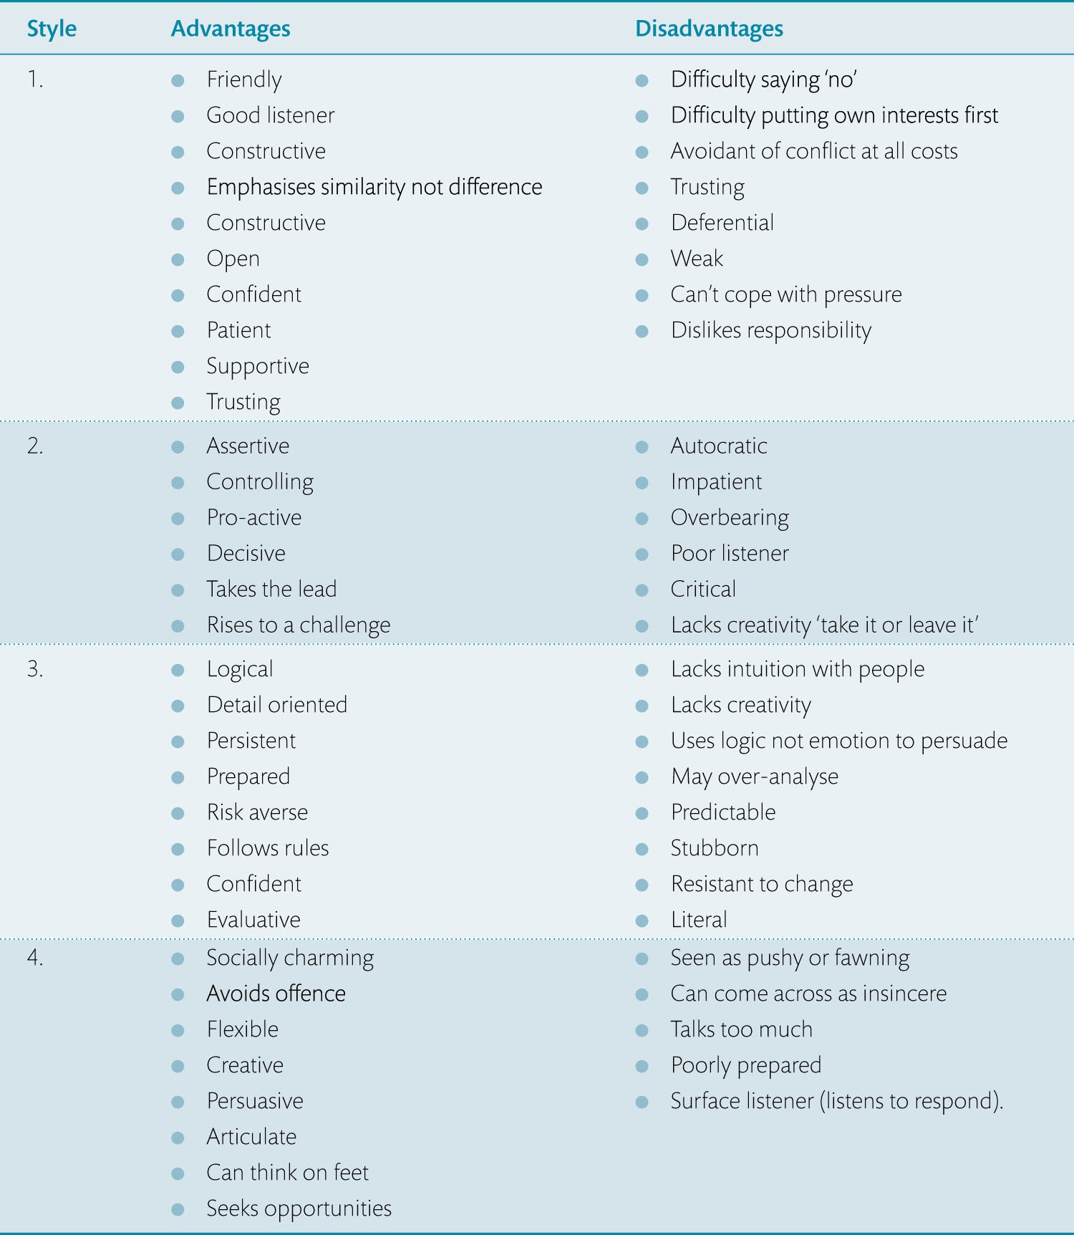
Table 12.2 Advantages and disadvantages of different personal styles, for negotiation

Slide 12
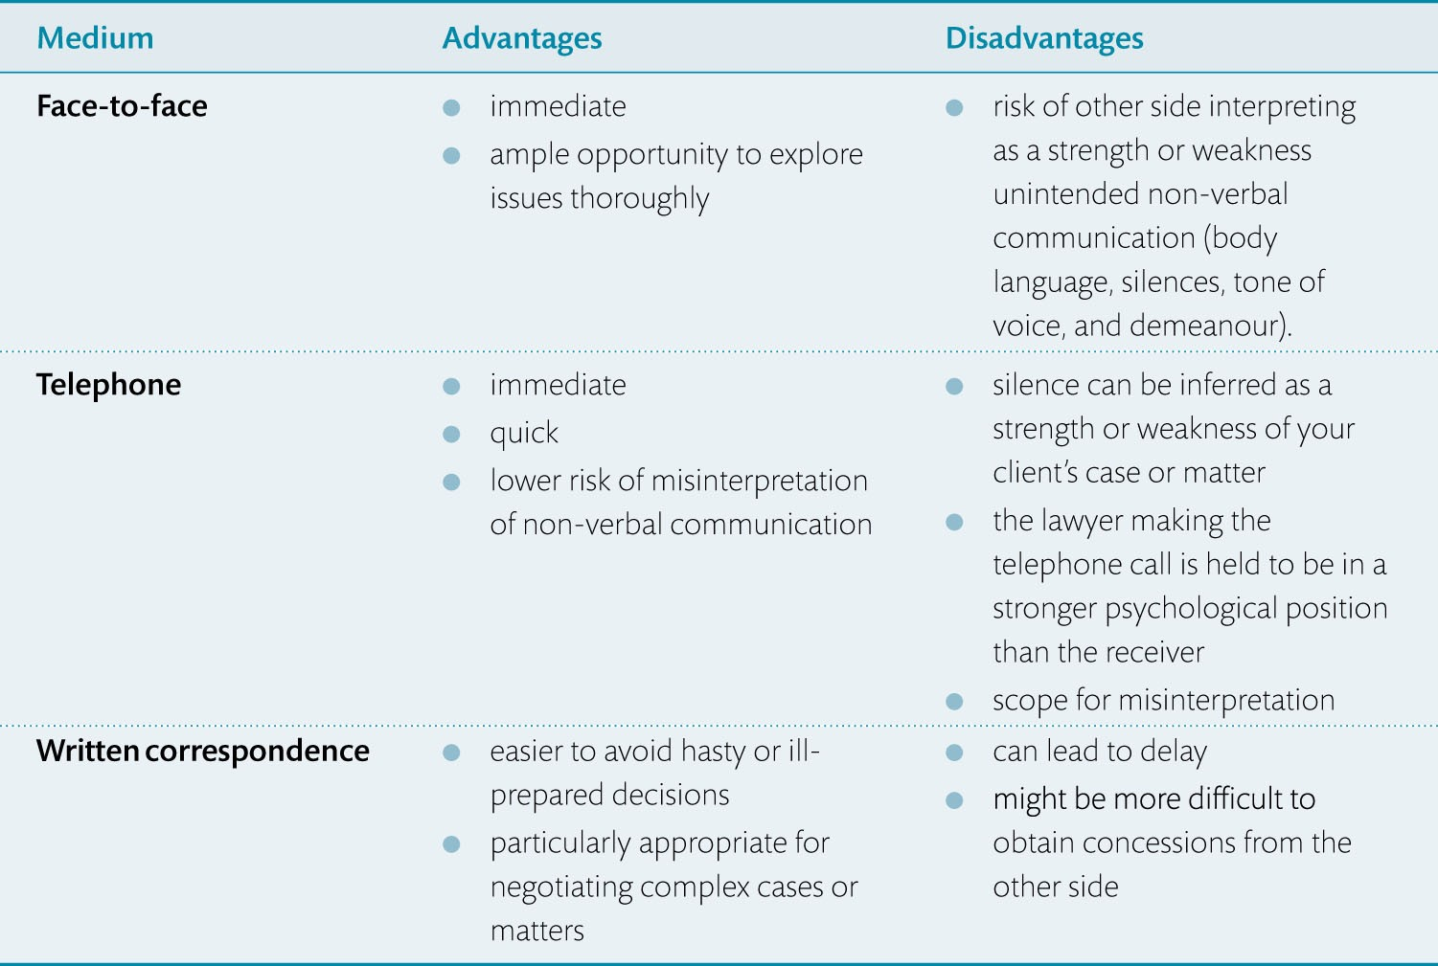
Table 12.3 Advantages and disadvantages of different negotiating media

