Slide 1
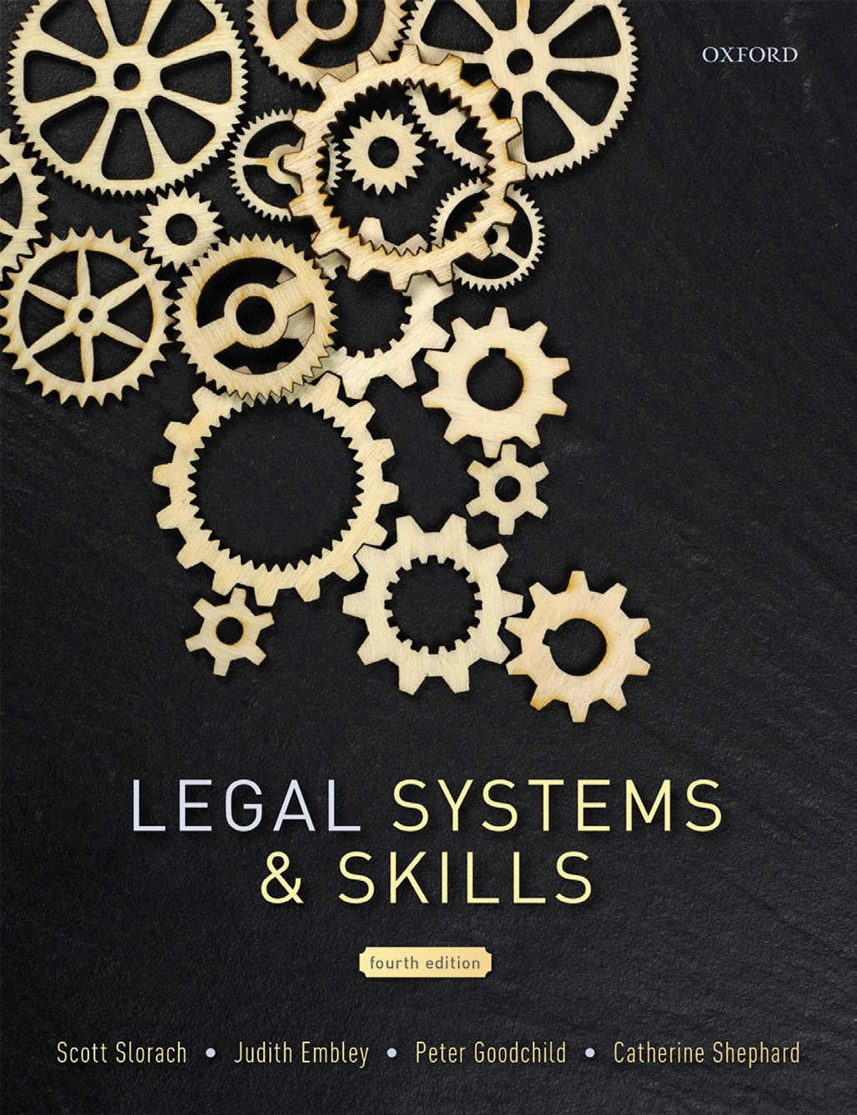
Legal Systems & Skills
by Scott Slorach, Judith Embley, Peter Goodchild and Catherine Shephard

Slide 2
Part 2
Legal Skills
Chapter 14
Writing and drafting

Slide 3
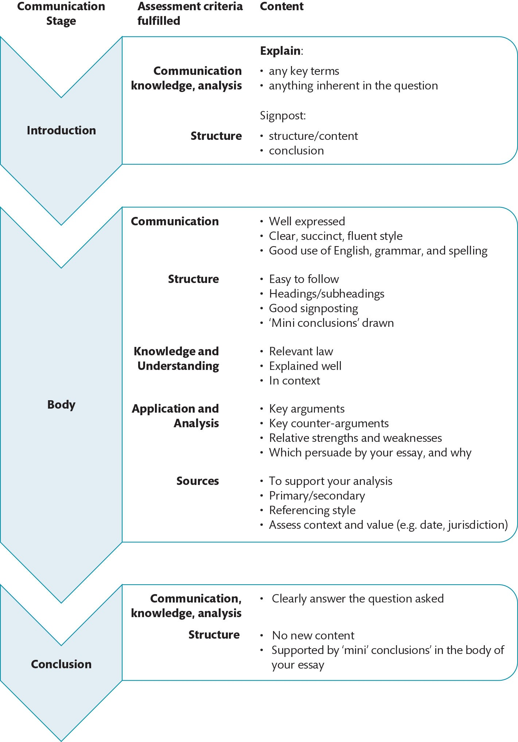
Figure 14.1 Essay-writing strategy

Slide 4
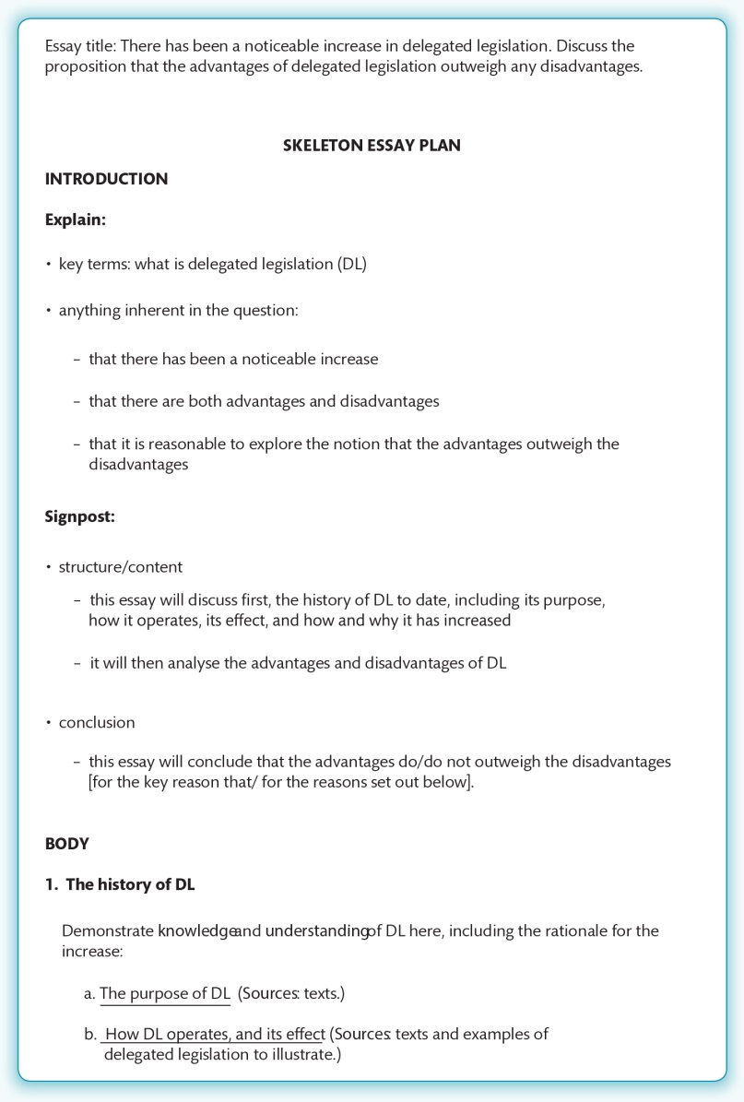
Figure 14.2 Example skeleton essay plan

Slide 5
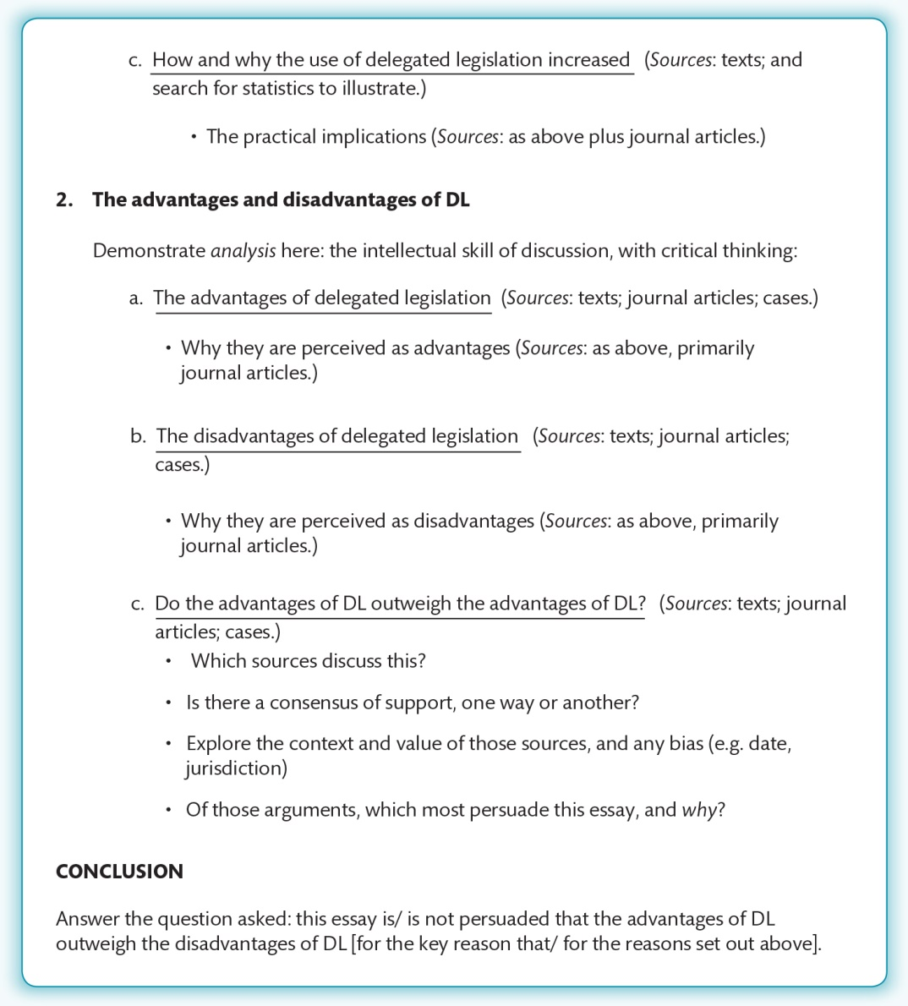
Figure 14.2 (Continued)

Slide 6
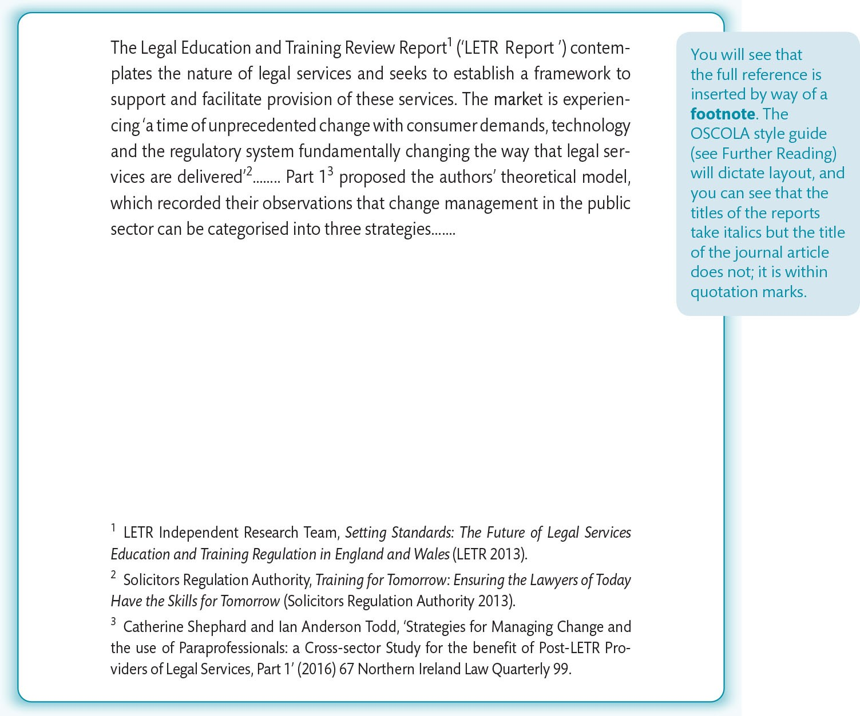
Figure 14.3 Example of a journal article referenced in OSCOLA Style

Slide 7
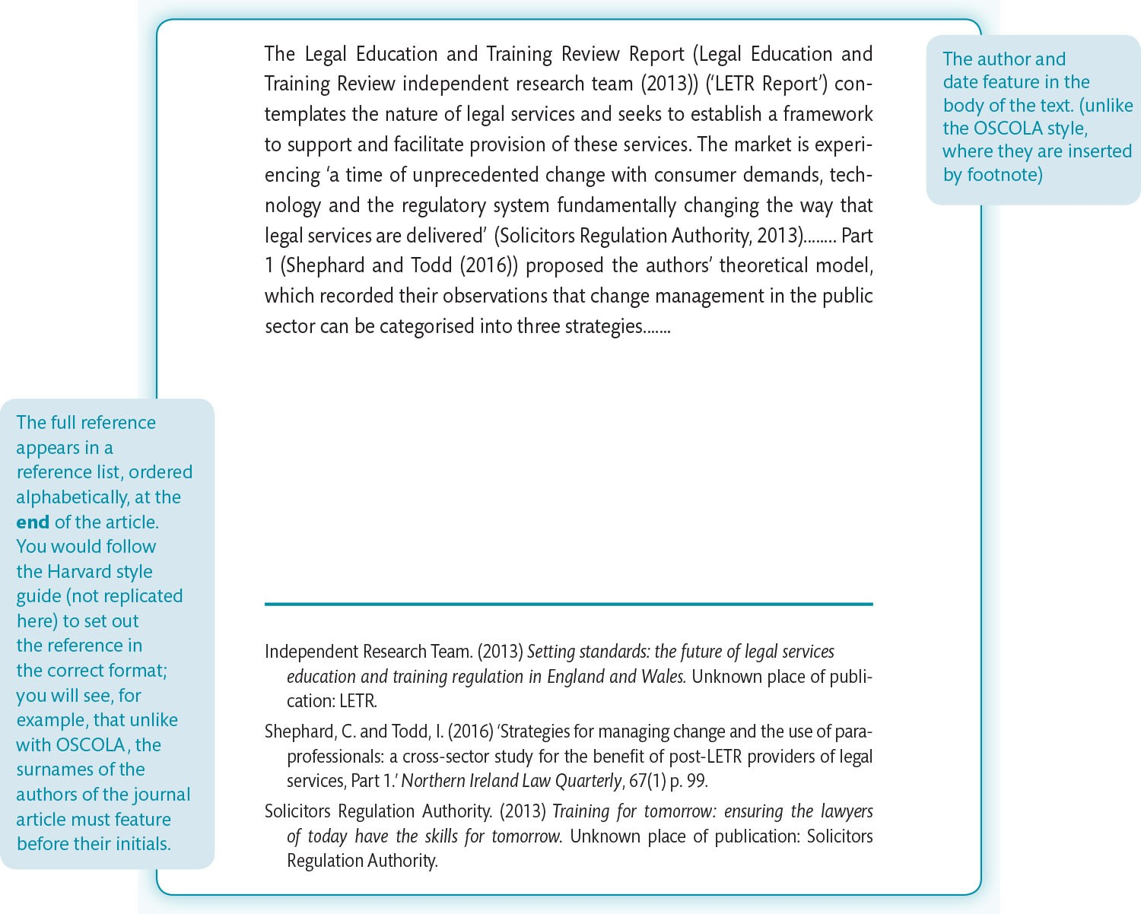
Figure 14.4 Example of the journal article at Figure 14.3, this time referenced in Harvard Style

Slide 8
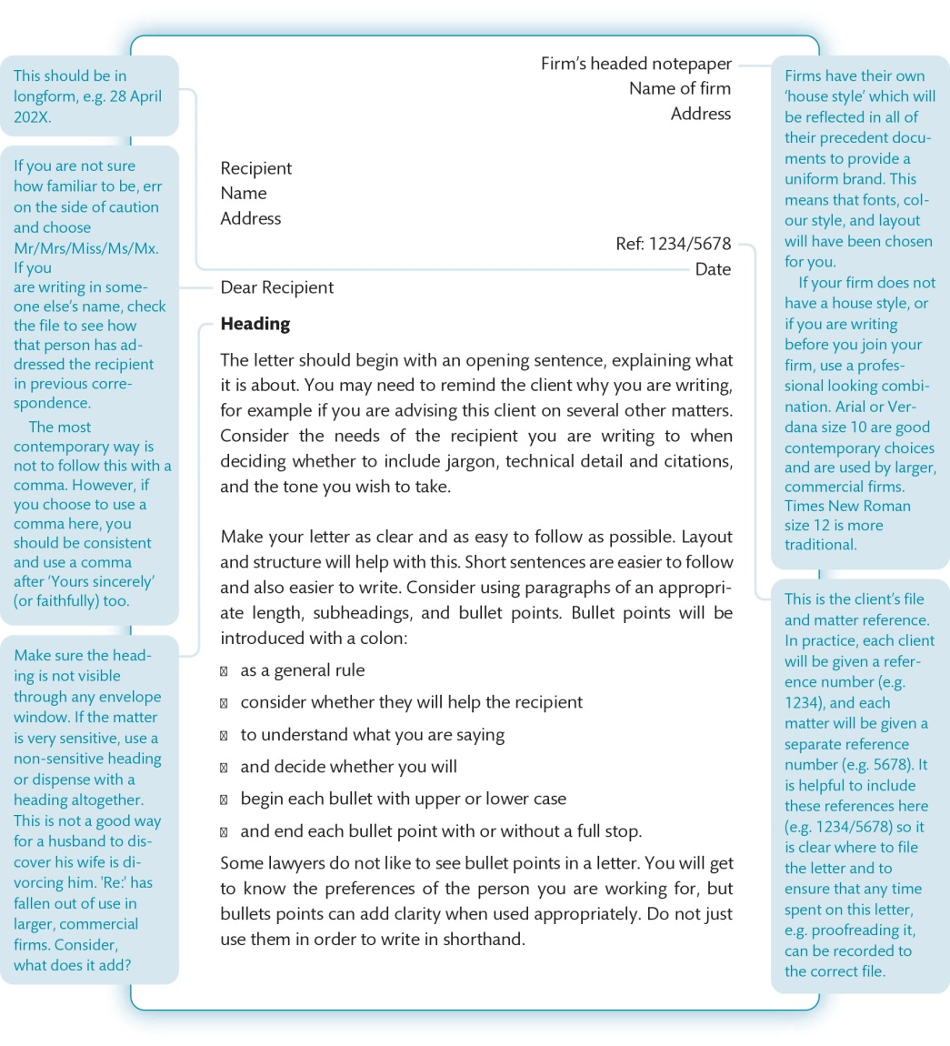
Figure 14.5 Letter template

Slide 9
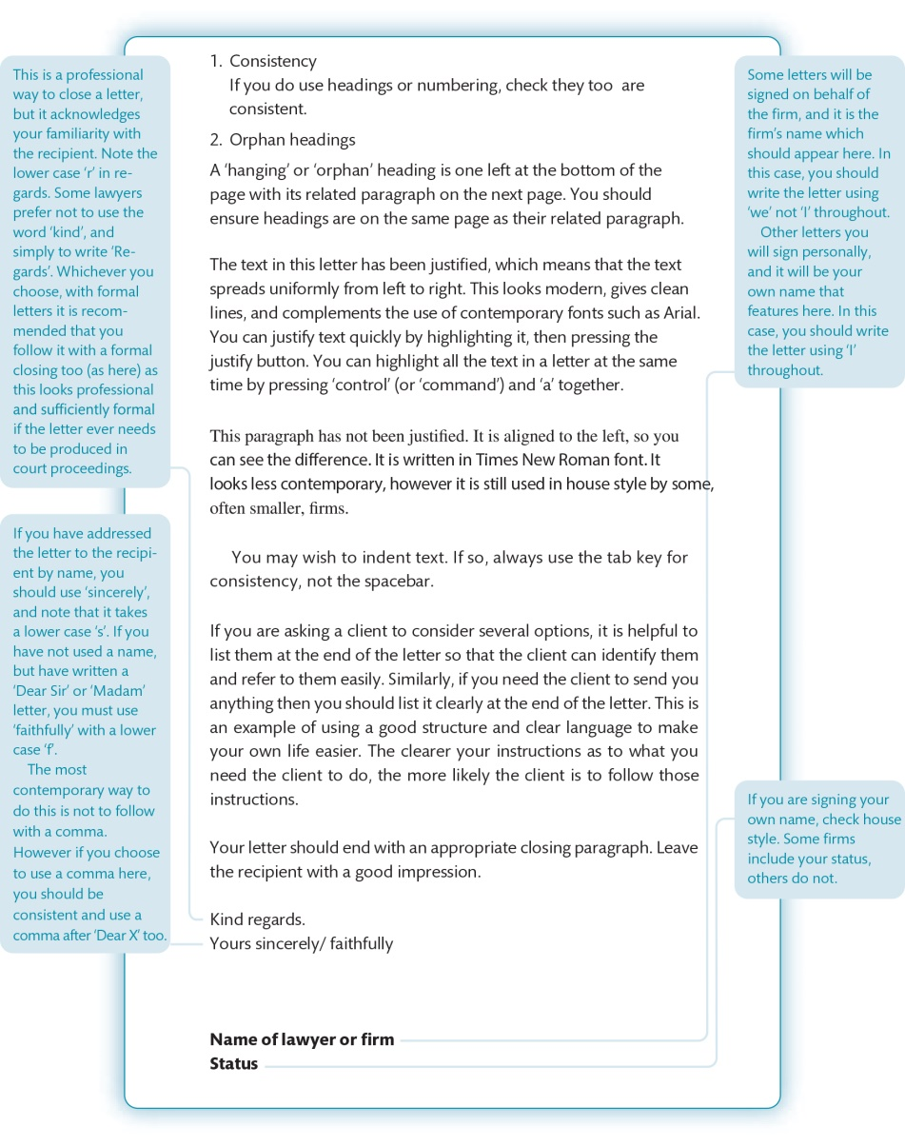
Figure 14.5 (Continued)

Slide 10
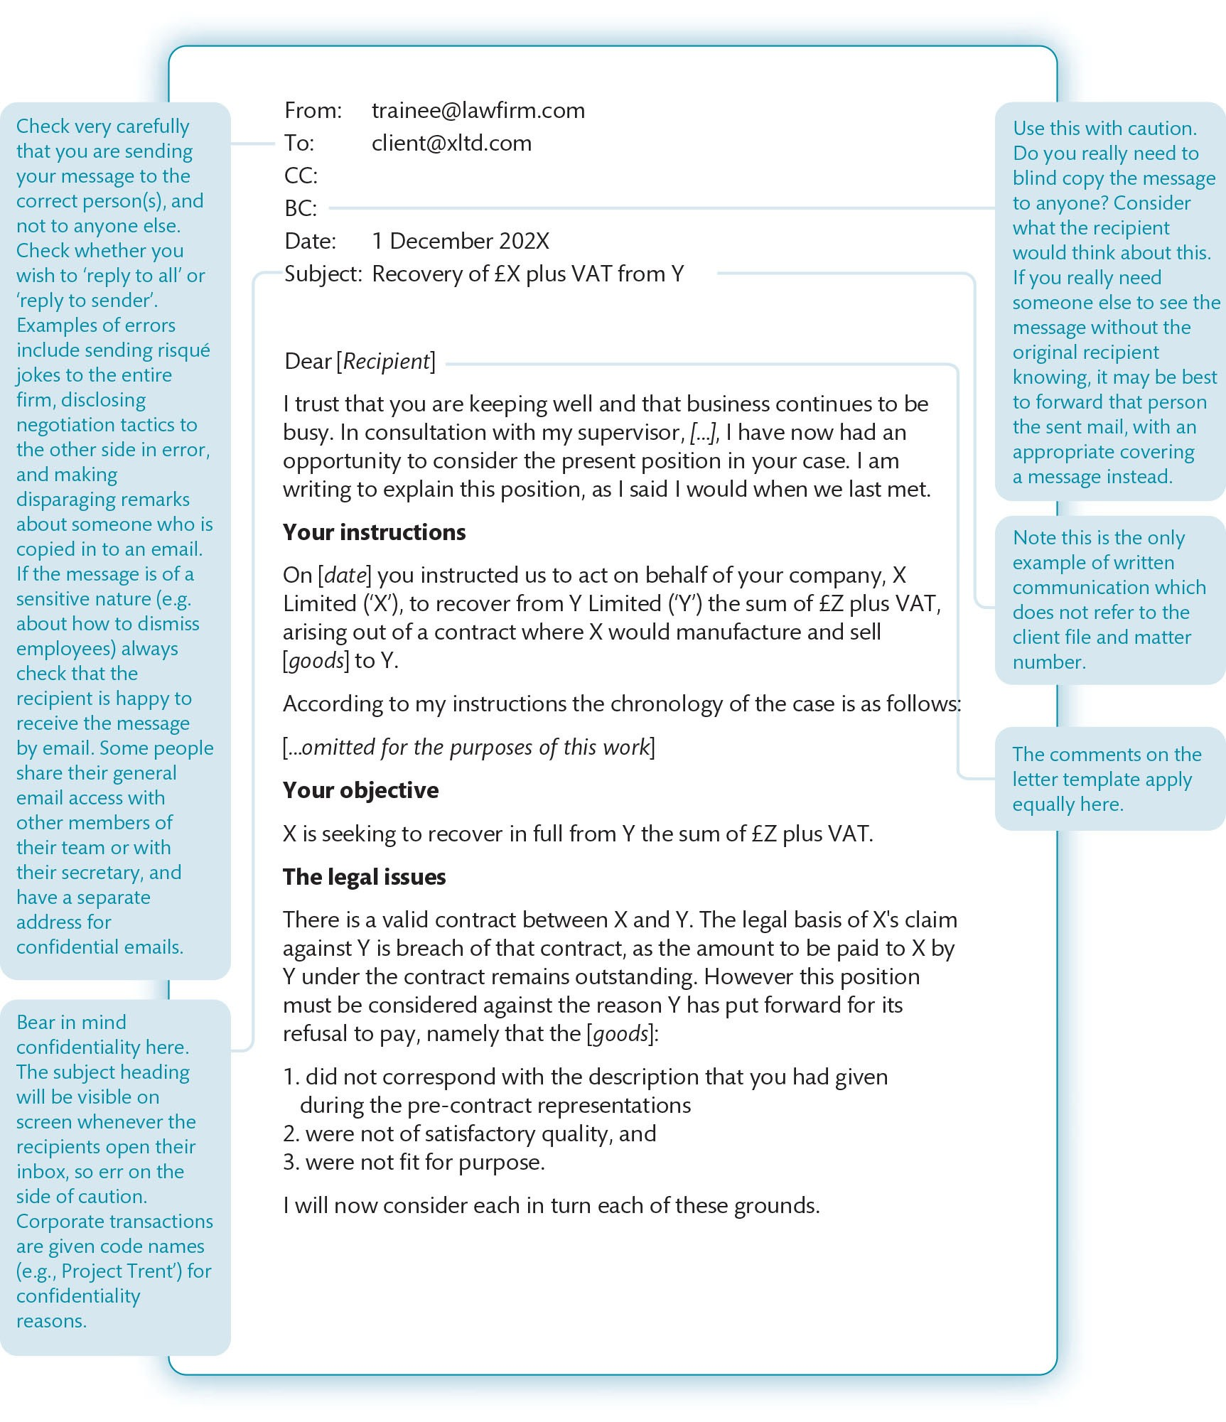
Figure 14.6 Email template

Slide 11
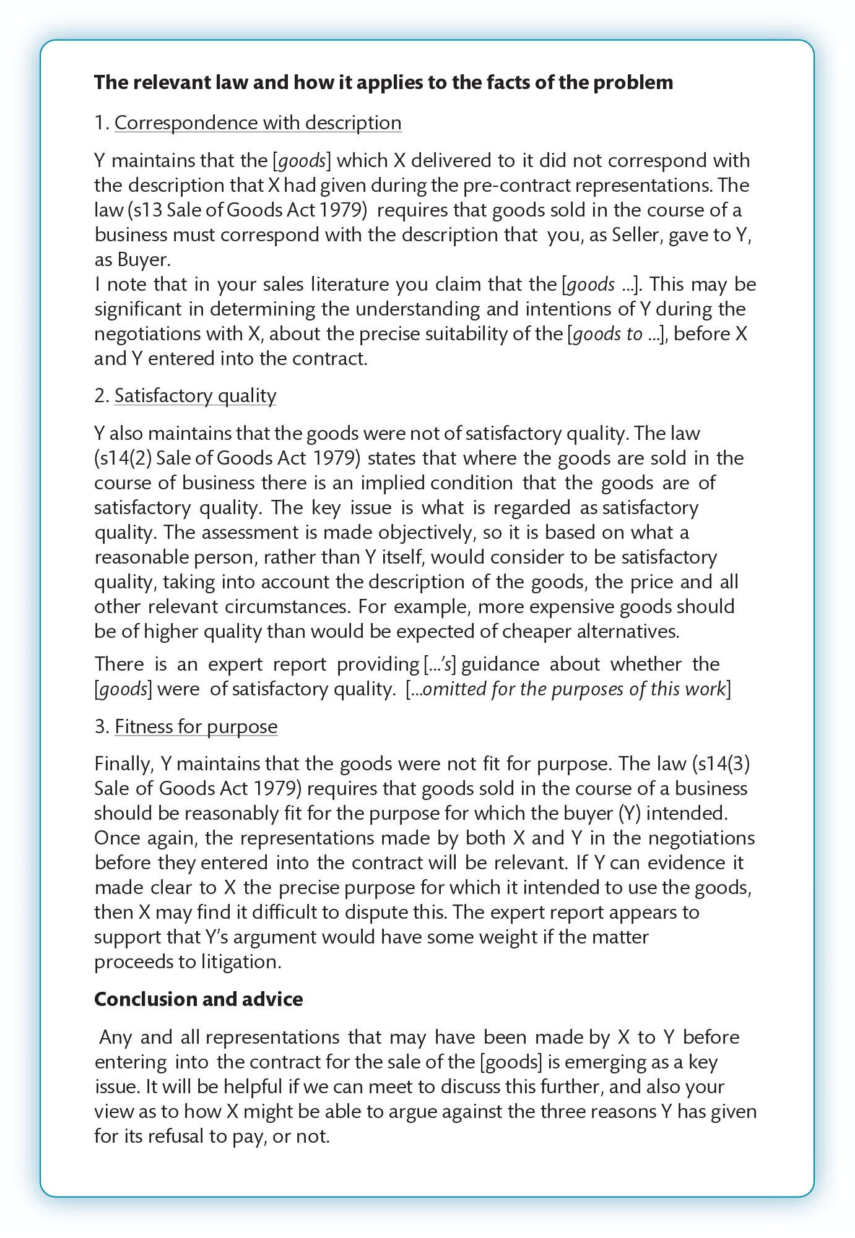
Figure 14.6 (Continued)

Slide 12
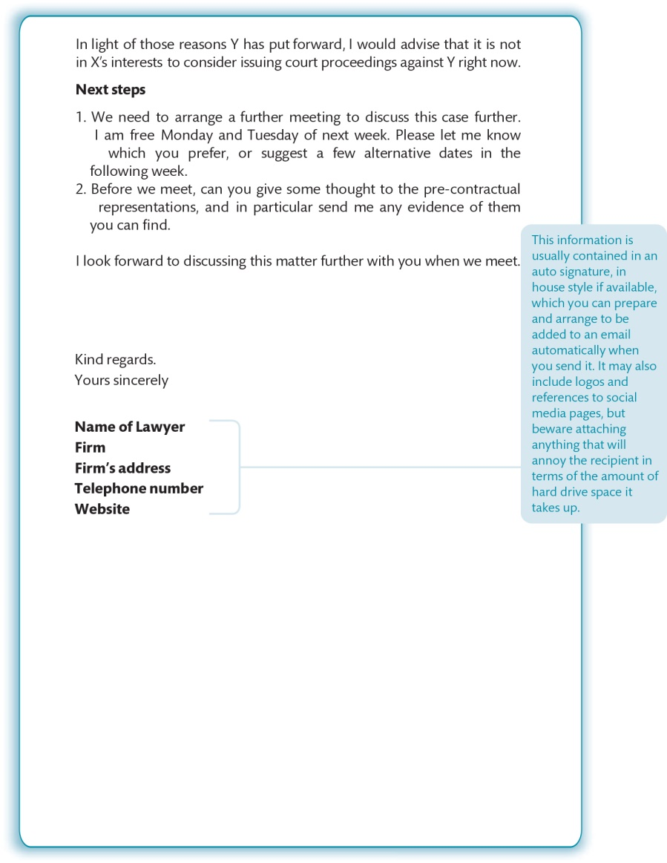
Figure 14.6 (Continued)

Slide 13
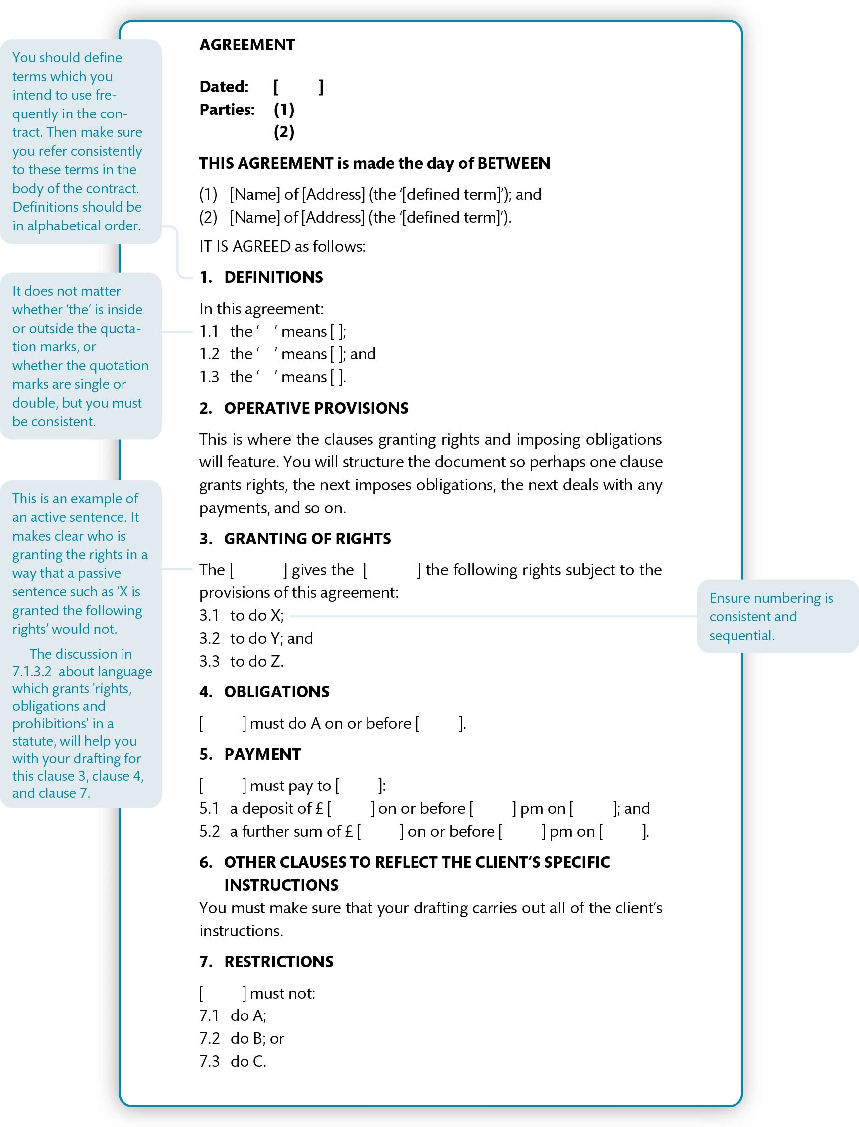
Figure 14.7 Contract template

Slide 14
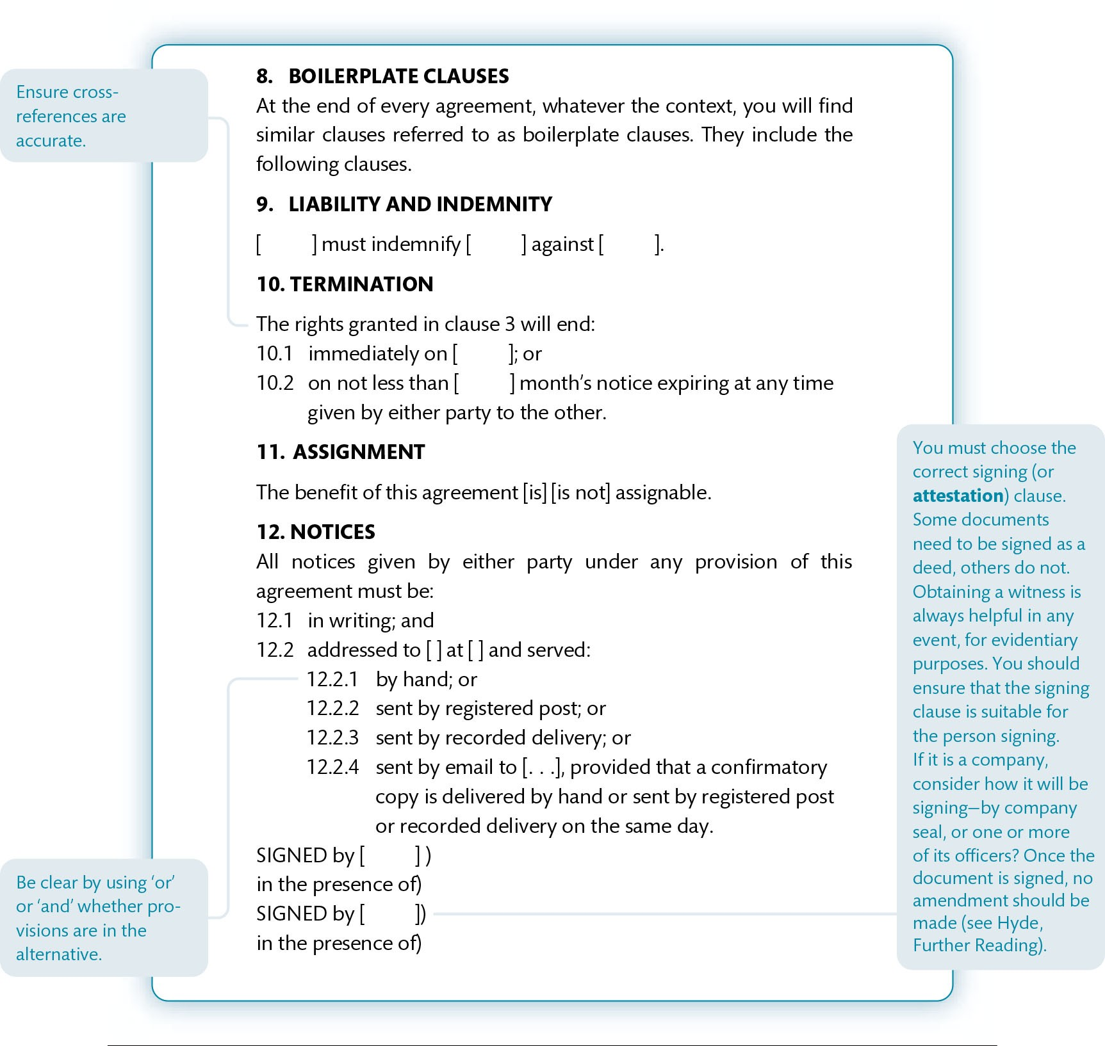
Figure 14.7 (Continued)

Slide 15
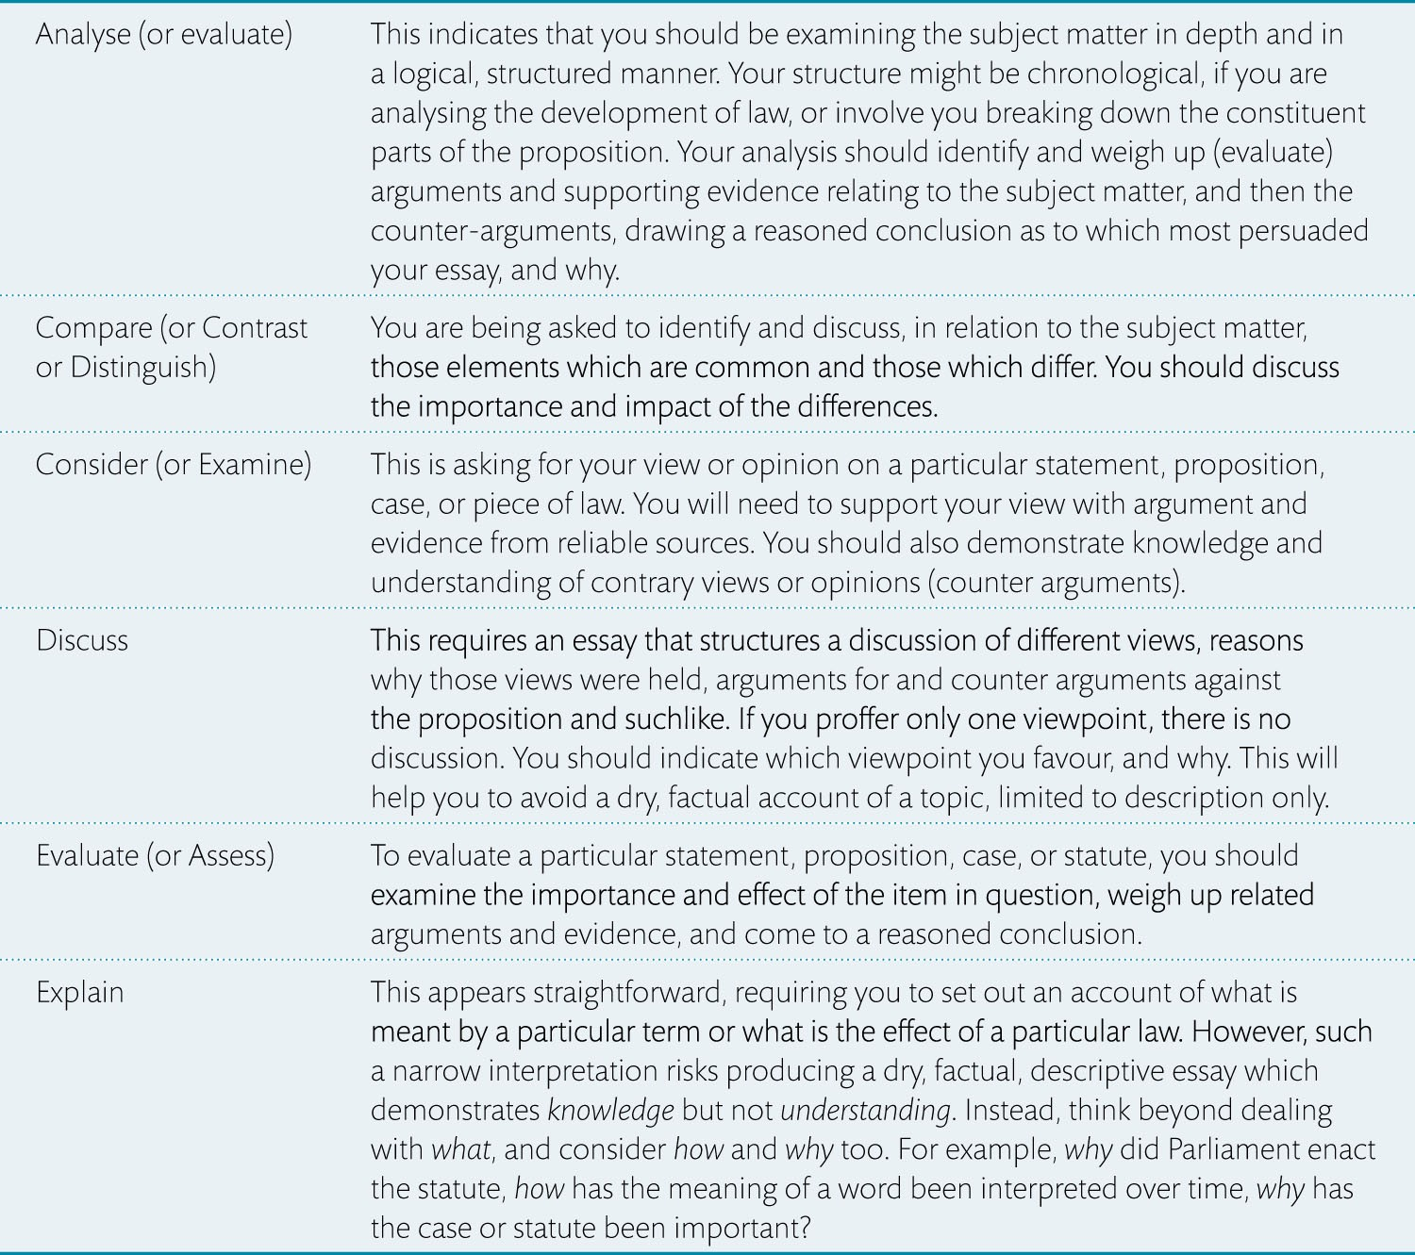
Table 14.1 What is the essay question asking you to do? (Critical thinking)

Slide 16
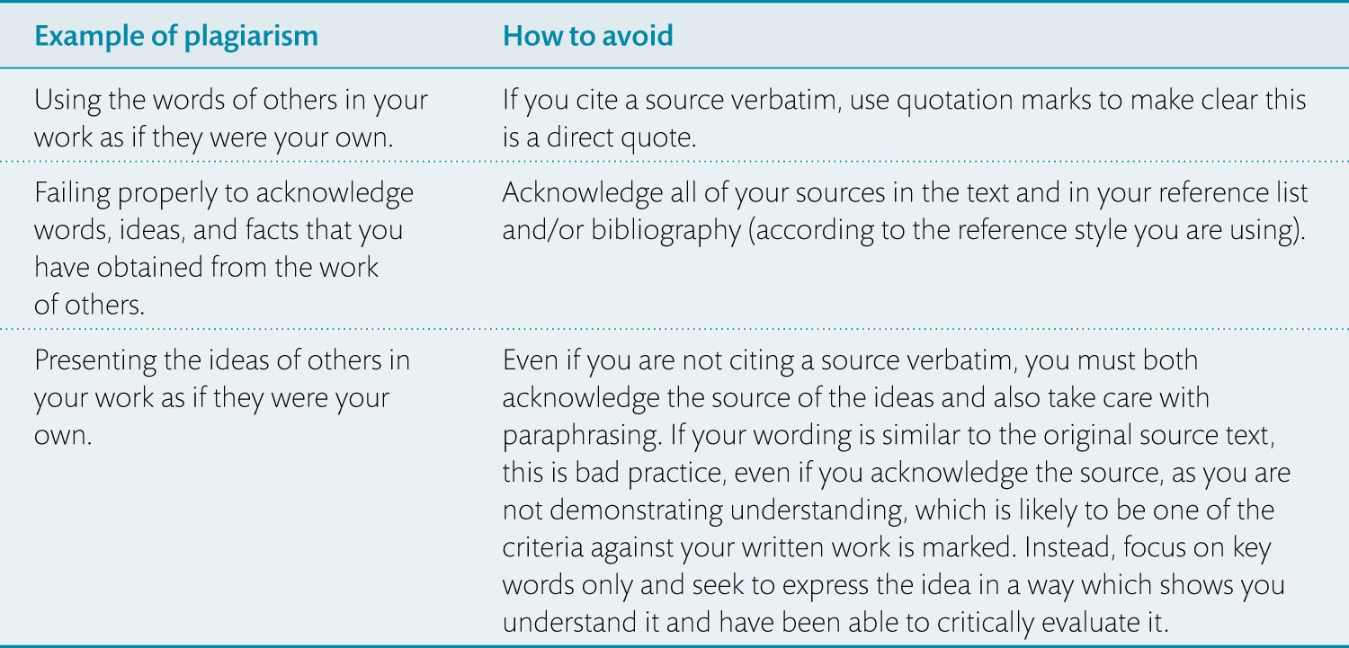
Table 14.2 Common examples of plagiarism and how to avoid them

