Slide 1
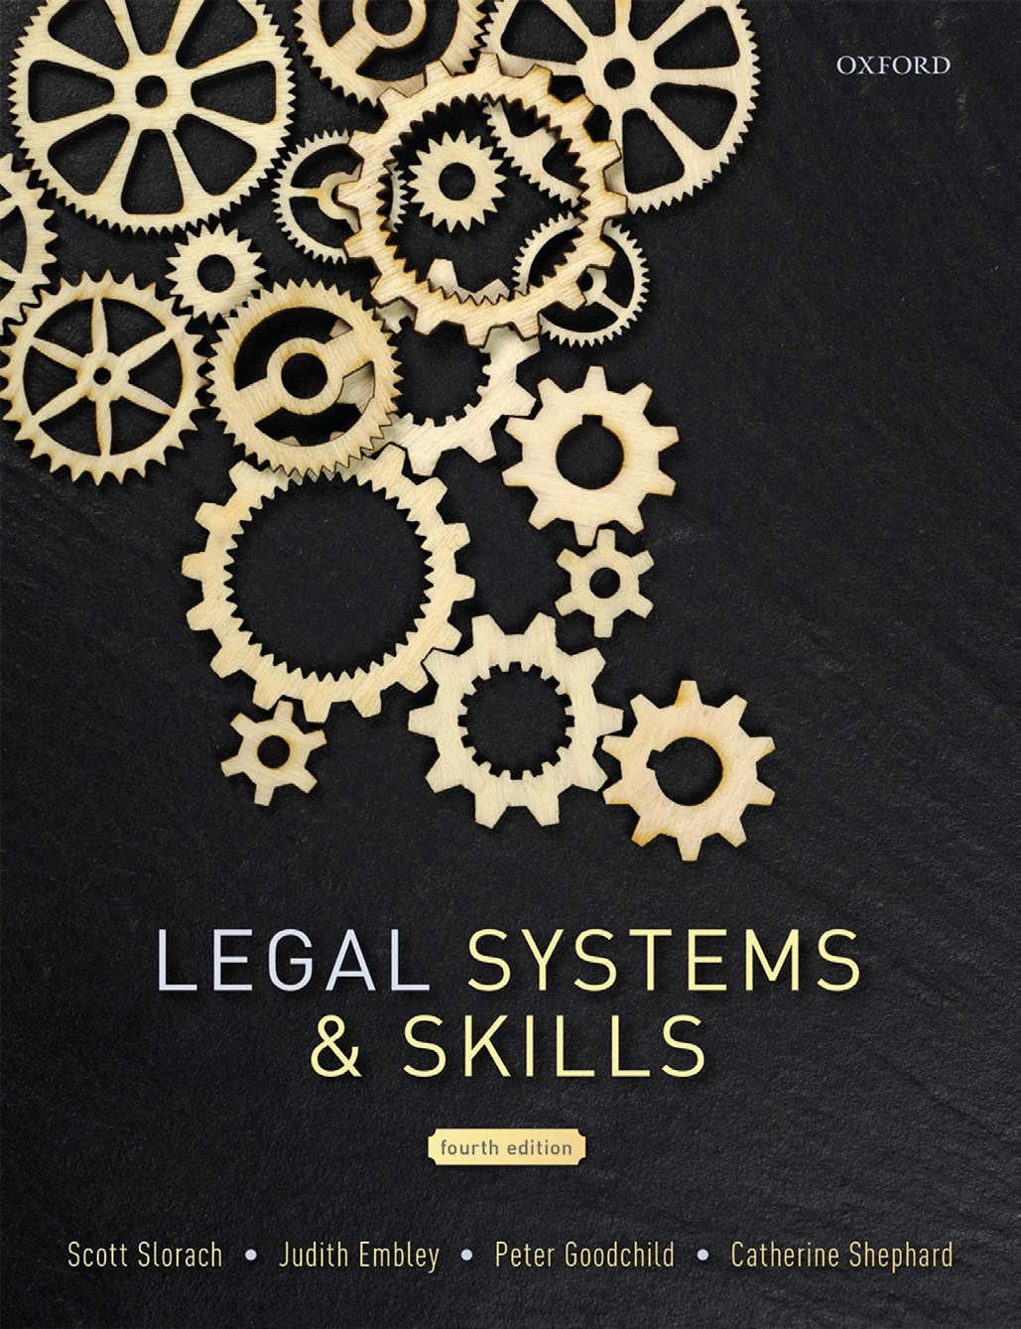
Legal Systems & Skills
by Scott Slorach, Judith Embley, Peter Goodchild and Catherine Shephard

Slide 2
Part 3
Employability and Commercial Awareness
Chapter 16
CVs, applications, and interviews

Slide 3
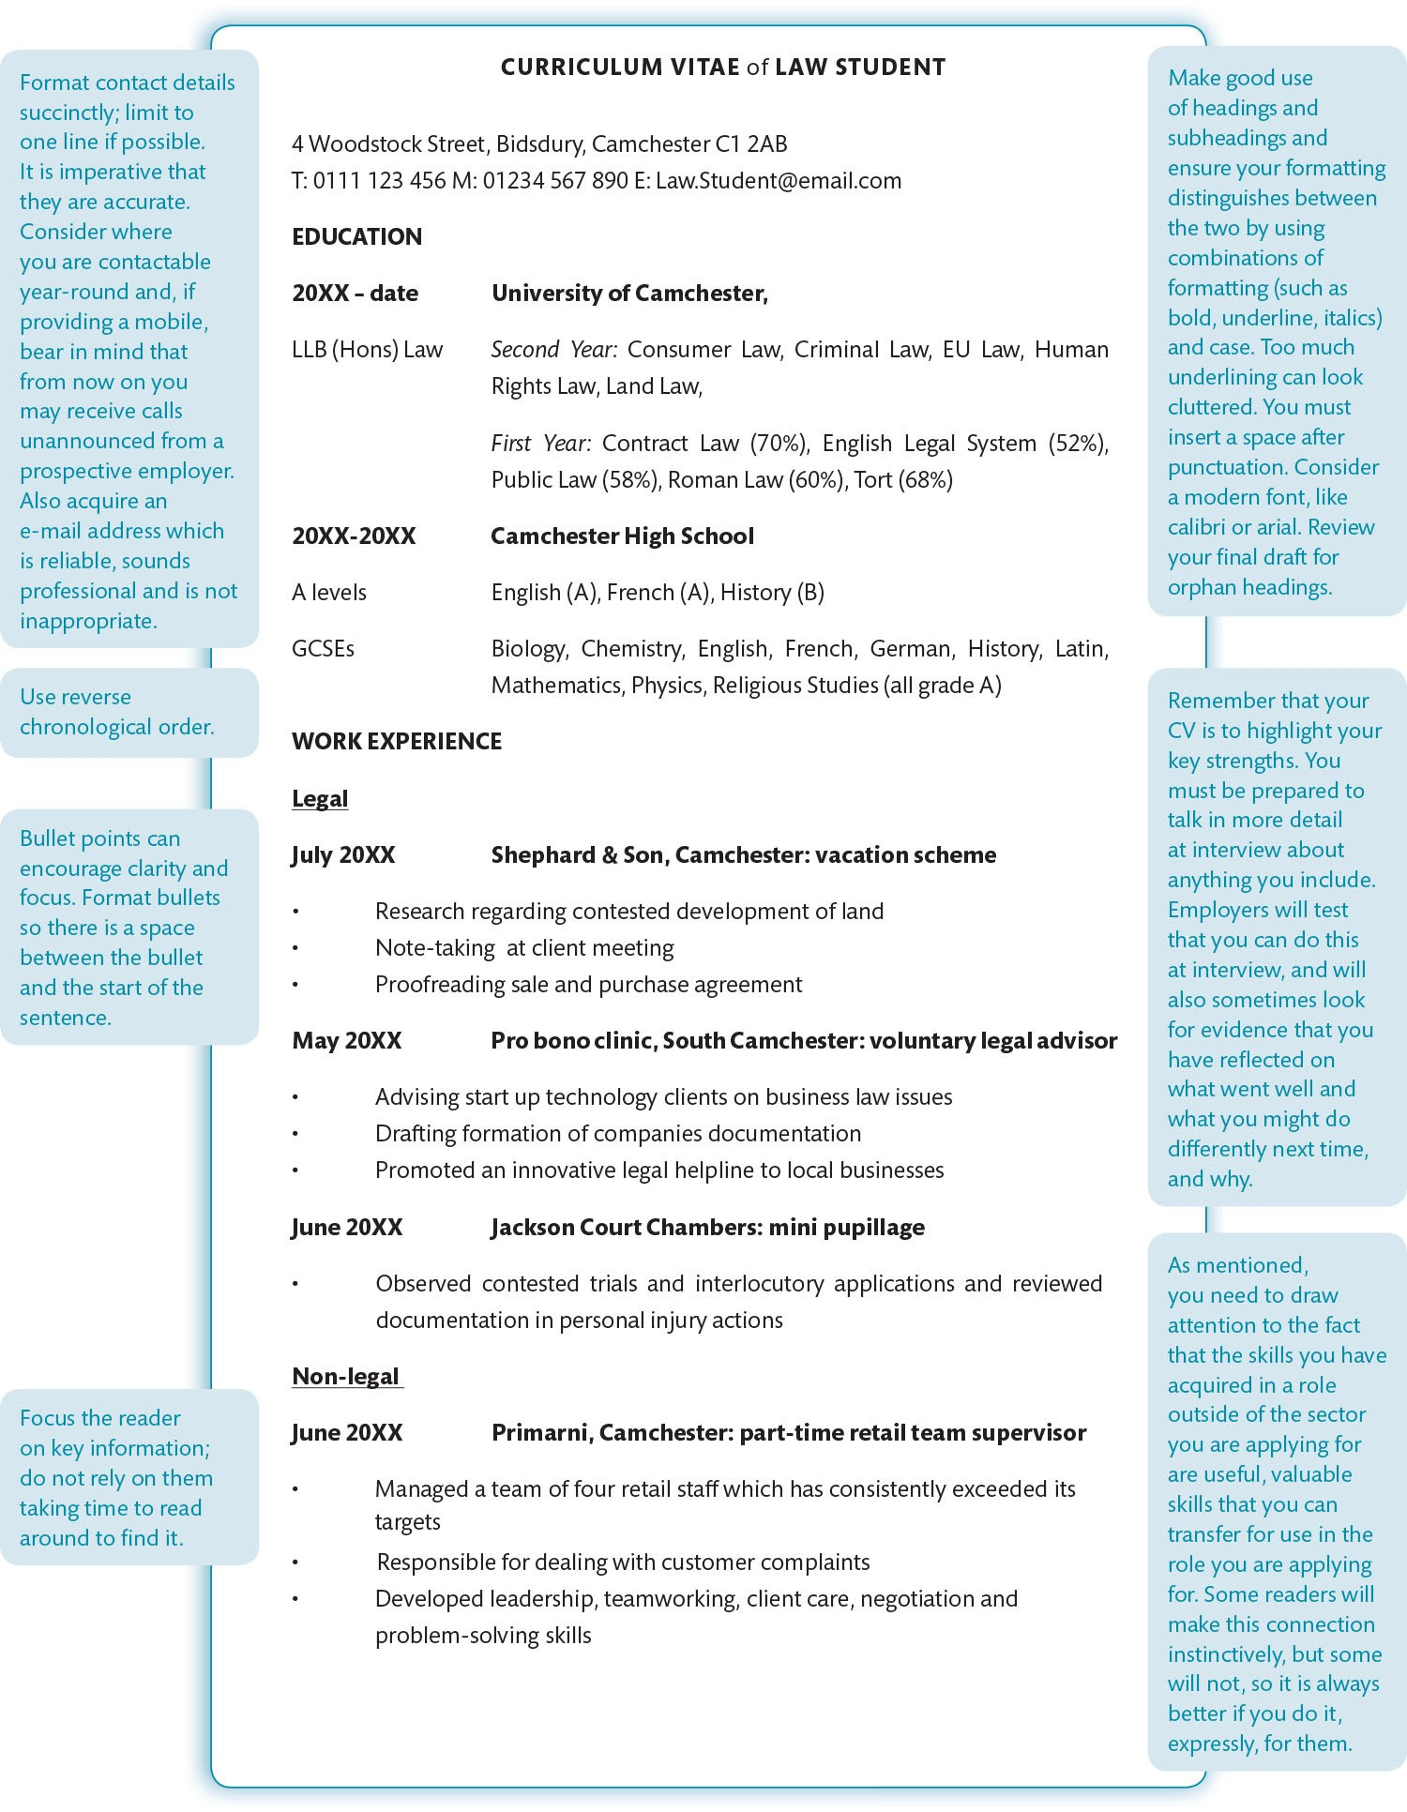
Figure 16.1 CV template

Slide 4
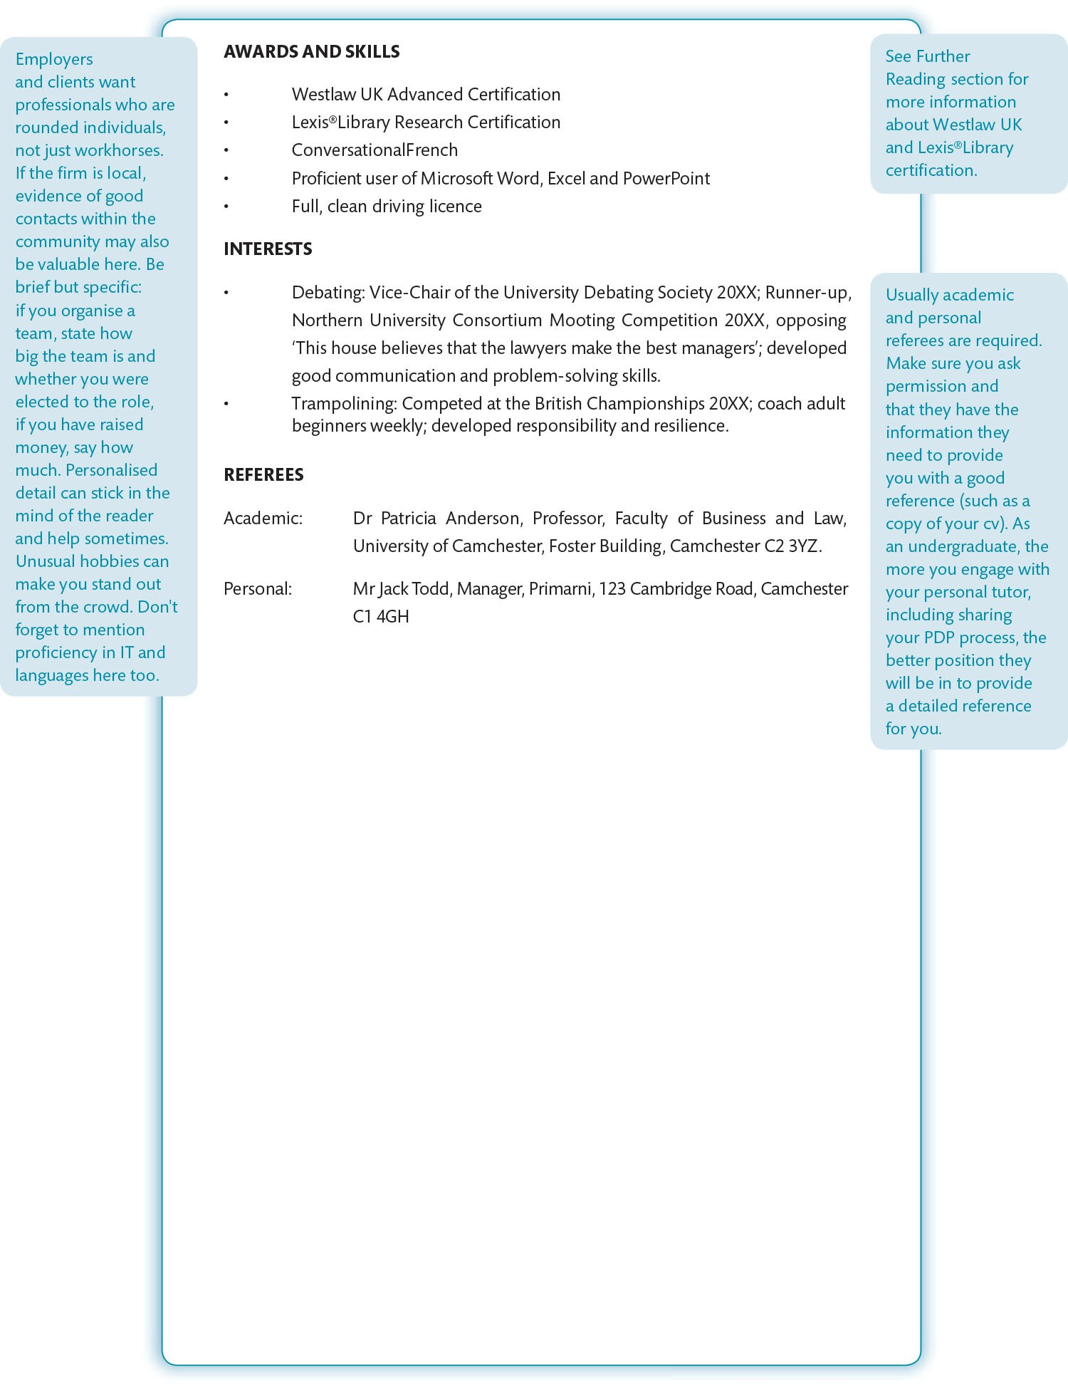
Figure 16.1 (Continued)

