Slide 1

Legal Systems & Skills
by Scott Slorach, Judith Embley, Peter Goodchild and Catherine Shephard

Slide 2
Part 3
Employability and Commercial Awareness
Chapter 19
Essential economics and finance

Slide 3
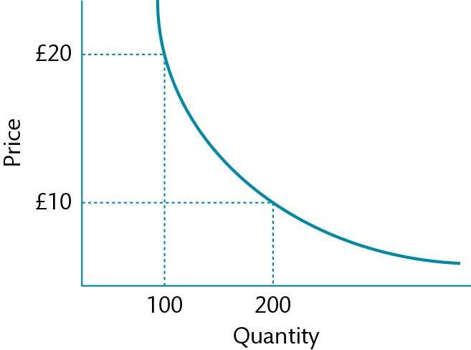
Figure 19.1 Demand curve

Slide 4
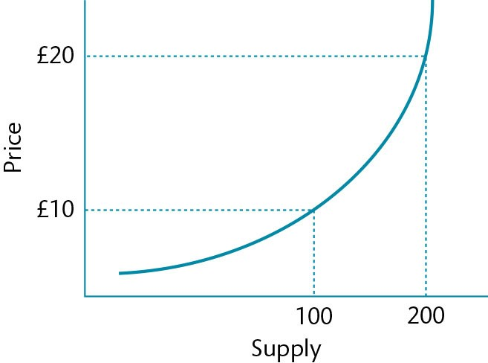
Figure 19.2 Supply curve

Slide 5
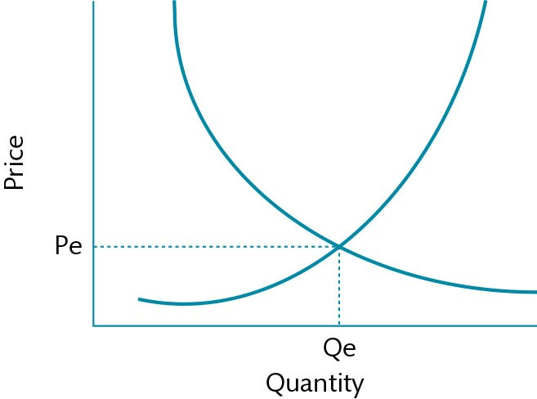
Figure 19.3 Equilibrium price

Slide 6
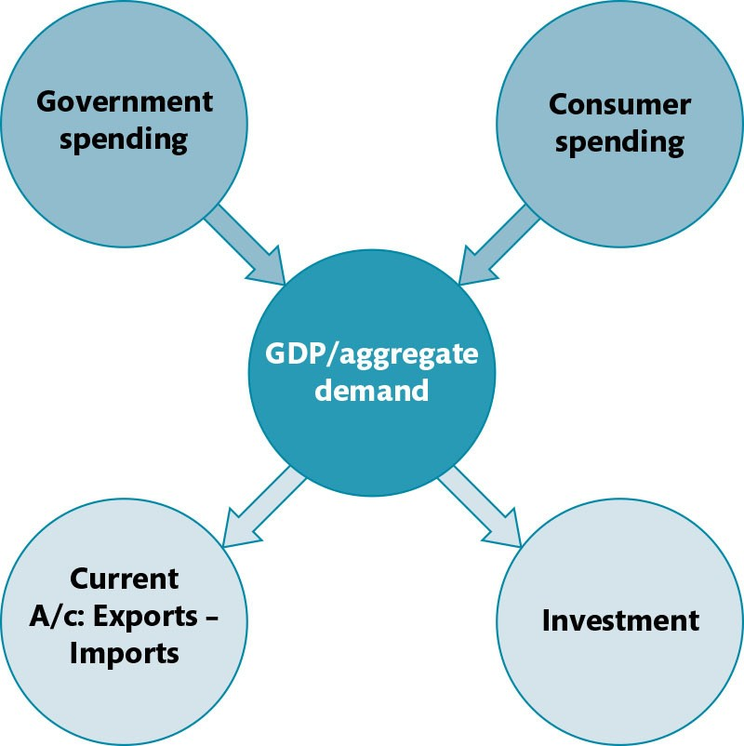
Figure 19.4 GDP or aggregate demand

Slide 7
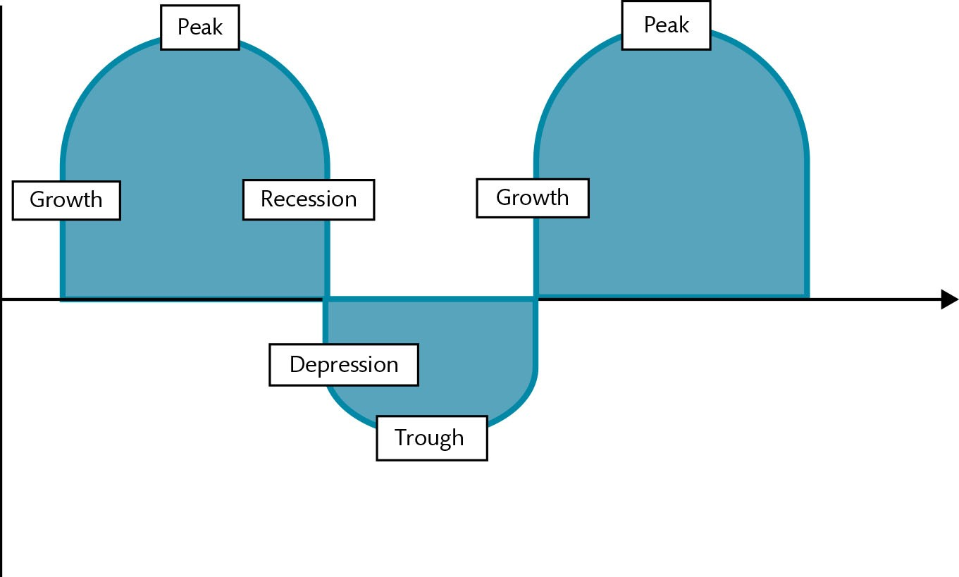
Figure 19.5 The business cycle

Slide 8
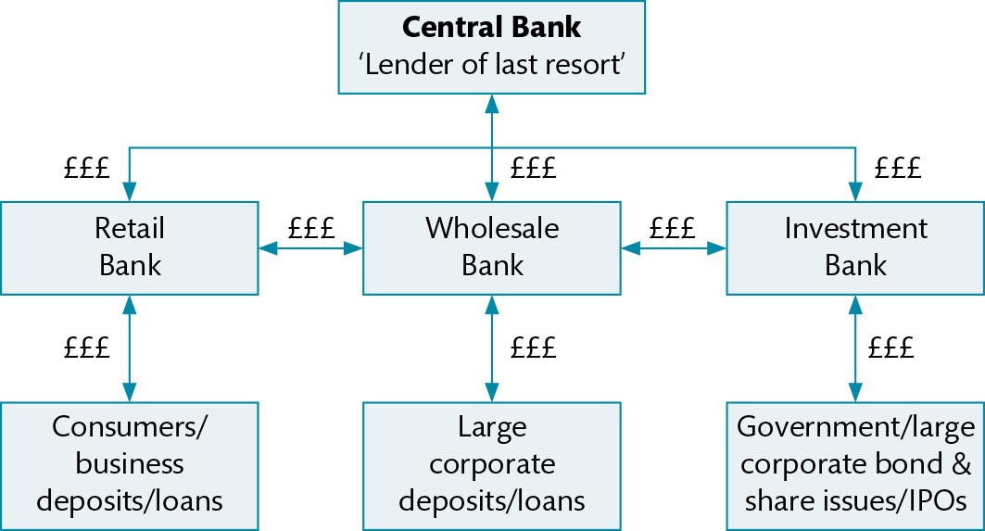
Figure 19.6 The banking system

Slide 9
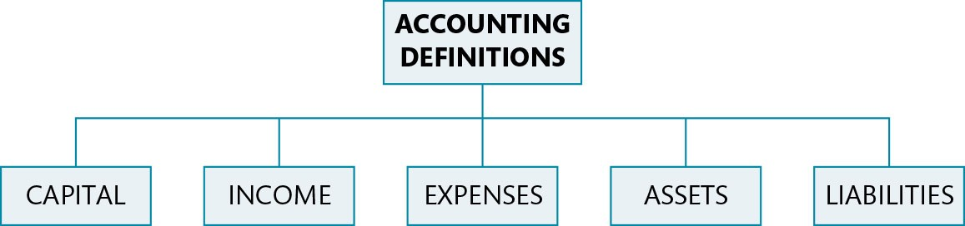
Figure 19.7 Basics of accounts

Slide 10
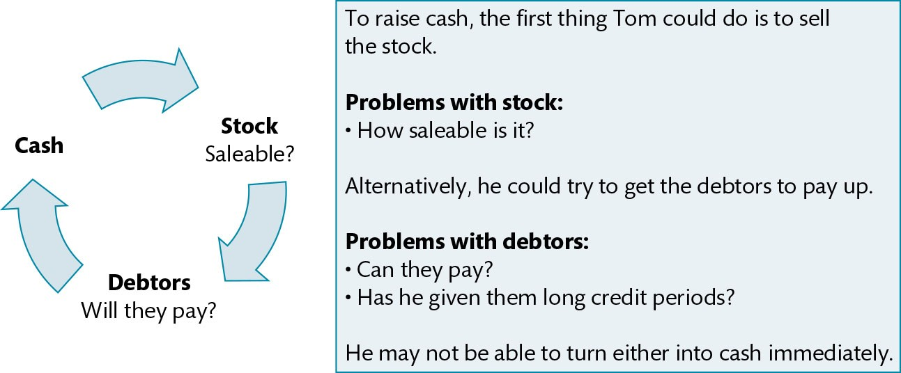
Figure 19.8 Cash flow

Slide 11
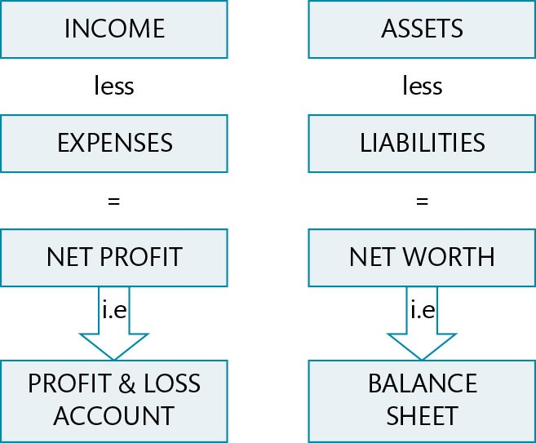
Figure 19.9 Simplified format of a set of accounts

