Slide 1
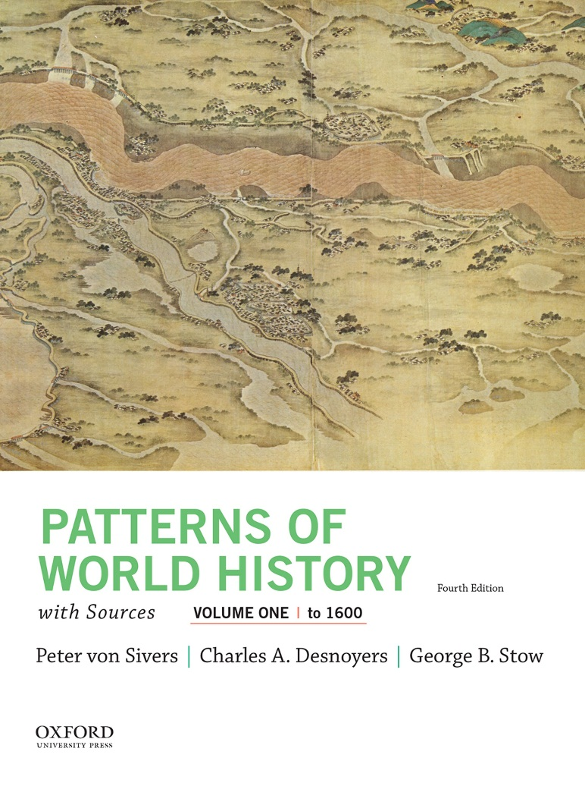
Patterns of World History by Peter von Sivers, Charles A. Desnoyers and George B. Stow

Slide 2
World Period Four
Chapter 18
New Patterns in New Worlds: Colonialism and Indigenous Responses in the Americas,
1500–1800

Slide 3
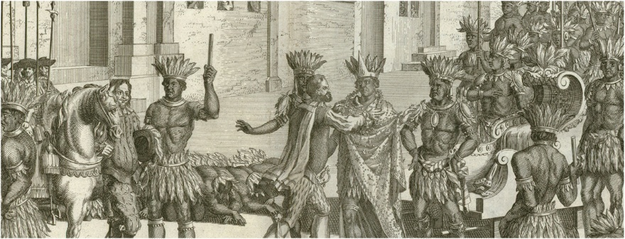
In his monumental Historia de la conquista de México, written more than 150 years after the events described, Antonio de Solís (1610–1686) depicted the meeting of Moctezuma and Cortés.

Slide 4
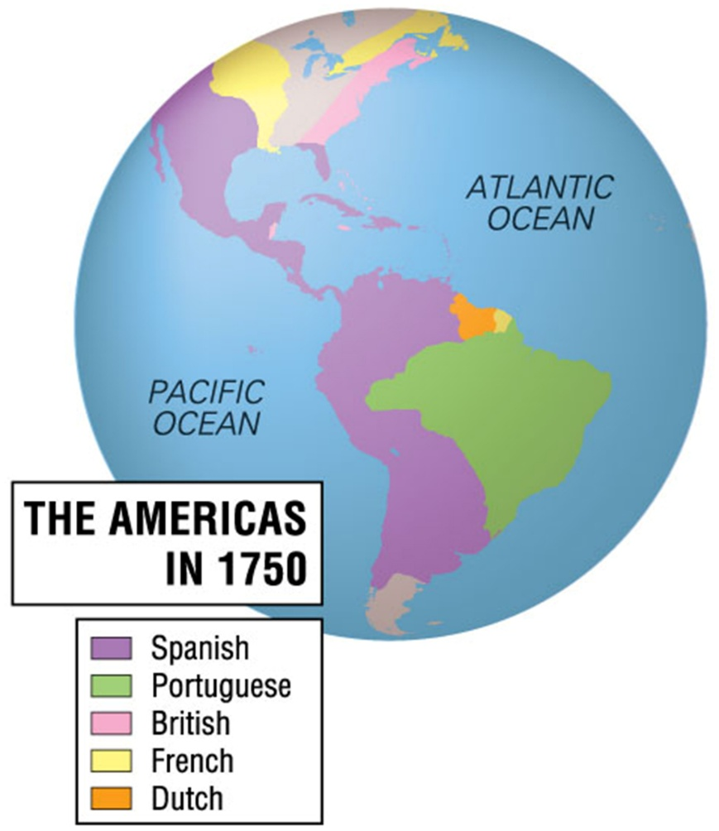

Slide 5
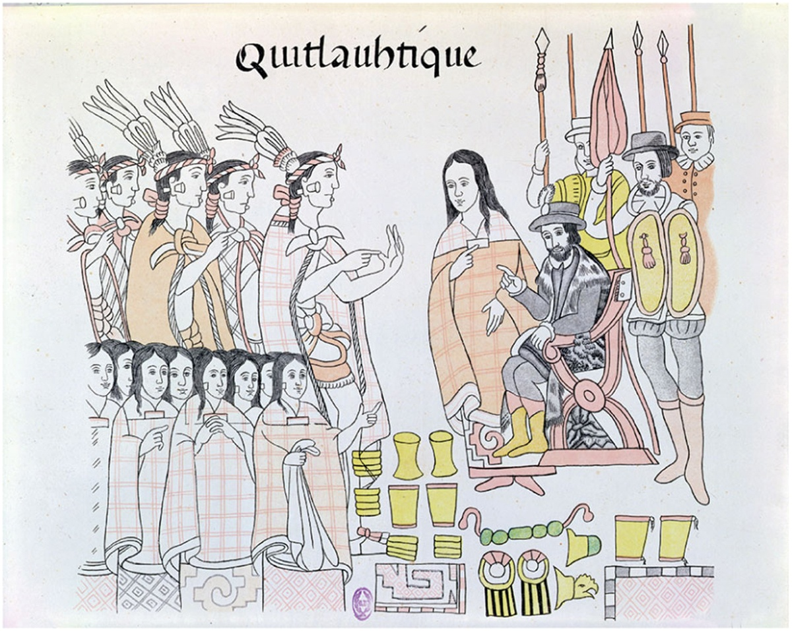
Cultural Intermediary. The Tabascans gave Malinche, or Doña Marina, to Hernán Cortés as a form of tribute after they were defeated by the Spanish. Malinche served Cortés as a translator and mistress, playing a central role in Cortés’s eventual victory over the Aztecs. She was in many respects the principal face of the Spanish and is always depicted center stage in Native American visual accounts of the conquest.

Slide 6
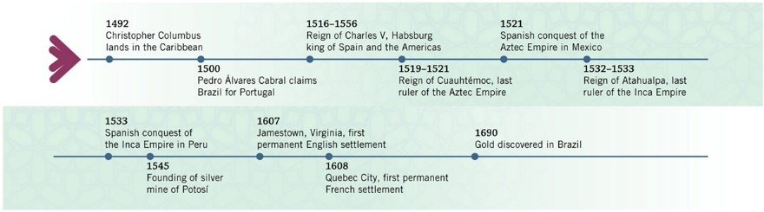

Slide 7
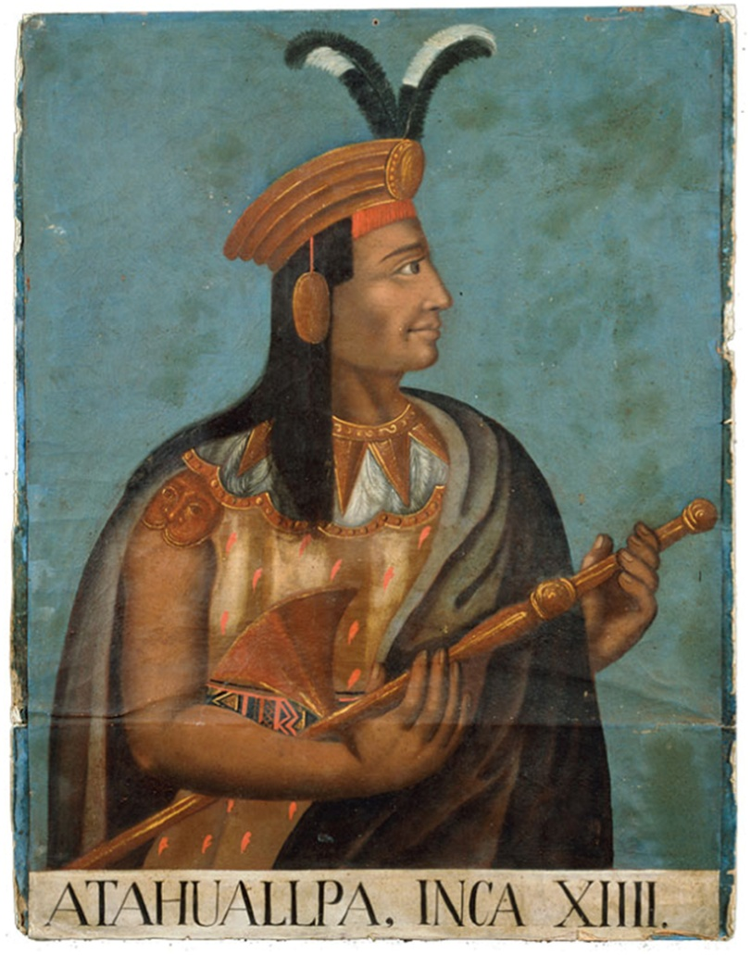
Conquest by Surprise. The Spanish conqueror Francisco Pizarro captured Emperor Atahualpa in an ambush.
Atahualpa promised a roomful of gold in return for his release, but the Spaniards collected the gold and murdered Atahualpa before generals of the Inca army could organize an armed resistance.

Slide 8
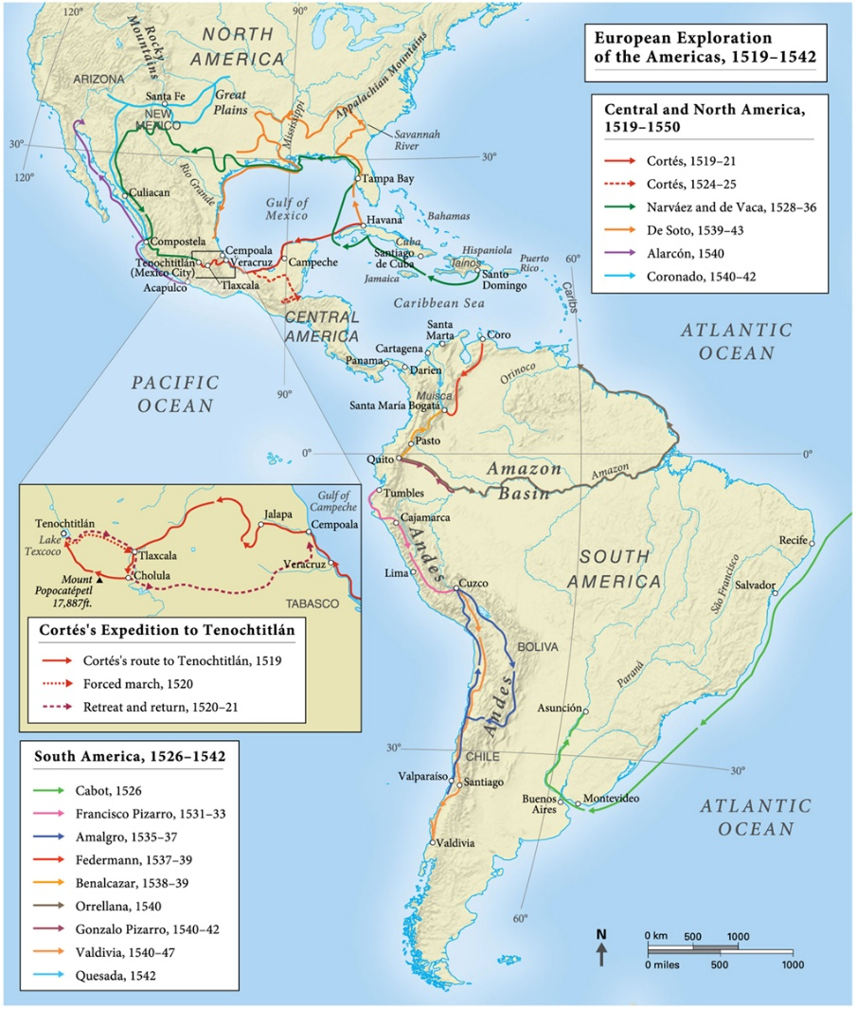
MAP 18.1 The European Exploration of the Americas, 1519–1542

Slide 9
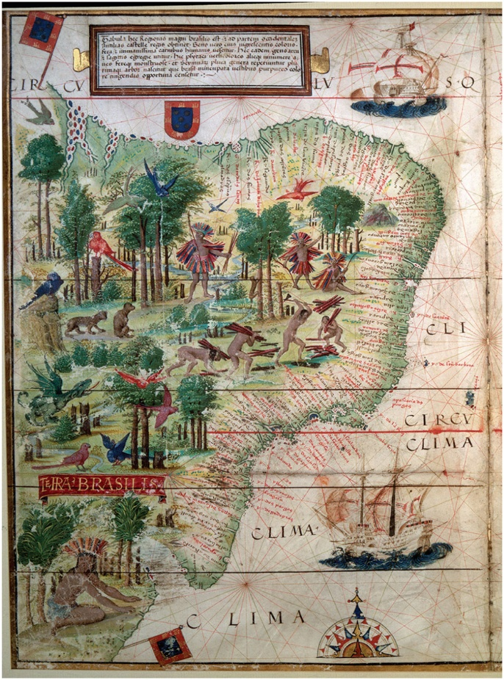
Brazil in 1519. This early map is fairly accurate for the northern coast, but increasingly less accurate as one moves south. First explorations of the south by both Portuguese and Spanish mariners date to 1513–1516. Ferdinand Magellan passed through several places along the southern coast on his journey around the world in 1520–1521. The scenes on the map depict Native Americans cutting and collecting brazilwood, the source of a red dye much in demand by the Portuguese during the early period of colonization.

Slide 10
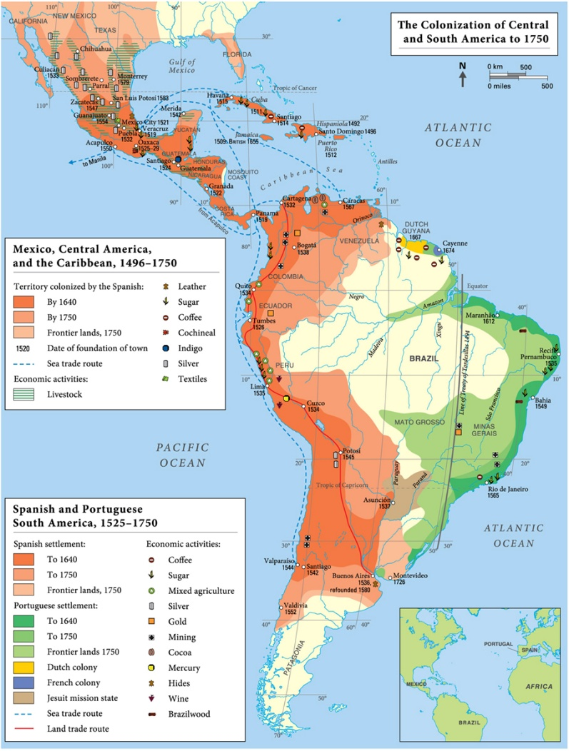
MAP 18.2 The Colonization of Central and South America to 1750

Slide 11
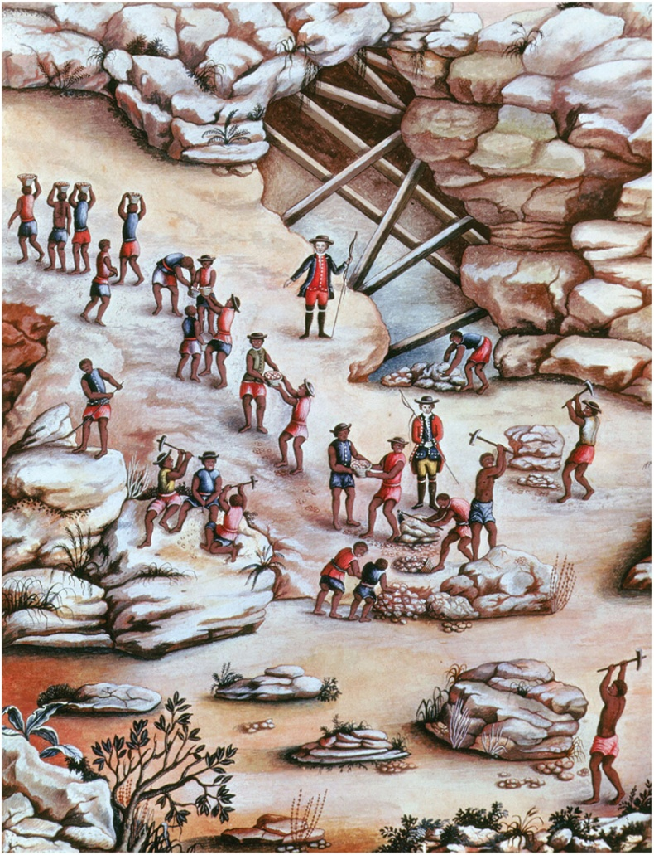
Mine Workers. The discovery of gold and diamonds in Minas Gerais led to a boom but did little to contribute to the long-term health of the Brazilian economy. With the Native American population decimated by disease, African slaves performed the backbreaking work

Slide 12
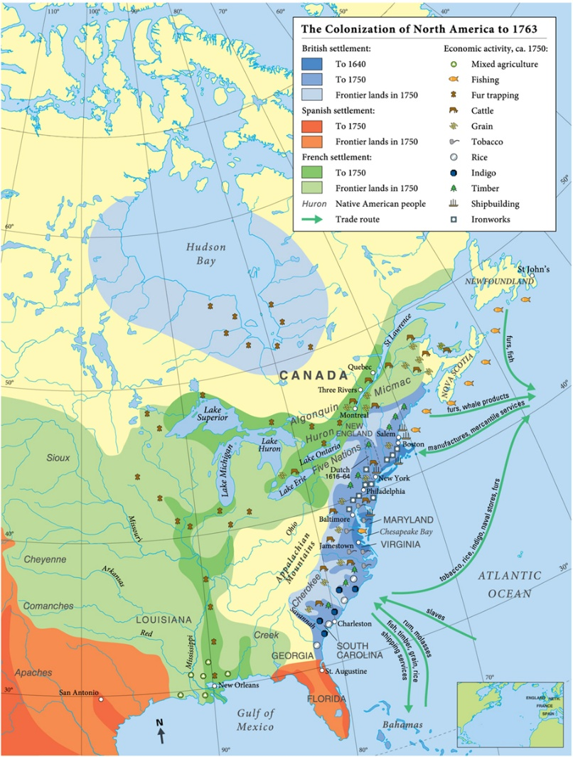
MAP 18.3 The Colonization of North America to 1763

Slide 13
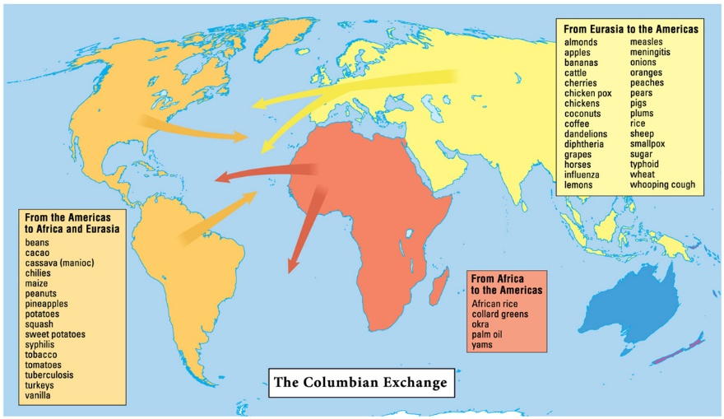
MAP 18.4 The Columbian Exchange

Slide 14
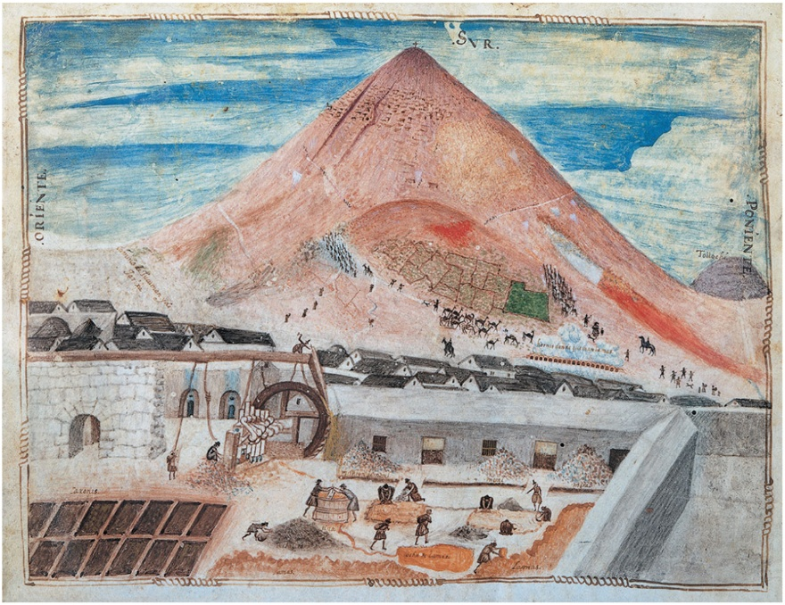
The Silver Mountain of Potosí. Note the patios in the left foreground and the waterdriven crushing mill in the center, which ground the silverbearing ore into a fine sand that then was moistened, caked, amalgamated with mercury, and dried on the patio. The mine workers’ insect-like shapes reinforce the dehumanizing effects of their labor.

Slide 15
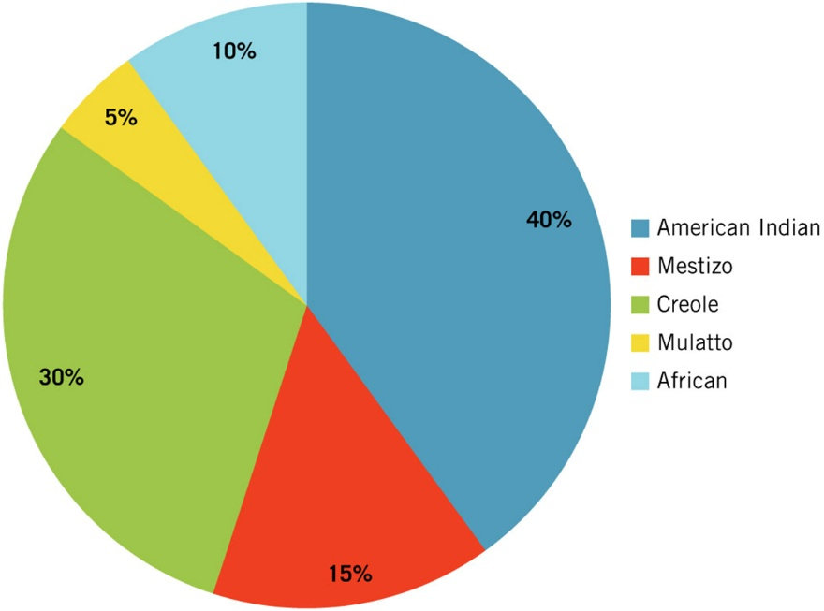
Figure 18.1 Ethnic Composition of Latin America, ca. 1800

Slide 16
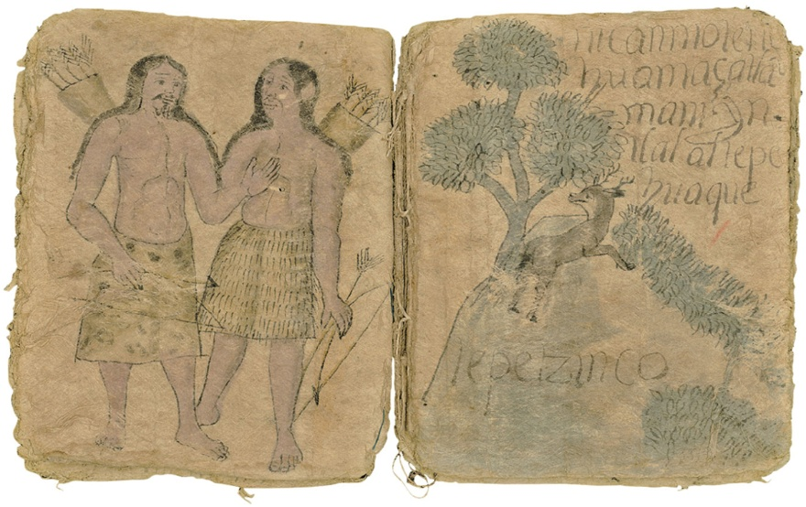
Illustration from an Indian Land Record. The Spaniards almost completely wiped out the Aztec archives after the conquest of Mexico; surviving examples of Indian manuscripts are thus extremely rare. Although the example shown here, made from the bark of a fig tree, claims to date from the early 1500s, it is part of the so-called Techialoyan land records created in the seventeenth century to substantiate native land claims. These “títulos primordiales,” as they were called, were essentially municipal histories that documented in text and pictures local accounts of important events and territorial boundaries.

Slide 17
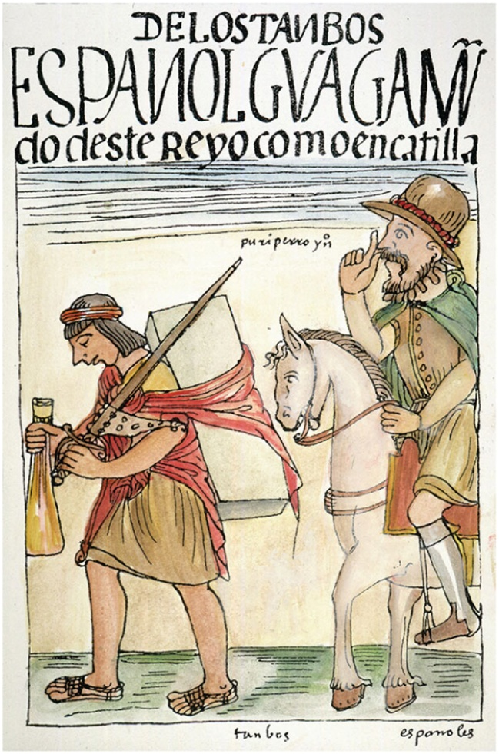
Spanish Cruelty to Incas. Felipe Guamán Poma de Ayala, a Peruvian claiming noble Inca descent, was a colonial administrator, well educated and an ardent Christian. He is remembered today as a biting critic of the colonial administration and the clergy, whom he accused of mistreating and exploiting the Andean population, as in this colored woodcut print.

Slide 18
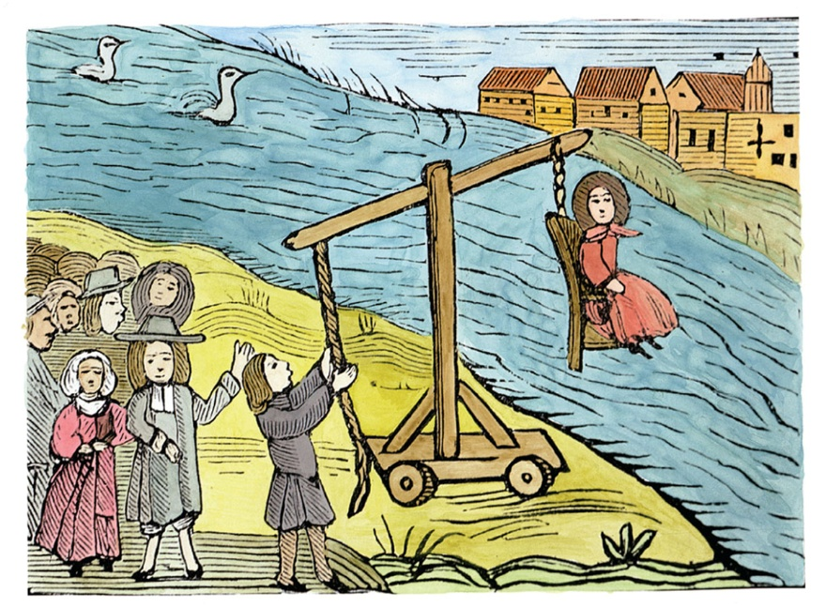
Witch Trial. In the course of the 1600s, in the relatively autonomous English colonies of Northeast America, more persons were accused, tried, and convicted of witchcraft than anywhere else. Of the 140 persons coming to trial between 1620 and 1725, 86 percent were women. Three witch panics are recorded: Bermuda, 1651; Hartford, Connecticut, 1652–1665; and Salem, Massachusetts, 1692–1693. This anonymous American woodcut of the early 1600s shows one method used to try someone for witchcraft: The accused would swim or float, if guilty—or sink, if innocent.

