Slide 1
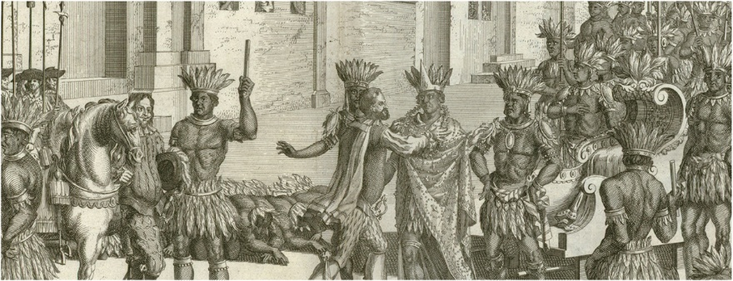
Chapter 18
New Patterns in New Worlds: Colonialism and Indigenous
Responses in the Americas,
1500-1800
Notes:
In his monumental Historia de la conquista de México, written more than 150 years after the events described, Antonio de Solís (1610– 1686) depicted the meeting of Moctezuma and Cortés.

Slide 2
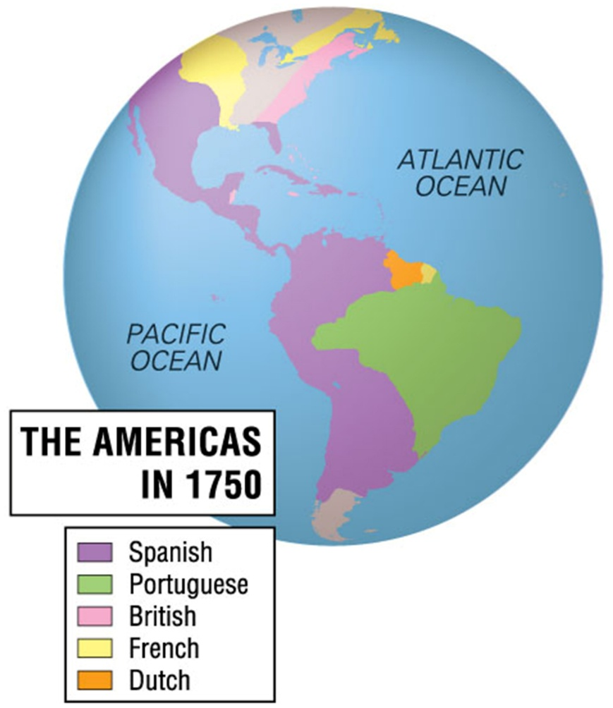
The Americas in 1750

Slide 3
The Colonial Americas: Europe’s Warm Weather Extension
Trading posts turned into conquest in the Caribbean
  Land-labor grants
  Effect of smallpox on native population
Hernan Cortes sent to start trading posts in the Yucatan Peninsula

Slide 4
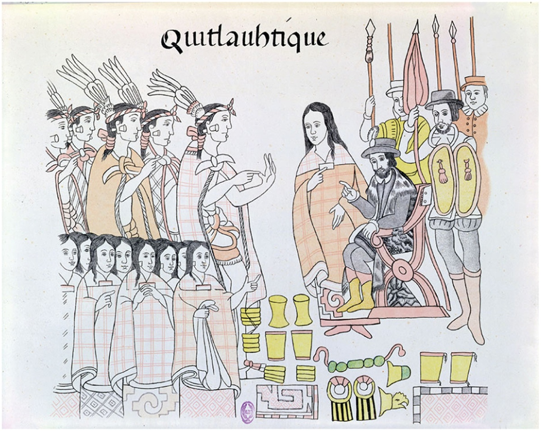
The Conquest of Mexico
Conquest of the Aztec Empire
Cortes allied with native peoples unhappy with Aztec rule
Captured Tenochtitlan with 2000 Spaniards and 50,000 native soldiers
Encomienda: land-labor grants
Notes:
Cultural Intermediary.
The Tabascans gave Malinche, or Doña Marina, to Hernán Cortés as a form of tribute after they were defeated by the Spanish. Malinche served Cortés as a translator and mistress, playing a central role in Cortés’s eventual victory over the Aztecs. She was in many respects the principal face of the Spanish and is always depicted center stage in Native American visual accounts of the conquest

Slide 5
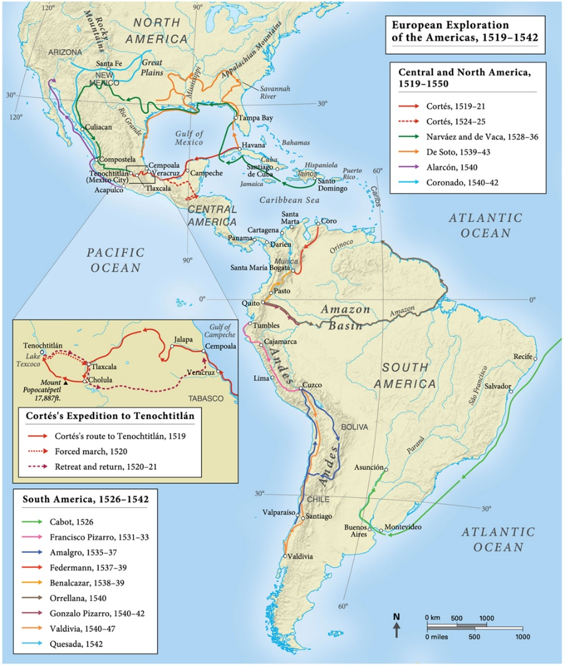
European Exploration of the Americas, 1519-1542

Slide 6
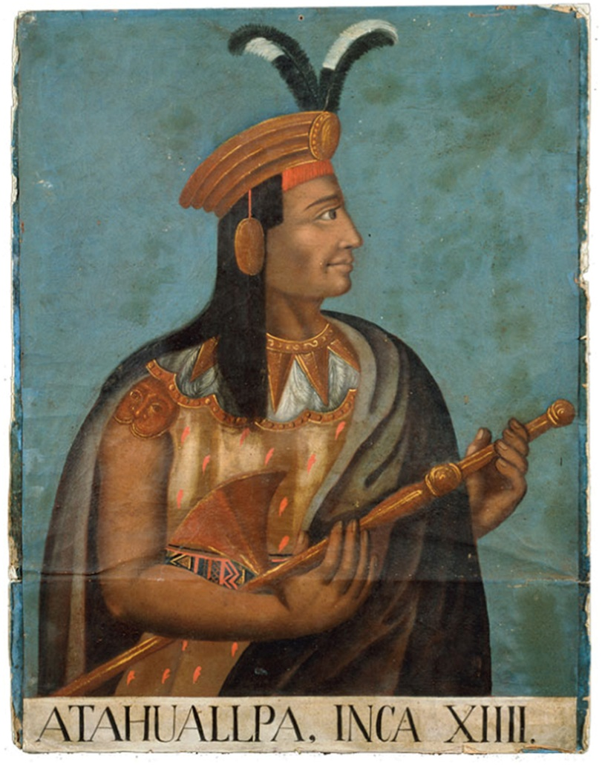
Conquest of the Inca Empire
Conquest of the Inca Empire
Francisco Pizarro given permission to found a trading post in the Inca empire
The empire was ravaged by smallpox and in the midst of civil war
Pizarro looted Inca cities of wealth and used it to found Lima, on the coast
Emperor Atahualpa
Notes:
Conquest by Surprise.
The Spanish conqueror Francisco Pizarro captured Emperor Atahualpa (top) in an ambush. Atahualpa promised a roomful of gold in return for his release, but the Spaniards collected the gold and murdered Atahualpa (bottom) before generals of the Inca army could organize an armed resistance.

Slide 7
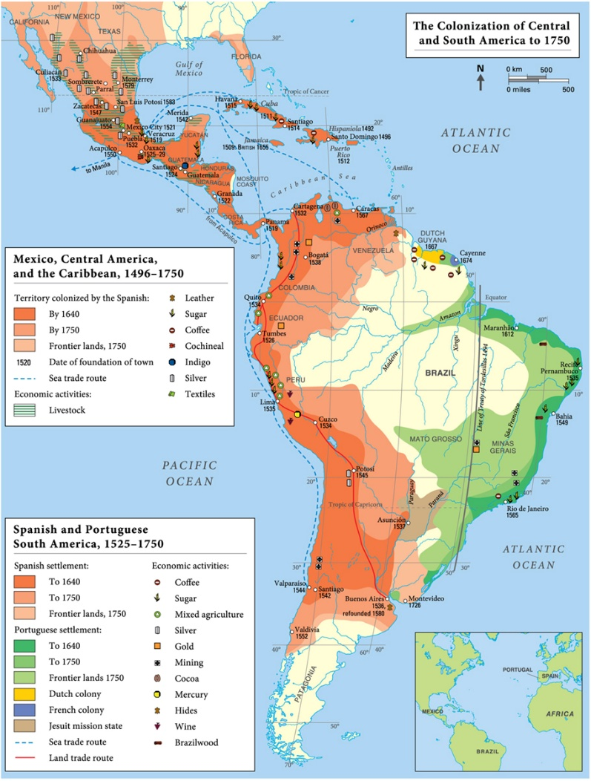
The Colonization of Central and South America to 1750

Slide 8
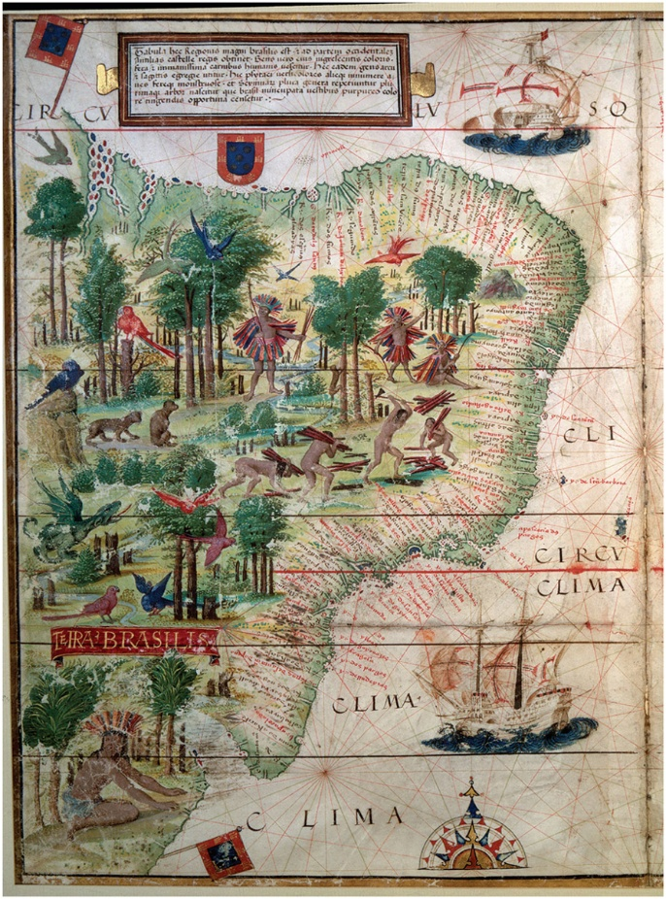
The Portuguese Conquest of Brazil
  Resulted from Portuguese competition for trade with French
Explanations for the Spanish Success
  Focused on removing the heads of societies, paralyzing opposition; weakness in empires and effect of smallpox made this easier; superior military technology meant that few Spaniards could hold their own against armies of Aztecs and Incas
Notes:
Brazil in 1519.
This early map is fairly accurate for the northern coast but increasingly less accurate as one moves south. First explorations of the south
by both Portuguese and Spanish mariners date to 1513–1516. Ferdinand Magellan passed through several places along the southern coast on his journey around the world in 1520–1521. The scenes on the map depict Native Americans cutting and collecting brazilwood, the source of a red dye much in demand by the Portuguese during the early period of colonization

Slide 9
The Establishment of Colonial Institutions
New colonies were centralized from the beginning
Dominated by creoles, Spaniards born in the New World
Riches gained from the Aztecs and Incas drove exploration and conquest
Real money came from exploiting mines and farmland using labor of native people
Small areas resisted conquest, particularly in the highlands or rainforest

Slide 10
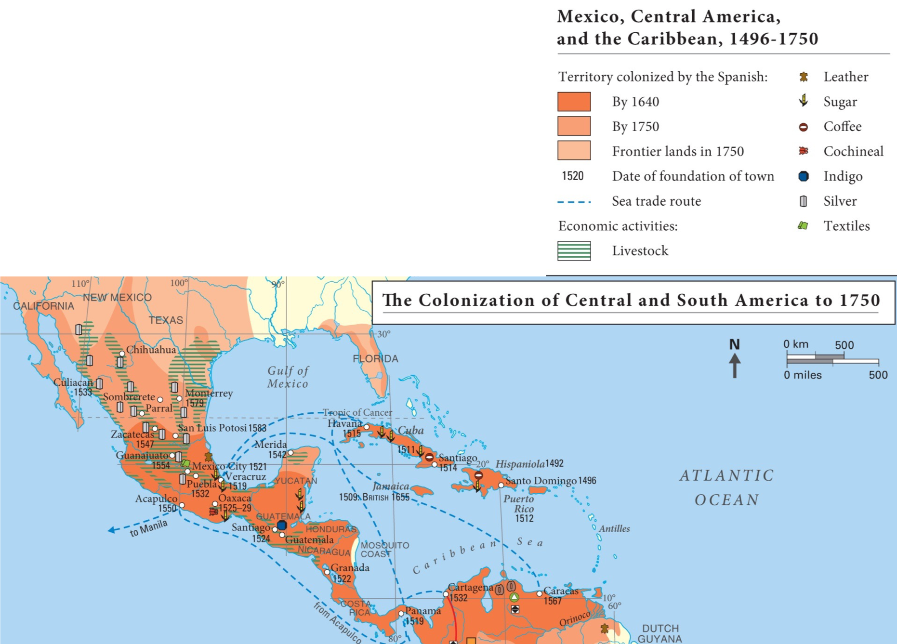
Mexico and Central America, and the Caribbean, 1496-1750

Slide 11
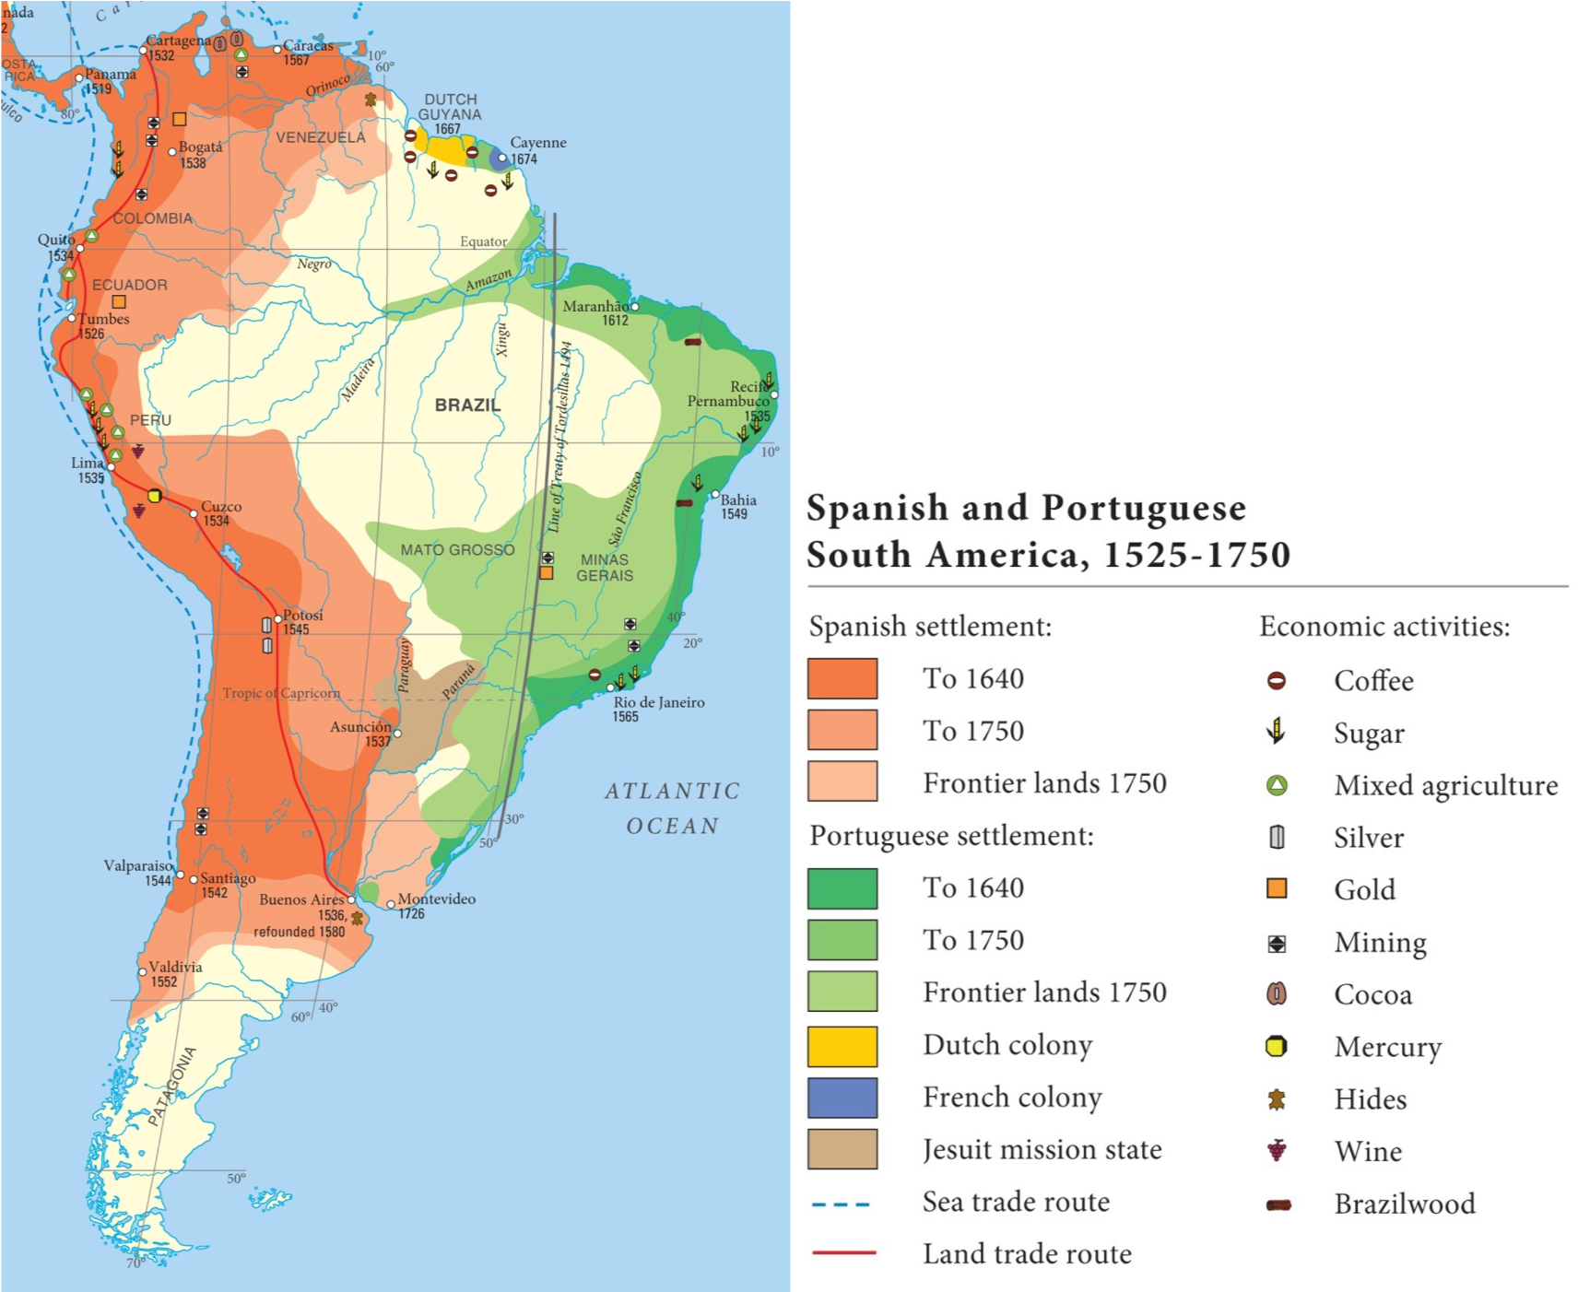
Spanish and Portuguese South America, 1525-1750

Slide 12
Bureaucratic Efficiency
  Delivered majority of the revenue of colonies to Spain
  Rotating labor assignments (repartimientos) kept usage of the declining native population efficient
The Rise of the Creoles
  Gained power as rule from Spain became too expensive

Slide 13
Northwest European Interference
  French, English, and Dutch governments began to challenge Spanish dominance of the Caribbean
    Privateers harassed Spanish shipping
New Bourbon dynasty in Spain attempted to regain control after 1700
  Naval connections and administrative control were improved
  Lack of investment in Spanish industry made it easy for French and English to dominate exports to the Americas

Slide 14
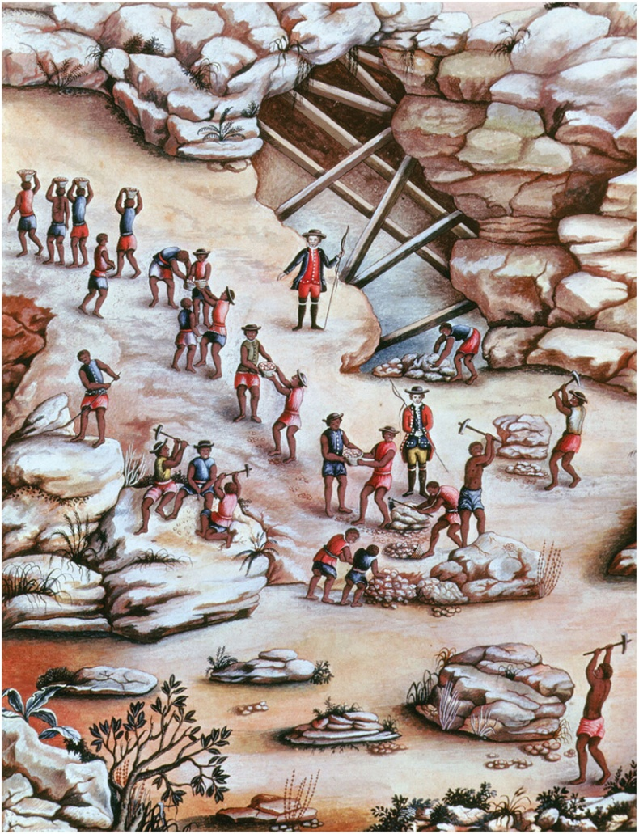
Early Portuguese Colonialism
Expansion into the Interior
Driven by discovery of gold mines
Smallpox decimated the population, led to the importation of African slave labor
Brazil was a valuable colony by mid-18th century
Mine Workers
Notes:
Mine Workers.
The discovery of gold and diamonds in Minas Gerais led to a boom, but did little to contribute to the long-term health of the Brazilian economy. With the Native American population decimated by disease, African slaves performed the backbreaking work.

Slide 15
North American Settlements
Less hospitable than South America
  Early English, French, and Dutch settlements struggled to survive
  Religious zeal in the north and development of tobacco as a cash crop in the south aided colonial survival
Resistance from powerful native confederations
Impact of smallpox and wars between native-European alliances devastated the Native American population

Slide 16
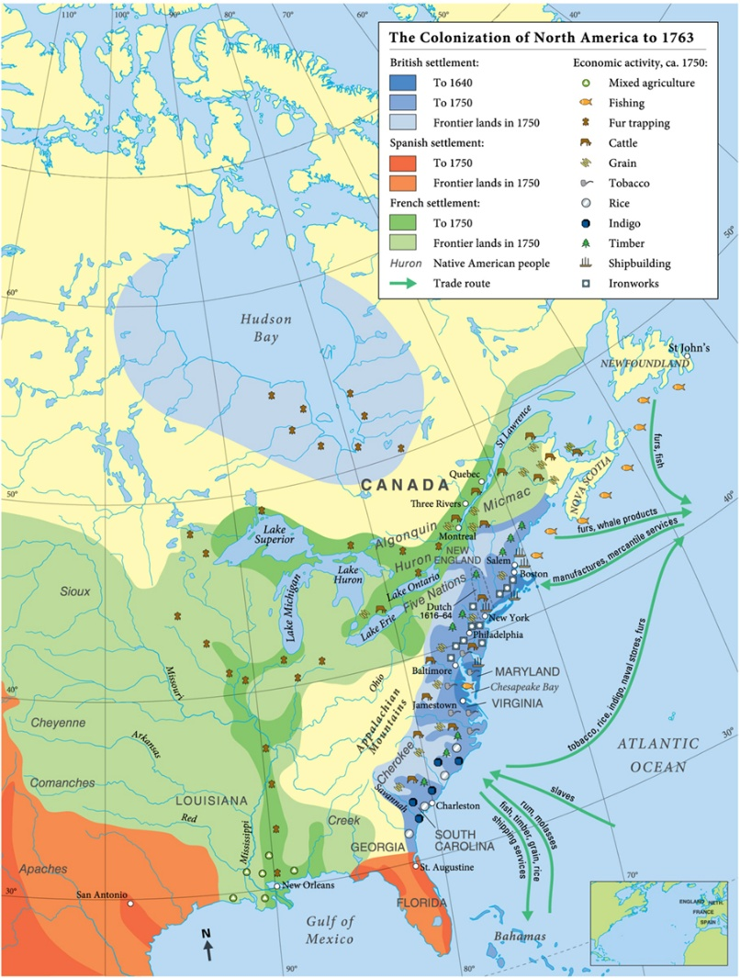
The Colonization of North America to 1763

Slide 17
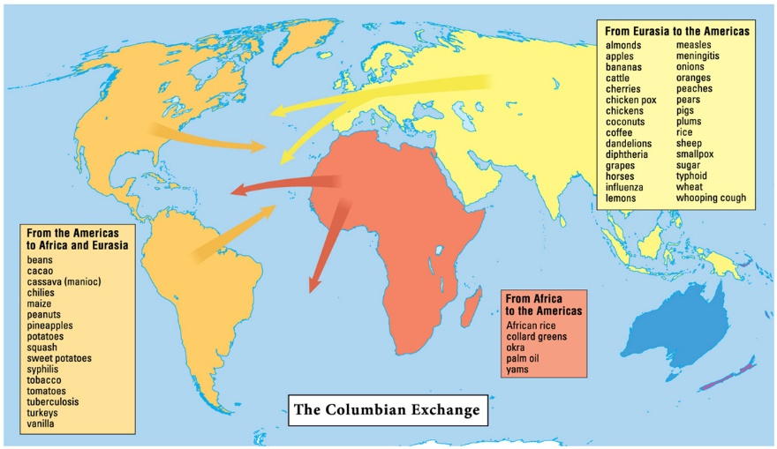
Patterns Up Close
The Columbian Exchange is the exchange of resources between old world and new, benefiting both.

Slide 18
Territorial Expansion and the Seven Years’ War
  Overpopulation in Europe led to expanding colonial populations
  Settlers gained a voice in government through local assemblies
England took governance of colonies away from charter corporations in the late 17th century, but the assemblies’ power survived
Restrictions on settlement made French colonies much smaller
Competition between British and French settlers in the Ohio River Valley led to the Seven Years’ War
Notes:
Land Sale.
Signatures of the leaders of the Iroquois federation on a treaty with Thomas and Richard Penn in 1736. By the terms of this treaty the Iroquois sold lands west of the Susquehanna River to the sons of the founders of the English colony of Pennsylvania. The leaders of the six nations that made up the Iroquois federation (Mohawk, Oneida, Onondaga, Cayuga, Seneca, and Tuscarora) signed with their pictograms. Their names were added later.

Slide 19
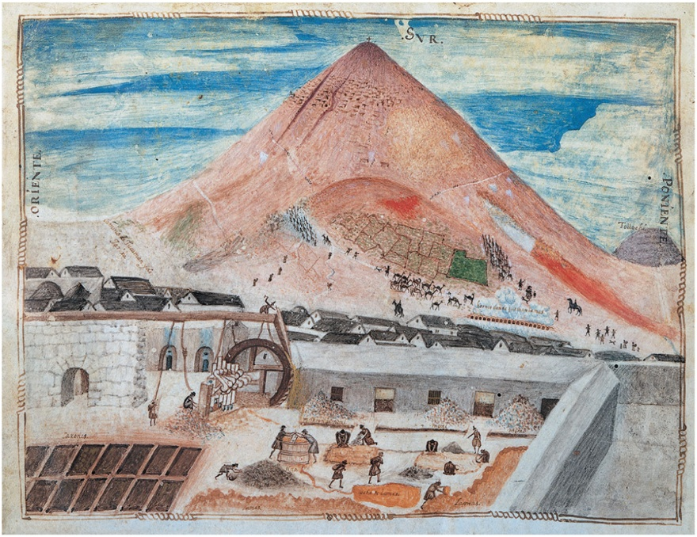
The Making of American Societies
Ways in which colonies were integrated into European economy affected development of society
Spanish colonies focused on mining in Bolivia and Mexico
Exploitation of native labor made colonial mines a major source of Spanish wealth
The Silver Mountain of Potosí
Notes:
The Silver Mountain of Potosí.
Note the patios in the left foreground and the water-driven crushing mill in the center, which ground the silver-bearing ore into a fine sand that then was moistened, caked, amalgamated with mercury, and dried on the patio. The mine workers’ insect-like shapes reinforce the dehumanizing effects of their labor.

Slide 20
Exploitation of Mineral and Tropical Resources
Wheat Farming and cattle ranching developed in colonies to support the mining centers
Brazil began as a trading and farming colony, until the discovery of gold in the 18th century
As plantation farming grew more important in North and South America, importation of slaves from Africa increased

Slide 21
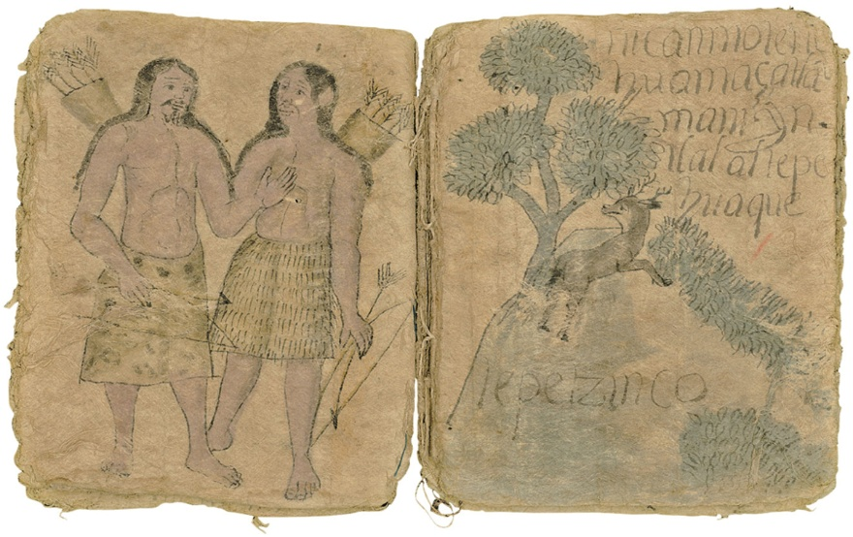
Social Strata, Castes, and Ethnic Groups
Europeans were the social elite
Lower Creoles: craftsmen and merchants, not as wealthy as the elite but still of European descent
Mestizos and Mulattoes-mixed race population, higher than the natives on the social ladder
Position of women varied based on social position
Disease reduced the numbers of Amerindians in the first 150 years after conquest
Notes:
Illustration from an Indian Land Record. The Spaniards almost completely wiped out the Aztec archives after the conquest of Mexico; surviving examples of Indian manuscripts are thus extremely rare. Although the example shown here, made from the bark of a fig tree, claims to date from the early 1500s, it is part of the so-called Techialoyan land records created in the seventeenth century to substantiate native land claims. These “títulos primordiales,” as they were called, were essentially municipal histories that documented in text and pictures local accounts of important events and territorial boundaries.

Slide 22
New England Society
Small family farm was the norm in early New England
Large port cities emerged in the 18th century
Wealthy merchant class formed
Placed priority on eduction-the majority of men were literate

Slide 23
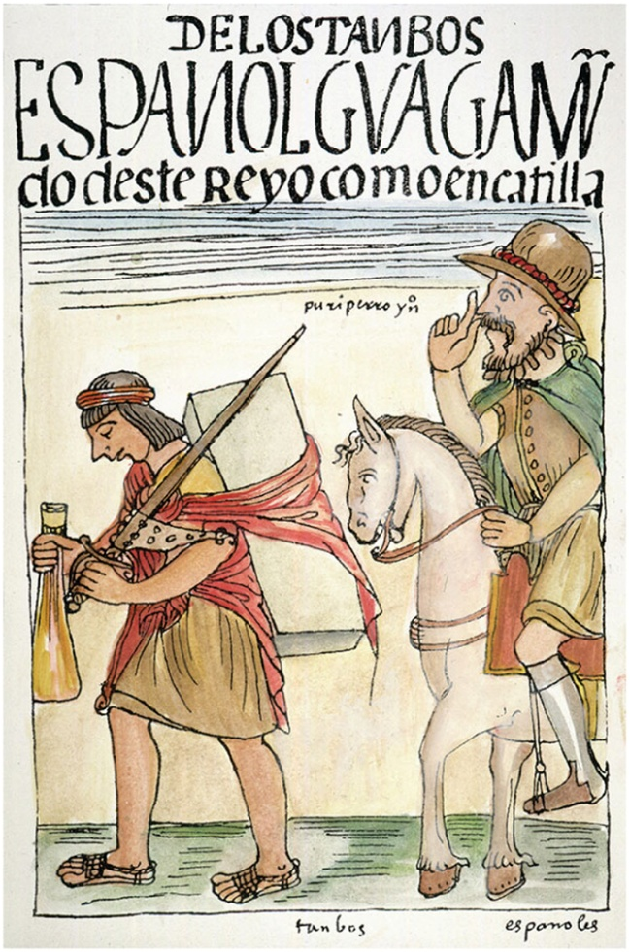
The Adaptation of the Americas to European Culture
Catholic Missionary Work
Monarchs relied heavily on the Church to help them rule the colonies
Cults of saints and the Virgin Mary replaced traditional native gods
Spanish cruelty to the Incas
Notes:
Spanish Cruelty to Incas. Felipe Guamán Poma de Ayala, a Peruvian claiming noble Inca descent, was a colonial administrator, well educated and an ardent Christian. He is remembered today as a biting critic of the colonial administration and the clergy, whom he accused of mistreating and exploiting the Andean population, as in this colored woodcut print.

Slide 24
Education and the Arts
Education was primarily through Catholic missionaries
Recording and Writing of native cultures and done by missionaries trying to understand the people they wanted to convert
Did not stop general mistreatment of natives

Slide 25
Protestantism in New England
Religious diversity defined English settlements in North America
Even in religiously unified colonies, like Massachusetts, dissenters frequently arose

Slide 26
New Sciences Research
New Science was more popular in English and Dutch colonies
Research by colonists like Ben Franklin added to the European tradition

Slide 27
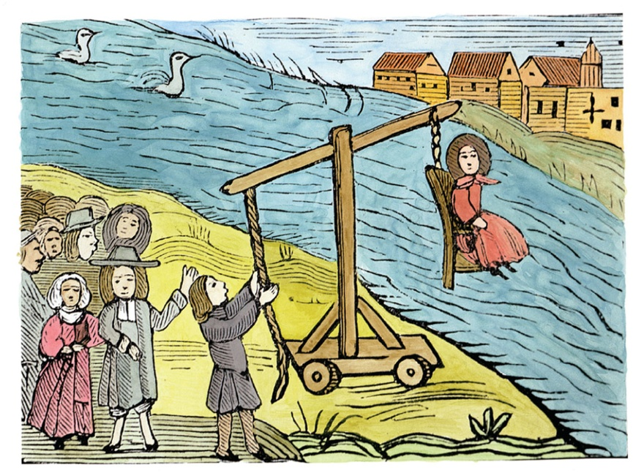
Witch Hunts and Revivalism
Intense religious rivalry in the colonies led to the outbreak of witch hunts in the late 17th century
  Salem witch trials
Religious fervor also led to periods of revival
  Great Awakening of the early 18th century
Notes:
Witch Trial.
In the course of the 1600s, in the relatively autonomous English colonies of Northeast America, more persons were accused, tried, and convicted of witchcraft than anywhere else. Of the 140 persons coming to trial between 1620 and 1725, 86 percent were women. Three witch panics are recorded: Bermuda, 1651; Hartford, Connecticut, 1652–1665; and Salem, Massachusetts, 1692–1693. This anonymous American woodcut of the early 1600s shows one method to try someone for witchcraft: swim or float if guilty, or sink if innocent.

