Slide 1
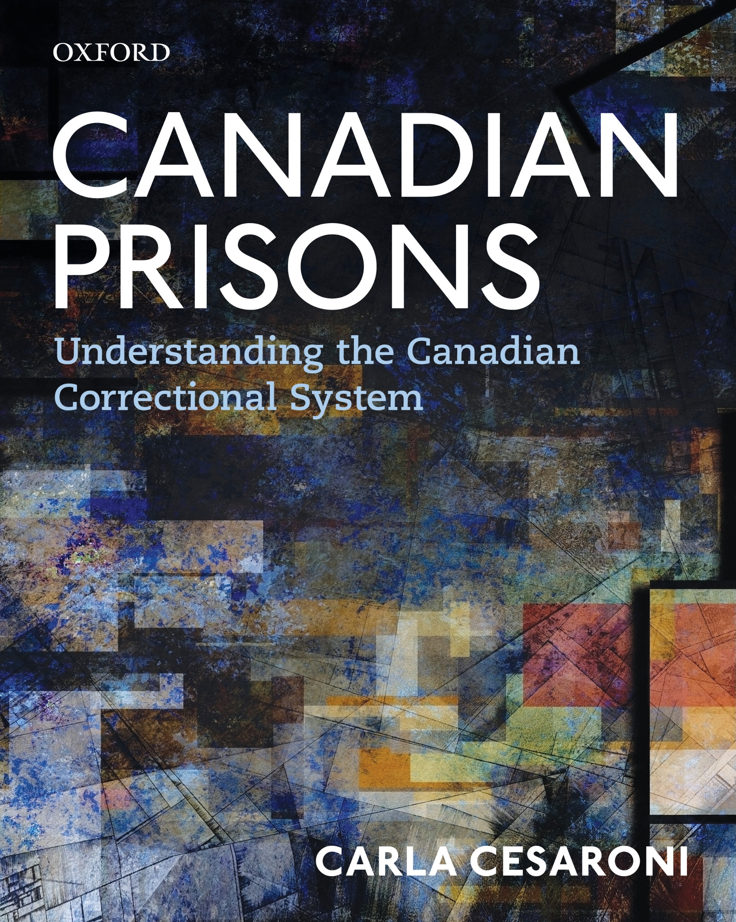

Slide 2
Chapter 1
The History of Prisons in Canada
Jim Phillips

Slide 3
Learning Objectives
  Appreciate the many different uses to which prisons were put before the 1830s
  Know when and why the prison became the principal sanction used by the courts when sentencing
  Describe what was novel about the prison regimes in Canada
  Know why Canada has two prison systems and the roles each play

Slide 4
Learning Objectives, cont’d
Explain how people in the late 1880s thought about women’s prisons, and how they believed they should be run differently than men’s prisons.
Describe how the two contradictory ideas about prisons – that they must punish and reform – have long co-existed.
Describe what has changed about prisons since World War II.

Slide 5
Chapter Overview
  European colonial settlements and jails in New France and English colonies.
  The move to penitentiaries and their corollary, the prison discipline system in the 1830s.
  The new arrangements for control of different carceral institutions at Confederation.
  Specialized institutions for women and youth.
  The “reform” that punctuates prison history.

Slide 6
Introduction
A history of the prison in Canada must be part of and engaged with three other histories:
    The building of colonial infrastructures
    2. The political development of Canada
    3. The changing approaches to penal philosophy across the modern world

Slide 7
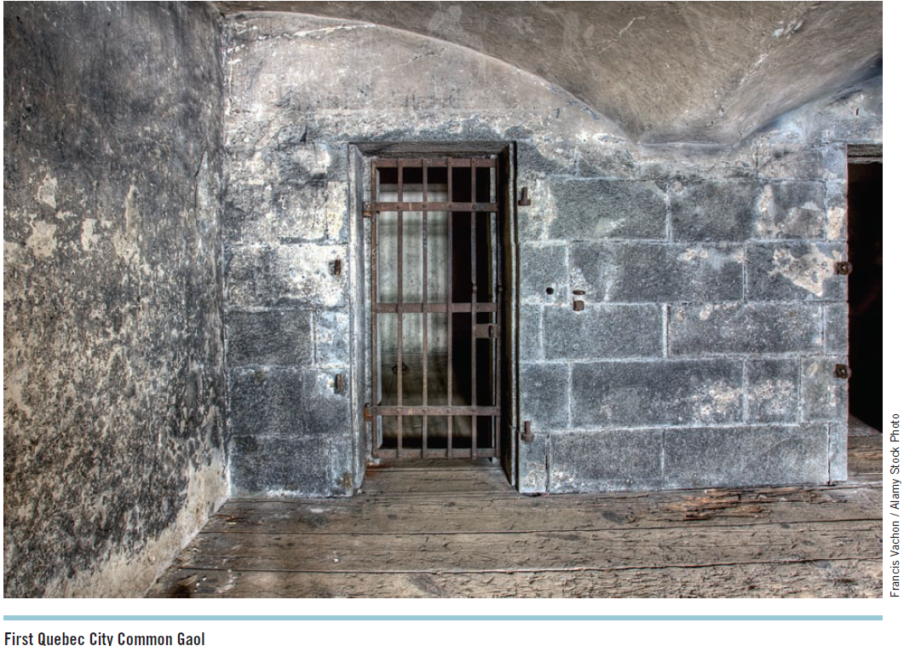
Early Prisons to circa 1800
First prisons started in 1670s:
  Towns in New France: Montreal, Quebec and Trois-Rivieres
  Dominated by physical punishments including banishment
By 1770s building prisons became part of institution building.
  E.g., The first jail was built in Halifax shortly after it was founded.

Slide 8
Early Prisons to circa 1800, cont’d
Prior to 1800 prisons in Canada paralleled developments in Europe and the United States.
Prisons were widely used in the administration of criminal justice and to support the social and economic order.
Prison conditions were poor with crowded tiny cells that were unheated.

Slide 9
The Transformation of Penal Practices: Circa 1800 to Confederation
Three related developments of the pre-Confederation period transformed both the role of the prison within the system of criminal punishment and the nature and purpose of imprisonment itself:
    The much greater use of imprisonment
    Changes were made to existing carceral institutions
      E.g., Halifax Bridewell – a “house of correction”
      Prison discipline movement
    The construction of Kingston Penitentiary in 1835

Slide 10
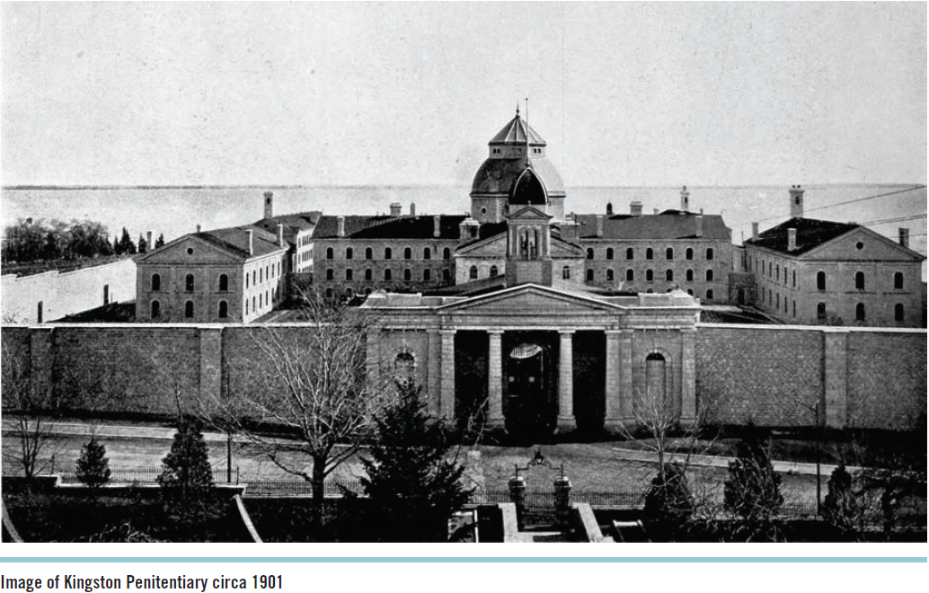
The Transformation of Penal Practices: Circa 1800 to Confederation, cont’d
Kingston Penitentiary:
  Focus on punishment or rehabilitation?
  The silent system
  The separate system
  The Brown Commission

Slide 11
The Transformation of Penal Practices: Circa 1800 to Confederation, cont’d
Other colonies in Canada experienced their penitentiary movements within a decade of Kingston’s opening.
  More prisons = more inmates
The Crofton system
The Rockwood Criminal Lunatic Asylum
Changes in prisons for women and juvenile prisoners

Slide 12
Confederation: The Federal-Provincial Division of Powers and the Origins of the National Penitentiary System
British North America Act
Two-year rule
Penitentiary Act

Slide 13
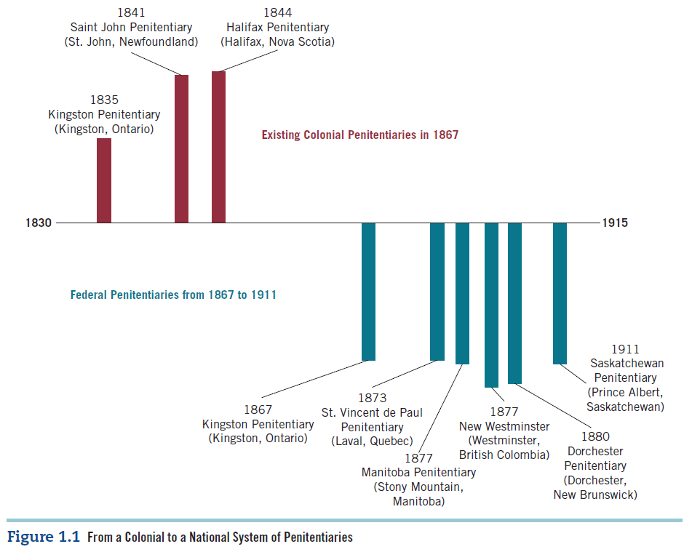
The National Penitentiary System

Slide 14
Territorial and Provincial Prisons from 1867
Guardhouses
Saskatchewan and Alberta
  First territorial jail in Regina
  Gaols Act; Gaols and Prisons Act
Increase in the prison population and attitudes
Regimes and conditions in provincial prisons:
  Little or no classification of prisoners
  Poor conditions

Slide 15
Territorial and Provincial Prisons from 1867, cont’d
The late 1800s saw two important new innovations in Ontario:
  The Andrew Mercer Reformatory for Women
  2. Ontario Central Prison

Slide 16
The Andrew Mercer Reformatory for Women
Reflected the feminist movement at the time
For female prisoners, run by women
Sentences mostly for prostitution, drunkenness, or vagrancy
Trained in religion, sobriety, and domesticity
Many problems arose

Slide 17
The Ontario Central Prison
Male inmates only serving sentences of less than two years
An industrial prison that would reform inmates through labour, the work being run by private contractors
Was deemed a failure

Slide 18
Federal Penitentiaries from 1867 to circa 1935
Little consistency in any aspect of penal philosophy and prison administration between 1867 and WW2
Dichotomy in the thinking of the two principal groups of people involved in managing prisons – prison professionals and politicians
Prison labour was designed to make prison time harder
Institutionalized aspects of the Crofton system:
  Earn early releasee through good behaviour and exemplary work
  Parole

Slide 19
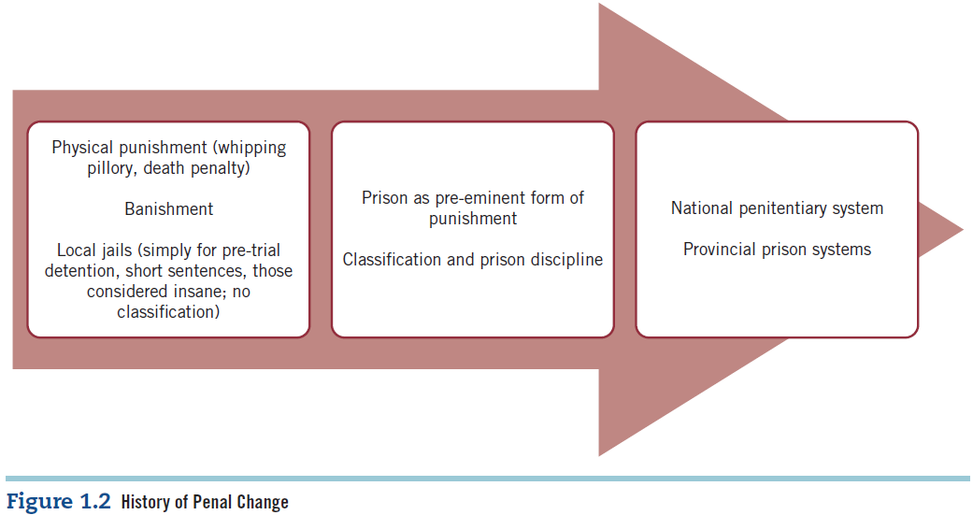
Federal Penitentiaries from 1867 to circa 1935, cont’d

Slide 20
Federal Penitentiaries from 1867 to circa 1935, cont’d
Riots and protests over the poor prison conditions
First national penal conference in Toronto in 1892
John Howard Society founded in Quebec in 1892
Enforcing the silent system was incredibly difficult
The Archambault Report
Opening of a separate prison for women within Kingston Penitentiary

Slide 21
Signal Moments: The Archambault (1938), Fauteux (1956), and Ouimet (1969) Reports
In the quarter century between the mid-1930s and 1961 three major investigations inquired into the state of the penitentiary system:
1. The Archambault Report
2. The Fauteux Report
3. The Ouimet Report

Slide 22
The Archambault Report (1938)
Chaired by Joseph Archambault
Included:
  An investigation of the treatment of convicted persons in penitentiaries
  The classification of offenders
  Prison punishments
  Prison labour
  Conditional release
  Aid to prisoners upon release
  A variety of other related subjects

Slide 23
The Archambault Report (1938), cont’d
Full title: The Royal Commission Report on Penal Reform in Canada
88 recommendations
The 32 chapter report argued that prisons should not just be for the temporary protection of the public, but should also serve to prevent crime and rehabilitate prisoners.

Slide 24
The Archambault Report (1938), cont’d
The report also paid attention to female prisoners, juvenile delinquents, family courts, and training schools.
Argued for a national system wherein all Canadian corrections should be handled by the federal government.

Slide 25
The Fauteux Report (1956)
More narrowly focused than Archambault
Investigated parole
Looked at treatment and rehabilitation
Pointed to the extend of overcrowding, which impaired classification

Slide 26
The Fauteux Report (1956), cont’d
Discussed sentence length, arguing that a sentence should be long enough to give enough time to rehabilitate, but short enough to allow the offender to maintain hope of spending an appreciable amount of his or her life outside.
Parole Act (1959) created and established the National Parole Board.
Recommendations:
  More vocational training and specific pre-release and post-release programs
  Hire more and better-trained personnel, including psychiatrists, psychologists, and social workers

Slide 27
The Fauteux Report (1956), cont’d
Plan to build 10 new prisons across the country:
  Seven were built in the 1960s in locations where there had not been such an institution before.
  Three were built on the same grounds (but separate) from existing institutions in Kingston and Stony Mountain.

Slide 28
The Ouimet Report (1969)
Last of the three major investigations into the federal prison system, and perhaps the most important.
Report from the Special Committee on Corrections chaired by Roger Ouimet.
Two of five members of the committee were not in law enforcement.
The report argued that there should be co-operation among law enforcement, the judiciary, and penal services.
It offered a more negative view of the prison system than any previous inquiry.

Slide 29
The Ouimet Report (1969), cont’d
8 main principles that prioritized rehabilitation over punishment were listed.
It argued that rehabilitation did more to protect society than punishment.
Condemned corporal punishment
Proposed serious alternatives to incarceration

Slide 30
The Ouimet Report (1969), cont’d
Caused a shift in thinking:
  Its recommendation that corporal punishment be abolished was accepted in 1972
Law Reform Commission of Canada

Slide 31
Conclusion
Modern history of prison in Canada dates from the early to mid-nineteenth century when there was a shift away from confining those awaiting trial, debtors, the insane and those sentenced to short periods of incarceration.
Acceleration of the construction of more prisoners to house those with longer sentences for serious crimes.
Rehabilitation has been a goal of the penitentiary system since then, at some times more so than others, but never more than an ambition: The prison has punished, but it has rarely rehabilitated.

