Slide 1
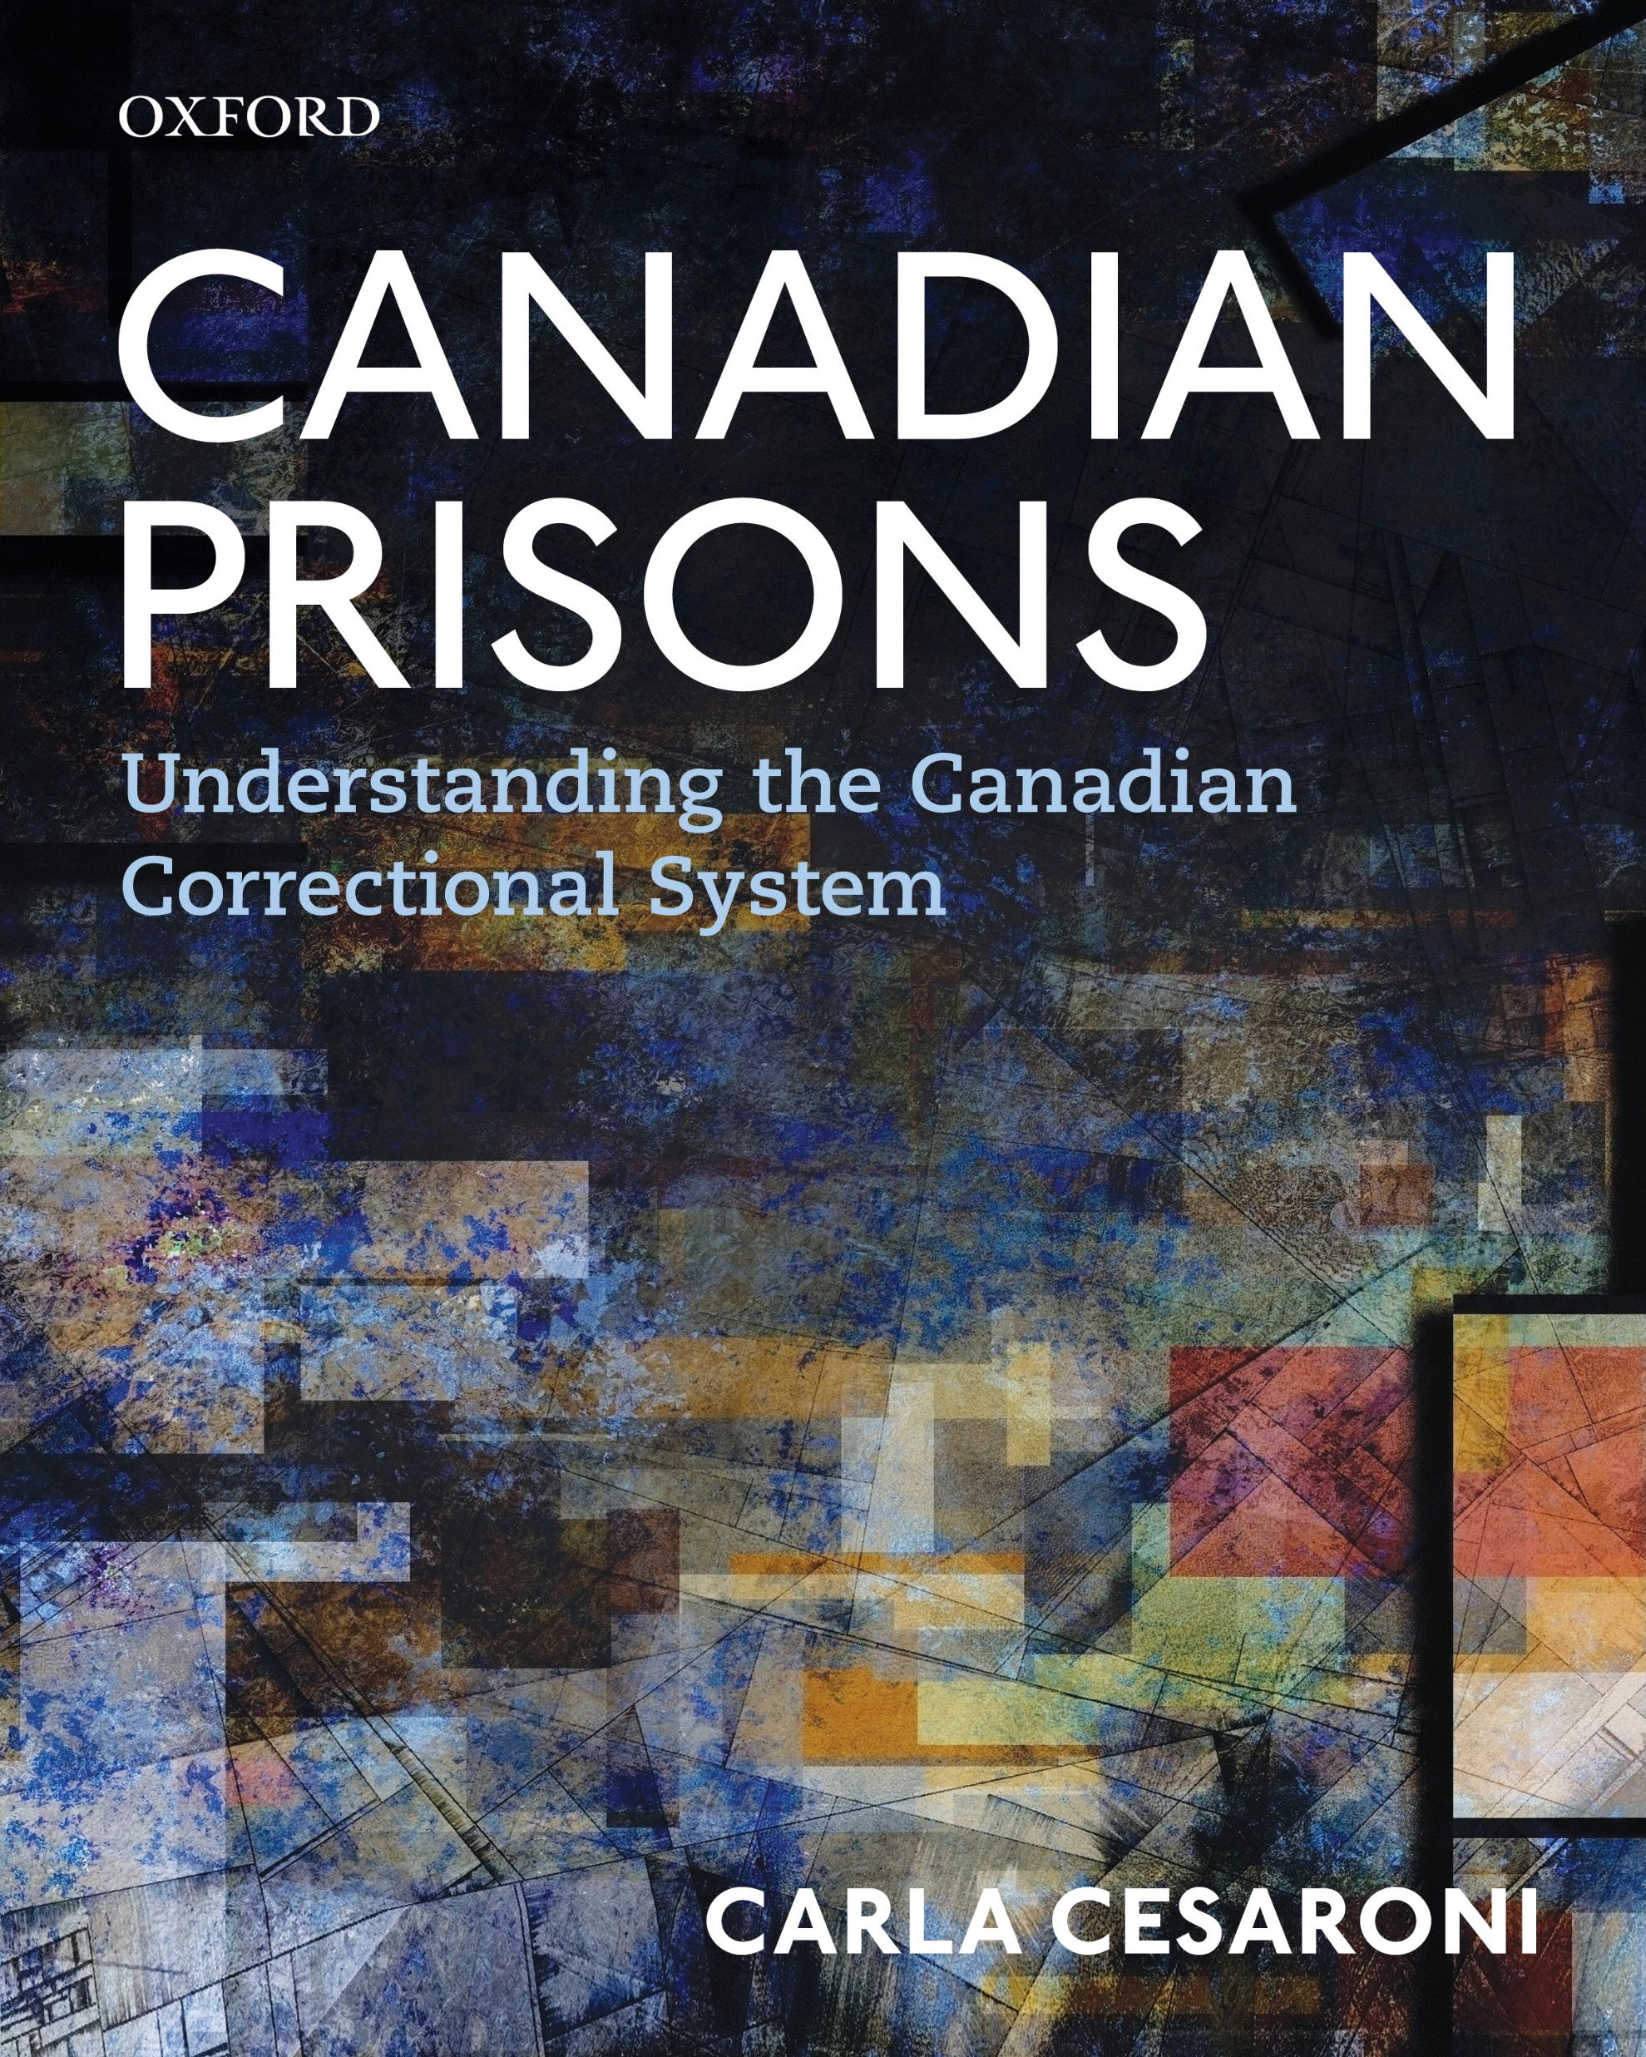

Slide 2
Chapter 2
Understanding Corrections in Canada: A Framework
Allison O’Donnell

Slide 3
Learning Objectives
  Define “corrections”
  Describe the tension that exists in corrections
  List the pieces of legislation that govern Canadian corrections
  Describe the difference between federal and provincial corrections in Canada in terms of their mandates, supervision, and prisoner populations
  Describe the role of the correctional investigator of Canada
  Discuss alternatives to Incarceration

Slide 4
Chapter Overview
What is “corrections”?
It will provide an overview of the purpose, key legislation, and the framework that guides the day-to-day operations of federal and provincial prisons as well as community corrections
Alternatives to incarceration
Review of correctional oversight

Slide 5
What is “Corrections”?
Corrections, along with the police and the courts, are an integral part of the criminal justice system.
Correctional systems have both non-institutional programs and services, as well as those that are delivered in institutional settings.
More correctional personal, offenders, and programs in community corrections than there are in correctional institutions.
  Only 20% of adults under correctional supervision in 2015-2016 were in custody.

Slide 6
What is “Corrections”? cont’d
Corrections comprises facilities, government policies, and programs delivered by the government and community organizations that are designed to punish, treat, and supervise individuals convicted of criminal offences.
Not-for-profit organizations and members of the public are part of the delivery of correctional services.
Corrections has the mandate to maintain the delicate balance between individual freedoms and rights and the maintenance of social order.

Slide 7
What is “Corrections”? cont’d
Corrections does not determine a sentence, how long a sentence will be, or whether it will be served in the community or a correctional facility.
Corrections is a set of institutions and services that attempt to punish, treat, and supervise individuals convicted of criminal offences.
A key role of corrections is to administer a sentence.

Slide 8
Correctional Ideology
Primary mandate is the protection of society
  Get tough approach
  Treatment approach
Prisons were considered more humane than the death penalty
Rehabilitation ideology (1935): correcting offenders first
1970s was a decade of unrest and violence in prisons across Canada
  Reintegration ideology emerged

Slide 9
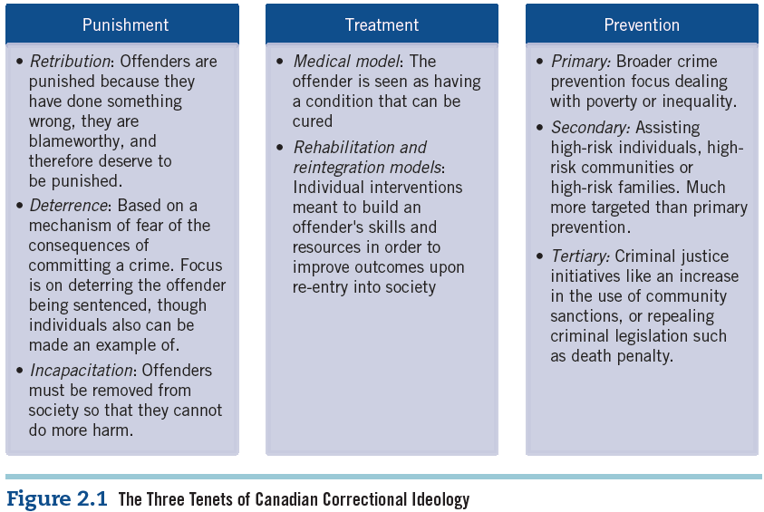
Correctional Ideology, cont’d
Canada’s correctional ideology has been a balancing act between three different
focuses:
  Punishment
  Treatment
  Prevention

Slide 10
The Purpose of the Canadian Correctional System
To administer the sentences of all individuals who have been sentenced
Acknowledge pubic safety and rehabilitation of offenders
Two key areas:
  Mandate
  Programming

Slide 11
Mandate
The federal correctional system acknowledges its role in contributing to the safety of the Canadian public through its control of offenders and assistance in their rehabilitation.
This mandate is upheld through the use of reasonable, safe, secure, and humane control of the offenders under its supervision.

Slide 12
Programming
Federal, provincial and territorial correctional systems acknowledge responsibility in aiding offenders rehabilitation through the use of programming.
A correctional plan is created for each offender with recommendations for treatment and rehabilitation.
CORCAN offers prisoners on-the-job and third-party certified vocational training.
  Training falls along 4 business lines: manufacturing, textiles, construction, and services
Reducing criminogenic risk factors

Slide 13
The Structure of the Correctional System of Canada
The Canadian correctional system is divided into two levels:
  Federal
  Provincial and Territorial
Adult corrections in Canada cost over $4.7 billion in 2016-2017.
An average of 39,873 adult offender are incarcerated on any given day.

Slide 14
Federal Incarceration
Operated by the CSC to administer court-imposed sentences that are two years or longer
Supervision of offenders who are in the community
As of 2019, the CSC operates 43 federal correctional institutions in five regions across the country.
  11 clustered sites
  5 minimum security
  9 medium security
  6 maximum security
  12 multi-level security (5 for women and 4 Aboriginal healing lodges)

Slide 15
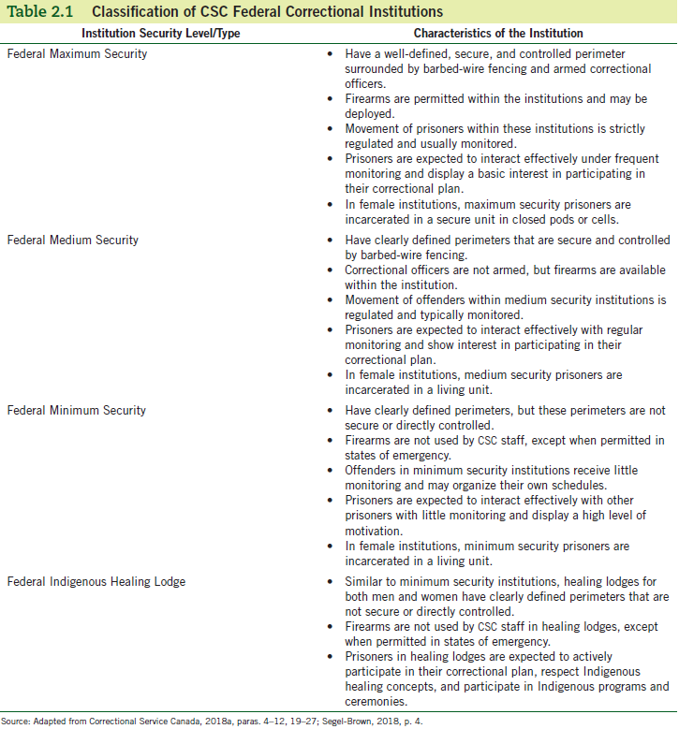
Federal Incarceration, cont’d

Slide 16
Federal Incarceration, cont’d
Number of prisoners classified per federal level of incarceration:
  63% medium security
  22% minimum security
  15% maximum security
Approximately 4% of all offenders who enter the correctional system in Canada will be under the supervision of the federal system.
Costs (2016-17): $1.3 billion. Approximately $105,286 per prisoner each year.

Slide 17
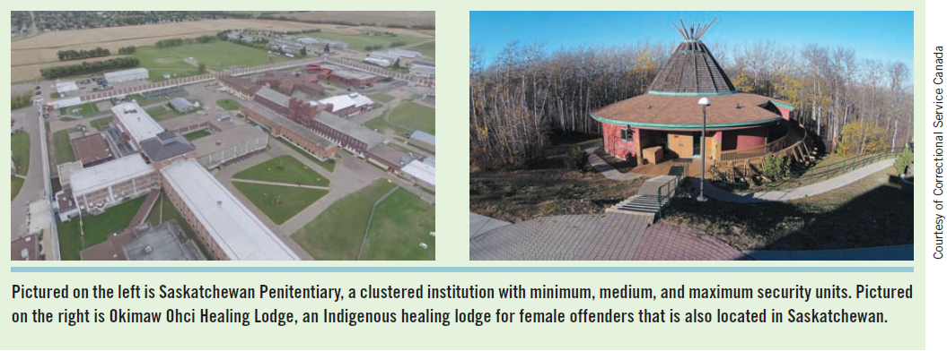
Federal Incarceration, cont’d
First 5 healing lodges developed in 1990
Today there are 4 healing lodges owned and operated by CSC
An additional 5 are funded by CSC, but operated by the community

Slide 18
Provincial and Territorial Incarceration
Responsible for the supervision of offenders who receive a sentence equal to or less than 2 years less a day.
Offenders in remand custody, as well as those who are being held for immigration purposes.
3 security levels, similar to federal incarceration: minimum, medium and maximum security (depending on risk and need).
They are classified at intake to ensure their needs are met.
In 2016-17 Statistics Canada reported that 96% of all offenders sentenced fell under the provincial and territorial jurisdiction.

Slide 19
Provincial and Territorial Incarceration, cont’d
Approximately 25,448 offenders on an average day in 2016-17.
The majority of offenders were on remand, meaning that they were awaiting trial or sentencing.
Totally custody costs for 2016-17 amounted to over $1.9 billion.
  However, the average cost is less than for federal incarceration.

Slide 20
Community Corrections
Both federal and provincial and territorial systems of corrections have a community component.
Types of federal release:
  Full parole
  Day parole
  Statutory release
  Unescorted temporary absences
  Long-term supervision orders
Goal is to release offenders with conditions to aid in a gradual and successful reintegration into the community.

Slide 21
Community Corrections, cont’d
Provincial and territorial community corrections are responsible for the supervision of offenders who are sentenced to probationary periods of up to three years, conditional sentences for two years less a day, and offenders servicing parole.
2016-17: Approximately 8,581 offenders on community release under federal supervision on any given day. Within the provincial and territorial system, 93,135 offenders were under supervision.
Much more cost effective

Slide 22
Alternatives to Incarceration, Probation, and Parole
The development of the probation system and the increasing costs associated with imprisonment both contributed to the establishment and expansion of community corrections in the 1970s.
  Resulted in a disparity in sentences because alternatives were not equally available across Canada.
  Alternatives to incarceration available across Canada are monetary, custodial, and community based.
  Drug treatment and mental health courts have also been introduced to divert certain individuals away from the correctional system.

Slide 23
Legislative Framework of Canadian Corrections
There are numerous pieces of legislation that govern the criminal justice system, including:
  The Canadian Charter of Rights and Freedoms
  The Constitution Act
  The Criminal Code
  Corrections and Conditional Release Act
  Provincial and Territorial Legislation
  International Agreements and Conventions
  The Youth Criminal Justice Act

Slide 24
The Canadian Charter of Rights and Freedoms
The Charter outlines the legal rights and fundamental freedoms that are afforded to every individual in Canada regardless of their citizenship, unless otherwise stated.
Legal and equality rights are laid out in sections 7 through 15.
The Charter protects the rights and freedoms of all individuals accused and convicted of a crime in Canada, expect for the rights and freedoms that are forfeited as a result of imprisonment.

Slide 25
The Constitution Act
The Constitution Act (1867) distinguishes the roles of the federal government and the provincial and territorial governments in Canada.
It divides the correctional system into two entities:
  The federal correctional system is responsible for the custody and supervision of offenders who receive a court-imposed sentence of two years or longer.
  The provincial and territorial systems assume the responsibility of offenders who receive a sentence of two years less a day or shorter.

Slide 26
The Criminal Code
The Criminal Code is a piece of federal legislation that provides a definition of criminal offences in Canada.
It defines an offence, when an individual is guilty of an offence, the means by which the offence should be prosecuted, and the penalties that may be imposed.
Offences in Canada can be prosecuted as a summary, indictable or hybrid offence.

Slide 27
Corrections and Conditional Release Act (CCRA)
The CCRA is the governing legislation of the federal correctional system.
  It governs both the CSC and the Parole Board of Canada (PBC).
The Act is a “living document,” meaning that it can be amended to reflect changes to legislation made by Parliament.
The CCRA is divided into 4 parts.
It addresses the needs of several vulnerable populations including Indigenous offenders and victims of crime.
It also provides the CSC with the ability to develop and enforce policies governing the day-to-day functioning of federal corrections, known as commissioner’s directives.

Slide 28
Provincial and Territorial Legislation
Each province and territory has enacted legislation that governs its correctional system, including its purpose, goals, and functions.
  For example, the Corrections Act enacted by the Government of Alberta
    The Act details the roles, responsibilities, and powers held by officials within the Department of Justice. It also includes policies and procedures concerning daily operations.

Slide 29
International Agreement and Conventions
Canadian corrections are also governed by international agreements and conventions, including the United Nations Standard Minimum Rules for the Treatment of Prisoners – known as the Nelson Mandela Rules.
They define the principles and practices that are accepted as proper treatment of offenders and prison management.
It clearly states that prisoners should be treated with the respect they deserve as human beings and should not be discriminated against.

Slide 30
The Youth Criminal Justice Act
Came into force on April 1, 2003 replacing the former Young Offenders Act.
This applies to youth between the ages of 12 and 17 who have been accused of a criminal offence. Youth under 12 who commit a criminal at in Canada cannot be convicted of an offence.
This Act includes specific rights and freedoms that are afforded to youth because of their age and lack of maturity.
Individuals are sent to custodial facilities rather than prisons.

Slide 31
Oversight of the Correctional System
The Office of the Correctional Investigator (OCI) was established as an ombudsperson for federal offenders as a result of the mandate in the CCRA.
The OCI assesses and reviews federal correctional practices and policies, and responds to individual offenders’ complaints.
Provinces and territories have ombudspersons that operate as third parties who are separate from government and political parties.
Their priority is to oversee government actions, services, and policies and ensure that the government is being held accountable.

