Slide 1
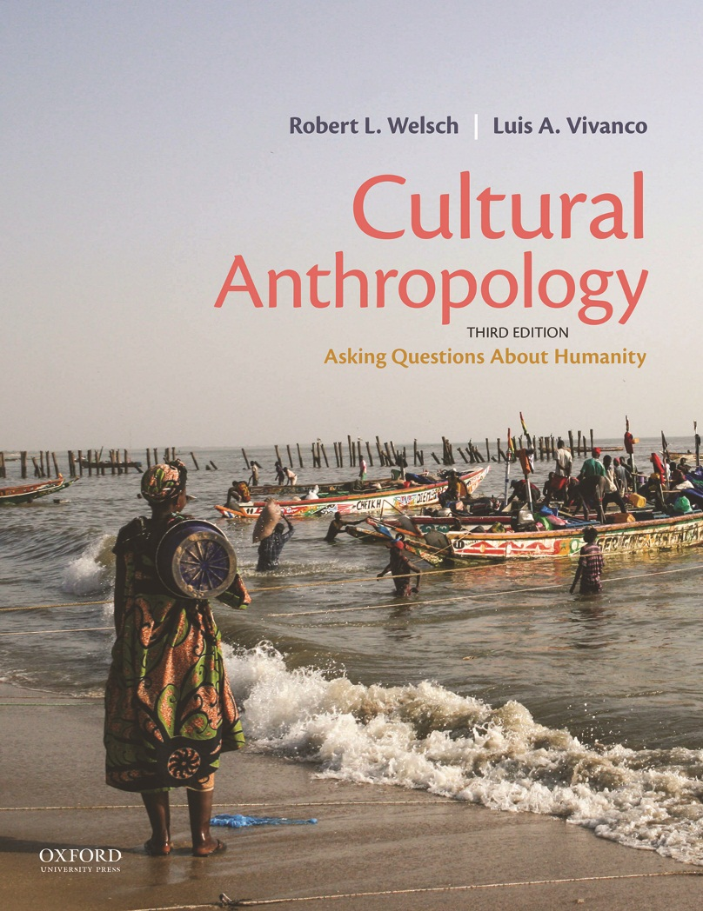
Cultural Anthropology by Robert L. Welsch and Luis A. Vivanco

Slide 2
Chapter 03
Ethnography

Slide 3
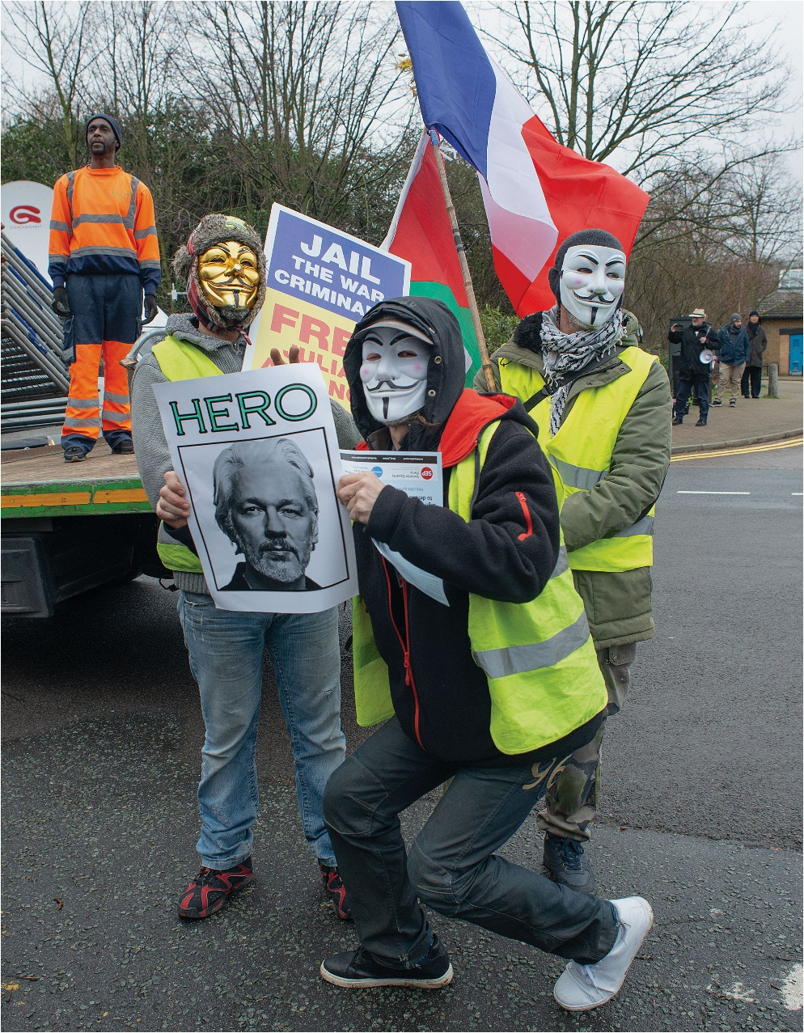
Ethnography

Slide 4
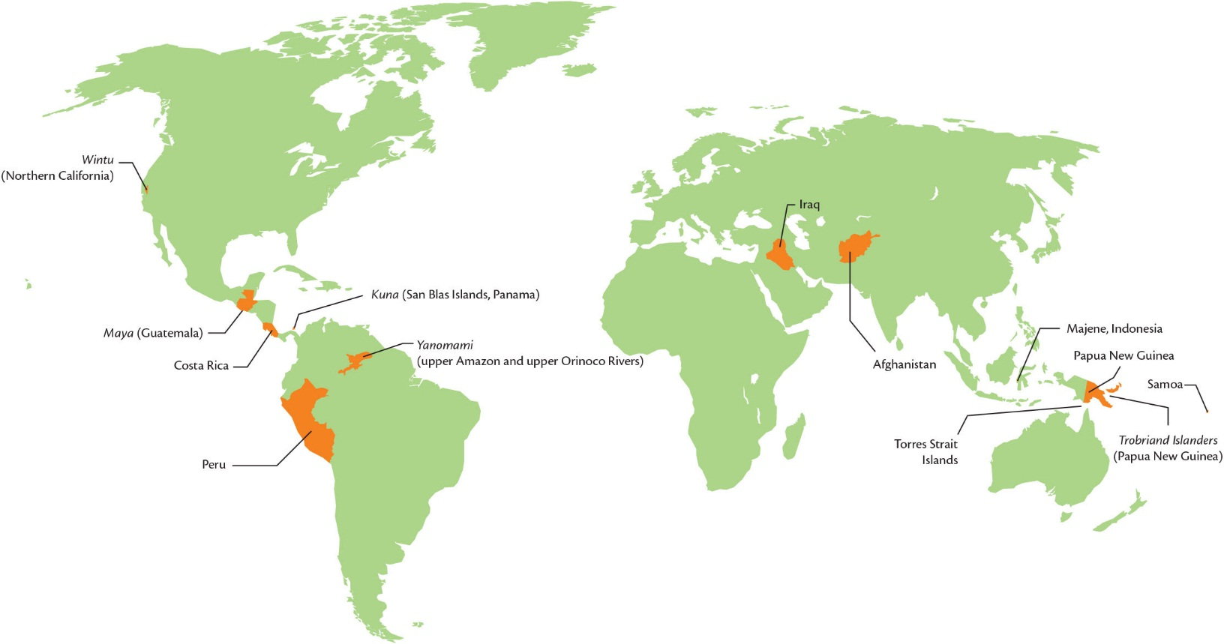
Figure 3.1 Select peoples and places discussed in Chapter 3.

Slide 5
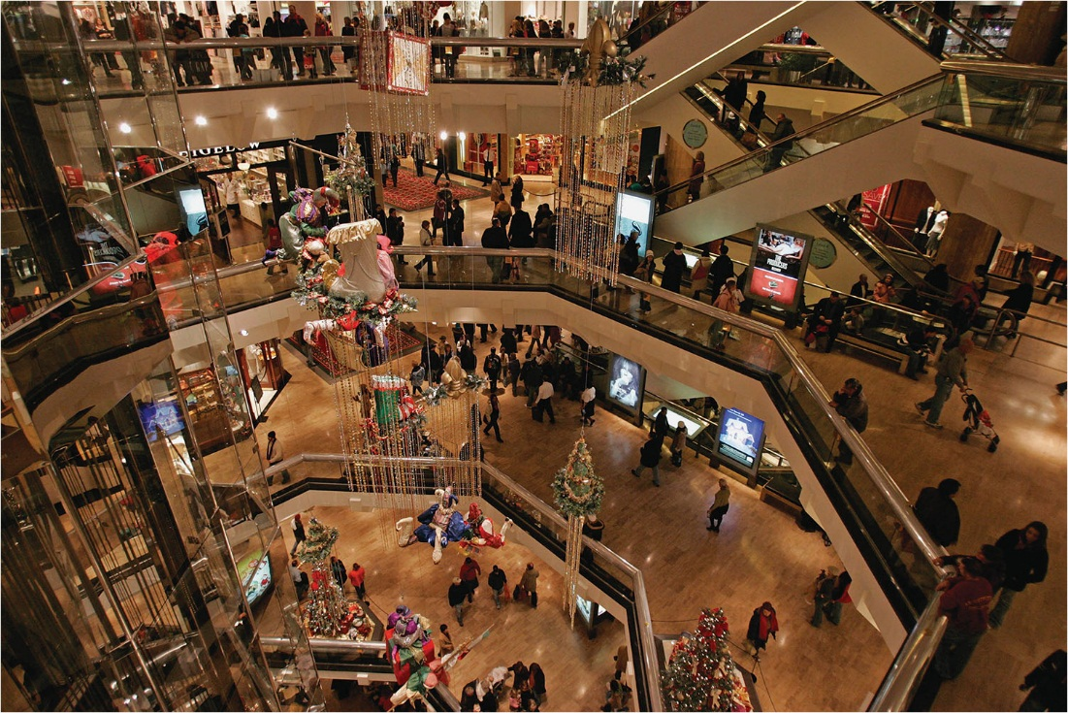
Figure 3.2 Inside an American shopping mall.

Slide 6
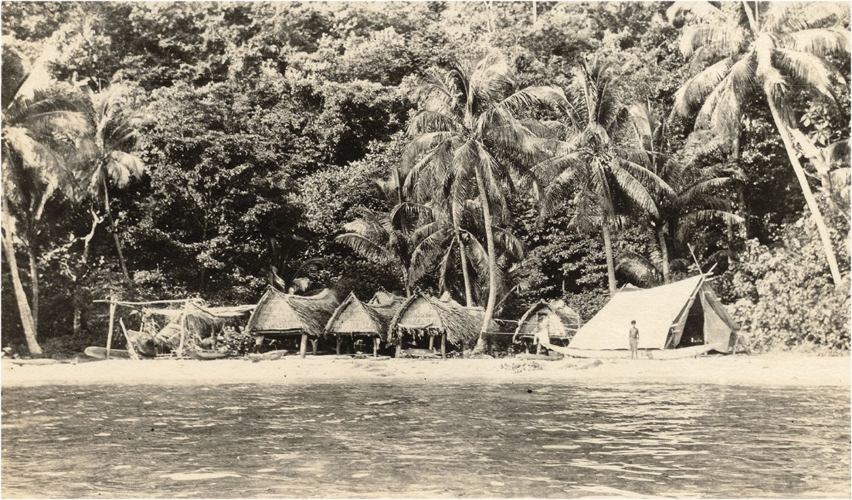
Figure 3.3 “The Native’s Point of View.” Bronislaw Malinowski’s tent on the beach of Nu’agasi, Trobriand Islands.

Slide 7
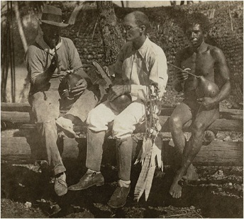
Bronislaw Malinowski sits on a canoe chewing betel nuts with a White trader and one of his Trobriand Islander informants, 1918.

Slide 8
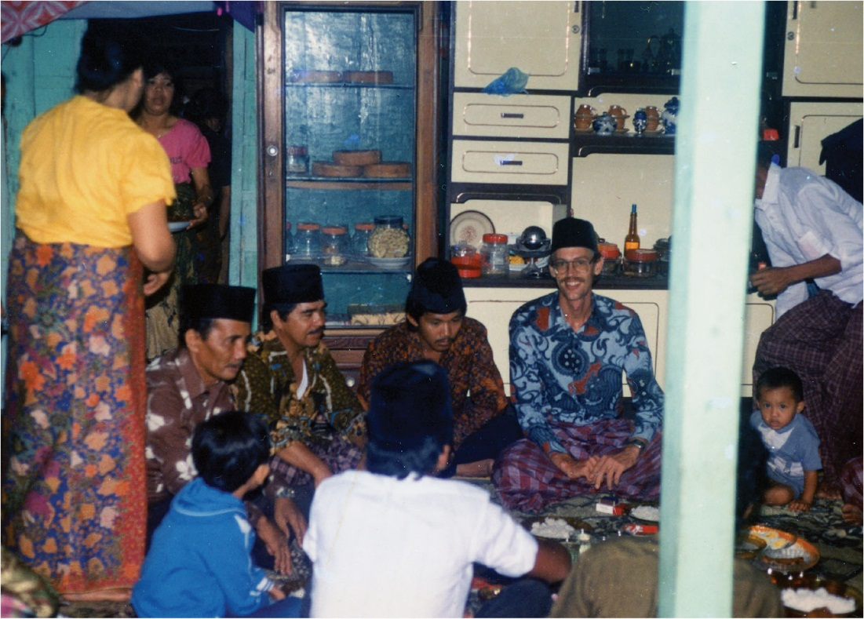
Figure 3.4 Building Rapport in the Field. Finding ways to “fit in” is always a key concern of anthropologists, and sometimes wearing appropriate clothing helps. In addition, an anthropologist can build rapport by demonstrating that he or she respects local customs and culture. Here coauthor Robert L. Welsch wears traditional Mandarese clothing, including a silk sarong, batik shirt, and cap to attend a wedding reception near Majene on the island of Sulawesi in
Indonesia.

Slide 9
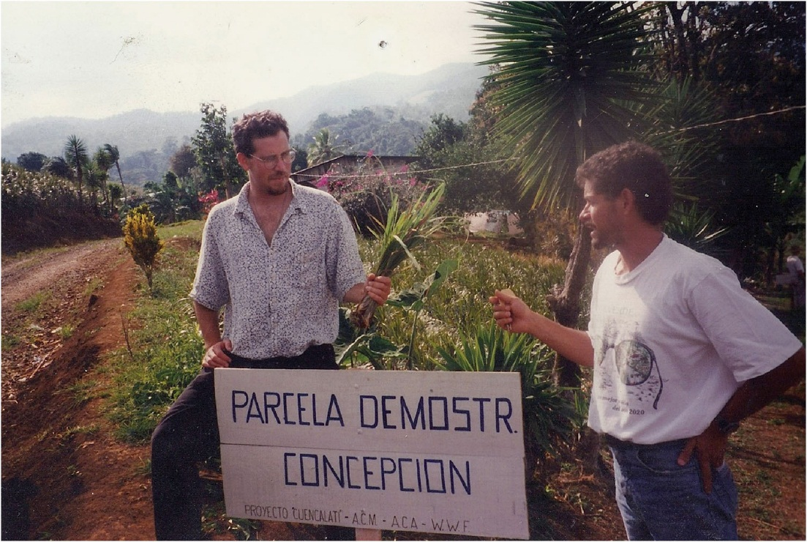
Figure 3.5 Interviews in the Field. Interviews take place in all kinds of settings, from the most formal and sterile, such as an office, to informal settings like this one, in which co-author Luis Vivanco (left, holding plants) interviews an environmental activist in rural Costa Rica who is showing him an agricultural demonstration project.

Slide 10
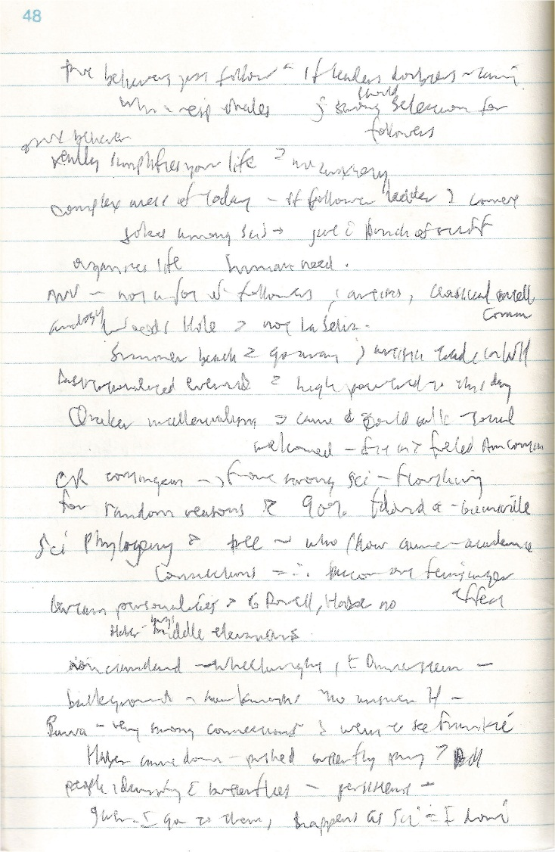
Figure 3.6 An Anthropologist’s Fieldnotes. Pictured here is a page of fieldnotes from Luis Vivanco’s fieldwork in Costa Rica during the 1990s and early 2000s. Every anthropologist develops their own particular way of taking notes.

Slide 11
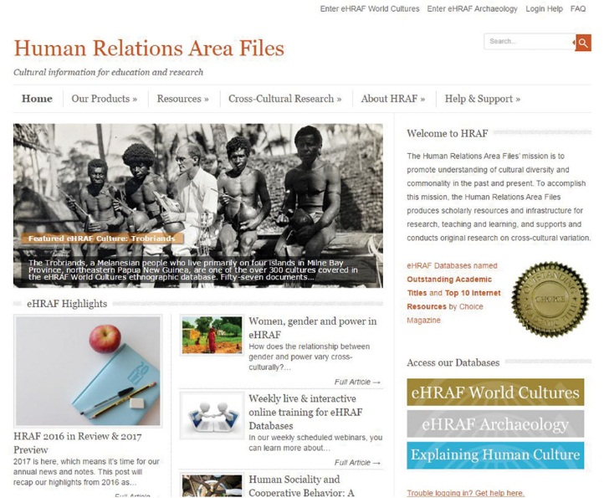
Figure 3.7 Opening page of HRAF’s website.

Slide 12
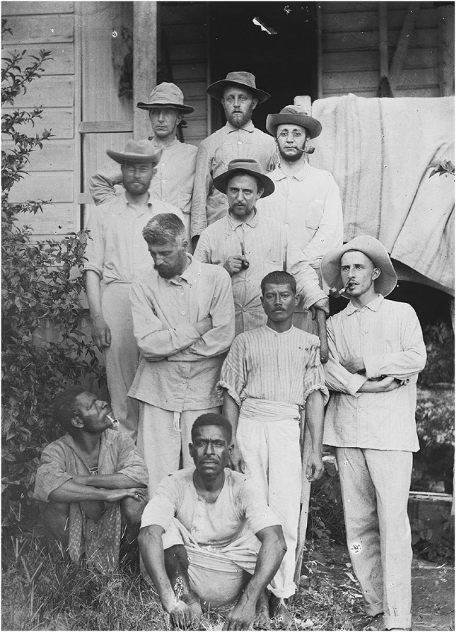
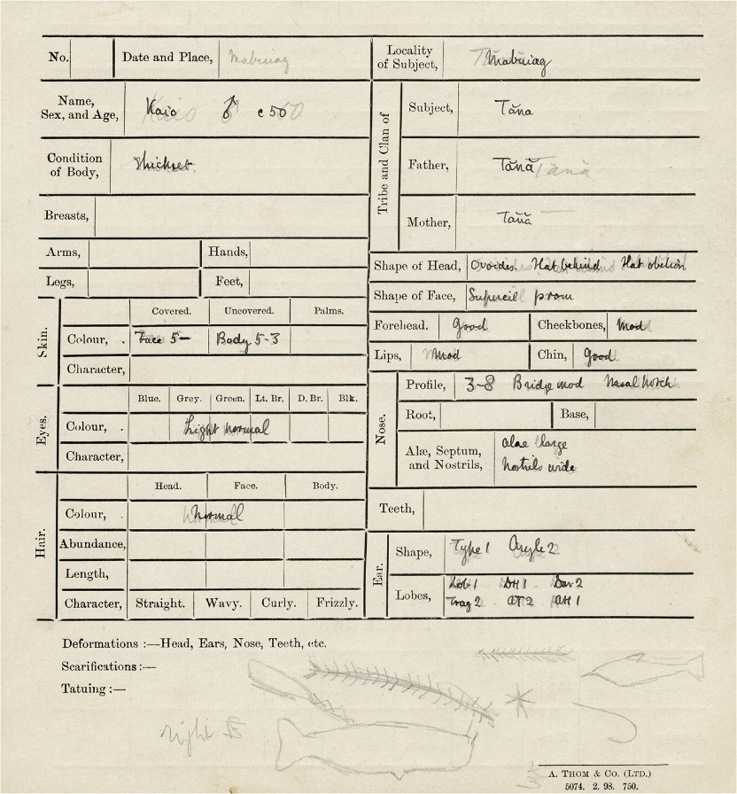
Figure 3.8 Members of the Cambridge Anthropological Expedition to the Torres Strait Islands. (Top) W. H. R. Rivers (standing left, wearing glasses), A. C. Haddon (standing in front of Rivers, looking down), C. G. Seligman (top right, with a pipe and glasses), linguist Sidney Ray (standing center, holding a pipe), and Charles Wilkin (standing front right). Each studied different aspects of life on the Torres Strait Islands, but their conversations provided a holistic view of the culture. (Bottom) An anthropological record card used in the 1898 Cambridge expedition to the Torres Straits. Anthropological guides such as this asked for anthropometric measurements, general assessments about how a particular community did things, or what they believed.

Slide 13
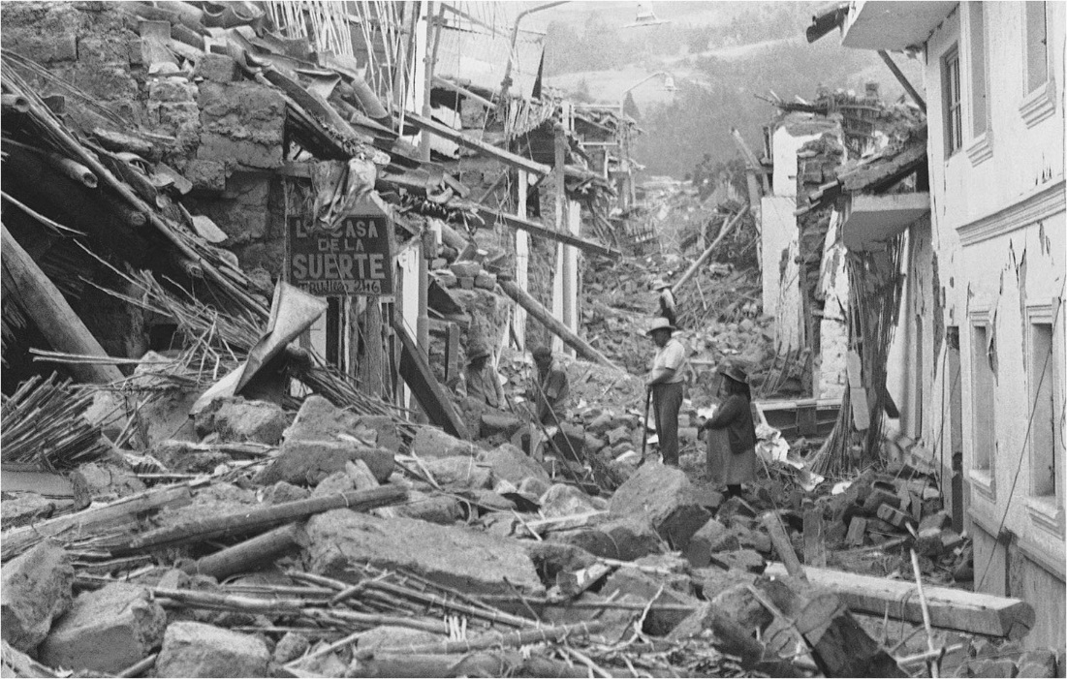
Figure 3.9 Short-Term Ethnography. Some projects have no time for long-term field research. Applied anthropologist Anthony Oliver-Smith investigates the impact of an earthquake in Peru.

Slide 14
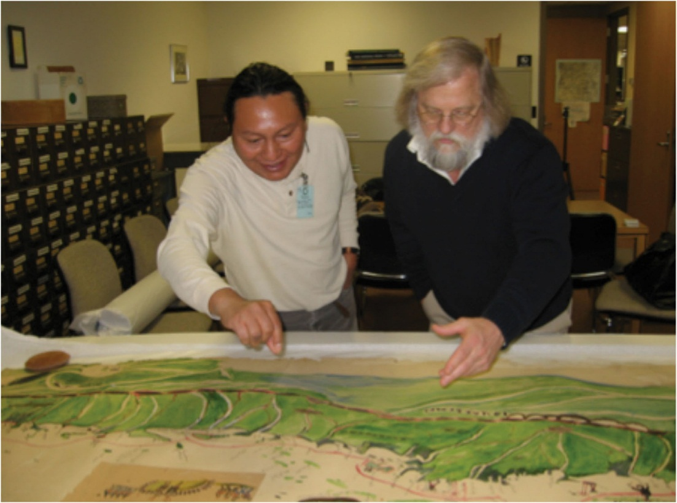
Figure 3.10 The National Anthropological Archives. Besides fieldnotes written by anthropologists, the National Anthropological Archives hold many things collected by anthropologists in the past. Here, anthropologist Jake
Homiak (right) and Achu Kantule from the San Blas Kuna community of Panama (left) examine a map of the Kuna sacred landscape drawn around 1925 by Kantule’s grandfather. It was collected by anthropologist John Peabody Harrington, who was a field ethnologist for the Smithsonian’s Bureau of American Ethnology during the early 1900s.

Slide 15
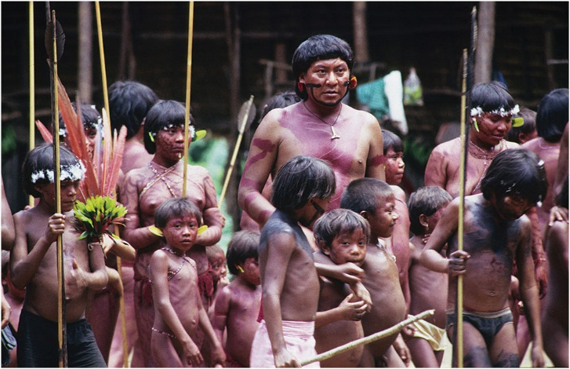
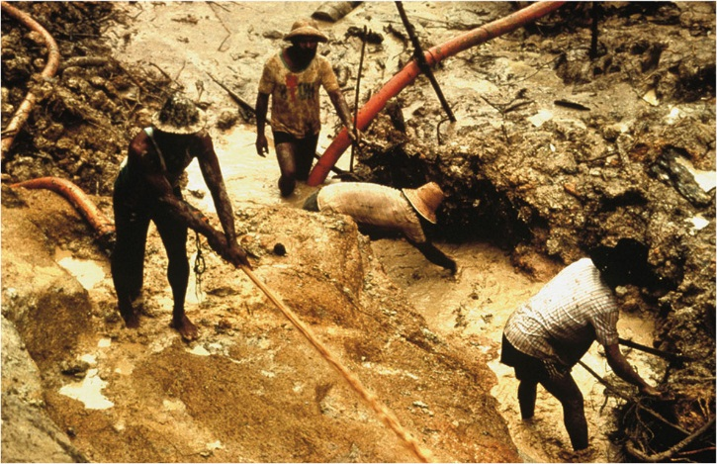
The Yanomami of Brazil. Yanomami Indians have suffered a great deal from the steady intrusion of more than 50,000 Brazilian peasants onto their traditional territory. The top photo shows Yanomami villagers; the bottom photo shows an example of land encroachment by Brazilian peasants.

