Slide 1
1
The Context of Mental Health Social Work Practice in Canada

Slide 2
Introduction
Mental health is the capacity of the individual, the group, and the environment to interact with one another in ways that promote:
Subjective well-being
The optimal development and use of mental abilities (cognitive, affective, and relational)
The achievement of individual and collective goals consistent with justice
The attainment and preservation of conditions of fundamental equality
CASW, 2019

Slide 3
Introduction, cont’d
Mental health is defined as a state of well-being in which every individual
Realizes his or her own potential
Can cope with the normal stresses of life
Can work productively and fruitfully
Is able to make a contribution to her or his community
World Health Organization, 2014

Slide 4
Introduction, cont’d
In any given year, 1 in 5 people in Canada will experience a mental health problem or illness
Suicide is the second leading cause of death among youth and young adults between the ages of 15–34 in Canada
In 2019, 52% of Canadian postsecondary students felt so depressed that they were unable to function and 69% reported overwhelming anxiety
More than ¼ of Canadians aged 80–84 and over half of those over age 85 have dementia
In 2011, the economic burden of mental illness in Canada totalled $50 billion
7.2% of health care funding in Canada was spent on mental health care in 2015

Slide 5
The Role of Social Work in Mental Health
In 1952, Mort Teicher identified two categories of a social worker’s job:
Intake
Helping patient and family express feelings
Assessing ability and willingness to engage in treatment
Continued service
Assisting with use of treatment services
Assisting with reintegration into the community

Slide 6
The Role of Social Work in Mental Health, cont’d
CASW (2019) identified three broad areas of social work practice in mental health:
Prevention
Reducing the incidence of mental illness and dysfunction through modifying stressful environments and strengthening individual coping, including preventative education, social action, and advocacy for social justice
Treatment
Reducing the impact of mental illness through early assessment, intervention, and treatment, including addressing trauma, relationship problems, and stress and managing risk
Rehabilitation
Reducing the aftereffects of mental illness to support maximizing abilities, including rehabilitation counselling, provision of resources, and advocacy to develop community resources or reduce barriers

Slide 7
The Role of Social Work in Mental Health, cont’d
Aspects of social work practice in mental health:
Direct services
Case management
Community development
Supervision and consultation
Program management/administration
Teaching
Program, policy, and resource development
Research and evaluation
Social action

Slide 8
An Ethical Framework for Social Work in Mental Health
The CASW Code of Ethics (2005) outlines six core areas of social work values:
Respect for the inherent dignity and worth of persons
Pursuit of social justice
Service to humanity
Integrity in professional practice
Confidentiality
Competence in professional practice

Slide 9
A Recovery Model for Mental Health and Social Work Values
In 2014, the Mental Health Commission of Canada signed onto a recovery declaration based on three core principles:
Hope: believing individuals possess strengths and capabilities to lead satisfying and hopeful lives even when living with mental health challenges
Dignity: treating people with respect and supporting personal journeys of healing and growth
Inclusion: engaging people in their own care and well-being and supporting them to exercise their rights

Slide 10
A Recovery Model for Mental Health and Social Work Values, cont’d
The recovery model for mental health practice is founded on the belief that individuals can and do recover from severe mental illness, and that individual participation is an integral component of the recovery process
Recovery can be viewed from a variety of perspectives

Slide 11
A Recovery Model for Mental Health and Social Work Values, cont’d
The Mental Health Commission released “Guidelines for Recovery Oriented Practice” in 2015:
Creating a culture and language of hope
Recovery is personal
Recovery occurs in the context of one’s life
Responding to diverse needs
Working with First Nations, Inuit, and Métis
Transforming services and systems

Slide 12
A Recovery Model for Mental Health and Social Work Values, cont’d
Fundamental components of the recovery model:
Self-direction and empowerment
Individualized and person-centred approaches
Holistic views
Non-linearity
Strengths-based focus
Peer support
Respect, responsibility, and hope
Professionals work in partnership with clients and families

Slide 13
A Recovery Model for Mental Health and Social Work Values, cont’d
The Culturally-Responsive Model of Recovery:
Individuals exist in a web of relations including family, community, cities, and countries
Culture, systems of oppression and privilege, and social determinants of health are central to recovery
Recovery is a collection of processes within the relational web, an aspect of which is the mental health system and the professionals within it

Slide 14
Psychiatric Medications and Social Work Practice
Explore with clients and their families the meanings they ascribe to medications
Ensure that clients and families have access to information about medications, including their purpose, effectiveness, and side effects
Assist clients in making informed decisions about their own treatment and recovery plan
Assist clients and families to advocate for themselves with respect to questions or concerns around medications

Slide 15
Evidence-Based Social Work: An Ethical Responsibility?
Evidence-based practice is consistent with good social work practice in terms of:
The obligation to provide our clients with services that are most likely to assist them and least likely to cause harm
The obligation to provide clients with the best available information for them to make informed decisions about their own care

Slide 16
Evidence-Based Social Work, cont’d
Three main assertions of evidence-based practice:
Intervention decisions should be based on empirical research
Critical assessment of empirically supported interventions must be conducted to determine their fit to and appropriateness for the practice situation at hand
Interventions should be subject to regular monitoring and the course of treatment revised based on outcome evaluation

Slide 17
Evidence-Based Social Work, cont’d
Criteria in considering evidence:
For evidence to be relevant, there must be an explanatory link between the intervention and the outcome, not just a correlation
Best available evidence must include all evidence, not a selected subset
Evidence must be evaluated on the basis of relevance, credibility, and strength

Slide 18
Evidence-Based Social Work, cont’d
Evidence-based decision-making involves a series of steps:
Evaluate the problem to be addressed and formulate answerable questions
Gather and critically evaluate the evidence available
Make a decision about which intervention strategy is the best approach
Consider client wishes, practitioner expertise, agency mandate and constraints, and the ecological context
Monitor and evaluate the outcome of the intervention

Slide 19
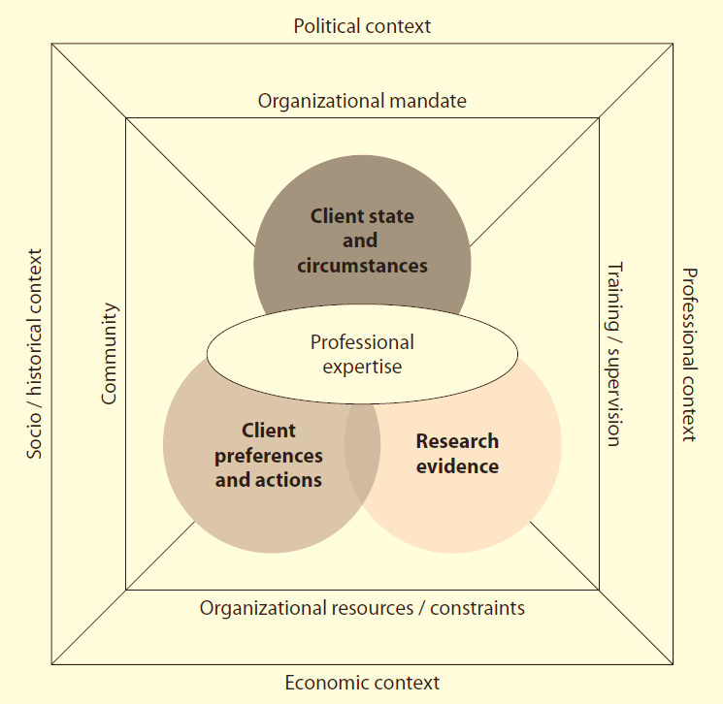

Slide 20
Multiple Levels of Influence
Assist other members of interprofessional teams to understand the social and community context
Assist families to support affected individuals and creatively manage change
Assist individuals to evaluate challenges and opportunities, make choices, deal with adversity, and recover from illness
Participate in the modification and development of programs, service systems, and policies

Slide 21
Impacts of Mental Health Practice on Social Workers
Positive impacts:
Commitment and compassion towards their clients
Rewards of working with those overcoming challenges
Resilience, a positive social orientation, optimism, social intelligence, an openness to new experiences, and a keen desire to continue to learn and grow
Increased sensitivity, compassion, and insight
Increased appreciation for the resilience of the human spirit

Slide 22
Impacts of Mental Health Practice on Social Workers, cont’d
Negative impacts:
Acute stress, posttraumatic stress, and secondary traumatic stress
Burnout and vicarious trauma
Addressing stress and trauma experienced by social workers is a shared responsibility between social workers themselves, the schools that educate them, and the organizations that employ them

