Slide 1
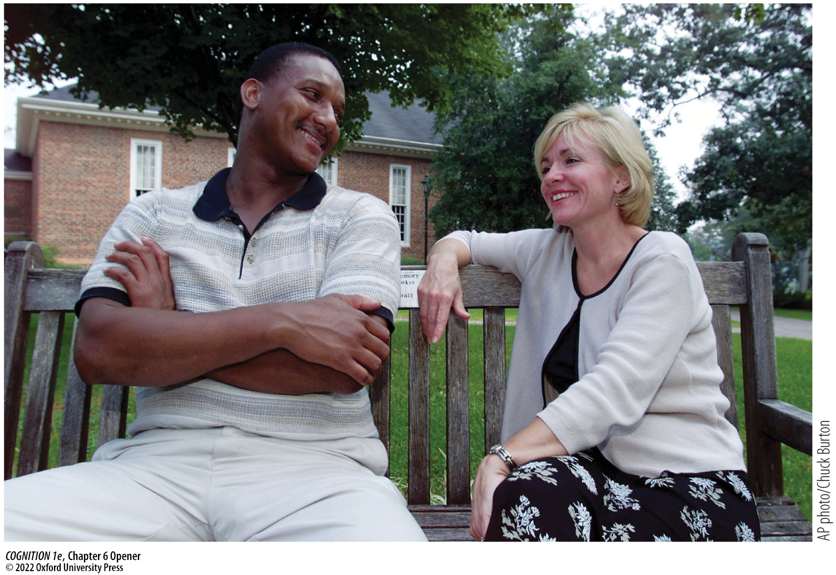
Chapter 6 Opener
Notes:
Chapter 6 Opener
In 1984, college student Jennifer Thompson (right) was violently assaulted. She later misidentified her assailant as Ronald Cotton (left), who went to prison for someone else’s crime. Years later, after Cotton’s innocence was proven, the two became unlikely friends—bonded by circumstances caused by the frailty of memory.

Slide 2
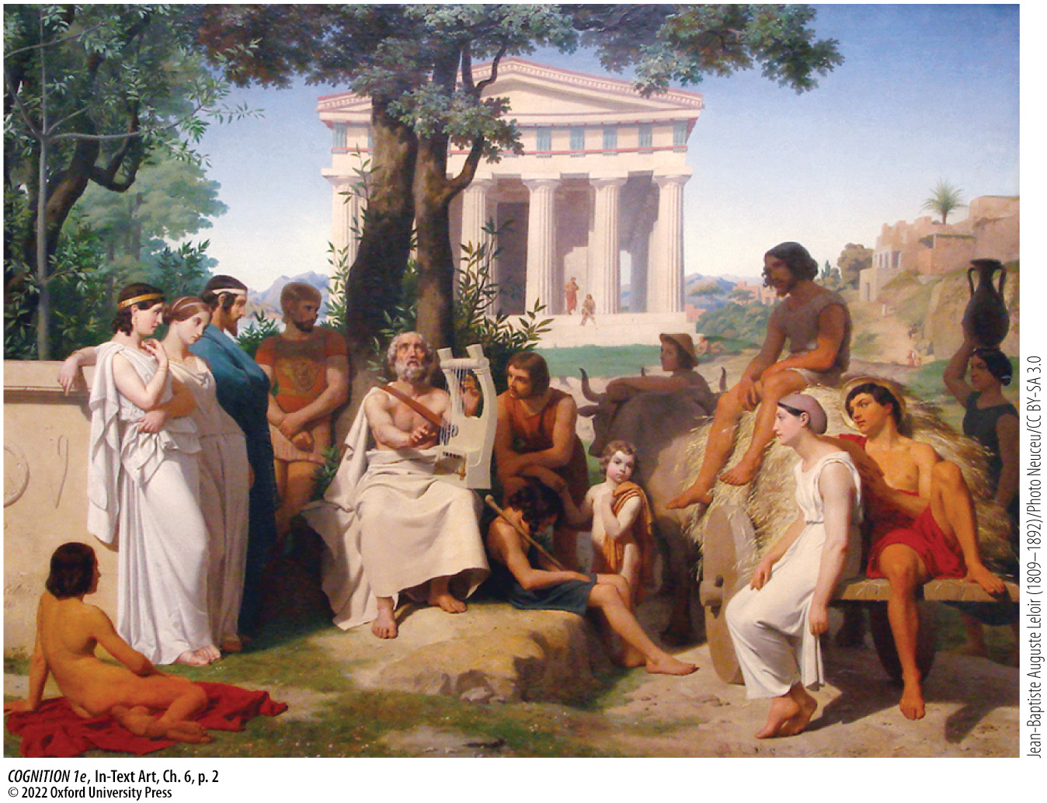
In-Text Art, Ch. 6, p. 2
Notes:
In-Text Art, Ch. 6, p. 2
Painting depicting the Greek bard Homer, by Jean-Baptiste Auguste Leloir.

Slide 3
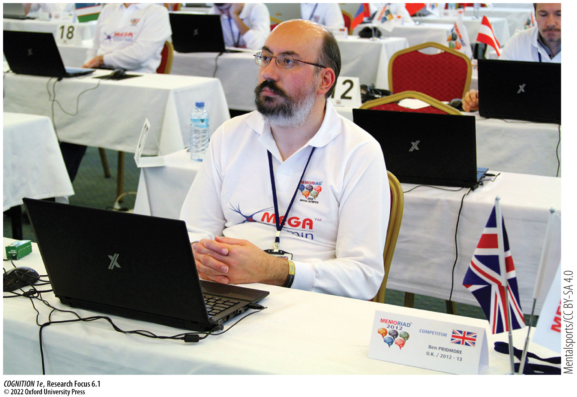
Research Focus 6.1
Notes:
Research Focus 6.1
The United Kingdom’s Ben Pridmore, a three-time world memory champion.

Slide 4
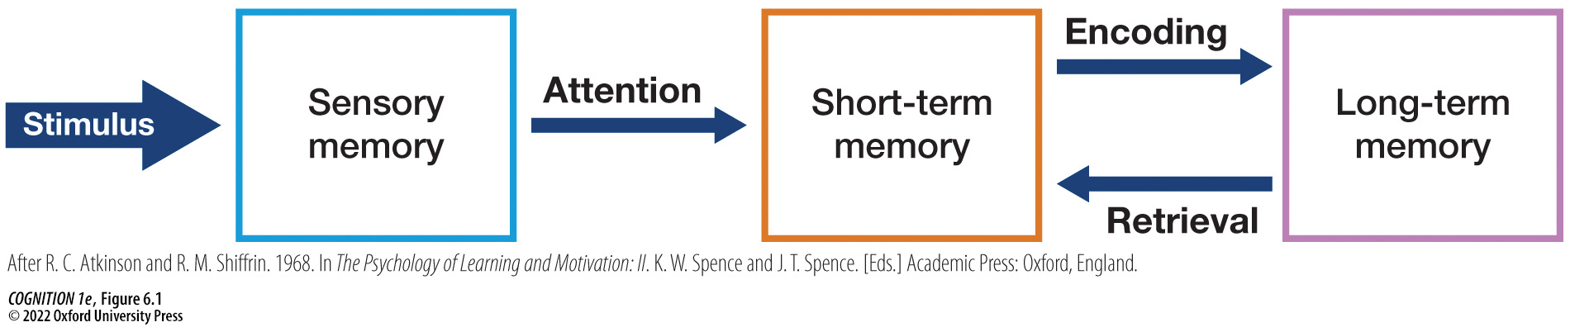
Figure 6.1 The relationship between sensory memory, short-term memory, and long-term memory as described in an influential model by Atkinson and Shiffrin (1968)
Notes:
Figure 6.1 The relationship between sensory memory, short-term memory, and long-term memory as described in an influential model by Atkinson and Shiffrin (1968)
After a stimulus appears, it persists for a fraction of a second in sensory memory before rapidly fading away. However, paying attention to a subset of its contents before they deteriorate can bring those contents into short-term memory. Although longer-lasting than sensory memory, short-term memory is also short-lived, so information must further be encoded into long-term memory in order to be recalled later. Such encoding can involve rehearsal, as well as other strategies. The contents of long-term memory can exist outside our immediate awareness. When we retrieve them (i.e., bring them into awareness), we temporarily bring them back into short-term memory (or working memory). (After R. C. Atkinson and R. M. Shiffrin. 1968. In The Psychology of Learning and Motivation: II. K. W. Spence and J. T. Spence. [Eds.] Academic Press: Oxford, England.)

Slide 5
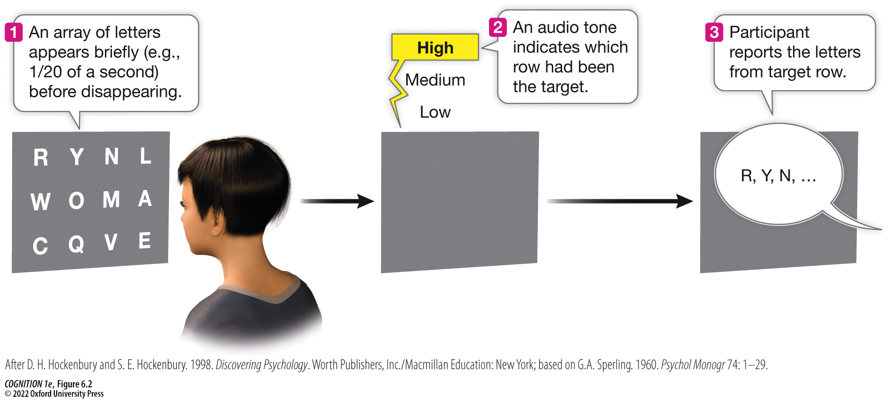
Figure 6.2 Sperling’s experiment demonstrating the duration of sensory memory (1)
Notes:
Figure 6.2 Sperling’s experiment demonstrating the duration of sensory memory
In George Sperling’s famous studies of iconic memory (persisting sensory memory), participants saw brief arrays of letters and numbers arranged in rows (e.g., flashed for 50 milliseconds). In some trials, a tone played after the array disappeared, which indicated the row that participants should report. Participants were often accurate even though the arrays were already gone when the tone sounded, suggesting that the visual information continued to persist in sensory memory for a fraction of a second. (After D. H. Hockenbury and S. E. Hockenbury. 1998. Discovering Psychology. Worth Publishers, Inc./Macmillan Education: New York; based on G.A. Sperling. 1960. Psychol Monogr 74: 1–29.)

Slide 6
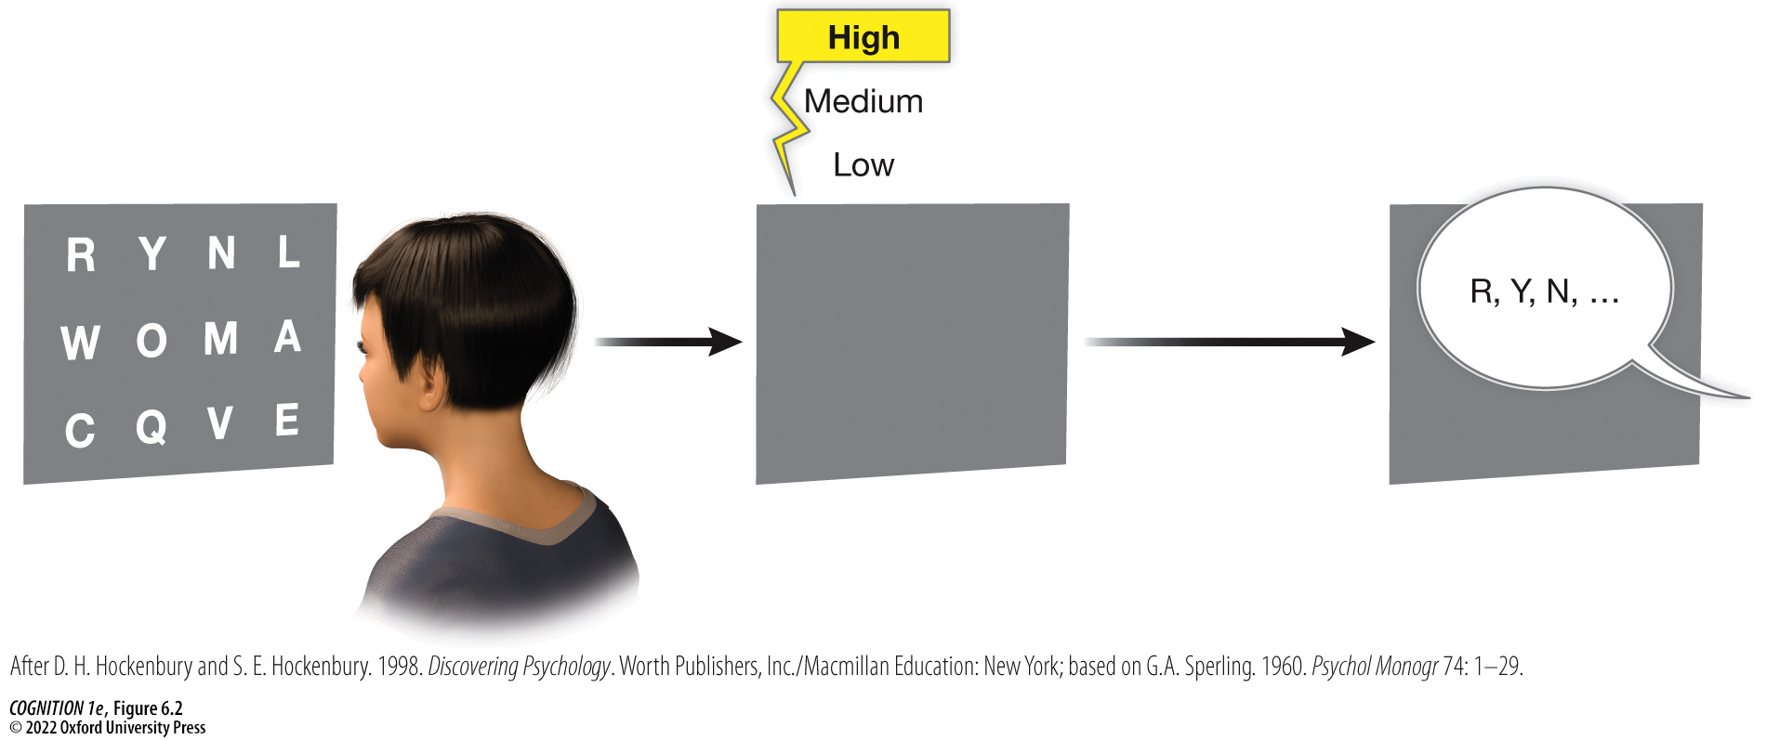
Figure 6.2 Sperling’s experiment demonstrating the duration of sensory memory (2)
Notes:
Figure 6.2 Sperling’s experiment demonstrating the duration of sensory memory
In George Sperling’s famous studies of iconic memory (persisting sensory memory), participants saw brief arrays of letters and numbers arranged in rows (e.g., flashed for 50 milliseconds). In some trials, a tone played after the array disappeared, which indicated the row that participants should report. Participants were often accurate even though the arrays were already gone when the tone sounded, suggesting that the visual information continued to persist in sensory memory for a fraction of a second. (After D. H. Hockenbury and S. E. Hockenbury. 1998. Discovering Psychology. Worth Publishers, Inc./Macmillan Education: New York; based on G.A. Sperling. 1960. Psychol Monogr 74: 1–29.)

Slide 7
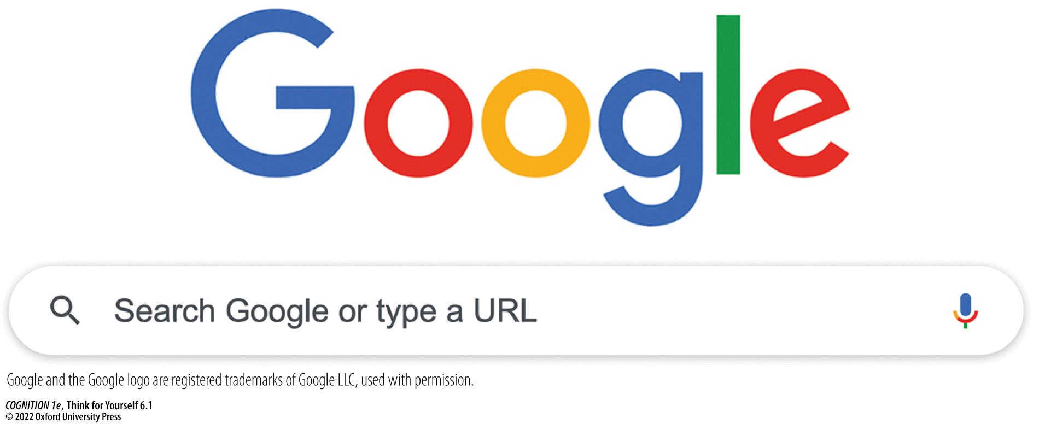
Think for Yourself 6.1
Notes:
Think for Yourself 6.1
Is Google Hurting Your Memory?

Slide 8
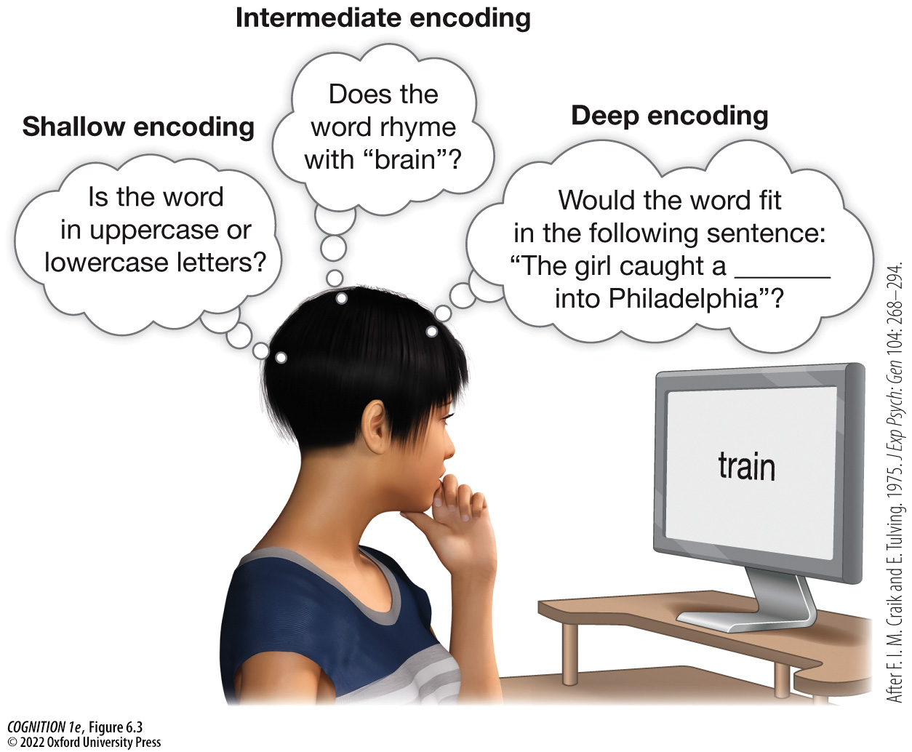
Figure 6.3 The deeper people encode the meaning of words, the better they remember them
Notes:
Figure 6.3 The deeper people encode the meaning of words, the better they remember them
In a study by Craik and Tulving (1975), shallow encoding was induced by asking people about typeface, intermediate encoding was induced by asking people about rhymes, and deep encoding was induced by asking people to fit words into sentences. Deep encoding led to better memory. (After F. I. M. Craik and E. Tulving. 1975. J Exp Psych: Gen 104: 268–294.)

Slide 9
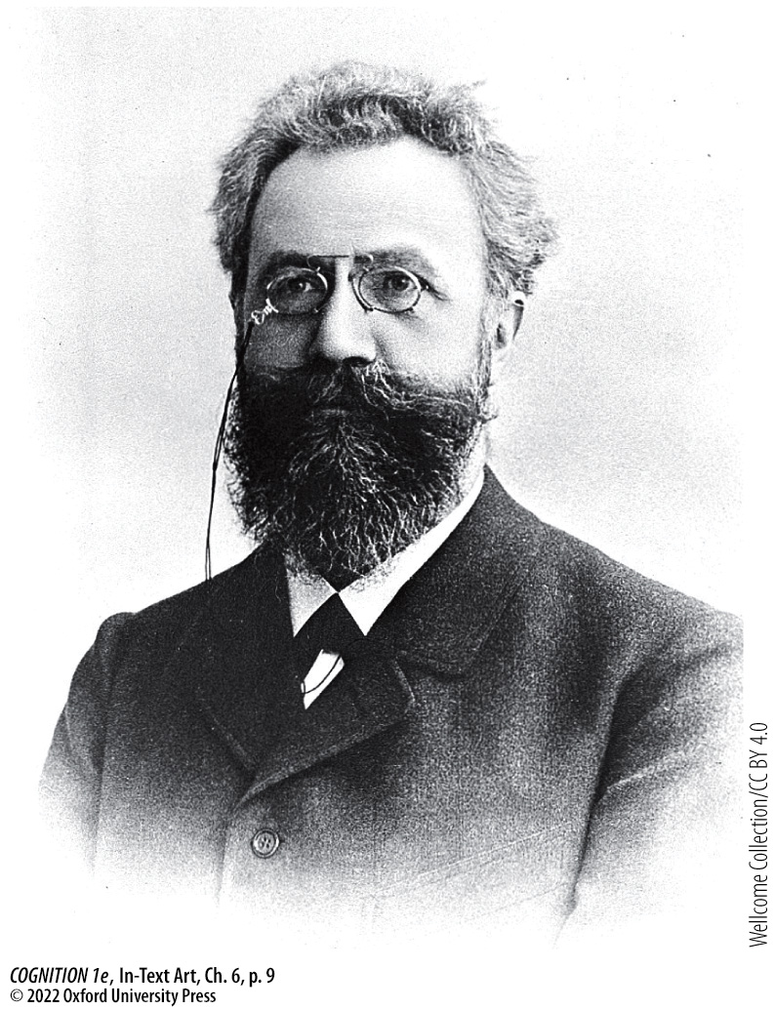
In-Text Art, Ch. 6, p. 9
Notes:
In-Text Art, Ch. 6, p. 9
Hermann Ebbinghaus was a pioneer of rigorous memory research.

Slide 10
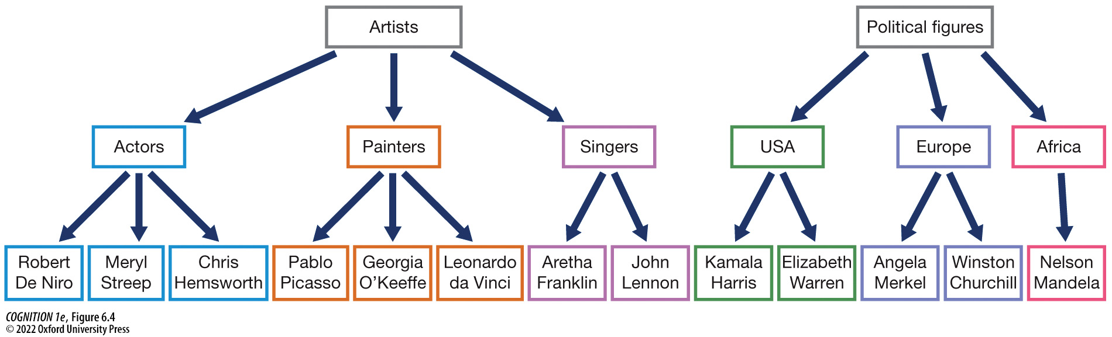
Figure 6.4 Hierarchical organization
Notes:
Figure 6.4 Hierarchical organization
One strategy for encoding information is to group it according to a hierarchy.

Slide 11
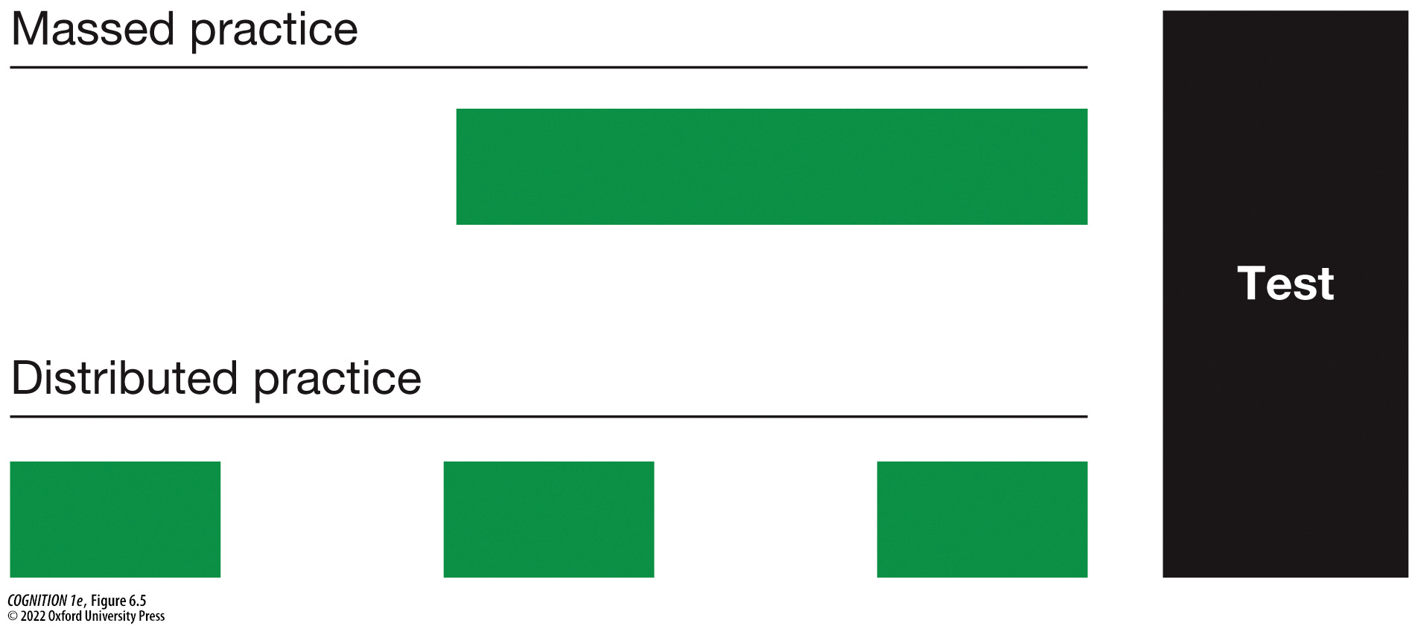
Figure 6.5 Massed vs. distributed practice
Notes:
Figure 6.5 Massed vs. distributed practice
Even when the total amount of time studying is the same, people tend to remember material better (e.g., such as on an exam) when their study sessions have been spaced out (“distributed practice”; bottom) than when crammed together in one session (“massed practice”; top).

Slide 12
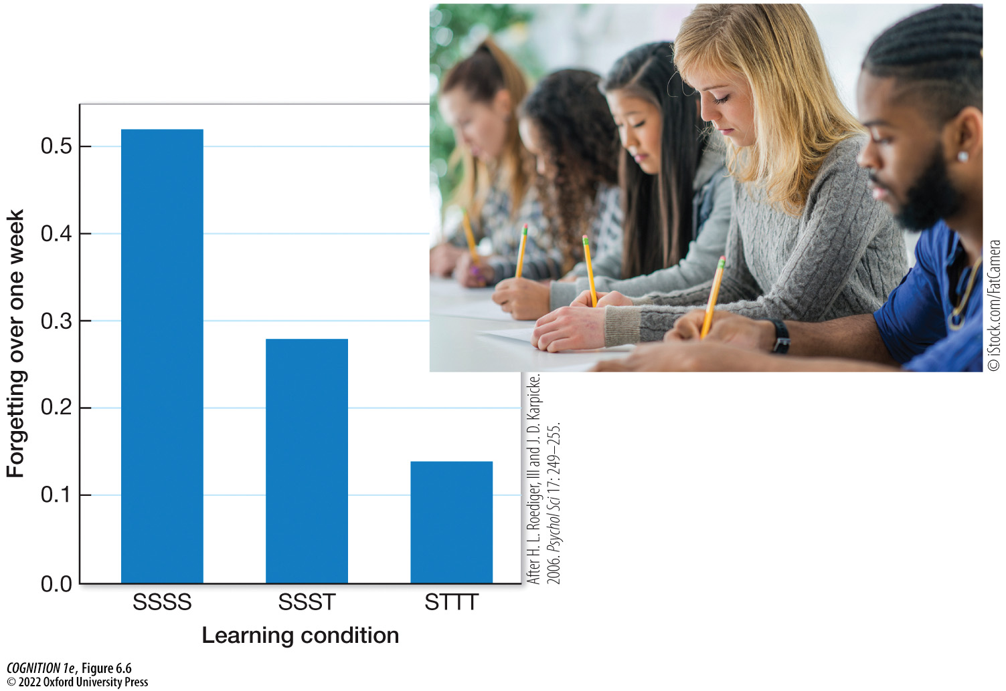
Figure 6.6 The testing effect
Notes:
Figure 6.6 The testing effect
In one study, people (A) studied material over the course of four study sessions (SSSS), (B) studied over three sessions followed by a single testing session (SSST), or (C) studied for one session followed by three testing sessions (STTT). Consistent with the testing effect, those who studied once and then were tested three times forgot the least amount of material by a week later. (After H. L. Roediger, III and J. D. Karpicke. 2006. Psychol Sci 17: 249–255.)

Slide 13
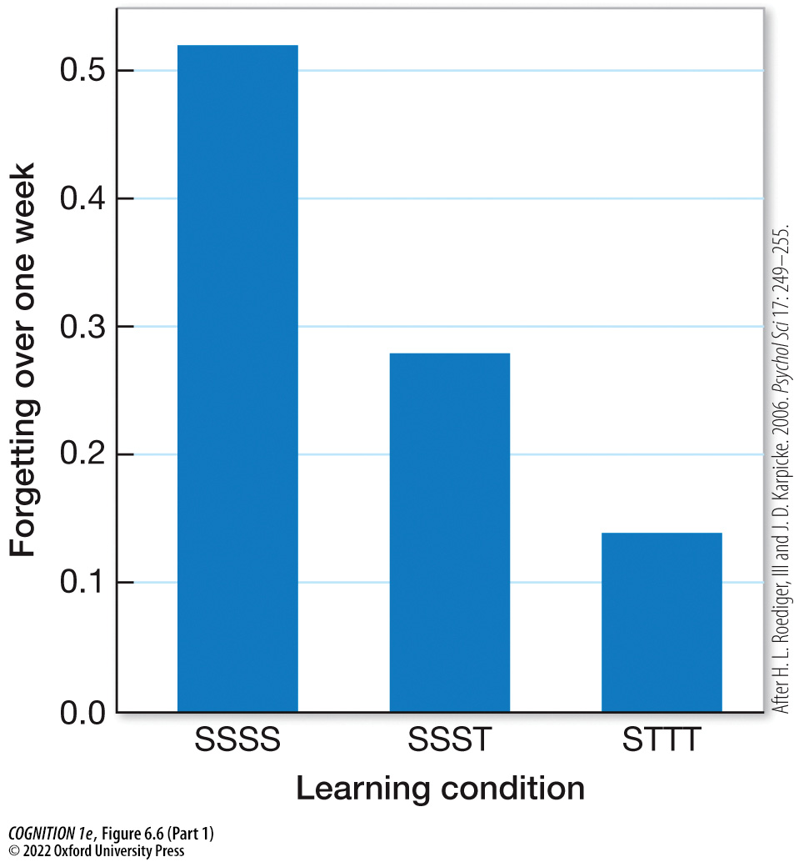
Figure 6.6 The testing effect (Part 1)
Notes:
Figure 6.6 The testing effect
In one study, people (A) studied material over the course of four study sessions (SSSS), (B) studied over three sessions followed by a single testing session (SSST), or (C) studied for one session followed by three testing sessions (STTT). Consistent with the testing effect, those who studied once and then were tested three times forgot the least amount of material by a week later. (After H. L. Roediger, III and J. D. Karpicke. 2006. Psychol Sci 17: 249–255.)

Slide 14

Figure 6.6 The testing effect (Part 2)
Notes:
Figure 6.6 The testing effect
In one study, people (A) studied material over the course of four study sessions (SSSS), (B) studied over three sessions followed by a single testing session (SSST), or (C) studied for one session followed by three testing sessions (STTT). Consistent with the testing effect, those who studied once and then were tested three times forgot the least amount of material by a week later. (After H. L. Roediger, III and J. D. Karpicke. 2006. Psychol Sci 17: 249–255.)

Slide 15
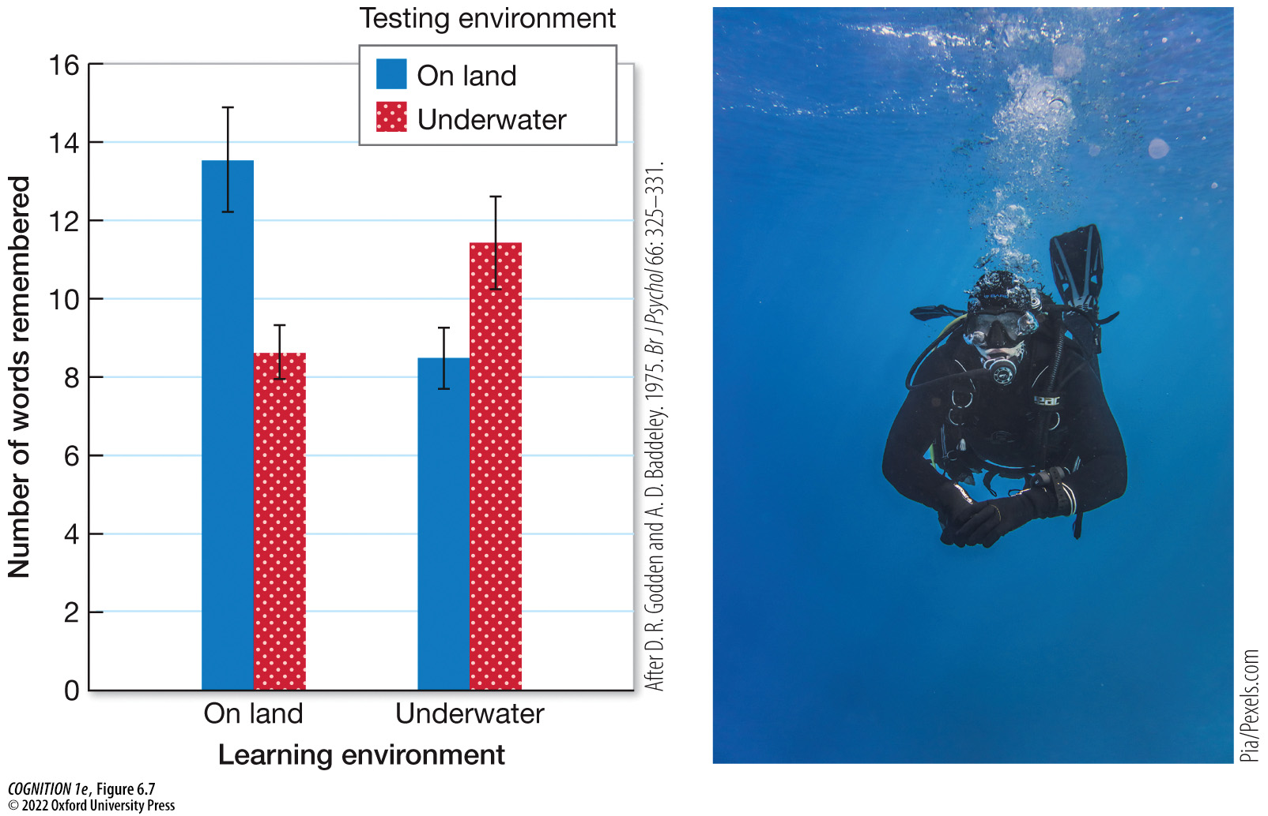
Figure 6.7 Context dependent memory
Notes:
Figure 6.7 Context dependent memory
When divers learned lists of words underwater, they had better memory for them when tested underwater than when tested on land. When they learned the lists on land, they remembered more when tested on land than when tested underwater. (After D. R. Godden and A. D. Baddeley. 1975. Br J Psychol 66: 325–331.)

Slide 16
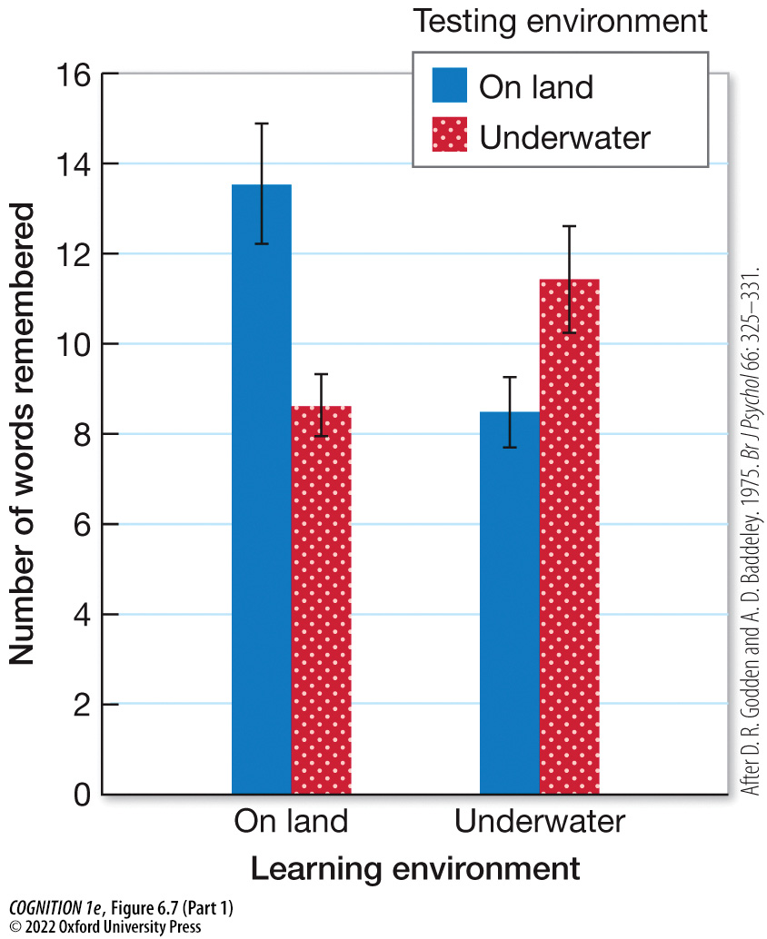
Figure 6.7 Context dependent memory (Part 1)
Notes:
Figure 6.7 Context dependent memory
When divers learned lists of words underwater, they had better memory for them when tested underwater than when tested on land. When they learned the lists on land, they remembered more when tested on land than when tested underwater. (After D. R. Godden and A. D. Baddeley. 1975. Br J Psychol 66: 325–331.)

Slide 17

Figure 6.7 Context dependent memory (Part 2)
Notes:
Figure 6.7 Context dependent memory
When divers learned lists of words underwater, they had better memory for them when tested underwater than when tested on land. When they learned the lists on land, they remembered more when tested on land than when tested underwater. (After D. R. Godden and A. D. Baddeley. 1975. Br J Psychol 66: 325–331.)

Slide 18
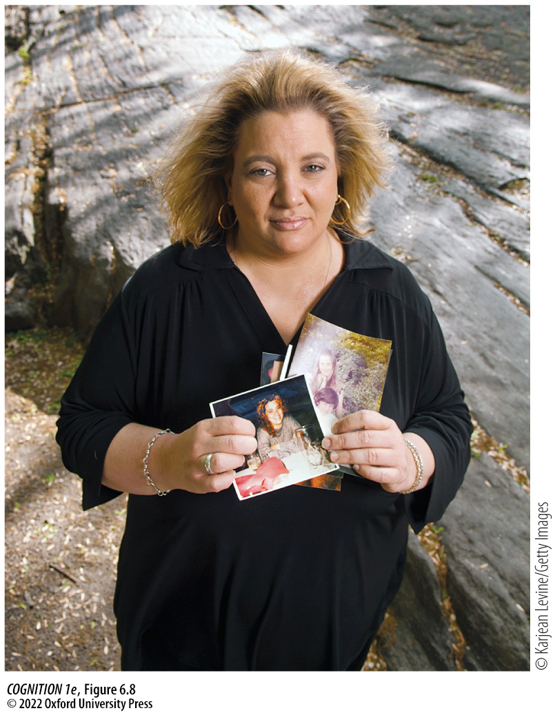
Figure 6.8 The woman who can’t forget
Notes:
Figure 6.8 The woman who can’t forget
Jill Price has astounded memory researchers with her uncanny ability to remember even mundane events from her life in detail. She is one of very few people in the world known to have hyperthymestic syndrome (also called highly superior autobiographical memory). In her memoir The Woman Who Can’t Forget, she describes the positives and negatives of living with her remarkable memory.

Slide 19
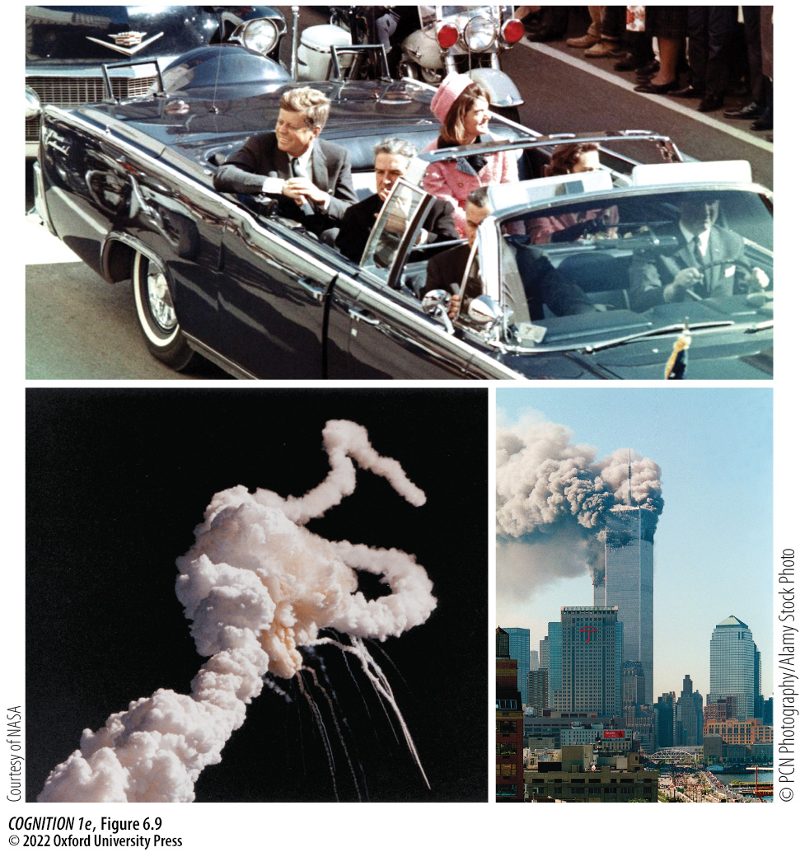
Figure 6.9 Flashbulb memories
Notes:
Figure 6.9 Flashbulb memories
Many people experience “flashbulb memories” of emotional or traumatic moments in their lives. For example, depending on their age, many people feel they have a vivid and clear memory of where they were and what they were doing when they heard about the assassination of John F. Kennedy, the explosion of the space shuttle Challenger, or the 9/11 terrorist attack on New York’s World Trade Center. What events in your own life have led to the feeling of a flashbulb memory?

Slide 20

Research Focus 6.2
Notes:
Research Focus 6.2
Knowledge of the mechanisms that cause emotional events to persist in memory might lead to the development of pills to reduce intrusive memories characteristic of PTSD.

Slide 21
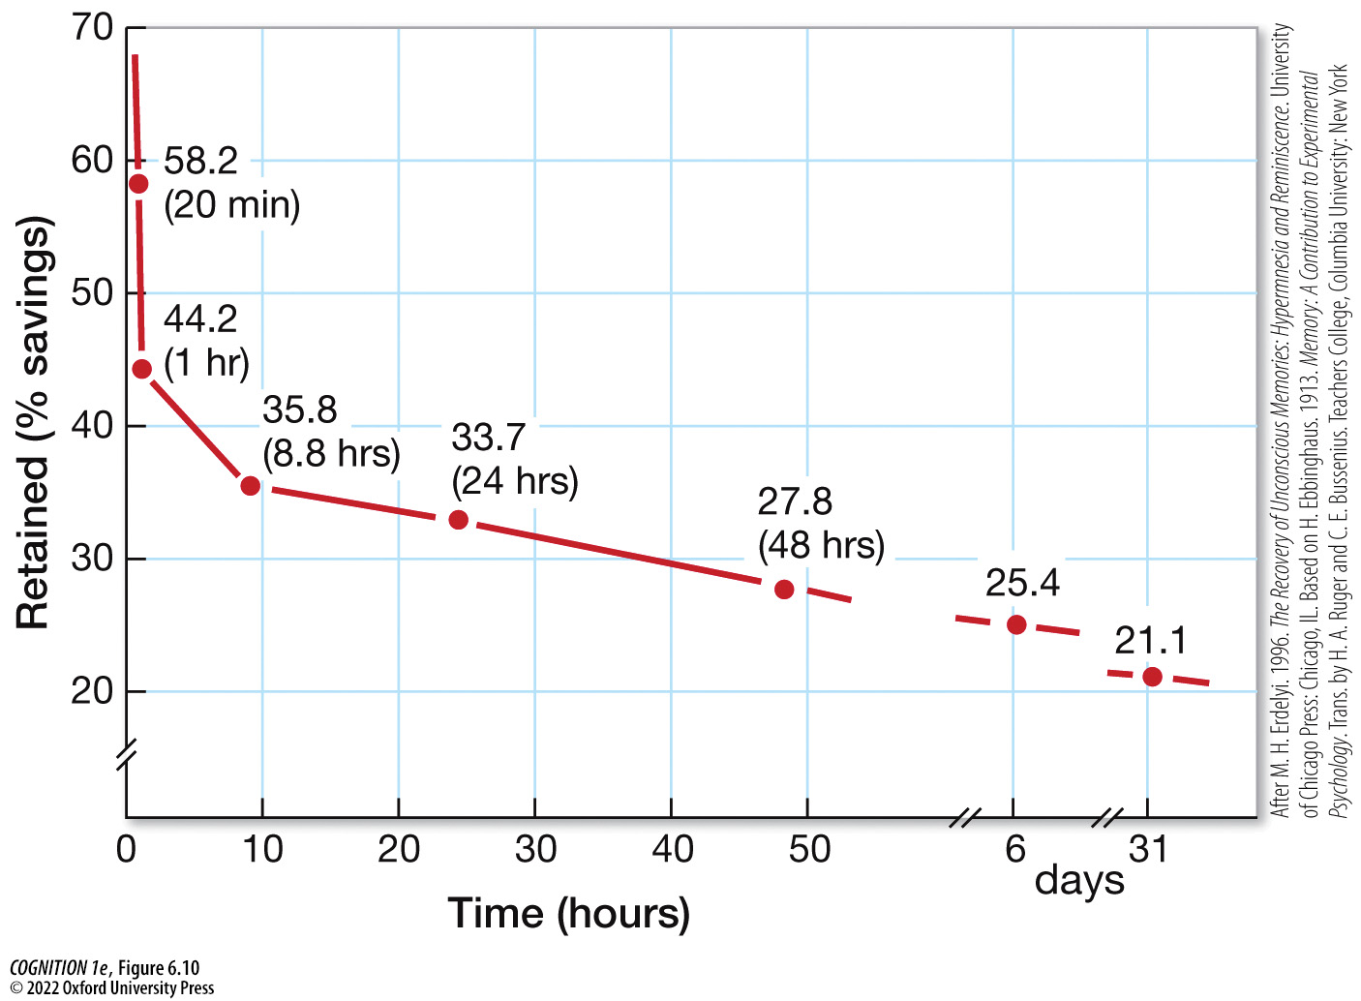
Figure 6.10 Ebbinghaus’s forgetting curve
Notes:
Figure 6.10 Ebbinghaus’s forgetting curve
The curve demonstrates that the relationship between time since studying and how much is retained in memory is curvilinear. Forgetting occurs most rapidly soon after learning and then starts to level off. (After M. H. Erdelyi. 1996. The Recovery of Unconscious Memories: Hypermnesia and Reminiscence. University of Chicago Press: Chicago, IL. Based on H. Ebbinghaus. 1913. Memory: A Contribution to Experimental Psychology. Trans. by H. A. Ruger and C. E. Bussenius. Teachers College, Columbia University: New York.)

Slide 22
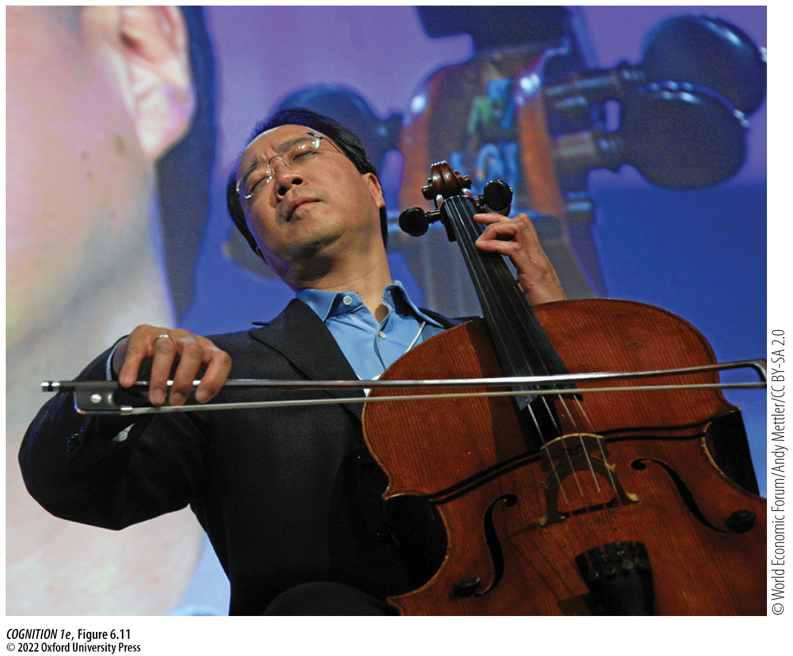
Figure 6.11 Absent-mindedness
Notes:
Figure 6.11 Absent-mindedness
Yo-Yo Ma, one of the world’s greatest cello players, accidentally forgot his $2.5-million cello in the trunk of a taxi cab after a moment of inattention.

Slide 23
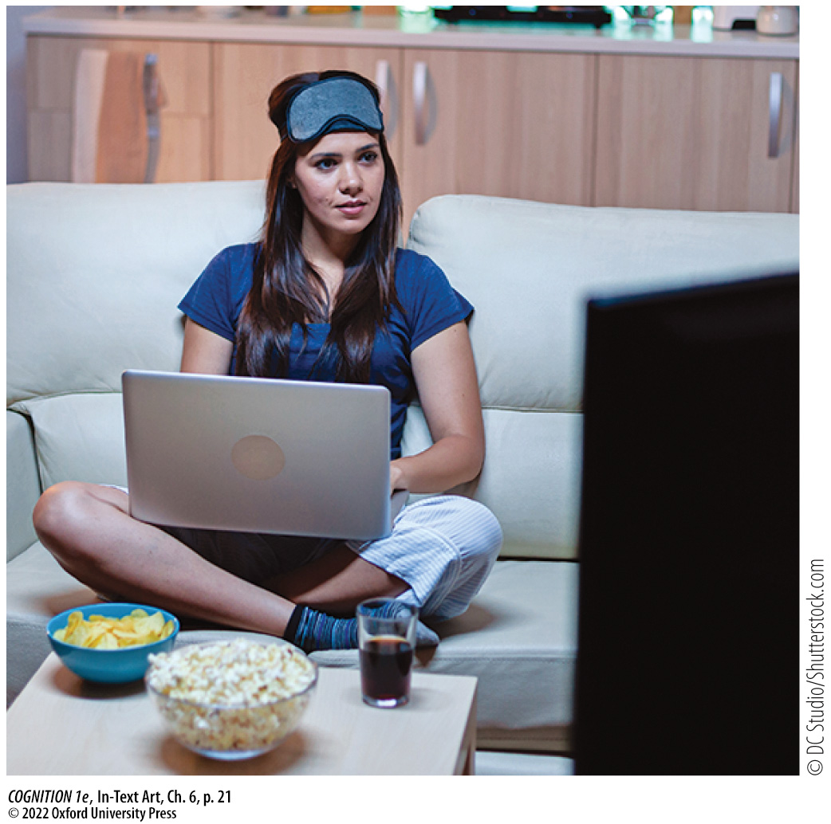
In-Text Art, Ch. 6, p. 21
Notes:
In-Text Art, Ch. 6, p. 21
It’s common for people to try to work or study in front of the TV or with Netflix open on their computer, but evidence suggests that such “divided attention” impairs memory for what you’re trying to learn. It’s probably better to schedule your studying and entertainment for different times.

Slide 24
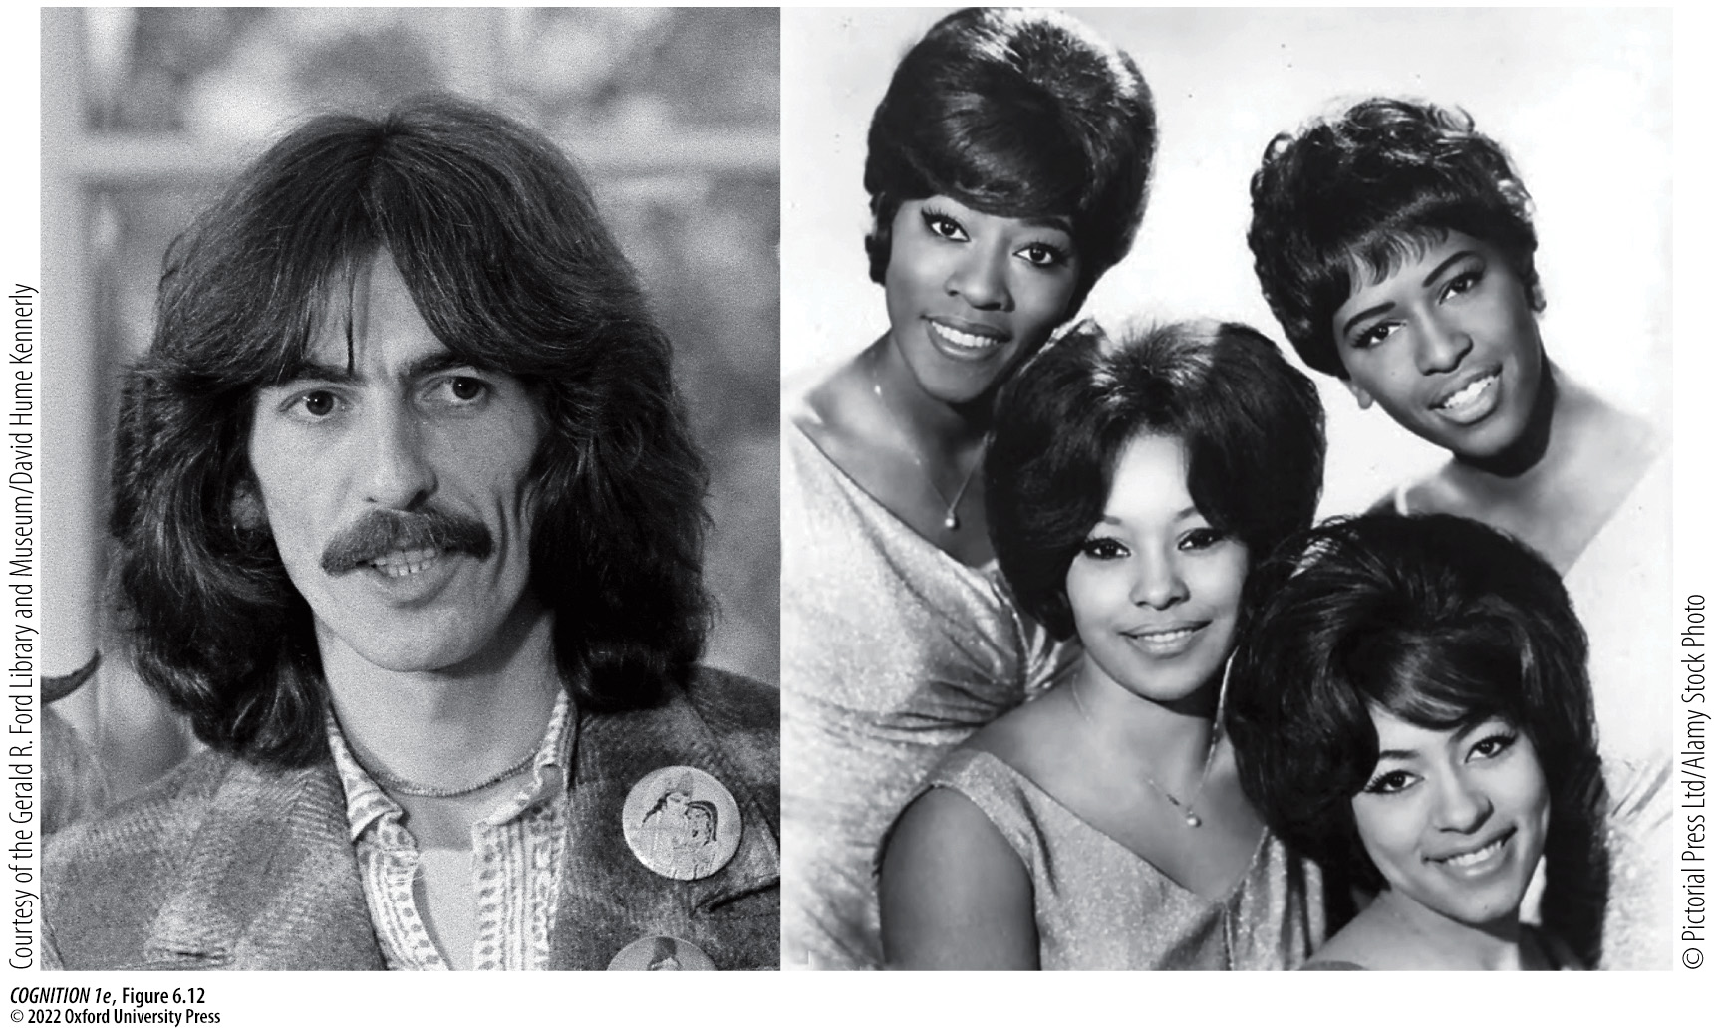
Figure 6.12 Source misattribution
Notes:
Figure 6.12 Source misattribution
In one of the more famous instances of possible source misattribution, former Beatle George Harrison was sued for copyright infringement, as his song “My Sweet Lord” was eerily similar to “He’s So Fine” by the Chiffons.

Slide 25
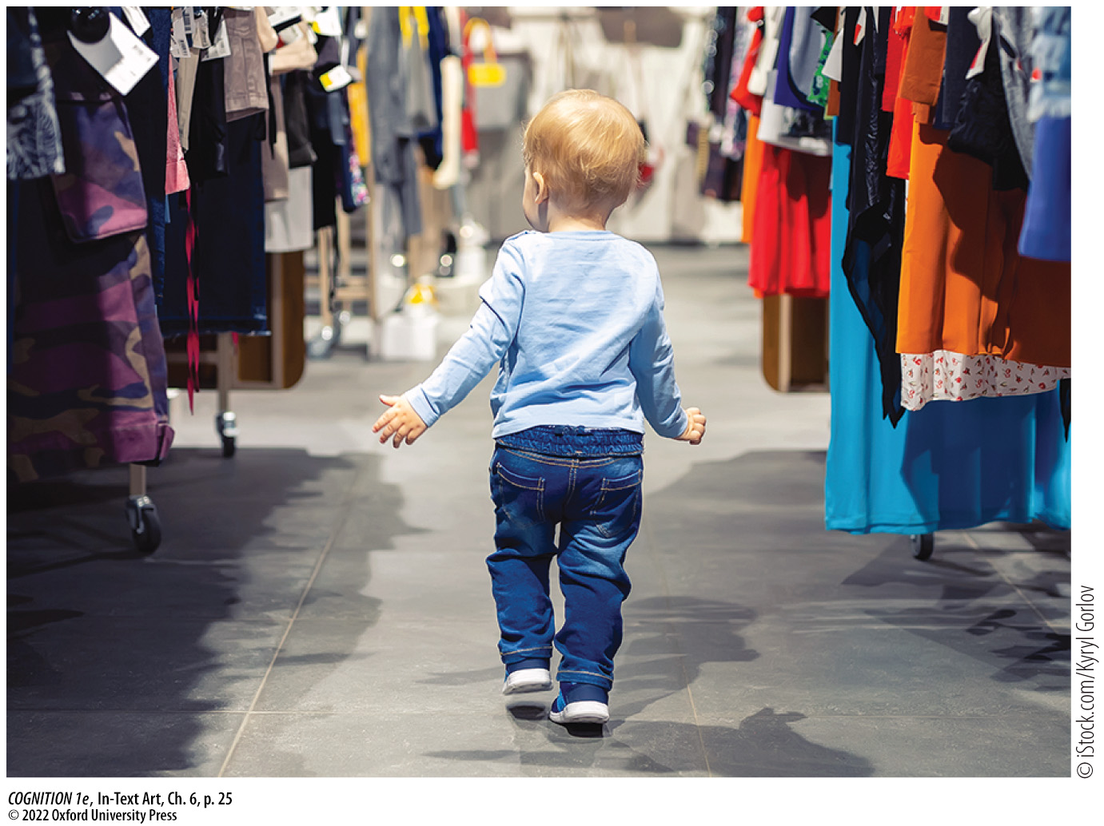
In-Text Art, Ch. 6, p. 25
Notes:
In-Text Art, Ch. 6, p. 25
In a classic study on false memory, researchers were able to implant a memory of getting lost in a mall as a child, an event that had not happened.

Slide 26
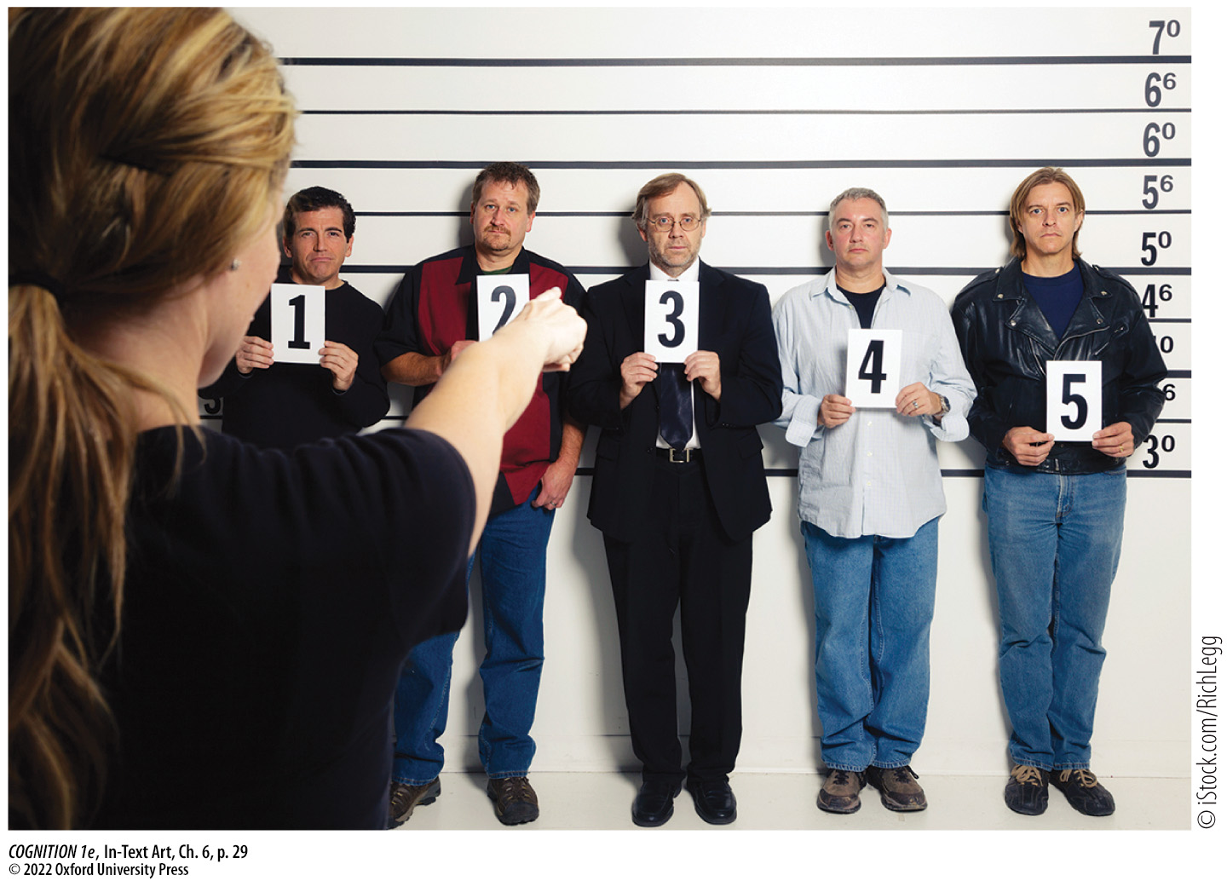
In-Text Art, Ch. 6, p. 29
Notes:
In-Text Art, Ch. 6, p. 29
Simultaneous lineups—as in this image—encourage eye-witnesses to compare the suspects to each other. In contrast, sequential lineups, in which suspects are viewed one at a time, are better at encouraging comparisons with memory.

