Slide 1




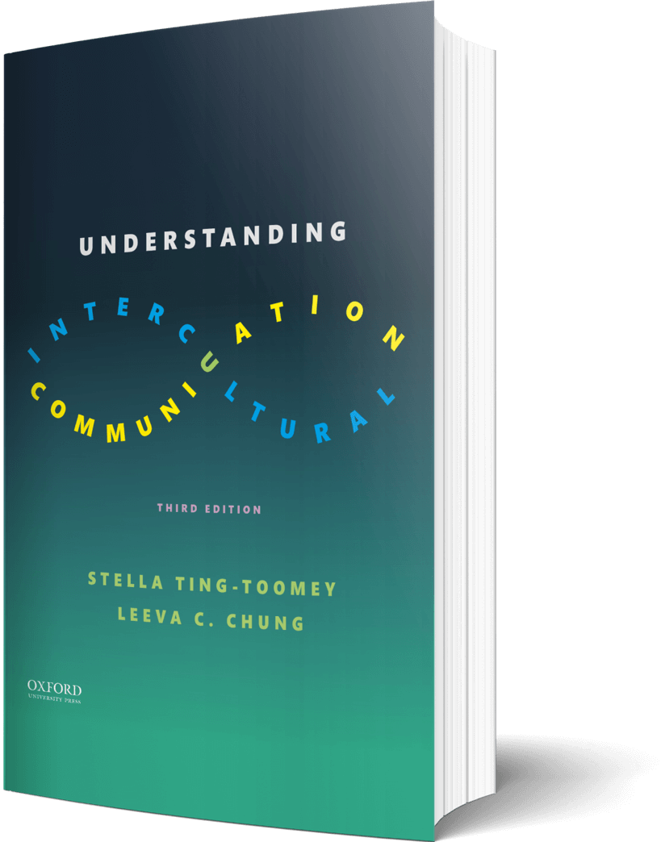

Intercultural Student
TOUR
Your adventure begins continues…
©2022

Slide 2

Prompt
Picture this…
Fill out this globe with your different ‘travel’ identities.
Who are you at home?
Who are you abroad?
Enter your answers on the next slide…

Slide 3

Travel Identities

Slide 4

Learn
Ideas
Pico Iyer explained in his TED Talk that “home is not just the place where you happen to be born. It’s the place where you become yourself.” Draw or add an image that represents your “home” outside of your physical house.
Draw your answers in the journal on the next page…

Slide 5

Draw
Draw or add an image that represents your “home” outside of your physical house…

Slide 6

Imagine
Apply
Think of one country unfamiliar to you. Make a list of the top culture shocks that may occur on your visit…..
Enter your answers in the journal on the next page…

Slide 7

Journal
Make a list of the top culture shocks that may occur on your visit…

Slide 8
?of
Checklist
1
PROMPT
CHAPTER 5
2
LEARN
3
IMAGINE…
4
CHECKOUT the practice quiz
Intercultural Student
5
CHECKOUT glossary-matching quizzes
TOUR

