Slide 1




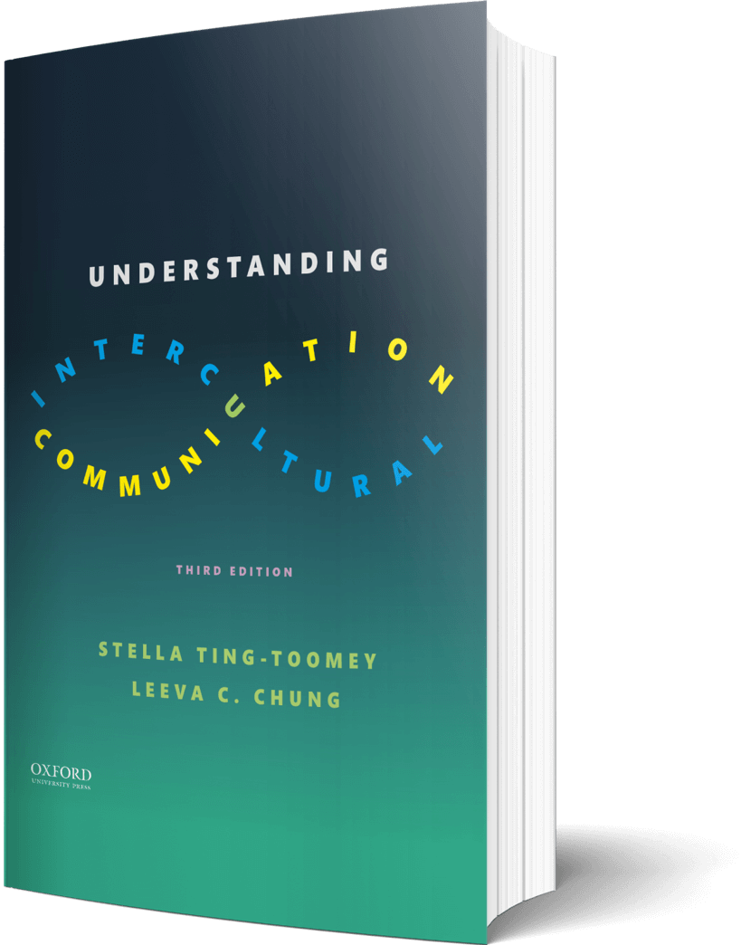

Intercultural Student
TOUR
Your adventure continues…
©2022

Slide 2

Prompt
Picture this…
You are watching an Olympic sport where 7 different countries are competing. What is an obvious example of in-group favoritism you can identify during the competition? Can you identify more than one? Explain…
Enter your answers in the journal on the next page…

Slide 3

Journal
An example of in-group favoritism…

Slide 4

Learn
Try This
Label each of these scenarios with small-power distance or large-power distance.
Parents are friends with their children
White-collar jobs are more valuable than blue-collar jobs
Access to power is regulated
The relationship between the boss and employees is casual.
Enter your answers in the journal on the next page…

Slide 5

Journal
Parents are friends with their children
White-collar jobs are more valuable than blue-collar jobs
Access to power is regulated
The relationship between a boss and employees is casual

Slide 6

Apply
Connect
Value dimensions are not “either or.”
We can be a mix, depending on the setting, situation, and context.
Create a bar graph with school, work, family, and friends—each representing a different bar. Make the bars taller the more you feel you are individualistic. Make the bars shorter the more you feel like you are collectivistic.
Create your bar graph on the next page…

Slide 7

Create
Create your bar graph of individualism and collectivism…

Slide 8

Imagine
Reflect
Call a close friend or family member and tell them about individualism and collectivism. Ask them, “do you think you are more individualistic or collectivistic?” How did this conversation flow? Do you agree or disagree with your family member?
Enter your answers in the journal on the next page…

Slide 9

Journal
Reaction to the conversation…

Slide 10
?of
Checklist
1
PROMPT
CHAPTER 3
2
LEARN
3
APPLY
Intercultural Student
4
IMAGINE
TOUR
5
CHECKOUT the practice quiz

