Slide 1




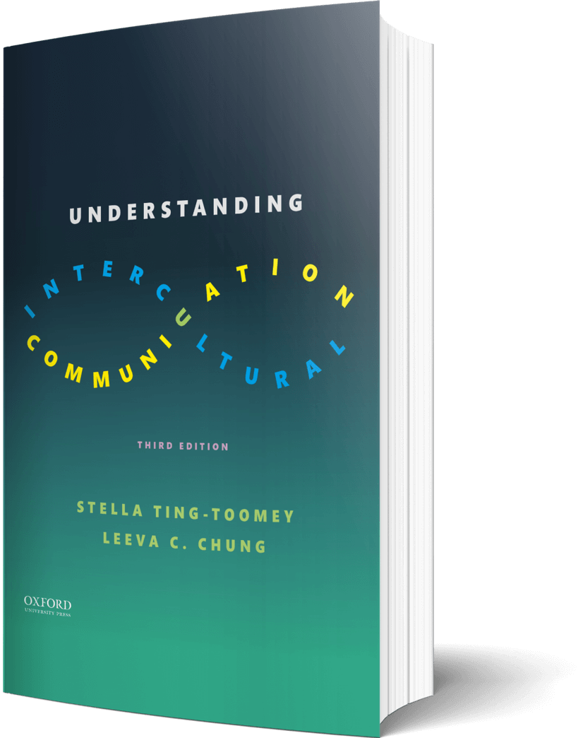

Intercultural Student
TOUR
Your adventure begins here
©2022

Slide 2

Prompt
Picture this…
You just landed an interview with TESLA- which is notorious for conducting group interviews…but an AI Robot will interview you. How will you set yourself apart from the ‘intelligence machine’?
Sell yourself!
Enter your answers in the journal on the next page…

Slide 3

Journal
How I will set my self apart…

Slide 4

Learn
Thoughts
After reading the importance of studying intercultural communication, what specific reasons were most compelling…for you?
Enter your answers in the journal on the next page…

Slide 5

List
Reasons why we should study intercultural communication…

Slide 6

Apply
Connect
Tomorrow is your first meeting with your virtual team. Team members are from different cultural communities. To prepare, list three things you want to ask your team before getting started on the work project.
Enter your answers in the journal on the next page…

Slide 7

My “Asks”
1 –
2 –
3 –

Slide 8

Reflect
Imagine
Pick a country or a cultural community that you have a strong desire to learn more about. What is the most important point you learned from Chapter 1 to understand that cultural community—both broadly and deeply?
Enter your answer in the journal on the next page…

Slide 9

Journal
Country name -
Reflect below…

Slide 10
?of
Checklist
1
PROMPT
CHAPTER 1
2
LEARN
3
APPLY
4
IMAGINE…
Intercultural Student
5
CHECKOUT the practice quiz
TOUR
6
CHECKOUT glossary-matching quizzes

