Slide 1




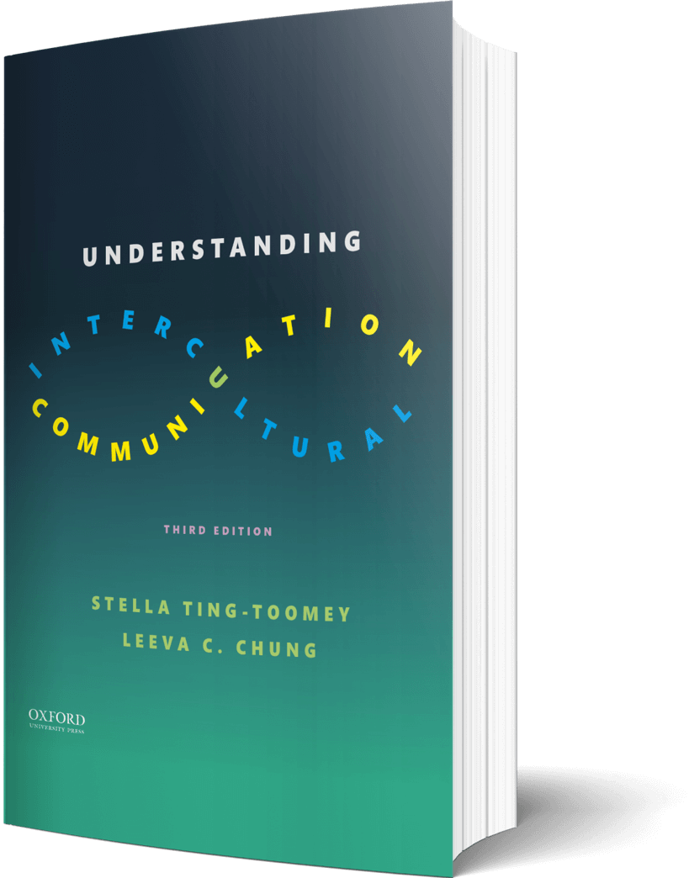

Intercultural Student
TOUR
Your adventure continues…
©2022

Slide 2

Prompt
Picture this…
It’s your first day studying abroad!
You are sitting next to students from totally different cultural communities you know little about. What is one way you can put mindfulness into practice when you attempt an initial interaction with your classmate?
Enter your answer in the journal on the next page…

Slide 3

Journal
How I will use mindfulness…

Slide 4

Learn
Reaction
In your own words, how would you explain “process consciousness?” (include one example of the eight principles discussed in this chapter).
Enter your answers in the journal on the next page…

Slide 5

Journal
In your own words, how would you explain
“process consciousness?”

Slide 6

Apply
Connect
Draw or add images that represent the staircase model with your everyday examples on each level.
Draw your answer in the journal on the next page…

Slide 7

Draw
Your staircase…

Slide 8

Imagine
Reflect
Pick a country, destination, or cultural community you’d love to visit. Think about a possible “culture bump or clash” that may occur during your visit (verbal or nonverbal). Describe it!
Enter your answers in the journal on the next page…

Slide 9

Journal
Pick a country, destination, or cultural community -
Tell us about it…

Slide 10
?of
Checklist
1
PROMPT
CHAPTER 2
2
LEARN
3
APPLY
4
IMAGINE
Intercultural Student
5
CHECKOUT the practice quiz
TOUR
6
CHECKOUT glossary-matching quizzes

