Slide 1




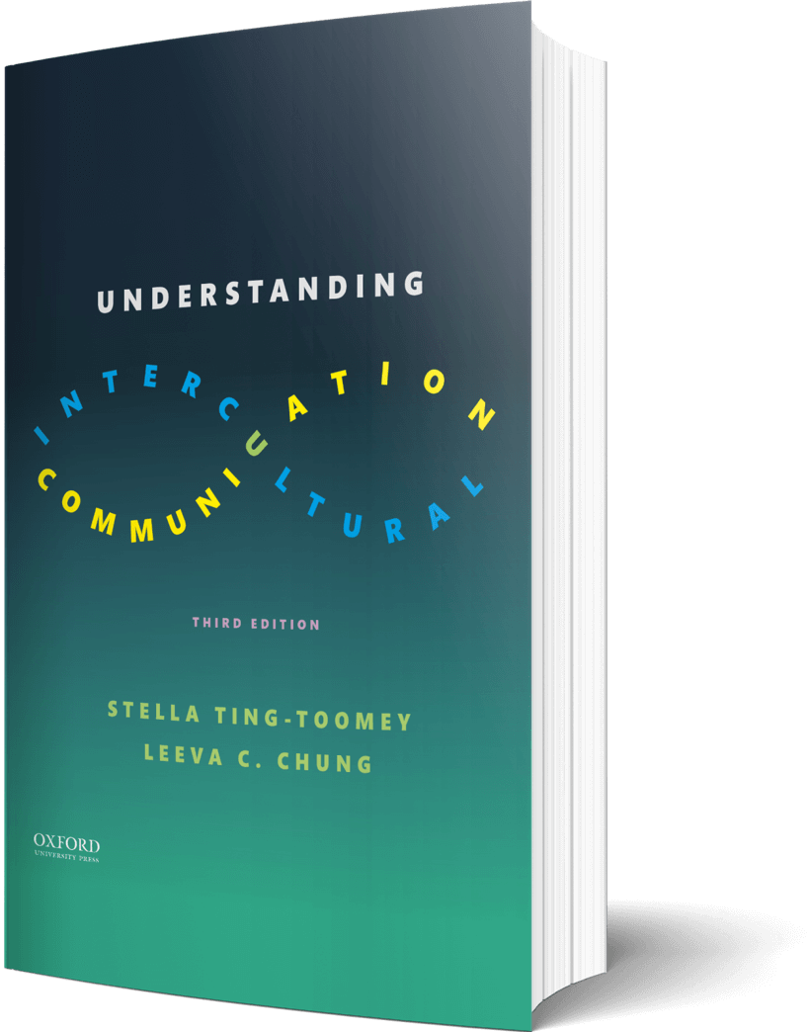

Intercultural Student
TOUR
Your adventure continues…
©2022

Slide 2

Prompt
Activity…
Create a personal playlist of 5 songs that highlight or describe experiences with your identity(ies). Why did you choose these songs? What are some feelings your playlist captures?
Create your playlist on the next page…

Slide 3

Create
My playlist and explanation…

Slide 4

Learn
Reflect
Using Cross’s Identity Development Model, find a movie or a television series where the main character is struggling with committing to one or more identities. In what ways did you see the stage model reflected in the movie?
Enter your reflection on the next page…

Slide 5

Reflect
My movie connection to the Cross Model…

Slide 6

Apply
Connect
Actress America Ferrera says, “my identity is my superpower, not my obstacle.” Create and draw a superhero with superpowers which represent your identities. Explain what the superpowers are and why they describe the communities representing your identity. What obstacles do these superpowers have the ability to overcome? - TED Talk
Discuss your superhero in the journal on the next page…

Slide 7

Discuss
Discuss your superpowers…

Slide 8

Imagine
Create
Imagine a situation where culture, communication, and identity intersect. Create an infographic of the skills you feel will help you to be a more mindful listener and greater validator of identity for this situation.
Create your infographic in the journal on the next page…

Slide 9

Create
Create your infographic…

Slide 10
?of
Checklist
1
PROMPT
CHAPTER 4
2
LEARN
3
APPLY
4
IMAGINE…
Intercultural Student
5
CHECKOUT the practice quiz
TOUR
6
CHECKOUT glossary-matching quizzes

