Slide 1




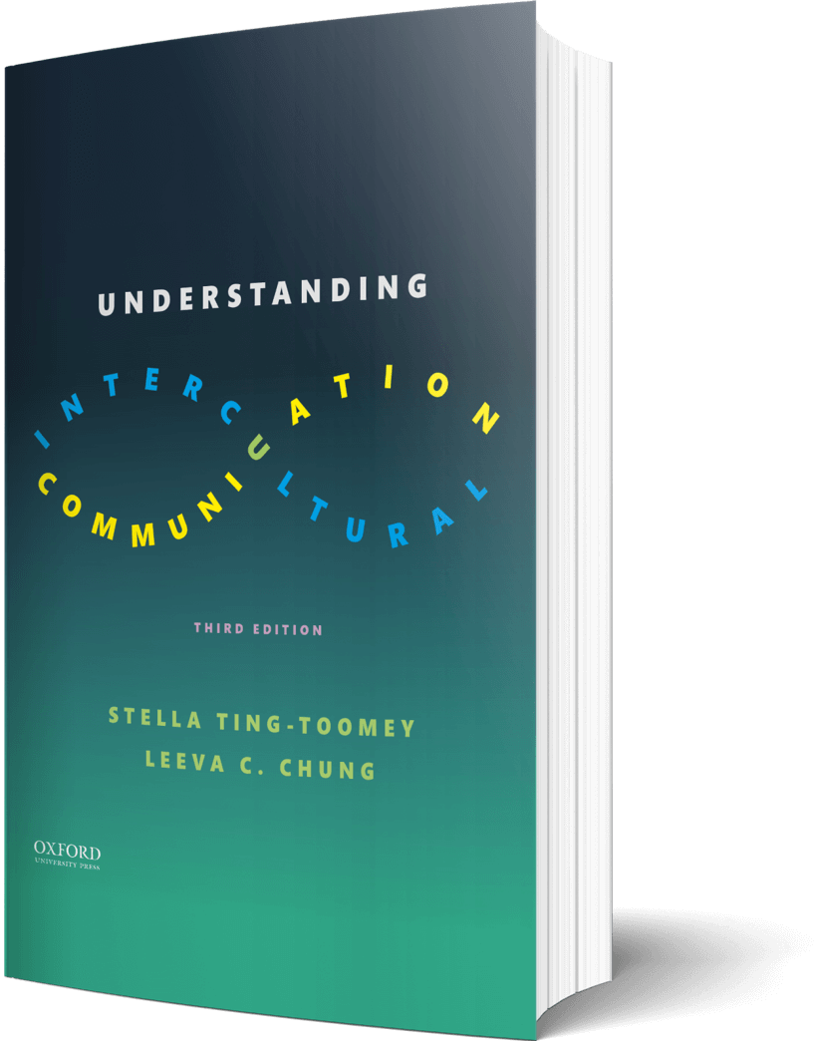

Intercultural Student
TOUR
Your adventure continues…
©2022

Slide 2

Prompt
Picture this…
You work at a local coffee shop and stayed late to close. You went above and beyond your normal duties and restocked the shelves. The next morning, a coworker brags to your manager- taking credit for your work. Which of the four conflict approaches will you use to handle this situation?
Enter your answers in the journal on the next page…

Slide 3

Journal
The conflict approach you will use to handle this situation…

Slide 4

Learn
Prompt
Do the five “animal” conflict styles represent each conflict? If you could pick a different animal to represent your conflict style, what would it be and why?
Enter your answers in the journal on the next page…

Slide 5

Journal
My reaction to the five animal conflict styles…
A new animal that matches my conflict style…
My reasons…

Slide 6

Apply
Connect
What image do you associate with “repairing face”? Can you draw an image that comes to mind?
Draw your image in the journal on the next page…

Slide 7

Draw
Start your drawing or add images…

Slide 8

Imagine
Explore…
X PLORE. How can you practice daily mindfulness? Record an audio file and embed it on the next slide.
Enter your answers in the journal on the next page…

Slide 9

Record
Embed your recording here!

Slide 10
?of
Checklist
1
PROMPT
CHAPTER 9
2
LEARN
3
APPLY
4
IMAGINE…
Intercultural Student
5
CHECKOUT the practice quiz
TOUR
6
CHECKOUT glossary-matching quizzes

