Slide 1




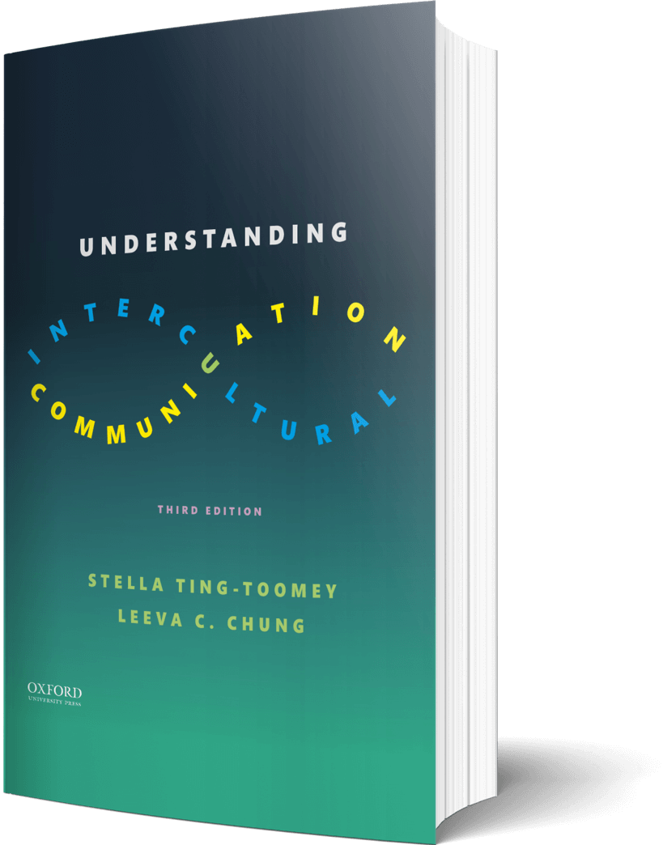

Intercultural Student
TOUR
Your adventure continues…
©2022

Slide 2

Prompt
Picture this…
Think about the idea that “opposites attract.” Compare a scene from a book or a movie—one from your cultural community and another from a different cultural community. How is this concept illustrated? What is your reaction to both?
Enter your answers in the journal on the next page…

Slide 3

Journal
Compare and contrast a scene from a book or a movie that illustrates opposites attract…

Slide 4

Learn
Explore
Make a list of the top criteria you want for a future partner. Do your criteria match Hofstede’s Value Dimensions? Any surprises?
Enter your answers in the journal on the next page…

Slide 5

Journal
My Criteria -
Thoughts -

Slide 6

Apply
Connect
Your roommate is dating a non-binary pansexual person from a different ethnic group. She is anxious about the judgment from her friends, family, and overcoming cultural differences. She just texted you about her situation – what advice would you give her in a text back?
Enter your answers in the journal on the next page…

Slide 7

Journal
Advice to text back to your friend…

Slide 8

Imagine
Reflect…
How would your family and close friends react if you chose to marry an individual who does not speak the same language, share the same political and religious preferences, and whose culture is vastly different from you? Make a list of the top statements you may get…
Enter your answers in the journal on the next page…

Slide 9

Journal
The reaction and the top statements you may get…

Slide 10
?of
Checklist
1
PROMPT
CHAPTER 10
2
LEARN
3
APPLY
4
IMAGINE…
Intercultural Student
5
CHECKOUT the practice quiz
TOUR
6
CHECKOUT glossary-matching quizzes

