Slide 1




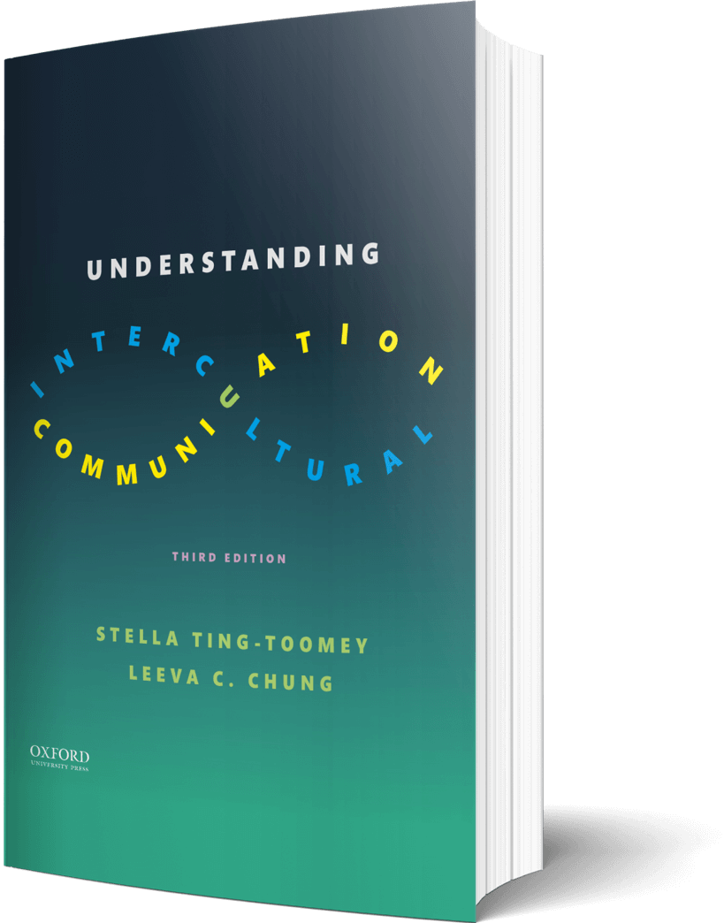

Intercultural Student
TOUR
Your adventure continues…
©2022

Slide 2

Prompt
Picture this…
Think about pop culture and entertainment you enjoy — music, movies, series, games, sports. Where in the world does it literally come from? Mark the places on the map and draw lines connecting them back to where you are located.
Draw your answers on the map on the next page…

Slide 3

My Map

Slide 4

Prompt
Learn
Take another look at your map. Using the inverted pyramid metaphor for e.neter’s, reflect on the role technology plays in your life. What kind of e.neter are you?
Enter your answers in the journal on the next page…

Slide 5

Journal
What kind of e.neter are you?

Slide 6

Apply
Connect
Draw (or describe in detail) what a global face might look like. Where do the facial features in the global face originate from?
Draw your image in the journal on the next page…

Slide 7

Draw
Draw (or describe in detail) the global face…

Slide 8

Imagine
List
Having no ability to text or DM for a month. List the ways that your communication with other people would change if every conversation had to be live — either in person or over the phone.
Enter your answers in the journal on the next page…

Slide 9

List
List the ways that your communication with other people would change…

Slide 10
?of
Checklist
1
PROMPT
CHAPTER 11
2
LEARN
3
APPLY
4
IMAGINE…
Intercultural Student
5
CHECKOUT the practice quiz
TOUR
6
CHECKOUT glossary-matching quizzes

