Slide 1
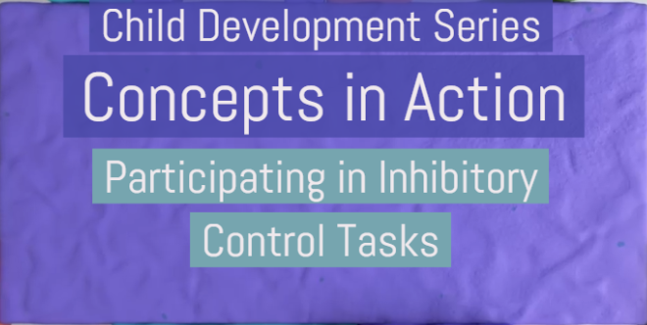
Chapter 9: Cognitive and Language Development in Early Childhood

Slide 2

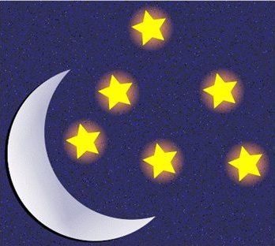
You will be presented with a succession of images. When shown a picture of the sun, say “DAY” and when shown a picture of the moon, say “NIGHT.”
Respond as quickly as you can!
Say: DAY
Say: NIGHT

Slide 3
Notes:
Correct Answer: DAY

Slide 4
Notes:
Correct Answer: NIGHT

Slide 5

Notes:
Correct Answer: NIGHT

Slide 6
Notes:
Correct Answer: DAY

Slide 7

Notes:
Correct Answer: DAY

Slide 8
Notes:
Correct Answer: DAY

Slide 9
Notes:
Correct Answer: NIGHT

Slide 10
Notes:
Correct Answer: DAY

Slide 11
Notes:
Correct Answer: DAY

Slide 12
Notes:
Correct Answer: NIGHT

Slide 13
Notes:
Correct Answer: DAY

Slide 14
Notes:
Correct Answer: NIGHT

Slide 15
Notes:
Correct Answer: NIGHT

Slide 16
That was easy, right? Now let’s try the reverse. Now when shown a picture of the sun, say “NIGHT” and when shown a picture of the moon, say “DAY.”
Respond as quickly as you can!
Say: NIGHT
Say: DAY

Slide 17
Notes:
Correct Answer: DAY

Slide 18
Notes:
Correct Answer: NIGHT

Slide 19
Notes:
Correct Answer: NIGHT

Slide 20
Notes:
Correct Answer: DAY

Slide 21
Notes:
Correct Answer: NIGHT

Slide 22
Notes:
Correct Answer: DAY

Slide 23
Notes:
Correct Answer: DAY

Slide 24
Notes:
Correct Answer: DAY

Slide 25
Notes:
Correct Answer: NIGHT

Slide 26
Notes:
Correct Answer: DAY

Slide 27
Notes:
Correct Answer: NIGHT

Slide 28
Notes:
Correct Answer: NIGHT

Slide 29
Notes:
Correct Answer: DAY

Slide 30
Not as easy, right? Let’s try another one.

Slide 31
You will be presented with a succession of words. When you see the word RED say “RED” and when you see the word GREEN say “GREEN.”
RED
GREEN
Say: RED
Say: GREEN

Slide 32
RED
Notes:
Correct Answer: RED

Slide 33
GREEN
Notes:
Correct Answer: GREEN

Slide 34
GREEN
Notes:
Correct Answer: GREEN

Slide 35
RED
Notes:
Correct Answer: RED

Slide 36
RED
Notes:
Correct Answer: RED

Slide 37
RED
Notes:
Correct Answer: RED

Slide 38
GREEN
Notes:
Correct Answer: GREEN

Slide 39
GREEN
Notes:
Correct Answer: GREEN

Slide 40
RED
Notes:
Correct Answer: RED

Slide 41
Now let’s try something else. When you see the word RED say “RED” and when you see the word GREEN say “GREEN.”
Now you will read what the word says and ignore the font color. Respond as quickly as you can!
RED
GREEN
Say: RED
Say: GREEN

Slide 42
RED
Notes:
Correct Answer: RED

Slide 43
GREEN
Notes:
Correct Answer: GREEN

Slide 44
GREEN
Notes:
Correct Answer: GREEN

Slide 45
RED
Notes:
Correct Answer: RED

Slide 46
GREEN
Notes:
Correct Answer: GREEN

Slide 47
RED
Notes:
Correct Answer: RED

Slide 48
RED
Notes:
Correct Answer: RED

Slide 49
GREEN
Notes:
Correct Answer: GREEN

Slide 50
GREEN
Notes:
Correct Answer: GREEN

Slide 51
GREEN
Notes:
Correct Answer: GREEN

Slide 52
RED
Notes:
Correct Answer: RED

Slide 53
GREEN
Notes:
Correct Answer: GREEN

Slide 54
Let’s change it up more time. When you see the word RED say “GREEN” and when you see the word GREEN say “RED.”
Now you will say the color of the font you see rather than the word that is appearing. Respond as quickly as you can!
RED
GREEN
Say: GREEN
Say: RED

Slide 55
RED
Notes:
Correct Answer: GREEN

Slide 56
GREEN
Notes:
Correct Answer: RED

Slide 57
GREEN
Notes:
Correct Answer: RED

Slide 58
RED
Notes:
Correct Answer: GREEN

Slide 59
RED
Notes:
Correct Answer: GREEN

Slide 60
RED
Notes:
Correct Answer: GREEN

Slide 61
GREEN
Notes:
Correct Answer: RED

Slide 62
RED
Notes:
Correct Answer: GREEN

Slide 63
GREEN
Notes:
Correct Answer: RED

Slide 64
GREEN
Notes:
Correct Answer: RED

Slide 65
RED
Notes:
Correct Answer: GREEN

Slide 66
GREEN
Notes:
Correct Answer: RED

Slide 67
Let’s try this task again with different words and colors. When you see the word RED say “RED” and when you see the word BLUE say “BLUE.”
RED
BLUE
Say: RED
Say: BLUE

Slide 68
red
Notes:
Correct Answer: RED

Slide 69
RED
Notes:
Correct Answer: RED

Slide 70
BLUE
Notes:
Correct Answer: BLUE

Slide 71
BLUE
Notes:
Correct Answer: BLUE

Slide 72
RED
Notes:
Correct Answer: RED

Slide 73
BLUE
Notes:
Correct Answer: BLUE

Slide 74
red
Notes:
Correct Answer: RED

Slide 75
BLUE
Notes:
Correct Answer: BLUE

Slide 76
BLUE
Notes:
Correct Answer: BLUE

Slide 77
red
Notes:
Correct Answer: RED

Slide 78
BLUE
Notes:
Correct Answer: BLUE

Slide 79
RED
Notes:
Correct Answer: RED

Slide 80
Now let’s try something else. When you see the word RED say “RED” and when you see the word BLUE say “BLUE.”
Now you will read what the word says and ignore the font color. Respond as quickly as you can!
RED
BLUE
Say: RED
Say: BLUE

Slide 81
RED
Notes:
Correct Answer: RED

Slide 82
BLUE
Notes:
Correct Answer: BLUE

Slide 83
BLUE
Notes:
Correct Answer: BLUE

Slide 84
BLUE
Notes:
Correct Answer: BLUE

Slide 85
RED
Notes:
Correct Answer: RED

Slide 86
RED
Notes:
Correct Answer: RED

Slide 87
BLUE
Notes:
Correct Answer: BLUE

Slide 88
RED
Notes:
Correct Answer: RED

Slide 89
BLUE
Notes:
Correct Answer: BLUE

Slide 90
RED
Notes:
Correct Answer: RED

Slide 91
Let’s change it up more time. When you see the word RED say “BLUE” and when you see the word BLUE say “RED.”
Now you will say the color of the font you see rather than the word that is appearing. Respond as quickly as you can!
RED
BLUE
Say: BLUE
Say: RED

Slide 92
RED
Notes:
Correct Answer: BLUE

Slide 93
BLUE
Notes:
Correct Answer: RED

Slide 94
BLUE
Notes:
Correct Answer: RED

Slide 95
RED
Notes:
Correct Answer: BLUE

Slide 96
BLUE
Notes:
Correct Answer: RED

Slide 97
BLUE
Notes:
Correct Answer: RED

Slide 98
BLUE
Notes:
Correct Answer: RED

Slide 99
RED
Notes:
Correct Answer: BLUE

Slide 100
RED
Notes:
Correct Answer: BLUE

Slide 101
BLUE
Notes:
Correct Answer: RED

Slide 102
Which task was the most challenging?

Slide 103
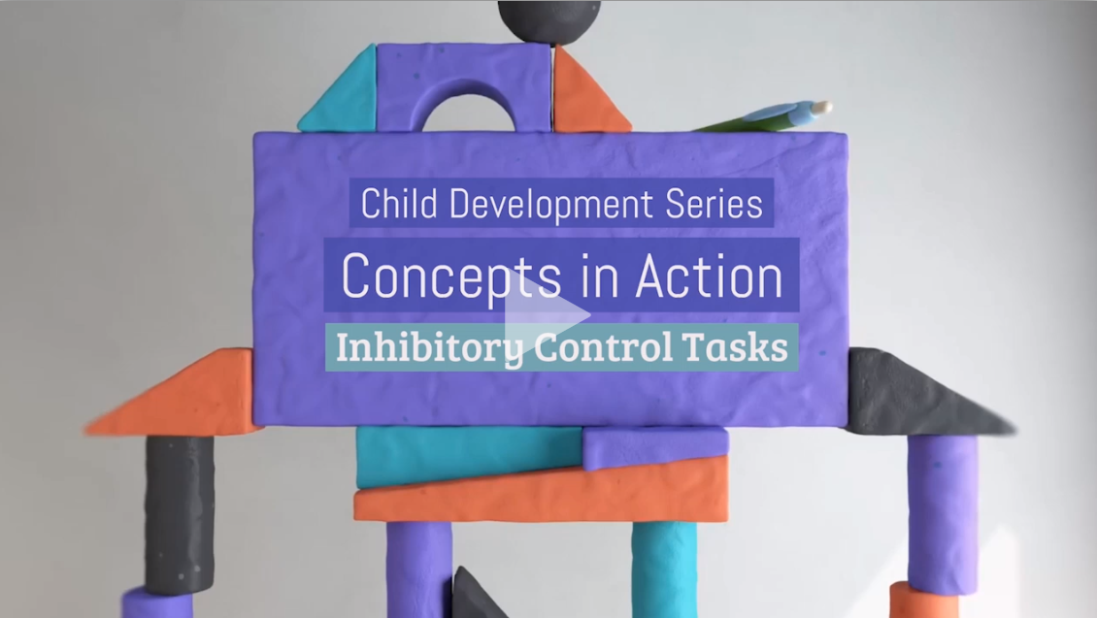
Watch this Video
Notes:
A fully accessible version of this video is available by logging on to Oxford LearningLink and selecting the appropriate Concept in Action video.
https://learninglink.oup.com/access/tamis-lemonda1e-student-resources#tag_concepts-in-action-videos

