Slide 1
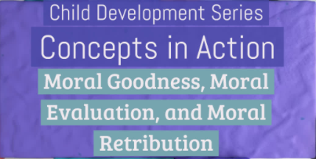
Chapter 7: Emotional and Social Development in Infancy and Toddlerhood

Slide 2
Morality: Scenario 1
Michelle is 2 years old. Michelle observes Mikey hit Zach. Ashleigh later takes a toy away from Mikey. Michelle wants to play with Ashleigh after Ashleigh punished Mikey.
What is this an example of?
Moral goodness
Moral evaluation
Moral retribution
Notes:
Correct Answer: C. Moral retribution

Slide 3
Morality: Scenario 2
Malika is almost 2 years old. Malika’s friend fell down in the playground. Malika comforts her friend with a hug.
What is this an example of?
Moral goodness
Moral evaluation
Moral retribution
Notes:
Correct Answer: A. Moral goodness

Slide 4
Morality: Scenario 3
Lisa is 3 years old. Lisa watches Billy hit Joey. She avoids playing with Billy.
What is this an example of?
Moral goodness
Moral evaluation
Moral retribution
Notes:
Correct Answer: B. Moral evaluation

Slide 5
Morality: Scenario 4
Nicole is 2 years old. Nicole watches Aidan share with Michael, but Michael doesn't share with Aidan. Nicole later chooses to play with Aidan, not Michael.
What is this an example of?
Moral goodness
Moral evaluation
Moral retribution
Notes:
Correct Answer: B. Moral evaluation

Slide 6
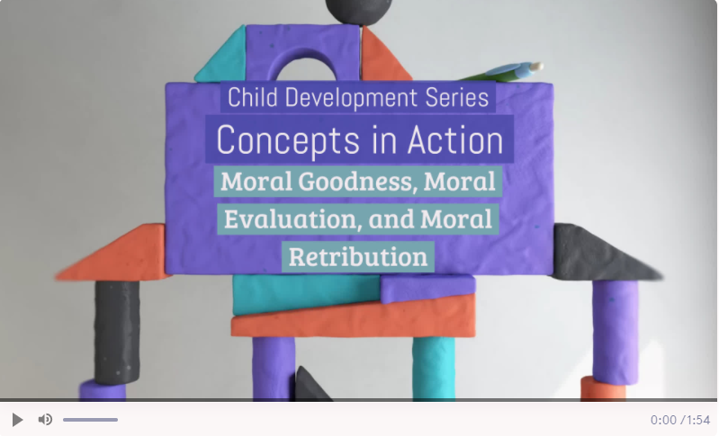
Watch this Video
Notes:
A fully accessible version of this video is available by logging on to Oxford LearningLink and selecting the appropriate Concept in Action video.
https://learninglink.oup.com/access/tamis-lemonda1e-student-resources#tag_concepts-in-action-videos

