Slide 1
American Popular Music, Sixth Edition
Larry Starr and Christopher Waterman with Brad Osborn

Slide 2
Chapter 14: “Smells Like Teen Spirit”
Hip-Hop, Alternative Music, and the Entertainment Business

Slide 3
Pop Loses its Stylistic Thumbprint
End of the 20th century—impossible to sustain a clear-cut dichotomy between the center of American popular music and its margins
  Economically successful popular music no longer presented a coherent stylistic thumbprint
  Established artists held devotion of many fans and able to attract new, younger listeners
    Johnny Cash (1932-2003) began his career in the mid-1950s as a rockabilly star, was an acclaimed country artist in the 1960s and 1970s, and in the 1990s had a resurgence with his series of “American Recordings”

Slide 4
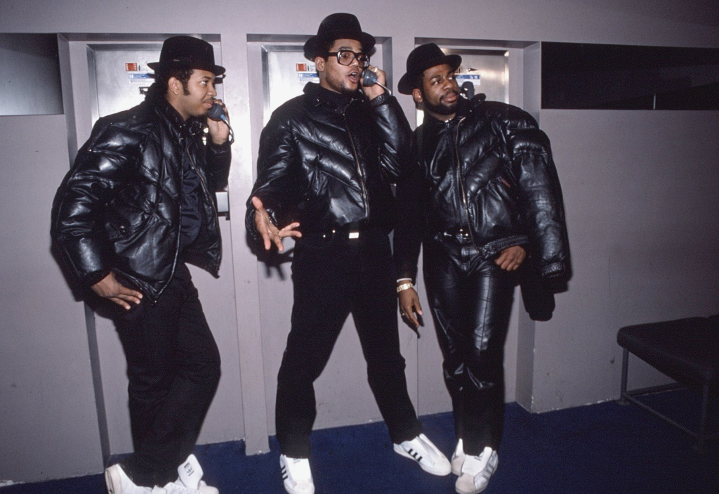
Hip Hop Breaks Out (1980s-1990s) 1 of 4
Mid-1980s—rapid acceleration of rap’s movement into popular mainstream
1986—release of first two multiplatinum rap albums: Run-D.M.C, Raising Hell and Beastie Boys, Licensed to Ill
  Run D.M.C.- trio of MCs Run (Joseph Simmons, b. 1964), and D.M.C. (Darryl McDaniels, b. 1964), and DJ Jam Master Jay (Jason Mizell, 1965-2002)
  Perhaps most influential act in history of rap music
  Recordings released by Def Jam records
    Raps were literate, rhythmically skilled
    Stark and powerful “beats” produced by Rubin and Jam Master Jay; mixed digitized loops of hard rock drumming with searing guitar heavy metal sounds
    First rap group to headline a national tour and appear on MTV
Notes:
Run DMC, (from left) Reverend Run (Joseph Simmons), Darryl McDaniels, Jam Master Jay (Jay Mizell), January 1986.

Slide 5
Listening Guide: “Walk This Way”
Written by Joe Perry and Steven Tyler; performed by Run-D.M.C. with Perry and Tyler (from Aerosmith) (recorded 1986)
Million-selling single
Opens with sample of rock drumming from original recording, interrupted by turntable scratching and the main riff of the song, played by Joe Perry
Run and D.M.C. trade lines of the song’s verses in aggressive, shouted style
First rap video put into heavy rotation by MTV
Played a pivotal role in mainstreaming of rap music

Slide 6
Hip-Hop Breaks Out (1980s-1990s) 2 of 4
Beastie Boys—rap trio and first commercially successful white act in hip-hop
  Recordings produced by Rick Rubin and released on Def Jam Records; distribution deal signed by Russell Simmons with industry giant Columbia
  Early recordings: fusion of youth-oriented rebelliousness of hardcore punk rock with the sensibility and techniques of hip-hop
  Experimented with combinations of rap, heavy metal, punk, psychedelic rock

Slide 7
Hip-Hop Breaks Out (1980s-1990s) 3 of 4
1987—series of million-selling singles had proven rap’s commercial potential on the pop and R&B charts
1988- emergence of new markets for hip-hop: launching of MTV’s first show dedicated to hip-hop music
  Yo! MTV Raps, hosted by Fab Five Freddie Braithwaite
  The Source—first magazine devoted solely to hip-hop music and fashion
  Rap category added to the Grammy Awards
  Billboard added a rap singles chart

Slide 8
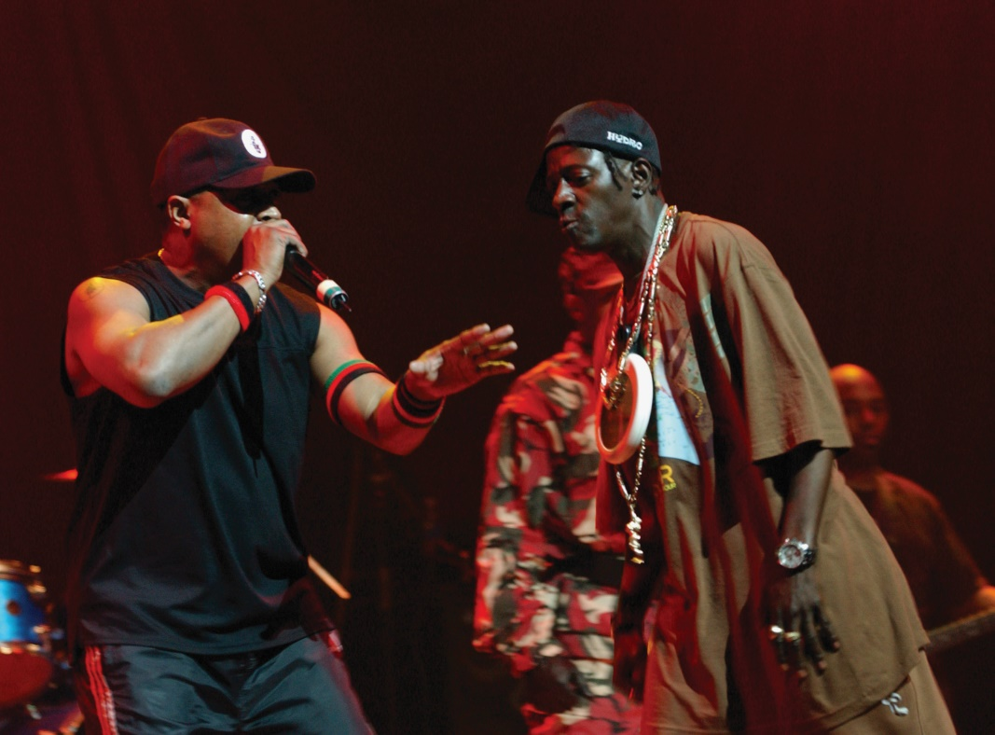
Hip-Hop Breaks Out (1980s-1990s) 4 of 4
Public Enemy—founded 1982 by members who met in college, drawn together by interests in hip-hop culture and political activism
  Two MCs: Chuck D (Carlton Ridenhour, b. 1960), Flavor Flav (William Drayton, b. 1959)
  DJ: Terminator X (Norman Lee Rogers, b. 1966)
  “Minster of Information”: Professor Griff (Richard Griffin, b. 1960)
  Security of the First World (S1W): dancers in paramilitary uniforms carrying Uzi submachine guns and performing marital arts inspired choreography
  1988- It Takes a Nation of Millions to Hold Us Back; fused trenchant social and political analyses of Chuck D with streetwise interjections of Flavor Flav in a dense sonic web created by production team, the Bomb Squad
Notes:
Flavor Flav and Chuck D of Public Enemy perform live on their 2007 tour.

Slide 9
Listening Guide: “Night of the Living Baseheads”
Written by Hank Shocklee, Eric Sadler, and Chuck D; performed by Public Enemy; recorded 1988
Lyrics combine images of zombies with commentary on the crack cocaine epidemic in inner cities during the 1980s
Complexly textured groove
Double meaning of the term “dope”
Grim message enveloped in jagged and stark sonic landscape
  Producers incorporated digital samples from 13 different recorded sources

Slide 10
Commercialization, Diversification, and the Rise of Gangsta Rap (1990s) 1 of 5
Gangsta rap—marginal variant of hip-hop featuring stylized narratives of dilemmas faced by urban communities: poverty, addiction, and violence; first-person, present-tense viewpoint giving grim survivalist outlook and celebrating gangster lifestyle
1990- watershed year for mainstreaming of hip-hop
  M.C. Hammer (Stanley Kirk Burrell, b. 1962): rapper from Oakland, CA; Please Hammer Don’t Hurt ‘Em became bestselling rap album of all time
  Vanilla Ice (Robert Van Winkle, b. 1968): White rapper considered hip-hop’s icon of “wackness” (weakness)

Slide 11
Commercialization, Diversification, and the Rise of Gangsta Rap (1990s) 2 of 5
Late 1980s—distinctive regional variations on the formula of hip-hop music established in cities
  Southern California is primary center of hip-hop innovation: independent labels and commercial AM station featuring hip-hop programming, KDAY
  “New school” West Coast rap differed from “old school” New York hip-hop
  Content became angrier, darker, more menacing
  Outlaw swagger in artists
    Ice-T (Tracy Marrow, b. 1958) recorded theme song for Colors, Dennis Hopper’s violent film about gang-police warfare in South Central Los Angeles

Slide 12
Commercialization, Diversification, and the Rise of Gangsta Rap (1990s) 3 of 5
  Emergence of West Coast gangsta rap
    N.W.A. formed in 1986 with O’Shea “Ice Cube” Jackson (b. 1969), Andre “Dr. Dre” Young (b. 1965) and Eric “Easy-E” Wright (1973-1995)
      Recordings expressed gangsta lifestyle, saturated with images of sex and violence straight out of the prison toast tradition
      Straight Outta Compton (1989)
      Breakup of group in 1989,members sold solo albums
        Dr. Dre- most influential and economically successful member, founded independent label, Death Row/Interscope
        Snoop Doggy Dogg (Calvin Broadus, b. 1972)

Slide 13
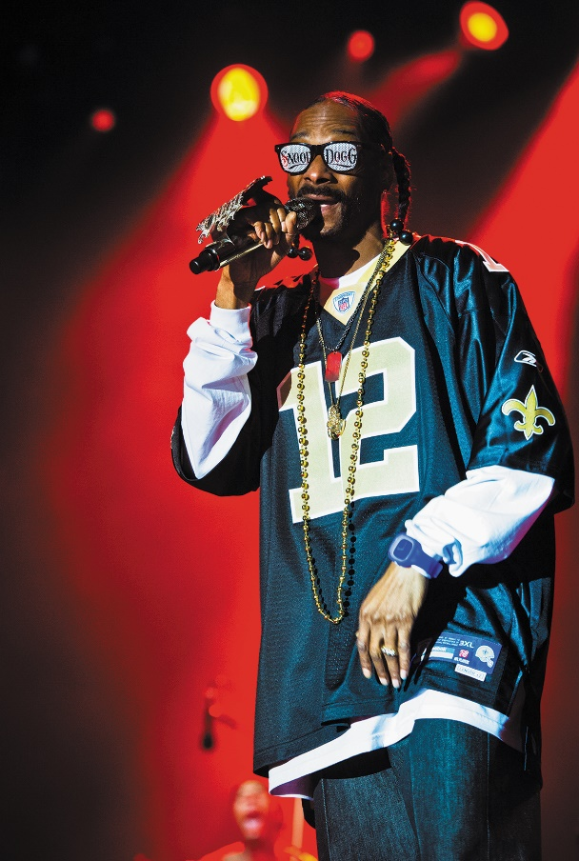
Listening Guide: “What’s My Name?”
Written by George Clinton, Gary Shider, Snoop Dogg, and David Spradley; produced by Dr. Dre; performed by Snoop Doggy Dogg (recorded 1993)
Sense of Snoop Doggy Dogg’s prowess as a rapper and Dr. Dre’s distinctive G-funk production style
Original released on album with a “clean” version on a single designed for radio airplay and mass distribution
Relaxed, medium-tempo dance groove with drum machine and keyboard synthesizers, digitally processed, nasal-sounding human voice
Notes:
Snoop Dogg.

Slide 14
Commercialization, Diversification, and the Rise of Gangsta Rap (1990s) 4 of 5
Mid-1990s: violent eruption of conflicts between east and west coast factions within hip-hop business
  Marion “Suge” Knight, CEP of Death Row Records (Los Angeles)
    Tupac (2Pac) Shakur (1971-1996)
  “Sean “Puffy” Combs (also called Puff Daddy or P. Diddy), CEP of New York based Bad Boy Records
    Notorious B.I.G. (Christopher Wallace, also called Biggie Smalls, 1972-1997)

Slide 15
Commercialization, Diversification, and the Rise of Gangsta Rap (1990s) 5 of 5
Gangsta rap: chronicled dilemmas of urban communities from a first-person, present-tense viewpoint
  Celebratory nihilism, propelled by funk-derived, digitally sampled grooves and surrounded in video versions with a continual flow of images of hip-hop fashion, champagne, expensive chars, and sexy women
  Understandable ambivalence on the part of observers genuinely sympathetic to the plight of people struggling for economic and cultural survival
  Rap music part of African American culture and American culture as a whole

Slide 16
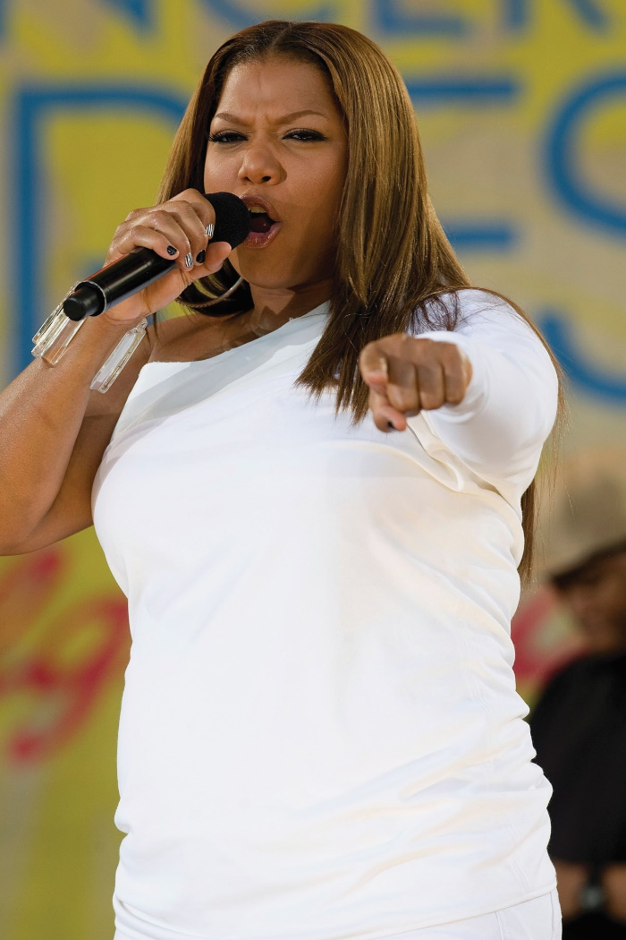
Queen Latifah
Queen Latifah (b. 1970)—most important woman in history of hip-hop by commercial success and effectiveness in establishing a feminist beachhead on male-dominated field of rap music
  Provided alternative to misogynist braggadocio of gangsta rappers like Snoop Dogg
  Born in Newark, NJ; nicknamed Latifah (Arabic word for “gentle” or “pleasant”)
  Began rapping in high school; in college, participated in Afrika Bambaataa’s Native Tongues collective, a group dedicated to raising political consciousness of hip-hop
  All Hail the Queen (1989): debut album, song “Ladies First”
    R&B, reggae, house music influence
Notes:
Queen Latifah.

Slide 17
Listening Guide: “U.N.I.T.Y.”
Written by Queen Latifah and Kier “Kay Gee” Gist (released 1994)
Opens with a sample of jazz tenor saxophone with guitar, string bass, and drum set accompaniment
Slow, reggae-influenced groove with bass riff and digitized snare backbeat
Latifah performs in Jamaican patois, interrupted by more aggressive responses in an American dialect
Chorus’s idealistic message: Black men and women should treat one another with love and respect
Structure: alternation of chorus with series of rapped verses; focus on verbal performance while music functions to set the mood, create a temporal flow, and evoke a range of associations

Slide 18
Techno: Dance Music in the Digital Age 1 of 2
Techno- broad term encompassing new forms of up-tempo, repetitive, electronic dance music developed in the club scenes of New York, Chicago, Detroit, and European cities; can be traced to early 1980s genres such as garage and house music
  Genre encompasses dozens of subcategories
  Musical dimension of a youth culture: arguments about good music and bad music informed by a set of shared assumptions and shared knowledge of the genre’s history
  Techno culture: focused on DJ/producers, who often attempt to remain anonymous

Slide 19
Techno: Dance Music in the Digital Age 2 of 2
Raves- dance club and semipublic events partly modeled on the be-ins of the 1960s counterculture
  Prevalent use of psychoactive drug Ecstasy
House music- (named after the Warehouse, a popular gay dance club) developed in Chicago
  Frankie Knuckles: DJ from New York who worked at the Warehouse from 1979 to 1983
    Introduced New York turntable technique to Chicago; emphasized dance beat more strongly

Slide 20
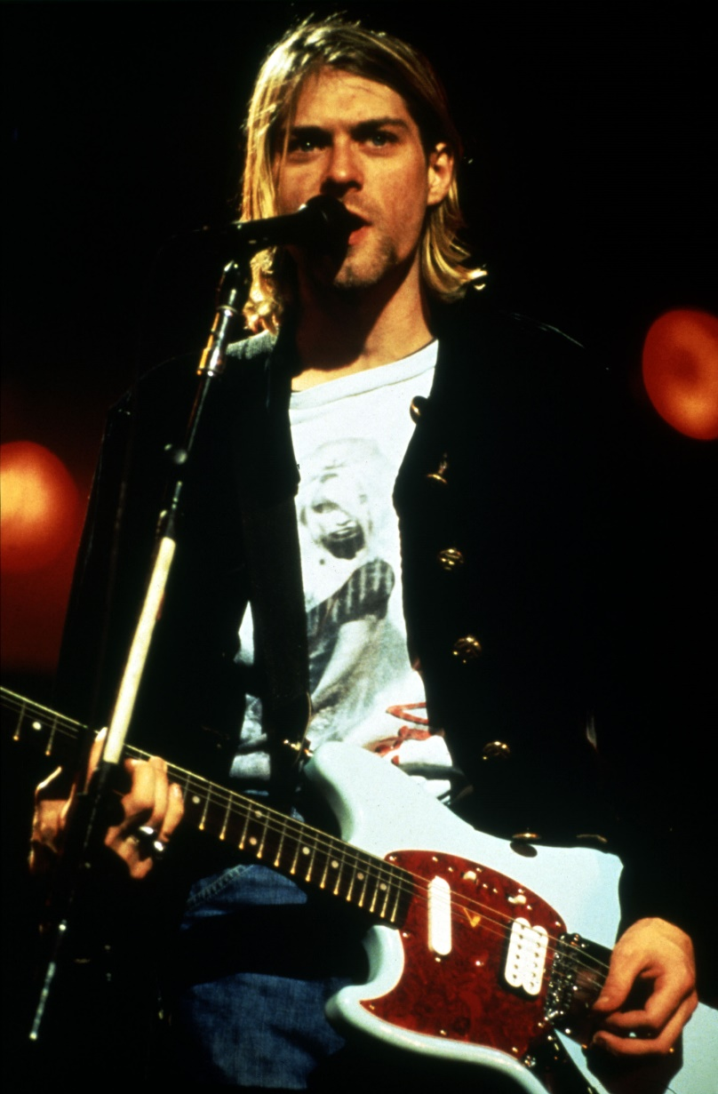
Alternative Currents
Hundreds of named genres—splintering of genres exceeding anything previously experienced in American popular music
  End of the 1990s: Almost every genre had sprouted an alternative subcategory
    Some recorded for major record labels, some for small, independent labels
    “Alternative” describes music that challenges the status quo
      Used to denote choices available to consumers via record stores, radio, cable television, Internet
      Major record labels create fake independent label to satisfy audiences hungry for musical expressions of authenticity and rebellion, culmination of decades-old trend within the music business
Pictorial Press Ltd/Alamy Stock Photo
Notes:
Kurt Cobain.

Slide 21
Alternative Rock, 1980s-1990s 1 of 5
Underground scenes in communities with large populations of college students and student-programmed college radio stations
  Started out as local phenomena—local, anticommercial, guitar-based music blending abrasive, do-it-yourself sensibility of 1970s punk with thick textures of heavy metal
  Some groups went on to achieve international commercial success, signing deals with major record companies and moving toward more pop-influenced sounds
  Other groups driven by ideology of nonconformity remained small, local, and close to their fan base
Most influential indie rock bands
  R.E.M.—reinterpretation of the punk aesthetic with folk rock
  Sonic Youth—pushed underground rock music in a direction influenced by avant-garde experimentalists

Slide 22
Alternative Rock, 1980s-1990s 2 of 5
Hardcore- extreme variation of punk pioneered in the 1980s by bands in San Francisco and Los Angeles
Pushed frenzied energy of the Ramones and Sex Pistols to the limit, playing simple riff-based songs at impossibly fast tempos and screaming nihilistic lyrics over a chaotic wall of guitar chords
  Listening Guide: “Holiday in Cambodia”
    Written and performed by the Dead Kennedys (recorded 1980)
    Example of early 1980s hardcore punk rock
    Jello Biafra (Eric Boucher, b. 1959)- lead singer
    Song directed to spoiled children of suburban yuppies
    Guitar pyrotechnics
    Political stance: opposed American imperialism overseas, destruction of human rights and the environment, and hypocritical and soulless suburban lifestyle

Slide 23
Alternative Rock, 1980s-1990s 3 of 5
Thrash—blended fast tempos and rebellious attitude of hardcore with technical virtuosity of heavy metal guitar playing
Nirvana: from Pacific Northwest; singer/guitarist Kurt Cobain (1967-1994), bassist Krist Novoselic (b. 1965), drummer Dave Grohl (b. 1969)
  Released two multiplatinum albums that moved alternative rock’s blend of hardcore punk and metal into the commercial mainstream
  Grunge rock
  Cobain and Novoselic met in 1985 in economically depressed town; inspired by underground rock, hardcore bands, and creativity of the Beatles; formed Nirvana in 1987
  Success destroyed Nirvana; Nevermind rose in charts and began to attract mass audience from genres to which their own music was explicitly opposed; outrageous behavior; rumors that Cobain and his wife Courtney Love were using heroin

Slide 24
Alternative Rock, 1980s-1990s 4 of 5
  1994: Cobain overdosed on champagne and tranquilizers; described as an accident, though suicide note found later; entered a detox program after coming out of a coma; died of a self-inflicted shotgun wound
  Listening Guide: “Smells Like Teen Spirit”
    Music by Nirvana; lyrics by Kurt Cobain; performed by Nirvana (recorded 1991)
    Combination of heavy metal instrumental textures and pop songwriting techniques; memorable verbal and melodic hooks
    Combines four chord heavy metal harmonic progression with conventional formal structure made up of four-, eight-, and twelve-bar sections; ABC
    First alternative rock single of the 1990s to enter the Top 10; carefully crafted pop record

Slide 25
Alternative Rock, 1980s-1990s 5 of 5
Phish—created loyal following by extending the approach of the Grateful Dead; embraced eclectic tastes and influences; devoted to improvisation
  Inspired by 1960s counterculture and improvisational work of jazz musicians
  Optimistic, energetic, and openminded alternative to nihilism and self-absorption of many alternative rock bands
  Popularity as a touring group never translated into massive record sales
  “Stash”—12.5 minute track from concert album Phish: A Live One (1995); loose-jointed, freewheeling approach to collective improvisation

Slide 26
The “Seattle” Sound
Regional sounds have played an important part in the history of popular music
Seattle: Nirvana honed their sound and built a local fan base; thriving alternative rock scene by the late 1990s
Green River, 1988 album Rehab Doll, helped popularize grunge rock, blending heavy metal guitar textures with hardcore punk
Push to define regional style often comes from promotion departments of record companies as much as the local artists and fans themselves

Slide 27
Women’s Voices:
Alternative Folk, Hip-Hop, and Country 1 of 4
Ani DiFranco (b. 1970): spent career resisting corporate music business, releasing an album, and playing approx. 200 live performances per year while building independent label and substantial grassroots following
  1989: recorded demo and pressed copies to sell at shows; quickly sold out and founded Righteous Babe Records in 1990
  Mid-1990s: mainstream media took notice; released all albums on the Righteous Babe label, despite many offers from major record companies
  “Not a Pretty Girl” from Not a Pretty Girl- self-revealing lyrics, minimalist studio sound that focuses on DiFranco’s voice and acoustic guitar; lyrics- man who wronged the singer, and general indictment of society’s treatment of women

Slide 28
Women’s Voices:
Alternative Folk, Hip-Hop, and Country 2 of 4
Lauryn Hill (b. 1975): hip-hop artist whose work is a self-conscious alternative to violence and sexism of rap stars such as Dr. Dre, the Notorious B.I.G., and Tupac Shakur
  Female empowerment builds on the work of Queen Latifah
  Fugees: New Jersey based hip-hop trio; successful blend of rap, reggae, and R&B
  Listening Guide: “Doo Wop (That Thing)”
    Written and performed by Lauryn Hill (recorded 1998)
    Combines aspects of 1950s R&B (soulful lead vocal, four-part harmony, horn section) with observations on male and female behavior
    Moral parable, delivered in terms that leaven anger with hip-hop jargon

Slide 29
Women’s Voices:
Alternative Folk, Hip-Hop, and Country 3 of 4
k.d. lang (b. 1961): Canadian whose early work showcased the influence of Patsy Cline; later recorded successful pop material
  1992: officially announced her homosexuality; New York magazine christened her an “icon of lesbian chic”
  1990s: shift to adult contemporary pop music
  Listening Guide: “Nowhere to Stand”
    Written by k.d. lang; performed by k.d. lang and the Reclines (recorded 1989)
    From 1989 album Absolute Torch and Twang; traditional song with series of four-line verses and a repeated chorus in triple meter
    Lyrics: indictment of the “traditional” practice of child abuse

Slide 30
Women’s Voices:
Alternative Folk, Hip-Hop, and Country 4 of 4
Why these artists achieved status of alternative
  DiFranco: introduction of instrumental textures and vocal style from punk rock
  Hill: lyric challenges aspects of the materialistic and sexist ideology on most commercially successful rap recordings
  Lang: public persona and subject matter

Slide 31
Modern Sounds in Country and Western Music:
Approaches to Tradition 1 of 2
Country and western- one of the most popular genres of American music; less youth-oriented than other genres; mature, stable, artists with long-standing careers as consistent hit-makers
George Strait (b. 1952), Alan Jackson (b. 1958), Toby Keith (b. 1961)
  All from working class backgrounds, established performer careers in their 30s
  Lyrics acknowledge country backgrounds and country traditions
    “Heartland” (Straight, 1993)—fiddles, steel guitar
    “Midnight in Montgomery” (Jackson, 1992)—tribute to Hank Williams
    “Should’ve Been a Cowboy” (Keith, 1993)—does not retain the fiddle
      All sing in full-voiced manner, without heavy regional accents; no trace of yodeling or “high lonesome” vocal sound
      Strong continuity of honky-tonk style updated with stronger backbeat; sound is similar to 1970s country-flavored pop-rock

Slide 32
Modern Sounds in Country and Western Music:
Approaches to Tradition 2 of 2
Taylor Swift (b. 1989)- “teen idol,” singer-songwriter pop phenomenon who self-identified as a country artist
  Still a teenager when her second album became the longest-running number one album of the 2000s: Fearless (2008)
Gretchen Wilson (b. 1973)- country artist known for “Redneck Woman” (2004)

Slide 33
More Country Alternatives:
O Brother Where Art Thou? and the Resurgence of Bluegrass 1 of 2
O Brother Where Art Thou? (2000)—Coen brothers’ film with bestselling soundtrack
  Encompasses generations of country artists and recordings
  Bluegrass music pushed into the limelight
    Style modeled on early acoustic string bands, continued to flourish steadily as an “alternative” to western swing, honky-tonk, rockabilly, countrypolitan, and more “modern” country idioms
Ralph Stanley (b. 1927): bluegrass veteran; performed with brother Carter as the Stanley Brothers from 1946; produced a body of outstanding bluegrass records

Slide 34
More Country Alternatives:
O Brother Where Art Thou? and the Resurgence of Bluegrass 2 of 2
Alison Krauss (b. 1971): career before 30 reached much further from strict traditionalism
  Fiddling champion and bluegrass fan; established credentials as a bandleader, vocalist, producer, and valuable collaborator on many recordings by others
  Union Station: band in which Krauss demonstrates close connections to traditional bluegrass and interest in creating a distinctive and original sound

Slide 35
Latinx Superstars of the 1990s 1 of 2
Gloria Estefan (b. 1957)
  Born in Havana, her family fled Cuba when Fidel Castro rose to power
  Albums: Cut Both Ways (1989), Into the Light (1991), first Spanish-language album: Mi Tierra (1993), Gloria! (1998)
  Sold 90M+ albums worldwide
  Formula: alternating among dance-oriented pop, English-language love songs, Spanish-language tracks aimed at an international Latin American audience
  “Dr. Pressure” (2005)- song that combined techno electronica hit “Drop the Pressure” with “Dr. Beat”
    Mash-up- recording that digitally combines two or more preexisting tracks, usually by overlaying the vocal track of one song over the music track of another

Slide 36
Latinx Superstars of the 1990s 2 of 2
Selena—“The Queen of Tejano (Texas-Mexican) music”
  Born in Lake Jackson, Texas; father was a working musician; she began by performing with his band
  Made a living by performing when family relocated to Corpus Christi
  1983: recorded first album for Freddie Records, a local independent label
  1989: signed with the Latin division of EMI
  Mid-1990s: several popular albums drawing on traditional accordion band style of Texas-Mexican music, romantic ranchera song tradition of Mexico, and pan-Latin dance music style called cumbia
  1994: role in the film Don Juan DeMarco; won her first Grammy
  1995: recording first English-language album, notified that president of her Texas fan club was embezzling money and fired her; met with her soon after, and Selena was shot and killed

Slide 37
Globalization and the Rise of World Music
World music- term used in the late 1980s by independent record label owners and concert promoters, replacing terms such as “traditional music,” “international music,” and “ethnic music”
  International records generally purchased by immigrants, cross-cultural music scholars, handful of aficionados
  Ravi Shankar (1920-2012)—Indian classical musician, whose album Live at the Monterey Pop Festival reached Number 43 in 1967
1980s: international musicians toured US with increasing frequency
  King Sunny Adé (b. 1946), leader of a Nigerian group called the African Beats who released Juju Music in 1982
1990: “World music” first appeared as a subcategory of the broader heading “adult alternative albums”

Slide 38
World Music Collaborations:
Ali Farka Touré and Nusrat Fateh Ali Khan
1990s- collaborations between American and foreign musicians had become more common
Talking Timbuktu (1994)—Grammy Award for Best World Music Recording
  Ry Cooder (b. 1947)—singer and guitarist who produced Talking Timbuktu
  Ali Farka Touré (1939-2006)—guitarist and traditional praise singer from West African nation of Mali
    “Diaraby”—close affinities with the blues styles; links between West African griot tradition and blues created by black musicians in America’s Deep South
  “The Face of Love”—produced by Ry Cooder
    Eddie Vedder (b. 1966)—lead singer of Seattle-based alternative rock band Pearl Jam
    Nusrat Fateh Ali Khan (1948-1997)—leading performer of qawwali, genre of mystical singing practiced by Sufi Muslims in Pakistan and India

Slide 39
Key Terms
Alternative music
Gangsta rap
Grunge rock
Hardcore
House music
Mashup
Rave
Speed metal
Techno
Thrash
World music

Slide 40
Key People
Alan Jackson
Alison Krauss
Andre “Dr. Dre” Young
Ani DiFranco
Bikini Kill
Chuck D
Dave Grohl
D.M.C.
Eddie Vedder
Enrique Iglesias
Eric “Eazy-E” Wright
Flavor Flav
George Strait
Gloria Estefan
Gretchen Wilson
Ice-T
Jam Master Jay
Jello Biafra
Johnny Cash
Kathleen Hanna
k.d. lang
King Sunny Adé
Krist Novoselic
Kurt Cobain
Lauryn Hill
Marshall “Eminem” Mathers
M.C. Hammer
Notorious B.I.G.
N.W.A.
O’Shea “Ice Cube” Jackson
Phish
Professor Griff
Public Enemy
Queen Latifah
Ralph Stanley
Ravi Shankar
R.E.M.
Ricky Martin
Run
Run-D.M.C.
Ry Cooder
Sean “Puffy” Combs
Selena
Snoop Doggy Dogg
Sonic Youth
Taylor Swift
Terminator X
Toby Keith
Tupac (2Pac) Shakur
Union Station
Vanilla Ice

