Slide 1

Social Problems: Finding Solutions, Taking Action
by Robert McNamara

Slide 2
Chapter 2
Why Is Crime Always in the News? Crime and Interpersonal Violence

Slide 3
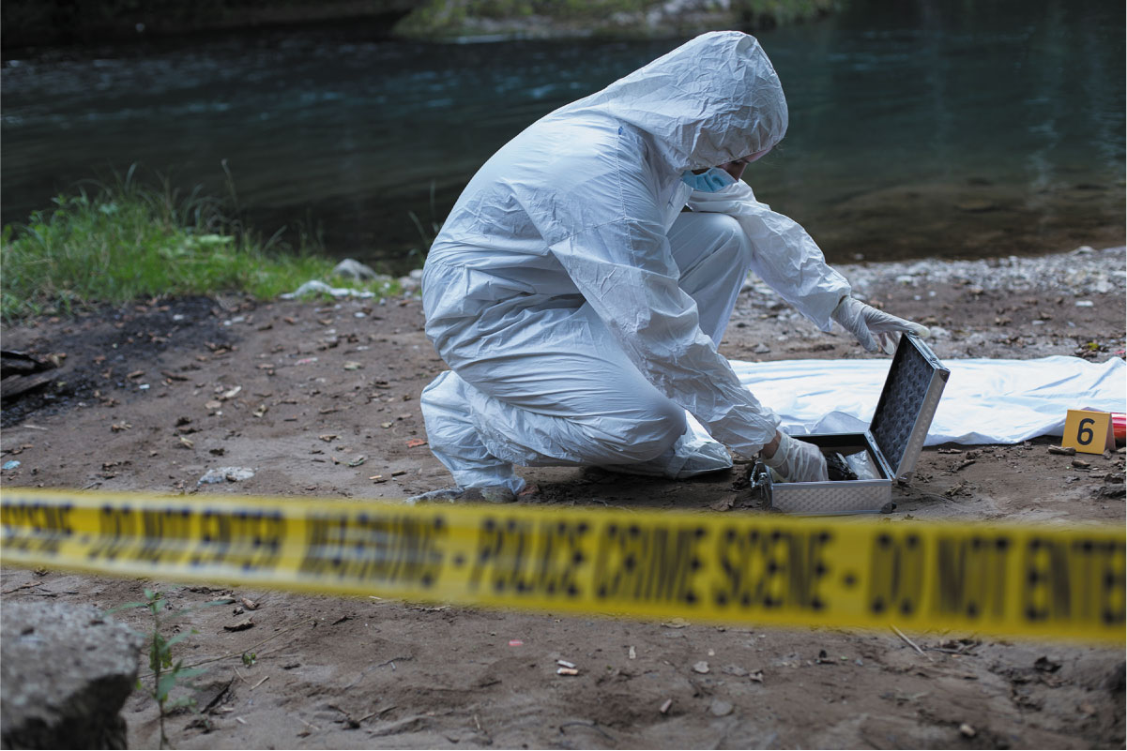

Slide 4
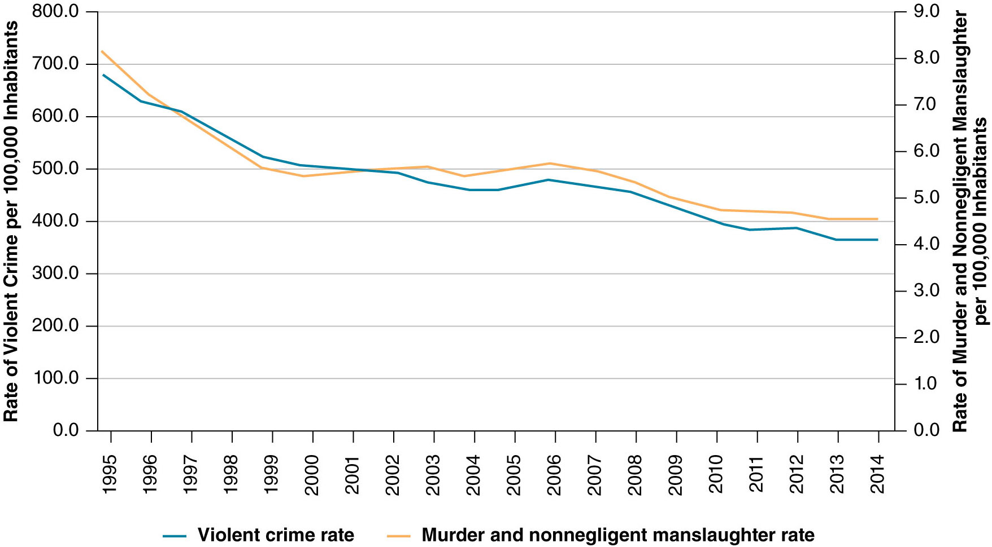

Slide 5
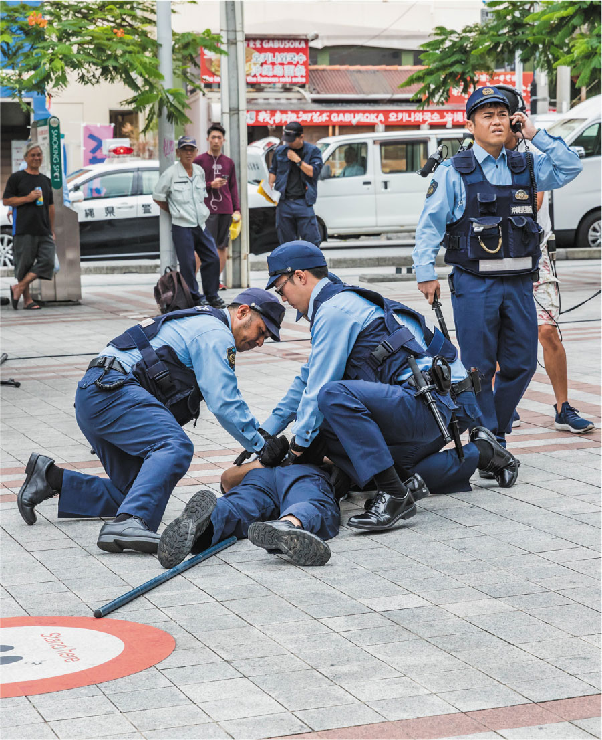

Slide 6
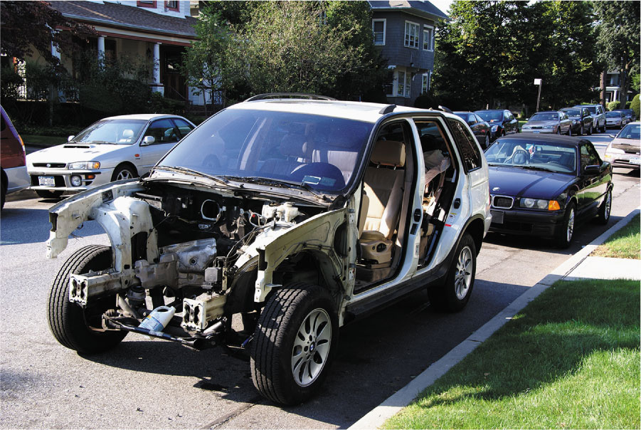

Slide 7
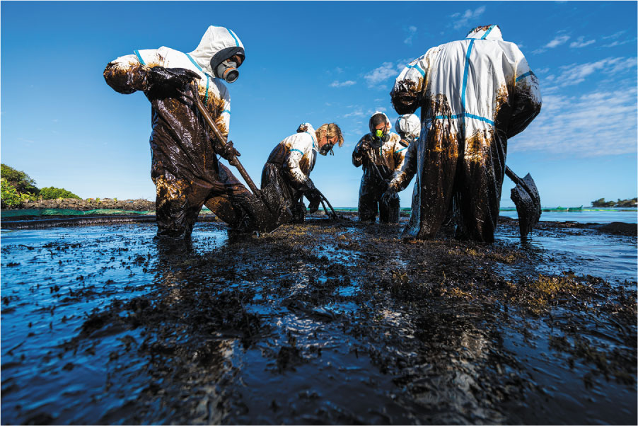

Slide 8
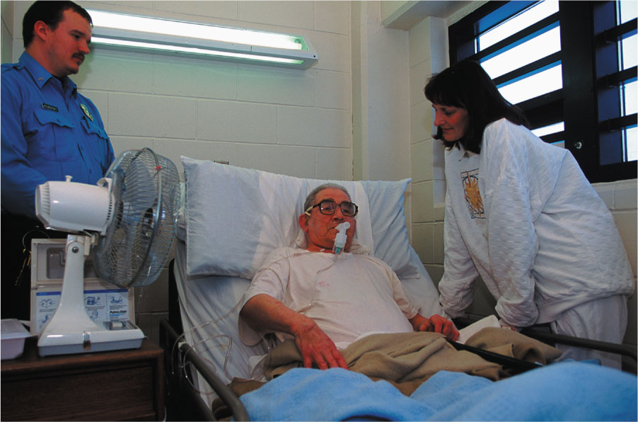

Slide 9
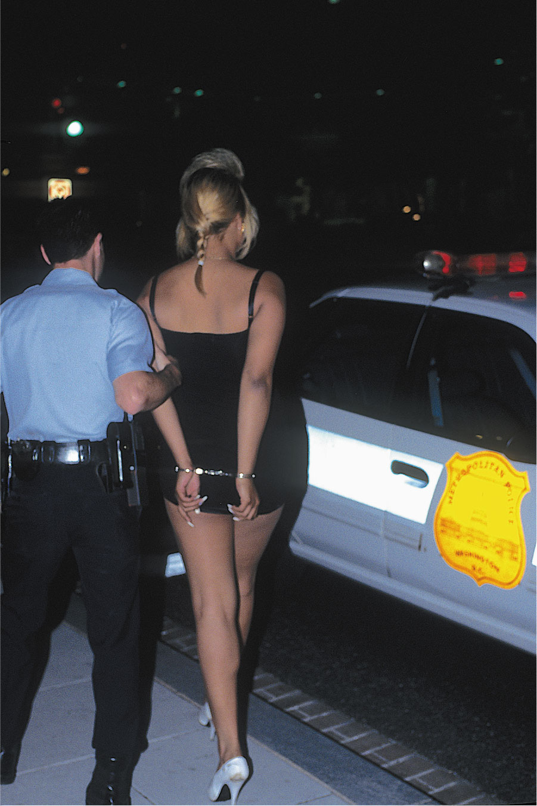

Slide 10


Slide 11
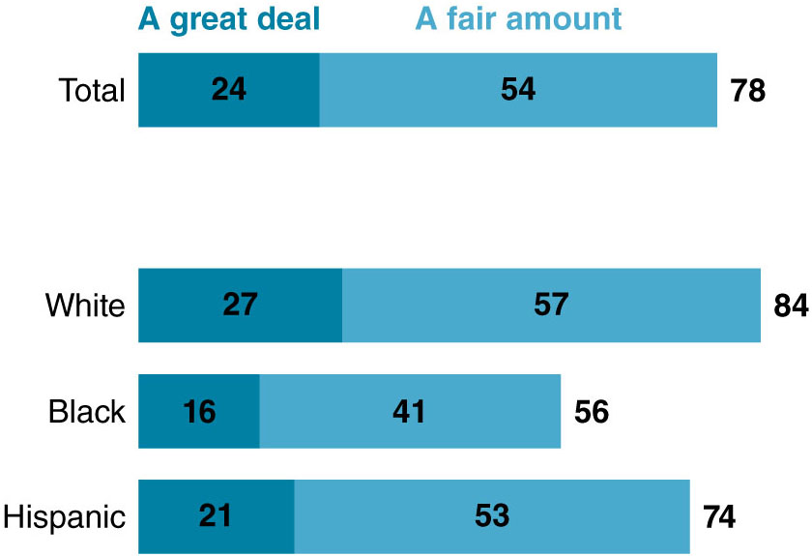

Slide 12
