Slide 1

Child Development
Context, Culture, and Cascades
by Catherine S. Tamis-LeMonda

Slide 2
PART 2
Infancy and Toddlerhood
CHAPTER 7
Emotional and Social Development in Infancy and Toddlerhood

Slide 3
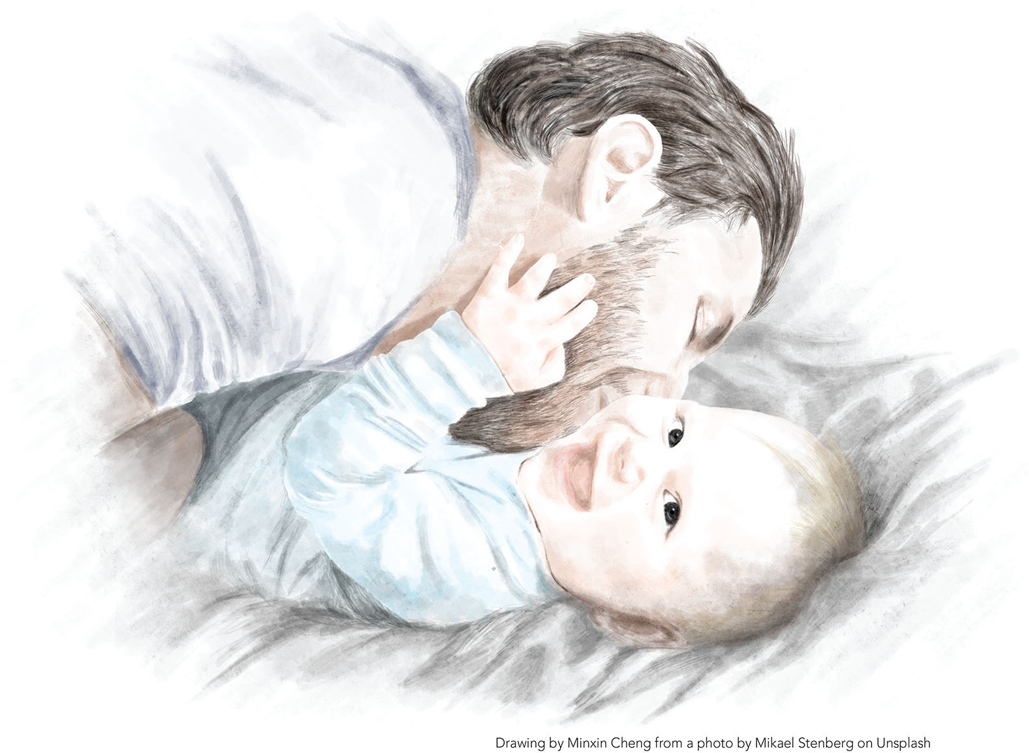
1

Slide 4
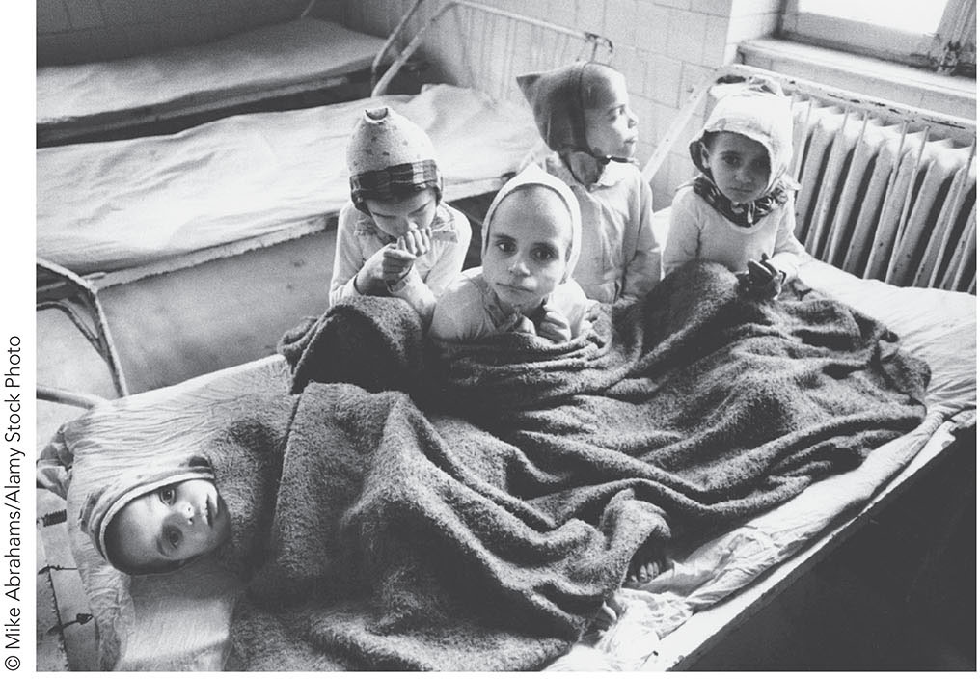
FIGURE 7.1 Romania’s abandoned children.

Slide 5
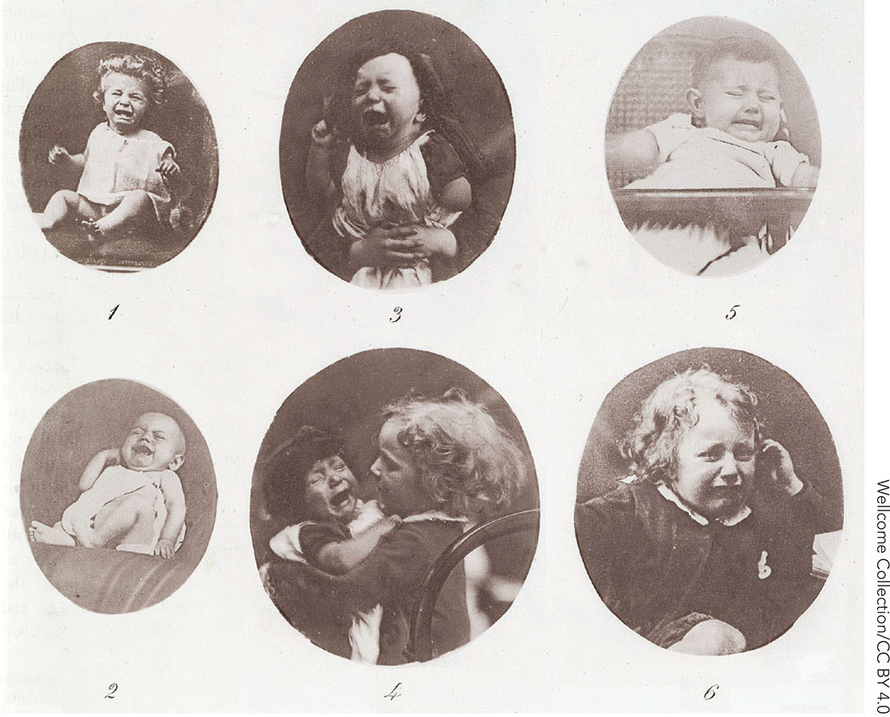
FIGURE 7.2 Darwin claimed that emotions serve critical survival functions in animals and humans.

Slide 6
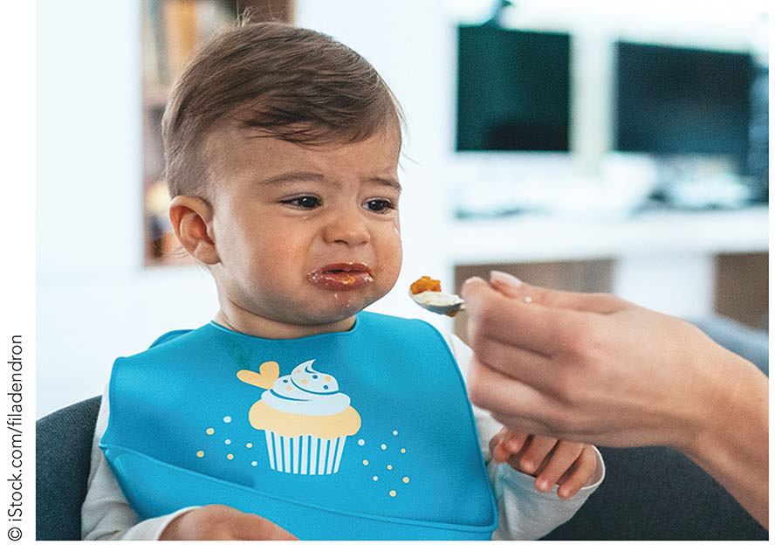
FIGURE 7.3 Disgust.

Slide 7
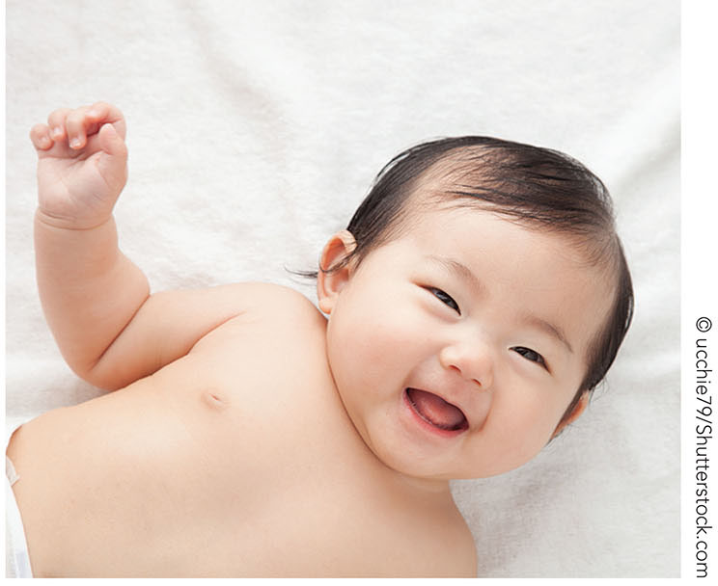
FIGURE 7.4 Social smiles emerge between 6 weeks and 3 months of age.

Slide 8
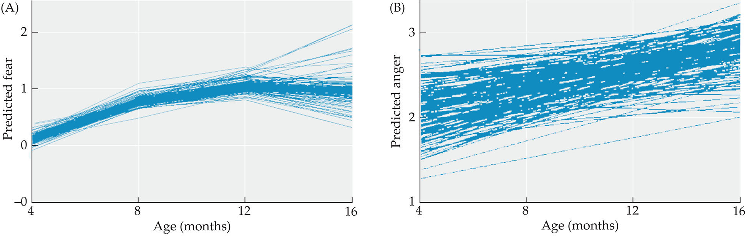
FIGURE 7.5 Infant anger and fear reactions increase from 4 to 16 months of age.

Slide 9
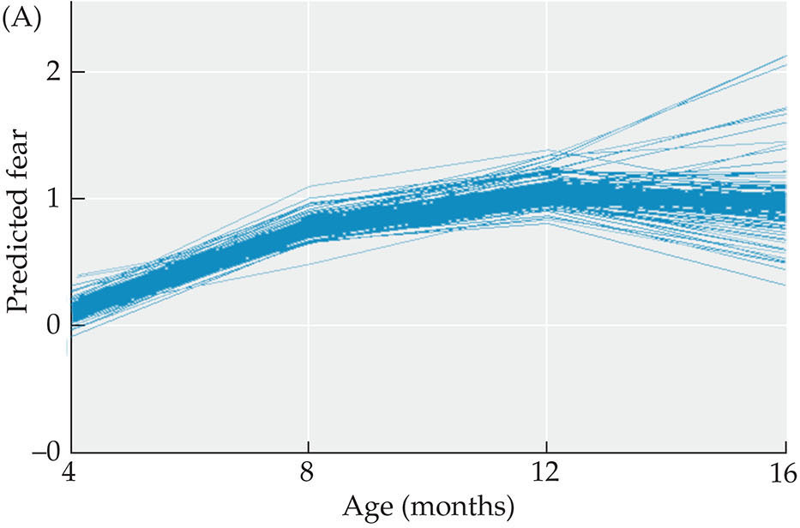
FIGURE 7.5 Infant anger and fear reactions increase from 4 to 16 months of age.

Slide 10
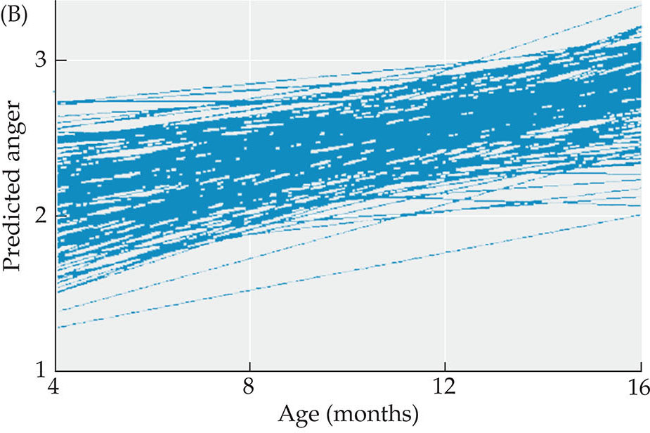
FIGURE 7.5 Infant anger and fear reactions increase from 4 to 16 months of age.

Slide 11
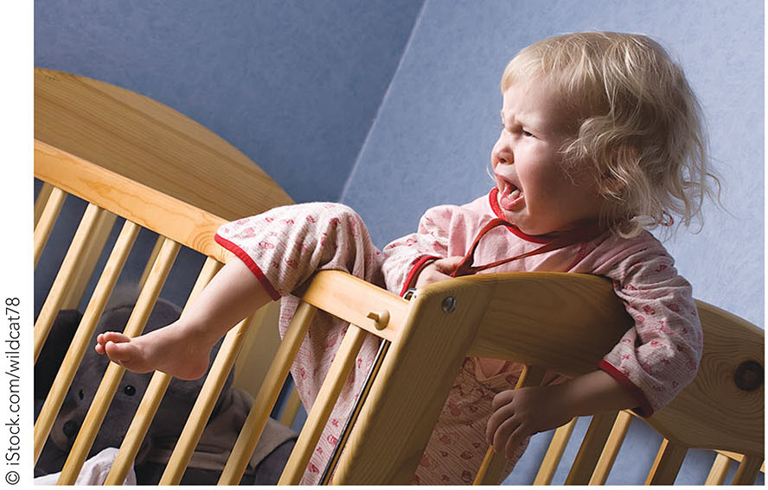
FIGURE 7.6 Expressions of anger generalize to a range of situations in toddlerhood.

Slide 12
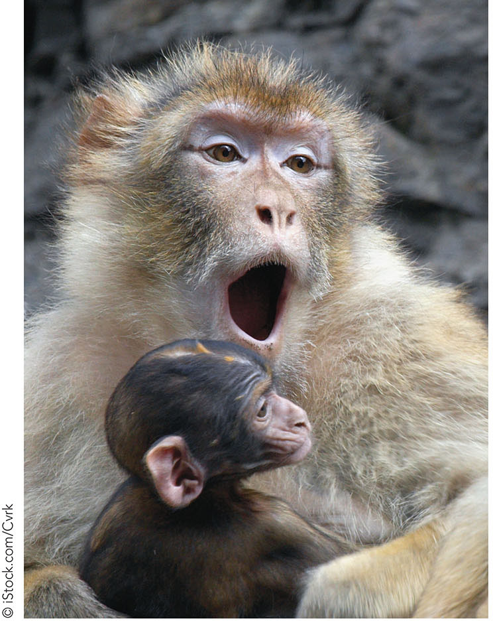
FIGURE 7.7 Learning fear.

Slide 13
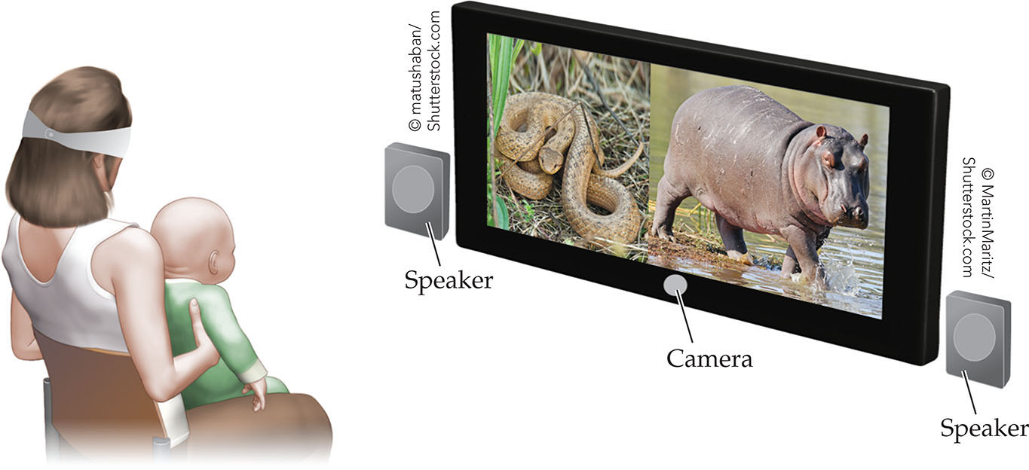
FIGURE 7.8 Infants may be biased to attend to potentially threatening stimuli, without being afraid.

Slide 14
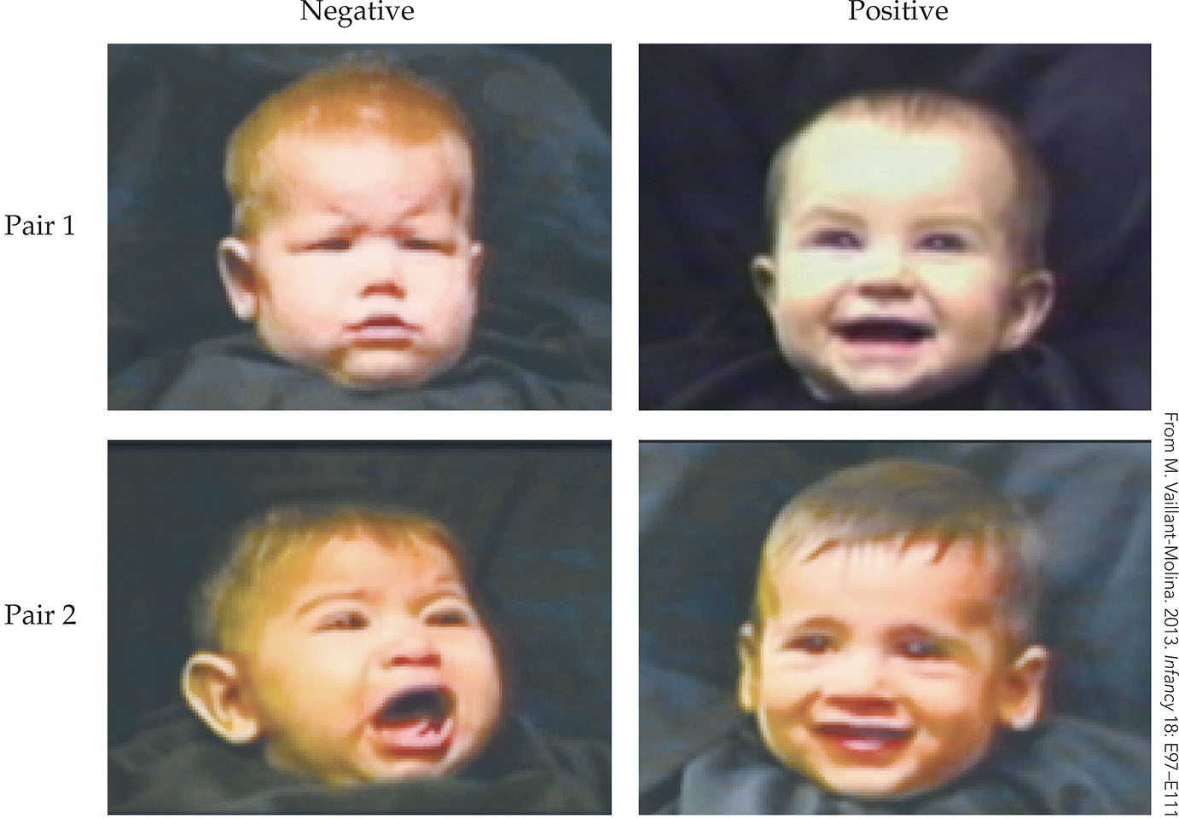
FIGURE 7.9 Infants match emotions in the faces of other infants to the emotions expressed by their vocalizations.

Slide 15
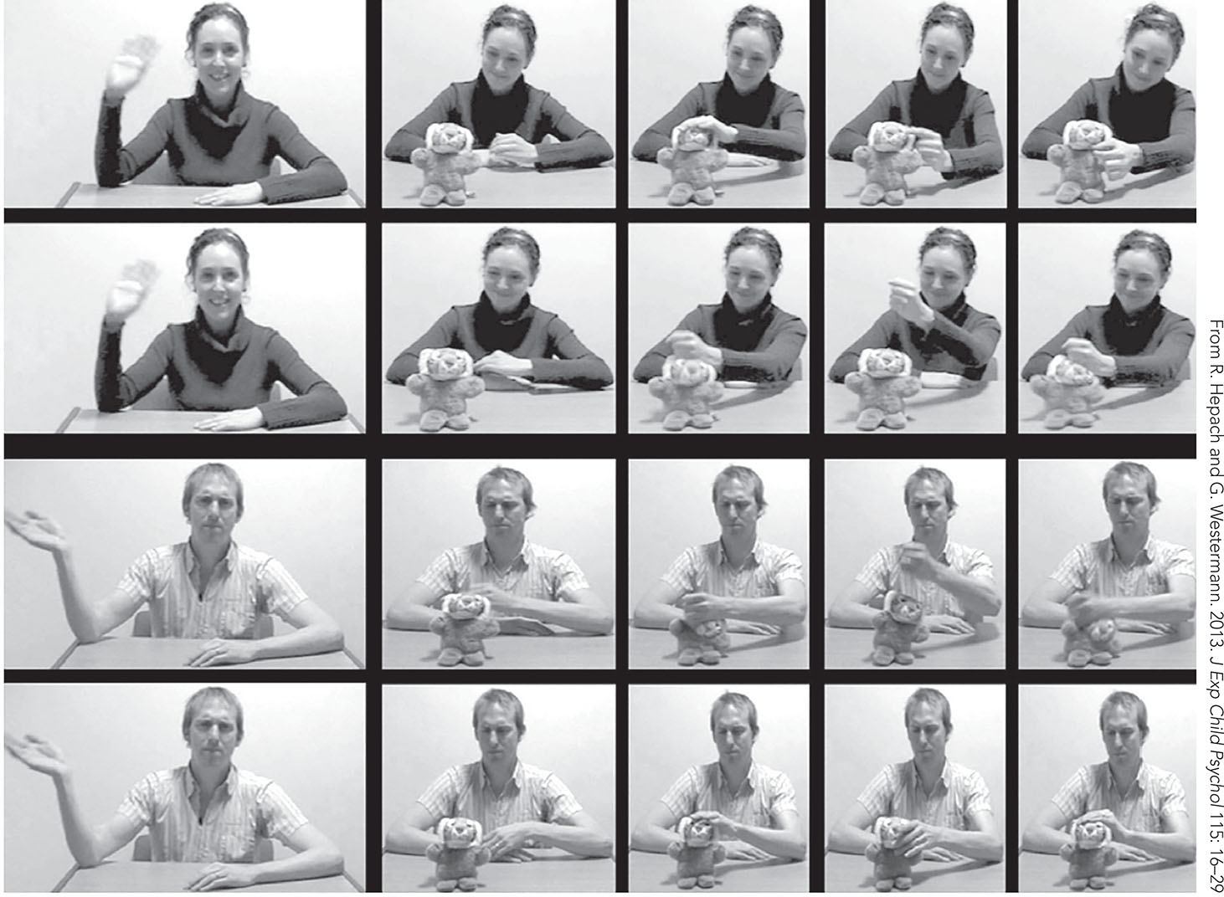
FIGURE 7.10 Infants match emotions with actions.

Slide 16
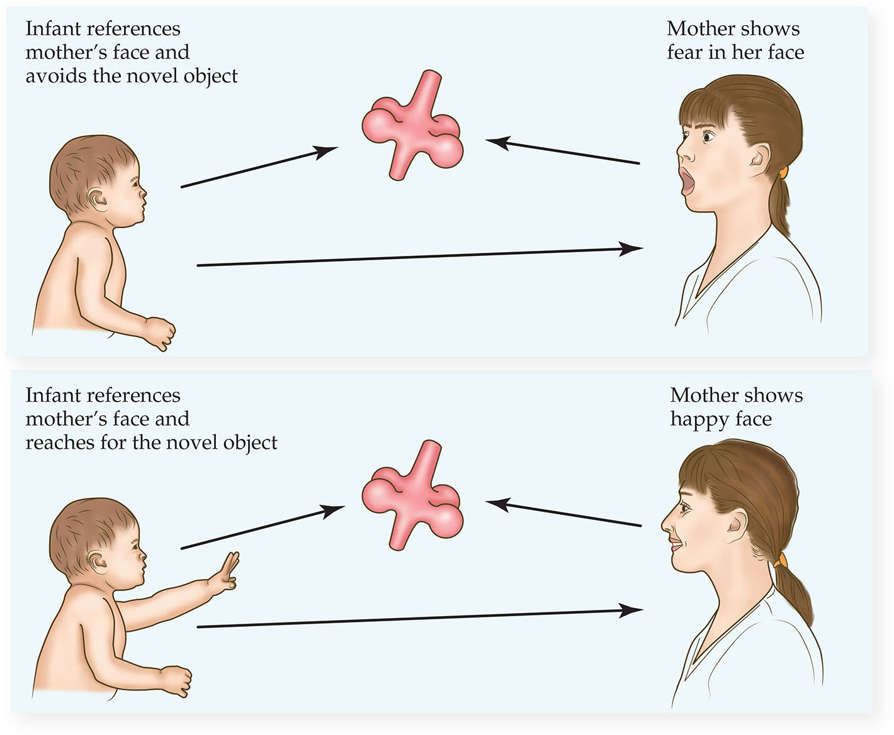
FIGURE 7.11 Infants approach or avoid stimuli in line with the emotional reactions of other people.

Slide 17
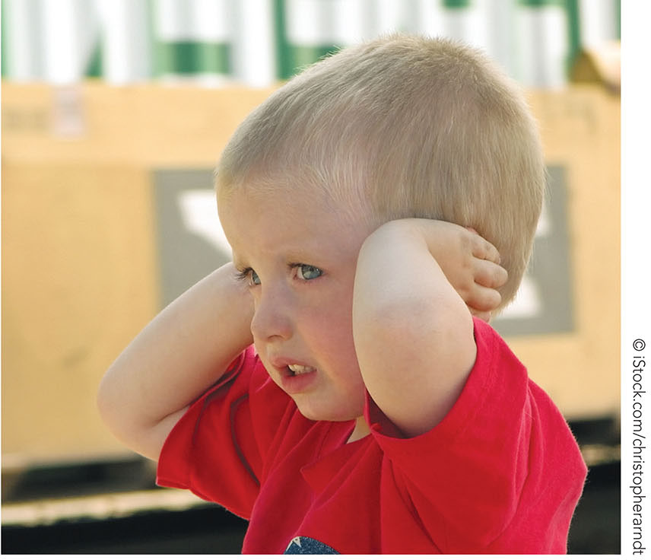
FIGURE 7.12 Effortful control.

Slide 18
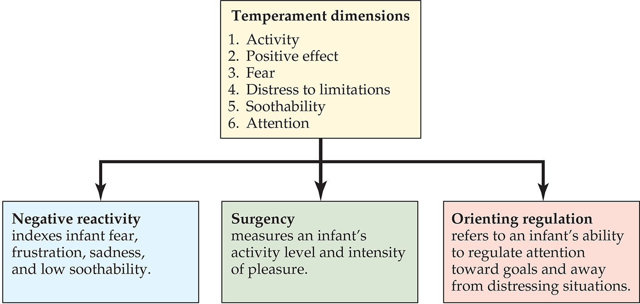
FIGURE 7.13 Rothbart and Bates’s temperament dimensions.

Slide 19
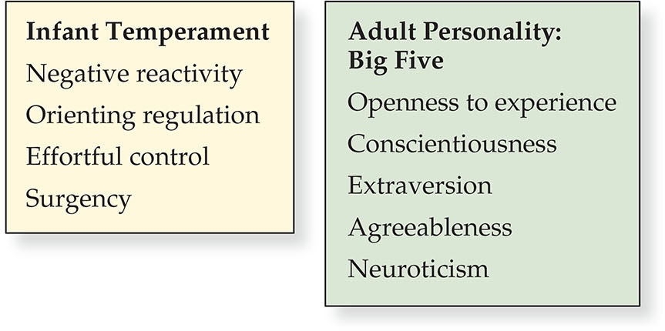
FIGURE 7.14 Toddler temperament predicts adulthood traits.

Slide 20
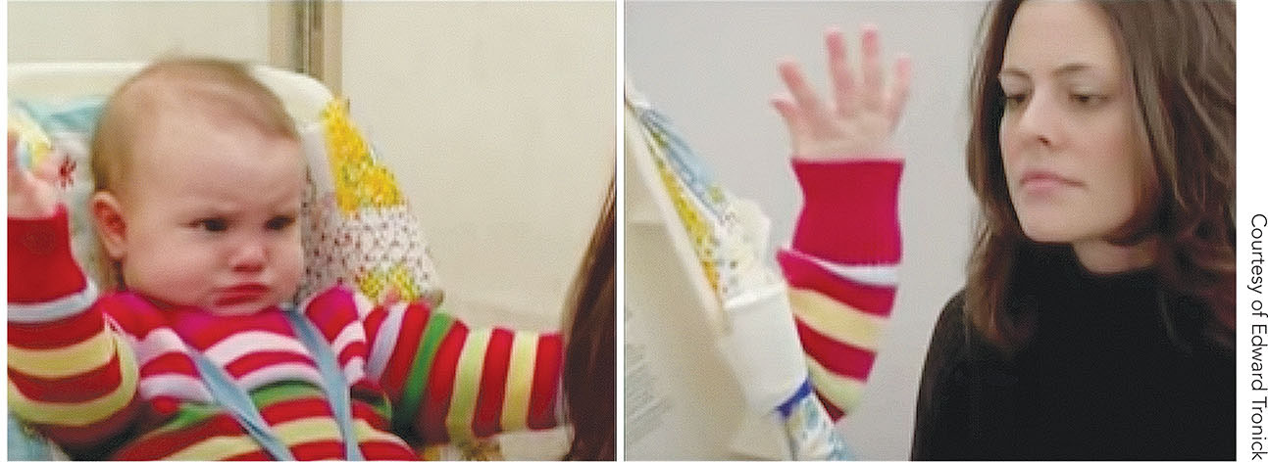
FIGURE 7.15 The still-face experiment.

Slide 21
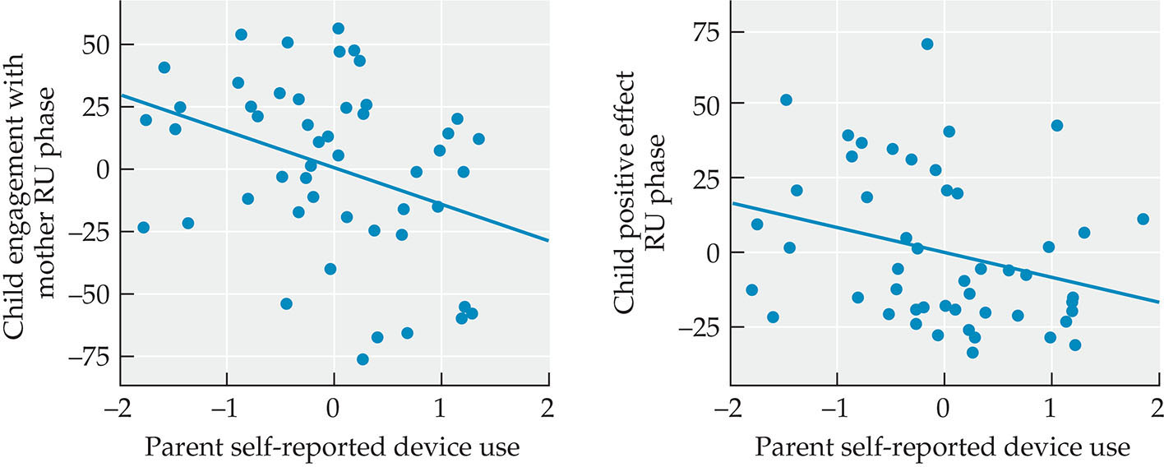
FIGURE 7.16 Technology distractions can affect infants’ emotional development.

Slide 22
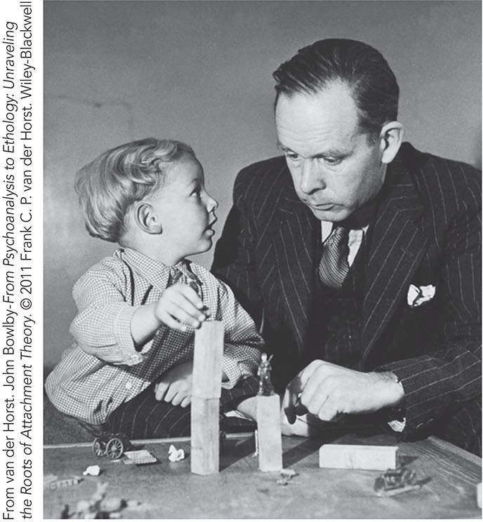
FIGURE 7.17 John Bowlby’s observations at the London Child Guidance Clinic.

Slide 23
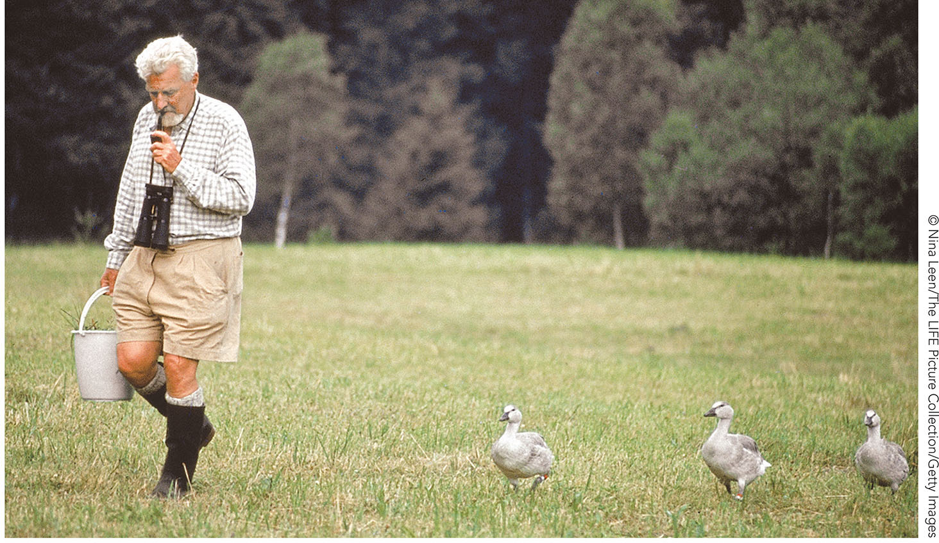
FIGURE 7.18 Imprinting.

Slide 24
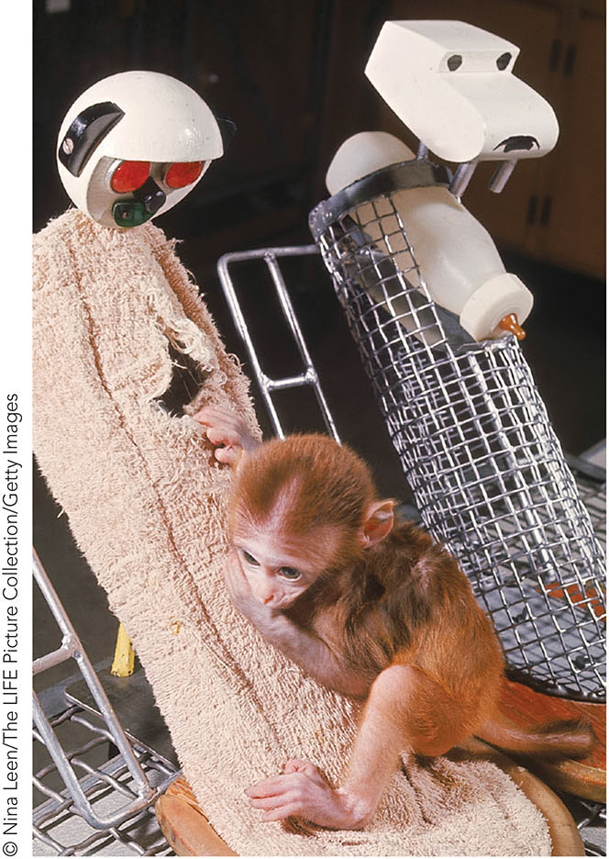
FIGURE 7.19 Harry Harlow’s studies of attachment in monkeys.

Slide 25
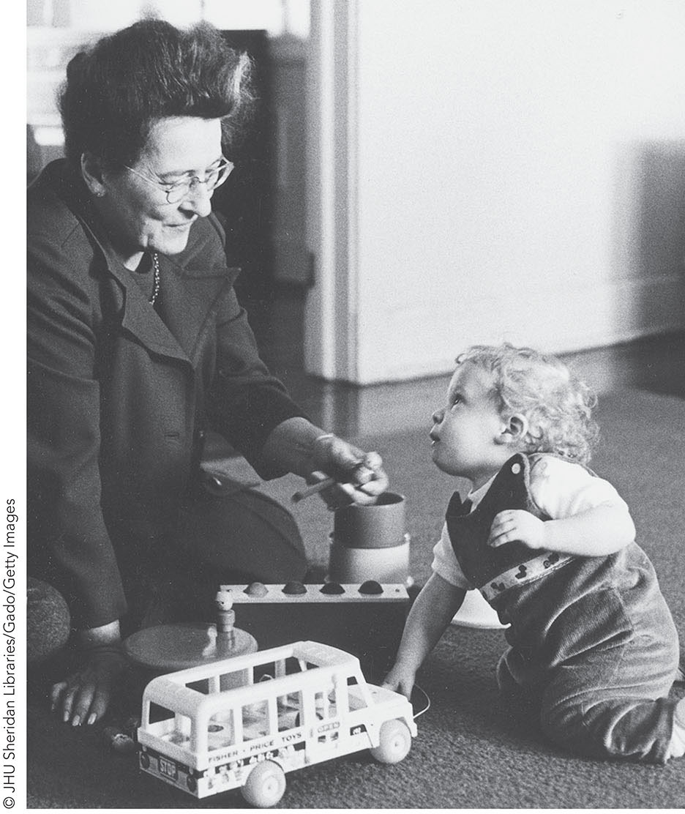
FIGURE 7.20 Mary Ainsworth’s research on infant attachment.

Slide 26
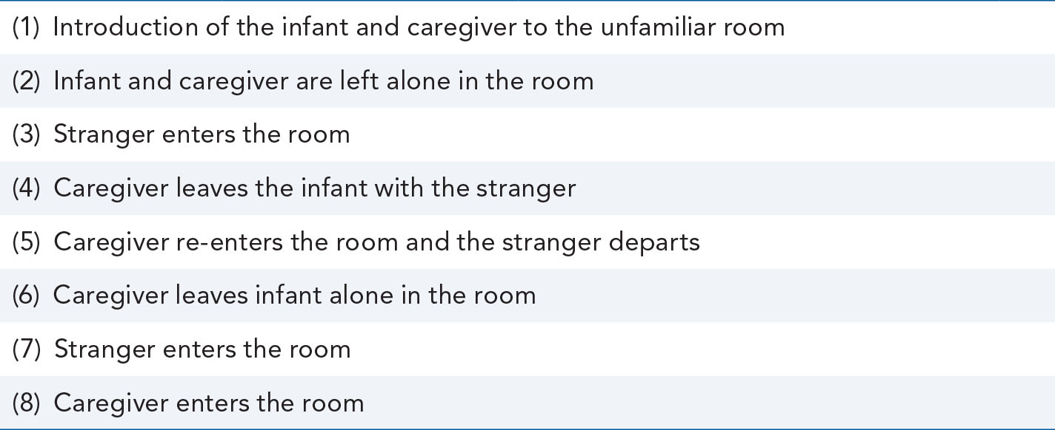
TABLE 7.1 The Eight Events of the Strange Situation

Slide 27
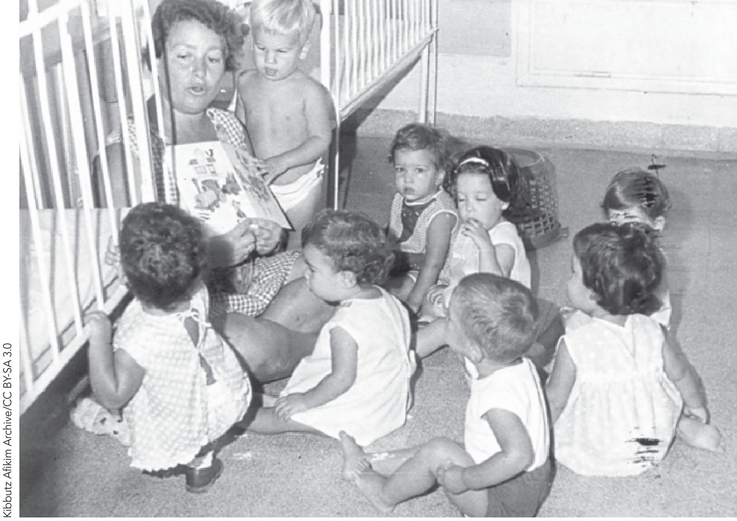
FIGURE 7.21 Communal childrearing practices.

Slide 28
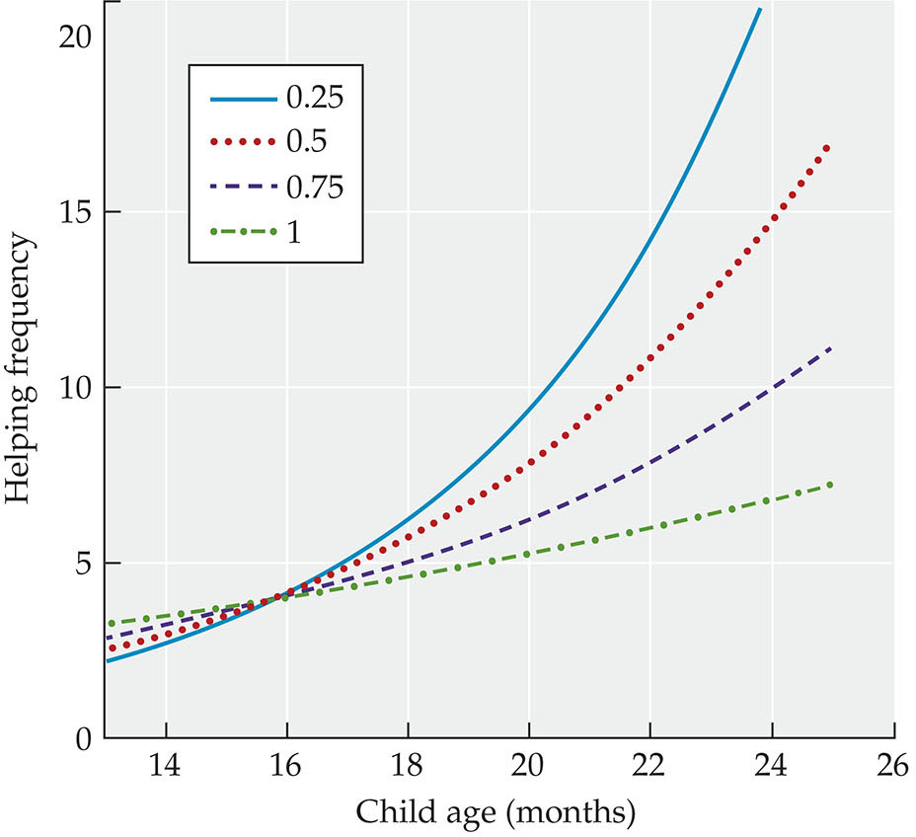
FIGURE 7.22 Infants’ natural tendency toward prosocial behaviors.

Slide 29
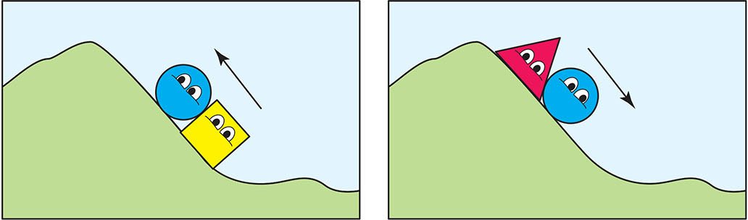
FIGURE 7.23 Helper-hinderer study.

Slide 30
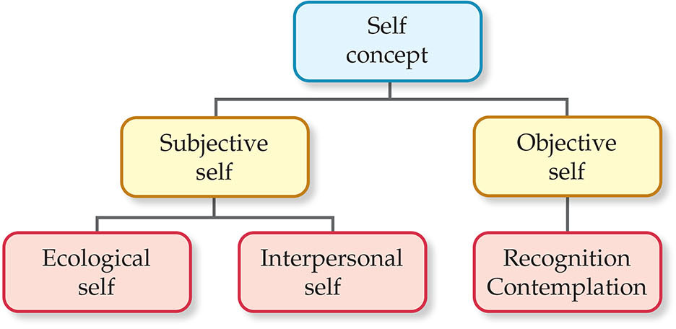
FIGURE 7.24 Self concept.

Slide 31
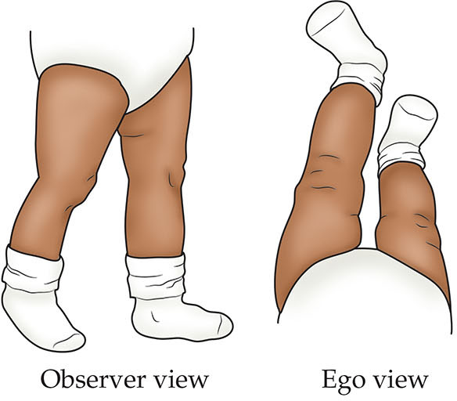
FIGURE 7.25 The “ego view” and the “observer view” of an infant’s moving legs.

Slide 32
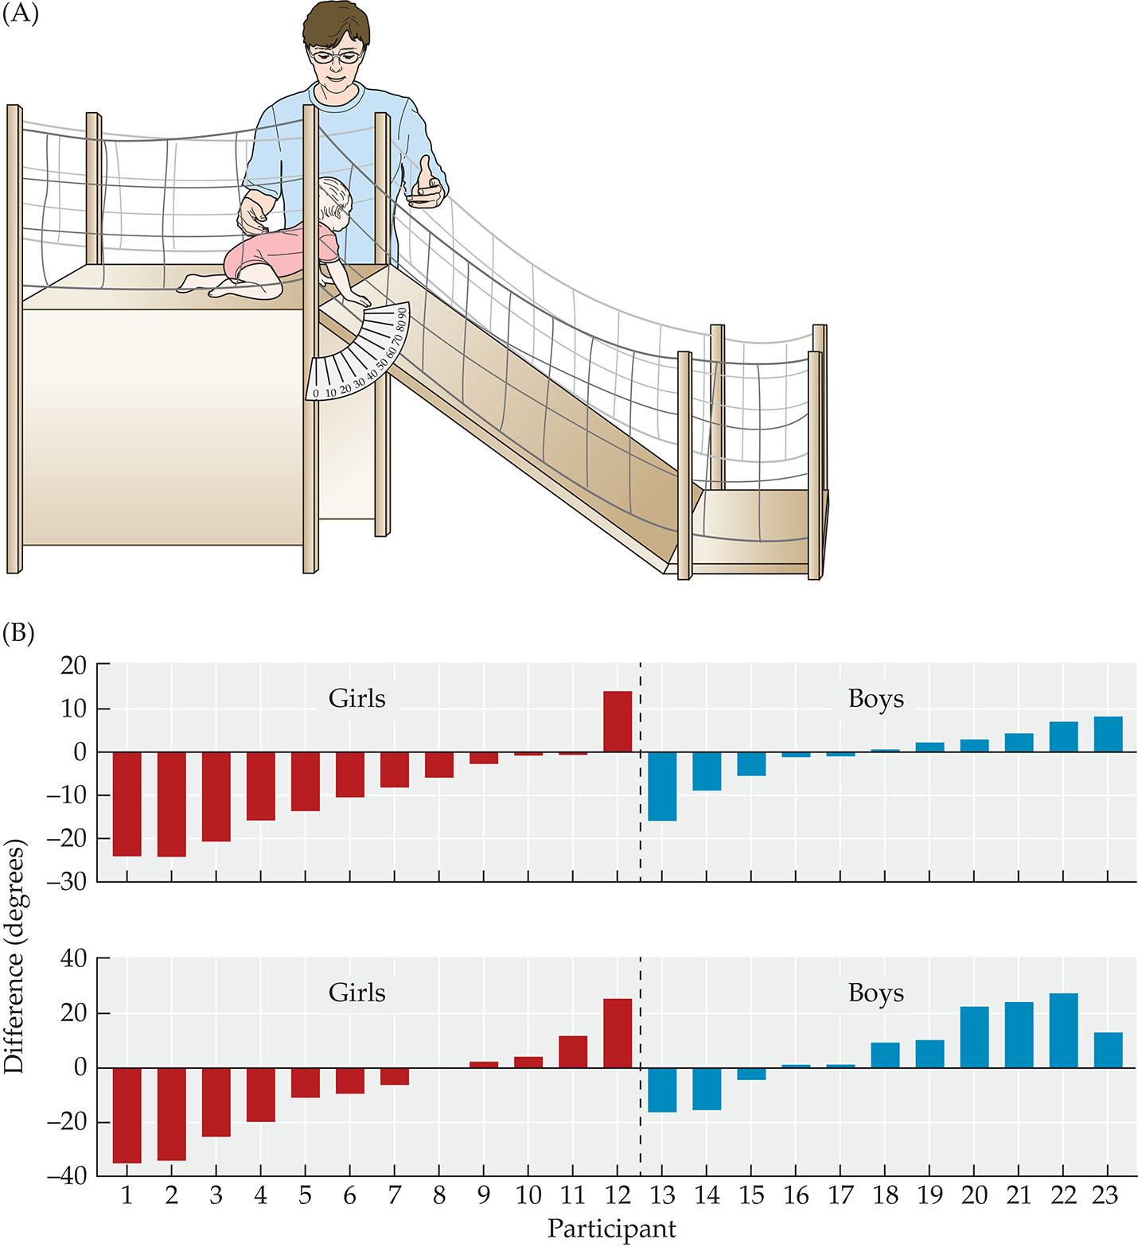
FIGURE 7.26 Parental socialization of gender.

Slide 33
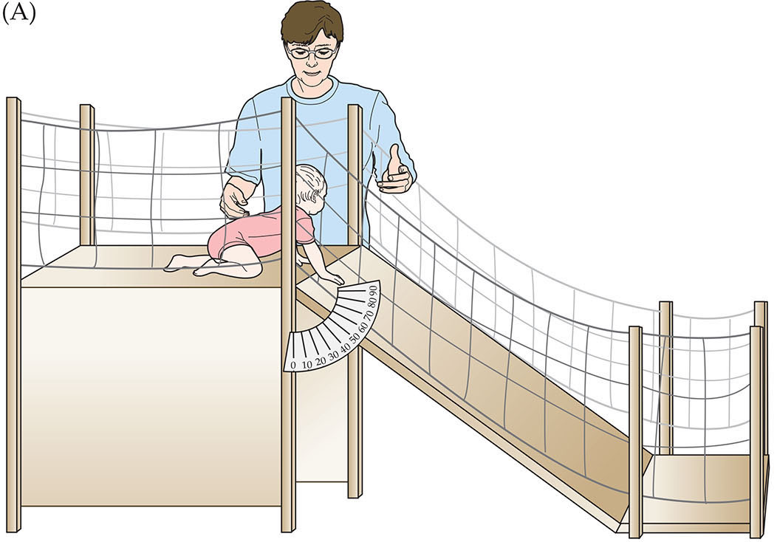
FIGURE 7.26 Parental socialization of gender.

Slide 34
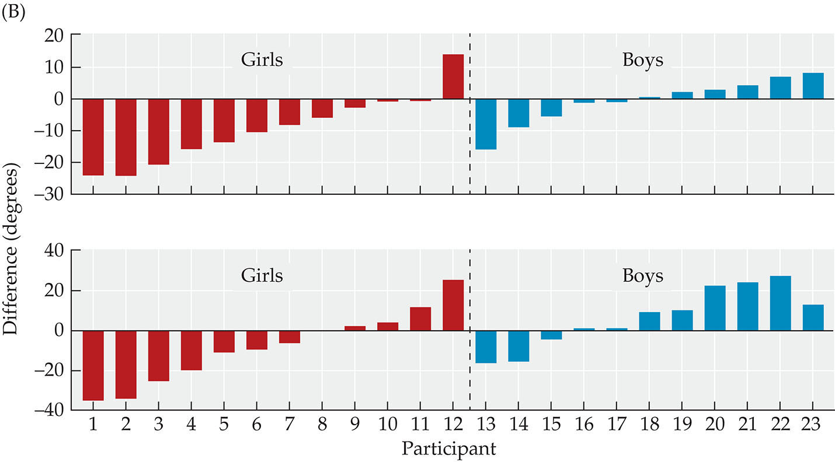
FIGURE 7.26 Parental socialization of gender.

Slide 35
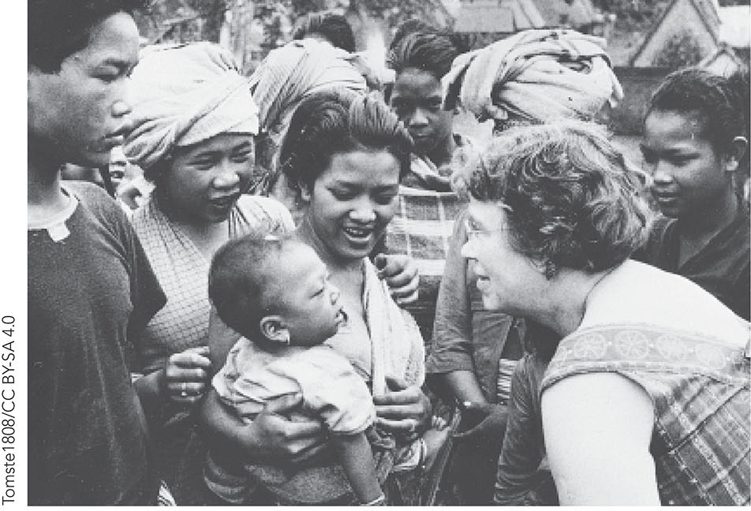
FIGURE 7.27 Margaret Mead.

Slide 36
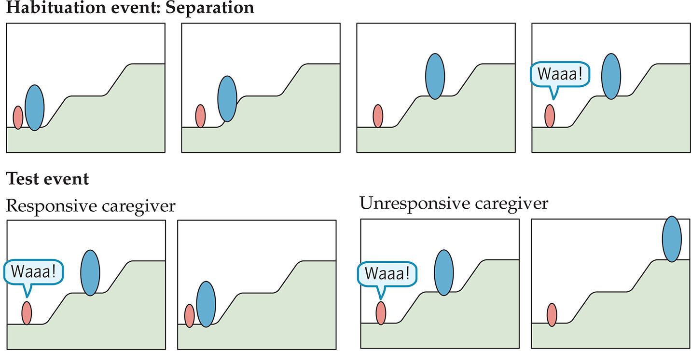
FIGURE 7.28 Internal working models of attachment in infancy.

