Slide 1
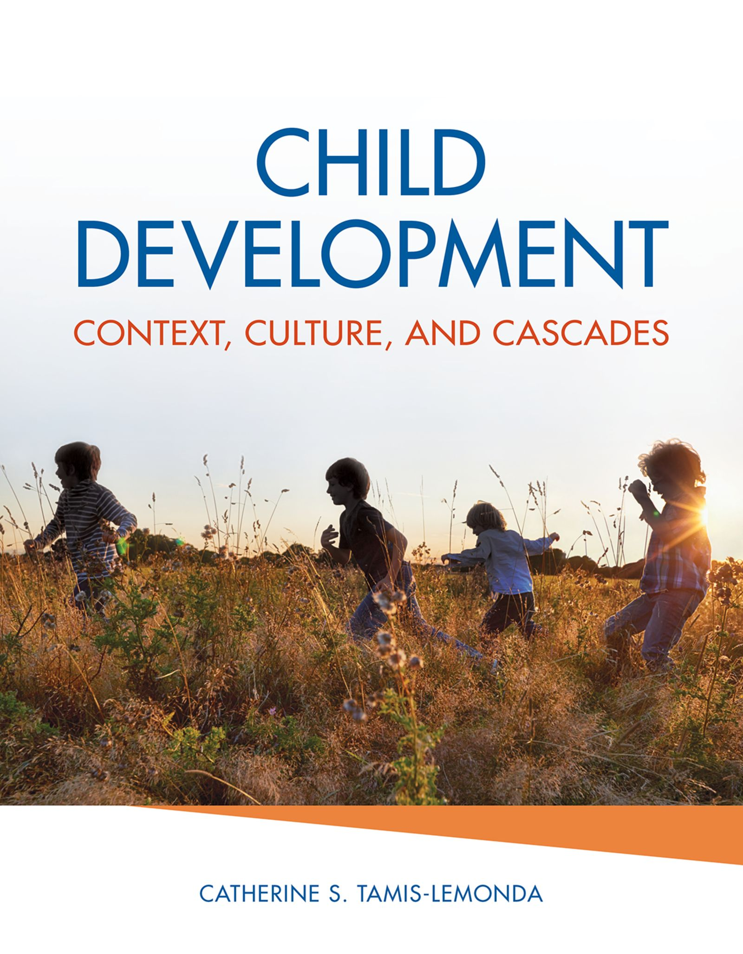
Child Development
Context, Culture, and Cascades
by Catherine S. Tamis-LeMonda

Slide 2
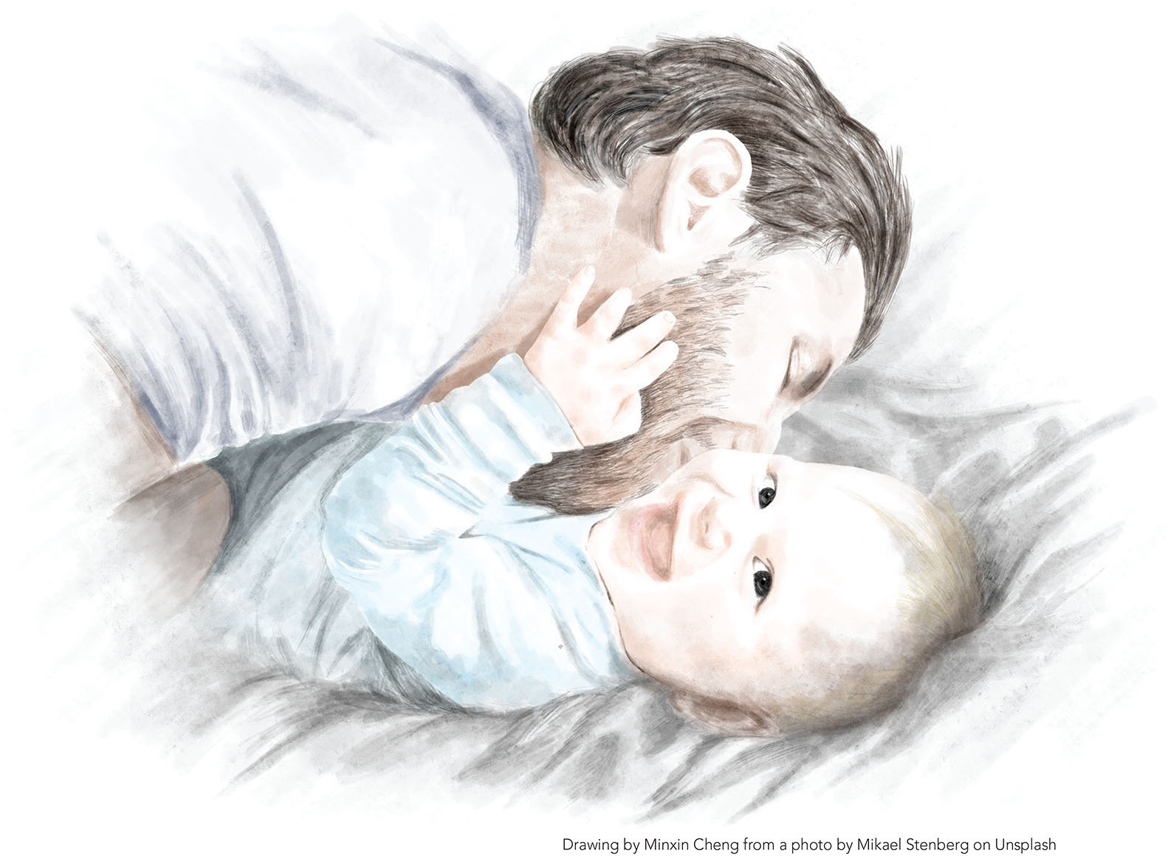
1
Chapter 7: Emotional and Social Development in Infancy and Toddlerhood

Slide 3
Overview of Chapter Topics
Emotional Development
  Emotional development
  Temperament
Social Development
  Attachment
  Peer relationships and origins of morality
  Emerging self-identity
Focus on Contexts, Culture, & Cascades

Slide 4
Emotional Development is Vital to Healthy
Development
Universal & adaptive
Development involves understanding, producing, and regulating emotions
Social contexts may support or hinder emotional development

Slide 5
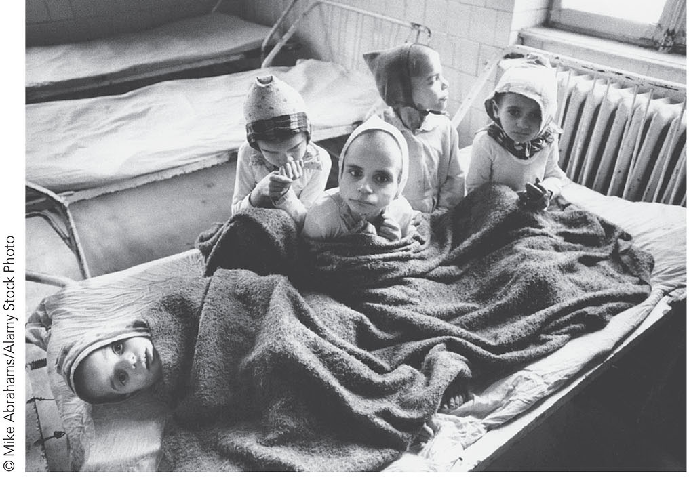
FIGURE 7.1 Romania’s abandoned children.

Slide 6
5 Features of Emotions
Emotion elicitors or triggers
Physiological changes
Cognitive appraisal
Emotional expression
Communicative function
Notes:
Instructor’s Note:
Universally, emotions can be characterized by 5 key features.

Slide 7
Feature 1: Emotion Elicitors
Internal or external triggers that instigate an emotion
  Infant hunger causes distress
  Fitting a puzzle piece elicits joy

Slide 8
Feature 2: Physiological Changes
The body’s reaction to the emotional experience
  Heart rate quickens under distress
  Heart rate slows down when calm

Slide 9
Feature 3: Cognitive Appraisal
Individuals’ interpretation of their feelings
  Infant is frightened by a loud bang because it unexpectedly disrupts the environment
  Infant wants Daddy, but a stranger approaches instead, leading to wariness

Slide 10
Feature 4: Emotional Expression
The outward display of an emotion
  Infant cries during distress
  Infant smiles when happy

Slide 11
Feature 5: Communicative Function
What an emotion communicates to others
  Infant cries communicate they are unhappy to caregivers
  The caregiver in turn offers comfort in the form of a hug, feeding, and so on

Slide 12
Evolutionary Theory and the Functions of Emotions
Emotions are universal
Emotions are adaptive
Notes:
Instructor’s Note:
Evolutionary theory emphasizes the universality of emotions and their adaptive functions.

Slide 13
Are Emotions Universal?
Basic emotions and cultural similarities
  Charles Darwin: humans and non-humans display basic facial expressions
  6 basic emotions: anger, fear, surprise, disgust, happiness, and sadness.
  Paul Ekman: humans are hardwired for 6 basic emotions (and possibly contempt)
Notes:
Instructor’s Note:
Evidence for universality begins with finding that humans and nonhumans display similar emotions.
Darwin first to state this in 1872.
Ekman asked adults from the United States, Japan, Brazil, Argentina, Chile, and a preliterate community in New Guinea to identify emotions of characters in a story by pointing to one of several photos of facial expressions. Adults across the different cultural communities generally interpreted the facial expressions in the same way.

Slide 14
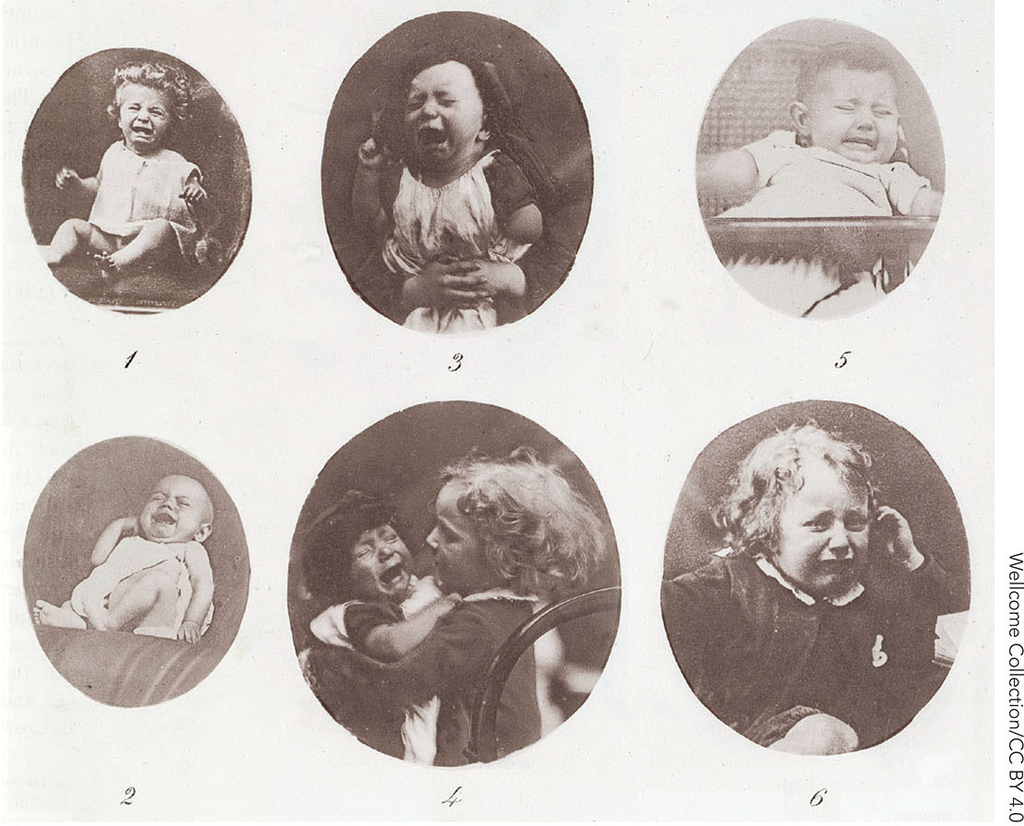
FIGURE 7.2 Darwin claimed that emotions serve critical survival functions in animals and humans.

Slide 15
Are Emotions Adaptive? Yes! They Serve:
Regulatory functions:
  Emotions prepare individuals to respond to threats in the environment and thus survive
Social functions:
  Communicate meaningful social information with the face, voice, and body

Slide 16
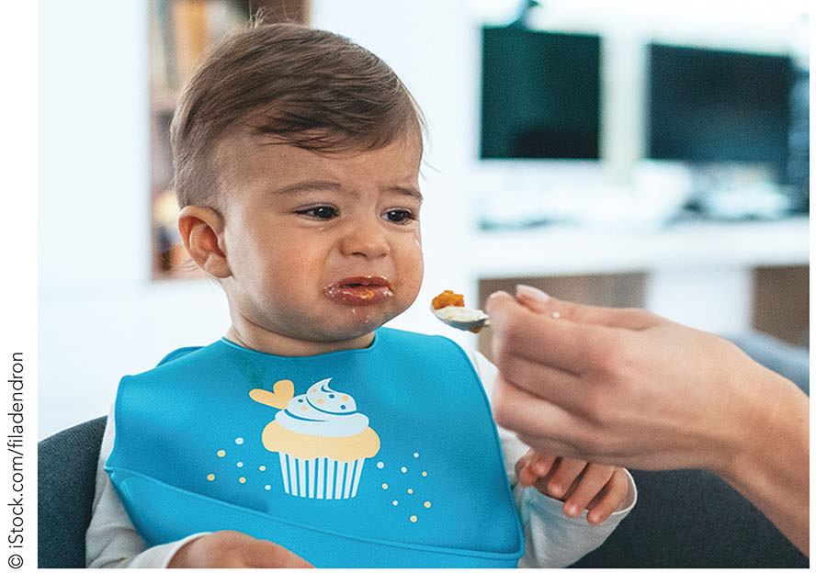
FIGURE 7.3 Disgust.

Slide 17
The Expression of Emotions:
“The Language of the Baby” (Emde, 1980)
Infant positive emotions
Infant negative emotions
Notes:
Emotional expressions are the very first ways that infants communicate, before infants begin to talk.

Slide 18
Infant Positive Emotions:
Development of Smiles
The earliest (seeming) smiles:
  Newborns: Brief
  Do not signal happiness as at older ages
“Social smiles”:
  Between 6 weeks and 3 months
  Upturned cheeks, at first directed toward primary caregivers

Slide 19
Infant Positive Emotions:
Extending Smiles
Extending smiles:
  3 to 8 weeks: smiles to external stimuli
  ~4 months: infants smile in response to smiles of familiar people
  End of first year: different smiles in different situations and to different people

Slide 20
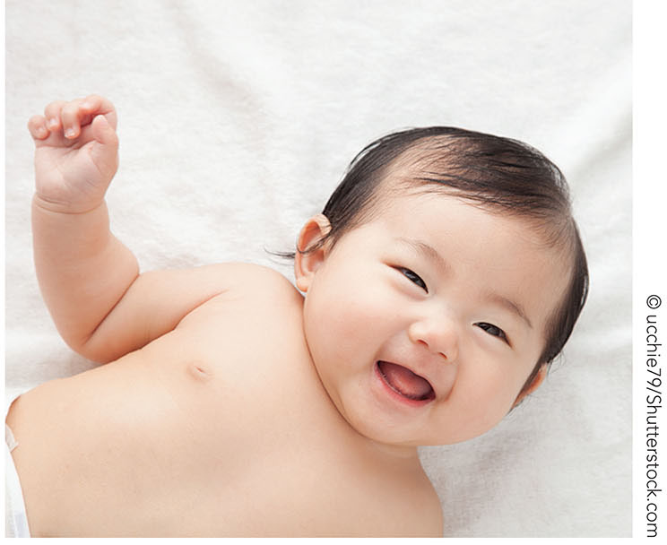
FIGURE 7.4 Social smiles emerge between 6 weeks and 3 months of age.

Slide 21
Research in Action Video: Social Smiles
Watch the video here:
Research in Action Video: Social Smiles

Slide 22
Infant Negative Emotions
Anger:
  Grows in intensity and frequency from 4-16 months (e.g., Braungart-Rieker, Hill-Soderlund, & Karrass, 2010)
Fear:
  Infants display “fear” in threatening situations
  Evolutionary origins to fear may exist
Notes:
Instructor’s Note:
From text:
To study infants’ development of anger, “arm restraint” lab tasks assessed infants’ reactions (anger) to their mothers’ gently holding down of their arms for 2 minutes (Stifter & Spinrad, 2002; Moscardino & Axie, 2006).
To study infants’ development of fear, researchers have used images of both threatening (a snake) and non-threatening (a frog) stimuli to compare infants’ responses to each. Additionally, researchers may show infants a picture of something “fearful” (such as a toy spider) and observe infant responses (both behavioral and physiological).

Slide 23
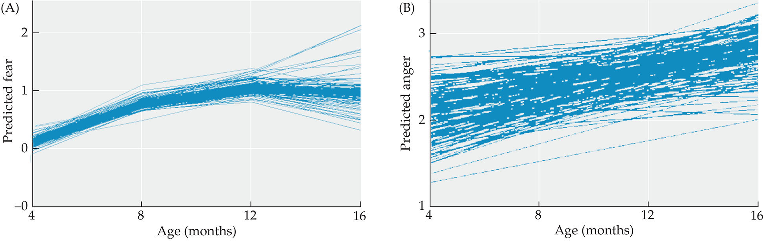
FIGURE 7.5 Infant anger and fear reactions increase from 4 to 16 months of age.

Slide 24
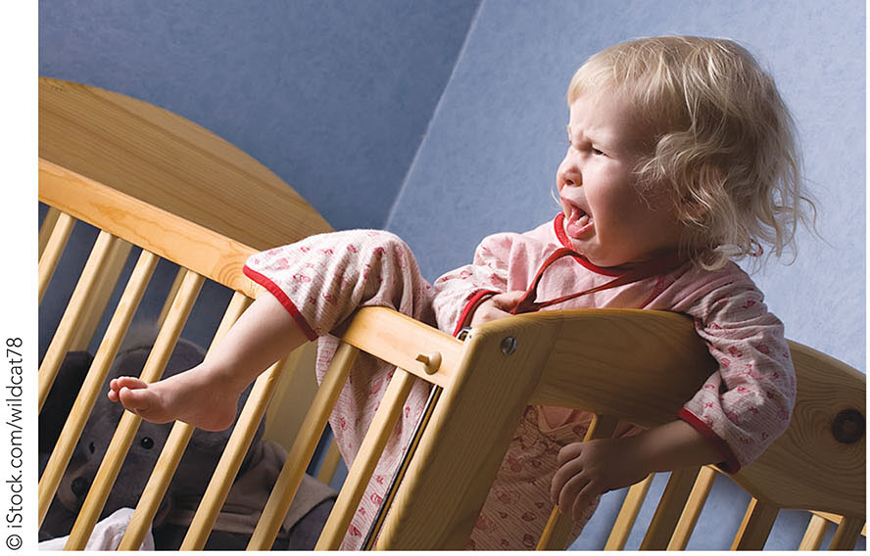
FIGURE 7.6 Expressions of anger generalize to a range of situations in toddlerhood.

Slide 25
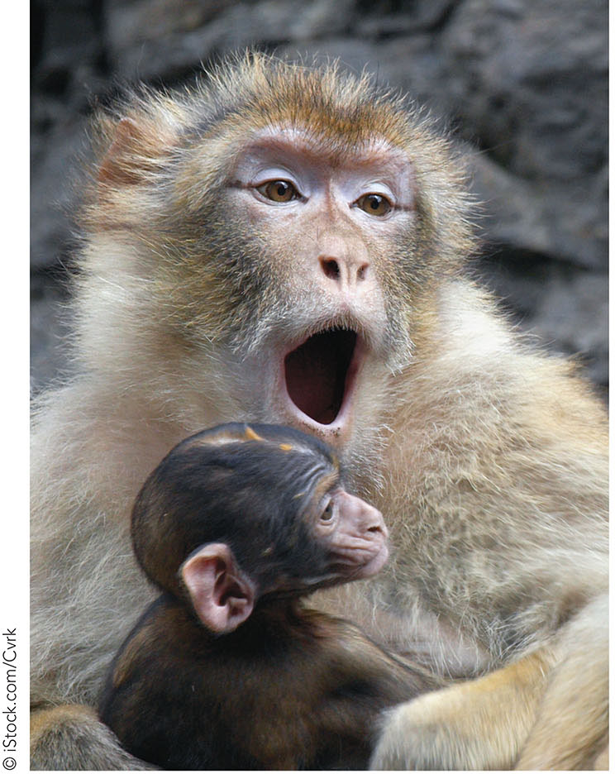
FIGURE 7.7 Learning fear.

Slide 26
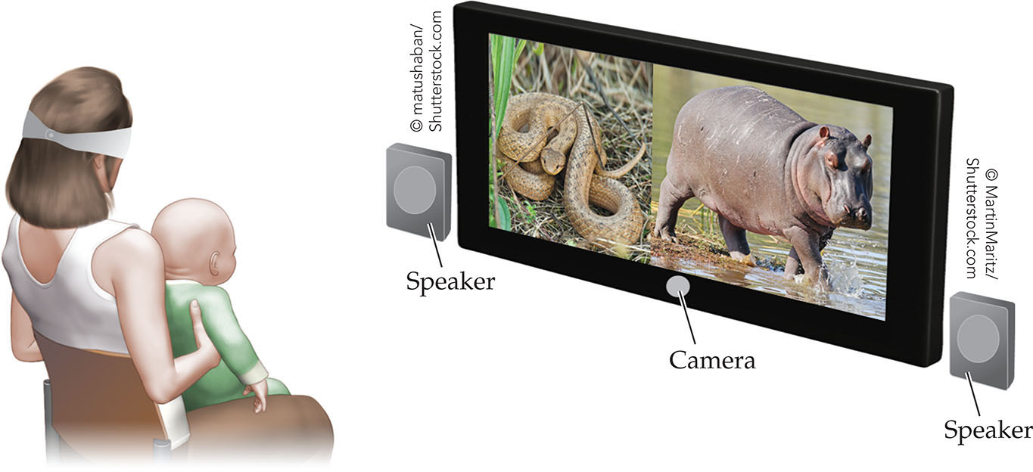
FIGURE 7.8 Infants may be biased to attend to potentially threatening stimuli, without being afraid.

Slide 27
Self-Conscious Emotions
Emotions related to a sense of self and awareness of others
  Pride
  Embarrassment
  Guilt
  Shame
Notes:
Instructor’s Note:
From text:
Emotions become more differentiated during the second and third years. Toddlers begin to show behaviors suggesting the emergence of self-conscious emotions.
For example, infants avoid eye contact and hide their face when they are the center of attention, suggesting that they are embarrassed (Lewis, 1995).
As another example, toddlers express behaviors that suggest guilt, such as trying to fix a toy they broke, and shame, such as avoiding the person who owns the toy that the toddler broke (Barrett, Zahn-waxler, & Cole, 1993).

Slide 28
Understanding Emotions
Discriminating emotions
Using emotional information
Notes:
Understanding emotions can be examined in two ways. First, do infants distinguish among different emotions in other people?
And second, how do infants use emotional information to guide their own behaviors?

Slide 29
Discriminating Emotions
The ability to distinguish among emotional expressions (Camras & Shuster, 2013)
  Newborns discriminate among emotions (e.g., open eyes to happy speech)
  3-month old infants detect gradations in the intensity of emotion expressions (e.g., subtle versus full-blown smiles)
Notes:
Instructor’s Note:
From text:
Researchers present infants with side-by side displays of two facial expressions, such as happy and sad, along with an audio recording of a voice that matches one of the facial expressions.
If infants look longer to the facial expression that matches the voice, it suggests that they have connected the emotions across visual and auditory channels.
Also from text: “Young infants likewise respond to gradations in the intensity of emotion expressions, such as by distinguishing between smiles that are subtle versus full-blown.
In a clever habituation-novelty preference study (See Chapters 4 and 5) researchers examined 3-month-old infants’ perceptions of smiling in relation to their interactions with mothers at home (Kuchuk, Vibbert, & Bornstein, 1986). Infants were shown a series of pictures of a female smiling, ranging from a subtle upturn of the lips to a full-blown smile with teeth exposed (Figure 7.9).
Mothers who more frequently encouraged their infants to look at them as they smiled had infants who were better able to distinguish among the different smile gradients. Infants looked longer to a picture of a smile of a different intensity after being habituated to a slightly larger or smaller smile.

Slide 30
Discriminating Emotions: Matching Studies
Assess whether infants match emotional content across different modalities
  Smiling face goes with happy voice
  Upset face goes with sad voice
Notes:
Instructor’s Note:
With experience, infants learn which voices belong to which faces, and match emotions across modalities
From text: Researchers present infants with side-by side displays of two facial expressions, such as happy and sad, along with an audio recording of a voice that matches one of the facial expressions. If infants look longer to the facial expression that matches the voice, it suggests that they have connected the emotions across visual and auditory channels.
By 5 months of age infants look longer to a positive facial expression when hearing a happy voice than when hearing an angry voice, and match facial expressions to voices at even younger ages when presented with their mothers’ faces (Kahana-Kalman & Walker-Andrews, 2001; Vaillant, Molina, Bahrick, & Flom, 2013).
Late in the first year, infants match positive emotions to positive events (Skerry & Spelke, 2014), and by the second year, infants match negative emotions to negative events (e.g., Reschke, Walle, Flom, & Guenther, 2017; Ruba, Meltzoff, Repacholi, 2019).

Slide 31
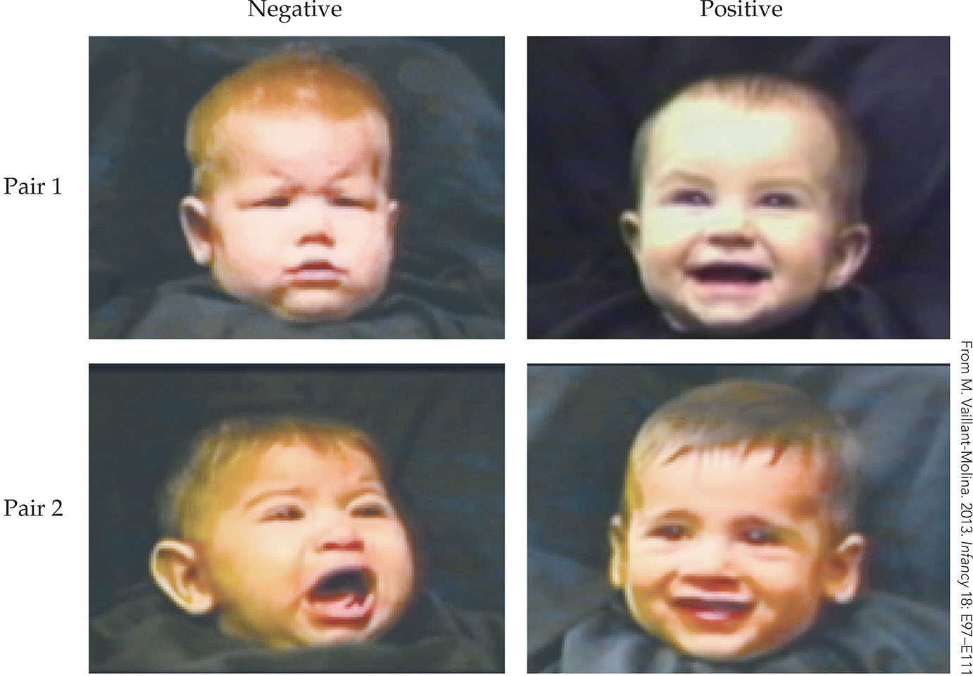
FIGURE 7.9 Infants match emotions in the faces of other infants to the emotions expressed by their vocalizations.

Slide 32
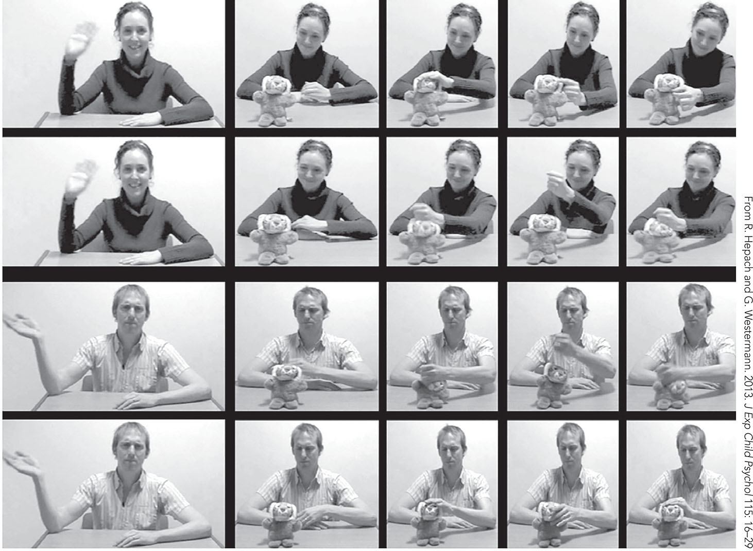
FIGURE 7.10 Infants match emotions with actions.

Slide 33
Using Emotional Information:
Social Referencing
Using emotions (social referencing) entails seeking and using social information in ambiguous situations
  During first year, infants are limited in social referencing abilities
  By about 12 months, infants avoid objects of others’ expressed fear
Notes:
Instructor’s Note:
From text: Donna Mumme and Anne Fernald (2003) examined 10- and 12-month-old infants’ behaviors after an experimenter’s different reactions to novel objects. Infants observed the experimenter’s neutral, positive, or negative reaction toward one of two unfamiliar objects.
Main finding: When later given the opportunity to play with the objects, 12-month-olds, but not 10-month-olds, avoided the object when the experimenter reacted negatively, but showed no avoidance when the experimenter reacted neutrally or positively.

Slide 34
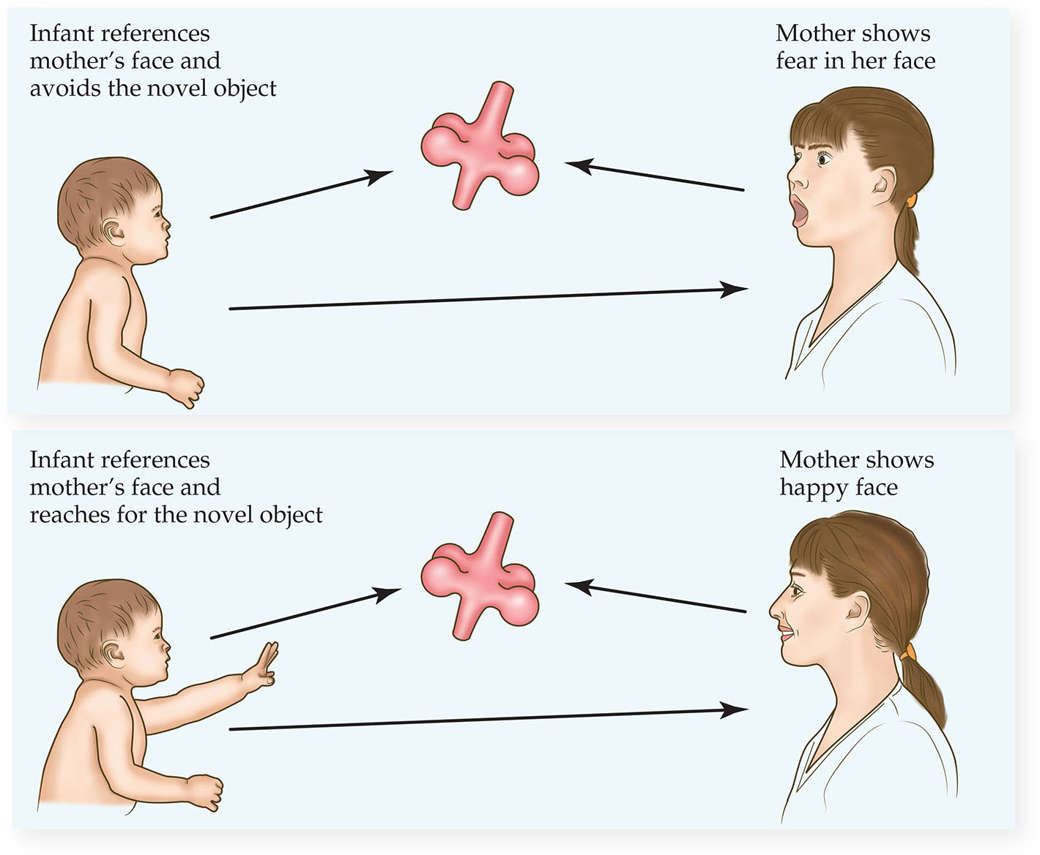
FIGURE 7.11 Infants approach or avoid stimuli in line with the emotional reactions of other people.

Slide 35
Regulating Emotions
Development in infant emotion regulation
Effortful control
Notes:
Infants develop in their abilities to regulate their emotions and in ”Effortful control”, which we review in the next slides

Slide 36
Emotion Regulation
The monitoring, evaluating, and moderating of emotional responses (Calkins & Hall, 2007)
  At first, infants have little control over their emotions and rely on external regulation
  By the end of the first year, infants begin to independently control their emotions (e.g., sucking a thumb for comfort)

Slide 37
Effortful Control
The capacity to voluntarily regulate attention and behaviors when responding to emotionally challenging situations (Eisenberg, Smith, Spinrad, 2019; Rothbart & Bates, 2006)
  Child looks away from a frightening scene
  Child inhibits an impulse to throw a toy when upset

Slide 38
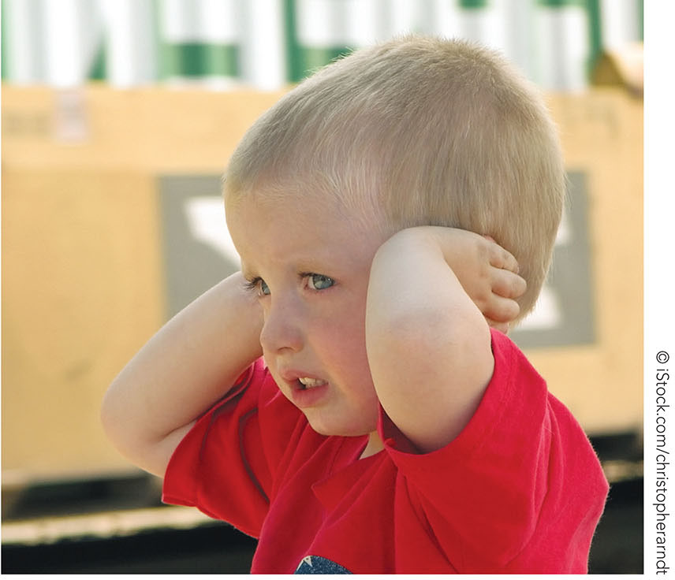
FIGURE 7.12 Effortful control.
Notes:
Instructor’s Note:
Photo caption: The attentional component of effortful control might be seen when a toddler looks away from a frightening scene on television or blocks her ears when hearing screaming, so as not to become distressed.

Slide 39
Inhibitory Control
The suppression of a dominant/preferred response in favor of an acceptable response (Diamond, 1991; Eisenberg et al., 2010)
  Attention and behavioral components of effortful control require inhibitory control
  Example: Child resists a cupcake before dinner (dominant response) to eat dinner instead (acceptable response)

Slide 40
Temperament: Overview
The history of temperament studies
Mary Rothbart’s 6 dimensions of temperament
Stability
Notes:
Instructor’s Note:
Temperament differs from emotions in that it is stable over time, rather than fleeting.
Infants differ in their “temperament”, as shown by researchers including Mary Rothbart

Slide 41
Temperament
A person’s intensity of reactivity and regulation of emotions, activity, and attention (Rothbart, Derryberry, & Hershey, 2000)
3 profiles identified by Thomas & Chess:
  Easy
  Difficult
  Slow to warm up
Notes:
Instructor’s Notes:
From text: To explore differences among infants in temperament, Thomas and Chess (1977) extensively interviewed mothers of 3-month-olds about their infants’ reactions to novel people and situations.
Mothers reported on their infants’ energy level, positive and negative emotions, adaptability to change, rhythmicity (how regular an infant was in sleeping, eating etc.), general mood, and distractibility.
Based on mothers’ responses, they identified three temperament profiles.

Slide 42
Easy Babies
Infants have regular eating and sleeping patterns and are adaptive to the environment
  Display positive emotions
  Approach new stimuli in their environment

Slide 43
Difficult Babies
Infants have irregular eating and sleeping patterns and take a long time to adapt to the environment
  Cry frequently
  Withdraw from novel situations

Slide 44
Slow-To-Warm Up Babies
Infants with low activity and intensity
  Slow to adapt to new situations
  Tend to withdraw from novel situations

Slide 45
Mary Rothbart’s 6 Dimensions of Temperament: Activity and Positive Affect
Activity: Infants’ level of gross motor activity
  Movement of arms, legs, torso
  Squirming
Positive affect: Infants’ expressions of happiness
  Smiling
  Laughter
Notes:
Instructor’s Note:
Building on the work of Thomas and Chess, Mary Rothbart and Jack Bates further measured temperament through parent reports and identified 6 dimensions of temperament.

Slide 46
Mary Rothbart’s 6 Dimensions of Temperament: Fear and Distress to Limitations
Fear: Infant’s intensity of reaction to novel stimuli; inhibition
  Baby is wary in approach of new situations
  Withdraws from unfamiliar people
Distress to limitations: Infant’s distress in relation to desired goals
  E.g., infant gets distressed waiting for food
  E.g., infant cries when being dressed

Slide 47
Mary Rothbart’s 6 Dimensions of Temperament: Soothability and Attention
Soothability: Infant’s reduction of fussing, crying, or distress when soothed by an adult
  Infant stops crying when parent gives bottle
Attention: Infant’s vocalizing, looking at, and engagement with an object
  Infant’s focus on stacking blocks

Slide 48
3 Components of Temperament: Surgency and Negative Reactivity
Surgency: A measure of an infant’s activity level and intensity of pleasure
  Displays of happiness (smiling, laughter)
Negative reactivity: An infant’s fear, frustration, sadness, and low soothability
  Easily becoming distressed by unfamiliar events or people; difficulty in controlling negative emotions
Notes:
Instructor’s Note:
Based on the 6 dimensions of temparement, Rothbart and colleagues identified 3 broad components of temperament

Slide 49
3 Components of Temperament: Orienting Regulation
Orienting regulation: An infant’s ability to regulate attention toward goals
  Infants high on orienting are better able to regulate their emotions (Rothbart, Posner, & Boylan, 1990)
Notes:
Instructor’s Note:
From text:
The temperament component of “Orienting” relates to the regulation of emotions as well:
Infants who were more attentive during a block task were less likely to become frustrated during arm restraint and toy removal tasks than were infants with low attention (Calkins et al., 2002).
And 9-month-old infants who were better able to attend to a picture without being distracted showed greater positive affect and less social withdrawal from peers than infants who had difficulty maintaining attention (Pérez-Edgar & Fox, 2000).

Slide 50
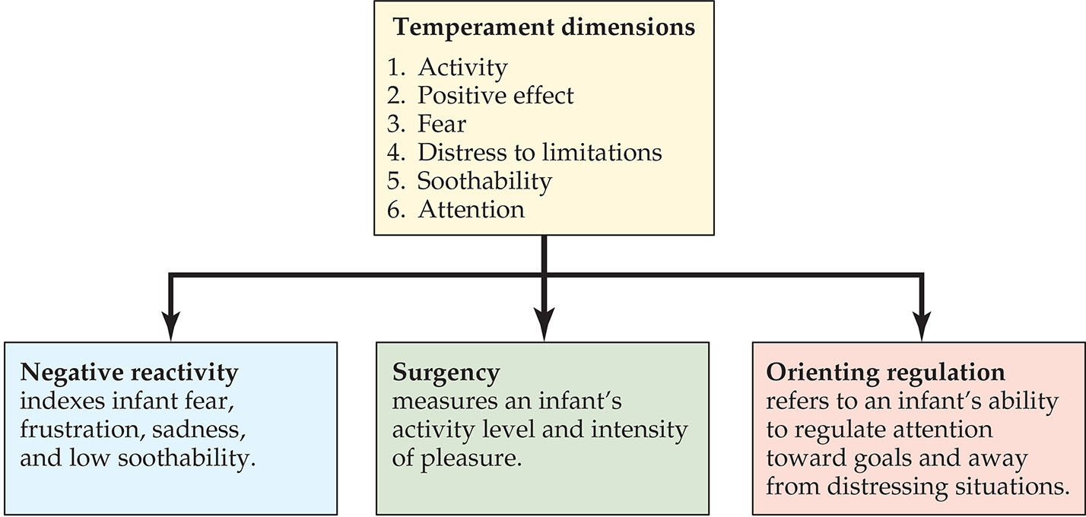
FIGURE 7.13 Rothbart and Bates’s temperament dimensions.

Slide 51
Temperament Stability: “Big Five of Personality” (Rothbart, 2007)
Openness:
  Degree of intellectual curiosity and openness to new experiences
Conscientiousness:
  Tendency to be organized and self-disciplined
Extraversion:
  Energy, surgency, outgoingness, and the tendency to seek stimulation socially
Notes:
Instructor’s Note:
Mary Rothbart identified connections between infant and toddler temperaments and later adulthood traits, as revealed in the “big five of personality.”

Slide 52
Temperament Stability: “Big Five of Personality” (Rothbart, 2007), Continued
Neuroticism:
  Vulnerability to quickly experiencing unpleasant emotions
Agreeableness:
  Tendency to be compassionate and cooperative

Slide 53
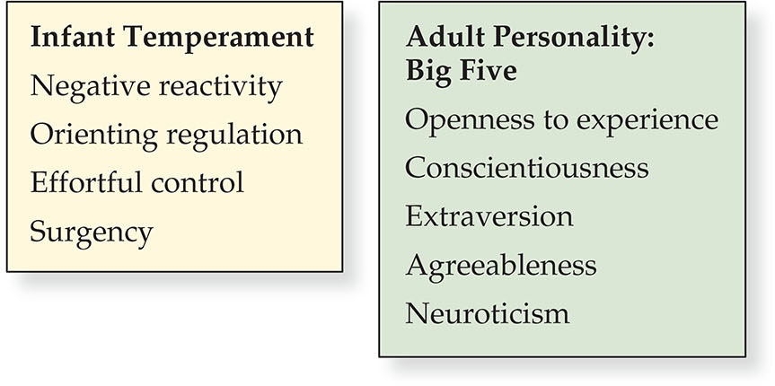
FIGURE 7.14 Toddler temperament predicts adulthood traits.

Slide 54
Evocative Effects
A type of gene-environment association in which a child’s inherited characteristics evoke strong responses from others that strengthen the child’s characteristics
Notes:
Instructor’s Note:
From text:
What accounts for stability from early to later temperament?
The answer lies in the interaction between a child’s biology and environmental experiences.
The term evocative effects refers to a type of gene-environment association in which child characteristics affect the child’s experiences to further strengthen those characteristics.

Slide 55
Social and Cultural Contexts of Emotional Development and Temperament
Contexts of temperament and goodness of fit
Parenting context of emotional development
Cultural context of emotional development
Notes:
Instructor’s Note:
However, temperament is not a “fixed” trait for life.
Rather, social and contextual forces affect an infant’s temperament and how the infant learns to express and regulate their emotions and behaviors.

Slide 56
Contexts of Temperament
Many factors contribute to an infant’s later personality
  Infants’ early experiences and temperament work together to develop a personality (Rothbart, 2007)

Slide 57
Goodness of Fit
The extent to which a person’s temperament matches the requirements, expectations, and opportunities of the environment (Chess & Thomas, 1991)
  Supportive caregiving can support infants’ skills at emotion regulation
  Harsh parenting can lead to heightened negative reactivity in infants
Notes:
Instructor’s Note:
Example of goodness of fit in infants’ daily life experiences: An infant with high negativity encounters a family reunion with unfamiliar adults in the home. The infant’s negative reaction may escalate if the infant is forced into the arms of an unfamiliar adult.
On the other hand, if the infant is given some time to adjust to the situation, a more positive, comfortable reaction to the family reunion may take place.

Slide 58
Parental Emotional Expressivity
Parents’ own emotional expressivity relates to that of their infants and children
  Children learn about emotions by observing parents’/caregivers’ emotional expressions and reactions
  E.g., expressions of happiness, surprise, and interest relate to children’s positive expressiveness from infancy through adolescence (Halberstadt & Eaton, 2002)

Slide 59
Distress Tolerance
The ability to persist when faced with negative emotions and cope with everyday stressors
  Parents with strong distress tolerance may be better able to develop positive relationships with their children
  Parents with lower distress tolerance may struggle more in relationships with children with negative reactivity
Notes:
Instructor’s Note:
From text:
Parents’ abilities to regulate their emotional experiences also affect their infants’ emotional development.

Slide 60
Depression and Anxiety
Parental depression and anxiety negatively affect infants’ emotions
  Parents who are depressed and anxious may display low emotional expressions when responding to their infants’ emotional expressions
The still-face experiment: Reveals the effects of parent depressed affect on infants
Notes:
Instructor’s Note:
From text:
In this experiment, a researcher instructs mothers to interact naturally with their infants for 3 minutes as usual, and to then interact with their infants for another 3 minutes while maintaining a flat, unresponsive still face (Figure 7.15).
After the still-face period, mothers resume natural interactions and soothe their infants if necessary.
Typically, infants become upset by their mother’s still face, and engage in strategies such as looking away to alleviate their distress (Cohn & Tronick, 1983; Ekas, Lickenbrock, & Braungart-Rieker, 2013).
When mothers re-engage their babies, infants typically calm down. Infants who are able to calm down and regulate their emotions after being distressed are thought to be securely attached to their caregivers.

Slide 61
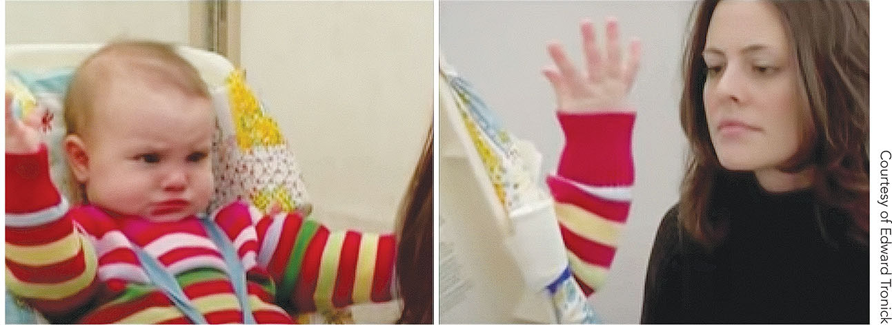
FIGURE 7.15 The still-face experiment.

Slide 62
Research in Action Video: The Still-Face Experiment and The Impact of Early Emotional Neglect
Watch the video here:
Research in Action Video: The Impact of Early Emotional Neglect

Slide 63
Parenting Context: Mirroring Behaviors
Caregivers reflect back the emotions of their infants
  Smiling in response to an infant’s smile
  Infants of mothers with high mirroring displayed more vocalizations and bids than did infants of mothers with low mirroring (Bigelow, Power, Pulmer, & Gerrior, 2018)

Slide 64
Parenting Context: Interaction Synchrony
Prompt, reciprocal ways that caregivers respond to infant behaviors and emotions
  Maternal warmth to their encourages emotion regulation years later
  Parental anger and harshness creates challenges for infants’ healthy emotional development
Notes:
Instructor’s Note:
From text: Interaction synchrony and maternal warmth fosters infants’ emotion regulation months and even years later (Brady-Smith et al., 2013; Feldman, Magori-Cohen, Galili, Singer & Louzoun, 2011).
Parental anger, harshness, and other negative and controlling behaviors impede toddlers’ development of emotion regulation, amplify stress in toddlers and young children, and at extremes, can cascade to psychopathology and emotional problems in children (Calkins et al., 1998; Cicchetti & Rogosch, 2012; Gunnar & Vazquez, 2006; Strang, Hanson, & Pollak, 2012).

Slide 65
Parenting Context: Cell Phone Use
Distractions from technology disrupt interaction synchrony
  Repeated and constant use of technology may interfere with infants’ emotional development
Notes:
Instructor’s Note:
From text: Mothers who reported frequent mobile device use had infants who were less positive in their affect during the initial phase of the still-face procedure and who showed less recovery at reunion than were infants of low users (Myruski, Gulyayeva, Birk, Pérez-Edgar, Buss, & Dennis-Tiwary, 2018).

Slide 66
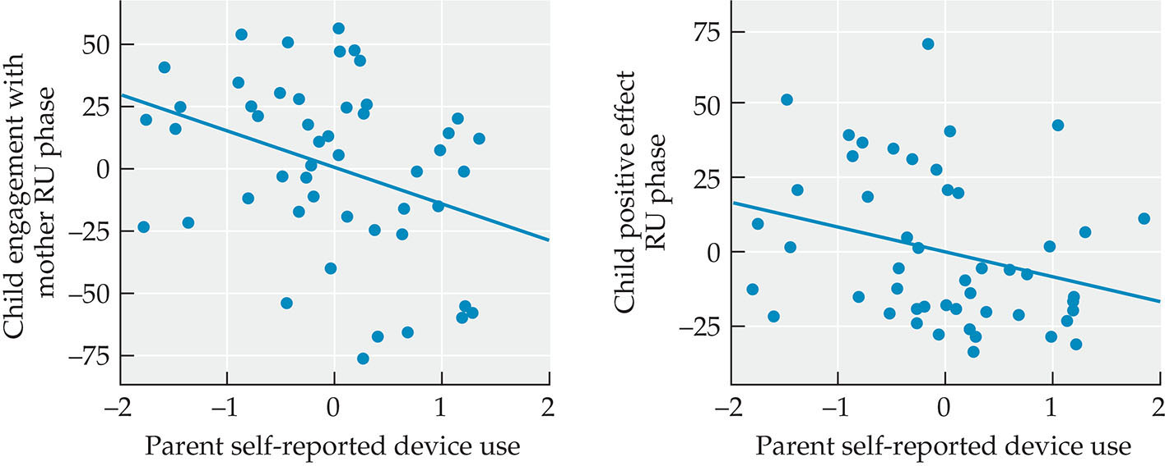
FIGURE 7.16 Technology distractions can affect infants’ emotional development.

Slide 67
Culture and Infant Temperament
Culture shapes expectations about infant behaviors and emotions
Fit of culture and infant temperament
  Infants with temperaments that fit with cultural values and practices show better adjustment than do infants without such fit (Ballantine & Klein, 1990; Wachs, 2006)
Notes:
Instructor’s Note:
From text:
Views around what makes an infant “difficult” vary across cultures
Example: In Kenya, where shared caregiving was typical, infants who were unable to adapt to multiple caregivers were considered to be difficult.
But in communities where a primary caregiver was the norm, the infant's distress at being handed off to multiple caregivers was expected (Super & Harkness, 1986).

Slide 68
Culture and the Perception of Emotions
Subtle cultural differences in adults’ perceptions of emotions in faces
Such differences may shape infants’ perceptions of emotions
Notes:
Instructor’s Note:
From text:
Adults from Western nations and adults from East Asia differ in their categorization of the six basic emotions—happy, surprise, fear, disgust, anger, and sad.
Adults from East Asia have a harder time distinguishing among these emotions in faces than do adults from Western nations, and they primarily base their ratings of emotion intensity on the eyes, whereas adults from Western nations tend to attend to other parts of the face such as the mouth (Jack et al., 2012).

Slide 69
Social Development and Attachment
Evolutionary views of attachment
Ainsworth and the Strange Situation
Contexts of attachment

Slide 70
What Is Attachment?
The affectionate bonds that infants develop toward the important people in their lives and their reliance on loved ones for comfort and protection
  Infants visually follow their caregivers’ movements
  Infants cling to their caregivers when distressed
  Infants seek proximity to loved caregivers

Slide 71
Bowlby’s Ethological Theory of Attachment
Attachment is an evolved response that aids a baby’s survival (Bowlby, 1958, 1963)
Notes:
Instructor’s Note:
From text: John Bowlby was an English psychiatrist whose interest in attachment stemmed from his volunteer work in a residential school for maladjusted children.
The initial distress of young children upon separation from their mothers gave way to despair and detachment.
Separated children were emotionally disturbed, depressed or listless, and unable to develop normal relationships. Even when reunited with their mothers, they remained anxious and defensive (Bowlby, 1953).
Bowlby’s observations led to his ethological theory of attachment (Bowlby, 1958, 1963).

Slide 72
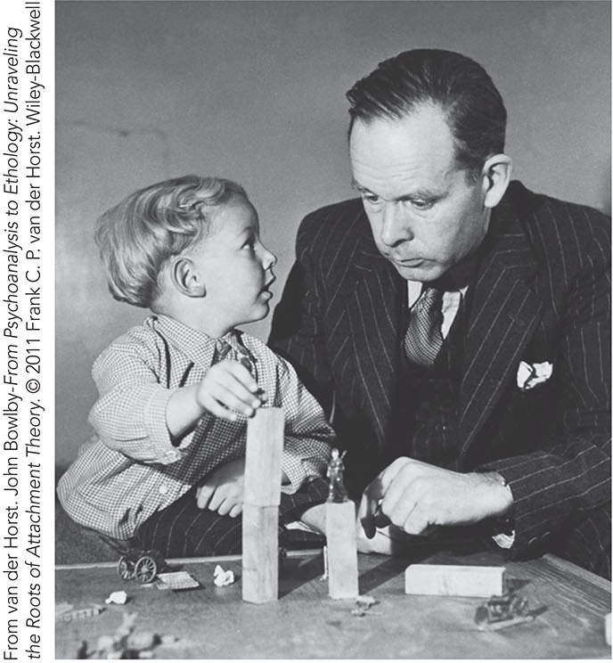
FIGURE 7.17 John Bowlby’s observations at the London Child Guidance Clinic.

Slide 73
Konrad Lorenz’s Imprinting
A phenomenon in which certain animal species are predisposed to follow whatever moving thing they see during a critical period early in life
Notes:
Instructor’s Note:
The work of Konrad Lorenz lent support to Bowlby’s theory by showing that certain animal species were predisposed to follow whatever moving thing they saw during a specific critical period early in life, a phenomenon referred to as imprinting.

Slide 74
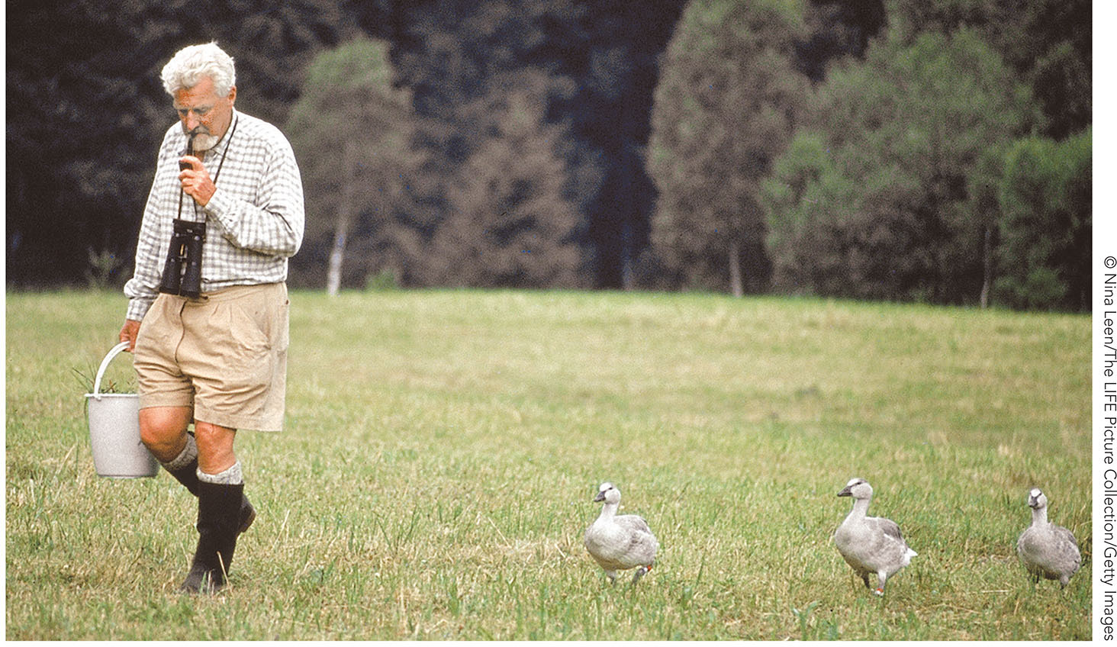
FIGURE 7.18 Imprinting.

Slide 75
Harry Harlow’s Monkeys
Study emphasized the biological view of attachment
  Monkeys spent more time clinging to a cloth “mother” than a wire “mother”
  Study highlighted the importance of proximity, closeness, and warmth as integral to attachment
Notes:
Instructor’s Note:
Harlow’s work offered additional support to Bowlby’s theory of attachment.
Harlow separated infant monkeys from their mothers and placed them in a cage that contained two “surrogate” mothers: a wire monkey that fed the infants milk and a cloth monkey that provided warmth and contact comfort.
The monkeys would spend most of their days clinging to the cloth monkey, and only approached the wire monkey to eat.
When exposed to a frightening stimulus, the monkeys fled to the warm, cloth surrogate for comfort, and monkeys whose cloth surrogates were removed displayed high anxiety and fear (Figure 7.19) (Harlow, 1958).

Slide 76
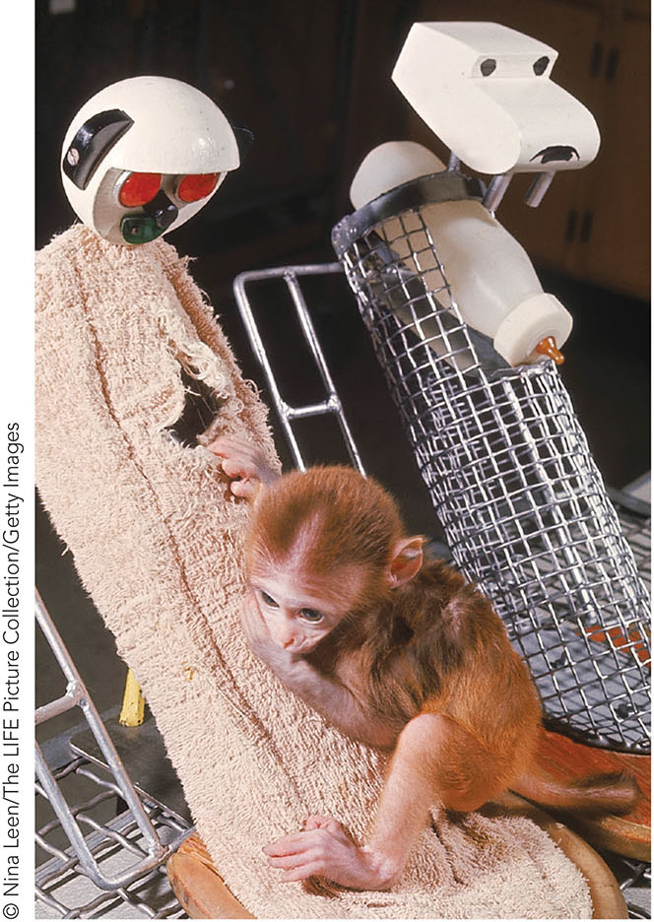
FIGURE 7.19 Harry Harlow’s studies of attachment in monkeys.

Slide 77
Research in Action Video: Harlow’s Monkeys
Watch the video here:
Research in Action Video: Harlow’s Monkeys

Slide 78
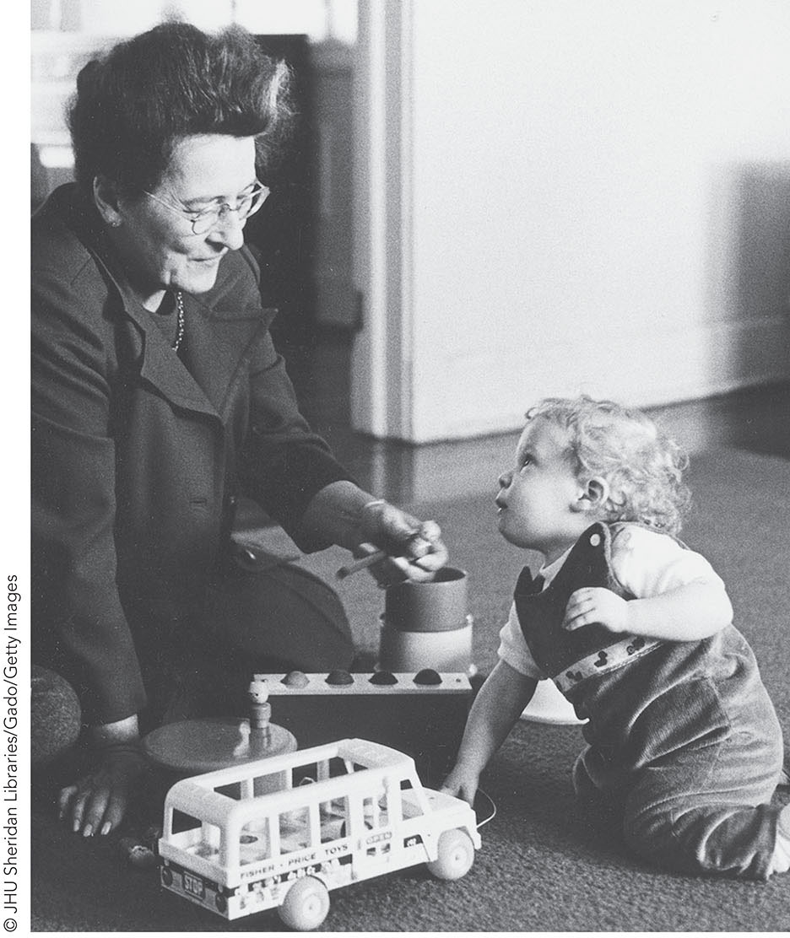
FIGURE 7.20 Mary Ainsworth’s research on infant attachment.

Slide 79
Mary Ainsworth’s Research
Mary Ainsworth tested Bowlby’s ethological theory:
  Examined attachment formation between infants and their mothers
  Began her studies by observing Ganda infants and mothers
Notes:
Instructor’s Note:
From text:
Developmental psychologist Mary Ainsworth sought to test Bowlby’s ethological theory by examining attachment formation between infants and mothers.
She accompanied her husband to the East African Institute of Social Research in Kampala, Uganda in 1954, where she conducted an observational study of Ganda infants and mothers (Figure 7.20). Ainsworth interviewed mothers about their childcare practices and infants’ development and observed infants’ interactions with mothers and other family members.
Ainsworth observed that infants actively sought contact with their mothers when they were afraid, hurt, hungry, and when their mothers left their vicinity. They treated mothers as a secure base from which to explore and showed distress at separation.

Slide 80
Ainsworth and the Strange Situation
Experiment to assess infant attachment to caregivers, based on infant behaviors in a lab playroom where infants experience:
  Separations from their caregiver
  Exposure to a stranger
  Reunification with their caregiver
Notes:
Instructor’s Note:
From text:
Upon returning to the United States, Ainsworth embarked on a longitudinal study of attachment at Johns Hopkins University. She visited local infant–mother pairs every 3 weeks from 3 to 54 weeks after the infant’s birth, recording infant attachment behaviors and mothers’ responses.
When infants were around 12 months, she assessed them in an experiment called the Strange Situation, which soon became a popular method for studying infant attachment.
In this procedure, the infant and mother visited a laboratory playroom, where after being introduced to the unfamiliar room, the infant experienced a series of separations from caregiver and exposures to a stranger.
From her observations, which she replicated in larger samples, Ainsworth and colleagues identified three groups of infant attachment (Ainsworth & Bell, 1969; Bretherton & Ainsworth, 1974).

Slide 81
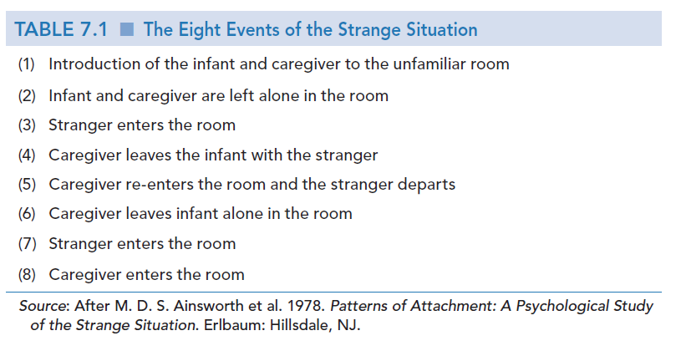
Table 7.1
The eight events of the Strange Situation

Slide 82
Research in Action Video: Mary Ainsworth and the Strange Situation
Watch the video here:
Research in Action Video: Mary Ainsworth and the Strange Situation

Slide 83
Group 1: Secure Attachment
Infants with secure attachments:
  Use caregivers as a safe base from which to explore the environment
  Become upset when caregiver leaves the room
  Are happy when caregiver returns
  Seek comfort from their caregiver

Slide 84
Group 2: Insecure Resistant
Infants with insecure resistant attachments:
  Become upset and anxious when caregiver leaves the room
  Are not easily comforted upon caregiver’s return

Slide 85
Group 3: Insecure Avoidant
Infants with insecure avoidant attachments:
  Do not become distressed when caregiver leaves the room
  Freely explore the room
  Easily comforted by the stranger

Slide 86
Disorganized Attachment
Infants with disorganized attachments:
  Express contradictory emotions and behavior
  Freeze when they see their caregiver
  Apprehension toward caregiver
Notes:
Instructor’s Note:
From text:
Years later, researchers Main and Solomon (1990) identified a fourth attachment style that did not fit with Ainsworth’s three groups: disorganized attachment.
Infants with disorganized attachment displayed contradictory behaviors and emotions (such as fear followed by laughter) and disorganized movements, freezing, and apprehension toward the mother.
Subsequent research identified associations between infants’ disorganized attachment and experiences of abuse or neglect (Baer & Martinez, 2006; Granqvist, Sroufe, et al., 2017). Infants’ experiences of their caregivers as psychologically unavailable and a source of alarm or fear may explain why some infants develop disorganized attachment (Hesse & Main, 2006; Solomon & George, 2011).

Slide 87
Contexts of Attachment
Caregiving context:
  Sensitive caregiving fosters strong and secure attachments in infants
Cultural context:
  Infants around the world form attachments and actively attempt to remain close to their caregivers (Dagan & Sagi-Schwartz, in press; van Ijzendoorn & Sagi, 2010)

Slide 88
Cultural Expectations and Practices
Infants from different cultures express attachment in ways that align with the unique cultural views and practices
  E.g., Ugandan infants displayed intense protests when separated from their mothers compared to infants in Baltimore
  E.g., U.S. infants tend to accompany their caregivers out of the home, whereas infants in Uganda tend to remain near their homes
Notes:
Instructor’s Note:
From text: Mary Ainsworth pioneered cross-cultural work in attachment (Ainsworth & Marvin, 1995). Ainsworth observed that Ugandan infants displayed more intense protest when separated from their mothers compared to infants in Baltimore, perhaps because Ugandan infants were not accustomed to being separated from their mothers.
Additionally, U.S. infants frequently accompanied their caregivers to out-of-home settings, such as the grocery store, post office, sibling’s school, and so forth, where they regularly encountered strangers.
In Uganda, infants remained in or near their homes and rarely encountered strangers.
Ainsworth speculated that such differences in infant experiences explained the different reactions of infants to the Strange Situation.

Slide 89
Cultural Differences in Child-Care Arrangements
Single-person household
Multiple-person household
Communal caregiving
Notes:
Instructor’s Note:
From text:
Cultural differences in child-care arrangements may likewise affect infant attachment.
In some cultural communities one or two parents raise infants in a nuclear family; whereas in others multiple caregivers may be involved, including grandparents and other relatives, siblings, and friends.

Slide 90
Infant Attachment to Fathers
Fathers play an essential role in their children’s attachment and development
  Infants display attachment behaviors to fathers, just as to mothers (Lamb, 1977)
  In some studies, infants show stronger attachment to fathers than to mothers, perhaps because dads engage in frequent play (Clarke-Stewart, 1978; Paquette, 2004)
Notes:
Instructor’s Note:
From text:
Lamb observed U.S. mother-infant and father-infant interactions at home when infants were at 15, 18, 21, and 24 months and in a laboratory context at 14 months (Lamb, 1977).
Infants expressed similar attachment behaviors—smiles, looks, vocalizations, and seeking proximity—toward their mothers and fathers.
Perhaps more surprisingly, infants of all ages showed more attachment behaviors toward fathers than toward mothers. Infants may have shown a father-preference because fathers engage infants in more play than do mothers, especially in the 2nd to 3rd years of life (Clarke-Stewart, 1978; Paquette, 2004).
Moreover, infants raised primarily by fathers seek comfort from their fathers, rather than mothers, under stressful conditions (Geiger, 1996; Lamb, 1977).

Slide 91
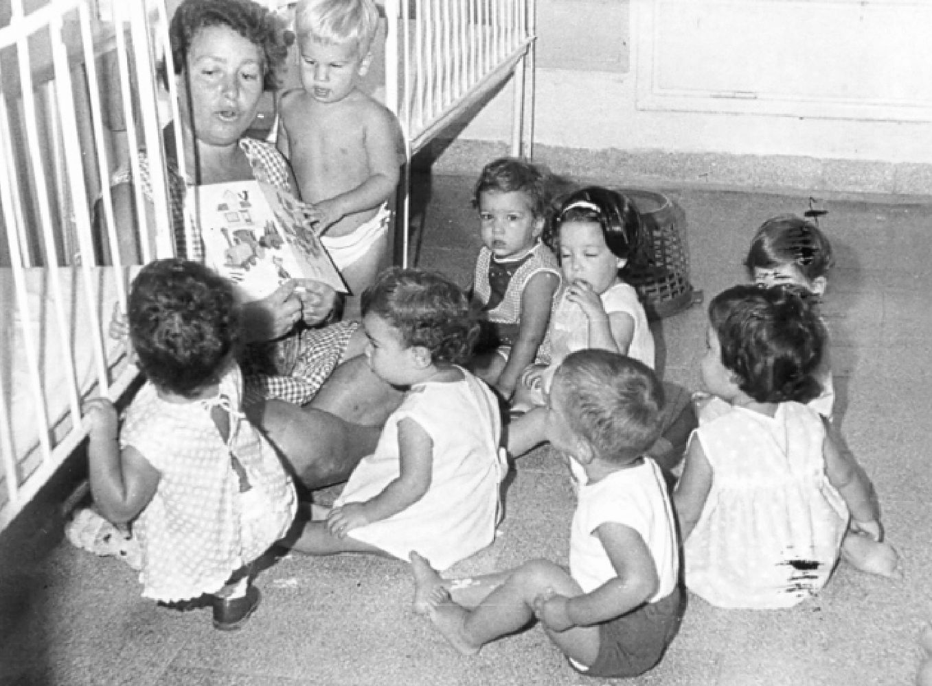
Figure 7.21
Communal childrearing practices

Slide 92
“Satellite Babies”
Infants cared for by grandparents in another country for an extended period of time
  “Satellite babies” return to their biological parents after years of separation and after developing attachment to their grandparents
  Prolonged infant-parent separation may result in developmental challenges, such as mental health problems
Notes:
Instructor’s Note:
From text :
In some cultural contexts, parents relinquish responsibility for the care of their infants to grandparents for an extended period of years, during which parents are in minimal contact with their children. Some immigrants to North America send their infants back to their country of origin after giving birth, where grandparents and other relatives raise them (Bohr & Tse, 2009).
Years later, these “satellite babies” return to their biological parents and attend school in their adopted country. From the perspectives of the parents, economic and social needs drive the decision to send their infants back to the home country. Parents believe they are offering their infants a chance to be reared by loving grandparents while they work to establish an economic foundation before their child returns to the United States, for example, to begin school.
However, according to attachment theory, prolonged infant-parent separation, and the subsequent disruption from relationships with grandparents and relatives, could have long-term, adverse developmental consequences.
In fact, children who have been separated from their parents for lengthy periods of time, and then reunited, have been found to suffer depression and mental health problems as adolescents (Suårez-Orozco, Todorova, & Louie, 2002).

Slide 93
Peer Relations and Morality Origins
Prosocial behaviors
Moral development
Aggression
Notes:
Instructor’s Note:
From text:
Beyond infants’ relationships with primary caregivers, infants display a keen interest in peers and people outside the family and engage in a rich variety of behaviors that may be precursors to mature forms of moral behavior and reasoning.

Slide 94
Prosocial Behaviors Develop over Time
Infants respond differently to other babies than they do to adults or their own image in a mirror by 1- to 3-months (Field, 1979; Fogel, 1979)
Infants smile and vocalize toward other infants ~ 6 months (e.g., Vandell, Wilson, & Buchanan, 1980)
Notes:
Instructor’s Note:
From text:
Infants ages 1 to 3 months already respond differently to peers than they do to mothers or their own image in a mirror (Field, 1979; Fogel, 1979). Midway through the first year, infants smile and vocalize toward other infants (Maudry & Nekula, 1939; Vandell, Wilson, & Buchanan, 1980).

Slide 95
Prosocial Behaviors Continue to Develop
By the end of the first year, infants distinguish between familiar and unfamiliar peers and express more smiles toward peers they know
Toddlers increasingly engage in prosocial behaviors such as helping, sharing, comforting
Notes:
Instructor’s Note:
From text:
For instance, an examiner may pretend to be distressed or in need of help and observe how infants respond. Infants as young as 14 and 18 months helped an experimenter pick up toys that were out of reach (Warneken & Tomasello, 2007), and 18- and 24-month-old toddlers shared their food with an experimenter who had not received any food during “snack time” (Dunfield et al., 2011).
Toddlers of 30 months willingly offered a favorite blanket or toy to comfort a distressed experimenter (Brownell et al., 2009). However, toddlers’ propensity to help depends on the friendliness, helpfulness, and trustworthiness of the other person.
Toddlers 21 months of age preferred to help people who shared a toy or showed a willingness to share in a previous interaction than to help those who did not (Dunfield & Kuhlmeier, 2010).

Slide 96
Moral Development: Moral Goodness
Feelings of concern for others and attempts to help individuals in need
  Around 2 years of age, toddlers increasingly display prosocial actions
  However, certain situations pose more of a challenge for toddlers

Slide 97
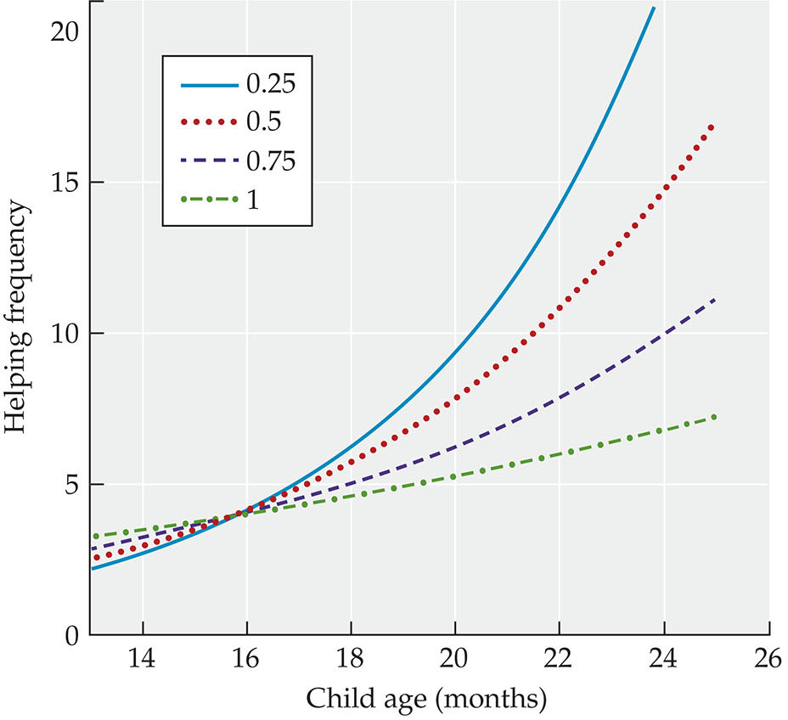
FIGURE 7.22 Infants’ natural tendency toward prosocial behaviors.

Slide 98
Moral Understanding and Evaluation
Identifying and liking individuals who are cooperative, empathetic, or helpful, and disliking individuals who are uncooperative, unempathetic, or unhelpful

Slide 99
Helper-Hinderer Studies
Common method for assessing infants’ moral understanding and evaluation
  Infants observe “helping” and “hurting” puppets
  Researchers observe infants’ responses (a general preference for a prosocial helper)
Notes:
Instructor’s Note:
From text:
Helper-hinderer studies are studies that assess infants’ moral understanding and evaluation by presenting infants with “helping” and “hurting” puppets (for example) and then testing whether infants behave differently toward the “helper” or “hinderer”.
Five- and 8-month-old infants preferred antisocial characters who harmed hinderers to prosocial characters who helped hinderers (Hamlin et al., 2011). For example, in a helper-hinderer type study, infants observed puppets who helped or hindered another puppet who was attempting to achieve a goal.
They were then introduced to new characters who either took a dropped ball away from or gave the ball back to the prosocial helper or antisocial hinderer.
Both groups of infants preferred the character who gave the ball to the prosocial helper. However, only 8-month-olds preferred the agent who took the ball away from the antisocial hinderer. Younger infants continued to prefer the giver.
Thus, as infants approach the end of the first year, they may recognize and support the notion of retribution toward antisocial agents.

Slide 100
Moral Retribution
The tendency to punish or support people who misbehave
  By the end of the first year, infants begin to recognize the idea of retribution toward antisocial persons
  After 2 years of age, infants increasingly display behaviors of moral retribution
Notes:
Instructor’s Note:
From text:
Five- and 8-month-old infants preferred antisocial characters who harmed hinderers to prosocial characters who helped hinderers (Hamlin et al., 2011).
For example, in a helper-hinderer type study, infants observed puppets who helped or hindered another puppet who was attempting to achieve a goal. They were then introduced to new characters who either took a dropped ball away from or gave the ball back to the prosocial helper or antisocial hinderer. Both groups of infants preferred the character who gave the ball to the prosocial helper. However, only 8-month-olds preferred the agent who took the ball away from the antisocial hinderer. Younger infants continued to prefer the giver.
Thus, as infants approach the end of the first year, they may recognize and support the notion of retribution toward antisocial agents.

Slide 101
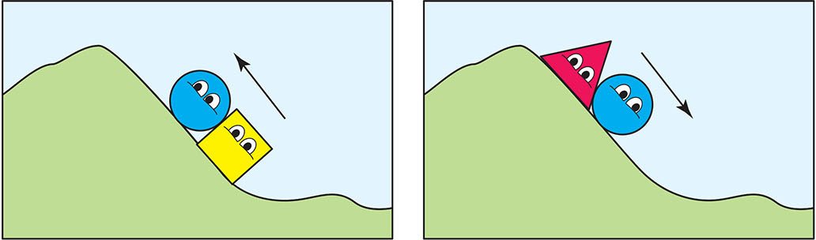
FIGURE 7.23 Helper-hinderer study.

Slide 102
Research in Action Video: Helpers and Hinderers
Watch the video here:
Research in Action Video: Helpers and Hinderers

Slide 103
Physical Aggression
Behavior causing physical harm to others
  Hitting
  Pushing
  Kicking
  Biting
Notes:
Instructor’s Note:
From text:
As infants grow in their “helpfulness” over the second year of life, they increasingly display negative behaviors such as hitting, biting, kicking and so on (Dahl, 2016, 2018).
There are 2 major forms of aggression that children display: physical and relational.

Slide 104
Relational Aggression
A type of non-physical aggression in which harm is caused by hurting someone’s relationships or social status
  Threatening to withdraw a friendship
  Withdrawing a friendship
  Ignoring a peer
  Excluding a peer
Notes:
Instructor’s Note:
Relational aggression begins to emerge in toddlers, though it is rare. They might play with one peer and ignore another, although their intentions in doing so are unclear.
Later in development, we will see that children intentionally engage in relational aggression.

Slide 105
Self-Identity
Aspects of self
Ecological and interpersonal selves
Objective self
Notes:
Instructor’s Note:
From text:
Infants’ understanding of the self, although basic, sets the stage for understanding and relating to others. And so, researchers and philosophers have long been intrigued with the developmental origins of self-identity: In what ways do infants experience a sense of self? How does infants’ understanding of the self change over the first years of life?

Slide 106
Conceptual Self
The characteristics a person uses to describe oneself
  The “me”
  The “objective self”
Notes:
Instructor’s Note:
Self-identity consists of 2 main selves: conceptual and subjective.

Slide 107
Subjective Self
The characteristics a person uses to describe oneself, as a unique entity in the environment
  The “I” of the self

Slide 108
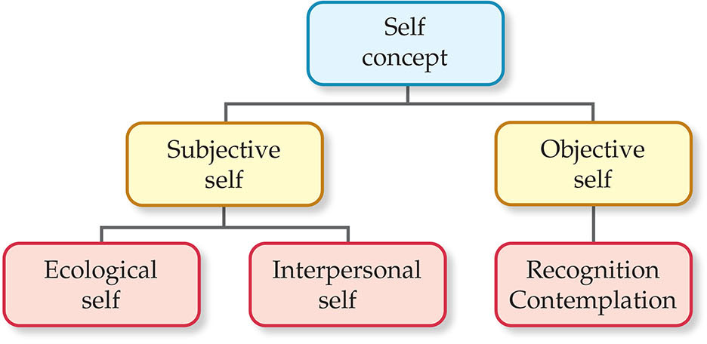
FIGURE 7.24 Self concept.

Slide 109
Ecological Self of the Subjective Self
The perception of one’s body in relation to the physical environment
  Feeling your feet move as you walk
  Feeling your arms move as you reach
Notes:
Instructor’s Note:
From text:
The subjective self further divides into the ecological self and interpersonal self.

Slide 110
Interpersonal Self of the Subjective Self
The perception of oneself in relation to other people
  Back-and-forth exchanges with others
  Eye contact

Slide 111
Single Touch and Double Touch Experiment
An experiment to test infant self-awareness (subjective self)
  Do young infants distinguish between an experimenter touching the infant’s cheek (single-touch; other-stimulation) and the infant’s own touch of the cheek (double-touch, self-stimulation)?
  Do they recognize their body moving?
Notes:
Instructor’s Note:
From text:
Developmentalists Philippe Rochat and Susan Hespos (1997) designed a clever method—the single touch and double touch experiment- to investigate whether very young infants can distinguish their own actions from the actions of others.
In their experiment, they observed the responses of newborns and 4-week-old infants to touches arising from self-stimulation, when infants touch their own cheek with a finger, to their responses to other-stimulation, when an experimenter’s finger touches the infant’s cheek. Infants were more likely to turn their heads and open their mouths, as though preparing to breastfeed, when an experimenter touched their cheeks (other stimulation) than when they touched their own cheeks (self-stimulation).
Rochat inferred that infants’ early ability to differentiate self from other touches is explained by the different sensory experiences associated with the two types of touches. When infants touch themselves, they experience a “double touch,” receiving tactile feedback on both finger and cheek as well as feedback from their moving arm. In contrast, touches by other people result in a “single touch” of a finger to cheek in this case—the distinction that inspired the name of the experiment.

Slide 112
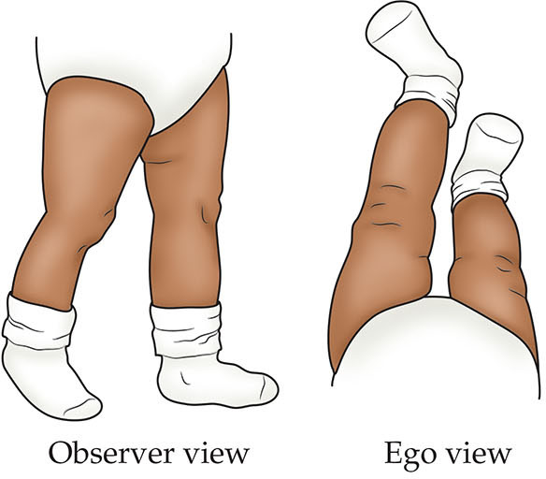
FIGURE 7.25 The “ego view” and the “observer view” of an infant’s moving legs.

Slide 113
Contingency Experiences
Environmental effects arising from infant actions, thought to reflect the ecological self
  Mobile moving in response to a swipe
Notes:
Instructor’s Note:
From text:
Infants further display their sense of the ecological self through their reactions to contingency experiences, environmental effects that arise from one’s actions.
Infants recognize, for example, when they have caused a mobile to move by kicking their legs (Rovee-Collier, 1989) or brought a picture into view by sucking on a nipple (Siqueland & Delucua, 1969).
And, infants’ perceptions of contingency extends to social interactions—the interpersonal self—as illustrated in a clever experiment conducted 3 decades ago.

Slide 114
The Objective Self
An infant’s objective/conceptual self typically emerges around the second year
Toddlers start to think about themselves objectively as they would about others (rouge test/experiment)
Notes:
Instructor’s Note:
From text:
Michael Lewis and Jeanne Brooks-Gunn were the first to study infants’ objective self in 1979 by dabbing rouge on the noses of 9-, 12-, and 18-month-old infants who stood in front of a mirror.
Nine- and 12-month-olds reached out and touched the mirror to rub off the rouge, seemingly not realizing that they were observing themselves in the reflection.
In contrast, the 18-month-old toddlers wiped their noses when they saw their reflection in the mirror.

Slide 115
Gender Identity
Knowing that one is a boy or a girl
  Gender self-labeling as demonstrated by toddlers
Notes:
Instructor’s Note:
From text:
Gender self-labeling indicates that toddlers have formed a basic gender identity, which refers to knowing that one is a boy or a girl.
Toddlers of 24 to 30 months of age also demonstrate their understanding of gender categories by pointing to boys and girls in photographs or a picture of their own gender when asked (Martin, Ruble, & Szkrybalo, 2002; Stennes et al., 2005).

Slide 116
Contexts of Self-Identity
Gender socialization and the home context
Gender socialization and the cultural context
Notes:
Instructor’s Note:
From text:
Context and culture may influence development of the conceptual self, in particular gender development.

Slide 117
Baby “X” Studies
Researchers label the same infant as a “boy” or a “girl”
They then observe how caregivers or adults talk and interact with the infant based on the labeled gender
Notes:
Instructor’s Note:
From text: Parents’ differential treatment of boy and girl infants cannot be attributed to infant behaviors alone, as shown in experimental manipulation of infant gender
In the Baby “X” studies, experimenters labeled the same infant as a “boy” or “girl” and observed how people talked about and interacted with the baby.
Infants labeled as “boys” were rated as bigger, stronger, and louder compared to infants labeled as “girls.”
Infants labeled as girls received more talk and nurturance from adults than did infants labeled as boys.
In a review of 23 Baby “X” studies, adults were more likely to encourage activity and whole-body stimulation with infants labeled as boys. The actual sex of the infant in the studies had no effect on how people viewed or treated them (Stern & Karraker, 1989).
Of course, Baby X studies and other highly cited studies on parents’ socialization of gender date back many years. Clearly, a growing number of parents aim to be gender-neutral in their parenting today. Nonetheless, observations of children’s rooms and toys reveal gender differences that mirror findings reported decades ago (MacPhee & Prendergast, 2018).
Although blatant differences in parents’ behaviors towards girls and boys may be rare, parents implicitly socialize gender in subtle but impactful ways, including through the products they buy and how they respond to children’s behaviors (Mesman & Groeneveld, 2018).

Slide 118
Parent Socialization of Gendered Behaviors
Parents select and offer specific toys to their boys and girls in their homes
  Parents buying girls dolls and tea sets
  Parents buying boys trucks and cars
Notes:
Instructor’s Note:
From text:
When researchers asked parents of 5- and 12-month old infants to report the toys they had at home, male children had more trucks than dolls at both ages, and female children had 3 times more pink toys than did male children at 5 months and 5 times more pink toys by the time they were a year old (Boe & Woods, 2018). In turn, the gendered nature of toys fed into infants’ toy play by 12 months of age.

Slide 119
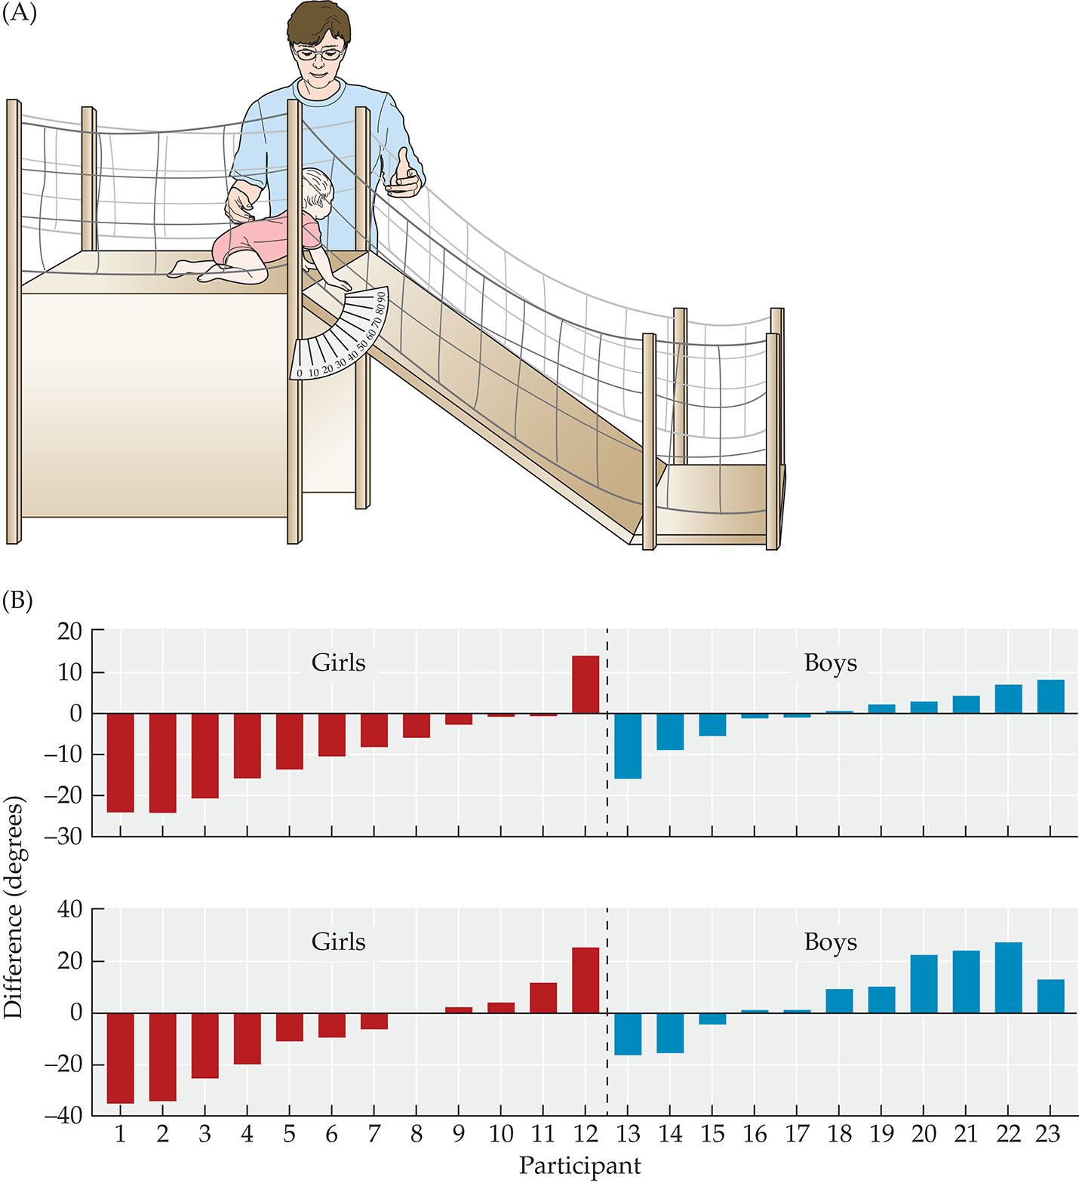
FIGURE 7.26 Parental socialization of gender.

Slide 120
Gender Socialization and the Cultural Context
Anthropologist Margaret Mead observed males and females in the communities of the Arapesh, Mundugumor, and Tchambuli
  In the Arapesh society, males and females were both gentle and responsive
  In the Mundugumor society, both males and females were aggressive and violent
Notes:
Instructor’s Note:
From text:
Gender socialization may look different across cultural communities. Still, based on existing evidence, differences in the roles of men and women in cultural life influence how boys and girls are raised.

Slide 121
Gender Socialization and the Cultural Context, Continued
Margaret Mead observations (continued):
  In the Tchambuli society, females were dominant and males were less responsible
  As pioneered by Mead, gender roles are social constructed in different ways across cultural communities throughout history

Slide 122
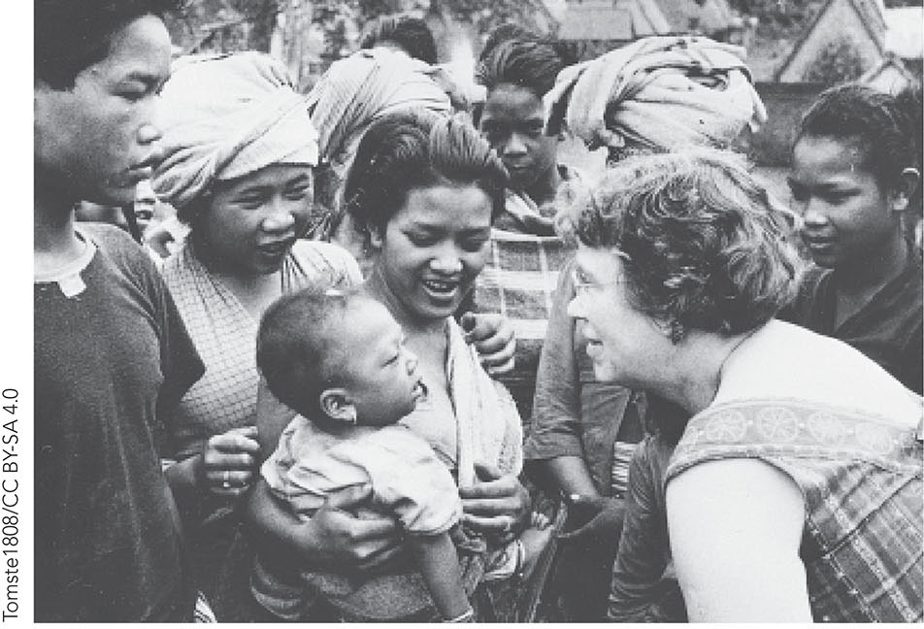
FIGURE 7.27 Margaret Mead.

Slide 123
Developmental Cascades
Emotion regulation and language learning
Emotion regulation and preschool learning
Emotion regulation and later social functioning
Attachment and later adjustment
Notes:
Instructor’s Note:
From text:
Emotional and social development in the first years of life can cascade to language learning, school readiness, academic achievement, and social functioning.

Slide 124
Emotion Regulation and Language Learning
Infants with some developmental control over their emotions may be better able to attend to people talking and learn words
In contrast, infants who are very aroused by emotions may take longer to develop language skills (e.g., Bloom, 1993)

Slide 125
Emotion Regulation and Preschool Learning
Challenges with effortful control in the first year of life may interfere with later:
  Task persistence
  Academic achievement
  Moral maturity
  Positive relationships with adults and peers (e.g., Eisenberg, 2010)

Slide 126
Emotion Regulation and Later Social Functioning
Early challenges with emotion regulation may hamper social interactions later
  Withdrawal from social situations
  Engaging in aggressive behaviors

Slide 127
Emotion Regulation and Later Social Functioning 2
Externalizing behaviors: Problem behaviors directed to the external environment
  Physical aggression
  Disobeying rules
  Destroying property

Slide 128
Attachment and Later Adjustment
Internal working models
  Mental representation of one’s attachment relationship with the primary caregiver
  Internal working models establish models for future social relationships
Notes:
Instructor’s Note:
From text:
Patterns of interaction between infants and caregivers solidify and extend to other relationships—from peers to teachers to romantic partners.
Infants who are neglected, abandoned, or otherwise deprived of a loving relationship with one or more caregivers suffer severe emotional, social, and cognitive problems throughout life.

Slide 129
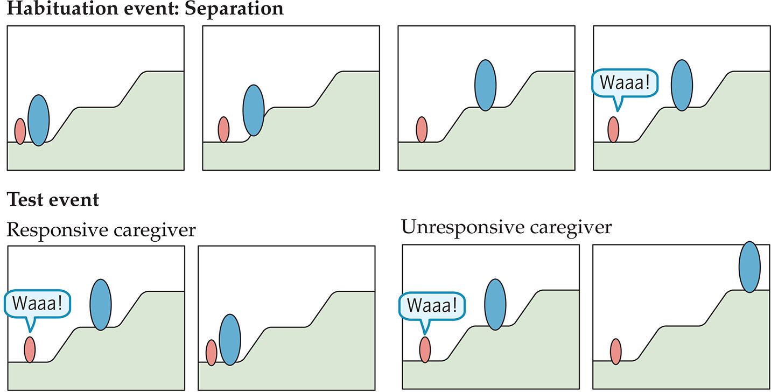
FIGURE 7.28 Internal working models of attachment in infancy.

Slide 130
In Closing…..
Infants show rapid change in understanding, expressing, and regulating emotions
Social relationships extend to caregivers and peers, with infants showing the rudiments of morality
Infants have an early sense of identity
Emotion and social development unfold in multiple contexts and reverberate across domains and time

