Slide 1


Child Development
Context, Culture, and Cascades
by Catherine S. Tamis-LeMonda

Slide 2
PART 3
Early Childhood
CHAPTER 9
Cognitive and Language Development in Early Childhood

Slide 3

1

Slide 4

FIGURE 9.1 Horses begin competitive races at equal starting points.

Slide 5
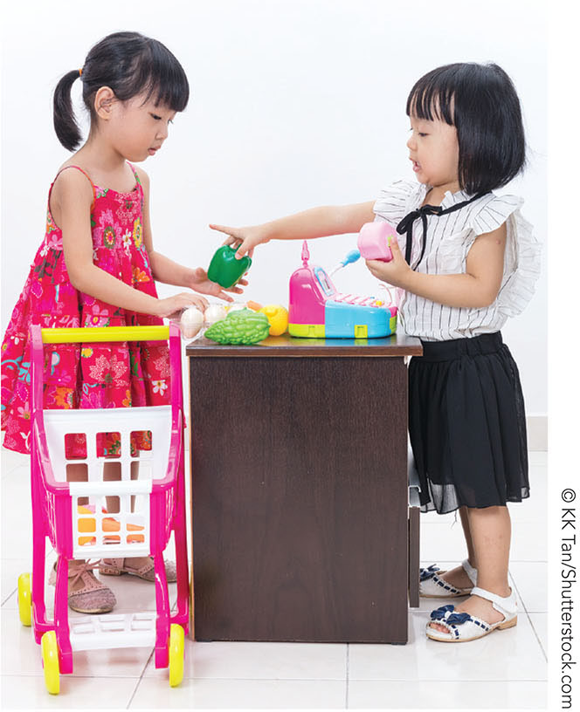
FIGURE 9.2 Preoperational thought

Slide 6
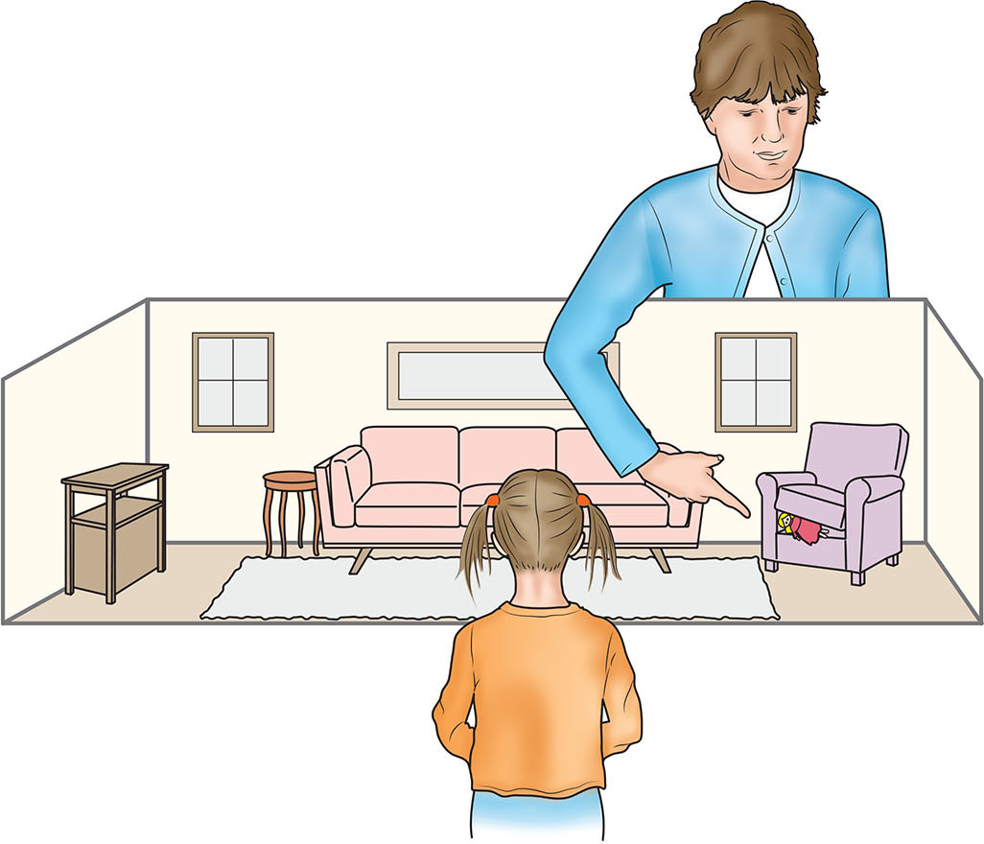
FIGURE 9.3 Dual representational skills.

Slide 7
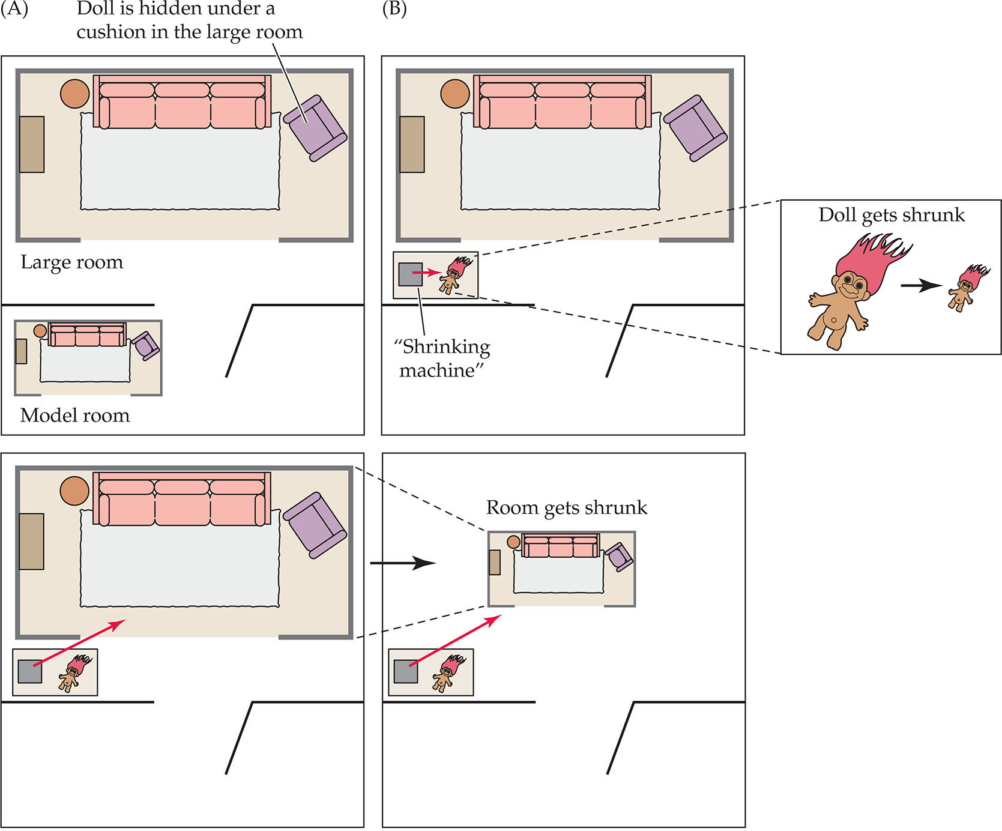
FIGURE 9.4 Shrinking room.

Slide 8
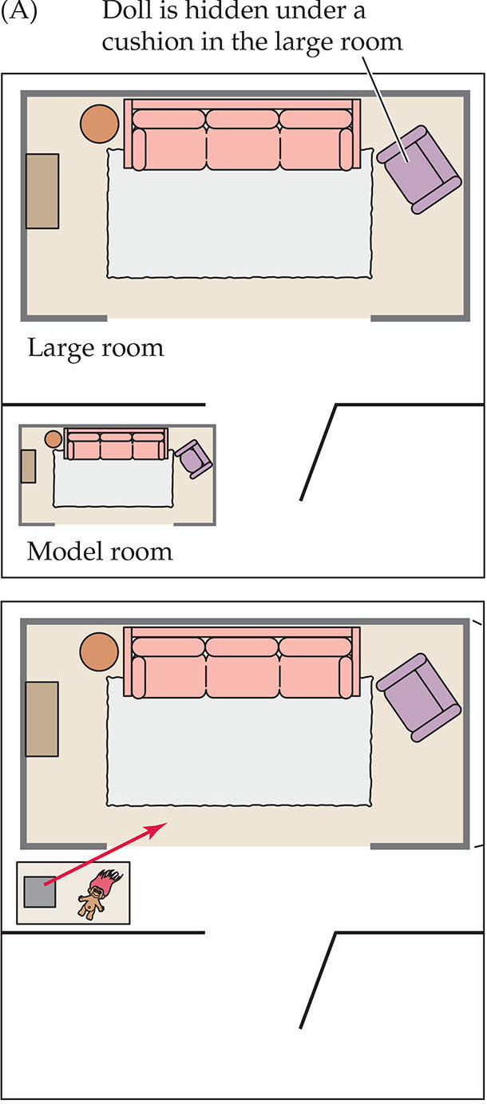
FIGURE 9.4 Shrinking room.

Slide 9
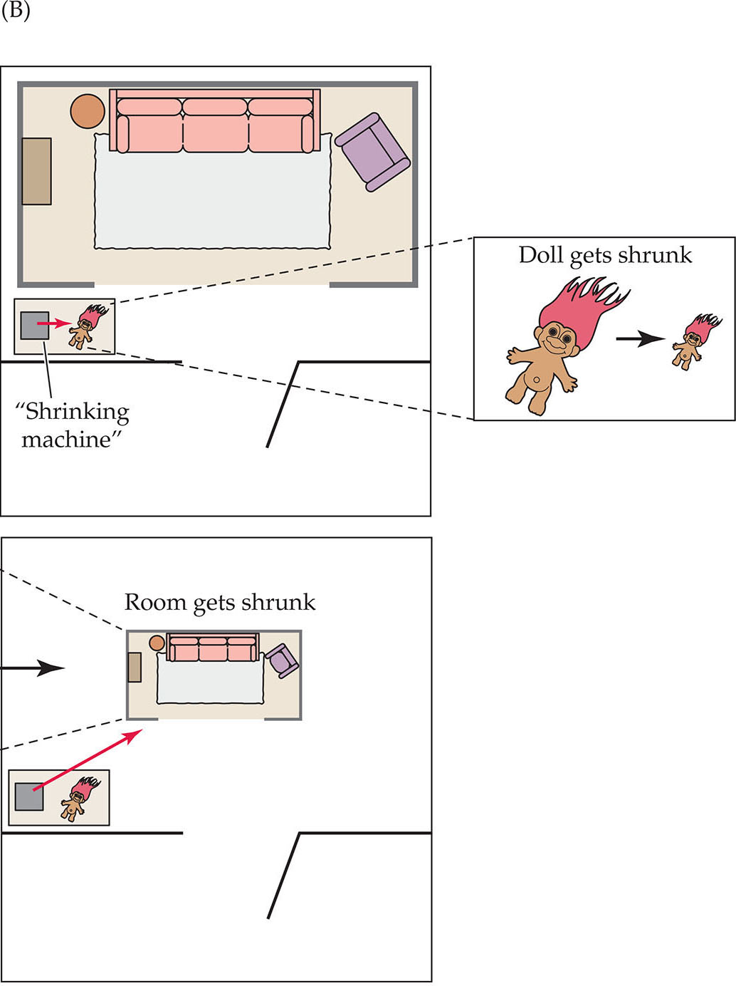
FIGURE 9.4 Shrinking room.

Slide 10

FIGURE 9.5 Sociodramatic play.

Slide 11
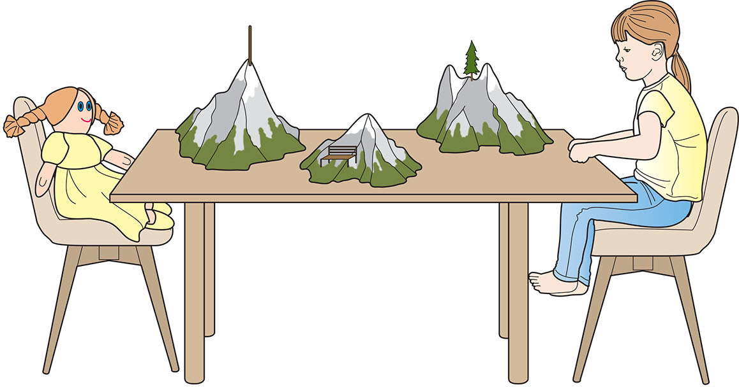
FIGURE 9.6 Piaget’s Three Mountains Task.

Slide 12

FIGURE 9.7 Cards used in the Gelman and Markman study.

Slide 13
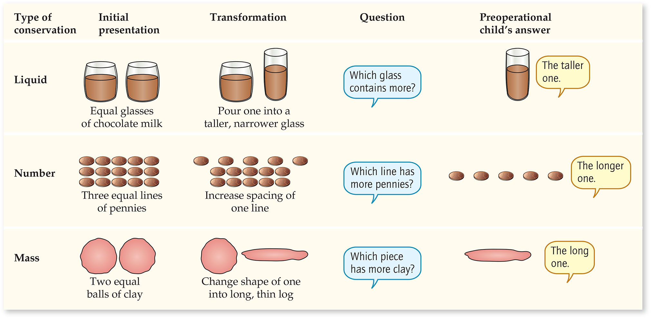
FIGURE 9.8 Conservation tasks.

Slide 14
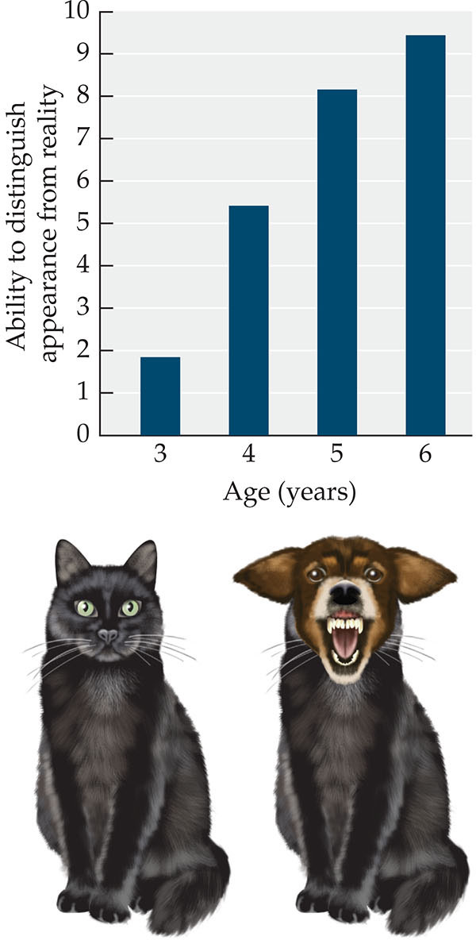
FIGURE 9.9 DeVries’s Appearance-Reality Task featuring Maynard the Cat.

Slide 15
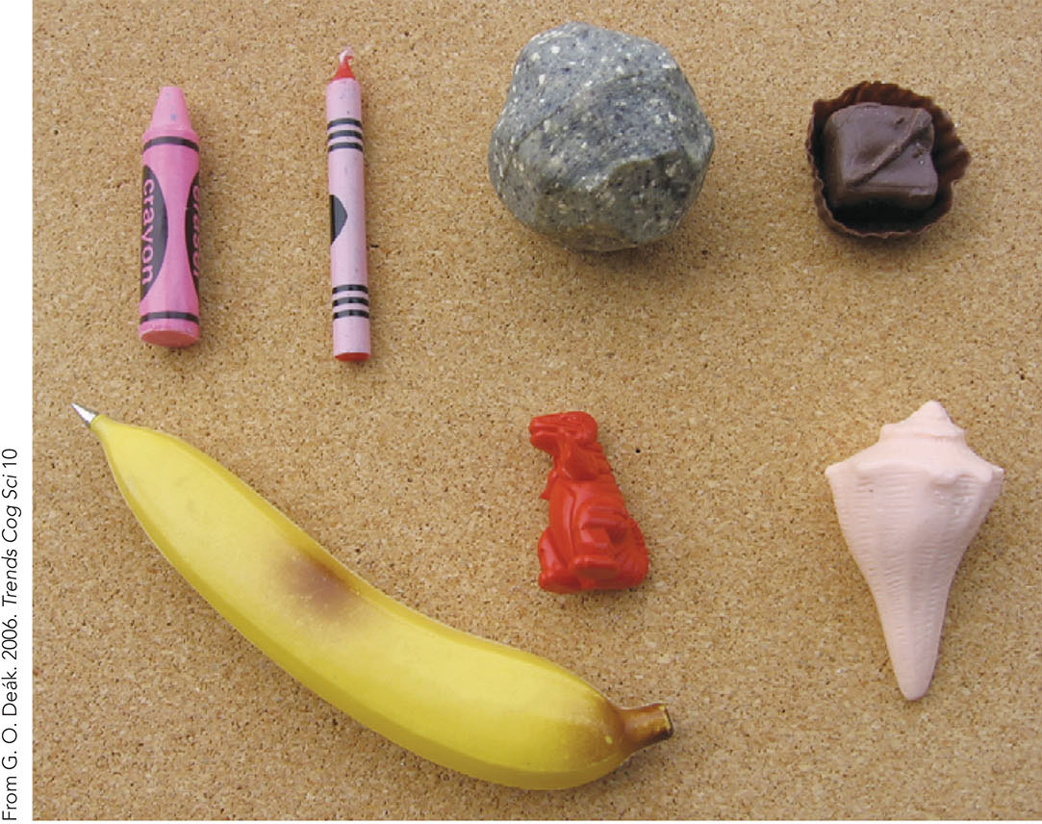
FIGURE 9.10 Distinguishing appearance from reality.

Slide 16
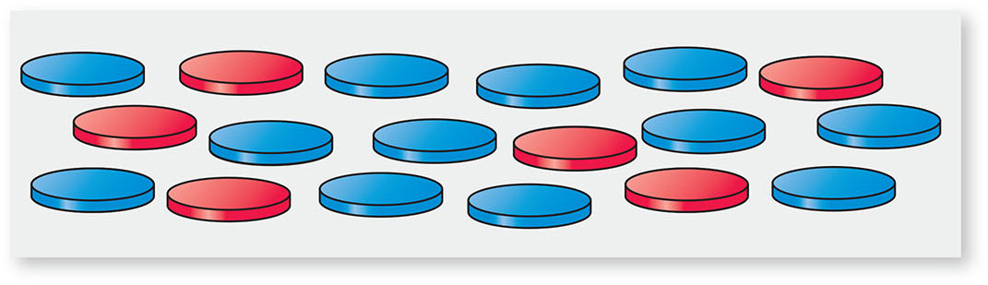
FIGURE 9.11 A class inclusion test.

Slide 17

FIGURE 9.12 Conservation.

Slide 18
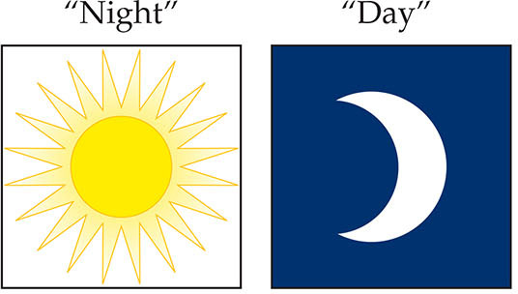
FIGURE 9.13 Day-night Stroop task.

Slide 19
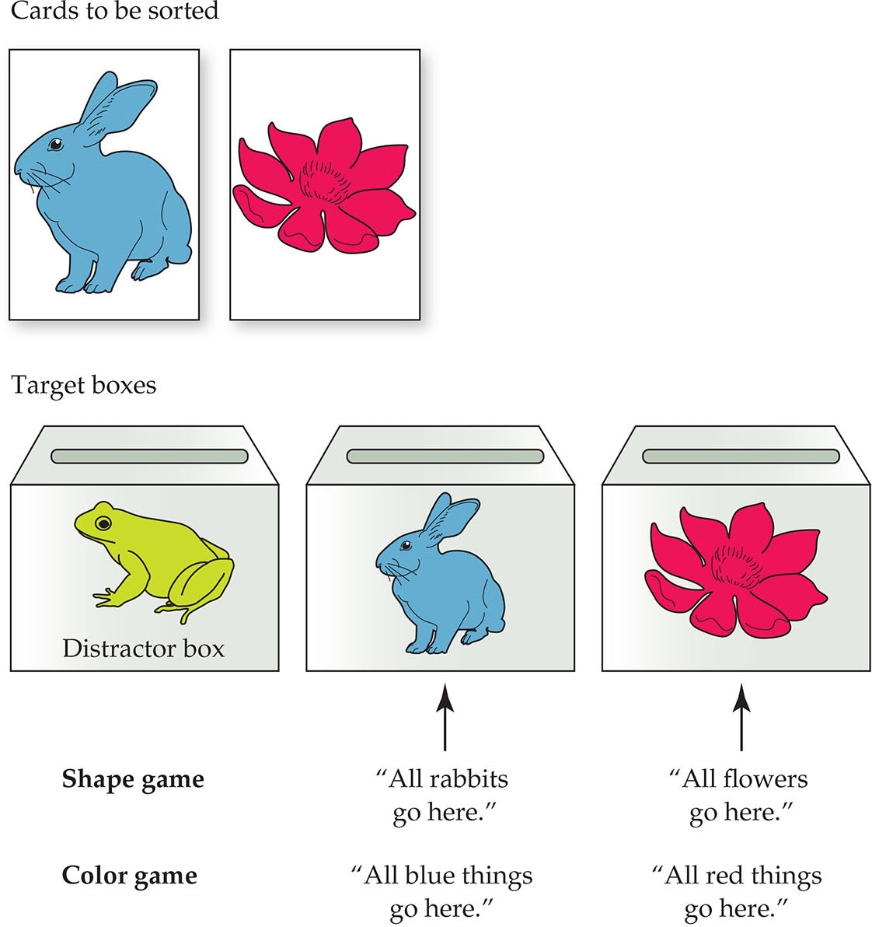
FIGURE 9.14 Dimensional card-sorting tasks.

Slide 20
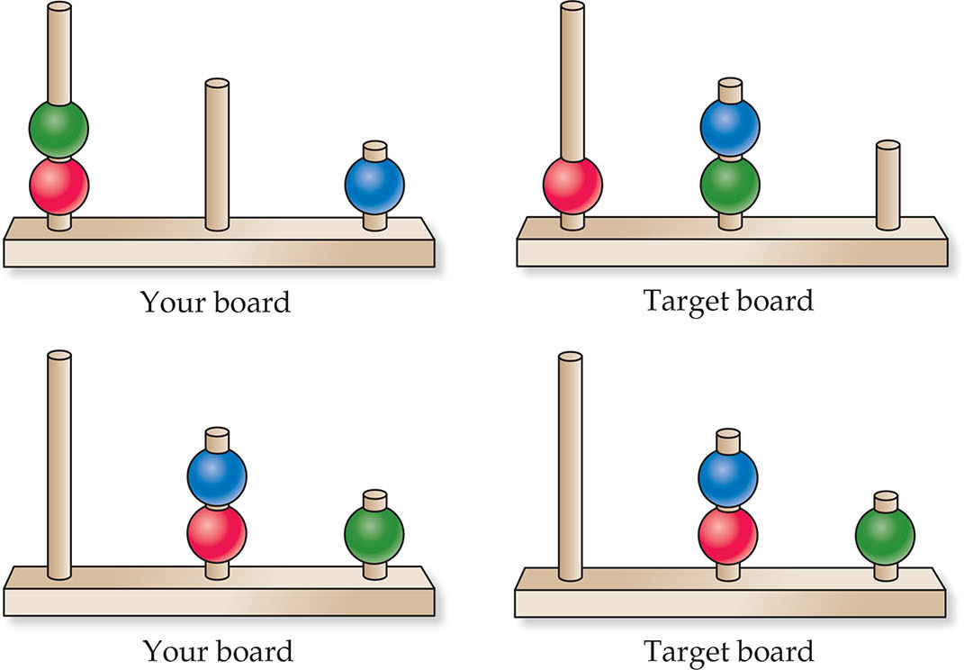
FIGURE 9.15 The Tower of London task.

Slide 21
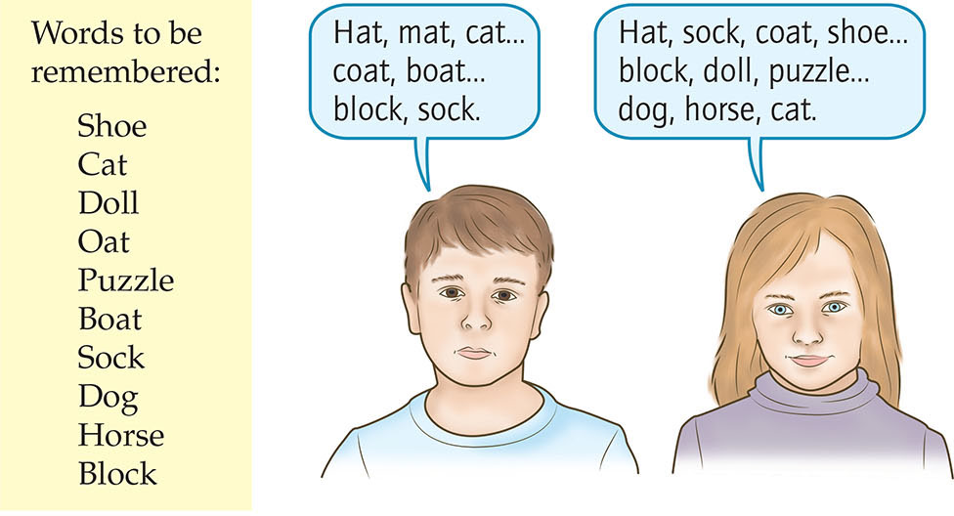
FIGURE 9.16 Encoding and retrieval.

Slide 22
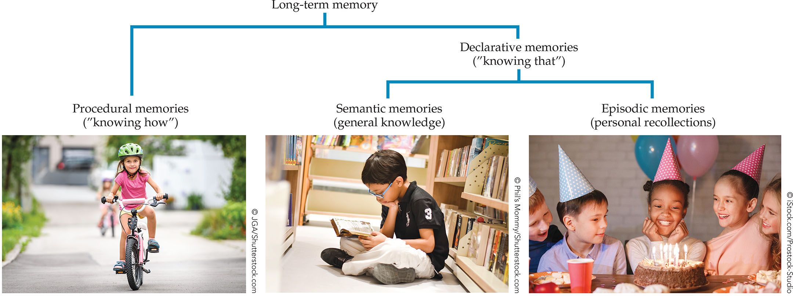
FIGURE 9.17 Types of declarative memory.

Slide 23
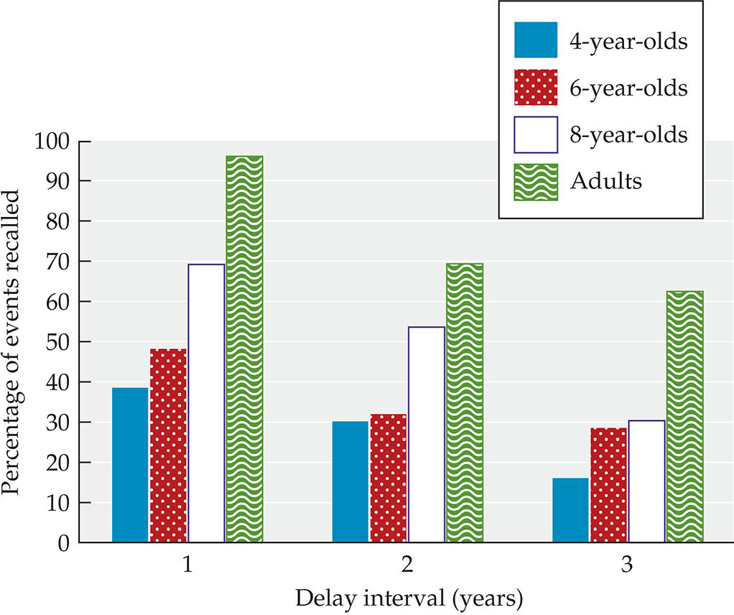
FIGURE 9.18 Developmental changes in semantic memory.

Slide 24
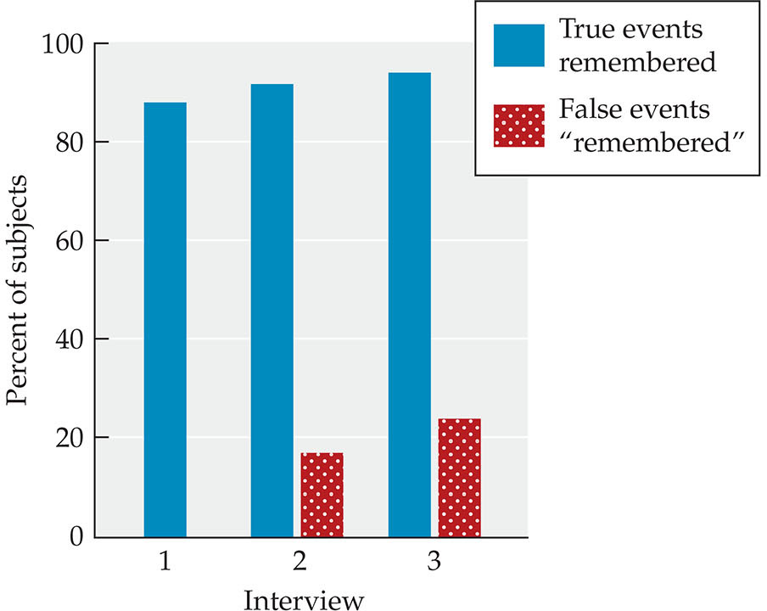
FIGURE 9.19 False memories.

Slide 25
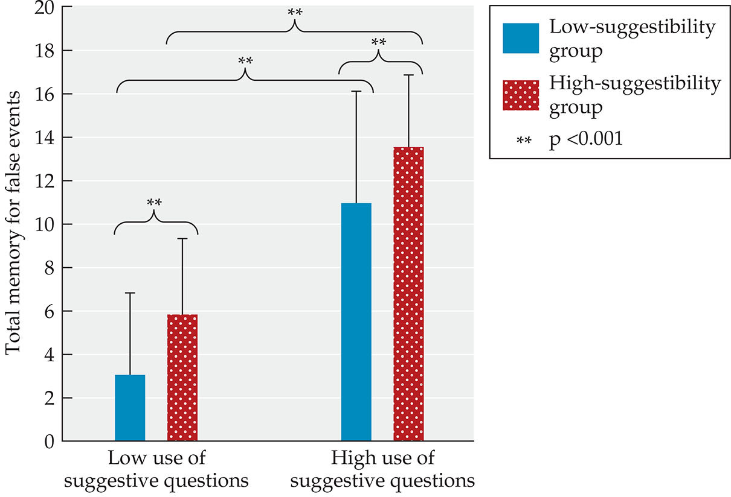
FIGURE 9.20 Children’s suggestibility.

Slide 26
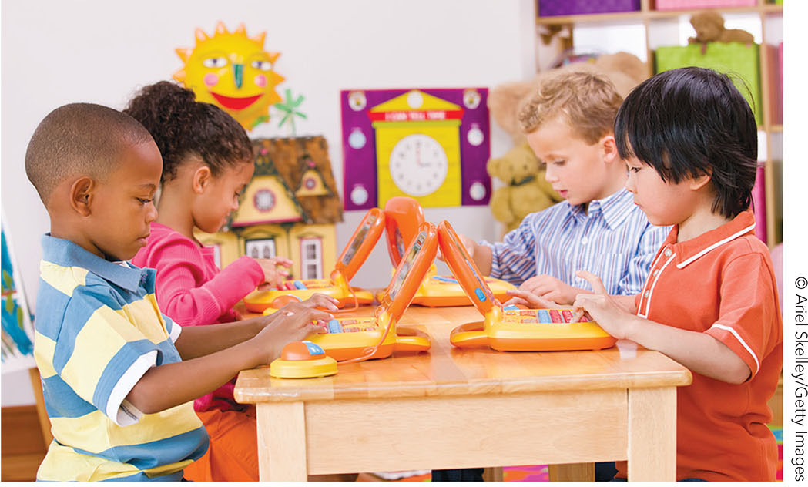
FIGURE 9.21 Tools of the Mind curriculum.

Slide 27
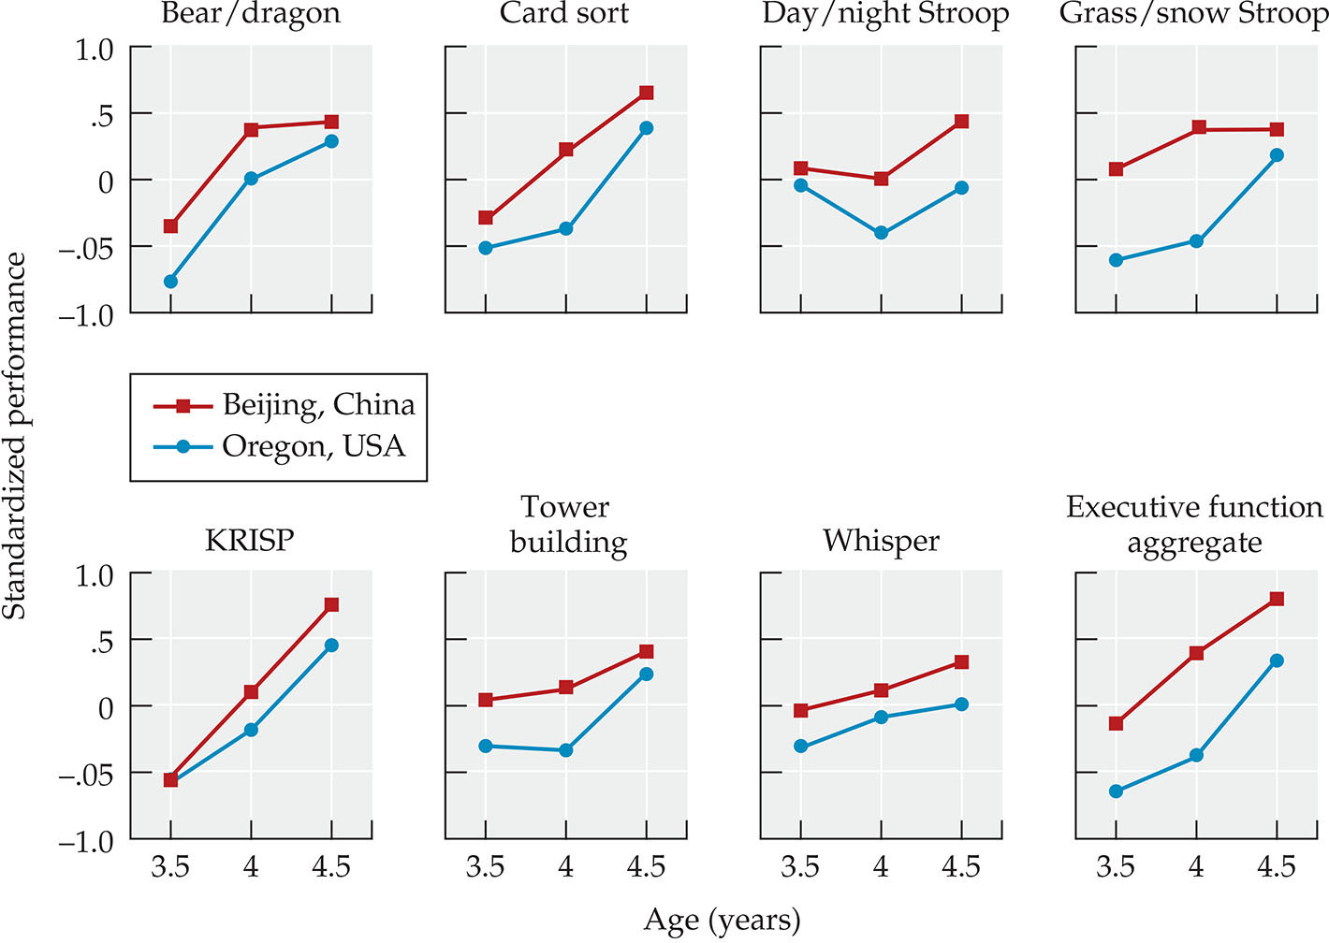
FIGURE 9.22 Cultural differences in executive functioning skills.

Slide 28
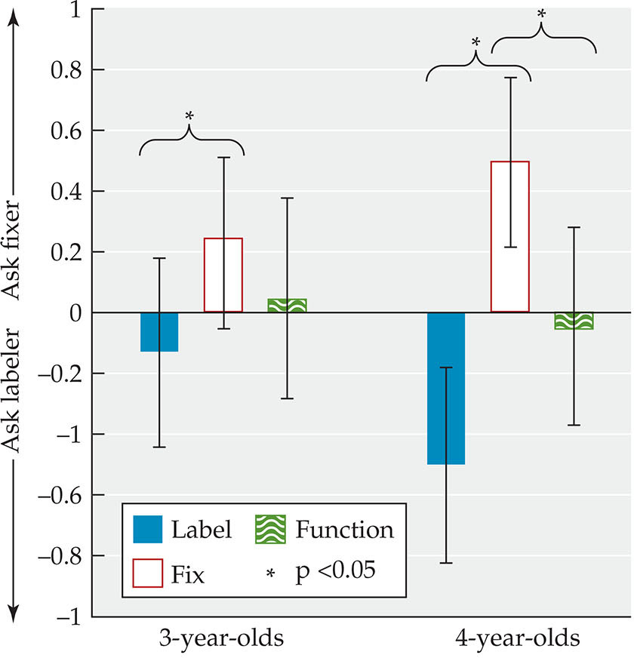
FIGURE 9.23 Reliability and trustworthiness.

Slide 29
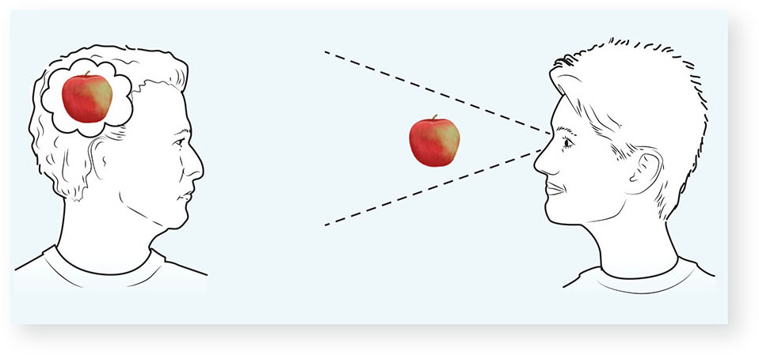
FIGURE 9.24 Theory of mind.

Slide 30
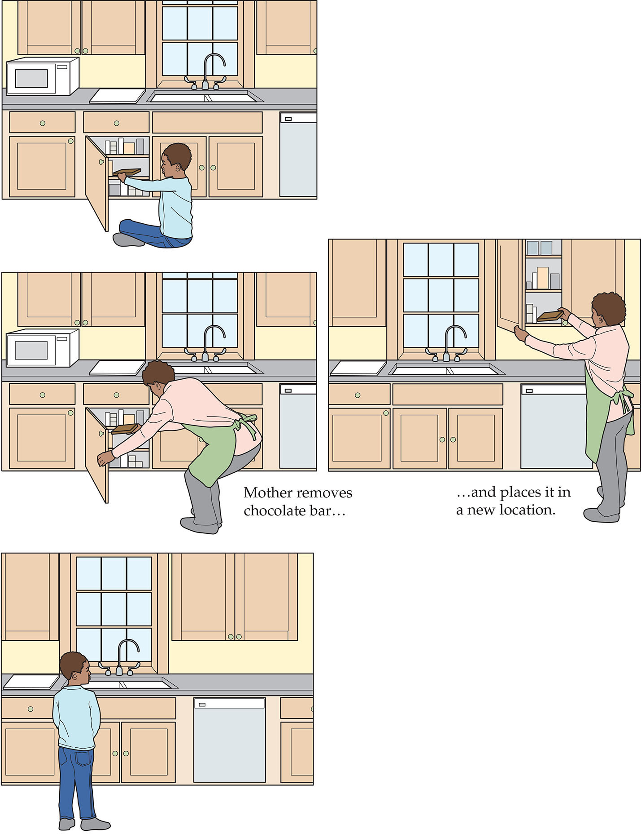
FIGURE 9.25 False-belief task.

Slide 31
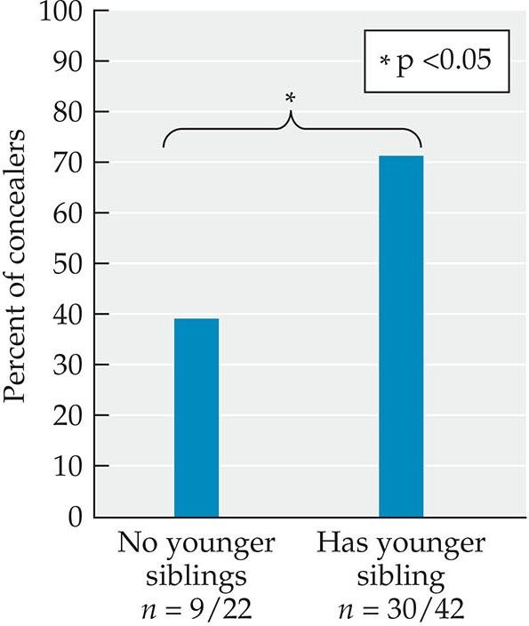
FIGURE 9.26 Siblings and lying.

Slide 32
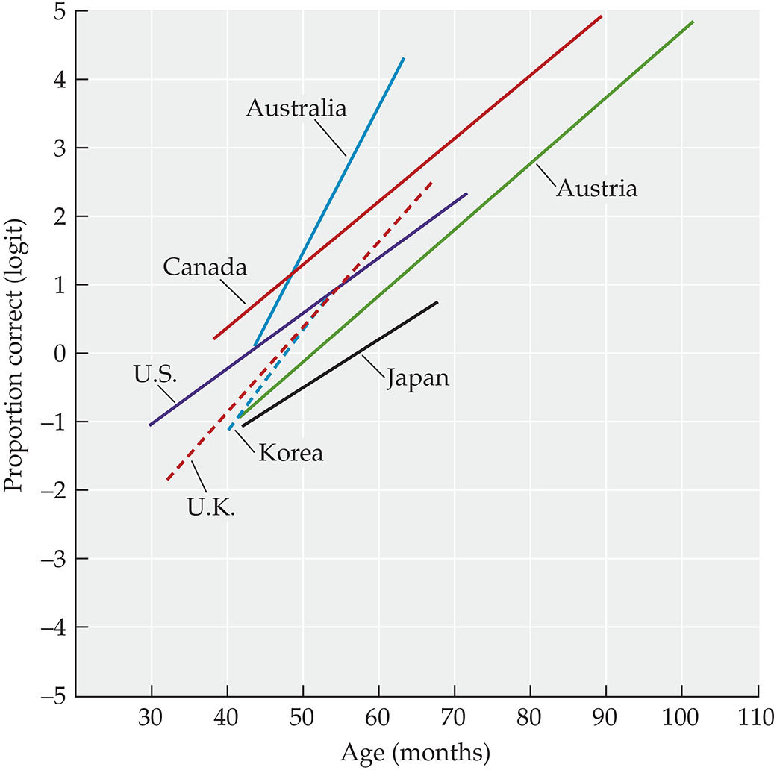
FIGURE 9.27 Cultural comparisons of theory of mind.

Slide 33
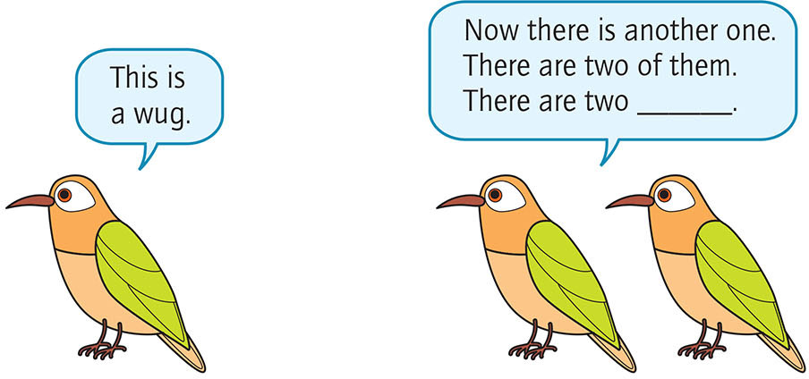
FIGURE 9.28 A wug test.

Slide 34
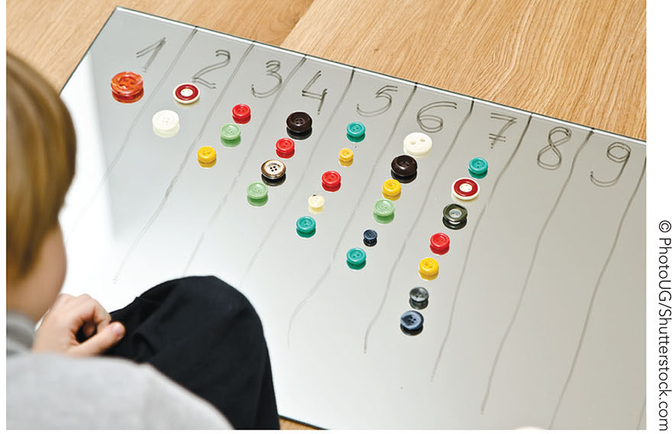
FIGURE 9.29 The cardinal principle.

Slide 35
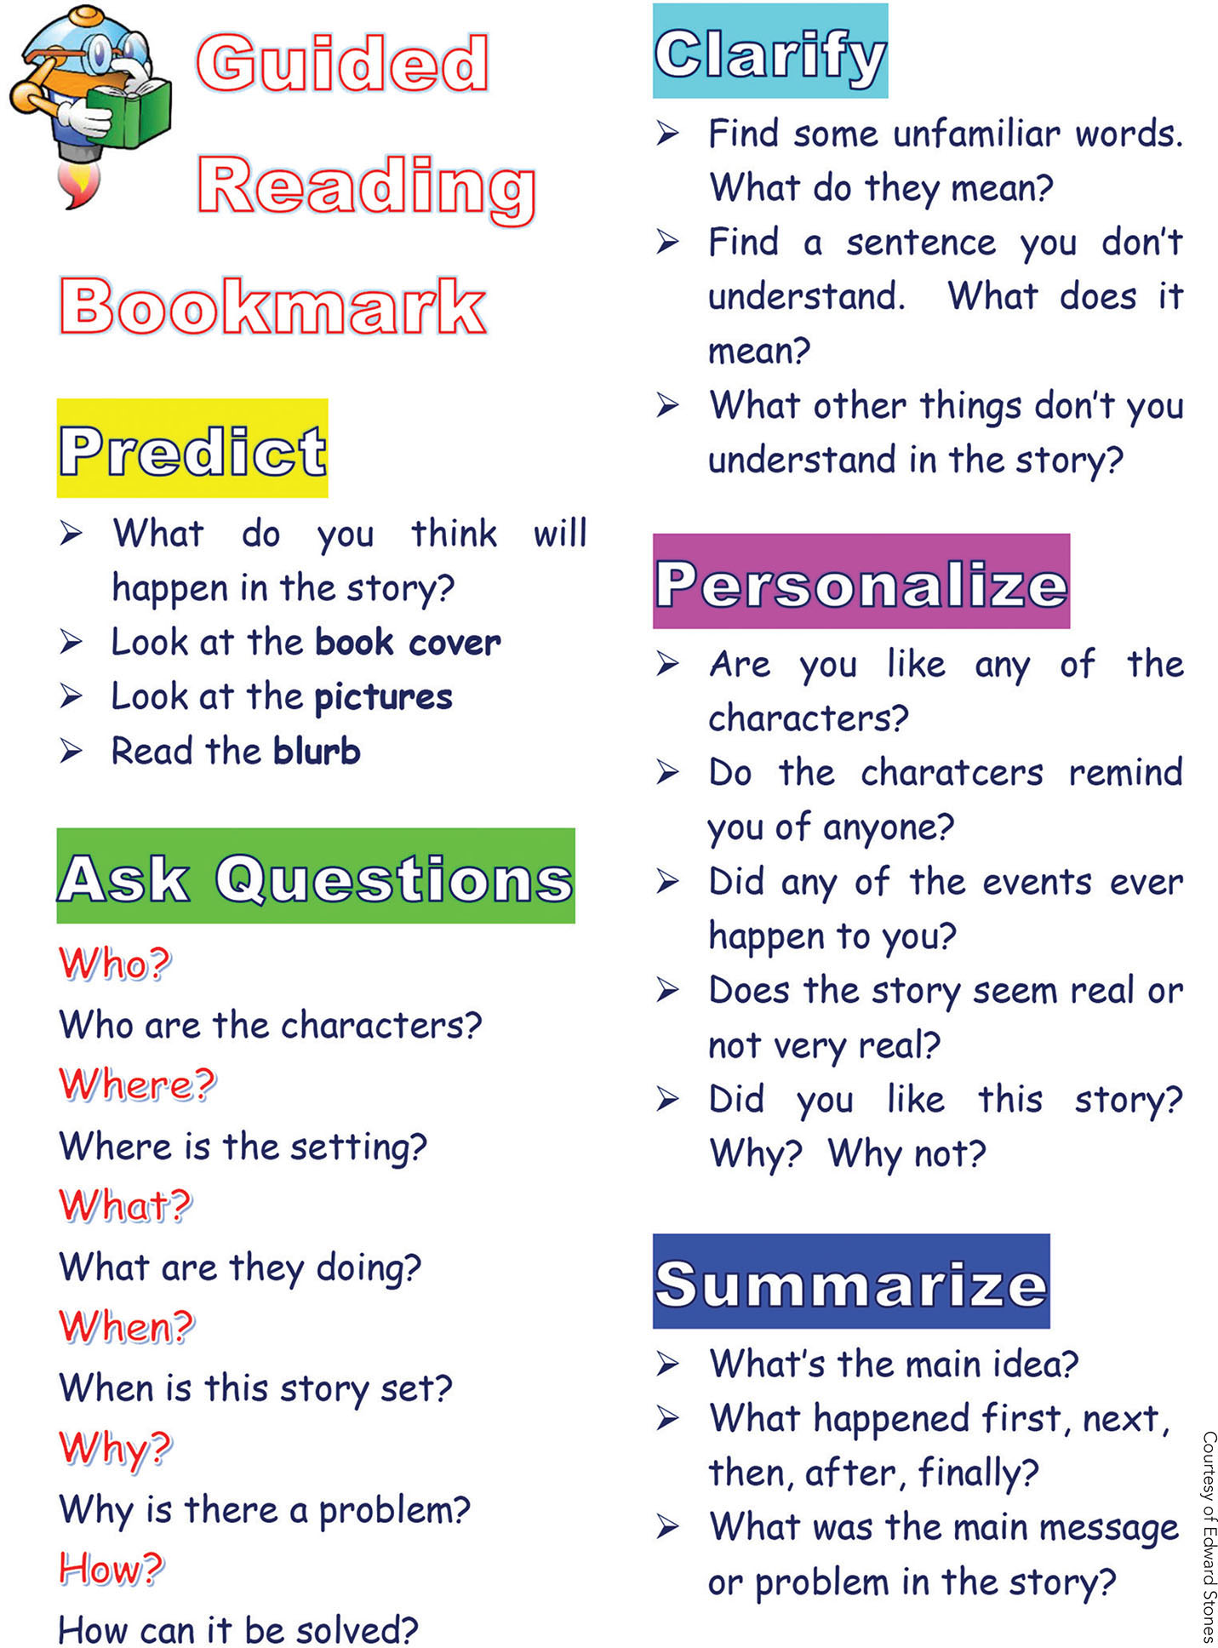
FIGURE 9.30 Dialogic reading.

Slide 36
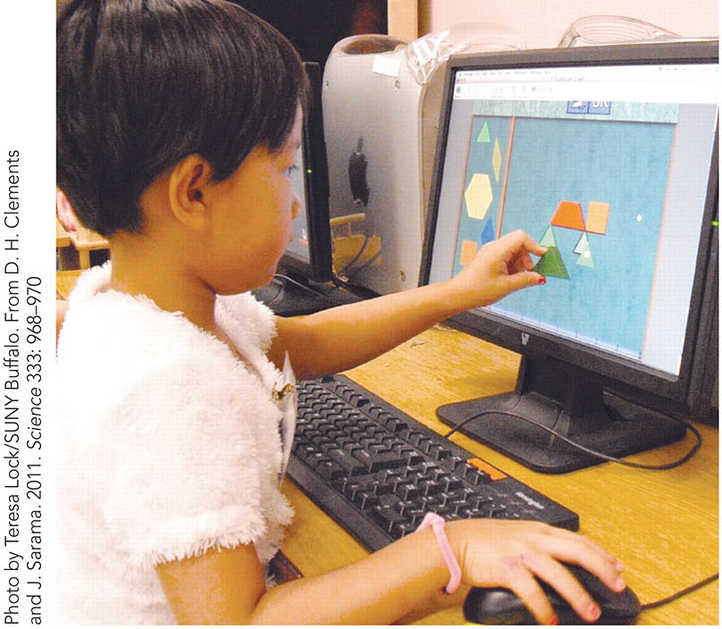
FIGURE 9.31 Big Math for Little Kids and Building Blocks Curriculum.

Slide 37
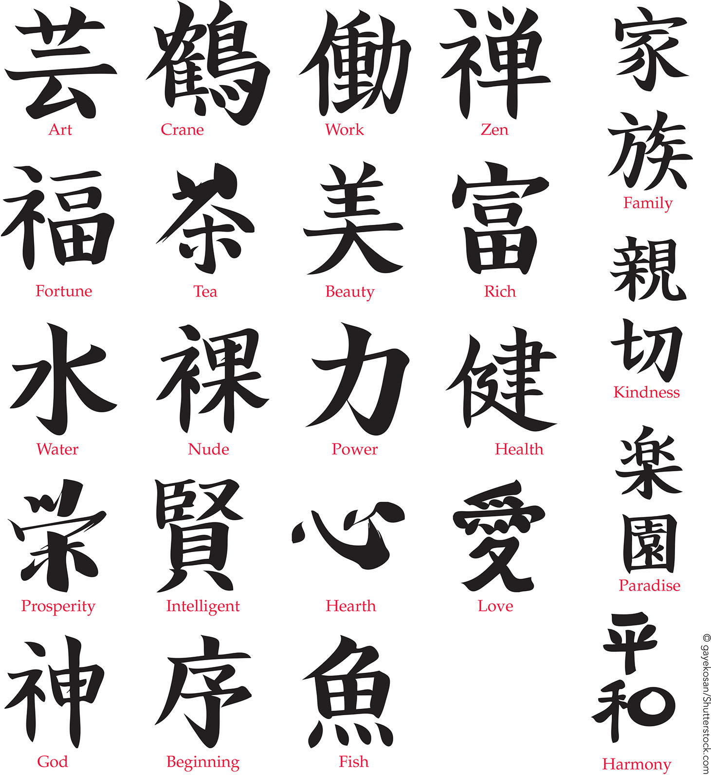
FIGURE 9.32 Cultural differences in learning mathematics.

Slide 38
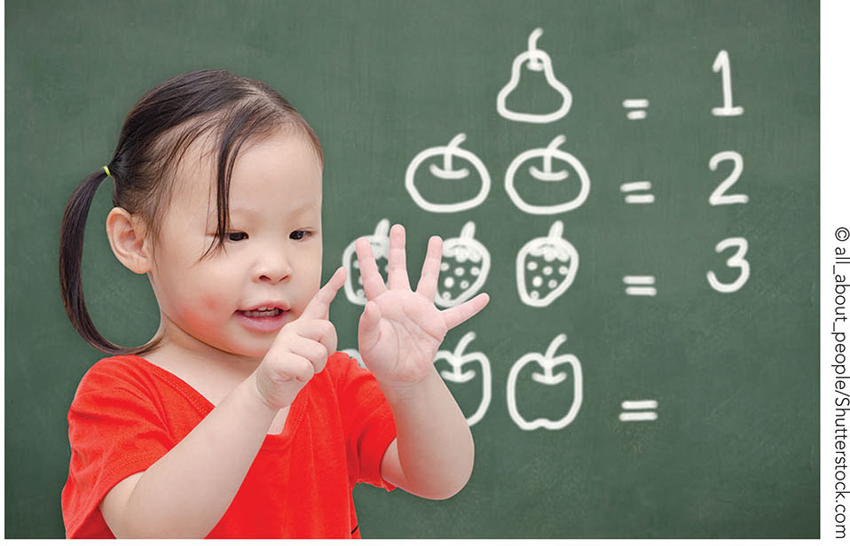
FIGURE 9.33 Math requires children to hold and efficiently manipulate different pieces of information in working memory while executing parts of a problem.

