Slide 1
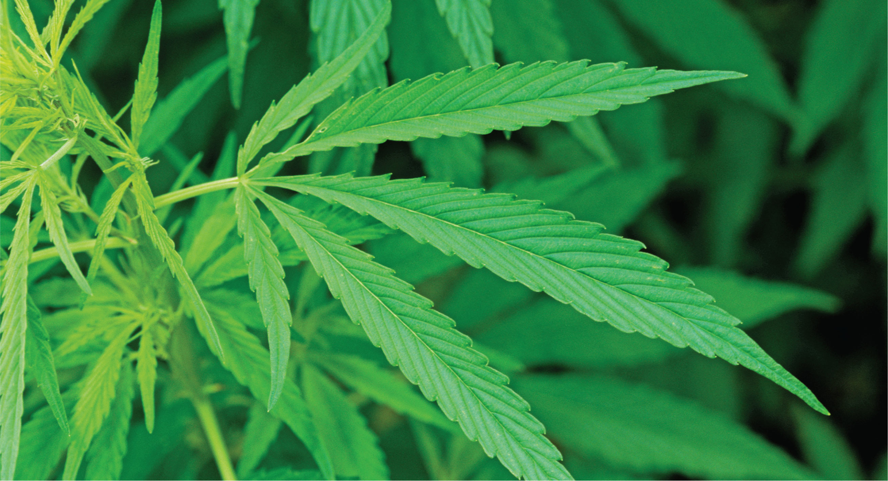
Chapter 9: Cannabis
Alamy ID: A68E5M

Slide 2
Chapter 9 Learning Objectives
Trace the various attitudes about cannabis throughout history.
Describe the relationship between cannabis use and the perception of risk in high school students.
Consider the social effects that result from marijuana’s status as a schedule I drug.
List some examples of phytocannabinoids, endocannabinoids, and synthetic cannabinoids.
Distinguish between the effects that result from oral administration of cannabis compared to smoking cannabis.

Slide 3
Chapter 9 Learning Objectives (2)
Define the endocannabinoid system.
List the major locations of cannabinoid receptors in the brain and body.
Summarize the acute physiological and behavioral effects of cannabis.
Evaluate the effect of long-term cannabis use on cognitive deficits.
Identify some of the potential therapeutic uses of cannabis.
Compare cannabis’s addictive potential to that of other psychoactive drugs.

Slide 4
Cannabis
Paradoxical and polarizing
  Debates about safety, therapeutic properties, and potential harm
  Simultaneously legal and illegal

Slide 5
History
Cannabis has been cultivated since the Stone Age
  Long tradition in many cultures as an important medical and religious substance
17th–19th century America
  Planted in Jamestown, Mount Vernon
  Considered an important and valuable crop
  Legal and widely available

Slide 6
History (2)
Early 20th century America
  Racially motivated fears about marijuana
    Mexican immigrants popularized smoking marijuana
      Fear and prejudice against African American musicians and Mexican immigrants
    Harry Anslinger
      First director of the Federal Bureau of Narcotics
      Led the charge to convince the public that marijuana was terrifying and dangerous

Slide 7
History (3)
William Randolph Hearst
  Printed terrifying (and false) stories about marijuana
Marijuana Tax Act of 1937

Slide 8
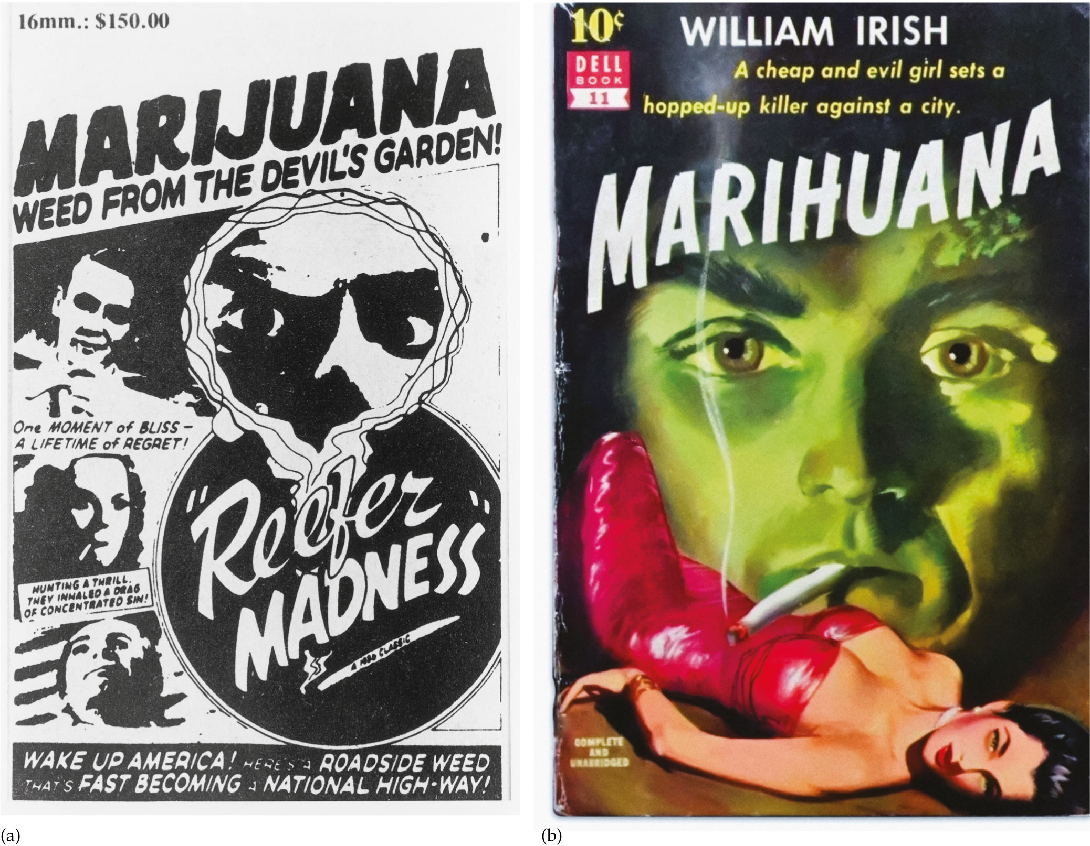
FIGURE 9.1. Anti-marijuana messages in the media.
Alamy ID: FAWDJN
Alamy ID: FAWHMY

Slide 9
History (4)
1940s–1970s
  La Guardia Report
  Marijuana Tax Act struck down as unconstitutional
  The Shafer Commission
  Attitudes about marijuana eased
    DEA considered decriminalizing the drug

Slide 10
History (5)
1980s–1990s
  Ronald Reagan
    Marijuana: “probably the most dangerous drug in the United States”
    Penalties increased
  Bill Clinton
    Escalated war on drugs
    More incarceration for marijuana

Slide 11
History (6)
1990s–today
  Cannabis use has increased
  Many states have decriminalized the drug, approved the use of medical marijuana, or legalized it entirely

Slide 12
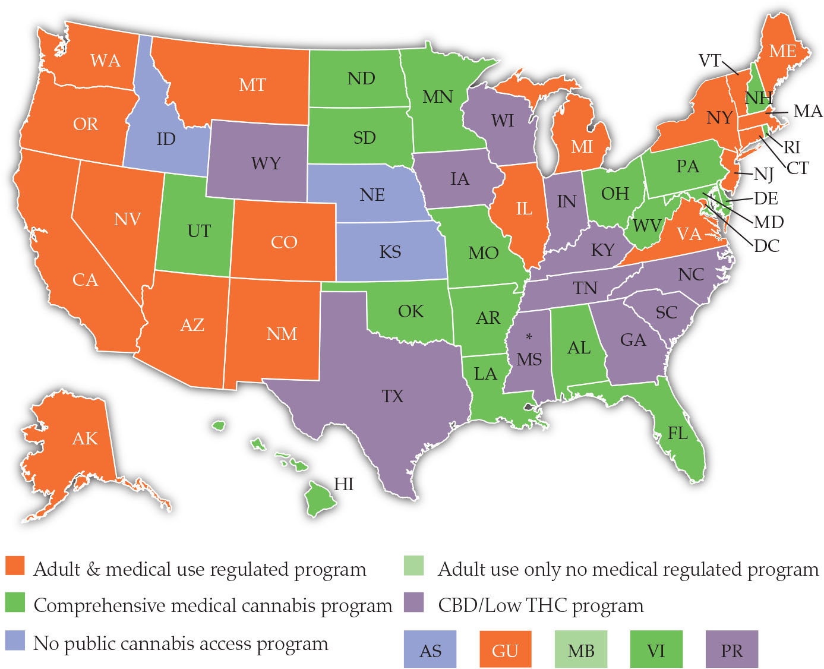
FIGURE 9.2. Cannabis laws by state as of July 2021.
National Conference of State Legislatures. (2020). State medical marijuana laws. https://www.ncsl.org/research/health/statemedical-marijuana-laws.aspx

Slide 13
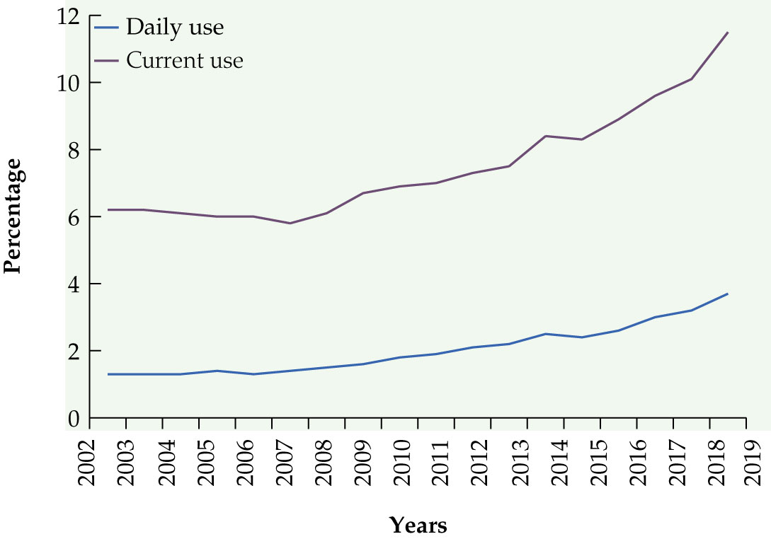
Prevalence
Cannabis is the most commonly used illicit drug in the United States
SAMHSA. (2020). Results from the 2019 national survey on drug use and health. Rockville, MD: Center for Behavioral Health Statistics and Quality.

Slide 14
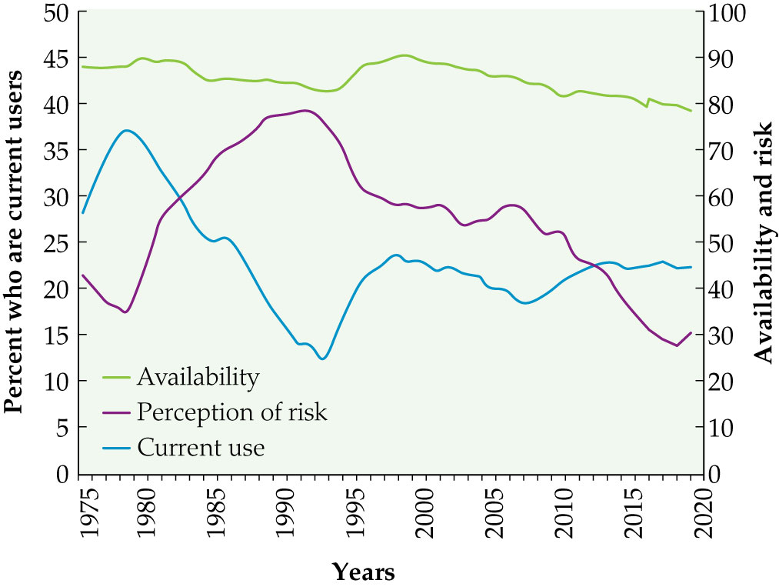
Prevalence (2)
There is an inverse relationship between marijuana use and perception of its risk among high school students
Johnston, L.D., Meich, R.A., O’Malley, P.M. Bachman, J.G., & Schulenberg, J.E., et al. (2020). Monitoring the Future: National survey results on drug use 1975-2019. Ann Arbor: Institute for Social Research, The University of Michigan.

Slide 15
Legal and Cultural Issues
Legal issues
  Inconsistent and ambiguous legal status
    Medical marijuana is legal in many states, and cannabis is legal for adult use in some, but federal law classifies marijuana as schedule I
  Arrests for nonviolent drug offenses
    Hundreds of thousands of people are arrested each year in America for cannabis possession
    Blacks are arrested and incarcerated significantly more than whites

Slide 16
Legal and Cultural Issues (2)
Some significant cannabis laws
  Even when individuals or businesses are in compliance with state cannabis laws, they are still violating federal cannabis laws (Gonzales v. Raich, 2005)
  If you have a doctor’s recommendation for medical marijuana and have acquired it according to the laws of your state, you can still get fired for testing positive for marijuana from your employer’s mandated drug test (Coats v. Dish network, 2015)

Slide 17
Legal and Cultural Issues (3)
Some significant cannabis laws (continued)
  Although cannabis is a multi-billion-dollar industry, because marijuana is still a schedule I drug, many cannabis businesses have little to no access to federal banks, credit cards, or checking accounts, and are forced to be all-cash operations
  Many of the normally accepted business tax deductions are disallowed for cannabis businesses (Internal revenue code 280§ E, Alterman v. Commissioner of Internal Revenue, 2018)

Slide 18
Legal and Cultural Issues (4)
Attitudes about legalization
  Most Americans support the legalization of marijuana

Slide 19
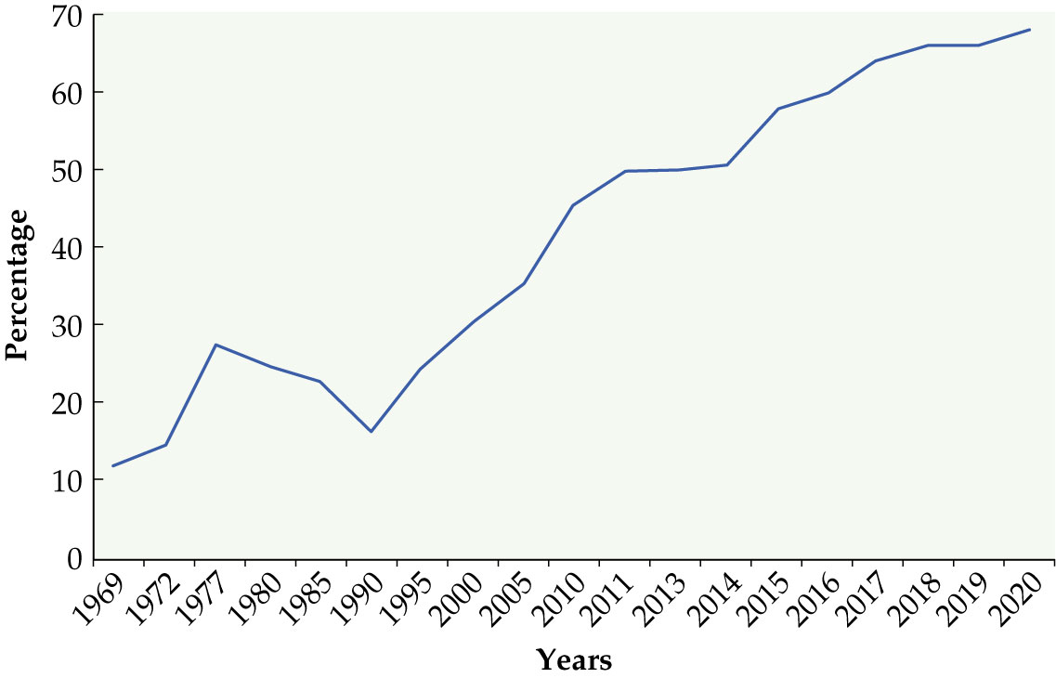
FIGURE 9.5. Percentage of Americans who believe marijuana should be legalized, by year.
Gallup poll. (2020). Support for legal marijuana inches up to new high of 68%. Accessed on November 9, 2020 from https://news.gallup.com/poll/323582/support-legal-marijuanainches-new-high.aspx

Slide 20
Legal and Cultural Issues (6)
Economics of legalization
  Financial costs as well as savings
Cannabis in popular culture
  References found in literature, art, music, television, and movies

Slide 21
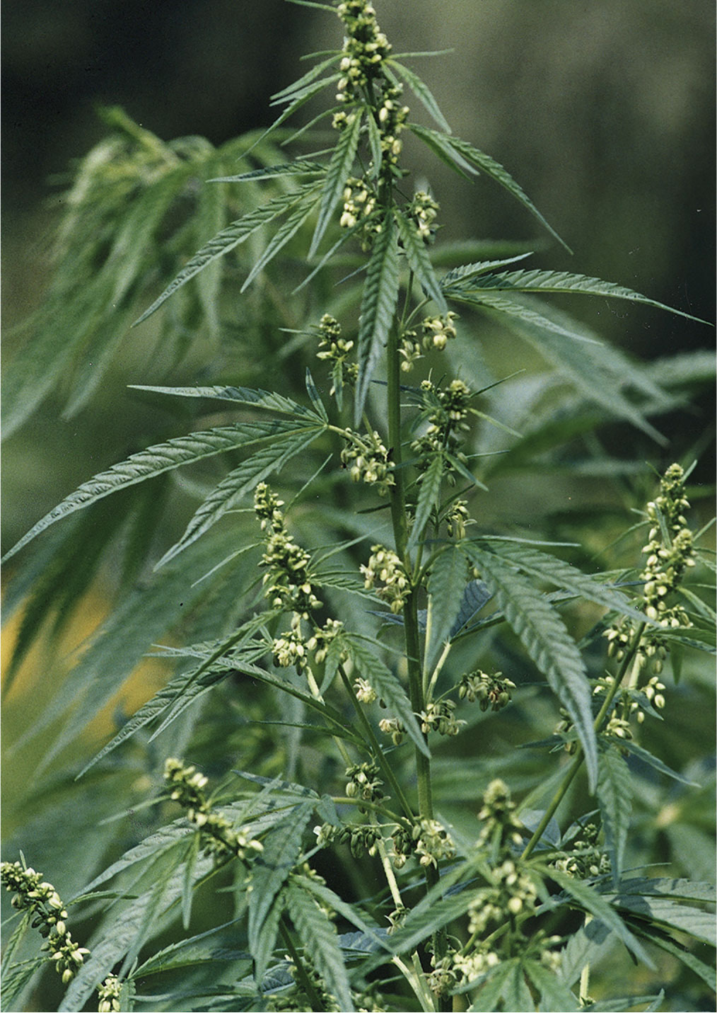
Source and Forms
Cannabis sativa
  Tall, slender, lighter green leaves
Cannabis indica
  Shorter, bushier, darker
Almost all strains today are hybrids
Getty ID: 542896615

Slide 22
Source and Forms (2)
Female cannabis plants
  Produce flower clusters (buds) with sticky psychoactive resin that catches pollen from male plants
  Seeds produced when pollen fertilizes female flowers
    After fertilization, female plant stops producing resin
  Separate male and female plants to increase psychoactivity of plant

Slide 23
Source and Forms (3)
Phytocannabinoids
  THC, CBD, others
    Bind to cannabinoid receptors in the body
    Percentage varies between different strains
      Depends on type of plant, growing conditions, timing of harvest, etc.
  THC
    Psychoactive
  CBD
    Anti-oxidant, anti-convulsant, anti-inflammatory, anti-anxiety, anti-psychotic, and neuro-protective

Slide 24
Source and Forms (4)
Other components of the cannabis plant
  Terpenes and flavonoids
  Entourage/ensemble effect
Hemp
  Source of fiber, fuel, food
  Only trace amounts of THC, not psychoactive
  Cultivation was prohibited in the U.S. until 2018
Synthetic cannabinoids
  Dronabinol (Marinol)
  Spice

Slide 25
Pharmacology
Routes of administration
  Smoked
    Joints, bongs, pipes
  Vaporizers
  Ingested
    Slower onset of effect, less predictability of action, and less user control
    First pass effect
      11-hydroxy-THC more potent than THC

Slide 26
Pharmacology (2)
Absorption, distribution, metabolism
  THC very fat-soluble and easily crosses the blood brain barrier
  Metabolized by cytochrome P450 system
    Metabolites can stay in body for days or even weeks

Slide 27
Pharmacology (3)
Cannabinoid receptors
  CB1, CB2 receptors
    Located in many areas of the brain and body
    THC partial agonist
    CBD negative allosteric modulator, blocks some of THC’s effects
  Cannabinoids also bind to other receptors in the body
    GABA, Serotonin, Glutamate, others

Slide 28
Mechanism of Action
Endocannabinoid system
  Widespread system that controls many important physiological effects and helps maintain homeostasis
  Neurotransmitters
    Anandamide, 2-AG
  Enzymes
    To synthesize and break down cannabinoids
  Receptors
    CB1, CB2
    Found in: Basal ganglia, cerebellum, hippocampus, cortex, amygdala, eye, pancreas, testes, uterus, and others

Slide 29
Acute Effects
Effects depend on many factors
  Dose
  Potency of the strain
  Ratio of THC to CBD
  User’s previous experience, expectations, and mood
  Environment in which it is used

Slide 30
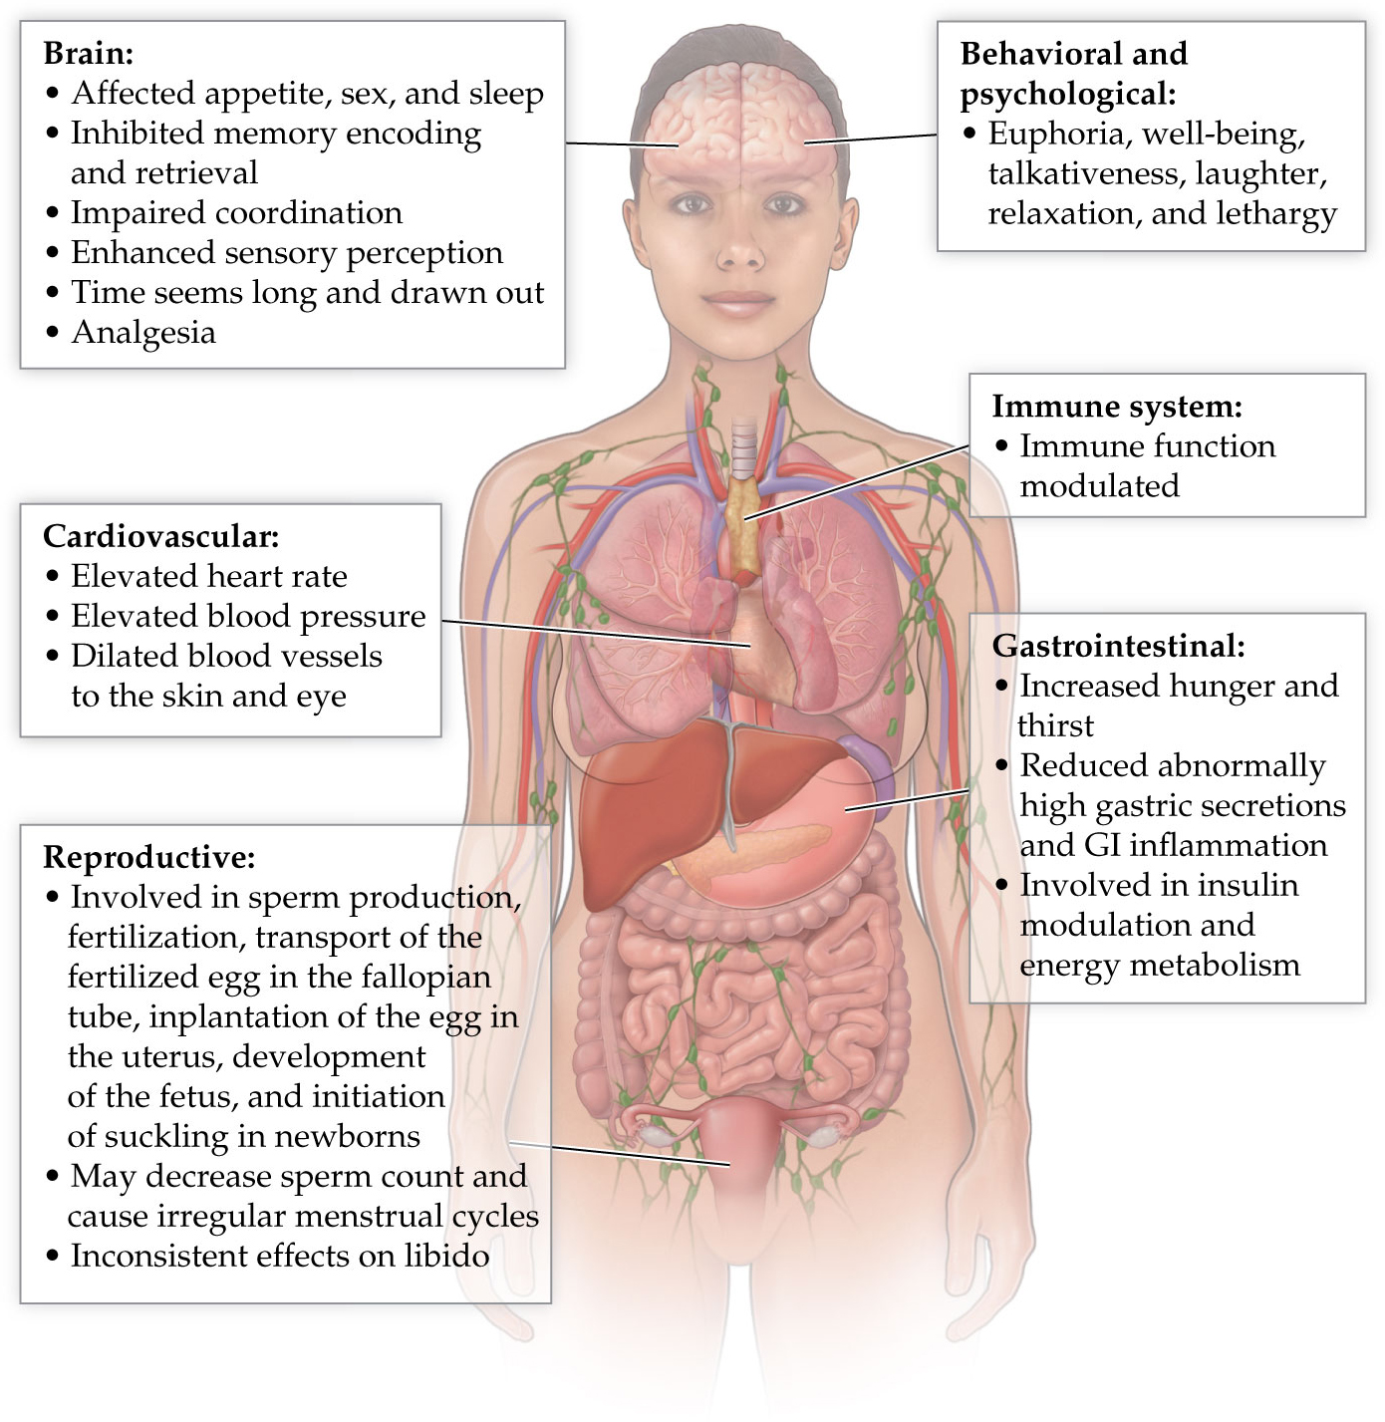
FIGURE 9.13. Acute effects of marijuana.

Slide 31
Acute Effects (2)
Therapeutic index very high
Potential negative physical and psychological effects
  High doses may impair fertilization
  May raise the risk of schizophrenia in a susceptible minority
  Drug interactions
  Cognitive effects?
Some adverse effects come not from the drug itself, but collateral damage due to criminal penalties, or one’s diminished reaction time and coordination

Slide 32
Medical and Therapeutic Uses
Well-documented benefits
  Treatment of chronic pain
  Reduce nausea and vomiting
  Stimulate hunger
  Alleviate stiffness and muscle spasms with MS
Other potential benefits being investigated
  Anti-inflammatory
  Treating seizure disorders, cancer, stroke, Alzheimer’s disease, diabetes, irritable bowel disease, depression, and other disorders
  Reduce use of prescription opioid pain drugs, alcohol, cocaine

Slide 33
Chronic Effects
Tolerance
  Regular use of marijuana will cause tolerance
Dependence and addiction
  Less addictive than other drugs of abuse, but can be addictive in some
  Treatment for cannabis dependence typically involves psychological approaches
Withdrawal
  If withdrawal symptoms occur, they are usually not severe

